Slide 1
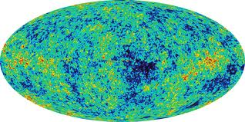
Neutrinos in Cosmology

Slide 2
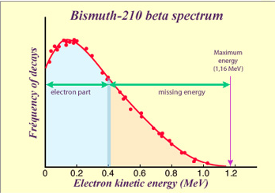
Over the past 85 years, Neutrinos have surprised us
Anomaly in beta spectrum

Slide 3
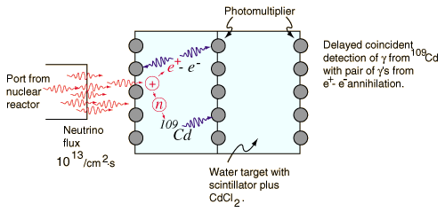
Over the past 85 years, Neutrinos have surprised us
Anomaly in beta spectrum
Resolved: introduce a single species of neutrinos

Slide 4
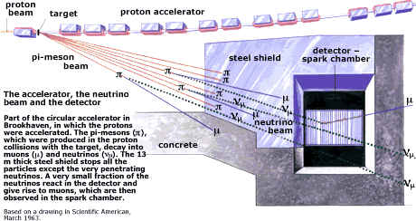
Over the past 85 years, Neutrinos have surprised us
Anomaly in beta spectrum
Resolved: introduce a single species of neutrinos
Second species discovered

Slide 5
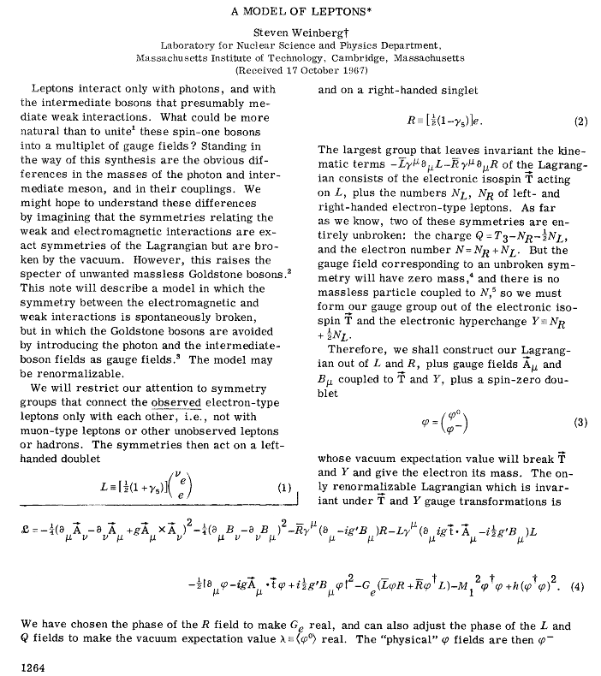
Over the past 85 years, Neutrinos have surprised us
Anomaly in beta spectrum
Resolved: introduce a single species of neutrinos
Second species discovered
Resolved: SM accommodates multiple generations of (massless) neutrinos

Slide 6
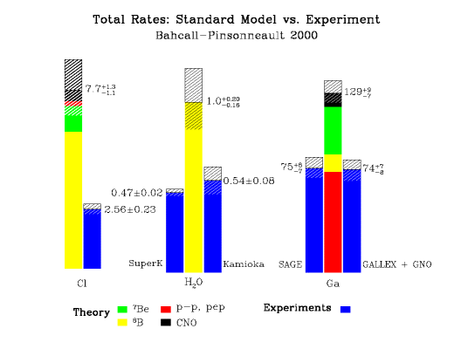
Over the past 85 years, Neutrinos have surprised us
Anomaly in beta spectrum
Resolved: introduce a single species of neutrinos
Second species discovered
Resolved: SM accommodates multiple generations of (massless) neutrinos
Transformations discovered → neutrinos have mass

Slide 7
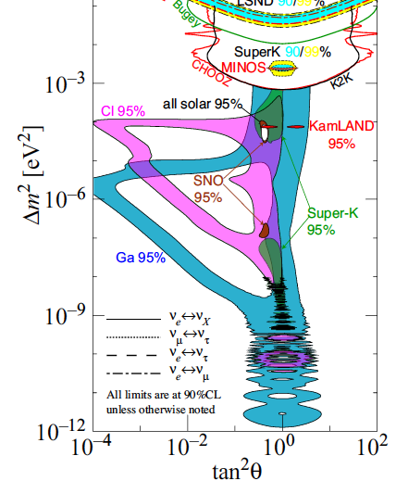
Over the past 85 years, Neutrinos have surprised us
Anomaly in beta spectrum
Resolved: introduce a single species of neutrinos
Second species discovered
Resolved: SM accommodates multiple generations of (massless) neutrinos
Resolved: 2 mass squared differences, three light neutrinos
Transformations discovered → neutrinos have mass

Slide 8
We now have a model that explains all the data
Are we done?

Slide 9
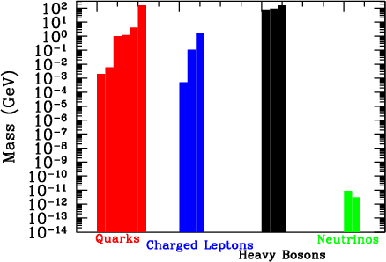
Maybe not: Neutrino Masses are off-the-charts weird

Slide 10
Also, How Do Neutrinos Get Mass?
Just as for electrons, neutrinos can get mass if right-handed neutrinos exist. Then neutrinos are like all other 4-component (L/R,particle/anti-particle) fermions.
Coupling to the Higgs produces a Dirac mass
It requires very small Yukawa couplings g (<10⁻¹⁴) so compounds mass mystery

Slide 11
There is another way …
This is equivalent to 2 mass eigenstates, M (assumed large) and m²/M, with a mixing angle θ=m/M.

Slide 12
There is another way …
The mass m²/M can be of order 10⁻² eV if m is of order the other fermion masses and M is of order 10⁹ GeV (See-Saw mechanism).

Slide 13
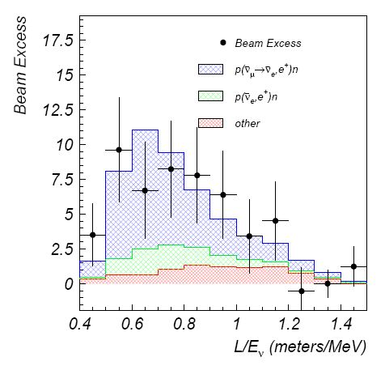
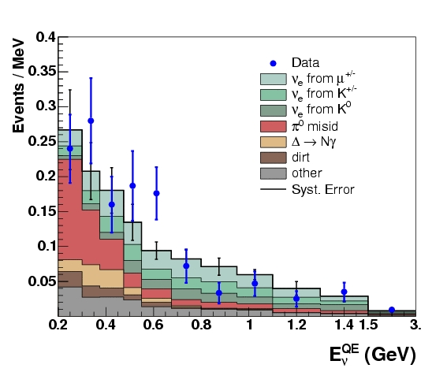
Maybe one or more of the right-handed neutrinos is light
Excess events in the Liquid Scintillator Neutrino Detector (LSND) and MiniBoone point to another oscillation …

Slide 14
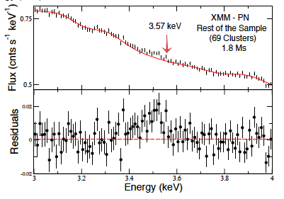
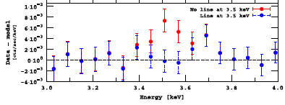
Recent hints for X-ray excess might be coming from keV sterile neutrinos
Stacked signal from many galaxy clusters
Bulbul et al (2014)
And from Andromeda
Bulbul et al (2014)

Slide 15
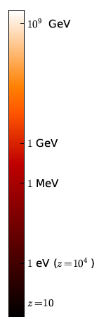
Opens up many possibilities for cosmology
Scale of Masses for See-Saw Mechanism?
Leptogenesis I: Right-handed neutrinos decay producing a lepton asymmetry?
Leptogenesis II:Sphalerons transform lepton asymmetry into Baryon asymmetry?
Light sterile neutrinos produced?
Neutrinos decouple (mostly)
Warm Dark Matter becomes non-relativistic?
Neutrinos affect the CMB damping tail
Massive neutrinos inhibit growth of structure
Neutrinos related to mechanism driving current epoch of cosmic acceleration (similar mass scales)?

Slide 16
Standard Model neutrinos are produced in the early universe
Alpher, Herman, & Gamow 1953
Even if no neutrinos initially when the temperature is much larger than m_{e}, rate for producing them via, e.g.,
Z

Slide 17
Standard Model neutrinos are produced in the early universe
Alpher, Herman, & Gamow 1953
Even if no neutrinos initially when the temperature is much larger than m_{e}, rate for producing them via, e.g.,
Z
is

Slide 18
Compare this to the expansion rate
the universe is radiation dominated at early times
ratio of neutrino production rate to expansion rate

Slide 19
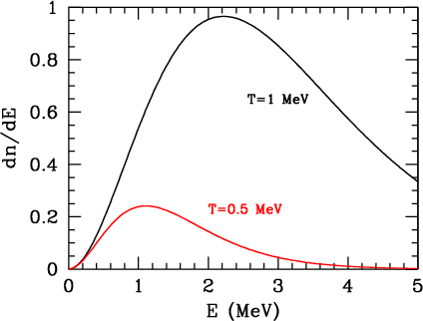
So at early times, neutrinos were in equilibrium with the rest of the cosmic plasma
Fermi-Dirac distribution with temperature T equal to the electron/photon temperature.
After the neutrinos decoupled from the rest of the plasma (kT<few MeV), they still maintained Fermi-Dirac distribution with T falling as the Universe expanded (except for slight heating from electron-positron annihilation due to residual interactions)

Slide 20
Calibrate off the well-known photon temperature to get the prediction
Number of species of weakly interacting neutrinos (3)
There are ~ a hundred quadrillion cosmic neutrinos (flux of 115x3c = 10¹³ cm⁻² sec⁻¹) passing through this screen (~10⁴ cm²) every second.

Slide 21
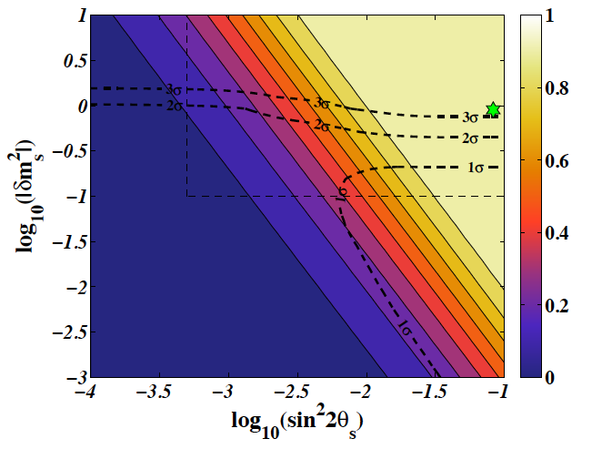
Sterile Neutrinos produced in the early universe via oscillations
where the mixing angle needs to be computed in matter but in vacuum is θ_{S} =m_{A}/m_{S}
Production peaks at ~100 MeV and can completely thermalize the state so that N_{ν}→4
1204.5861

Slide 22
Cosmic Neutrinos cannot be detected directly*
But they leave signatures in the cosmos so can be detected indirectly
* “Every experimentalist goes through a phase when s/he tries to figure out a way to detect the cosmic neutrino background and then moves on” (paraphrase, Joseph Formaggio)

Slide 23
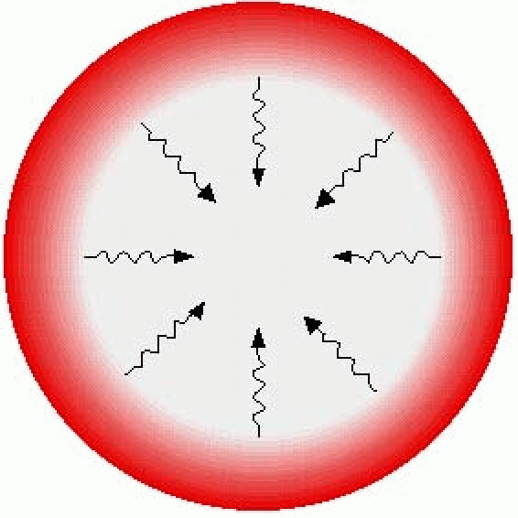
Neutrinos leave a subtle imprint on the sky
Cosmic Microwave Background:
Picture of the Universe when it was 380,000 years old

Slide 24
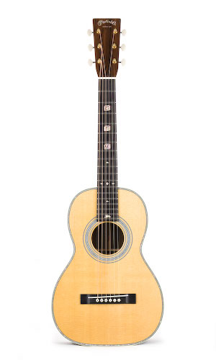
Acoustic Oscillations
At these early times, electrons, protons, and photons were tightly coupled, acted as single fluid
Subject to restoring force: over-dense regions become under-dense as photons stream out → acoustic oscillations

Slide 25
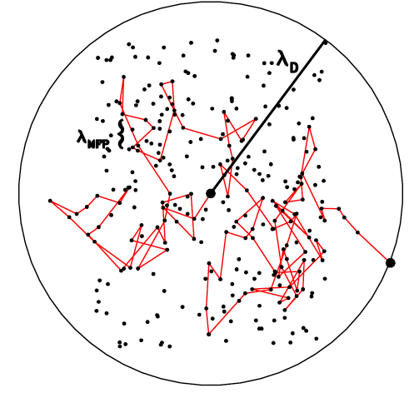
Acoustic Oscillations and Damping
At these early times, electrons, protons, and photons were tightly coupled, acted as single fluid
Subject to restoring force: over-dense regions become under-dense as photons stream out → acoustic oscillations
On small scales, photons can random walk and suppress perturbations → damping

Slide 26
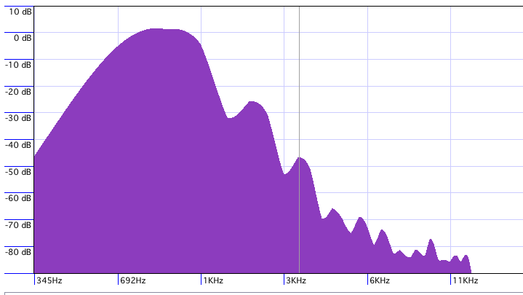
Acoustic Oscillations and Damping
At these early times, electrons, protons, and photons were tightly coupled, acted as single fluid
Subject to restoring force: over-dense regions become under-dense as photons stream out → acoustic oscillations
On small scales, photons can random walk and suppress perturbations → damping
Spectrum of Musical Note

Slide 27
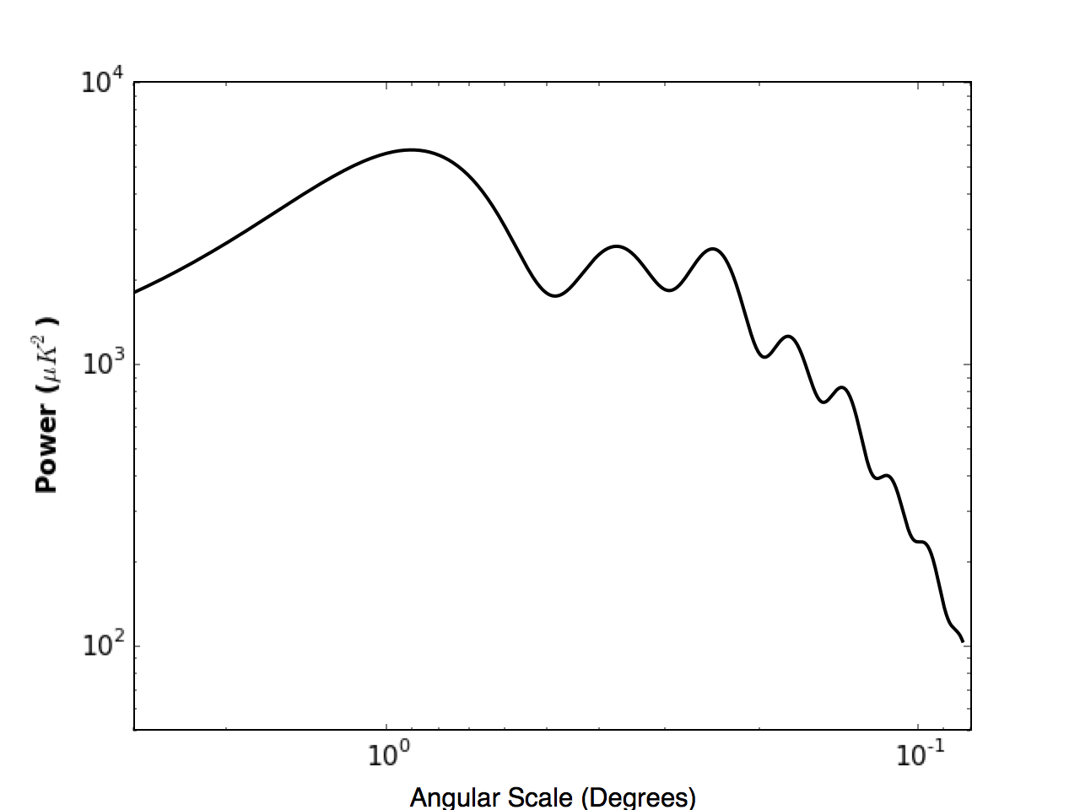
Power Spectrum of CMB Temperature Anisotropy

Slide 28
Technical Digression: Power Spectra and Fluctuations
Variance of temperature fluctuations
Sum over all scales (low l corresponds to large angular scale)
This combination is called the power

Slide 29
Ratio of Acoustic Scale to Damping scale

Slide 30
Ratio of Acoustic Scale to Damping scale
The ratio of the damping scale to the acoustic scale:

Slide 31
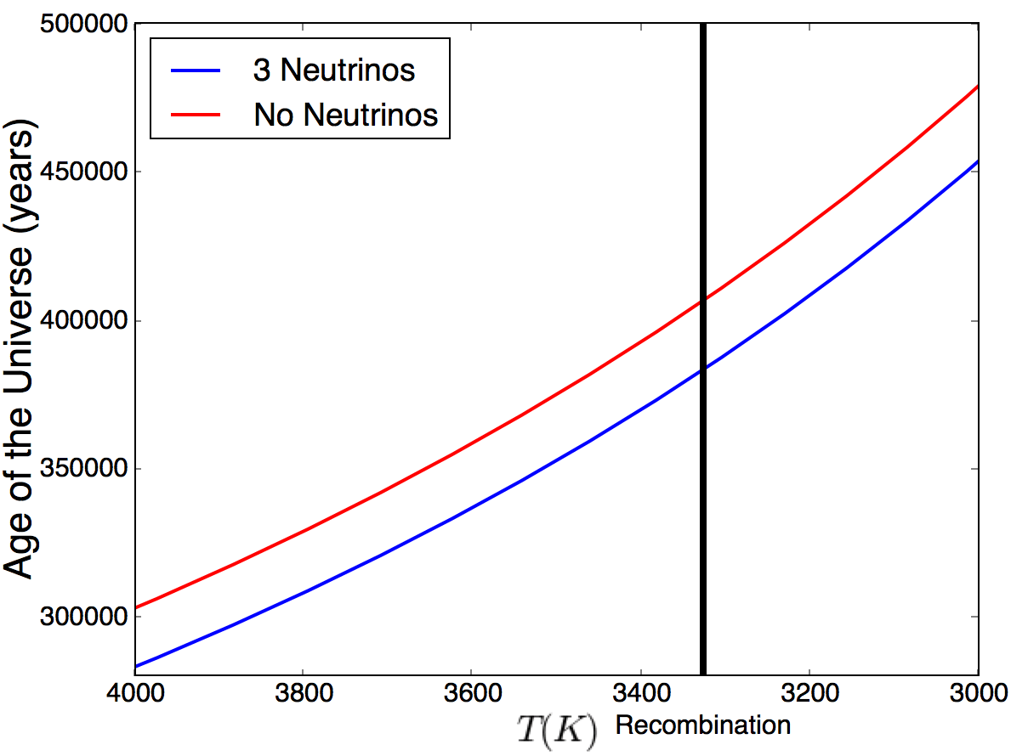
Neutrinos contribute to energy density of the early Universe
Einstein’s equations → Expansion Rate proportional to energy density
Age of the universe at given Temperature is higher if expansion rate is slower (e.g., if neutrinos did not contribute to the energy budget)

Slide 32
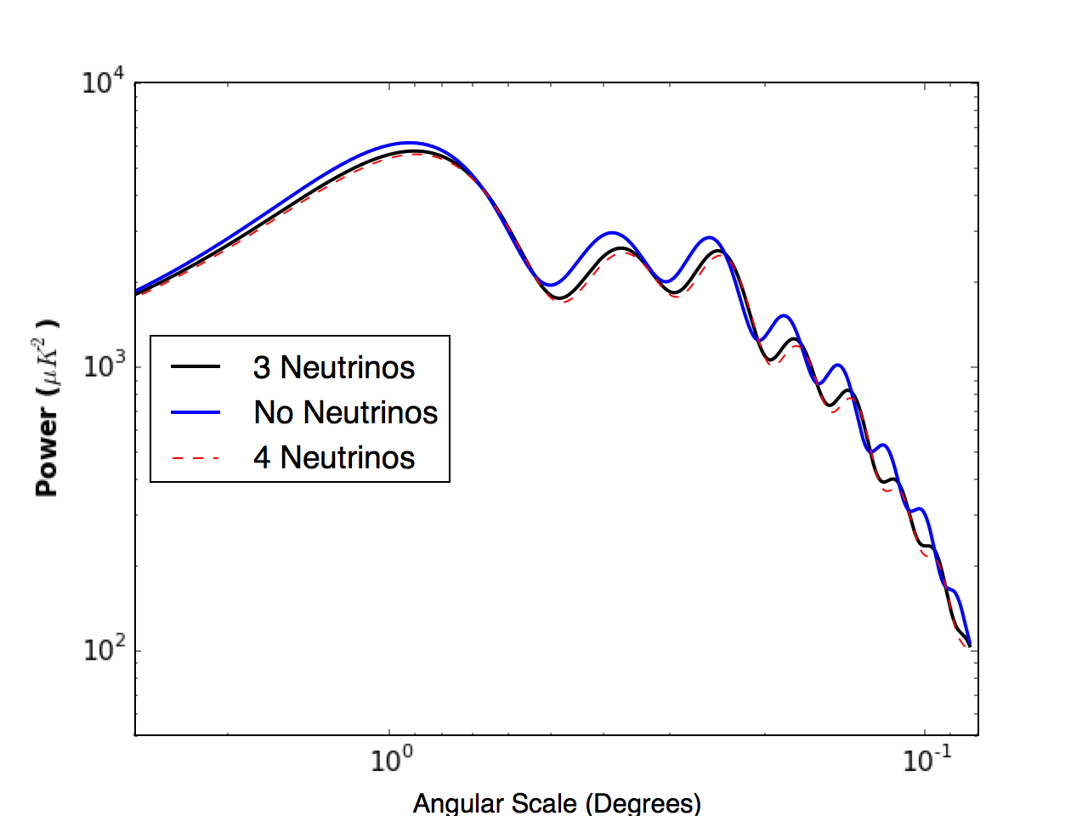
More neutrinos → More Damping
→ Less power on small scales

Slide 33
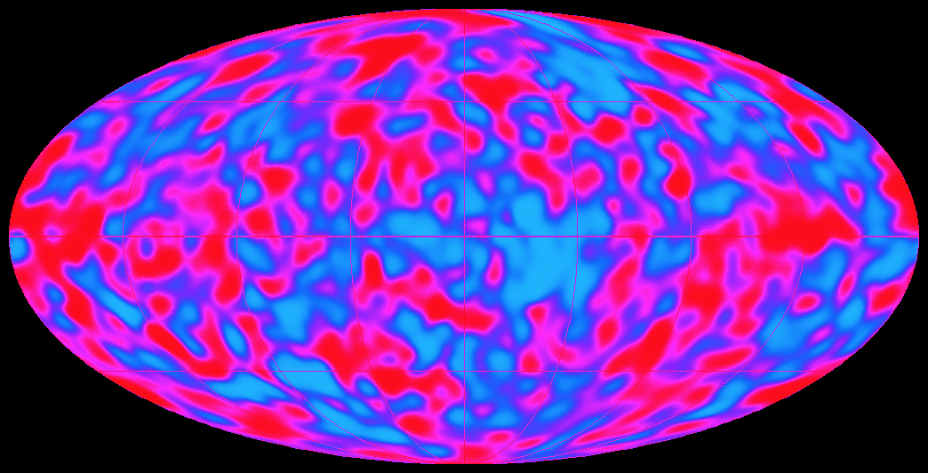
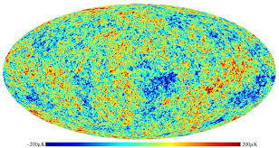
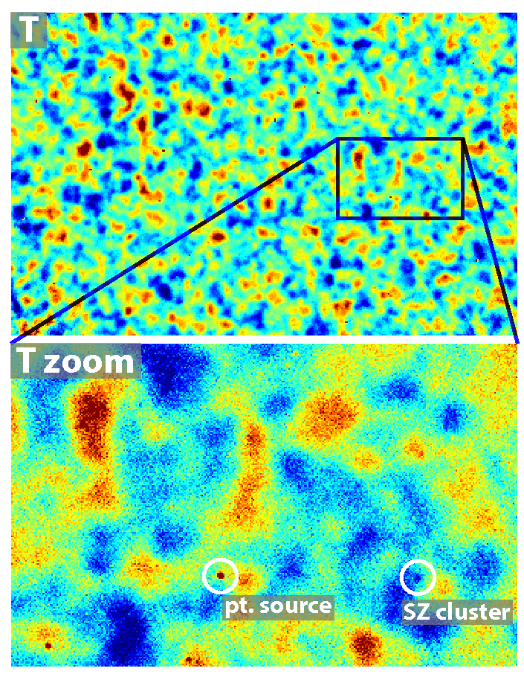
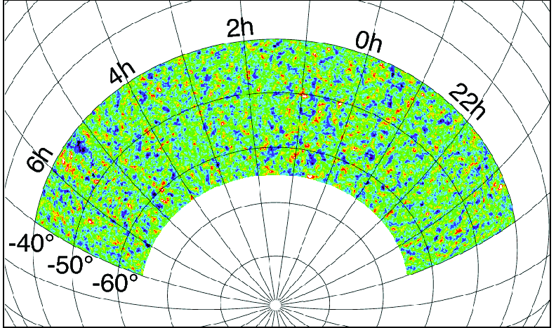
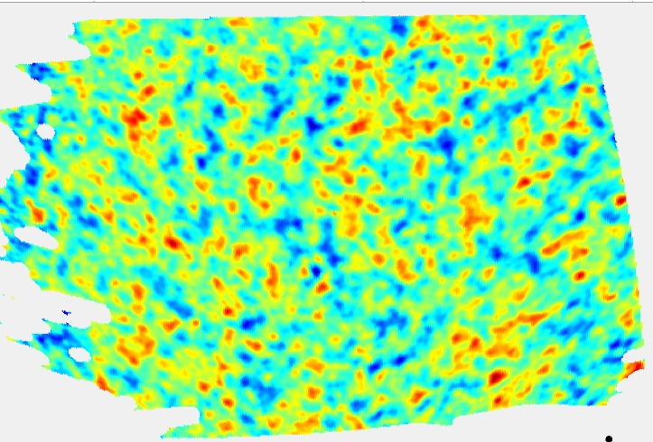
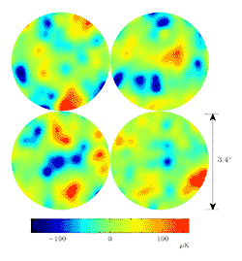
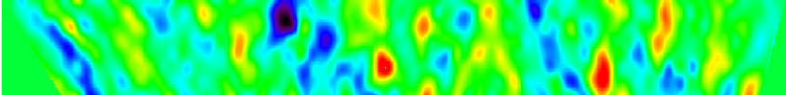
CMB Anisotropies measured for over 20 years
Sky Coverage
COBE 1992
WMAP 2003-14
ACT 2013
SPT 2013
Boomerang 2000
DASI 2001
Angular Resolution
Python 1997

Slide 34
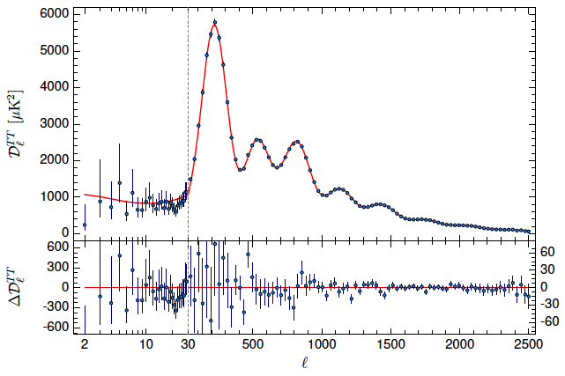
Planck Results
Planck 2015
Multipole moment l conjugate to angle

Slide 35
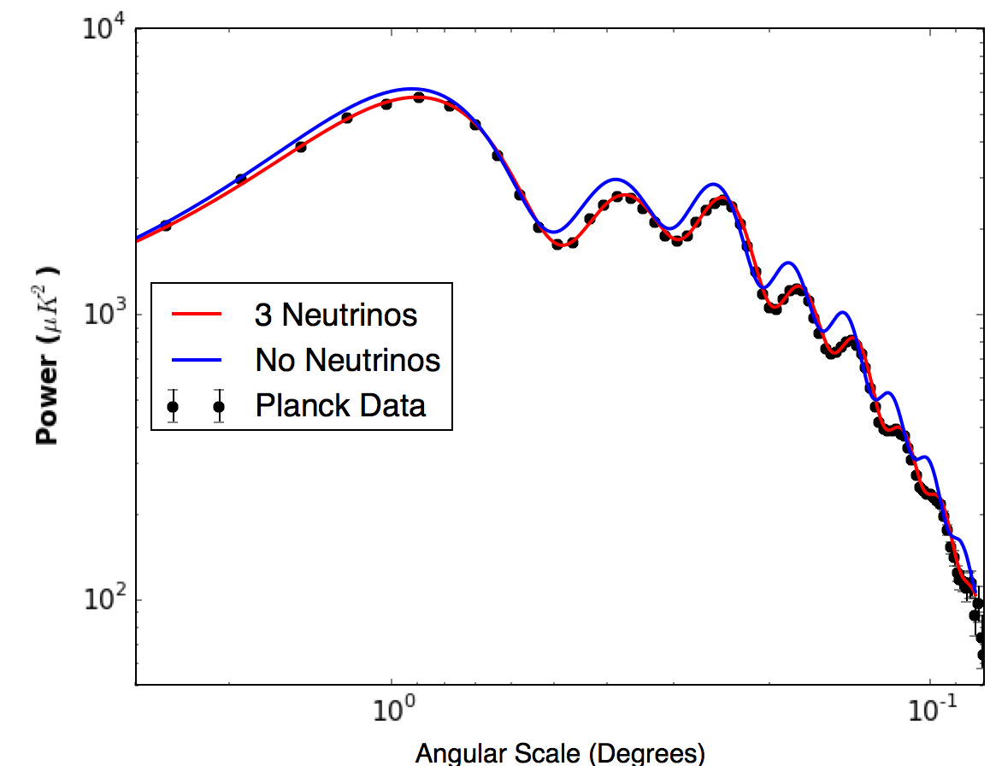
(Indirect) Detection of Cosmic Neutrino Background!
Damping scale in model without neutrinos is too small: 10-sigma detection

Slide 36
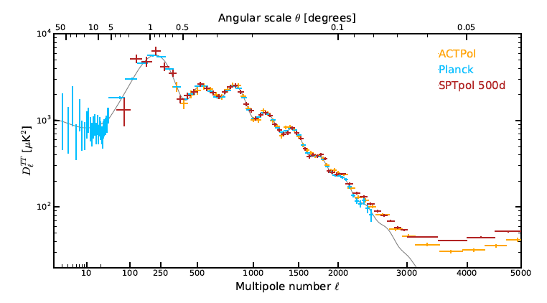
SPTPol Results from 3 weeks ago
SPTPol: Henning et al. (2017)
Ground-Based 10m telescope enables greater resolution

Slide 37
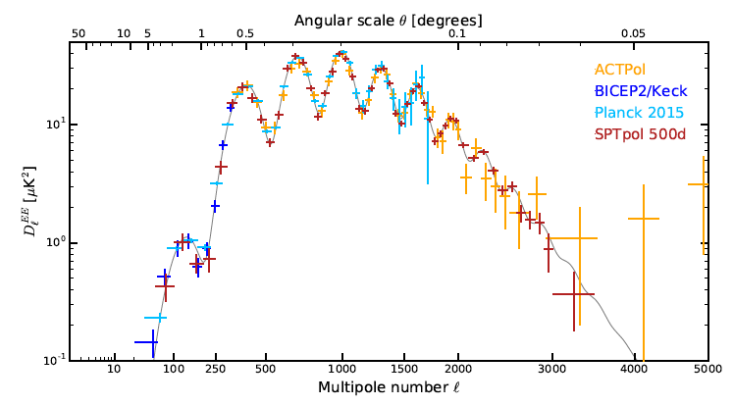
CMB also polarized, with imprint from acoustic peaks
SPTPol: Henning et al. (2017)

Slide 38
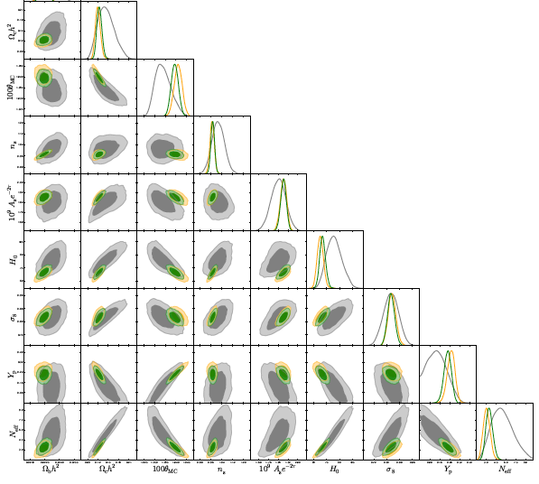
Light Sterile Neutrino Disfavored at ~3-sigma
SPTPol: Henning et al. (2017)
Number of neutrino species: 3.13± 0.27

Slide 39
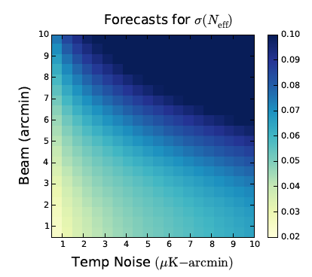
Stage-4 CMB will get very tight limits
CMB-S4 Science Book (2016)

Slide 40
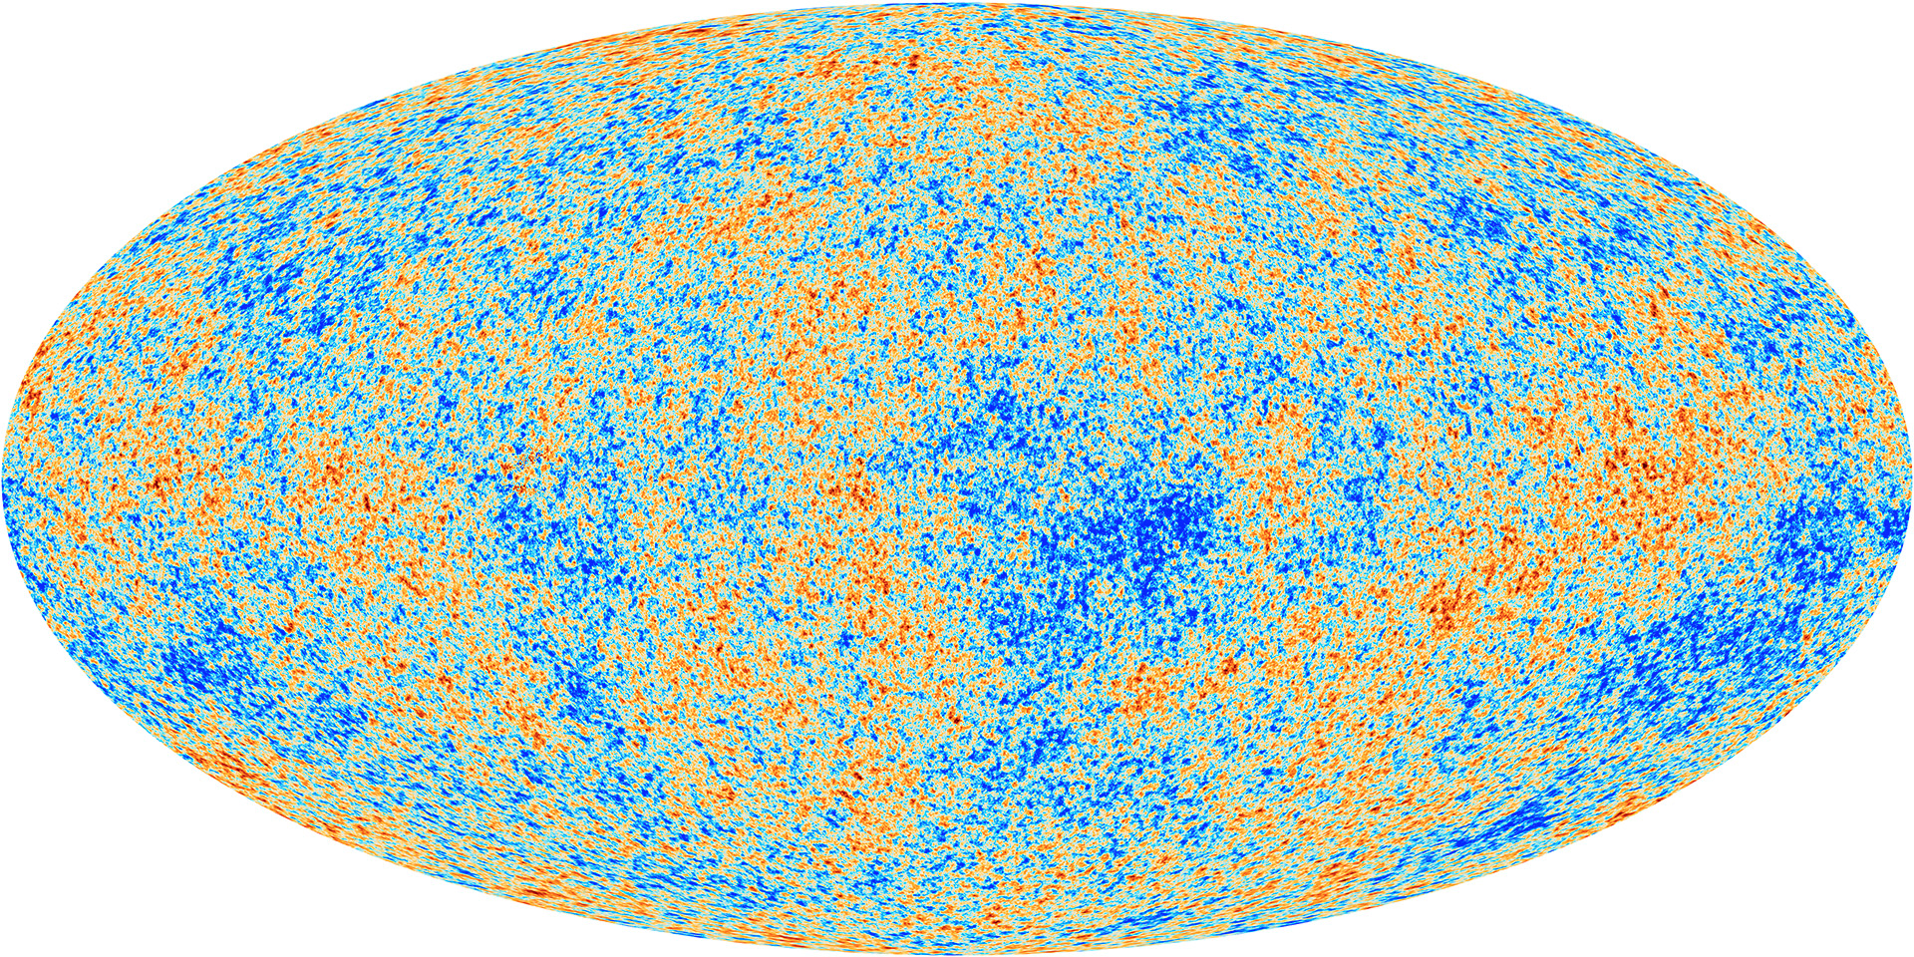
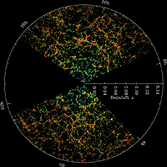
Maps of the Universe at different times inform us about the constituents of the Universe … in particular neutrinos
This evolution was driven by gravity: over-dense regions became more over-dense, eventually forming galaxies and stars
Uniform to one part in 10,000
Very non-uniform

Slide 41
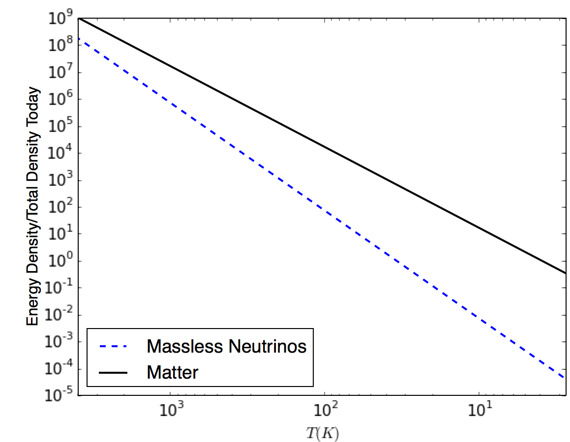
Maps of the Universe at different times inform us about the constituents of the Universe … in particular neutrinos

Slide 42
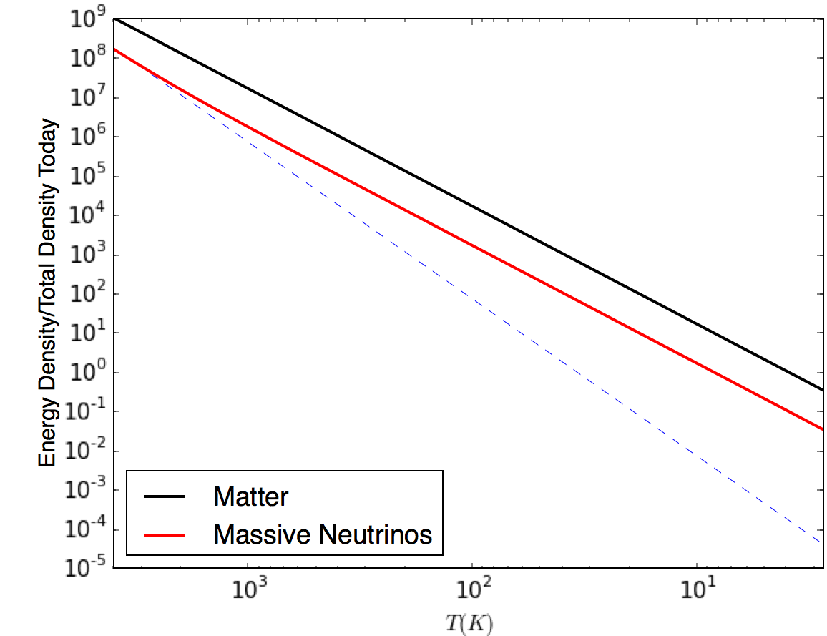
Maps of the Universe at different times inform us about the constituents of the Universe … in particular neutrinos
Massive neutrinos affect the evolution of structure

Slide 43
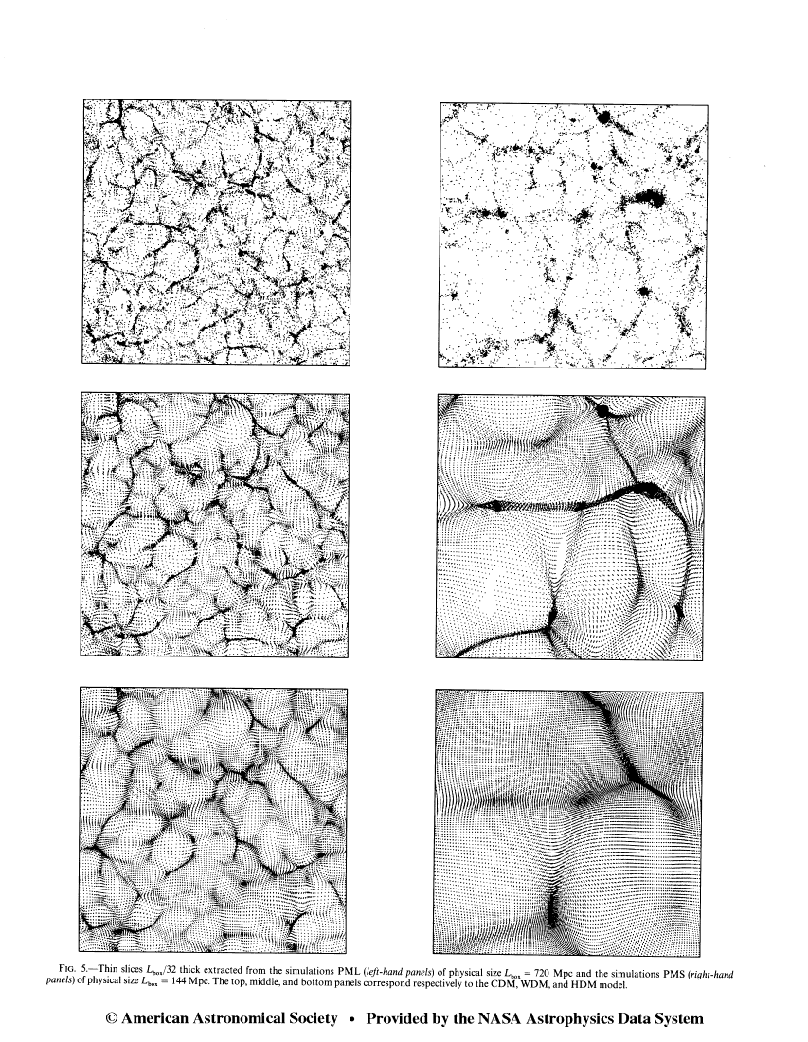
Neutrinos Inhibit Small Scale Structure
Neutrinos have large thermal velocities so do not cluster on small scales. This non-clustering component inhibits the formation of small scale structure.
With Massless Neutrinos
With Massive Neutrinos

Slide 44
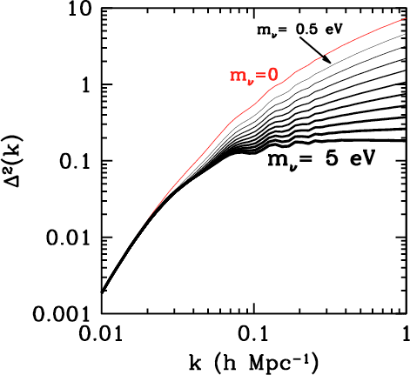
Neutrinos Inhibit Small Scale Structure
The analog to the 2D temperature field is the 3D density field:
We quantify this with the power spectrum, or the dimensionless k³P(k). This is the 3D analog of the 2D C_{l}’s

Slide 45
Technical Aside
Recall, in 2D:

Slide 46
Technical Aside
Recall, in 2D:
Similarly, in 3D:

Slide 47
Technical Aside
Recall, in 2D:
Similarly, in 3D:
More complex 2-point functions:
For historical reasons, cosmologists quantify amplitude of fluctuations with σ₈

Slide 48
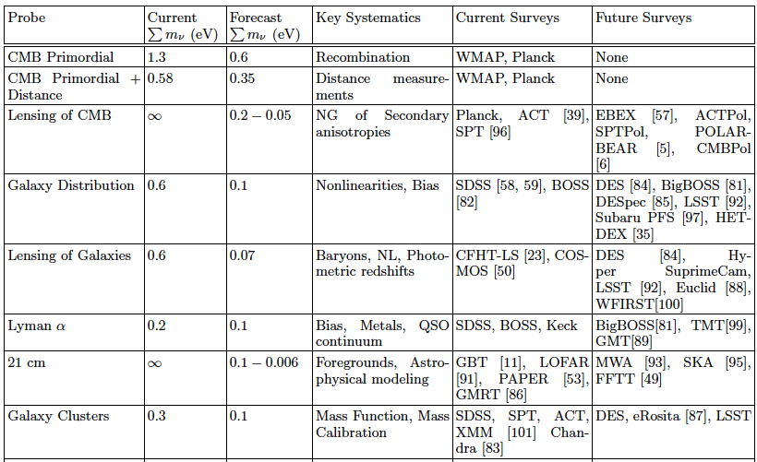
Probes of Structure

Slide 49
Probes of Structure

Slide 50
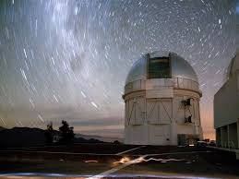
Dark Energy Survey
570 Megapixel camera built at Fermilab for the Blanco 4m telescope in Chile
Full Survey 2013-18
(Y1 2013-4)
  5000 sq. deg. (1300)
  5 Bands
  ~24th magnitude (23rd)
  Sub-arcsec seeing
Notes:
Pictures – put this here or later?
Describe spt?
2500 sq degree survey, 2007-2011
Slide about mocks?

Slide 51
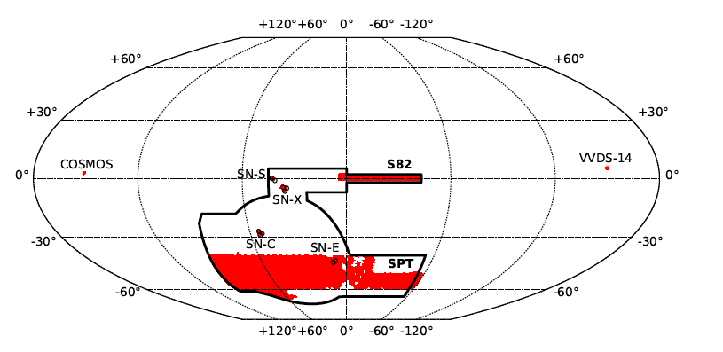
1800 square degrees in the Southern Sky: 2-10 larger than previous similar surveys
Alex Drlica-Wagner, et al. 2017

Slide 52
How to measure mass when we see only light?
Use Galaxies as tracers
Galaxies form in over-dense regions, so an excess of galaxies <-> an excess of mass. But the precise relation between overdensities is governed by a bias parameter
Measure the shapes of background galaxies
Shapes are distorted as the light they emit traverses through the inhomogeneous universe. Infer information about the mass along the line of sight. The distortions are small, much smaller than random variations

Slide 53
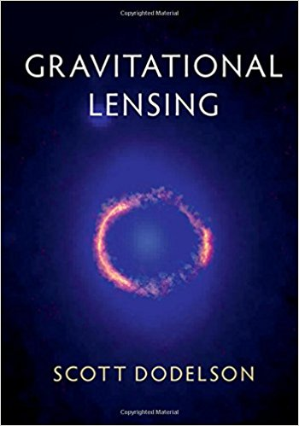
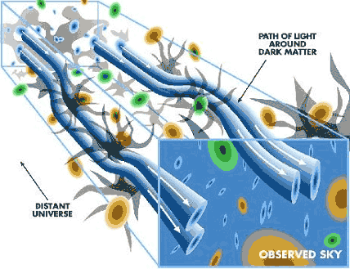
Weak Gravitational Lensing:
Galaxy Shapes are Distorted by intervening Mass
</shameless plug>
Measure galaxy shapes → Infer mass integrated along line of sight

Slide 54
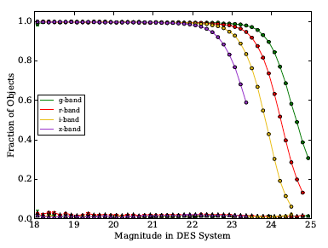
137 Million Objects in the Gold Catalog
DES measures the shapes of 35 million of these
Alex Drlica-Wagner, et al. 2017

Slide 55
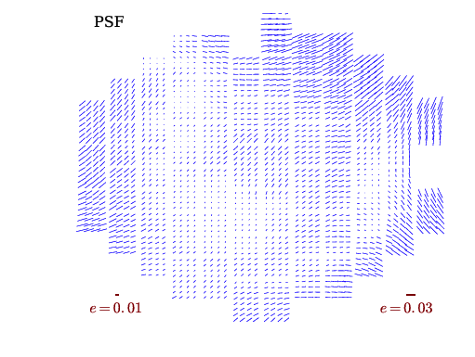
Shapes: True galaxy shapes are convolved with the
“Point Spread Function”
DES: Joe Zuntz et al. 2017

Slide 56
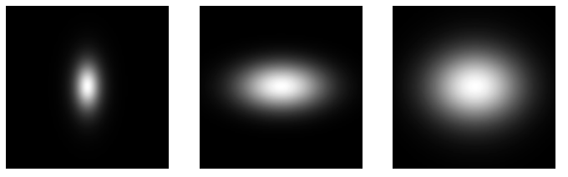
We aim to measure shapes at the percent level
PSF
True Galaxy
Observed Galaxy
Gravitational Lensing, Dodelson (2017)
available July 31 </shameless plug>

Slide 57
Two different pipelines account for PSF in different ways
METACAL uses 3 filters and is less noisy; it serves as our primary catalog
DES: Joe Zuntz et al. 2017

Slide 58
Two fields:
Galaxy over-density δ_{g}(θ)
Galaxy ellipticity e_{i}(θ)
Three 2-point functions:
Angular correlation function w(θ)=<δ_{g}δ_{g}>
measures the clustering of “lens” galaxies
Galaxy-galaxy lensing γ_{t}(θ)=<δ_{g}e_{i}>
measures the distortions in “source” galaxies by mass associated with “lens” galaxies
Shear correlation function ξ(θ)=<e_{i}e_{j}>
measures the correlations between shapes of nearby “source” galaxies due to similar distortions by line-of-sight mass
So, like the CMB, unlike a spectroscopic survey,
DES measures statistics of 2D fields

Slide 59
DES is a Photometric Survey: 2D not 3D
Measure fluxes in bands, not complete spectra that would enable us to measure the redshift, and therefore how far away each galaxy is

Slide 60
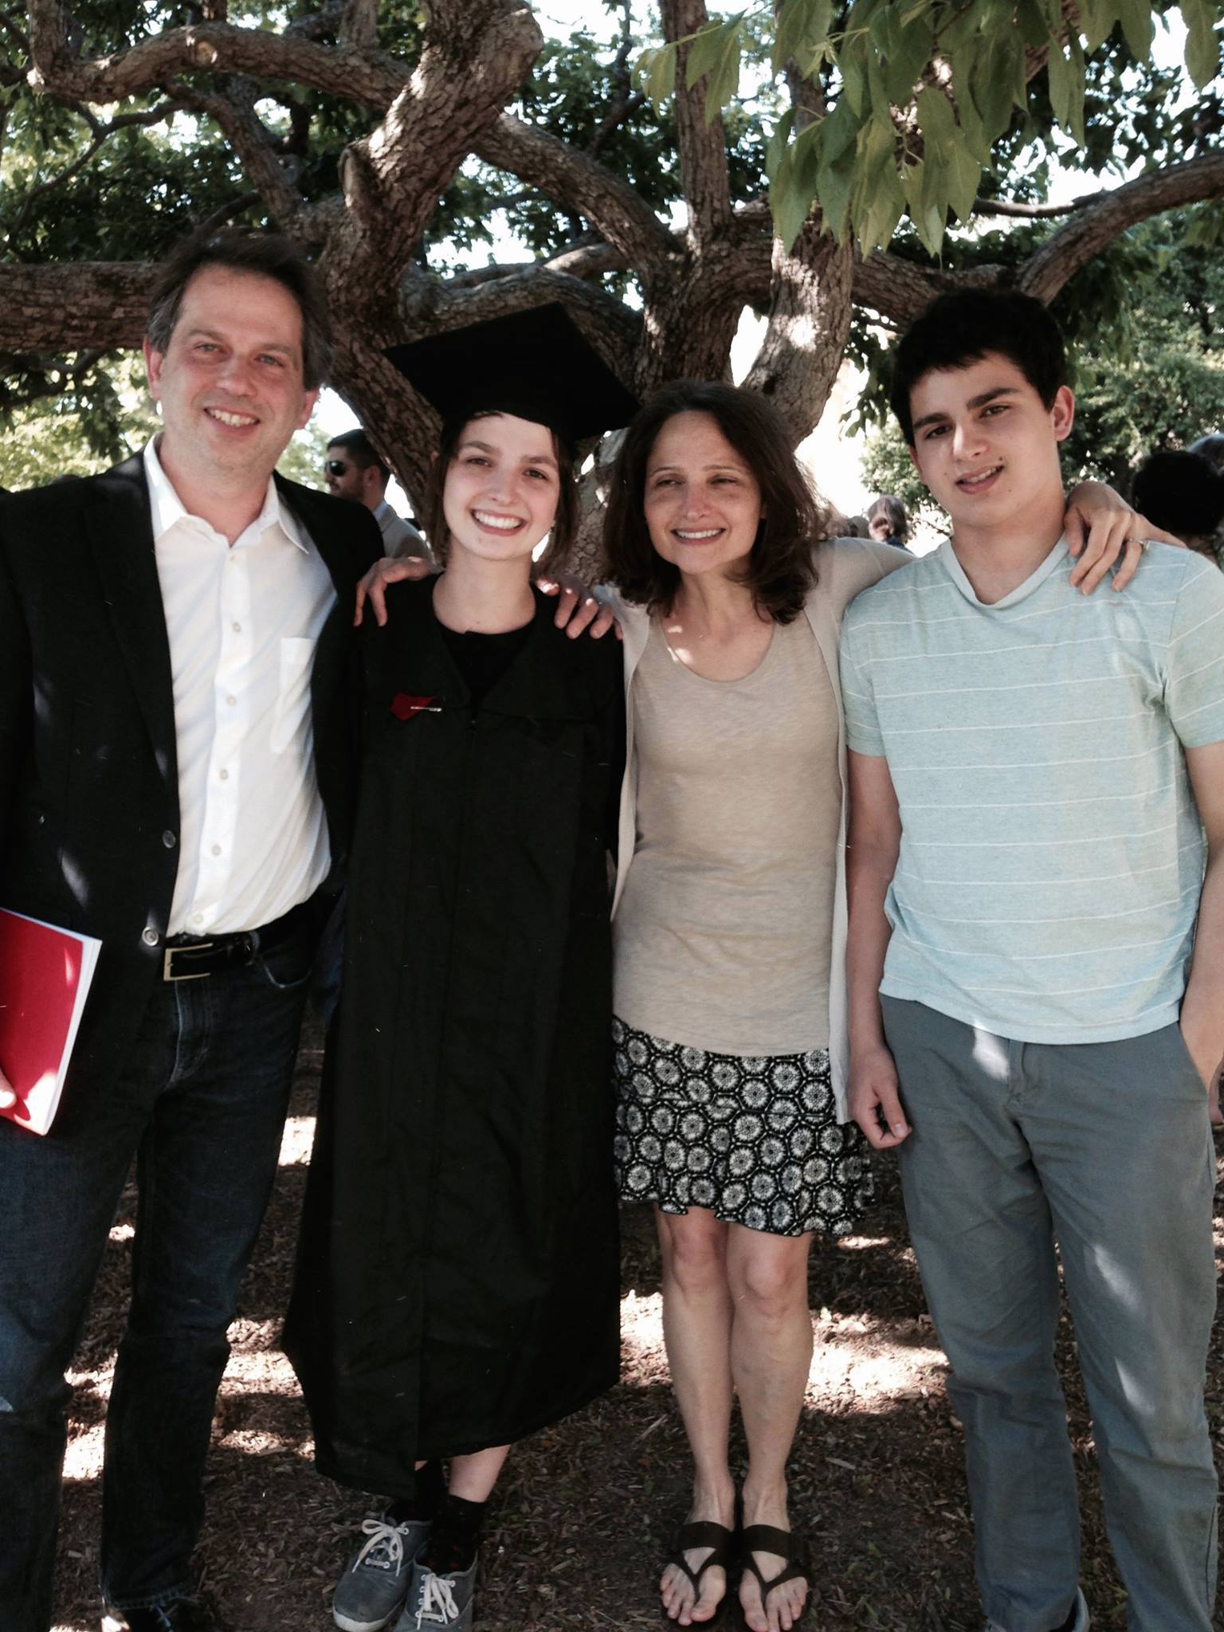
DES is a Photometric Survey: 2D not 3D
Measure fluxes in bands, not complete spectra that would enable us to measure the redshift, and therefore how far away each galaxy is

Slide 61

red Matched-Filter Galaxy Catalog
Eduardo Rozo et al. 2015 devised an algorithm to find old, red galaxies and -- using the position of the 4000 Ang break – determine their redshifts very accurately

Slide 62

Well-measured redshifts
Eduardo Rozo et al. 2015

Slide 63


660,000 redMaGiC galaxies are the “lenses”, divided into 5 tomographic bins
DES: Jack Elvin-Poole et al. 2017

Slide 64
There are 457 data points:
Angular Correlation Function in 5 lens bins
DES: Jack Elvin-Poole et al. 2017

Slide 65
There are 457 data points:
Galaxy-galaxy lensing in 4 source bins x 5 lens bins
DES: Judit Prat, Carles Sanchez et al. 2017

Slide 66
There are 457 data points:
Lensing Correlation Function in 4 source bins x 4 source bins
DES: Michael Troxel et al. 2017

Slide 67

There are 457 data points:
Need a Covariance Matrix
Elisabeth Krause et al. 1706.09359

Slide 68
There are 457 data points need a covariance matrix
w_{i}(θ) i=1,5
γ_{t}^{ij}(θ) i=1,5; j=1,4
ξ±^{jk}(θ) j,k=1,4
Elisabeth Krause et al. 1706.09359

Slide 69

Unblinding: July 7, 2017

Slide 70



Data Release August 3; 9 papers on arXiv last week

Slide 71

Data Release August 3; 9 papers on arXiv last week

Slide 72
We will focus on three parameters
Σm_{ν} The sum of the neutrino masses
Ω_{m} The mass density (stars, neutrinos, atoms, dark matter) in units of the critical density
σ₈ The root mean square of the fluctuations in the mass density smoothed over scales of 8 h⁻¹ Mpc today

Slide 73

Although we quote σ₈, the amplitude of the fluctuations today, this is a parameter, so when measured by CMB experiments, it is 3 orders of magnitude smaller!

Slide 74

DES Science Verification Data tested this …
RMS fluctuations
Mean Density
DES: Kwan et al. 2016

Slide 75

Other experiments have reported tension
Hildebrandt et al. 2016

Slide 76
DES Y1 Results: Power a bit lower than expected

Slide 77
DES Y1 Results: Can accommodate with larger neutrino mass
So, the 95% CL upper limit on the sum of the neutrino masses actually gets looser by ~20% when adding in DES Y1 data:

Slide 78
DES Y1 Results: We would like to know the neutrino mass

Slide 79

Conclusion
Neutrinos raise doubts about this iconic “set-in-stone” chart

Slide 80
Conclusion
At the simplest level, keV sterile neutrinos could be the Dark Matter
Neutrinos raise doubts about this iconic “set-in-stone” chart

Slide 81
Conclusion
At the simplest level, keV sterile neutrinos could be the Dark Matter
More importantly, we have learned from neutrinos that when we think we know everything, we don’t
Neutrinos raise doubts about this iconic “set-in-stone” chart

Slide 82
Conclusion
At the simplest level, keV sterile neutrinos could be the Dark Matter
More importantly, we have learned from neutrinos that when we think we know everything, we don’t
We think we have a simple* cosmological model that fits everything. Maybe we don’t … and neutrino experiments will lead the way to a better understanding of the evolution of the universe
Neutrinos raise doubts about this iconic “set-in-stone” chart
* with 3 new ingredients invented to fit the data and disconnected from the rest of physics

Slide 83
Complementarity with neutrinoless double beta decay
Dodelson & Lykken 2014
“At least one good thing will have come out of P5”
(Anonymous member of P5 in the depths of “consensus building”)

Slide 84
What assumptions are made?
Within the simple (hyper-successful) cosmological ΛCDM model, theoretical assumptions are: standard weak interactions, general relativity, statistical mechanics

Slide 85

What assumptions are made?
Within the simple (hyper-successful) cosmological ΛCDM model, theoretical assumptions are: standard weak interactions, general relativity, statistical mechanics
Relaxing priors on the model lead to looser constraints
Zhao et al 2013

Slide 86

Sterile Neutrinos as Dark Matter (Dodelson & Widrow 1994)
Heavier sterile neutrinos (~keV) could be produced sub-thermally and be the dark matter
Production rate inversely proportional to M, so Ω_{s} independent of mass, determined by mixing to active neutrinos.
Easy to get correct DM abundance
Abundance much lower than thermal neutrinos and mass higher, so not constrained by standard CMB search

Slide 87



Sterile Neutrinos as Dark Matter
Two Main Signatures:
Decay to light neutrino + photon
keV Dark Matter particle damps structure on small scales

Slide 88

Constraints on Sterile Neutrino as Dark Matter
Abazajian et al. (2012)
DW

Slide 89
Recent hints for X-ray excess
Stacked signal from many galaxy clusters
Bulbul et al (2014)
And from Andromeda
Bulbul et al (2014)

Slide 90

Recent hints for X-ray excess
If interpreted as sterile neutrino decay, mixing angle is too small for them to be produced enough in the early universe in the standard scenario, but alternatives abound: resonances, etc.
Bulbul et al (2014)

Slide 91

Social Media responded

Slide 92

Social Media responded
with predictable results …

Slide 93


More importantly, no signal seen in other areas
Stacked Dwarf Spheroidals
Stacked Galaxies
Malyshev et al (2014)
Anderson et al (2014)
7-keV vs. r=0.1 vs. Galactic Center DM?

Slide 94


Neutrino-less Double Beta Decay
Rate must be proportional to the Majorana masses of the neutrino:

Slide 95

Theory

Slide 96
Theory
Determine zero order cosmology using Einstein equations and energy-momentum conservation

Slide 97
Theory
Determine zero order cosmology using Einstein equations and energy-momentum conservation
On large scales (small k) perturbations are small, so solve linear perturbation theory using coupled Einstein- Boltzmann equations
Perturbed f can be used to compute δ(k,t); the predicted power spectrum is |δ(k,t)|²

Slide 98

Planck constraints on sterile massive neutrinos

Slide 99

With a new mass squared difference
Three mass squared differences imply at least 4 light neutrinos

Slide 100

And there are other hints …
Mention et al. 2011
Anti-neutrino flux 7 percent lower than expected (3-sigma)

Slide 101

Pointing to possibly another mass squared difference

Slide 102
If you open up the possibility of right-handed neutrinos …
We have the freedom of a 6x6 matrix:
Some information about these elements
along with 6 masses, with only two solid constraints so far

