Slide 1
Accelerator Division Status
Daniel Johnson
All Experimenters’ Meeting
05 December 2016

Slide 2
Content Slide [22pt Bold]
Bullet points are optional. If preferred, only first level bullets can be used or bullets can be set to “NONE.” [18pt Regular]
First level bullet [18pt Regular]
Second level bullet [16pt Regular]
Third level bullet [15pt Regular]
Fourth level bullet [14pt Regular]
Fifth level bullet [14pt Regular]

Slide 3
Accelerator Operations Summary
From: November 28, 2016 (0000 hours)
To: December 05, 2016 (0000 hours)
Calendar Week # 48
NuMI Weekly Integrated Intensity 9.43 E18 protons
Beam Hours To NuMI 131.1 hours
BNB Weekly Integrated Intensity 1.32 E19 protons
Beam Hours To BNB 154.5 hours
NMuon Weekly Integrated Intensity 1.34 E14 protons
Beam Hours To NMuon 18.9 hours
MTest Weekly Integrated Intensity 6.31 E13 protons
Beam Hours To MTest 43.7 hours
MCenter Weekly Integrated Intensity 0.00 E12 protons
Beam Hours To MCenter 0.0 hours

Slide 4
NuMI Operation

Slide 5
BNB Operation

Slide 6
Content and Caption Slide [22pt Bold]
Click to add caption text [13pt Bold]
First level bullet [18pt Reg]
Second level bullet [16pt]
Third level bullet [15pt]
Fourth level bullet [14pt]
Fifth level bullet [14pt]

Slide 7
Complex Status
LINAC
Running well
Booster
Running well
~5.1 E12 p/p
MI/RR
Recycler startup
MI52 extraction septum sparking/vacuum
Fix leaking magnet before slipstacking
NuMI
Running at ~375 kW
Booster Neutrino Beamline (BNB)
Running well
Switchyard
SeaQuest beam when requested
Meson Test beam when requested
General
Access Wednesday/Thursday
Beam off Wednesday, December 7th @ 0500
Keys available at 0700
MI Supervised Access
Startup Thursday, December 8th @ 1300

Slide 8
MI-12 Communication Duct
Summary from Wed, November 23rd Meeting
Emergency Repair Plan In Place
Need 2 hour notification
Vendor has cable
New Communications Duct Plan
Targeting communications duct installation completion by January
A portion of new duct has been installed
Plans for routing remainder of new duct underway
Expect cable delivery in mid-January
Hope to move to new cable in January/February
Try to coordinate downtime with Master SubStation outages
Damaged on 10/24/16
Protected from further damage
Provides timing/date to Neutrino Experiments
Experiments running fine

Slide 9
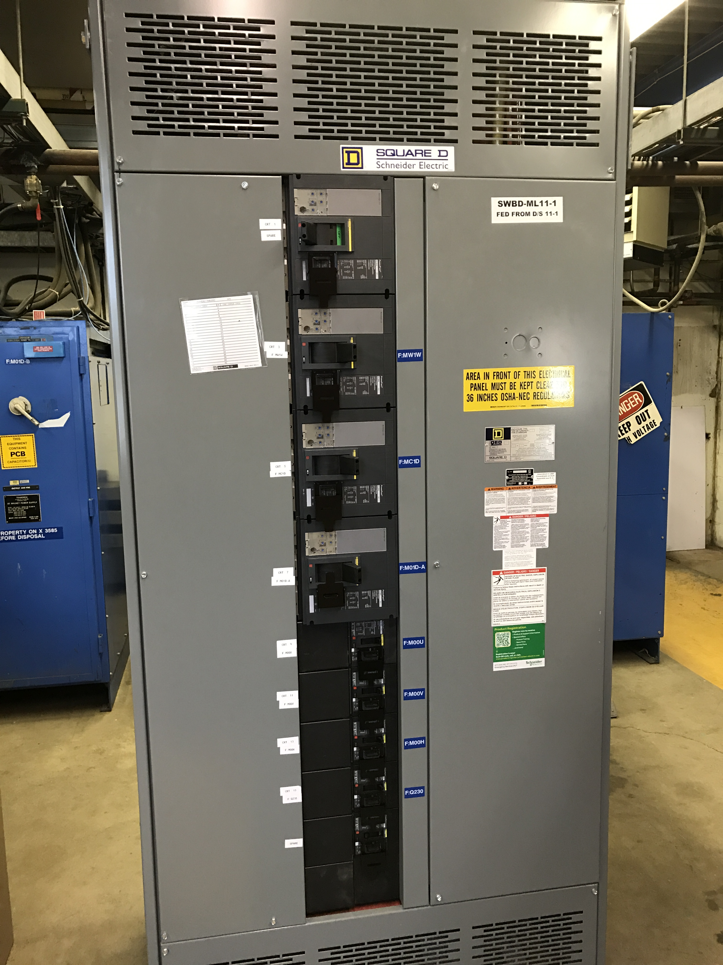
MS1 Bus Failure
All power supplies cabled into breaker panel
Work completed

Slide 10
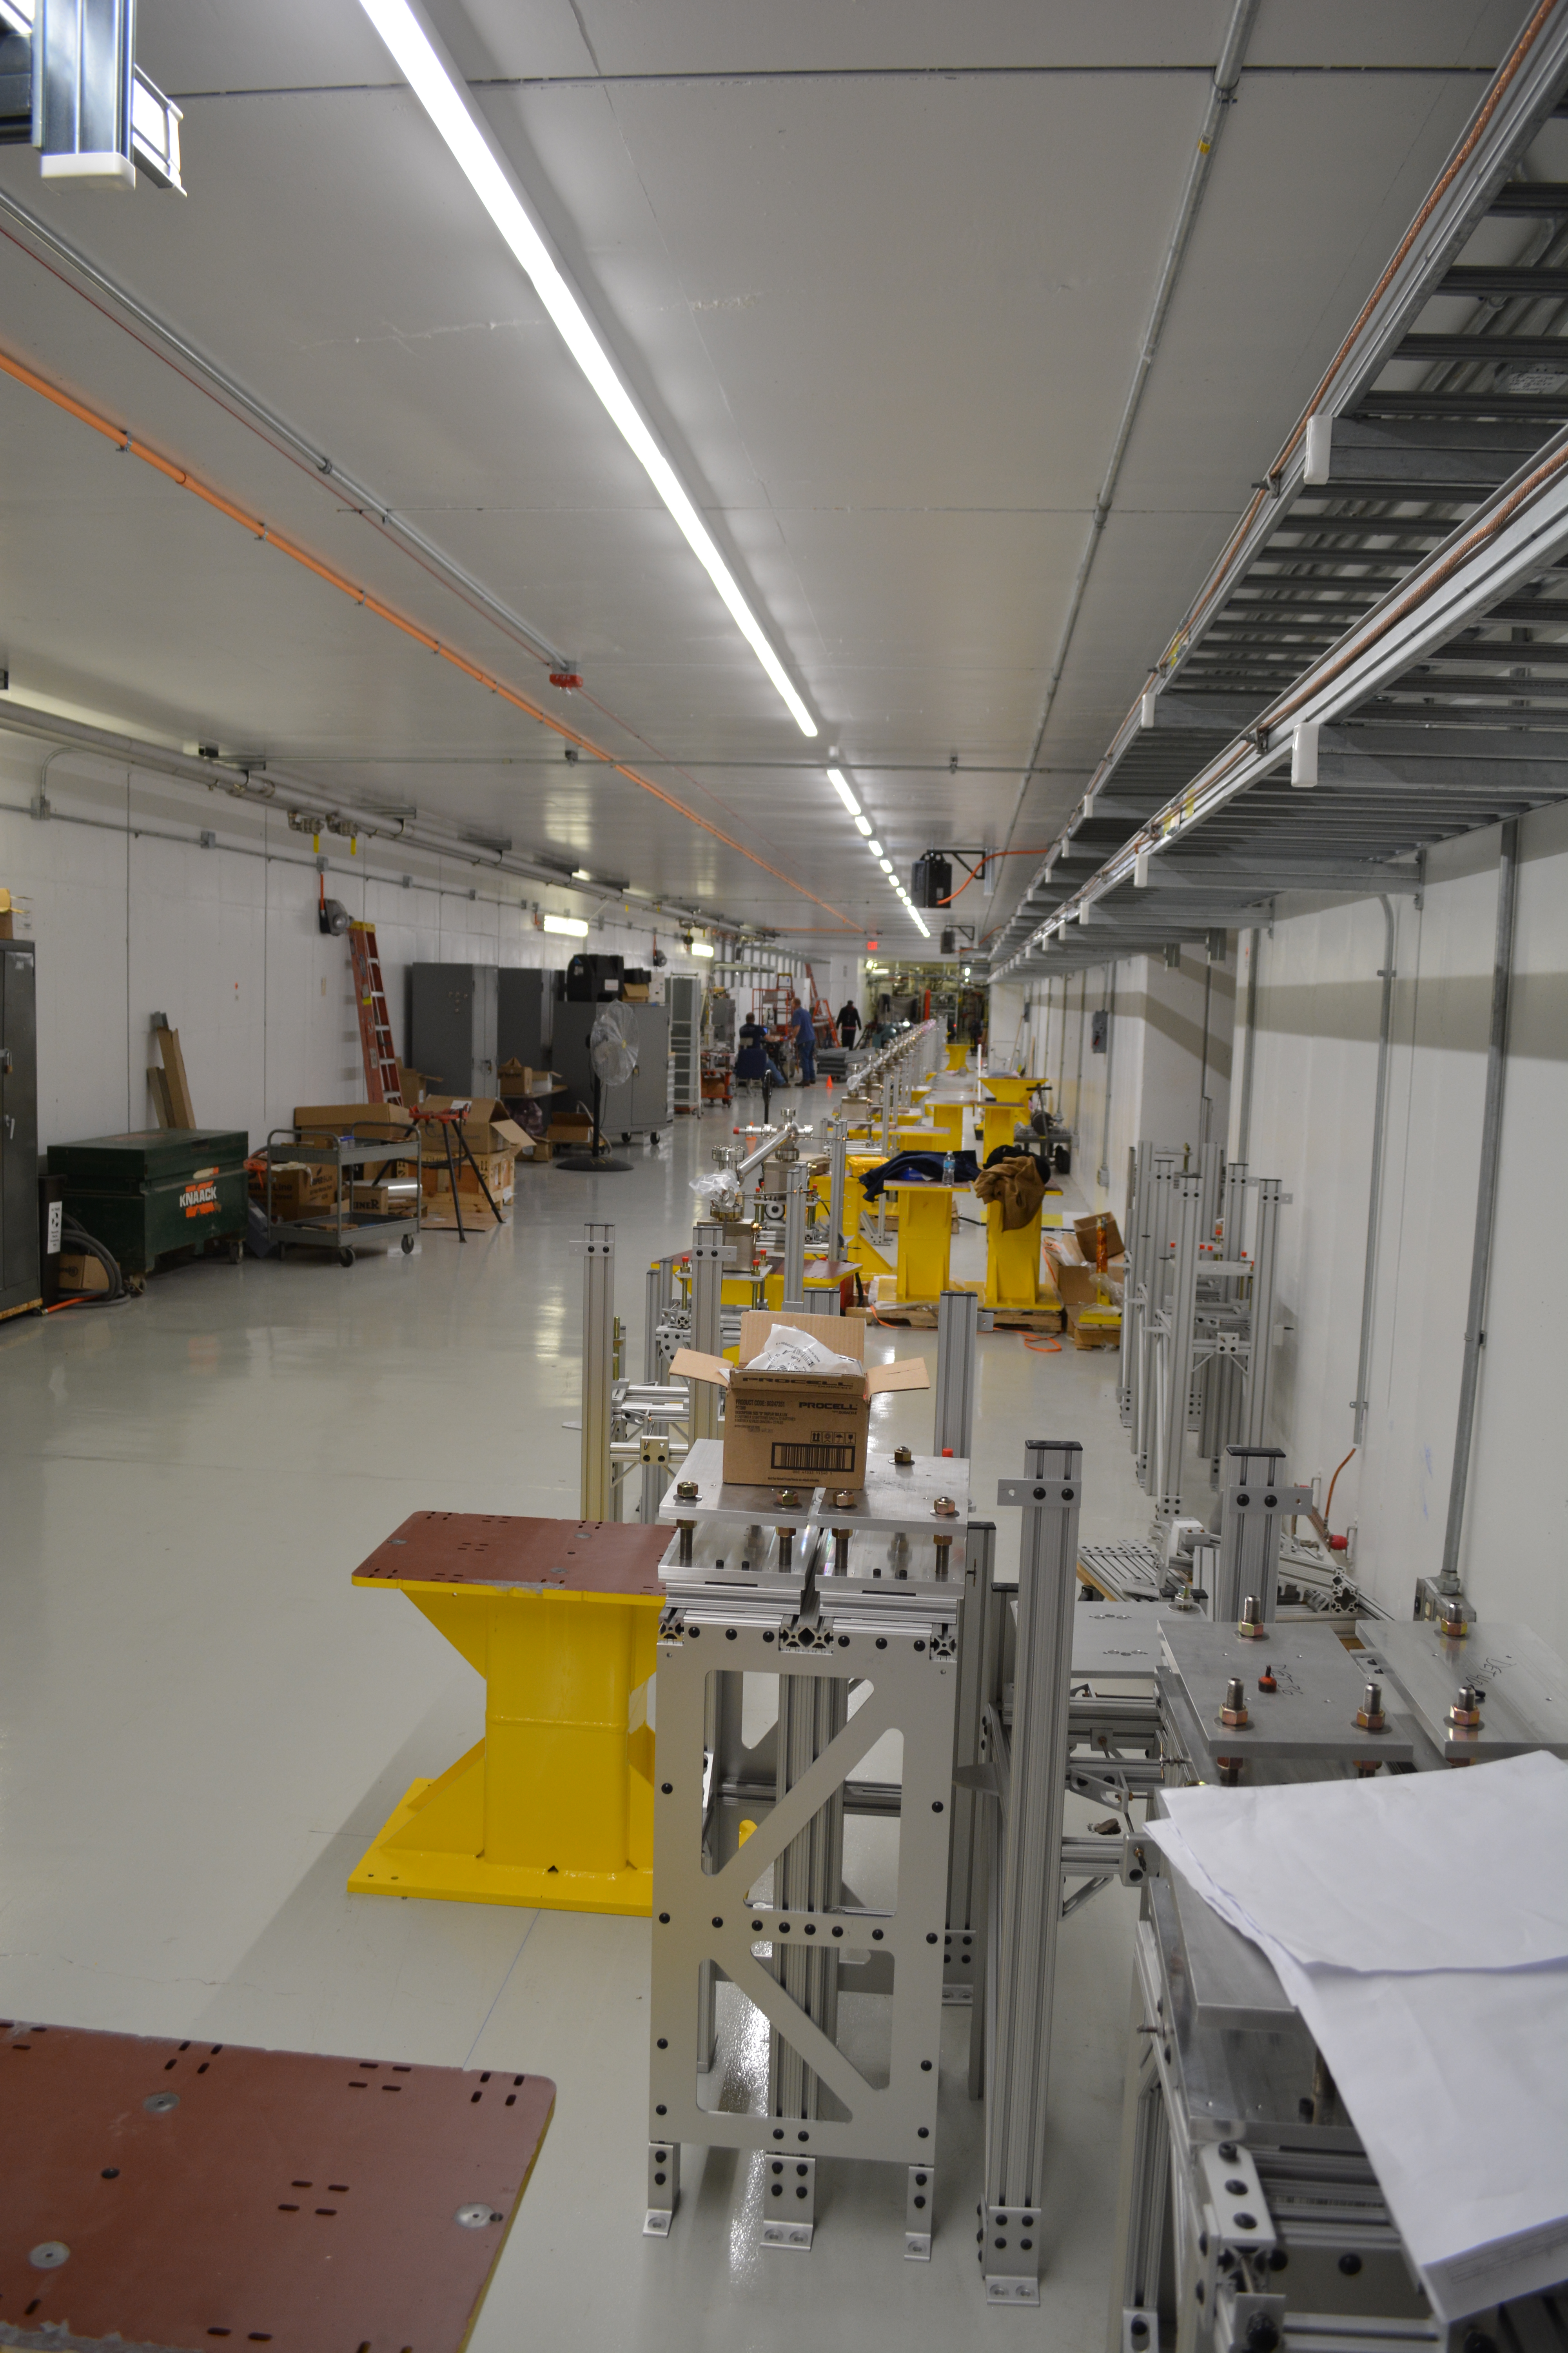
PIP-II Injector Test & FAST Status
PIP-II Injector Test
CW RFQ operation
Recovered from damaged bellows and collimator
Performing 24 hour operation test this week (Tuesday)
Beam scans and studies
Low power operation
Small vacuum leak on RFQ coupler
Collecting data
FAST
No gun operation
Working on drive laser
Shutdown for 300 MeV upgrade
Cave Roof Block Installation complete
Working on shielding assessment
Begin magnet and stand installation
Working on IOTA proton injector source at MDB

Slide 11
CMTS1 Status
LCLSII Prototype Cryo Module
Cryo
Cryo safety walkthrough complete
Waiting on engineering note approval
Cooldown to follow
Accomplishments
Mechanical work complete
Installing supplementary shielding for 8 cavity operation (Unit testing)
Miscellaneous other activities
Plan for the week
Receive engineering note approval
Begin cryo cooldown process
Purify, pump and backfill
A couple weeks until cold

Slide 12
ICW Reduction
Looking at measuring flows on systems
Stakeholders impacted
AD, TD, PPD, CD, FESS
Need to establish new Casey’s Pond West Strainer Vault
Everybody working on priority projects
Will be difficult to line up downtime schedules
Reducing flow will be painful
Estimate two week reduction for work
Performing measurements in late November/early December
Planning on early 2017 (January)
Will know more after December measurements (Today)
2 week reduction period
Should not impact most experiments
Will impact experiments/projects with cryogenic operation

Slide 13
December 2016

Slide 14
January 2017

Slide 15
Schedules and Links
Schedule can be accessed from the Operations Department Home Page
Schedules -> Operations Schedule
Direct link to schedule
http://www-ad.fnal.gov/ops/schedule.html

Slide 16
Collaborations / Partnerships / Members [22pt Bold]

