Slide 1
SCD Computing Summary
November 28th, 2016 though December 5th, 2016

Slide 3
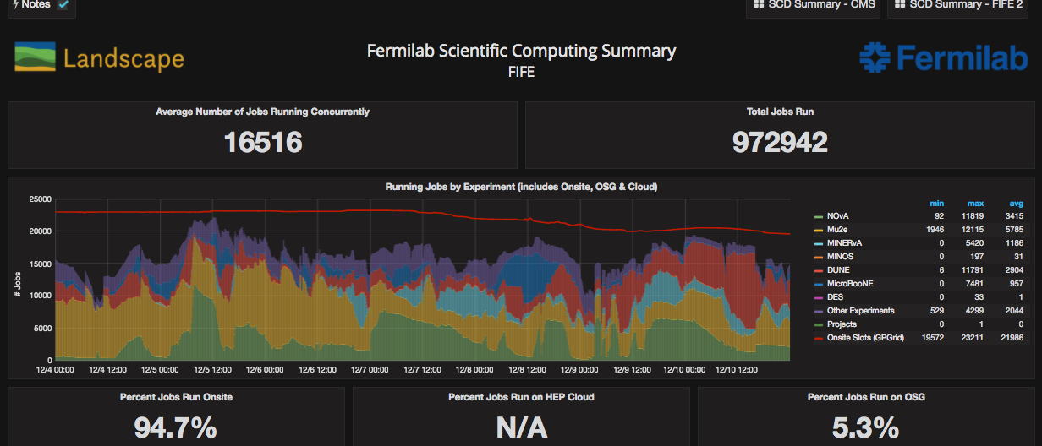
FIFE Operations
https://fifemon.fnal.gov/monitor/dashboard/db/scd-summary-fife?from=now-1w%2Fw&to=now-1w%2Fw
Drop in red line is due to retirement of old worker nodes (savings on power and cooling).

Slide 4
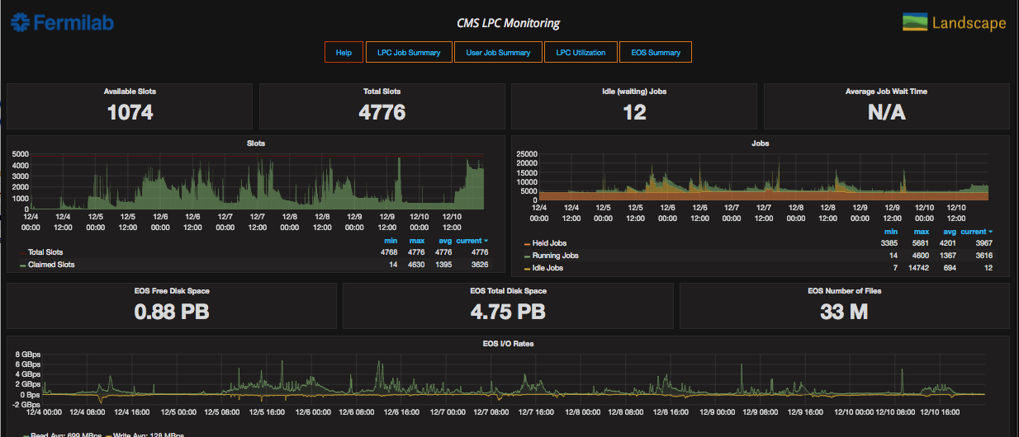
CMS LPC Operations
https://landscape.fnal.gov/lpc/dashboard/db/lpc-summary?from=now-1w%2Fw&to=now-1w%2Fw

Slide 5
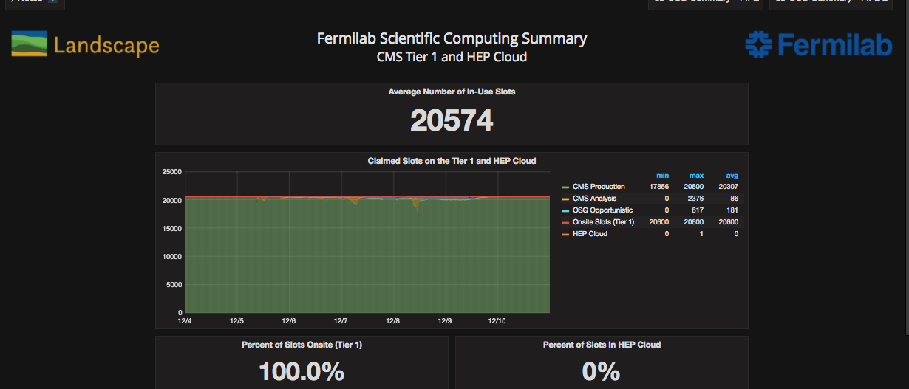
CMS Operations
https://fifemon.fnal.gov/monitor/dashboard/db/scd-summary-cms?from=now-1w%2Fw&to=now-1w%2Fw

Slide 6
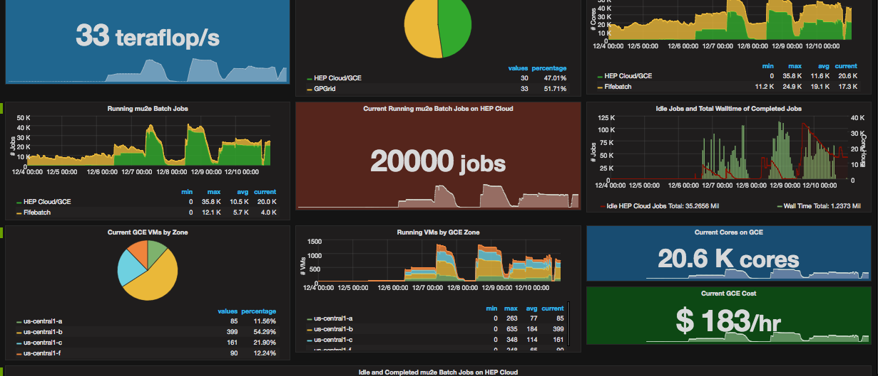
Mu2e on Google cloud!
https://fifemon.fnal.gov/monitor/dashboard/db/scd-summary-cms?from=now-1w%2Fw&to=now-1w%2Fw
First demo of Intensity Frontier on google cloud

