Slide 1
Generative Adversarial Networks
Prasanna Balaprakash
Assistant Computer Scientist
Mathematics and Computer Science Division &
Leadership Computing Facility
Argonne National Laboratory

Slide 2
Outline
Generative Modeling
Generative Adversarial Networks
Tips and Tricks
Applications and Extensions
Notes:
Data
Complexity
Humans
Optimization
Real-time

Slide 3
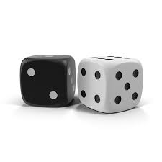
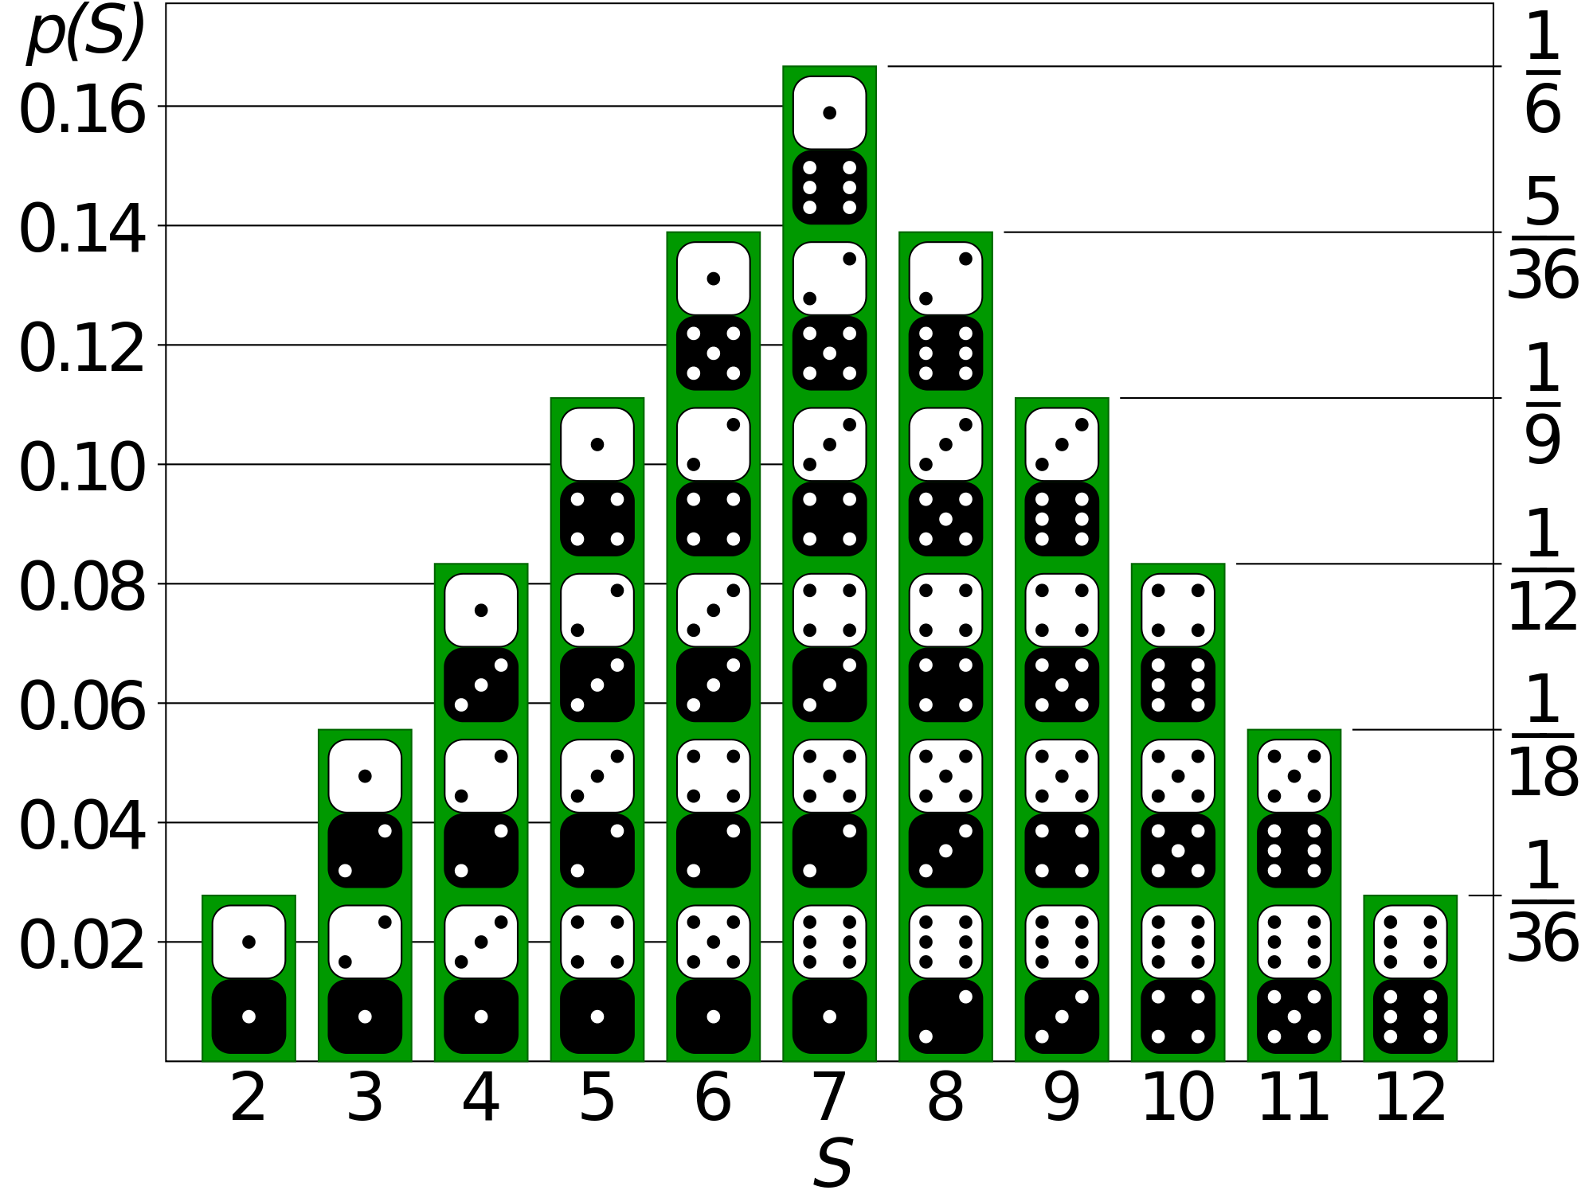
Generative Models
Sample data
Distribution
Model how the data was generated

Slide 4
Generative Models
Sample data
Distribution
Model how the data was generated

Slide 5
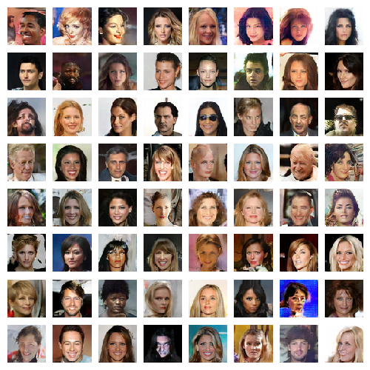
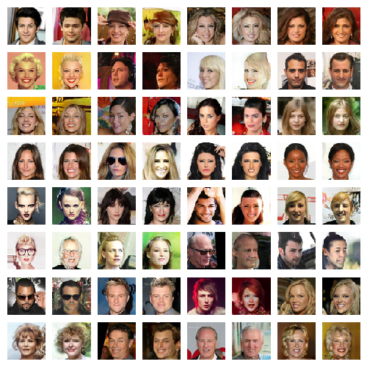
Generative Models
Sample data
Distribution data
Generate data from the distribution
Notes:
Take a lot of training examples
learn the probability distribution
Estimate of the function of that defines the distribution
New samples from the distributon

Slide 6
Why Generative Models?
Ability to use high-dimensional, complicated probability distributions
Simulate possible futures or simulated reinforcement learning
Missing data
semi-supervised learning
Multi-modal outputs (many outputs for a single input)
Realistic generation of samples

Slide 7
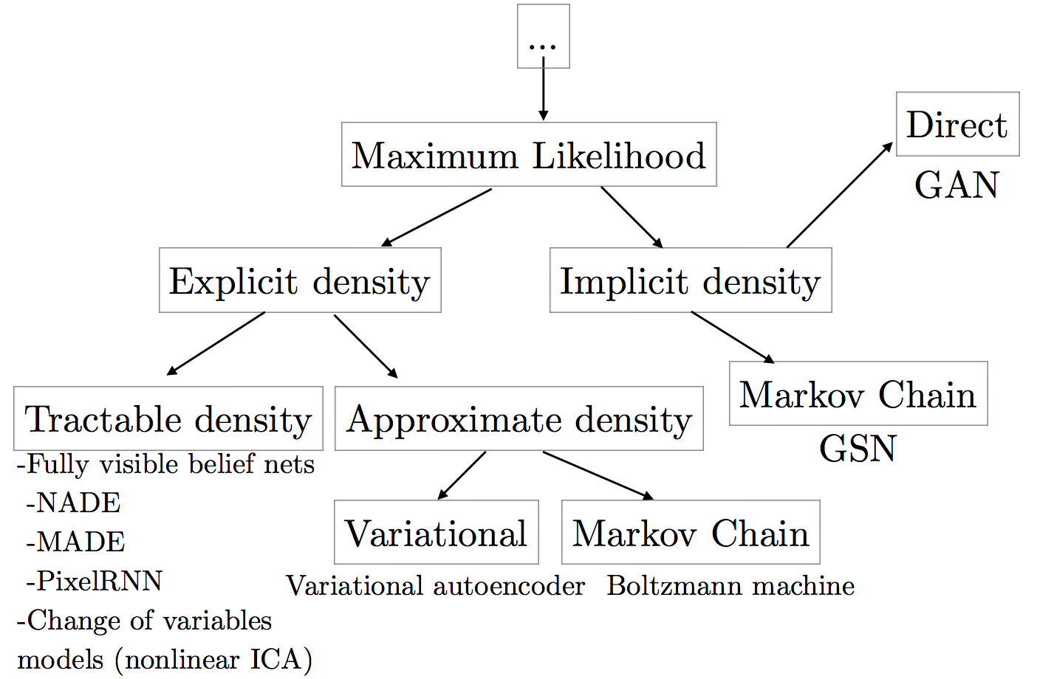
Taxonomy of Generative Models

Slide 8
Outline
Generative Modeling
Generative Adversarial Networks
Tips and Tricks
Applications and Extensions

Slide 9
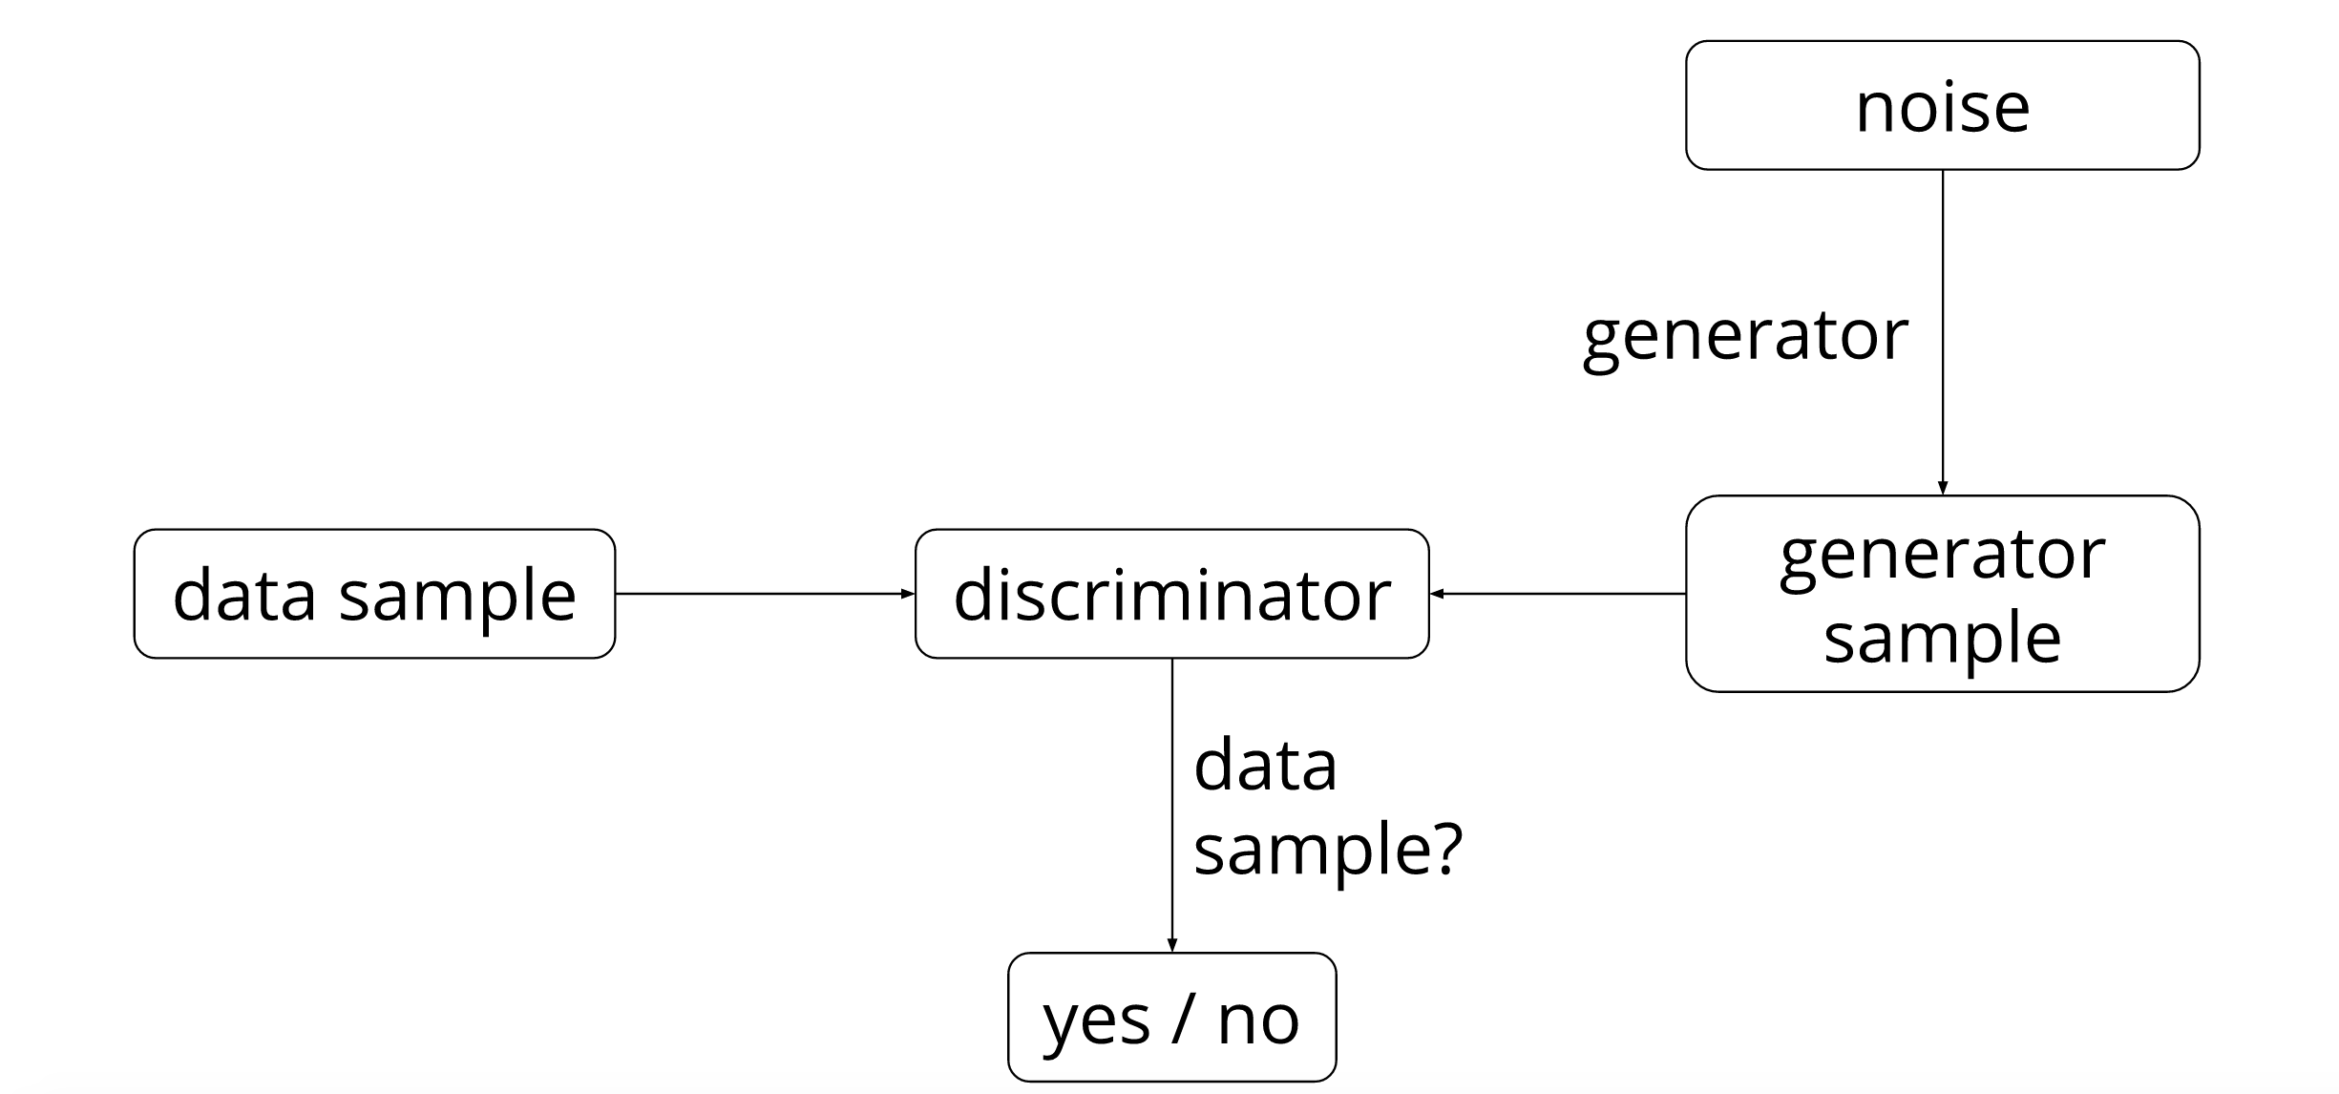
Generative Adversarial Networks
Notes:
Source: https://ishmaelbelghazi.github.io/ALI/

Slide 10
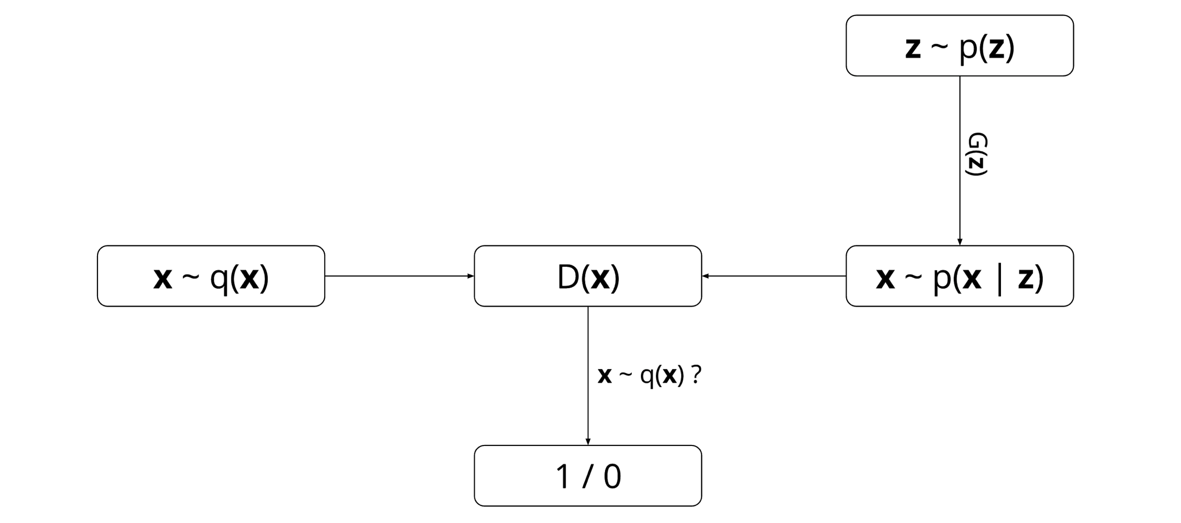
Generative Adversarial Networks
GAN pits two neural networks against each other:
a discriminator network D(x)
a generator network G(z)
Notes:
https://ishmaelbelghazi.github.io/ALI/

Slide 11
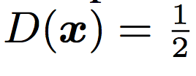
Generative Adversarial Networks
Maximize discrimination
Minimize
getting caught

Slide 12
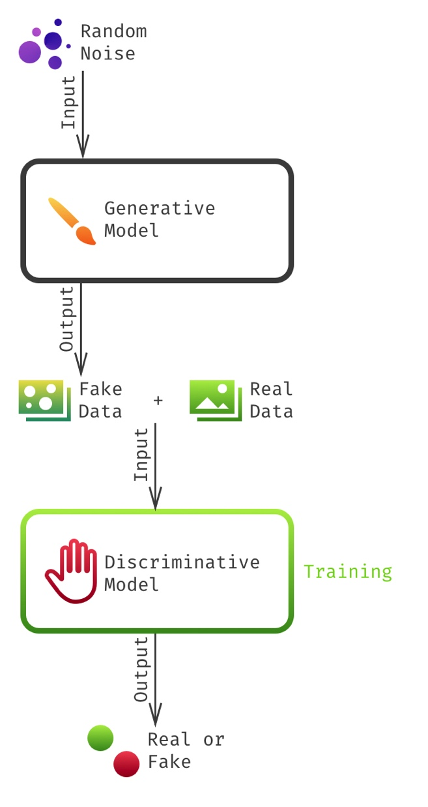
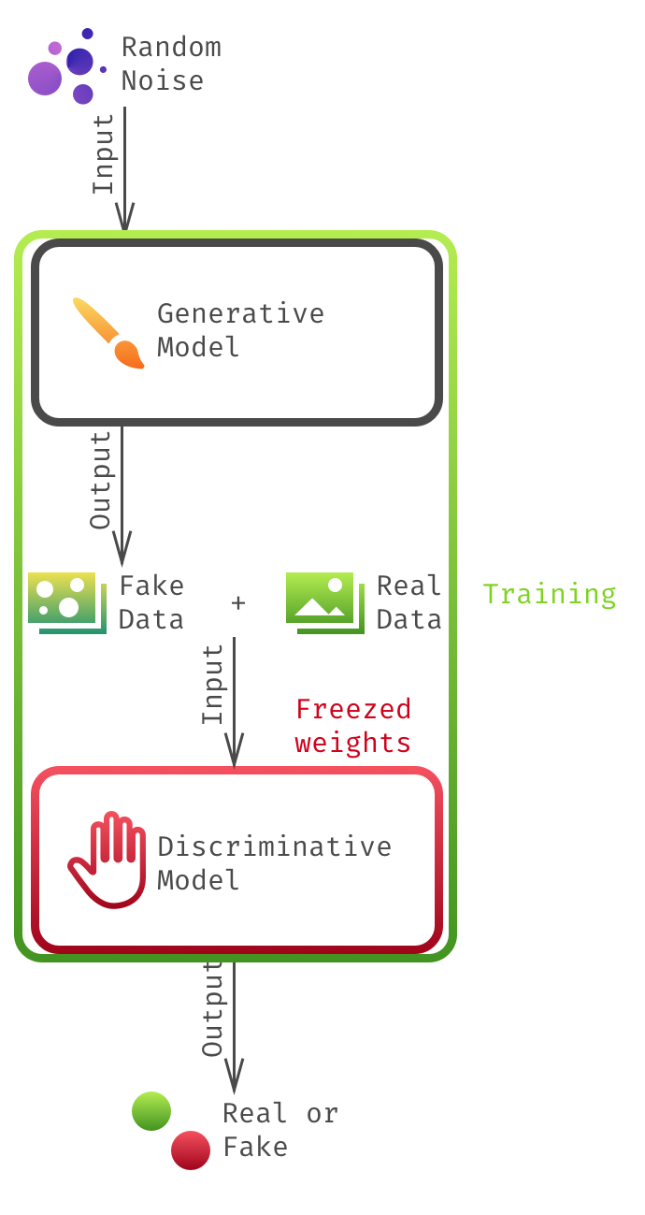
Generative Adversarial Networks
Step1:
Train the discriminator
Step2:
Train the generator via
chained models
Notes:
http://www.rricard.me/machine/learning/generative/adversarial/networks/2017/04/05/gans-part1.html

Slide 13
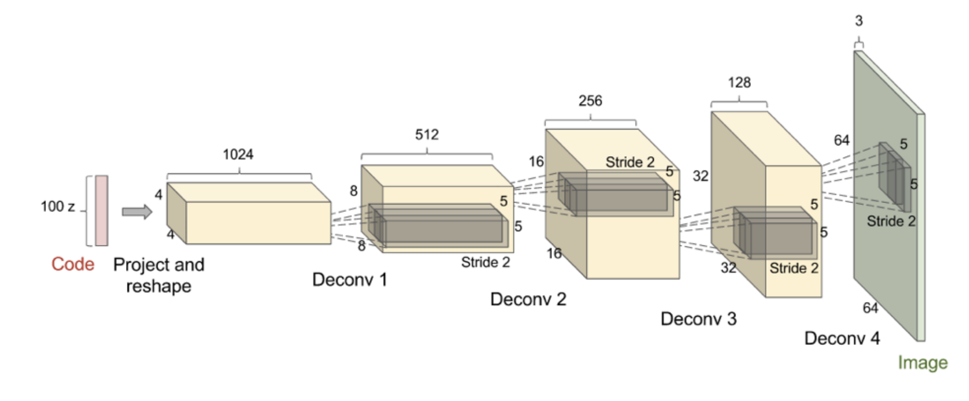
DCGAN Architecture
De-convolution: convolution run backwards (with stride > 1)
Batch normalization: faster and stable learning
No pooling layers: because pooling operation is not invertible

Slide 14
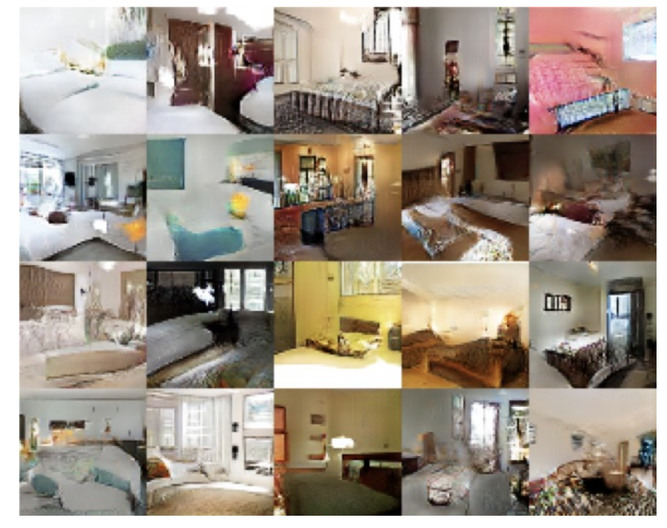
DCGAN Architecture
Sample images of bedrooms generated by a DCGAN trained on the LSUN dataset

Slide 15
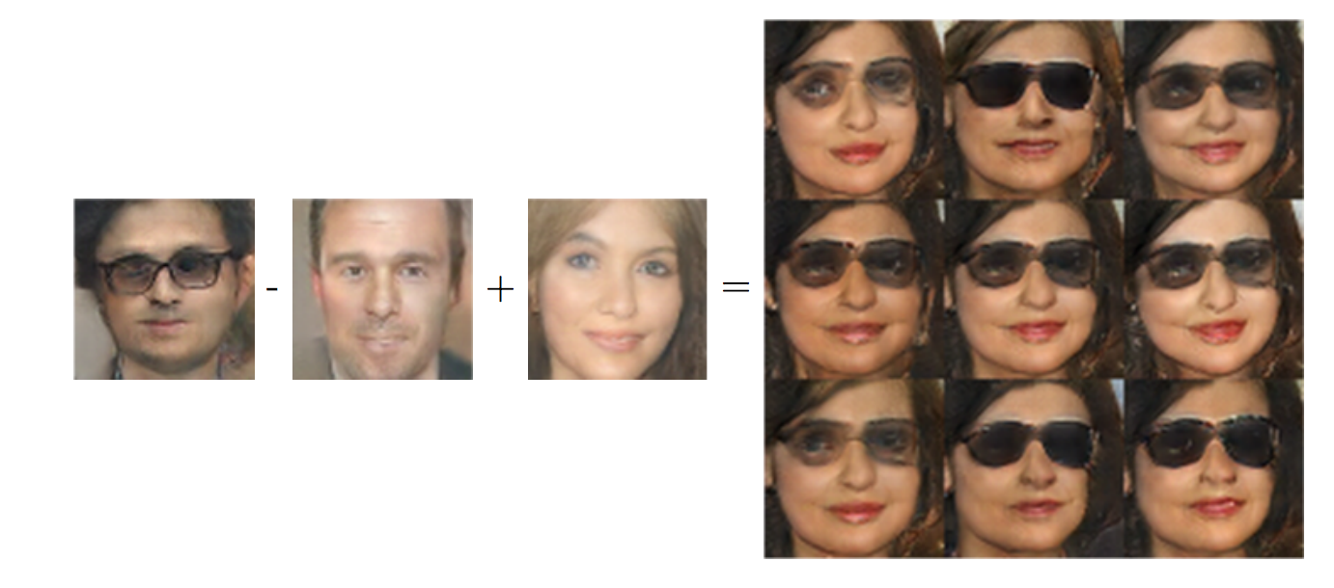
Vector Space Arithmetic

Slide 16
Outline
Generative Modeling
Generative Adversarial Networks
Tips and Tricks
Applications and Extensions
Notes:
Data
Complexity
Humans
Optimization
Real-time

Slide 17
Mode collapse
Generator produce same image
Maximize discriminator and minimize generator
fully maximize the discriminator first is OK
fully minimize the generator first is NOT OK
maps the noise to the argmax of the discriminator
Use mini-batch with image diversity

Slide 18
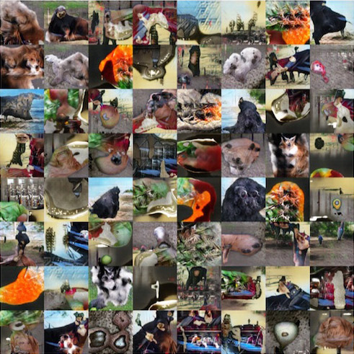
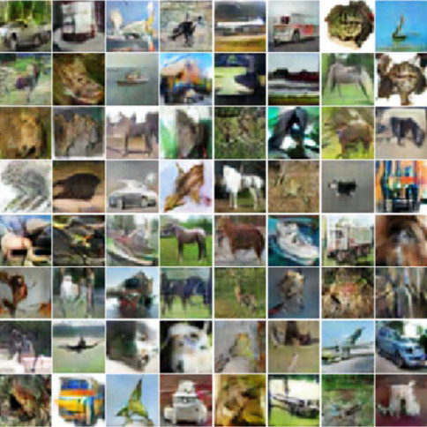
Imagenet and CIFAR10
Notes:
https://arxiv.org/pdf/1606.03498.pdf

Slide 19
Tips and tricks to make GANs work
Normalize the inputs
normalize the images between -1 and 1
Tanh as the last layer of the generator output
Loss function to optimize G is min (log 1-D), but in practice use max log D
Sample Z from a Gaussian distribution
Construct different mini-batches for real and fake
Don’t GAN without reading
https://github.com/soumith/ganhacks

Slide 20
Outline
Generative Modeling
Generative Adversarial Networks
Tips and Tricks
Applications and Extensions
Notes:
Data
Complexity
Humans
Optimization
Real-time

Slide 21
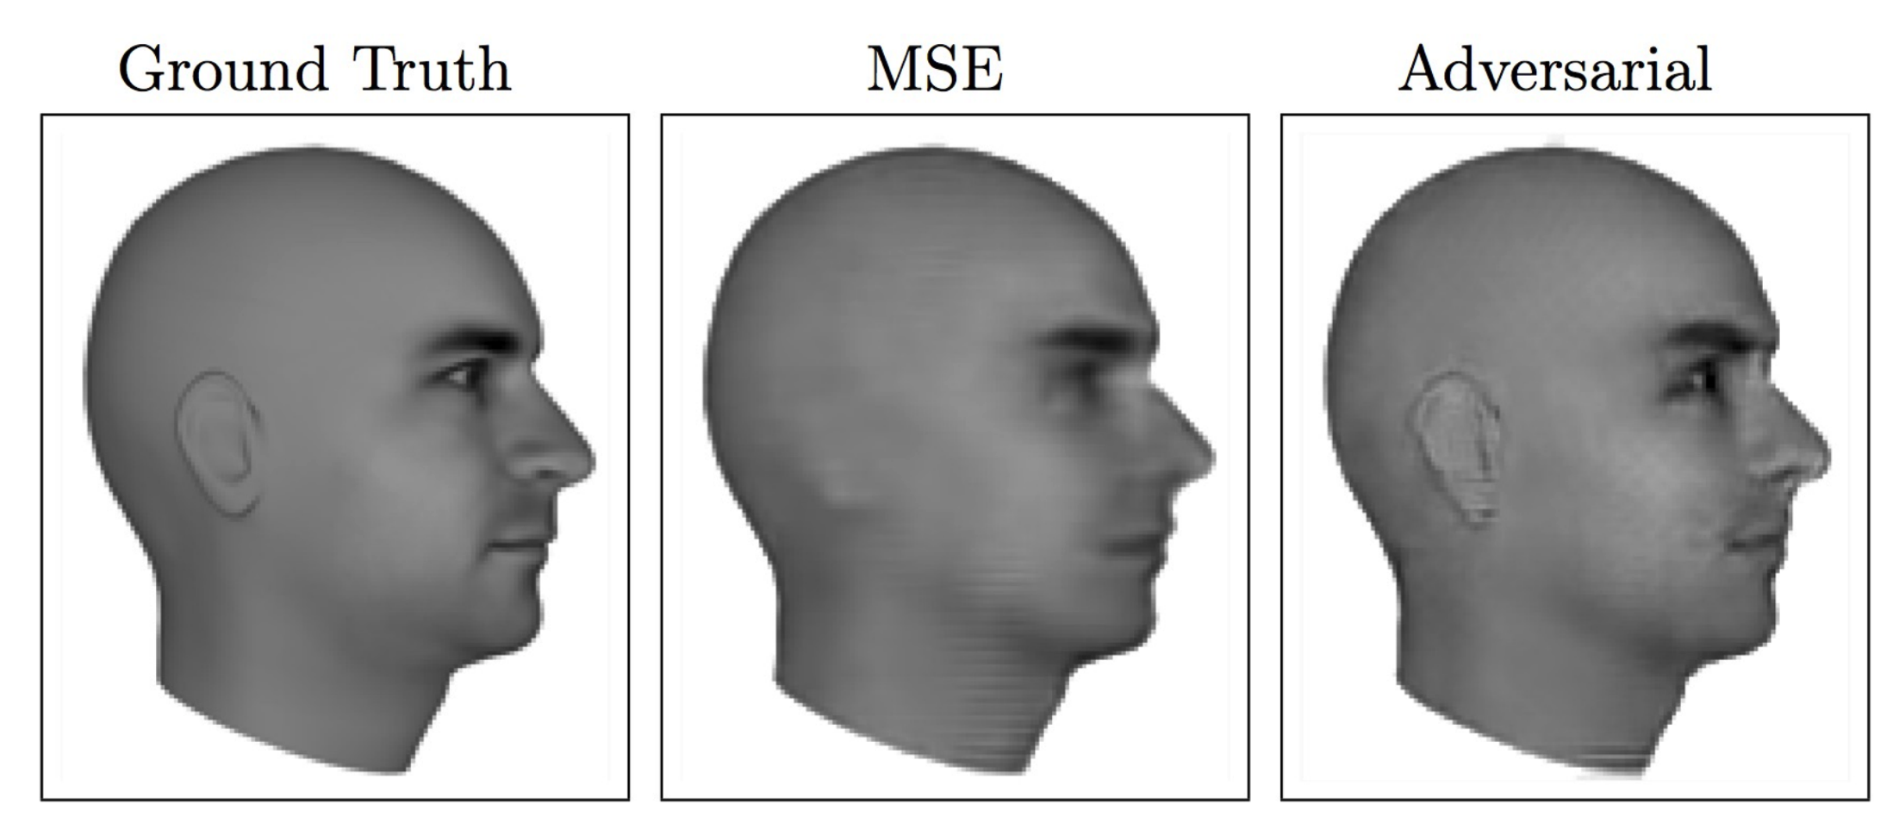
Next video frame prediction
(Lotter et al 2016)

Slide 22
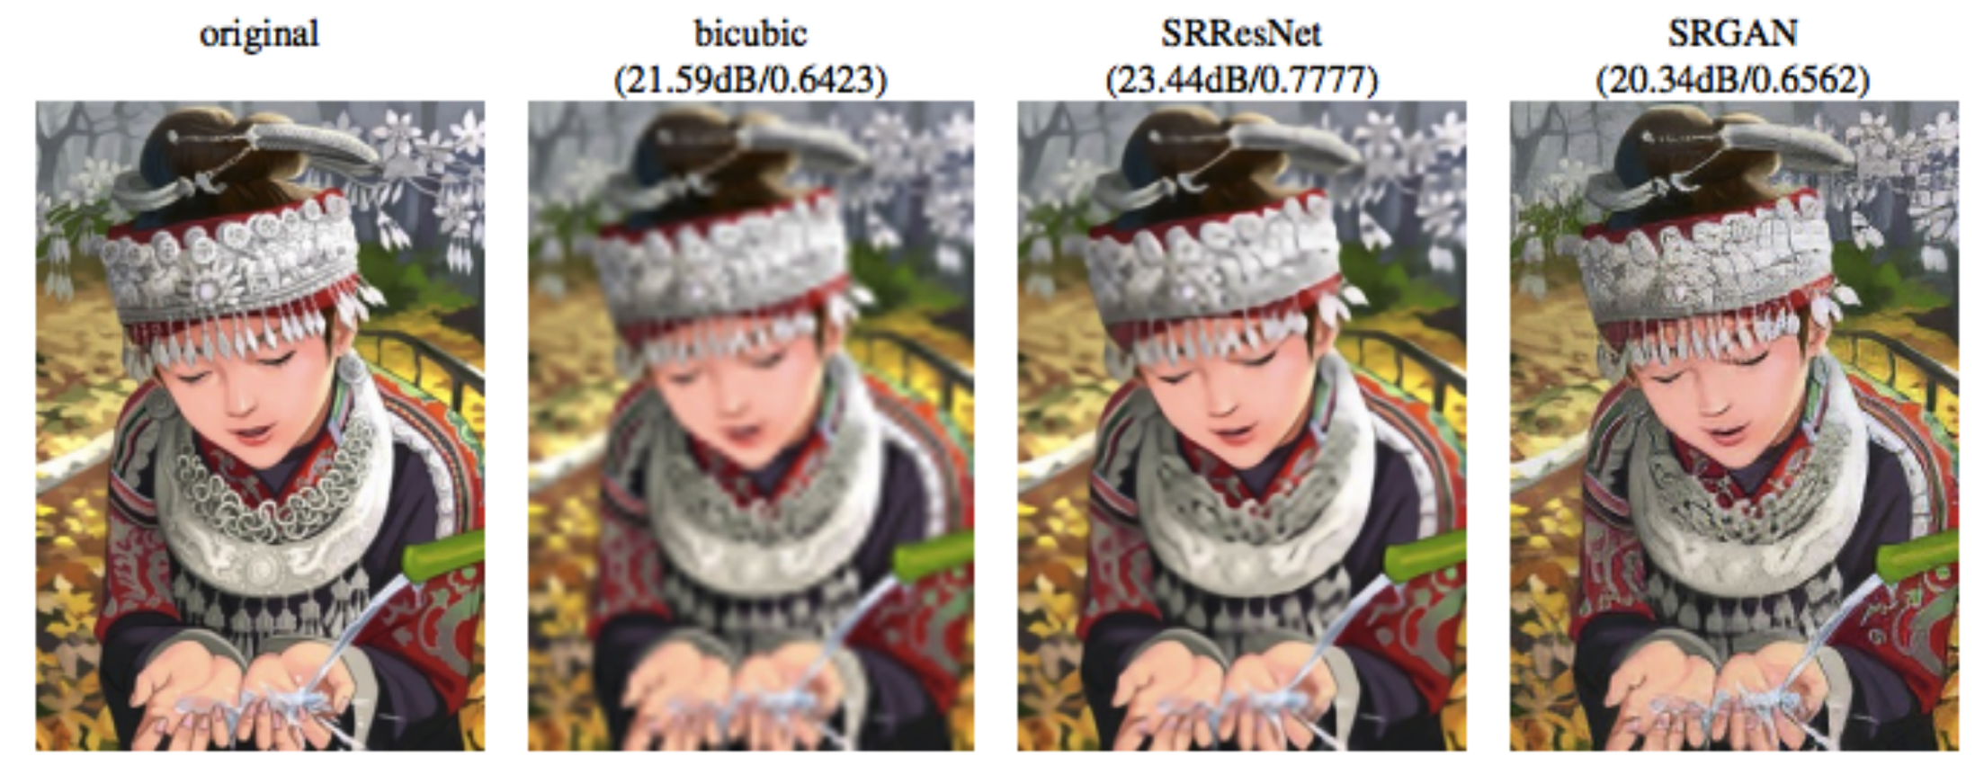
Image super resolution
(Ledig et al 2016)

Slide 23
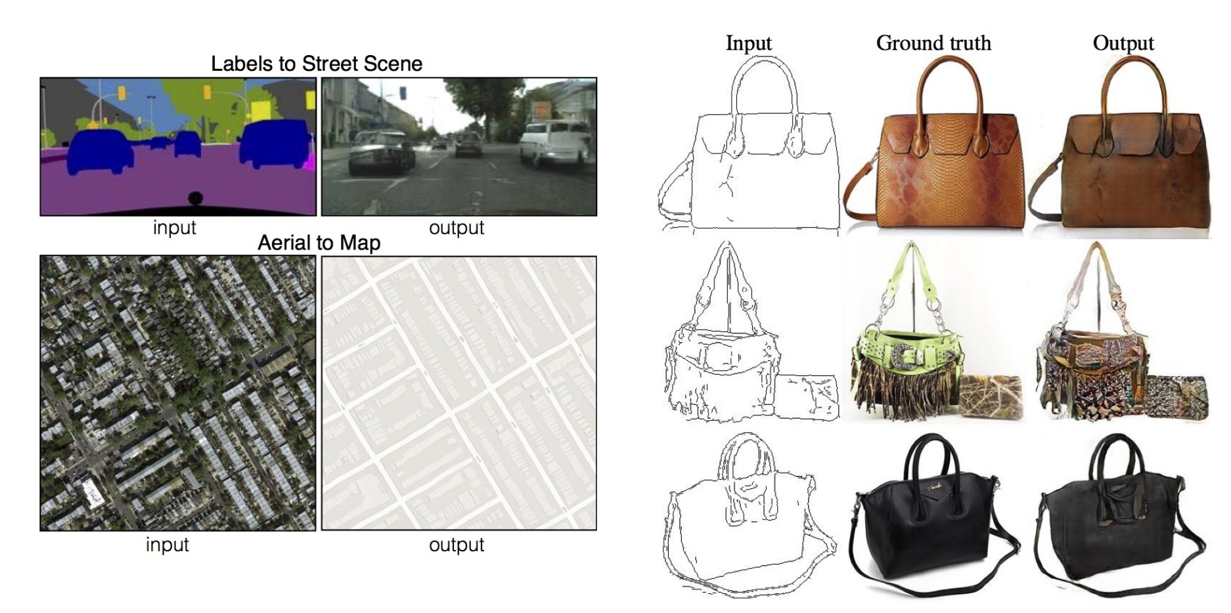
Image to image translation
(Isola et al 2016)

Slide 24
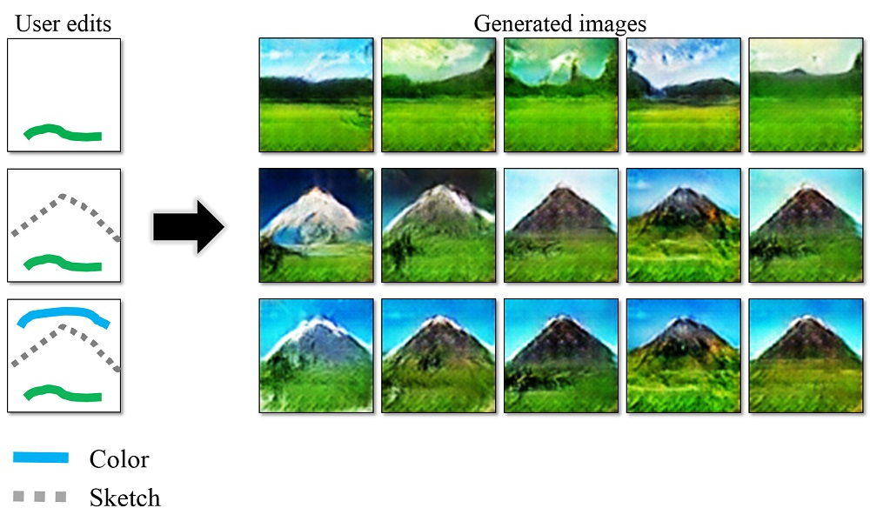
iGAN
(Zhu et al 2016)
(Zhu et al 2016)
(Zhu et al 2016)

Slide 25
Extensions
Adversarial auto encoders
Semi-supervised learning
Transfer learning
Reinforcement learning
Inverse problems
…

Slide 26
Outline
Generative Modeling
Generative Adversarial Networks
Tips and Tricks
Applications and Extensions
Notes:
Data
Complexity
Humans
Optimization
Real-time

Slide 27
Conclusion and summary
GANS
approximate probability density
use supervised learning to approximate an intractable cost function
simulate many cost functions, including the one used for maximum likelihood
generate high resolution samples from diverse image classes
Successful in several (image-based) applications
Training is still an art than science
Many interesting research directions and extensions

Slide 28
“Adversarial training is the coolest thing since sliced bread.”
Yann LeCun, Director of AI Research at Facebook and Professor at NYU

Slide 29
Acknowledgements
I. Goodfellow, et al. “Generative adversarial nets.” Advances in neural information processing systems. 2014.
T. Salimans et al. “Improved techniques for training gans.” Advances in Neural Information Processing Systems. 2016.
I. Goodfellow. "NIPS 2016 Tutorial: Generative Adversarial Networks." arXiv preprint arXiv:1701.00160 (2016)
http://www.iangoodfellow.com/presentations.html
https://ishmaelbelghazi.github.io/ALI/
https://github.com/soumith/ganhacks
http://www.rricard.me/machine/learning/generative/adversarial/networks/2017/04/05/gans-part1.html
https://blog.openai.com/generative-models/

Slide 30
ALCF Data Science Program (ADSP) Proposals due June 15
“Big Data” science problems that require the scale and performance of leadership computing resource such as Theta and Aurora, and will enable new science and novel usage modalities on these systems.
Projects will cover a wide variety of application domains that span computational, experimental and observational sciences.
Focus on data science techniques including but not limited to statistics, machine learning, deep learning, UQ, image processing, graph analytics, complex and interactive workflows
Two-year proposal period and will be renewed annually. Proposals will target science and software technology scaling for data science. In 2016, four projects were funded spanning material science, neuroscience, imaging and high-energy physics.
Projects receive ALCF staff support in Data and Computational Science. Tier-1 projects will be supported in part with postdoctoral scholars.
Yearly call for proposal. Next deadline – June 15, 2017 (5 PM CST) https://www.alcf.anl.gov/alcf-data-science-program

Slide 31
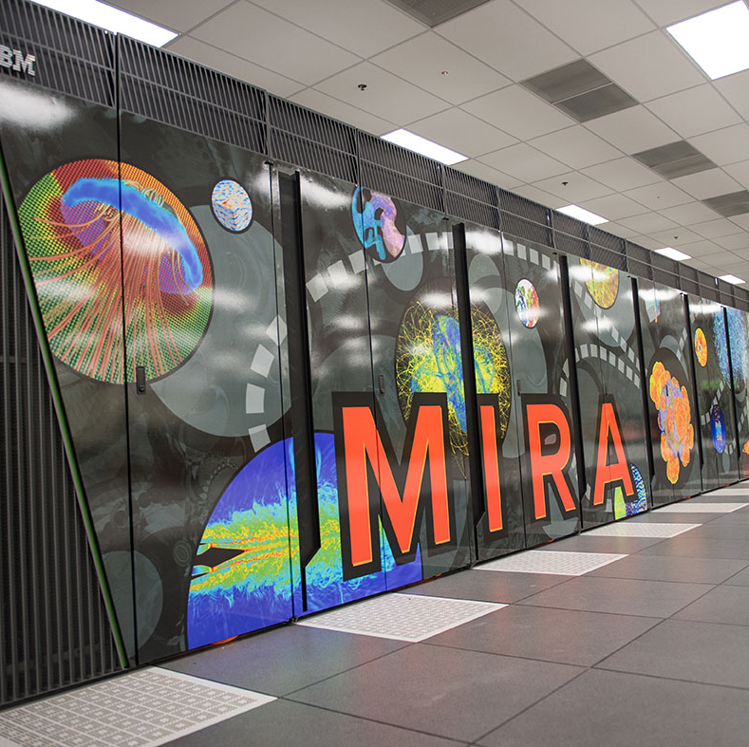
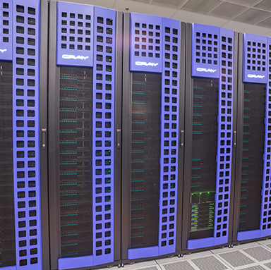
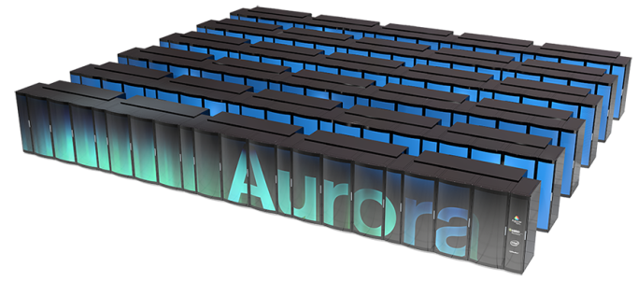
ADSP System Resources
Mira – IBM BG/Q
Cooley - Cray/NVIDIA
Theta- Cray/Intel
Sage- Cray Urika-GX
49,152 nodes
786,432 cores
786 TB RAM
10 PF
126 nodes (Haswell)
1512 cores
126 Tesla K80
48 TB RAM (3 TB GPU)
3240 nodes (KNL)
829,440 cores
50.6 TB MCDRAM
607.5 TB DDR4 RAM
414.7 TB SSD
32 nodes (Haswell)
8 TB DRAM
25.6 TB NVMe SSD
BigData Analytics Stack
Over 180 PF peak performance
> 50,000 nodes with 3rd Generation Intel® Xeon Phi™ processor codename Knights Hill, > 60 cores
Over 7 PB total system memory

Slide 32
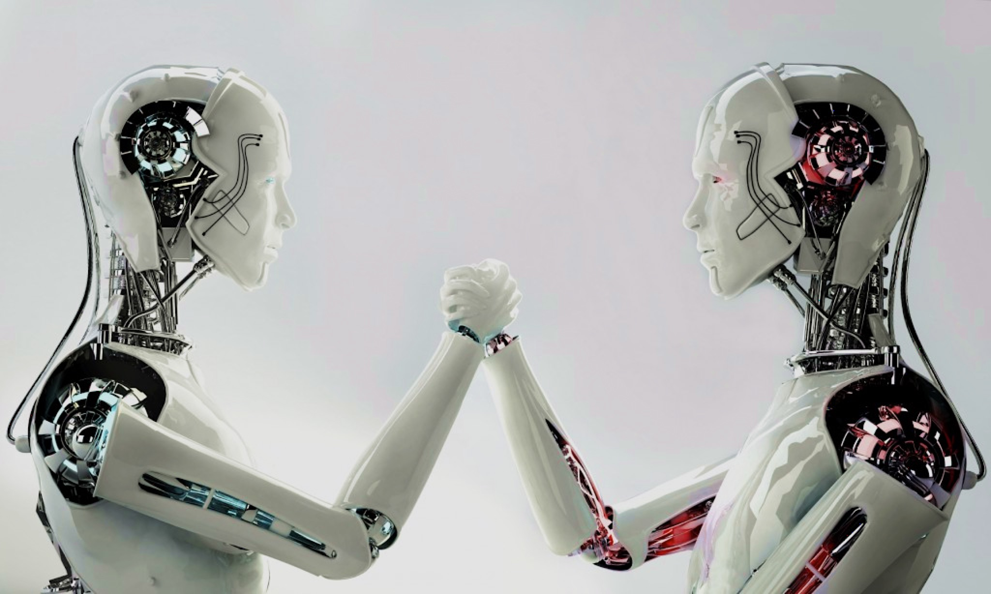
Thank You
Discriminator
Generator

