Slide 1
Programming
Neuromorphic Computing Systems
Catherine Schuman
Computational Data Analytics
Oak Ridge National Laboratory
DSHEP 2017
May 10, 2017

Slide 2
Outline
Introduction and motivation
Models and implementations
Programming paradigms
Applications
Where we’re going next
Conclusion

Slide 3
What is a neuromorphic computer?
A neuromorphic computer is a computer whose underlying architecture and the way that it performs computation is inspired by biological brains.

Slide 4
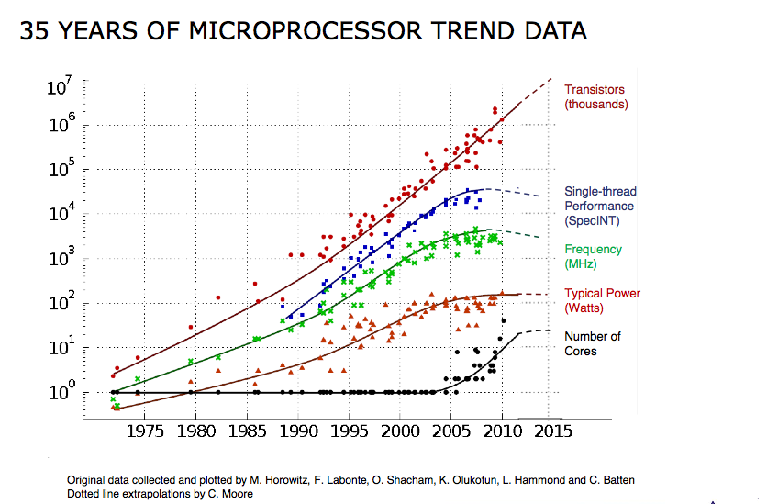
Motivation
End of Moore’s Law:
  Hitting physical limits on scaling
End of Dennard Scaling:
  Energy costs for computing are increasing.
Von Neumann bottleneck:
  I/O and memory are still catching up with computation.
Increased need for machine learning and data analytics:
  Smart processing of big data
Notes:
Dennard scaling: states, roughly, that as transistors get smaller their power density stays constant, so that the power use stays in proportion with area: both voltage and current scale (downward) with length.
An increased core count benefits many (though by no means all) workloads, but the increase in active switching elements from having multiple cores still results in increased overall power consumption and thus worsens CPU power dissipation issues.^{[6][7]} The end result is that only some fraction of an integrated circuit can actually be active at any given point in time without violating power constraints.

Slide 5
Approaches to Beyond Moore’s Law Computing
Medium Term: Beyond CMOS
Long Term:
Novel computing platforms (Quantum, neuromorphic)
Future of Computing
Short Term:
Squeeze all possible performance out of CMOS
Notes:
CMOS = Complementary metal–oxide–semiconductor

Slide 6
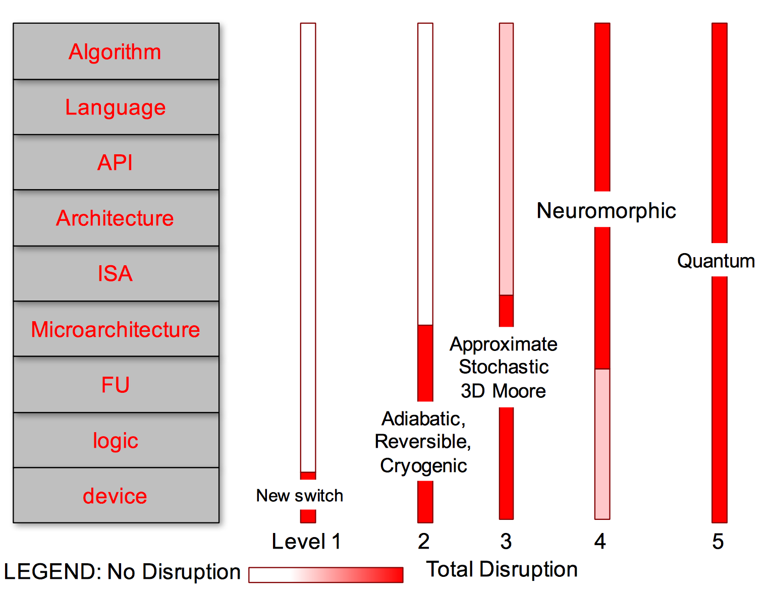
Disruption Levels for Neuromorphic Computing
Source: http://www.cccblog.org/2016/08/08/whistling-past-the-graveyard-what-the-end-of-moores-law-means-to-all-of-computing/

Slide 7
Neuromorphic Computing
What characterizes a neuromorphic computer?
  Many simple processor/memory structures (e.g., neurons and synapses).
  Communication using simple messages (e.g., spikes).
  Algorithms usually emphasize temporal interaction.
    Messages have a time-stamp (implicit or explicit).
    Operation is usually event-driven.
Key properties of most neuromorphic computers:
  Low power.
  Collocated processing and memory.
  Relatively low clock rates (e.g., 1 kHz – 1 MHz).
  Natively perform “intelligent” computing – neural network-style computation.
  Can be implemented with a variety of new and emerging device types (beyond CMOS).

Slide 8
Major Neuromorphic Computing Projects
Neuromorphic Project | Biology/Computation | Hardware
SpiNNaker¹ | Biology | ARM Boards, Custom Interconnection
BrainScaleS² | Biology | Wafer-Scale ASIC
Neurogrid³ | Biology/Computation | Fabbed using existing processes. Analog components.
TrueNorth⁴ | Computation | Fabbed using existing processes.
Furber, Steve B., et al. "Overview of the spinnaker system architecture." Computers, IEEE Transactions on 62.12 (2013): 2454-2467.
Brüderle, Daniel, et al. "A comprehensive workflow for general-purpose neural modeling with highly configurable neuromorphic hardware systems." Biological cybernetics 104.4-5 (2011): 263-296.
Benjamin, Ben Varkey, et al. "Neurogrid: A mixed-analog-digital multichip system for large-scale neural simulations." Proceedings of the IEEE 102.5 (2014): 699-716.
Merolla, Paul A., et al. "A million spiking-neuron integrated circuit with a scalable communication network and interface." Science 345.6197 (2014): 668-673.

Slide 9
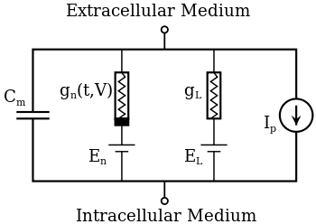
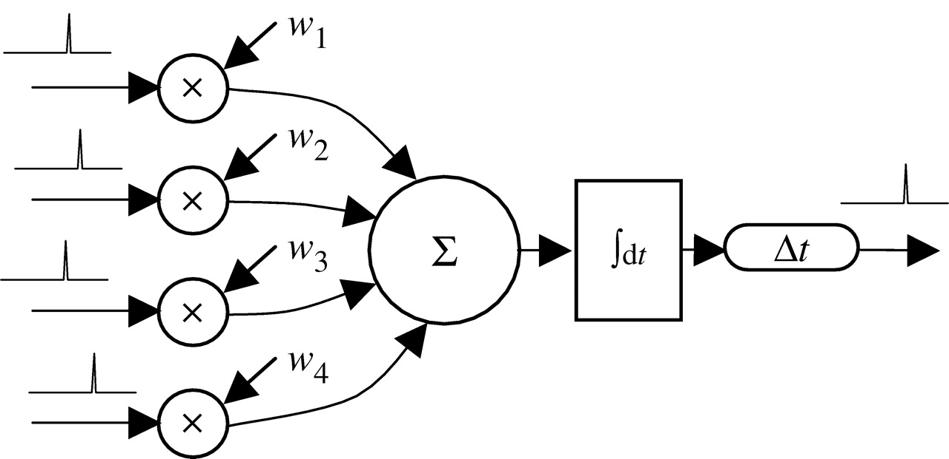
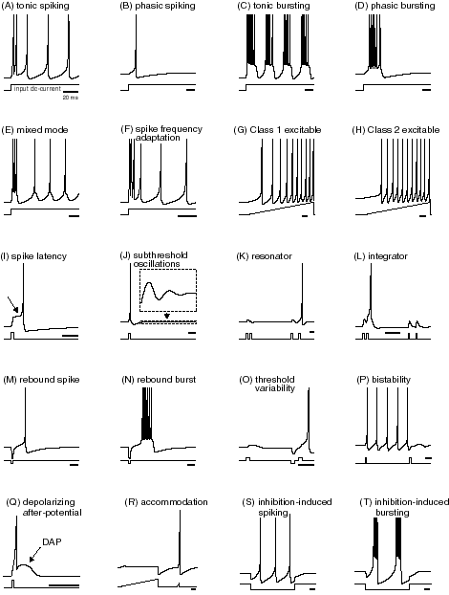
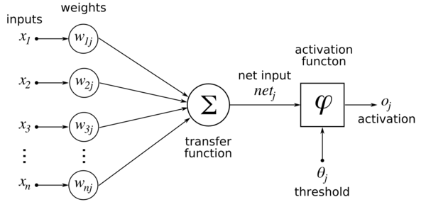
Neuron and Synapse Model Choices
Biologically Accurate
Hodgkin-Huxley
Leaky Integrate and Fire
NIDA
Izhikevich
Traditional Perceptron
Biologically Inspired

Slide 10
Neuroscience-Inspired Dynamic Architectures (NIDA)
Spiking neural network embedded in 3D space.
Simple neuron and synapse implementation.
Flexible structure.

Slide 11
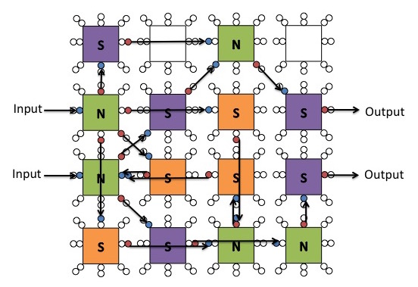
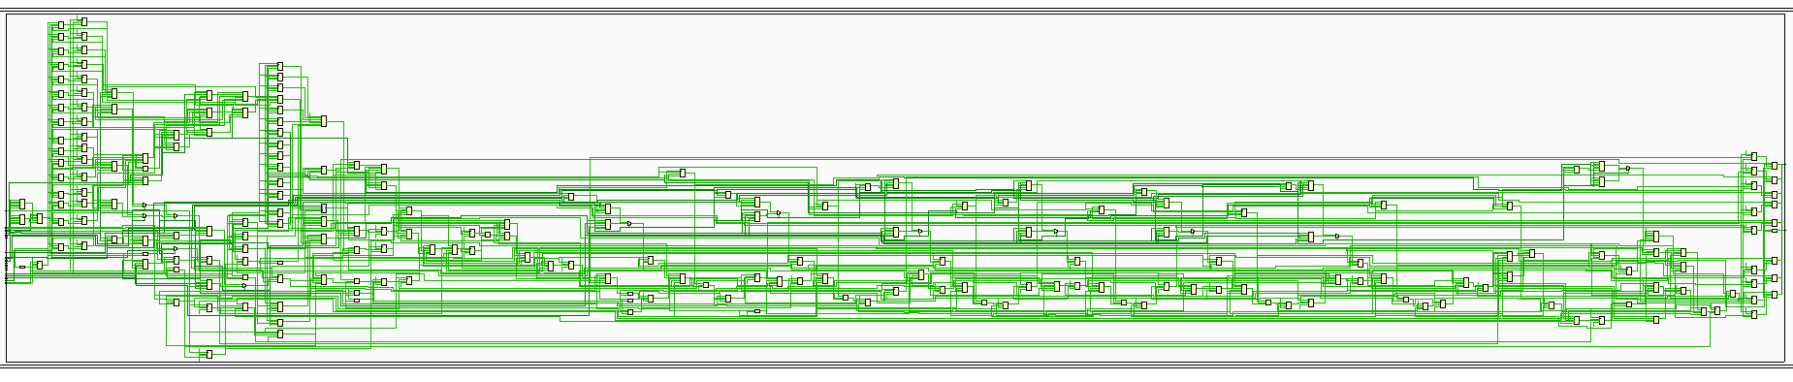
Dynamic Adaptive Neural Network Arrays (DANNA)
Fully digital implementation.
Array of programmable neuromorphic elements.
Elements can connect to up to 16 neighbors.
Current: FPGA.
In progress: VLSI.

Slide 12
Memristive DANNA (mrDANNA)
Mixed analog/digital implementation.
  Digital neurons.
  Each synaptic weight is implemented with two memristors.
More restrictive in terms of achievable weights than DANNA.
Lower energy, better scaling than digital implementations.

Slide 13
Comparison
Neuromorphic System | Programmable Structure | Component Complexity (Neuron/Synapse) | On-Chip Learning
DANNA/mrDANNA¹ | Neurons and synapses | 2 / 2 | Yes
TrueNorth² | Fixed (Synapses on/off) | 10 / 3 | No
Neurogrid³ | Fixed (Synapses on/off) | 79 / 8 | No
BrainScaleS⁴ | Neurons and synapses | Variable | Yes
SpiNNaker⁵ | Neurons and synapses | Variable | Yes
Dean, Mark E., Catherine D. Schuman, and J. Douglas Birdwell. "Dynamic adaptive neural network array." Unconventional Computation and Natural Computation. Springer International Publishing, 2014. 129-141.
Merolla, Paul A., et al. "A million spiking-neuron integrated circuit with a scalable communication network and interface." Science 345.6197 (2014): 668-673.
Benjamin, Ben Varkey, et al. "Neurogrid: A mixed-analog-digital multichip system for large-scale neural simulations." Proceedings of the IEEE 102.5 (2014): 699-716.
Brüderle, Daniel, et al. "A comprehensive workflow for general-purpose neural modeling with highly configurable neuromorphic hardware systems." Biological cybernetics 104.4-5 (2011): 263-296.
Furber, Steve B., et al. "Overview of the spinnaker system architecture." Computers, IEEE Transactions on 62.12 (2013): 2454-2467.

Slide 14
Training/Learning/Programming
Programming: Manual programming
Learning: Unsupervised learning
Training: Supervised learning

Slide 15
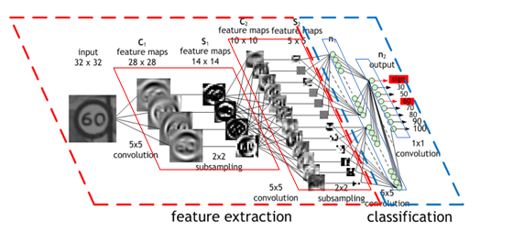
Training
Forced translation
(Programmed)
State-of-the-Art Deep Learning Networks
(Trained)
Does not use the device in training.
Does not train directly for the device.
Spiking
Neuromorphic
Device
Conv Net Image Source: https://devblogs.nvidia.com/parallelforall/deep-learning-nutshell-core-concepts/
Notes:
What types of learning should be supported?
Off-line vs. on-line?
Off-chip vs. on-chip?
Which biologically-inspired learning mechanisms are important for learning?
Spike-timing dependent plasticity.
Neurogenesis.
Neuromodulation.
Which optimization methods are appropriate for training or learning?
Back-propagation
Evolutionary optimization.
Should training/learning/programming affect both topology and parameters?

Slide 16
Training: Evolutionary Optimization

Slide 17
Training: Evolutionary Optimization
Application
Simulation Engine
Spiking
Neuromorphic
Device

Slide 18
Training: Evolutionary Optimization
1.5
Application
Simulation Engine
Spiking
Neuromorphic
Device

Slide 19
Training: Evolutionary Optimization
1.5
4
Application
Simulation Engine
Spiking
Neuromorphic
Device

Slide 20
Training: Evolutionary Optimization
1.5
4
Application
Simulation Engine
2
Spiking
Neuromorphic
Device

Slide 21
Training: Evolutionary Optimization
1.5
4
Application
Simulation Engine
2.5
1
Spiking
Neuromorphic
Device

Slide 22
Training: Evolutionary Optimization
1.5
4
2.5
1

Slide 23
Training: Evolutionary Optimization
Next Generation
1.5
4
2.5
1
Notes:
Why evolutionary optimization?
Can use the device
Designs directly for the device
Can work with a variety of architectures
Doesn’t require any prior knowledge about the architecture
Produces lots of results for study
----- Meeting Notes (6/27/16 13:10) -----
Pull the circle around the children and put them back into the next generation.

Slide 24
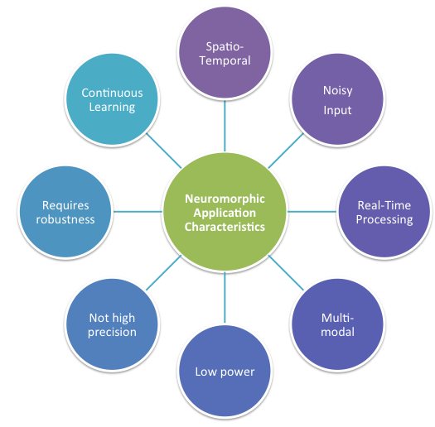
Applications

Slide 25

Control: Pole Balancing

Slide 26
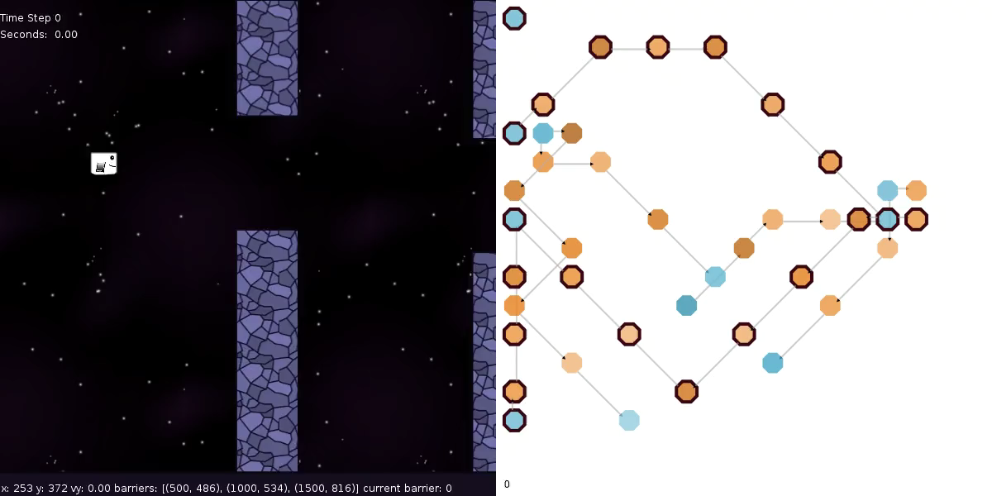
Control: One Dimensional Navigation with Gravity

Slide 27
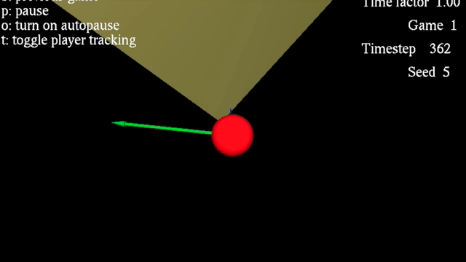
Control: Two Dimensional Navigation

Slide 28
Anomaly Detection
Task: Detect a change in mean arrival rate of packets at a node in a packet-switched communication network with the goal of helping to determine if the communication network is under attack (represented by a sharp increase in packet traffic) or if there has been a failure in the network (represented by a sharp decrease in packet traffic).

Slide 29
Data from MINERvA (Main Injector Experiment for v-A)
Neutrino scattering experiment at Fermi National Accelerator Laboratory
The detector is exposed to the NuMI (Neutrinos at the Main Injector) neutrino beam.
Millions of simulated neutrino-nucleus scattering events were created.
Classification task is to classify the horizontal region where the interaction originated.
MINERvA Detector
Source: A. Terwilliger, et al. Vertex Reconstruction of Neutrino Interactions using Deep Learning. IJCNN 2017.

Slide 30
Two Approaches: Deep Learning and Spiking Neural Networks
 | Deep Learning | Spiking
Training Method | Back-propagation | Not well established (here, genetic algorithms)
Native Input Types | Images/Arrays of values | Spikes
Network Size | Large (many layers, many neurons and synapses per layer) | Relatively small (fewer neurons and sparser synaptic connections)
Processing Abilities | Good for spatial | Good for temporal
Performance | Well understood and state-of-the-art | Not well understood

Slide 31
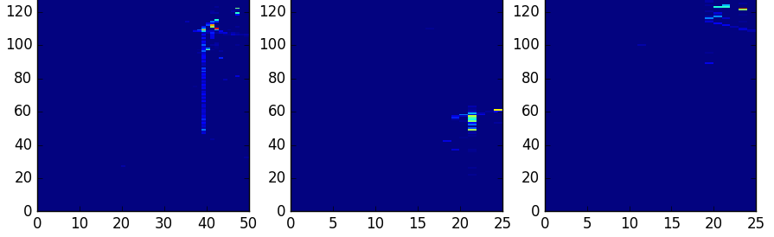
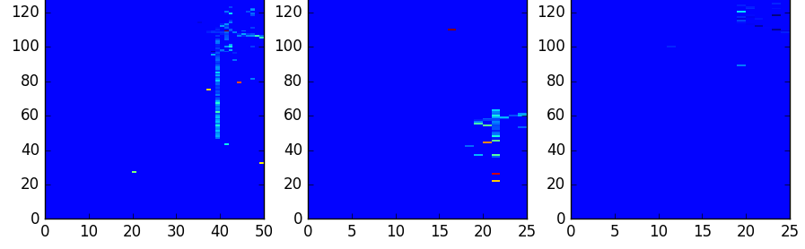
Two Data Inputs Types (Three Views)
Deep Learning: Energy values as interpreted as pixels
Spiking: Time when energy deposition goes over a very low threshold

Slide 32
Preliminary Results
Number of Nodes | Maximum Classification Accuracy after One Hour
100 | 70.82%
1000 | 72.6%
10000 | 79.11%
This research used resources of the Oak Ridge Leadership Computing Facility, which is a DOE Office of Science User Facility supported under Contract DE-AC05-00OR22725.

Slide 33
Best Results: Single View
x-view (127x50)
conv1 (8x3)
pool1 (2x1)
conv2 (7x3)
pool2 (2x1)
conv3 (6x3)
pool3 (2x1)
conv4 (6x3)
pool4 (2x1)
fc1 (196)
drop out
fc2 (98)
drop out
fc3 (11)
classification
Convolutional Neural Network Result: ~80.42%
90 neurons, 86 synapses
Estimated energy for a single classification for mrDANNA implementation: 1.66 μJ
Spiking Neural Network Result: ~80.63%
Source for CNN results: A. Terwilliger, et al. Vertex Reconstruction of Neutrino Interactions using Deep Learning. IJCNN 2017.

Slide 34
Proposed Plan Moving Forward
Biology
Computing
Connect Theory of Computation with Neuroscience and Nonlinear Dynamics
Architecture of the Brain and Relation to Computing and Learning
Simulation of Computational Models and Systems
System Software, Algorithms & Applications
Stan Williams at Neuromorphic Computing Workshop at ORNL 2016
Chip Design – System-on-Chip
Chip Processing and Integration
Devices and Materials – in situ and in operando test and measurement
Hardware
Materials

Slide 35
Summary
Neuromorphic computing is an important post Moore’s era technology.
Programming and using neuromorphic computers is fundamentally different from programming and using traditional computers.
One way to program neuromorphic computers for particular applications is genetic algorithms.
Neuromorphic computing has potential to be applied to applications in control and classification, including temporal scientific data.
  Able to be deployed in very efficient devices.

Slide 36
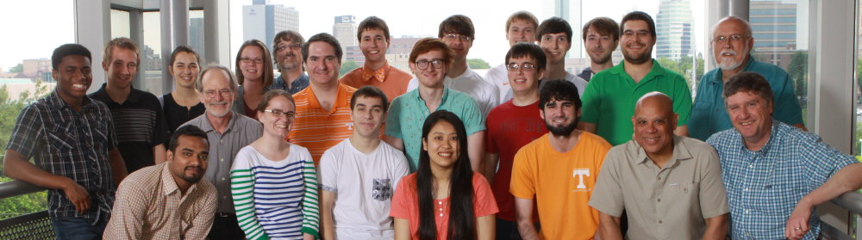






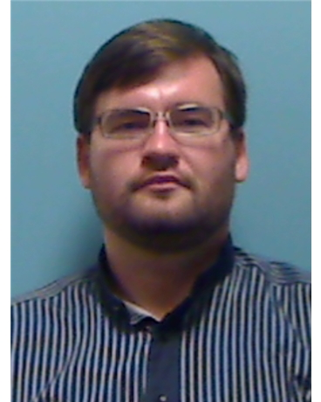

Acknowledgements

Slide 37
Neuromorphic Computing Symposium
July 17-19, 2017
Knoxville, Tennessee
ornlcda.github.io/neuromorphic2017

Slide 38
Thank you!
Questions?
Contact: schumancd@ornl.gov
Website: CatherineSchuman.com

Slide 39
Supplementary Slides

