Slide 1
Accelerator Division Status
Daniel Johnson
All Experimenters’ Meeting
19 December 2016

Slide 2
Content Slide [22pt Bold]
Bullet points are optional. If preferred, only first level bullets can be used or bullets can be set to “NONE.” [18pt Regular]
First level bullet [18pt Regular]
Second level bullet [16pt Regular]
Third level bullet [15pt Regular]
Fourth level bullet [14pt Regular]
Fifth level bullet [14pt Regular]

Slide 3
Accelerator Operations Summary
From: December 12, 2016 (0000 hours)
To: December 19, 2016 (0000 hours)
Calendar Week # 50
NuMI Weekly Integrated Intensity 1.36 E19 protons
Beam Hours To NuMI 158.6 hours
BNB Weekly Integrated Intensity 1.15 E19 protons
Beam Hours To BNB 164.1 hours
NMuon Weekly Integrated Intensity 0.00 E13 protons
Beam Hours To NMuon 0.0 hours
MTest Weekly Integrated Intensity 0.00 E13 protons
Beam Hours To MTest 0.0 hours
MCenter Weekly Integrated Intensity 0.00 E12 protons
Beam Hours To MCenter 0.0 hours

Slide 4
NuMI Operation

Slide 5
BNB Operation

Slide 6
Content and Caption Slide [22pt Bold]
Click to add caption text [13pt Bold]
First level bullet [18pt Reg]
Second level bullet [16pt]
Third level bullet [15pt]
Fourth level bullet [14pt]
Fifth level bullet [14pt]

Slide 7
Complex Status
LINAC
Running well
Booster
Running well
~3.6 E12 p/p
MI/RR
Slipstacking 6+6
NuMI
Running at ~500 kW
Booster Neutrino Beamline (BNB)
Running well
Switchyard
MI-52 septa short
No beam until repairs are made
Will coordinate repair with another failure or scheduled two-day shutdown.
General
No planned accesses until January 2017
No Call period for Christmas weekend
Shutdown scheduled for January 10th and 11th .
Master SubStation currently scheduled to be energized January 17th .

Slide 8
MI-12 Communication Duct
Summary
Emergency Repair Plan In Place
Need 2 hour notification
Vendor has cable
New Communications Duct Plan
Targeting communications duct installation completion by January
A portion of new duct has been installed
Plans for routing remainder of new duct underway
Expect cable delivery in mid-January
Hope to move to new cable in January/February
Try to coordinate downtime with Master SubStation outages
Damaged on 10/24/16
Protected from further damage
Provides timing/date to Neutrino Experiments
Experiments running fine

Slide 9
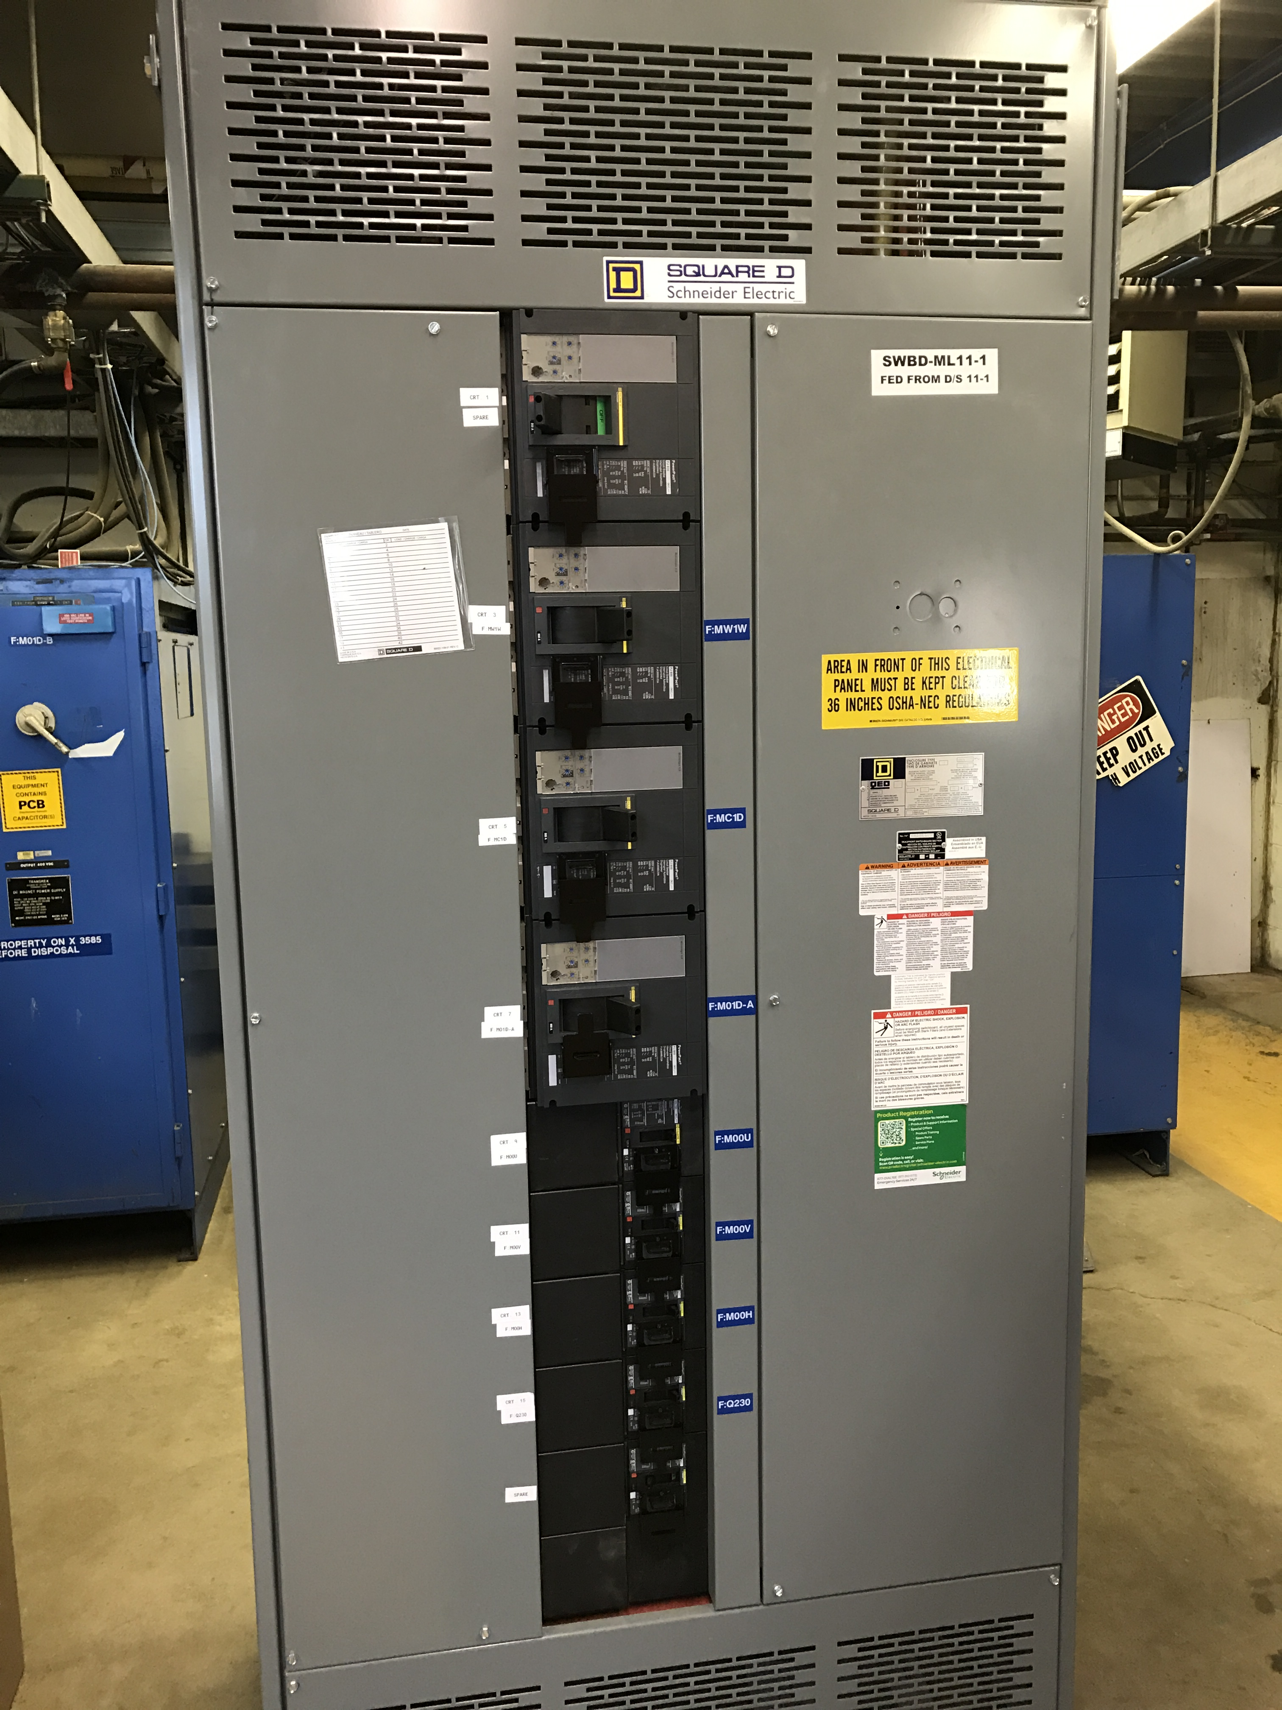
MS1 Bus Failure
All power supplies cabled into breaker panel
Work completed

Slide 10
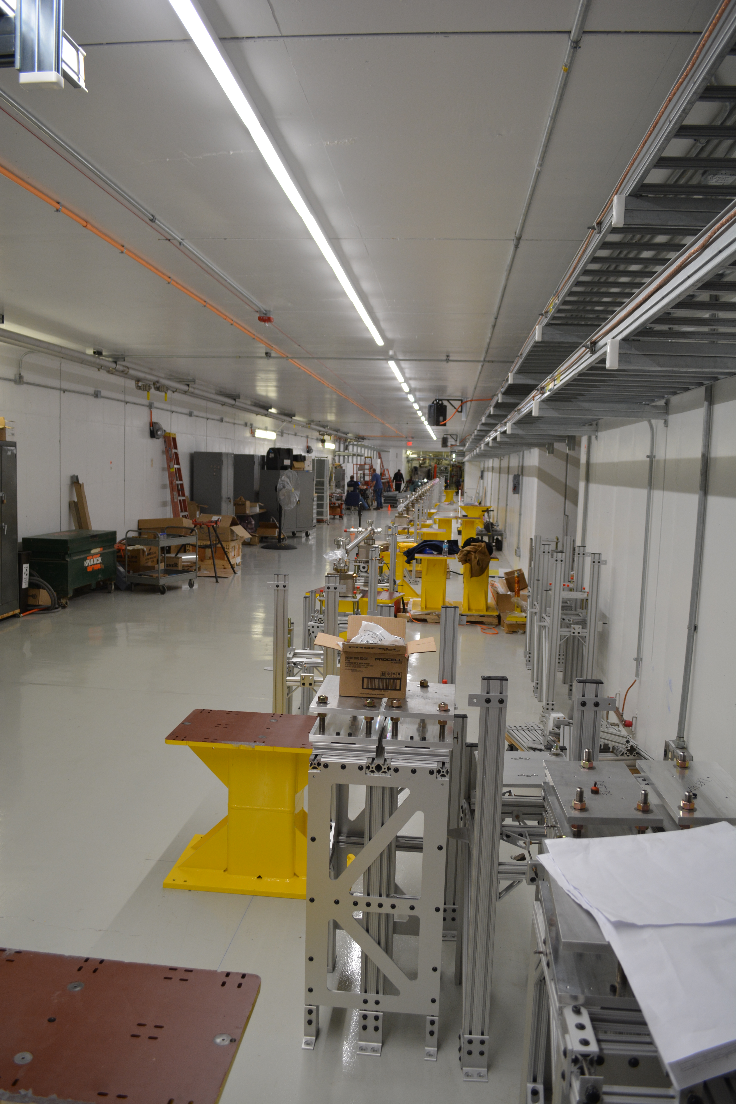
PIP-II Injector Test & FAST Status
PIP-II Injector Test
RFQ operation
Shutdown during the week
Leaking RFQ vacuum window replaced
Plans for the week
Shutdown for ~ 1 week
Install emittance scanner
Maintenance
FAST
No gun operation
Working on drive laser
Shutdown for 300 MeV upgrade
Cave Roof Block Installation complete
Working on shielding assessment
Magnet and stand installation
Working on IOTA proton injector source at MDB

Slide 11
CMTS1 Status
LCLSII Prototype Cryo Module
Cryo
Cooldown holding at 4K
Accomplishments
Fast cooldown completed Sunday
Miscellaneous other activities
Plan for the week
RGA scans in cave
Control measurements at 4 K
Start cooldown to 2K afternoon
Secure cave and prepare for operation
Tune cavity to 1.3 GHz
LLRF checkout
Magnet test plans and measurements

Slide 12
ICW Reduction
Looking at measuring flows on systems
Stakeholders impacted
AD, TD, PPD, CD, FESS
Need to establish new Casey’s Pond West Strainer Vault
Everybody working on priority projects
Will be difficult to line up downtime schedules
Reducing flow will be painful
Estimate two week reduction for work
Performing measurements in late November/early December
Planning on early 2017 (January)
ICW measurements revealed higher than expected usage at some locations
Resolved issues, current expectation
2 week reduction period
Should not impact most experiments
Will impact experiments/projects with cryogenic operation

Slide 13
December 2016

Slide 14
January 2017

Slide 15
Schedules and Links
Schedule can be accessed from the Operations Department Home Page
Schedules -> Operations Schedule
Direct link to schedule
http://www-ad.fnal.gov/ops/schedule.html

Slide 16
Collaborations / Partnerships / Members [22pt Bold]

