Slide 1
Accelerator Division Status
Daniel Johnson
All Experimenters’ Meeting
09 January 2017

Slide 2
Content Slide [22pt Bold]
Bullet points are optional. If preferred, only first level bullets can be used or bullets can be set to “NONE.” [18pt Regular]
First level bullet [18pt Regular]
Second level bullet [16pt Regular]
Third level bullet [15pt Regular]
Fourth level bullet [14pt Regular]
Fifth level bullet [14pt Regular]

Slide 3
Accelerator Operations Summary
From: December 19, 2016 (0000 hours)
To: December 26, 2016 (0000 hours)
Calendar Week # 51
NuMI Weekly Integrated Intensity 1.55 E19 protons
Beam Hours To NuMI 160.7 hours
BNB Weekly Integrated Intensity 1.06 E19 protons
Beam Hours To BNB 161.3 hours
NMuon Weekly Integrated Intensity 0.00 E13 protons
Beam Hours To NMuon 0.0 hours
MTest Weekly Integrated Intensity 0.00 E13 protons
Beam Hours To MTest 0.0 hours
MCenter Weekly Integrated Intensity 0.00 E12 protons
Beam Hours To MCenter 0.0 hours

Slide 4
Accelerator Operations Summary
From: December 26, 2016 (0000 hours)
To: January 02, 2017 (0000 hours)
Calendar Week # 52
NuMI Weekly Integrated Intensity 1.57 E19 protons
Beam Hours To NuMI 150.0 hours
BNB Weekly Integrated Intensity 9.08 E18 protons
Beam Hours To BNB 158.9 hours
NMuon Weekly Integrated Intensity 0.00 E13 protons
Beam Hours To NMuon 0.0 hours
MTest Weekly Integrated Intensity 0.00 E13 protons
Beam Hours To MTest 0.0 hours
MCenter Weekly Integrated Intensity 0.00 E12 protons
Beam Hours To MCenter 0.0 hours

Slide 5
Accelerator Operations Summary
From: January 02, 2017 (0000 hours)
To: January 09, 2017 (0000 hours)
Calendar Week # 01
NuMI Weekly Integrated Intensity 1.78 E19 protons
Beam Hours To NuMI 155.4 hours
BNB Weekly Integrated Intensity 7.16 E18 protons
Beam Hours To BNB 156.6 hours
NMuon Weekly Integrated Intensity 0.00 E13 protons
Beam Hours To NMuon 0.0 hours
MTest Weekly Integrated Intensity 0.00 E13 protons
Beam Hours To MTest 0.0 hours
MCenter Weekly Integrated Intensity 0.00 E12 protons
Beam Hours To MCenter 0.0 hours

Slide 6
NuMI Operation

Slide 7
BNB Operation

Slide 8
Content and Caption Slide [22pt Bold]
Click to add caption text [13pt Bold]
First level bullet [18pt Reg]
Second level bullet [16pt]
Third level bullet [15pt]
Fourth level bullet [14pt]
Fifth level bullet [14pt]

Slide 9
Complex Status
LINAC
Running well
Booster
Running well
MI/RR
Slipstacking 6+6
NuMI
Running at ~630 kW
Reduced to ~345 kW today prior to access work tomorrow
Booster Neutrino Beamline (BNB)
Running well
Switchyard
MI-52 septa short
No beam until repairs are made
General
Two Day Access
Tuesday, January 10th & 11th
Beam off at 0430
Keys available at 0700
BNB back up Tuesday evening
NuMI end of day on Wednesday
New Septa installation

Slide 10
MI-12 Communication Duct
Summary
Emergency Repair Plan In Place
Need 2 hour notification
Vendor has cable
New Communications Duct Plan
Targeting communications duct installation completion by January
New duct installed late December
Expect cable delivery in mid-January
Hope to move to new cable in February
Coordinate downtime with Master SubStation outages
Damaged on 10/24/16
Protected from further damage
Provides timing/date to Neutrino Experiments
Experiments running fine

Slide 11
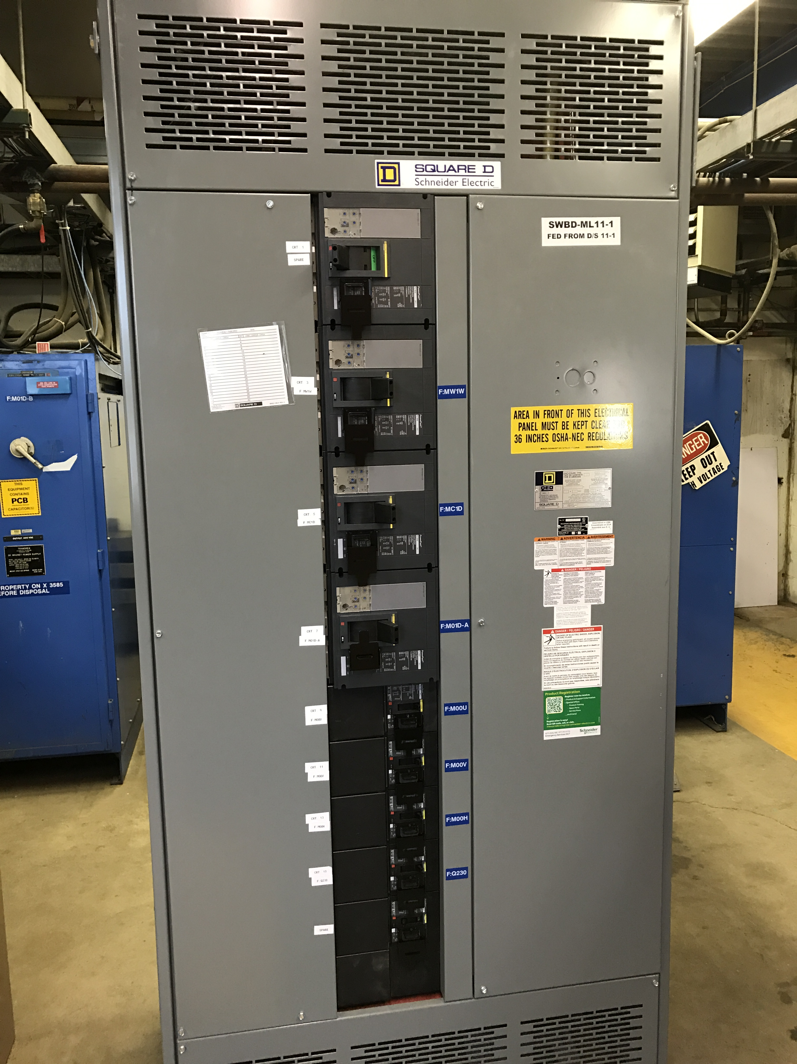
MS1 Bus Failure
All power supplies cabled into breaker panel
Work completed

Slide 12
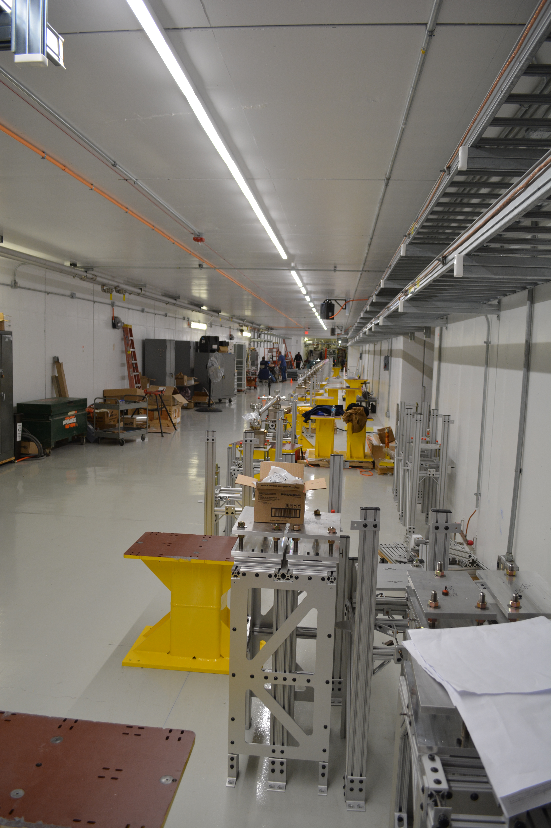
PIP-II Injector Test & FAST Status
PIP-II Injector Test
RFQ operation
Shutdown over the holidays
Installed emittance scanner
Performed maintenance
Plans for the week
FAST
No gun operation
Working on drive laser
Shutdown for 300 MeV upgrade
Cave Roof Block Installation complete
Working on shielding assessment
Magnet and stand installation
Working on IOTA proton injector source at MDB

Slide 13
CMTS1 Status
LCLSII Prototype Cryo Module
Cryo
Operation at 2K restored
Accomplishments
On Friday, January 6th all 8 cavities of pCM were powered simultaneously but not quite at full gradient.
Completed Q0 measurements
Heater calibration runs
Gathering lots of microphonics data
Plan for the week
Try powering all 8 cavities of pCM to full gradient
Investigate Kinney pump trip
Slow cooldown Monday or Tuesday
Joint LCLS-II cryomodule testing workshop this week at JLab

Slide 14
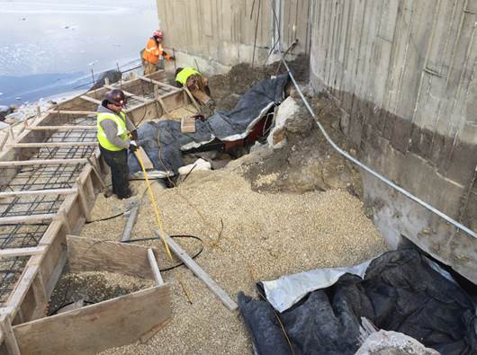
ICW Reduction
Flow reduction began Thursday, December 29th
Flow rates down to required 4300 GPM and holding
Stakeholders impacted
AD, TD, PPD, CD, FESS
Estimate two week reduction for work
Work is on schedule and looking good for
completion by the end of this week.

Slide 15
January 2017

Slide 16
February 2017

Slide 17
February 1st

Slide 18
February 13th

Slide 19
February 14th

Slide 20
February 15th

Slide 21
February 16th

Slide 22
Schedules and Links
Schedule can be accessed from the Operations Department Home Page
Schedules -> Operations Schedule
Direct link to schedule
http://www-ad.fnal.gov/ops/schedule.html

Slide 23
Collaborations / Partnerships / Members [22pt Bold]

