Slide 1
FPC Issues
Premo
LCLS-II 1.3 GHz Cryomodule Production Readiness Review (JLAB)
9-11 January, 2017

Slide 2
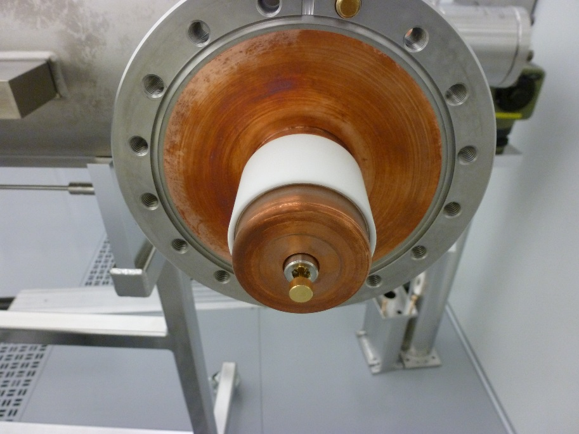
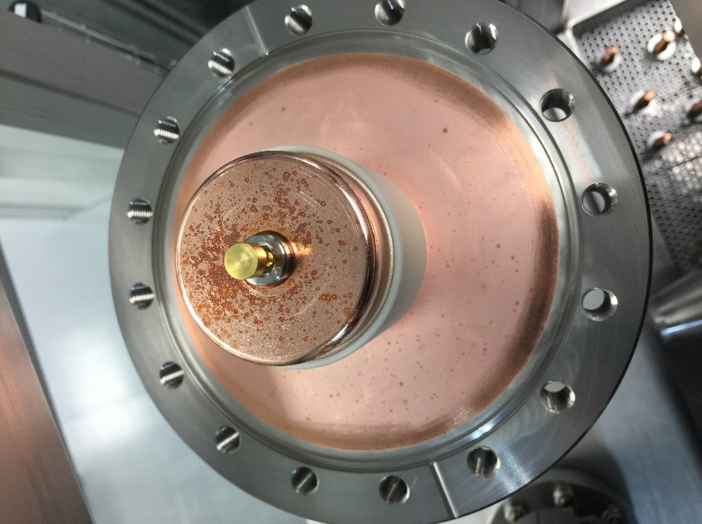
FPC Issues, Oxidation on recent shipments
CPI Couplers, 5 returned
Cause: Cleaning with 30 % water Isopropyl alcohol
RITH Couplers, 2 returned
Cause: Unknown

Slide 3
Storage of FPC components until ready for use
Store ready for use after incoming QC
Warm end and cold ends will be stored separately
Cold ends to be stored under vacuum, inside MP9 clean room
Warm ends stored in cabinet under nitrogen purge, to prevent oxidation
Hardware to be stored in kits
Storage problems due to mismatch of FPC delivery and installation at partner labs:
All couplers are scheduled to be delivered by March-April 2017
Cryomodule production is not expected to be complete until May 2018
Parts in circulation concept requires quick return of shipping cases and cold end stands, and couplers will have to be stored

Slide 4
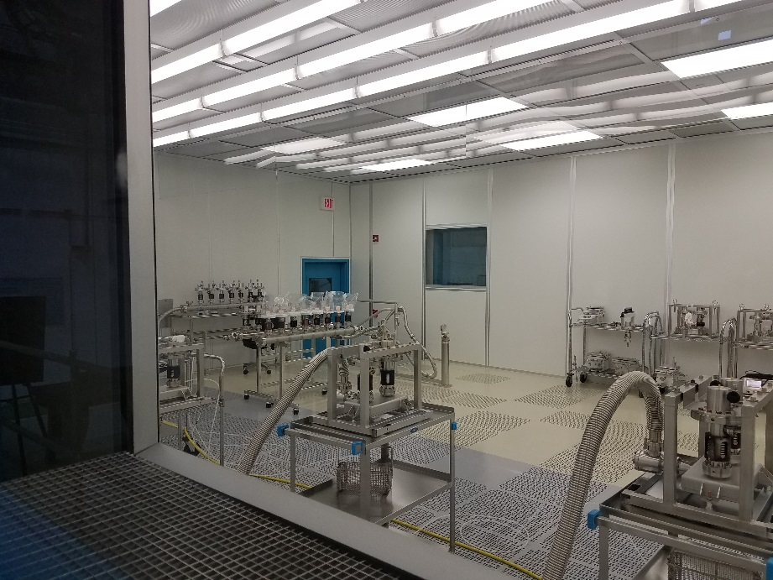
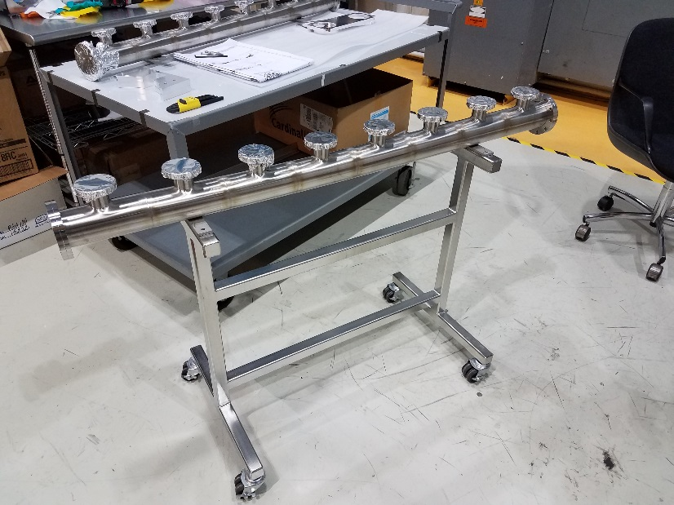
FPC Storage, cold ends
Based on latest delivery and production schedules:
Estimated up to 100 cold ends will be in storage in MP9 clean room
Duration in storage could be as long as 1 year
Cold ends should be stored under vacuum
Vacuum storage manifolds (Qty 10, storage of 80 couplers) are being procured for storage inside the clean room
At the end of coupler production, some coupler cold ends could be stored as shipped on the stands

Slide 5
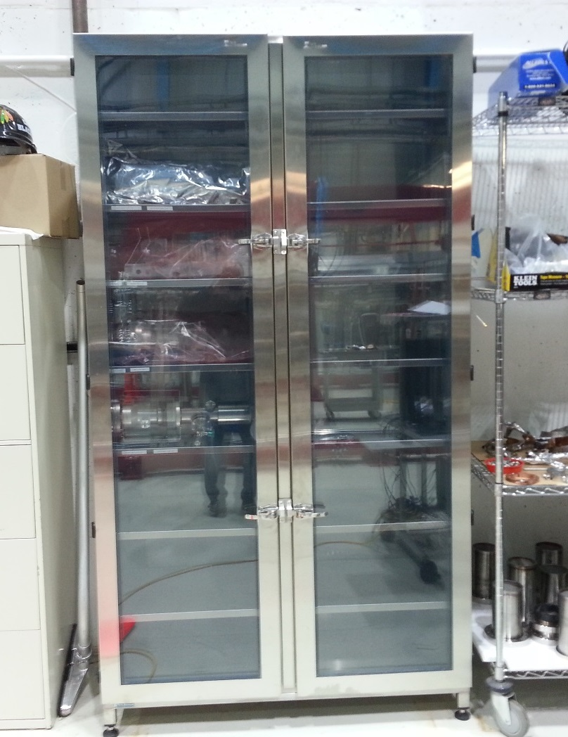
FPC Storage, warm ends
Based on latest delivery and production schedules:
Estimated up to 120 coupler warm ends will be in storage
Duration in storage could be as long as 1 year
Warm ends should be stored under nitrogen purge desiccator to prevent oxidation
There is one available cabinet in MP9, this cabinet can hold up to 32 warm ends
In order to provide adequate storage, 4 cabinets will be required to store 120 warm ends
3 additional cabinets are ordered delivered in January
Cabinet in MP9

Slide 6
FPC Delivery
Current delivery rate is about 8 couplers/Lab/week
All couplers were scheduled to be delivered by March-April 2017
Due to PIC and quality issues original delivery schedule has slipped about 2 months
Estimate of completion May –June 2017
There is no current official schedule of deliveries from the vendors to reflect these changes
Coupler deliveries will not impact CM production schedule
We have plenty of couplers

Slide 7
FPC Issues
Quality Issues
Initial shipments: problems with cleanliness, dirty bellows restraint
Vendor has solved most of these issues, not a problem now
Plating oxidation issues on CF100 area, CPI and RITH, 7 couplers
CPI solved problem, RITH investigating cause
Leak through RAV valve on wave guide stands, (2) couplers, CPI
Couplers arrived not under vacuum
Valve red tagged, vendor notified
PIC and storage issues
Lack of sufficient # of PICs delayed production
Additional PICs procured and delays due to PICs eliminated for now
Lack of storage delayed PIC returns and therefore production
Storage capacity increased at FNAL, solution in place by end of January 2017

