Slide 1
JLab CM Production Plan Update
Bob Legg
On behalf of the Jlab Team
10 January 2017

Slide 2
Contents
First Section
pCM Status and Lessons Learned
  Overview
  Documentation
  Cavity and string assembly
  Cryomodule assembly
  Schedule
Summary

Slide 3

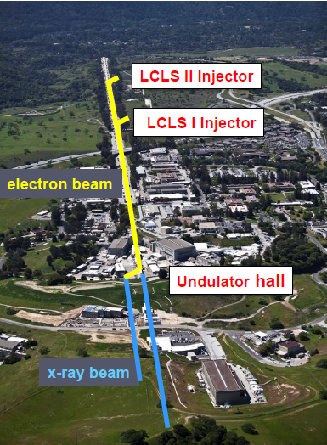

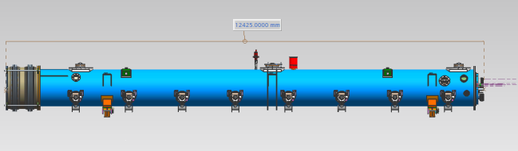
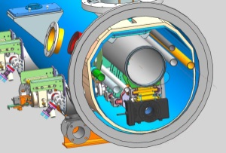
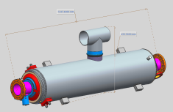
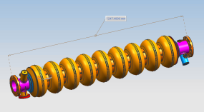
LCLS-II Cavity/Cryomodule Process at JLab
Supplier
Partners
JLAB SRF Facility
Receiving in SRF Inventory
Mechanical Inspection CMM
 | Component | FNAL | JLAB | SLAC
Cavity String | Niobium (Prototype) - existing cavities | NA
 | Niobium (Production) | X
 | Cavities (Prototype) - existing cavities | NA
 | Helium Vessels (Prototype) | X
 | Cavities w/Helium Vessels -VTS Ready (Production) |  | X
 | Cavity Feedthroughs |  | X
 | Cavity Flanges & Assoc. Hardware/Seals (VTS & HTS compatible) |  | X
 | Fundamental Power Coupler (FPC) |  |  | X
 | Cavity String Interconnecting Bellows |  | X
 | Cavity String Assembly Hardware & Seals | X
 | SC Magnet Assembly | X
 | Beam Position Monitor (BPM) | X
 | Gate Valves |  | X
 | Beamline Vac. Monitoring Manifold & Gauge | X
Cryomodule | Two-phase Pipe Bellows | X
 | Tuner, actuator, piezos (Prototype) | X
 | Tuner , actuator, piezos (Production) |  | X
 | Magnetic Shielding | X
 | GRHP Sub-assembly | X
 | Vacuum Vessel | X
 | Coupler Pumping Lines & Pumps (ion+TSP) + vacuum gauges | X
 | Instrumentation | X
 | Liquid Level Probes & JT Valve | X
 | Beamline Interconnect Parts including Aluminum Heat Shields | X
 | HOM Absorber |  | X
 | Shipping Frames & End Caps + Shock Log Devices |  | X
 | X = Lead Lab per SLAC LCLSII-4.1-PM-0229-R0 (June2014)
Cavity /Helium Vessel Prep. & Test
VTA RF Test in liquid Helium @ 2 K
Cavity String Assembly & Leak Test
Assemble Cavity String -Class 100 Clean Room
Courtesy Chi-Chang Kao, SLAC
Cryomodule Assembly
Instrumentation & Wiring
Tuners, MLI– Multi Layer Insulation,
Cryogenic Circuits , magnetic shielding, alignment
Super Insulation Cabling & Shield
Vacuum Vessel & Final Alignment
Install Cryogenic Supply Interfaces
  Horizontal Test Preparation
  Pressure Test & Leak Check (vacuum)
Commissioning at SLAC
Install Cryomodules in Accelerator, cool to 2 K
Weld & certify leak tight , pressure test
check Controls,
Gradient & Dynamic Heat Load - Q_{o}
Cryomodule Test in “Test Cave”
Cryomodule integrity @ 2 K
Tuners - Range, Hysteresis, & Resolution/ Sensitivity
Cavities for Gradient & Dynamic Heat Load Q_{o}
LCLS-II 1.3 GHz Cryomodule
Cryomodule shipping to SLAC
JLAB support for installation of first 3 Cryomodule

Slide 4
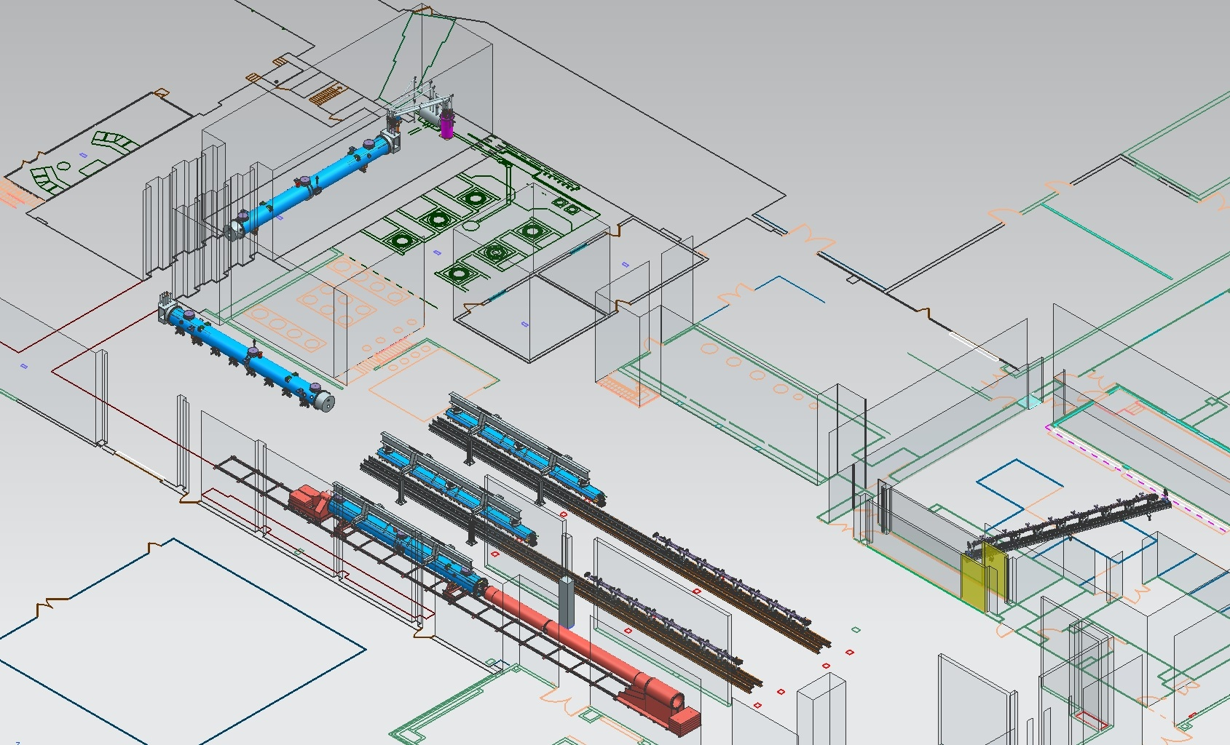
JLab Layout for LCLS-II CM Production
CM Testing
Phase II CM Assembly (2X)
Clean Room String Assembly
Phase I CM Assembly (2X)
Final Assembly / Prep for Testing
Vacuum Vessel Installation

Slide 5
1.04.06.06 JLab Prototype 1.3 GHz Cryomodule
Technical Objective
Producing and testing one 1.3 GHz prototype cryomodule incorporating many of the LCLS-II features.
CM meets technical specification for the machine.
Scope of Work
Development of all procedures and documentation required to support production of one cryomodule with 8 cavities, 1 SC magnet and 1 BPM package
Deliverables
All procedures and documentation required to support production of one cryomodule with 8 cavities similar to the LCLS-II production design
Relationship/Interfaces
1.04.06.05.01 JLab Prototype Design, 1.04.06.05.04 High Q0 Development, 1.04.06.06.04 Infrastructure
Assumptions
Design will be such that Cryomodule will be usable as "first article " at SLAC
Cavities provided from FNAL's ILC inventory

Slide 6
JLab pCM Assembly – Major Tasks
  Documentation Travelers and Procedures
  Component Acceptance
  Cavity Preparation and Test
    Inspection, CMM, Chemistry, Clean Assembly, Vertical Test
  Cavity String Assembly
  Upper Cold Mass Assembly
  Cold Mass Assembly I
  Cold Mass Assembly II
  Vacuum Vessel Assembly
    Cold Mass Insertion into Vacuum Vessel
  Final Assembly
  Cryomodule Acceptance Test
  Ship
Completed

Slide 7
Processes, Procedures and Travelers
Developed a master list of procedures and travelers for CM production based on C100 experience
  Master list refined as our understanding of the LCLS II cryomodule improved
Initial contents of travelers and procedures were influenced by
  LCLS II Qo R&D program
  Discussions with SME at Saclay
  FNAL documents shared through Vector and between assembly and engineering peers
Documents have continued to evolve (and will continue)
  Hands-on experience with pCM
  Collaborative efforts of assembly groups
    Site visits, many meetings and discussions
  Maturing of the cryomodule design
  Plan to refine production procedures and travelers
    Based on collective pCM experience
    Lessons learned

Slide 8
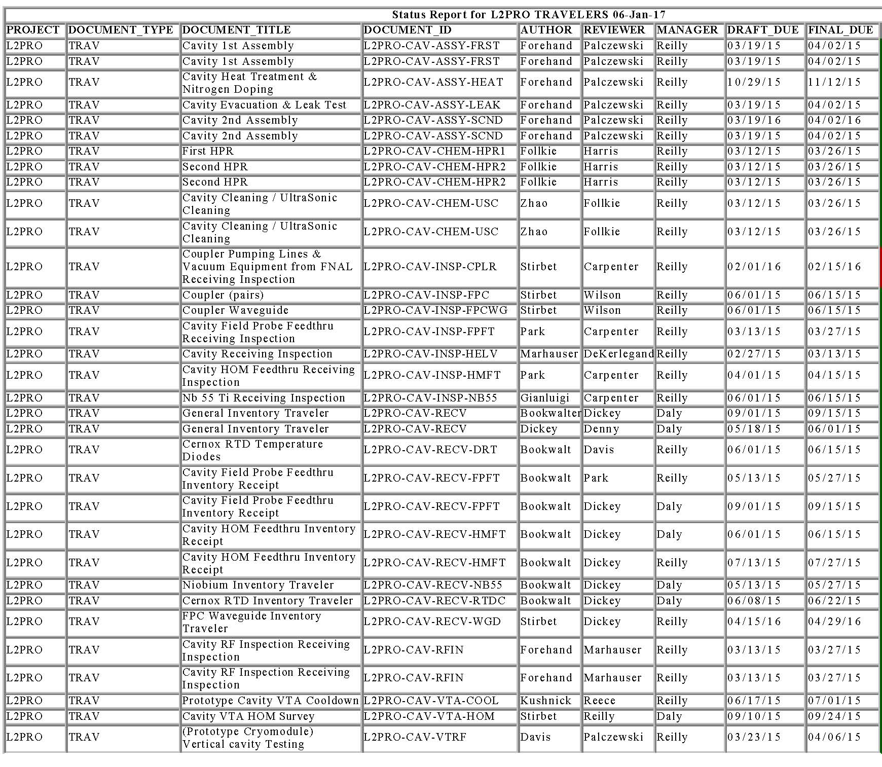
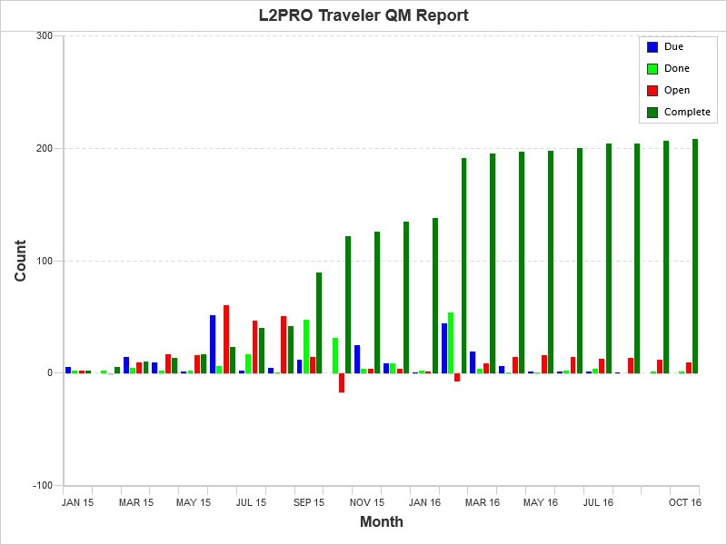
pCM Documentation - Travelers & Procedures
Travelers and procedures were developed and implemented from receiving and acceptance inspections through all phases of pCM assembly
Travelers
~ 100 Receiving
~ 70 Acceptance Inspection
~ 20 Assembly
5 Test
2 pCM Shipping
Procedures
~ 40 Assembly

Slide 9
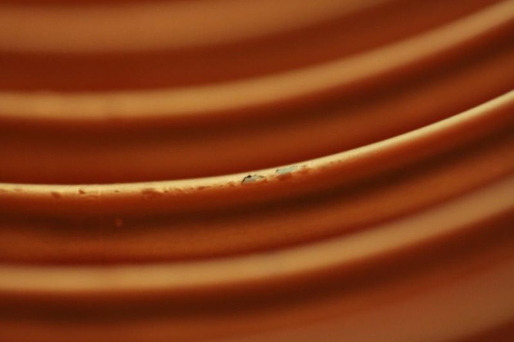
Cavity String Assembly Experience and Lessons Learned
Copper plated bellows
Quality issues with plated parts from vendor
  Pin holes, blistering and flaking of Cu plating, scratches on flanges
  Engaged SLAC plating SME
    Process changes implemented at vendor
    Parts stripped and plated at SLAC and vendor
  Delayed string assembly by weeks
SLAC is currently providing copper plated string components for first two production strings
New plating vendor qualified and under contract
Significant NCR issued to Project

Slide 10
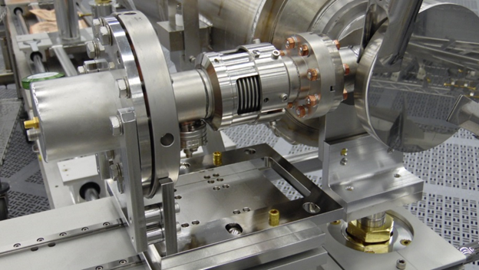
Cavity String Assembly Experience and Lessons Learned
Cavity String Assembly
Initial string assembly was completed in about 3 weeks
  Cavity bleed-up, disassembly, HPR, string assembly, pump down and leak check
Leak check revealed leaks along the beam line and at the FPC
  Attempts to correct the leaks using higher torques were not successful
String was completely disassembled
  All sealing surfaces were inspected and any suspect blemish was polished
  Discovered that three of the FPCs were not aligned properly at the flange
    Corrective actions taken to eliminate misalignment
      Mock assemblies, additional quality checks (visual and feeler gauge)

Slide 11
Cold Mass Assembly Experiences and Lessons Learned
Quadrupole Magnet
  The quad magnet had an assembly problem which confused alignment; the two halves faces were not in plane
  We aligned the center of the quad to the centerline of the beamline and ignored the magnet faces. The magnet face was then shimmed where it bolted to the BPM flange
Cavity Magnetic Shields
  Two suppliers, different designs, each with special controls due to different permeability
  Modified all the magnetic shields (both vendors) prior to installation
Alignment
  Alignment of the string was more complicated than originally thought; Learning curve
  Added an additional clamp to hold cavity 1 to Invar rod against vacuum loading
HOM clamps
  Would not go on as originally designed and received
  Parts modified to last drawing revision to incorporate the thermal sensor and scallop feature

Slide 12
Cold Mass Assembly Experiences and Lessons Learned
Helium Circuit Stainless Steel Pipe
  Pipe acquired by the project for the He piping did not work well with the orbital welder, surface finish not polished
  Sections of Helium pipes were hand welded
Vacuum Vessel
  The lifting fixture for the vacuum vessel was specified with slots for metric all thread supports, but SAE all thread ordered
  Modifications were made to lifting fixture and because it was part of a lifting fixture, Load test by an outside source was required
  The threads in VV for lifting rods were loose fit.
  Nuts placed on threaded rods after it passed through the lifting plate
  The vacuum vessel had a vacuum leak as received
  Leak welded shut. Leak check added to receipt inspection.

Slide 13
Cold Mass Assembly Experiences and Lessons Learned
Power outage in Test Lab
  Ion pump on string lost power for 7 hours at work station 2
  Use procedure to restart pump. Put beamline ion pumps on emergency power.
Helium circuit pipes’ ends not in correct transverse positions
  Explosively bonded joints were not square. Resulting pipes ‘bent’.
  Risk of fracture in explosively bonded joint high if pipe re-bent. Use as is.
Tuners
  Limit switches were wired incorrectly from the vendor
  A check of the limit switch wiring will be included in the traveler
  A tuner motor was found to be shorted after assembly, requiring complete disassembly of the tuner
  Motors will be tested for shorts during the inspection traveler
  Only one set of tools available for two teams doing installation delayed work
  Four sets of tools procured and segregated for tuner installation

Slide 14
Cold Mass Assembly Experiences and Lessons Learned
JT Insulation and heat stationing
  JT valve at FNAL exhibited icing during operation.
  Use production MLI and heat stationing design from FNAL for JT installation
VV to Cold mass Integration
  Support posts bound up during lift and mating operation
  Fully loosen alignment screws before integration.
  Support posts are heavy and difficult to lift above cantilever fixture
  Use separate chainfall to lift support posts into place
50K shields
  50K shields required re-machining to match new drawings
  Always use latest drawing revisions.
  50K shields did not clear ¼” Helium fill lines; potential heat leak
  Shields were modified to give more clearance and Helium lines were pushed up against the Helium vessel after welding.

Slide 15
Cold Mass Assembly Experiences and Lessons Learned
Warm couplers
  Insufficient production Warm couplers available for prototype.
  Installed RI couplers on cavities 1-4; 5-8 are CPI prototypes.
  Sensor wiring damaged where they were taped to berrybolts
  Changed dressing of wiring in tuner area
  Berry bolts sheared during removal
  Remove pieces and change part call out to avoid SS on SS interfaces
End Cap Installation
  Coils installed on VV for demagnetization interfered with clamps used to hold the End cap and Bayonet box on the pCM
  Move coils from ends of pCM onto End Cap and Bayonet Box. Reused for final demag on all future cryomodules.
  Flange surfaces warped and would not seal.
  Duct seal for test and re-machine flange on second end cap for next test
  Shipping
  Insufficient room around shipping fixture on flat bed to safely install CM in-situ.
  Move shipping fixture to floor and install CM, then re-lift to truck bed. Load test of shipping fixture required.

Slide 16
Cold Mass Assembly Lessons Going Forward
Warm couplers
  Bad coupling of tuning rod between warm and cold couplers.
  After pCM is warmed up, remove to work station 5 and disassemble to determine cause. Correct tooling, procedures, etc?
Heat Exchanger Can
  Borrowed heat exchanger bypass valve may have slowed cool down.
    Main cause was valve in u-tube that was incorrectly installed limiting flow rate. Problem has been corrected.
  New heat exchanger on order and will be delivered before next CM test with modified bypass valve (large Cv) as a mitigation
U Tubes
Return U tube valve may have slowed cool down.
Valve controller reset to vendor’s specification
Installing CM into CMTF
Impossible to have two modules at cave entrance and lift a module in simultaneously
Changed direction of module approach to cave from south to north

Slide 17
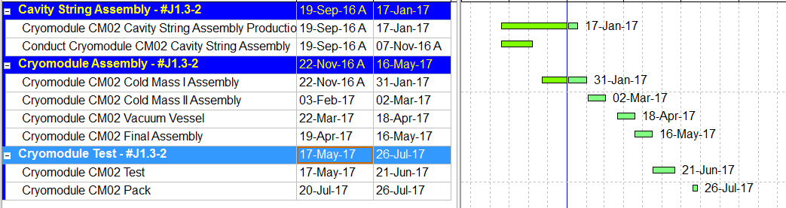
P6 Schedule
pCM assembly to be completed by 11/30
Acceptance test to be completed by 2/17

Slide 18
Summary
Infrastructure added for LCLS II has all been installed and exercised through the pCM assembly
  Actual use and mock-ups
The documentation processes and work control documents (travelers, procedures, NCRs) were implemented and in full use for the pCM
Acceptance Inspection and QA work centers got a lot of “burn-in” with the pCM (well over 200 NCRs!)
Cavity Prep and Test yielded a very good set of prototype cavities
CM assembly groups have gained a lot of experience with the LCLS II type of cryomodule and with technology transfer!
  The collaborations have gained much run time!
Staff in SRF Ops have all had a hand in the production aspects of the LCLS II pCM
  Have gained a good amount of experience which will pay dividends in our production efforts
Based on our prototype experience, JLAB is ready to start production of LCLS-II Cryomodules

Slide 19
Thanks for your attention!
Questions?

Slide 20
Backup Material

Slide 21
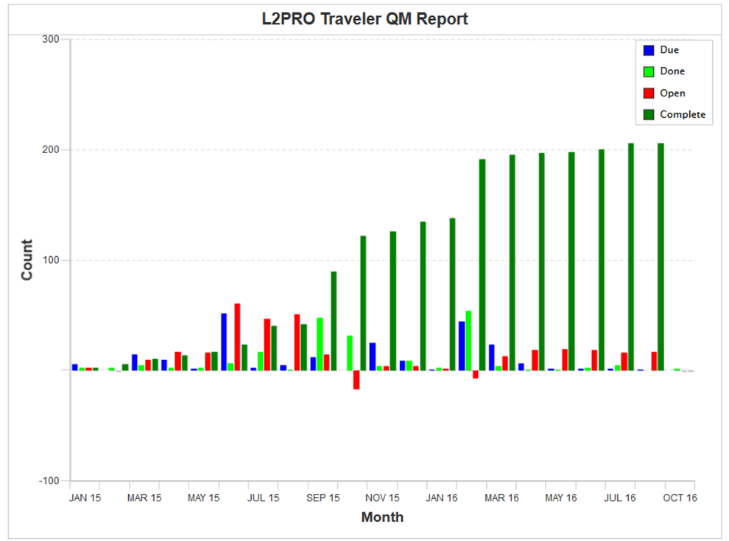
pCM Traveler Development Progress Chart

Slide 22
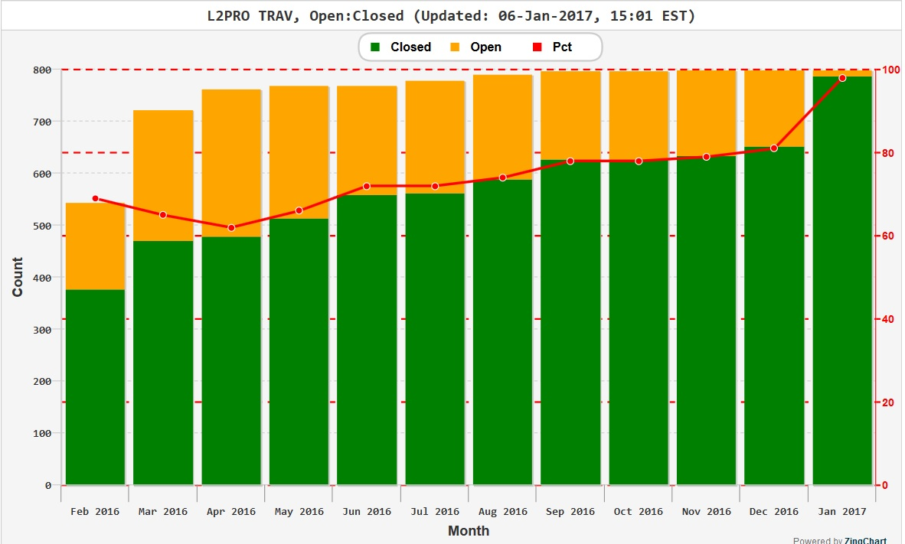
Traveler Status (listed by Month)

Slide 23
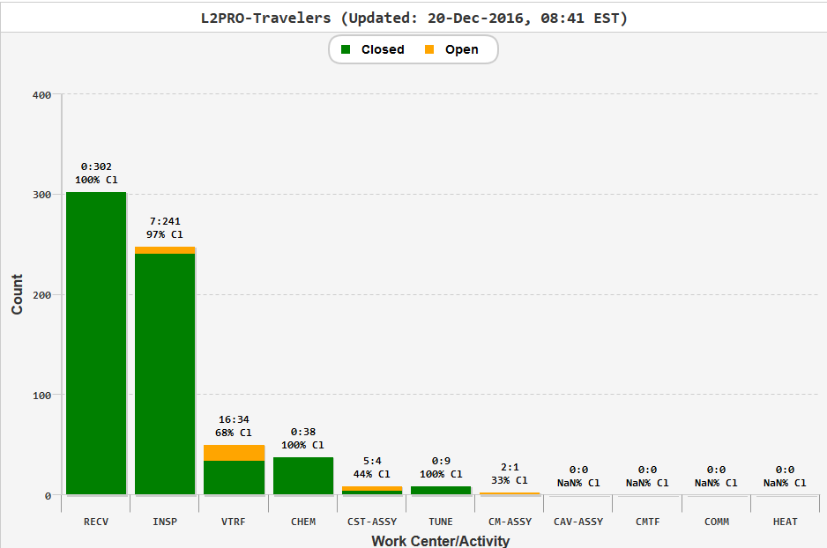
Traveler Status (listed by Work Center Activity)

Slide 24
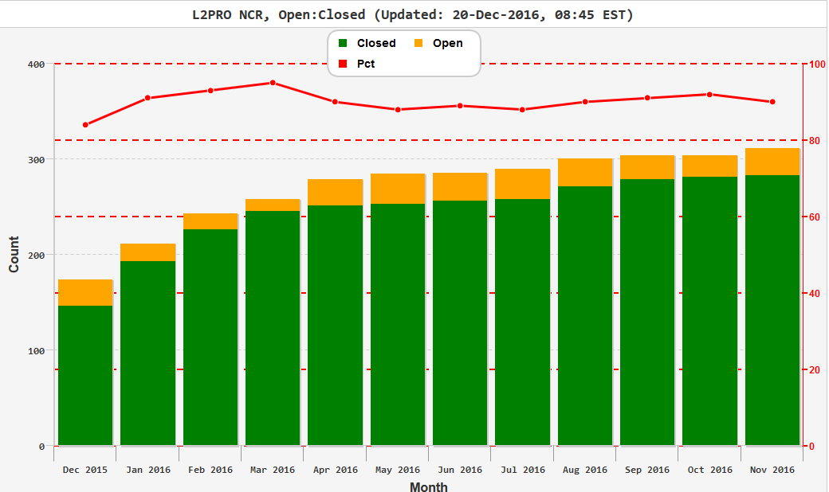
NCR Status (listed by Month)

Slide 25
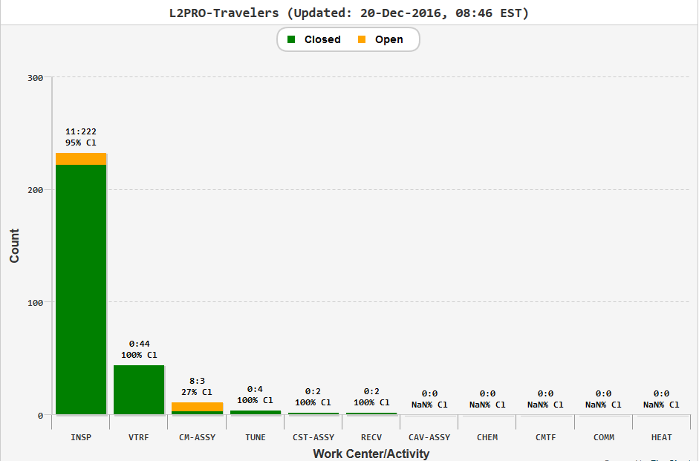
NCR Status (listed by Work Center Activity)

Slide 26
Open NCRs: Cavity
Status Report for L2PRO-NCR,L2PRO-NCR on 20-Dec-16
TRAV_SEQ_NUM | TRAV_OPEN_DATE | PARTDESCRIPTION | DESCRIBECOMMENT | SN | TRAVELERID | TRAVSEQNUMBER | DISPOSITION
156 | 24-Nov-15 | Weldment Bellows Long | Dark stains and blisters remain in plating after final disposition of cleaning in NCR #155. | 19 | L2PRO-NCR | 155
271 | 13-Apr-16 | UNKN | Shock recorder missing | CPI FPC Pair03 | L2PRO-CAV-INSP-FPC | 7
285 | 4-May-16 | UNKN | With main valve (SN2516) on CPC R397361-02-04 in close position, cannot achieve pressure better than 2 10-5 mbar. Suppose damaged valve. Red tagged valve - CPI should check/replace this valve. | CPI-PA-04 | L2PRO-CAV-INSP-FPC | 8
286 | 4-May-16 | UNKN | Static vacuum of CPI-PA-04 R397361-02-04 1000 mbar (normal pressure). Main valve related or improperly torque nuts on cavity flange. Leak check OK. | CPI-PA-04 | L2PRO-CAV-INSP-FPC | 8
287 | 4-May-16 | UNKN | Difficult to remove cold ceramic protection cup and found residues form the flat VITON gasket on CF100 copper plated. | CPI-PA-04 | L2PRO-CAV-INSP-FPC | 8
288 | 4-May-16 | UNKN | Push-rod 006 with weld issues on bellows. Sent back to CPI to be replaced. | CPI-PA-04 | L2PRO-CAV-INSP-FPC | 8
289 | 5-May-16 | UNKN | Dirty Swagelog nitrogen admission valves (on WP as well as on CP). | R397361-02-04A04 | L2PRO-CAV-INSP-FPC | 8
290 | 5-May-16 | UNKN | Dirty Swagelog nitrogen admission valves (on WP as well as on CP). | CPI-PA04 | L2PRO-CAV-INSP-FPC | 8
296 | 1-Aug-16 | UNKN | Missing hardware Kit Electron probe with male sex High particulate counts on external surfaces 5K copper anchor oxidized Blood like stains on test stand frame Greasy Swagelog valves | PA003 | L2PRO-CAV-INSP-FPC | 11
304 | 17-Aug-16 | LCLSII couplers | 1. Greasy nitrogen admission valves on cold ceramic protection cups. 2. SMA connectors with reverse sex. - Use adapters. 3. Particulate counts on external surfaces higher than ESD specifications ( >>100 counts). 4. Oxidized 5K copper anchors. | CPI LPA#04 | L2PRO-CAV-INSP-FPC | 12
305 | 17-Aug-16 | CPI couples for LCLSII | 1. Particulate counts on external surfaces higher than ESD specifications ( >>100 counts). 2. Oxidized 5K copper anchors. 3. Missing M8 Nitronic hardware 4. Missing manual antenna actuators | CPI LPA07 | L2PRO-CAV-INSP-FPC | 13
306 | 17-Aug-16 | CPI LCLSII couplers | 1. Particulate counts on external surfaces higher than ESD specifications ( >>100 counts). 2. Oxidized 5K copper anchors. 3. Missing M8 Nitronic hardware 4. Missing manual antenna actuators | CPI LPA#08 | L2PRO-CAV-INSP-FPC | 14

Slide 27
Open NCRs: Magnetic Shielding
Status Report for L2PRO-NCR,L2PRO-NCR on 20-Dec-16
TRAV_SEQ_NUM | TRAV_OPEN_DATE | PARTDESCRIPTION | DESCRIBECOMMENT | SN | TRAVELERID | TRAVSEQNUMBER | DISPOSITION
278 | 20-Apr-16 | Magnetic Shielding | Part number F10017757 does not match drawing; additional tabs present; Part number F10017758 does not match drawing; additional tabs present. Note:Spacer holes are NOT present on the above parts and and the drawing does not require them.Part number F10018116 does not match drawing; additional tabs present;Part number F10018117 does not match drawing; additional tabs present;Note: the above two parts DO have spacer holes not required by the drawing.Note:Part number F10017749, F10017754, F10017755, F10017756 Do Not have spacer holes. Part number: F10018116, F10018117, F10018120, F10018121, F10039382, F10039384 Do Have Spacer holes present. Drawing does not require them. | 10 | L2PRO-CM-INSP-MAG | 9 | Hold/Modify
279 | 20-Apr-16 |  | Part number F10017757 does not match drawing; additional tabs present; Part number F10017758 does not match drawing; additional tabs present. Note:Spacer holes are NOT present on the above parts and and the drawing does not require them.Part number F10018116 does not match drawing; additional tabs present;Part number F10018117 does not match drawing; additional tabs present;Note: the above two parts DO have spacer holes not required by the drawing. Note: Part number F10017749, F10017754, F10017755, F10017756 Do Not have spacer holes. Part number: F10018116, F10018117, F10018120, F10018121, F10039382, F10039384 Do Have Spacer holes present. Drawing does not require them. Part number F10018117 has a broken screw in threaded insert. | 11 | L2PRO-CM-INSP-MAG | 10 | Hold/Modify
280 | 20-Apr-16 | Magnetic Shielding | Part number F10017757 does not match drawing; additional tabs present; Part number F10017758 does not match drawing; additional tabs present. Note:Spacer holes are NOT present on the above parts and and the drawing does not require them.Part number F10018116 does not match drawing; additional tabs present;Part number F10018117 does not match drawing; additional tabs present;Note: the above two parts DO have spacer holes not required by the drawing.Note:Part number F10017749, F10017754, F10017755, F10017756 Do Not have spacer holes. Part number: F10018116, F10018117, F10018120, F10018121, F10039382, F10039384 Do Have Spacer holes present. Drawing does not require them. | 12 | L2PRO-CM-INSP-MAG | 11 | Hold/Modify
281 | 20-Apr-16 |  | Part number F10017757 does not match drawing; additional tabs present; Part number F10017758 does not match drawing; additional tabs present. Note:Spacer holes are NOT present on the above parts and and the drawing does not require them.Part number F10018116 does not match drawing; additional tabs present;Part number F10018117 does not match drawing; additional tabs present;Note: the above two parts DO have spacer holes not required by the drawing.Note:Part number F10017749, F10017754, F10017755, F10017756 Do Not have spacer holes. Part number: F10018116, F10018117, F10018120, F10018121, F10039382, F10039384 Do Have Spacer holes present. Drawing does not require them. | 13 | L2PRO-CM-INSP-MAG | 12 | Hold/Modify

Slide 28
Open NCRs: Mag Shielding cont. & VV & BBRD
Status Report for L2PRO-NCR,L2PRO-NCR on 20-Dec-16
TRAV_SEQ_NUM | TRAV_OPEN_DATE | PARTDESCRIPTION | DESCRIBECOMMENT | SN | TRAVELERID | TRAVSEQNUMBER | DISPOSITION
282 | 20-Apr-16 |  | Part number F10017757 does not match drawing; additional tabs present; Part number F10017758 does not match drawing; additional tabs present. Note:Spacer holes are NOT present on the above parts and and the drawing does not require them.Part number F10018116 does not match drawing; additional tabs present;Part number F10018117 does not match drawing; additional tabs present;Note: the above two parts DO have spacer holes not required by the drawing.Note:Part number F10017749, F10017754, F10017755, F10017756 Do Not have spacer holes. Part number: F10018116, F10018117, F10018120, F10018121, F10039382, F10039384 Do Have Spacer holes present. Drawing does not require them. | 14 | L2PRO-CM-INSP-MAG | 13 | Hold/Modify
283 | 20-Apr-16 |  | Part number F10017757 does not match drawing; additional tabs present; Part number F10017758 does not match drawing; additional tabs present. Note:Spacer holes are NOT present on the above parts and and the drawing does not require them.Part number F10018116 does not match drawing; additional tabs present;Part number F10018117 does not match drawing; additional tabs present;Note: the above two parts DO have spacer holes not required by the drawing.Note:Part number F10017749, F10017754, F10017755, F10017756 Do Not have spacer holes. Part number: F10018116, F10018117, F10018120, F10018121, F10039382, F10039384 Do Have Spacer holes present. Drawing does not require them.Part number F10037667 has a bent corner. | 15 | L2PRO-CM-INSP-MAG | 14 | Hold/Modify
291 | 20-Jun-16 | Vacuum Vessel | Damage and scratches present on some flanges.Damage F10030811 . Damage F10026614. See detailed inspection report attached and photos link. Scratches present on some flanges.Paint residue F10018083 (DS). Contamination found in o-ring groove F10023643..Contamination found in o-ring groove F10020935. Scratches F10030285. Scratches/damage F10030301. Refer to Vacuum Vessel Inspection report attached. Most threaded holes are contaminated with chips,burrs,and dirt making the Go Thread Gage not go for full depth. Photo link: M:\cmm\Pictures\Inspection Pictures\LCLS2\Prototype CM\Vacuum Vessel | 2 | L2PRO-CM-INSP-VV | 1 | Hold/Modify
294 | 26-Jul-16 | Rupture Disc Holder | Seal surface scratched. | 15006443A-1 | L2PRO-CM-INSP-BBRD | 1
295 | 26-Jul-16 | Rupture Disc Holder | Scratches present on seal surface. | 15001065A-2 | L2PRO-CM-INSP-BBRD | 2

Slide 29
Open NCRs: CM-ASSY-FRST
Status Report for L2PRO-NCR,L2PRO-NCR on 20-Dec-16
TRAV_SEQ_NUM | TRAV_OPEN_DATE | PARTDESCRIPTION | DESCRIBECOMMENT | SN | TRAVELERID | TRAVSEQNUMBER | DISPOSITION
310 | 15-Nov-16 | PT103 Platinum RTDs | Main Coupler #1, 12 o'clock position was broken during installation. Removed broken sensor using hand drill. Installed new sensor. Verified good with DMM. Note: these RTDs are very fragile. | CM01 | L2PRO-CM-ASSY-FRST | 1
311 | 15-Nov-16 | PT103 Platinum RTDs | Main Coupler #3, RTD, 6 o'clock position, was broken during installation. Replaced with new RTD. Verified good with DMM. | CM01 | L2PRO-CM-ASSY-FRST | 1
312 | 15-Nov-16 |  | Magnet RTD 2K Quadlead sensor has an "OPEN" across pins 2 & 4. Removed bad sensor and installed new. Verified good with DMM. | CM01 | L2PRO-CM-ASSY-FRST | 1
313 | 15-Nov-16 | Broken RTD (PT103) wires | Found 3 broken RTD (PT103) wires after removal of the barry bolts from the main coupler flanges on Cavities 3 (12 & 6 o'clock positions) and cavity 8 (6 o'clock only). Wires were taped to bolts. RTDs not repairable due to inaccessibiltiy. Installed new RTDs on the front of the main coupler flanges at 12 and 6 o'clock positions and removed the wires from the broken RTDs as per Ed Daly. | CM01 | L2PRO-CM-ASSY-FRST | 1
314 | 15-Nov-16 | MP4 temperature sensor | Found magnet temperature sensor MP4, serial #D6055418, electrically OPEN using 4-wire DMM. This sensor is internal to the magnet and not accessible for repair or replacement. Iaw Fred Lewis (FNAL)use extra (unused) internal sensor, serial #D6055800, located on Q1 in place of MP4. No further action required. | CM01 | L2PRO-CM-ASSY-FRST | 1
315 | 15-Nov-16 | Main Coupler #8 RTD | Main Coupler #8 RTD, 12 o'clock position, found electrically "OPEN" with 4-wire DMM. Assembly is too far advanced to replace broken RTD (PT103). Left "as is" as per Kirk Davis. | CM01 | L2PRO-CM-ASSY-FRST | 1
316 | 15-Nov-16 | Fluxgate extension wires | Fluxgate extensions were made using a smaller 26 awg wire. Procedure called for 24 awg but we used the in-house 26 awg to avoid creating a long delay waiting for the larger 24 awg that was several weeks from being delivered. Fred Lewis (FNAL) agreed that the 26 awg wire was adquate. No further action required. | CM01 | L2PRO-CM-ASSY-FRST | 1
317 | 28-Nov-16 | CRYOMODULE | Quad magnet short in the 50K thermal clamp. When the heat station joint was being assembled, the insulating G10 sheet was not installed properly on the V+ flag and allowed the flag to short to the Al cooling strap. The picture shows the G10 does not protrude past the end of the V+ flag. The short was discovered and the joint was remade with fresh G10 so that the flag was properly covered with insulation. The V- joint at the bottom was also remade even though there was no short discovered there. | CM01 | L2PRO-CM-ASSY-FRST | 1

Slide 30
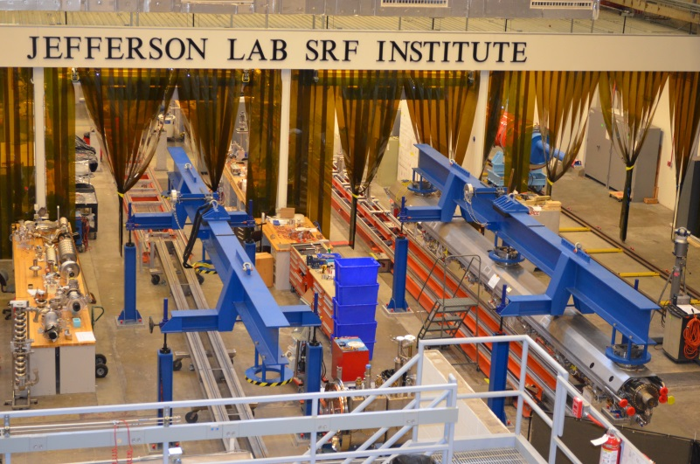
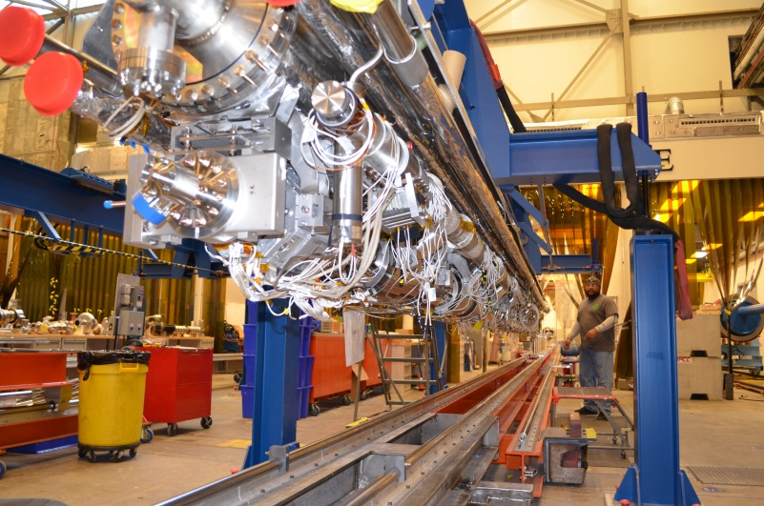
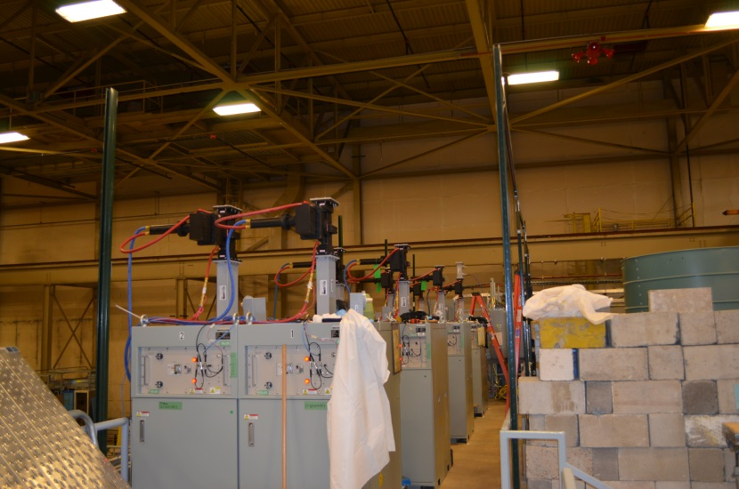
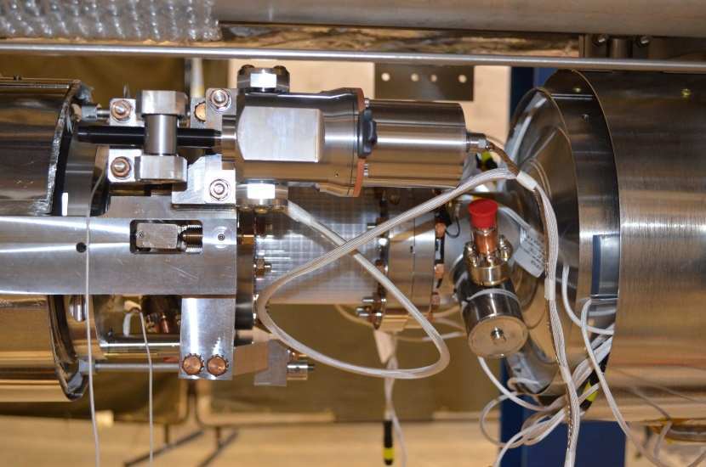
Cryomodule Hardware
Test Lab Assembly Facility
pCM Cold Mass Assembly
LCLS II Solid State Amplifiers
pCM Cavity Tuner Assembly

