Slide 1
PRR Process &
Project Overview @ JLab
Edward Daly for the JLab CM Team
LCLS-II 1.3 GHz CM PRR
10-11 January 2017

Slide 2
Outline
  Introduction
  Review of Charge & Agenda
  JLab’s PRR Approach
  Status
  Summary

Slide 3
Introduction – PRR Process
  Combined PRRs for FNAL & JLab (@ FNAL Sep-2016)
    Design, Assembly and Testing aspects
    Tour of FNAL Facilities & Infrastructure
    FNAL closed out PRR with pCM test results (31-October) via telecon
  Combined PRR for JLab & FNAL (@ JLab Jan-2017)
    Completion of pCM assembly at JLab
    Focus on initial test results for JLab and extended test results for FNAL
    Tour of JLab Facilities & Infrastructure
    Opportunity to assess progress, risks and challenges
    JLab plans to close out PRR with full test results via telecon
  PRR process concludes with confidence that both production lines can meet LCLS-II project needs

Slide 4
Production Readiness – Main Conclusions
  The committee thanks the organizers of the review and commends the speakers for the quality of the material presented and of the discussions ensuing the many questions asked to them.
  The scope of the Review encompasses WBS chapters 1.04.05.08/1.04.05.09/1.04.05.10/1.04.05.11, from ‘1.3 GHz Cryomodule Cavity Prep/Test’ to ‘1.3 GHz Cryomodule Test’.
  The labs are ready to go for production but one key element is still missing, namely the results of the pCMs tests at FNAL and at JLab. The conclusions (comments and recommendations) of this Review are therefore contingent to the successful realization of these tests, and to the compliance of the measured performance of the cryomodules.

Slide 5
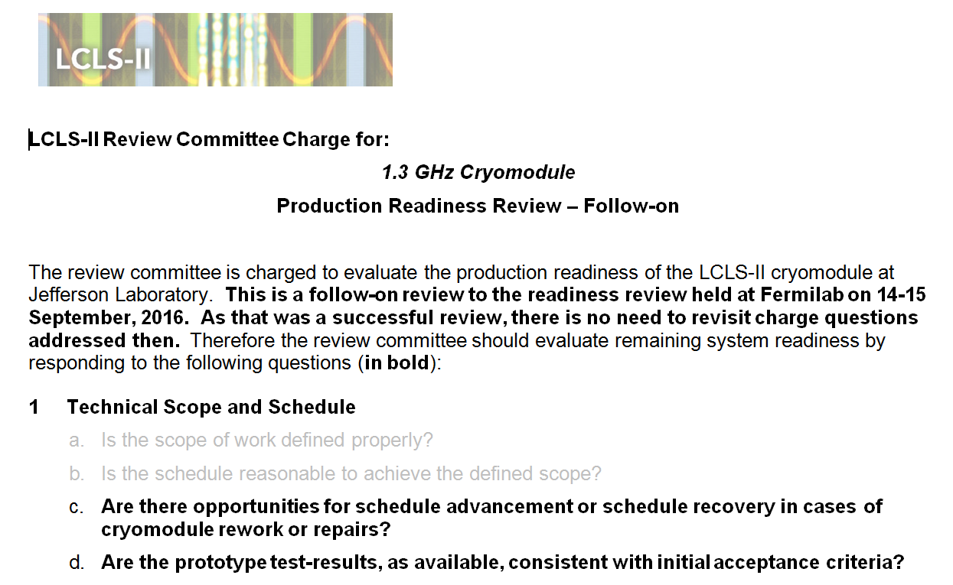
Charge (1/2)

Slide 6
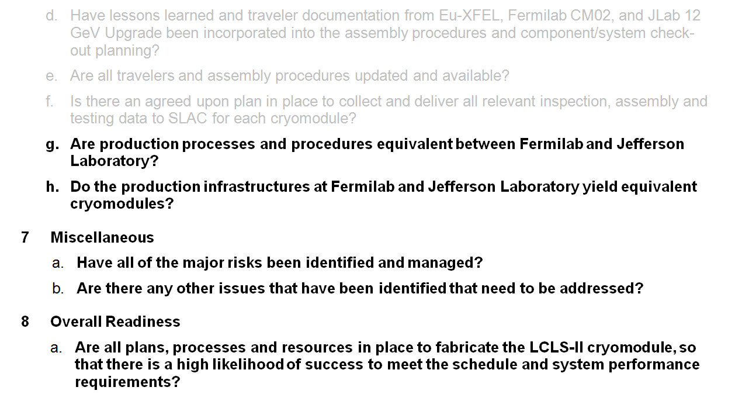
Charge (2/2)

Slide 7
JLab’s PRR Approach
  Assessed at September PRR as “ready to go” except for pCM test results
  Initial pCM test results presented today
  Plan to follow up with a video call to present full set of results from pCM in February 2017
  Schedule risk mitigation as components are available
    Advance CM02 at WS2 & WS3 during January and February
    Commence CM03 cavity string in late January

Slide 8
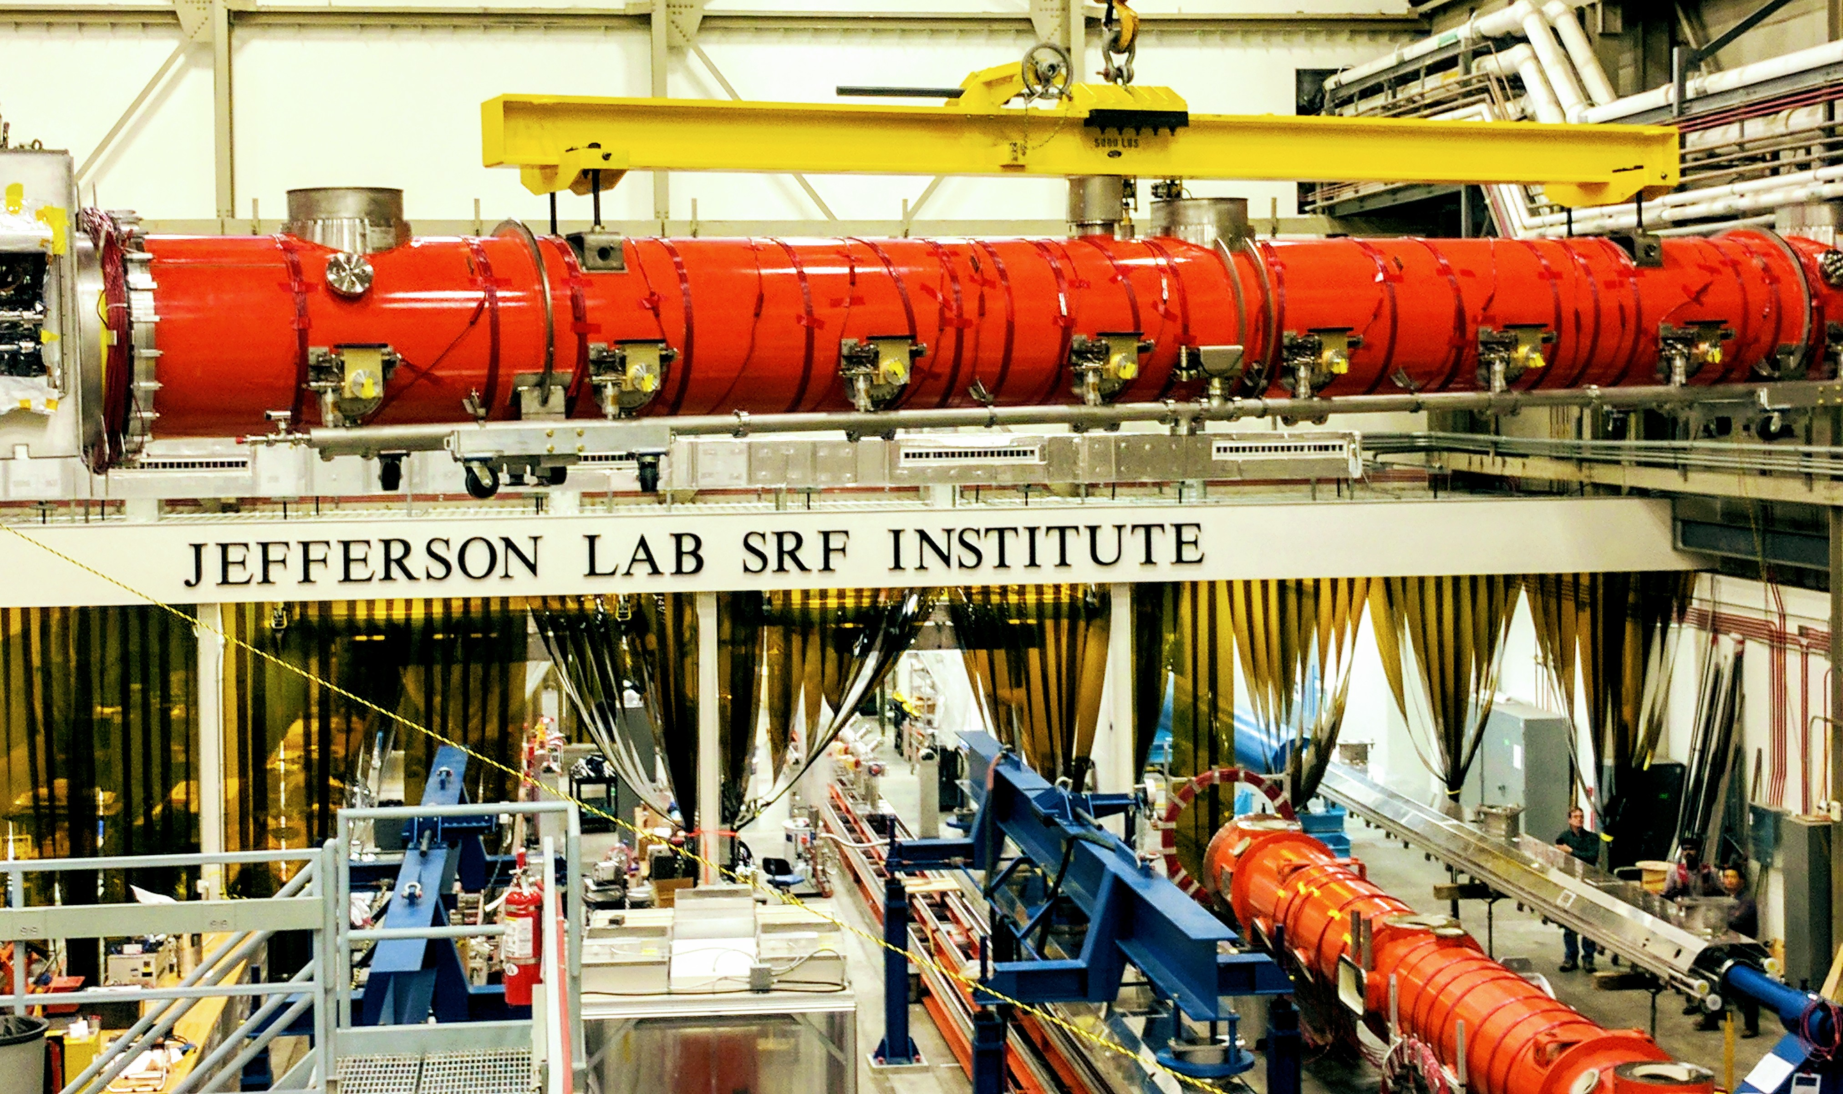
Cryomodule Assembly at JLab

Slide 9
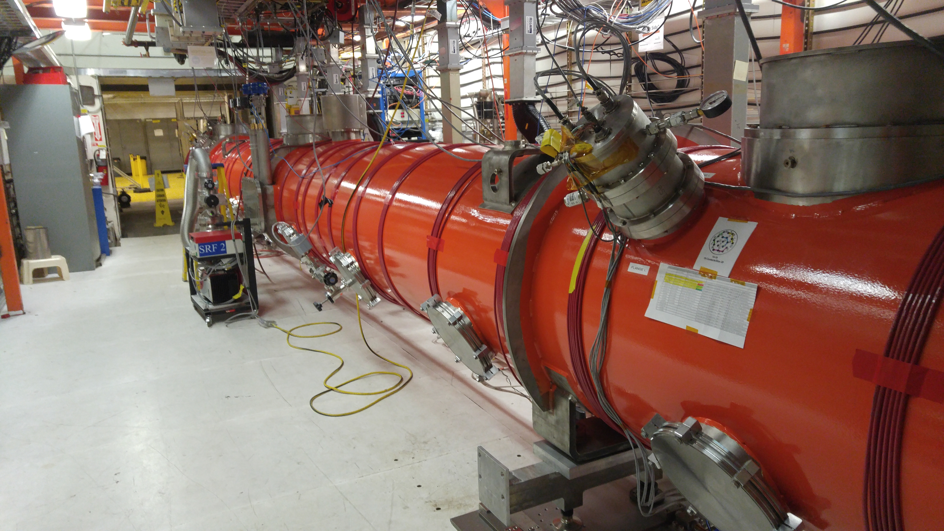
CM Test Facility – pCM in Testing

Slide 10
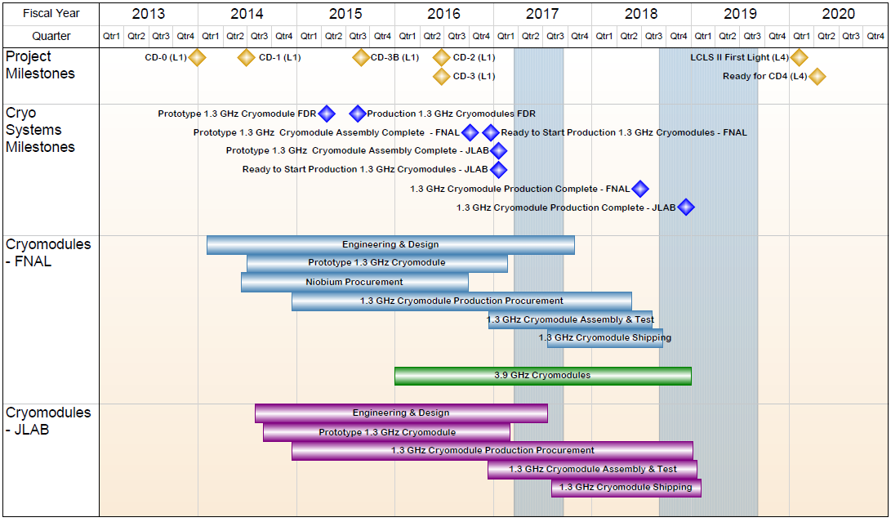
1.04.06 JLAB Cryomodules- Summary Schedule

Slide 11
Challenges
Production cavity delivery schedule (recipe improvements, vendor process control)
Supply chain management – continuity and understanding technical requirements
Cryogenics availability (CTF down)
On-site inventory & logistics – quantity of components, available space
Transferring processes between labs
  SOTRs & Production Leads, Equivalent processes
  Updates, modifications and improvements
  Implementation of acceptance criteria listing (ACLs)

Slide 12
Summary
Goal for production of CMs at JLab/FNAL is “identical design, identical parts, equivalent processes to yield equivalent performance”
pCM assembly complete; traveler status > 90% closed
pCM currently in testing in CMTF
Travelers & procedures in very good shape for production CMs
Overall Plan for Cryomodule Production
  Start of Production 1.3 GHz CMs (33 units) Jul-2016
    Rates of 1 CM per 6 weeks in current plans
  Production Readiness Review (Phase I) Sep-2016
  CM02 String Assembly Complete Oct-2016
  Prototype CM completed and in CMTF Nov-2016
  PRR (Phase II) includes pCM Test Results Jan-2017
  Close-out VC after testing completion Feb-2017

Slide 13
Acknowledgements
  Big Thanks – V. Bookwalter, M. Salvador (Pansophy Team), B. Legg, K. Wilson, M. Drury, J. Fischer, F. Marhauser, K. Davis, C. Ginsburg, T. Arkan
  Many Thanks - JLab, FNAL and SLAC colleagues
  Special Thanks - XFEL Project Team at DESY & CEA/Saclay

Slide 14
Back Up

Slide 15
Strategy – One Design, Two Production Lines
  Designs for Prototype and Production CMs (aim to satisfy PR and CM FRS)
  Identical Prototypes - utilize as much existing hardware as possible to reduce schedule risk and reduce overall cost while achieving the same performance as the production CMs
  Identical Production Designs - utilize as much of the DESY/XFEL design as practically possible to reduce schedule risk and reduce overall cost
    FNAL produces 16 CMs; JLab produces 17 CMs + 1 spare CM
  Identical Parts Received at Partner Labs
    Well-developed drawing packages, clear requirements and specifications
    Concurrent reviews within LCLS-II project
    Procurement activities – lead technical contacts at Jlab/FNAL/SLAC work together during all phases
  Identical Tooling Interfaces
    Interfaces between CM hardware and tooling are identical
      Avoid adding custom features to CM
    Adapt non-CM hardware interfaces to Lab-specific tooling
  Equivalent Processes yielding Equivalent Performance
    Recognize that some tools are different at each lab (e.g. HPR, vertical testing systems, vacuum leak checking equipment, etc.)
    Monitor key process variables in consistent fashion (e.g. samples to verify etch rates)

Slide 16
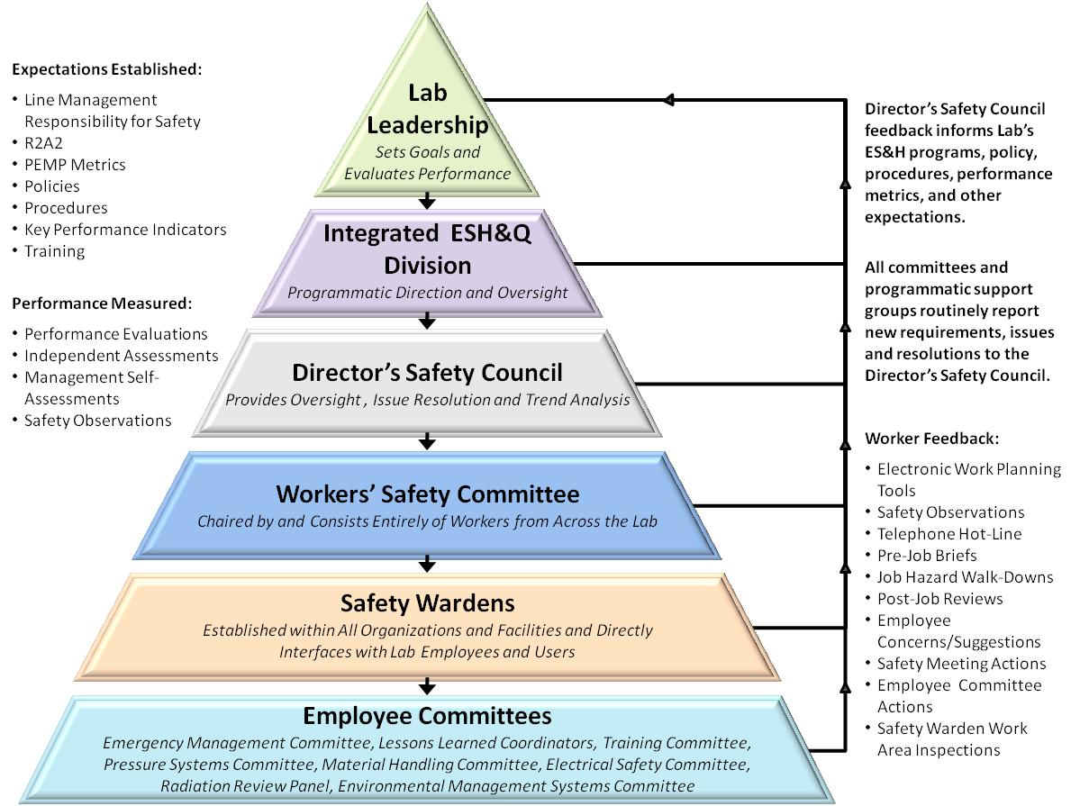
LCLS II Uses Well-Established JLab ISM program
  15 work Observations were conducted,
  ESH professionals, Division Safety Officer, and Accelerator Division staff and management.
  All safe for all observations
  ISM – Integrated Safety Management applies for all work.
    Presenters will address their specific areas (VTA, Assembly, Testing)
  Example - Shoulder injury experienced by a technician while loosing a bolt on a LCLSII cavity flange.
    Immediate actions to modify work procedures, larger wrench
    Follow up in depth investigation by Division Safety Officer
    All corrective actions are either complete or on-schedule for completion.

Slide 17
Processes, Procedures and Travelers
Developed list of procedures and travelers for CM production based on CM assembly processes
  Leveraged C100 experience
Procedures are a composite of C100 and LCLS II Qo experience folding in FNAL procedures and XFEL techniques in use at Saclay
  Assembly travelers for pCM cavity string assembly
  Assembly travelers for pCM assembly
  Procedure development - good collaboration with FNAL team
Implemented receiving and inspection travelers for the prototype and production CM components
  FNAL & JLab SOTRs are collaborating
  Plan to refine production procedures and travelers based on pCM experience & Lessons Learned
  PRR – venue for review prior to start of string assembly

Slide 18
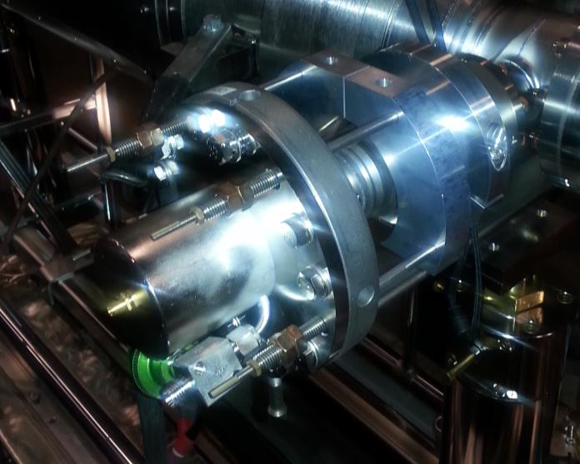
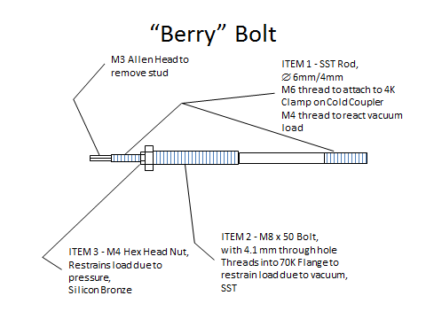
JLab Cavity String Assembly – Berry Bolts
Restraint that enable pump down and keep cavity string under vacuum using “Berry” Bolts
Installed outside of clean room during cryomodule assembly phase I

Slide 19
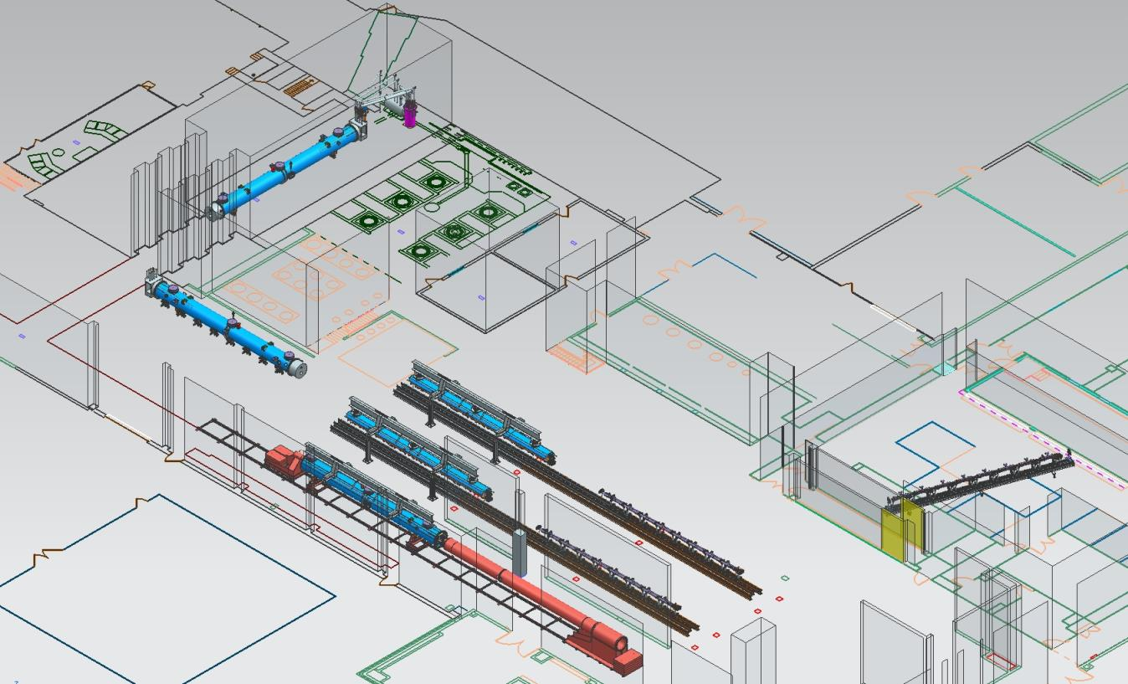
JLab Layout for LCLS-II CM Production
CM Testing
Phase II CM Assembly (2X)
Clean Room String Assembly
Phase I CM Assembly (2X)
Final Assembly / Prep for Testing
Vacuum Vessel Installation

Slide 20

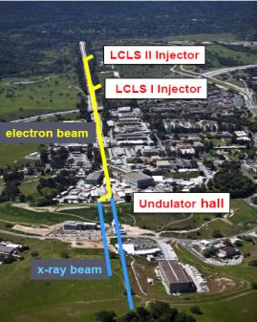

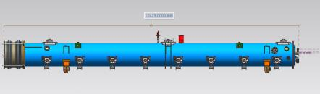
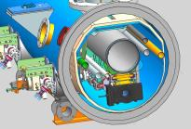
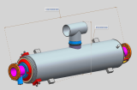
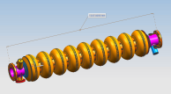
LCLS-II Cavity/Cryomodule Process at JLab
Supplier
Partners
JLAB SRF Facility
Receiving in SRF Inventory
Mechanical Inspection CMM
 | Component | FNAL | JLAB | SLAC
Cavity String | Niobium (Prototype) - existing cavities | NA
 | Niobium (Production) | X
 | Cavities (Prototype) - existing cavities | NA
 | Helium Vessels (Prototype) | X
 | Cavities w/Helium Vessels -VTS Ready (Production) |  | X
 | Cavity Feedthroughs |  | X
 | Cavity Flanges & Assoc. Hardware/Seals (VTS & HTS compatible) |  | X
 | Fundamental Power Coupler (FPC) |  |  | X
 | Cavity String Interconnecting Bellows |  | X
 | Cavity String Assembly Hardware & Seals | X
 | SC Magnet Assembly | X
 | Beam Position Monitor (BPM) | X
 | Gate Valves |  | X
 | Beamline Vac. Monitoring Manifold & Gauge | X
Cryomodule | Two-phase Pipe Bellows | X
 | Tuner, actuator, piezos (Prototype) | X
 | Tuner , actuator, piezos (Production) |  | X
 | Magnetic Shielding | X
 | GRHP Sub-assembly | X
 | Vacuum Vessel | X
 | Coupler Pumping Lines & Pumps (ion+TSP) + vacuum gauges | X
 | Instrumentation | X
 | Liquid Level Probes & JT Valve | X
 | Beamline Interconnect Parts including Aluminum Heat Shields | X
 | HOM Absorber |  | X
 | Shipping Frames & End Caps + Shock Log Devices |  | X
 | X = Lead Lab per SLAC LCLSII-4.1-PM-0229-R0 (June2014)
Cavity /Helium Vessel Prep. & Test
VTA RF Test in liquid Helium @ 2 K
Cavity String Assembly & Leak Test
Assemble Cavity String -Class 100 Clean Room
Courtesy Chi-Chang Kao, SLAC
Cryomodule Assembly
Instrumentation & Wiring
Tuners, MLI– Multi Layer Insulation,
Cryogenic Circuits , magnetic shielding, alignment
Super Insulation Cabling & Shield
Vacuum Vessel & Final Alignment
Install Cryogenic Supply Interfaces
  Horizontal Test Preparation
  Pressure Test & Leak Check (vacuum)
Commissioning at SLAC
Install Cryomodules in Accelerator, cool to 2 K
Weld & certify leak tight , pressure test
check Controls,
Gradient & Dynamic Heat Load - Q_{o}
Cryomodule Test in “Test Cave”
Cryomodule integrity @ 2 K
Tuners - Range, Hysteresis, & Resolution/ Sensitivity
Cavities for Gradient & Dynamic Heat Load Q_{o}
LCLS-II 1.3 GHz Cryomodule
Cryomodule shipping to SLAC
JLAB support for installation of first 3 Cryomodule

Slide 21
1.3 GHz Production CM Procurement Status
Vast majority of production procurements awarded

Slide 22
SRF Operations:
Organization
https://www.jlab.org/accel/office/org_chart.pdf
Approximately 43 people including several hires would in part work on LCLS-II production
Engineering Department Staff (matrixed/assigned to SRF Engineering)
K. Wilson G. Cheng
H. K. Park T. Hiatt

Slide 23
1.3 GHz Production CM Procurement Status
Dressed Cavities (F. Marhauser’s Talk)
  HOM & FP Feedthrus (100% received)
  Parts in Circulation (100% received)
Cu Plated Bellows and Spools
  SLAC has plated four sets successfully
  Production stainless parts (>50% received)
  Qualified first of two production plating vendors
Gate Valves – 100% Received at PLs
End Lever Tuners – first production units received
Beamline HOM Absorbers – planned for award OCT-16

Slide 24

SRF Operations FY16/17 Staffing Plan
LCLS II Term Hires
Cryomodule Group
Add (8-10) mechanical technicians
  Need to be capable of completing C50/C75 cryomodules during LCLS II
  Two hires are in progress
  Add (2) per quarter through Q2FY17
  Be fully staffed by end of Q2FY17
Cavity Group
Add (2) cleanroom mechanical assembly technicians
Add (1) general duty technician
Add (1) parts clean technician (?)
VTA/Electrical Group
Add (1) electronics technician
Project Support/QA Group
Add (1) computer scientist
Add (1) QC/CMM operator
Technical Services Group
Add (1) produciton support technician
Hires by Quarter
Q1FY16
(2) cryomodule assembly technicians
(2) cleanroom assembly technician
(1) general duty technician
(1) computer scientist – Done
Q2FY16
(2) cryomodule assembly technicians
(1) QA/CMM operator
Q3FY16
(2) cryomodule assembly technicians
(1) inventory technician
Q4FY16
(2) cryomodule assembly technicians
(1) cleanroom technician
Q1FY17
(2-4) cryomodule assembly technicians
  Actual number will be determined based on prototype cryomodule experience
Done
Done

Slide 25
Production Cavity Summary Table
Init_FEonsetMVm value of 100 means no FE
CAV SN | Init_FEonset MVm | Qo_Grad_16 |  | final_EmaxMVm | final_Qo At Emax | final_Rad Max | Comment
005 | 16.5 | 2.2 E10 |  | 16.4 | 2.20E+10 | 0.001 mR/h | Quench Limited
002 | 100 | 2.6 E10 |  | 24.2 | 2.63E+10 | 0.006 mR/h | Post degaus of HeV Admin Limited
001 | 100 | 2.3 E10 |  | 24.1 | 1.69E+10 | 0.001 mR/h | Admin Limited
004 | 100 | 2.5 E10 |  | 21.0 | 2.51E+10 | 0.004 mR/h | Cable BD limited to 21 MV/m
009 | 100 | 2.7 E10 |  | 17.1 |  | 0.001 mR/h | Quench limit 17.1 MV/m
012 | 17 | 2.3 E10 |  | 16.8 | 2.0 E10 | 834mR/h | Radiation limited: rinse retest 8/30
010 | 17.5 | 2.1 E10 |  | 17.5 | 2.1e10 | 30 mR/h | Quench limited, plan to rerinse, retest 9/7
014 | 100 | 2.7 E10 |  | 24.0 | 2.7 E10 | 0.001 mR/h | Admin limited
Fully Qualified, no NCR |  |  |  |  | Major NCR, no rework planned |  | Jlab NCR, rework/retest planned

