Slide 1
Fermilab Cryomodule Assembly
C.M. Ginsburg (CAM)
LCLS-II 1.3 GHz Cryomodule Production Readiness Review at JLab
10-11 January 2017

Slide 2
Outline
Technical scope of work
Current CM status
Schedule
Cryomodule assembly team, roles and responsibilities
Risk registry
Some challenges
Conclusions

Slide 3
FNAL cryomodule WBS scope of work – for this review
PL Management & Integration (1.04.05.01)
Engineering & Design (1.04.05.05)
Prototype Cryomodule (1.04.05.06)
1.3 GHz Cryomodule Procurements (1.04.05.07)
1.3 GHz Cryomodule Cavity Prep/Test (1.04.05.08)
1.3 GHz Cryomodule Cavity String Assembly (1.04.05.09)
1.3 GHz Cryomodule Assembly (1.04.05.10)
1.3 GHz Cryomodule Test (1.04.05.11)

Slide 4
Current 1.3 GHz CM status
1.3 GHz design activities complete/closed
Some modifications are necessary as lessons learned
>95% procurements awarded (by cost)
pCM at CMTS1 in extended test
CM2 at WS3
CM3: 8 qualified cavities are in the MP9 class 10 cleanroom
Coupler installation and string assembly

Slide 5
Production Cavity Status
CM2 string complete
CM3 cavities available
Cavity availability for string assembly is a challenge being actively managed by whole Cryo Systems

Slide 6
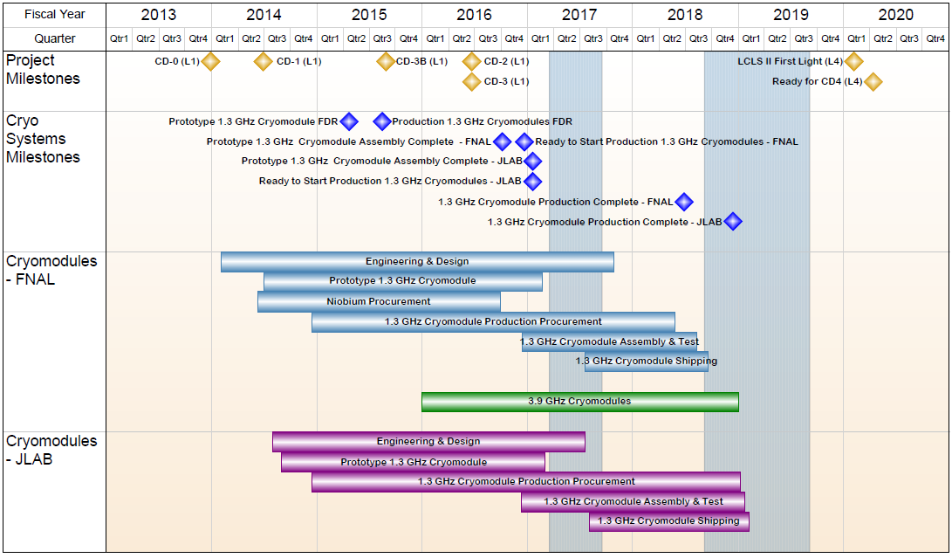
1.04.05 - FNAL Cryomodules - Summary Schedule

Slide 7
FNAL CM Staff
Highly experienced staff who worked on prototype CM continue to work on 3.9 GHz and production CM’s

Slide 8
Risks & Risk Mitigations (High Impact) (1/2)
Title | IF/THEN | Mitigations | Schedule
pCM Assembly | If pCM designs don't integrate as planned, THEN production assembly will be delayed | Develop Lessons Learned, Use prototype work to refine processes and design to reduce impact to production assembly. Revise tooling, update procedures, and revise QA/QC processes. cold test will give lessons learned, design changes and process improvements. | Fermilab pCM begins cold testing 09.2016 JLab pCM cold testing 10.2016.
Damage during shipping | If shipping subjects CM has extreme shock Then delivery will be delayed. | Other labs (DESY XFEL) have realized 2/101 failure without mitigations in place. SNS similar Perform dry-runs under realistic conditions. Investigate and determine alternate scheme. Shipping test March 2017. labs will need to store Cryomodules until OK. | Preliminary shipping test for Q1FY17
CM rework | Production Cryomodule fails test Then require rework/retest | Supply Chain, Defective Parts Include pre-production Cryomodule in project plan at each partner laboratory. Production plan includes longer duration for the first three Cryomodules to finalize assembly and QC procedures. | pCM almost complete 9/2016.

Slide 9
Risks & Risk Mitigations (High Impact) – (2/2)
Title | IF/THEN | Mitigations | Schedule
JLAB Cryomodule test lab availability | If the CMTF is not available because of cryoplant refurbishment, then the project will experience delays in testing | Actively seeking other cryogenic facilities for backup testing, and evaluating testing cycles, assessing schedule impact. | CMTF cryoplant work is scheduled for early 2017. Integrated planning underway
Cryo. Heat Load | If cavities do not expel magnetic flux and residual magnetic field is high, then cryo. heat load will be high → cryogenic margin reduced 2x | Improvements to flux expulsion-based on single-cell testing. Include higher bake temperature, tuning and stress analysis. Assure low residual magnetic field | Single cell cavity tests May-Nov 2016 9 cell tests begin August through Nov 2016. Production process improvement steps in Q1FY17

Slide 10
Some Challenges
pCM test has uncovered some issues (Genfa)
New cryogenic system, new test stand, new cryomodule
Multipacting – was fairly easy to process
Microphonics – under intense scrutiny now
Some design/compo modifications are made to CM2 and CM3+ (Tug)
Initial plan was for all production CM’s to be identical
Receipt of some procurements is delayed for various reasons
Magnets, 55K lower thermal shield, etc.
Many others are really good, e.g., MLI, instrumentation
So far, we have managed to expedite enough to keep CM2 going
Couplers are coming too fast! We have to store them.
We have not yet realized production throughput rates
Magnet testing
Cavity qualification (test rate is good)
Cryomodule testing
Coupler qualification
Some components still requires substantial SME intervention during installation (coupler thermal straps, magnet, tuners, etc.)
Alignment group is very busy and has to be scheduled carefully
Ramp-up rate for CM2,3,4 is built-in to plan

Slide 11
FNAL Cryomodule Summary
Design reviews are complete
Safety, QA/QC have been well developed within the existing partner lab and SLAC/LCLS-II framework
Staff in place and working, with clear roles and responsibilities
Procurements well advanced; most awards are placed
Risk mitigations are considered continually
Based on Sep. PRR, we added a set of lollipops for schedule risk mitigation of the WS1+WS2 bottleneck
Prototype CM test well underway, informs production
Thanks in advance for your help with this review

