Slide 1
Microphonics study at FNAL (pCM)
T.Arkan, B. Chase, J.Einstein-Curtis, B.Hansen, J.Holzbauer, E. Harms, J.Kaluzny, A. Klebaner, M. Mcgee, Yu. Pischalnikov, W. Schappert, R.Stanek, J. Theilacker, R.Wang.
January 11, 2017

Slide 2
Outline
Introduction
System description (Jay Theilacker)
Measurement results
Planned tests
Planned mitigations

Slide 3
Introduction
Level of microphonics that measured during first cool-down cycle was in 10-20 time large than LCLS II specs (10Hz peak)
FNAL management put together strong multidisciplinary team (LLRF, mech. engineers, cryo-engineers, resonance control experts, etc.) to address problems with microphonics with FNAL pCM.
External source studies were conducted through period of cryoplant shutdown, upgrade and cryoplant turning back on
Microphonics studies on pCM are in progress
Our short list of warm tests on CM2 to help (maybe) reduce the microphonics

Slide 4
System Description

Slide 5
Fermilab CMTF
The CMTF Cryogenic system has two methods to achieve 2K operation in the cryomodule test stand
  Cryoplant Cold Compressors and Warm Vacuum Compressor
  (2K Refrigeration Mode, 500W capacity)
  Advantages: JT heat exchanger in plant
  Disadvantages: Min. CC flow, Less forgiving, Learning curve
  Cryoplant in Liquefier Mode with Kinney Vacuum Pump
  (Liquefaction Mode)
  Advantages: More forgiving/flexible, Better turndown
  Disadvantages: No JT HX

Slide 6
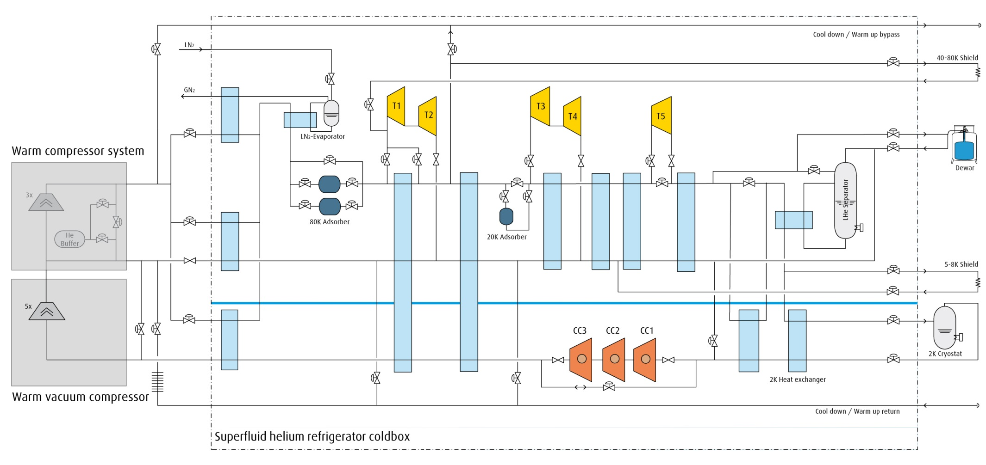
Fermilab CMTF Operating Modes
2K
Load
Kinney Pump

Slide 7
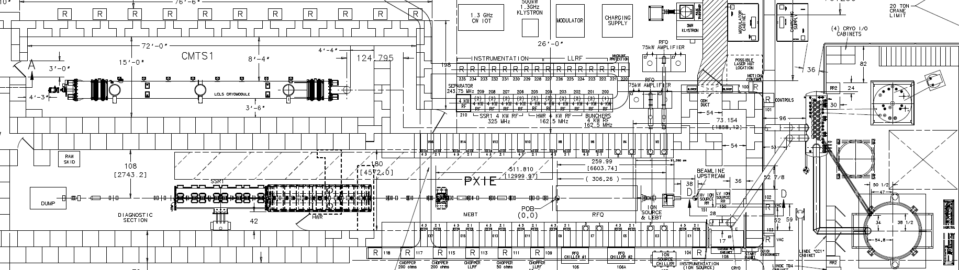
CMTF Layout
Cryo Transferline
CMTS
VB
DB
SCP
Kinney Header

Slide 8
pCM Cryogenic Operating History
  2K Plant
    Long recovery from CC trips (learning curve)
    Anxious for data for CM PRR
  4.5K Plant and Kinney Vacuum Pumping
    Could only achieve 2.1K due to pressure drop and high flows resulting from the lack of a JT HX
    Single cavity tests were performed in this mode
  2K Plant
    Single cavity tests at 1.93K
  Shutdown
    Addressed Kinney header ΔP, added LN₂ shield cooling to DB, changed CC drives, changed one control valve, added thermal intercept to CM JT valve, added flow meter to Kinney discharge
  4.5K Plant and Kinney Vacuum Pumping
    Current mode at 2K

Slide 9
Operational Experiences
  Apparent thermoacoustic oscillation (TAO) in CM JT valve
    Added thermal intercept, investigating valve stem wiper
  High flow rates due to high JT valve inlet temperature (no JT HX and TAO)
    Addressing TAO, investigating JT HX possibilities
  Liquid level stability in CM was challenging
    Four contributors:
      Incline
        Design requirement
      high total flow rate
        See previous
      JT flow injection into two-phase pipe disrupting liquid surface
        Adding baffle, increasing JT line size
      apparent flow regime throughout two-phase pipe not as expected
        Researching

Slide 10
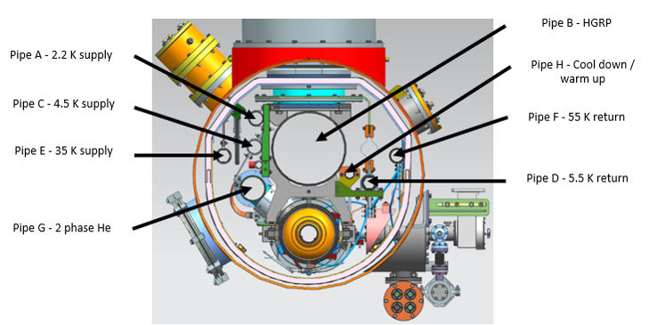
Cryomodule Pipings
Courtesy of T. Arkan

Slide 11
Measurements and Preliminary Results

Slide 12
External sources investigation did not find significant contribution sources.
Starting from December, 2016 concentration of the efforts shifted from analysis of just vibration measurements from geophones mounted on the different components of CM (with goals to find external source(s) of vibration penetrated inside CM) to studies the correlation between cavity microphonics & cryo-system operational parameters.

Slide 13
Microphonics tests completed with pCM (during December/ January, 2016/17)
Measurements of the cavities transfer functions (Piezo-to-RF). Objective was to confirm that cavity/tuner system has no low frequency (below 100Hz) resonances. Cavity/tuner TF did not change from HTS studies.
One shift (8 hours) test at T=2K (recorded microphonics on one cavity at a time)/ during 2 hour test JT valve was fully closed for 5 min...
1⁄2 shift ( 4 hours) test at T=2K (recorded microphonics on all 8 cavities simultaneously)
One shift (8 hours) test at T=4K (when cryo-system recovering after Kinney pump trip) – Microphonics at 4K was so large/ data has no value. At the same shift done some efforts to mitigate large (near cavity #1) bellow vibration (analyzing data from geophones)
One shift (8 hours) test at 2K. Stable operation with JT control by AD cryo-control system (2 hours)/fixed position of JT valve/ closed flow to 5K shield / supply He through CD valve...
One shift (8 hours) test at 2K... Regulate Liquid Level into 2-phase pipe through 300mm pipe (Valve PV8AB the AB turn around)

Slide 14
FNAL pCM Vibration Levels

Slide 15
FNAL pCM Vibration Levels

Slide 16
FNAL pCM Vibration Levels

Slide 17
FNAL pCM Vibration Levels

Slide 18
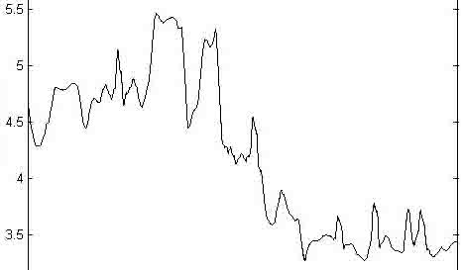
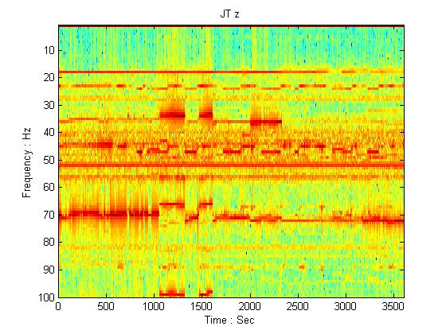
Vibration Measurement by Geophone
2-Phase Liquid Level Study
Wed 28 Dec 2016 12:00 to 13:00
JT Observations:
Change in Mass Flow (C:8FTA2) correlation to change in longitudinal (z) JT mid 30 Hz & ~70 Hz response
Mass Flow
Mass Flow
Geophone Spectrogram
M. McGee, et al.

Slide 19
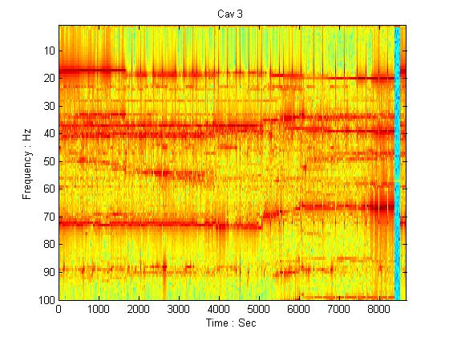
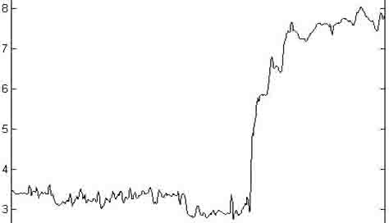
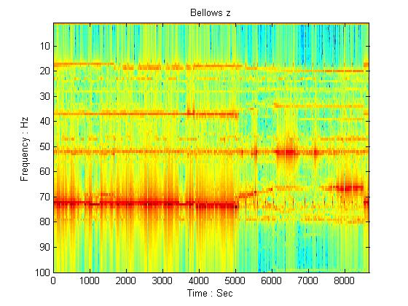
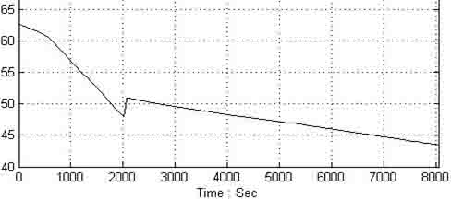
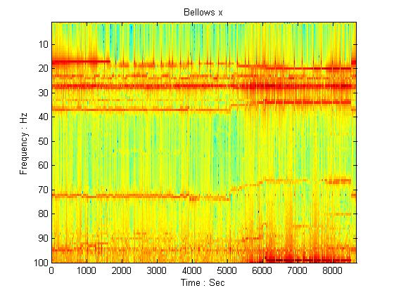
Vibration Measurement by Geophone
2-Phase Liquid Level Study
Wed 28 Dec 2016 13:00 to 15:15
Cavity Observations:
Longitudinal Response of Cavity 3, 19 Hz signal diminishes with operation of CLL301 beneath 62% Full
Cavity operation directly affected by mass flow with very little transmission to large feed bellows
Bellows
Mass Flow
Longitudinal
Mass Flow
Bellows
CLL301 – Liquid Level
Transverse
M. McGee, et al.

Slide 20
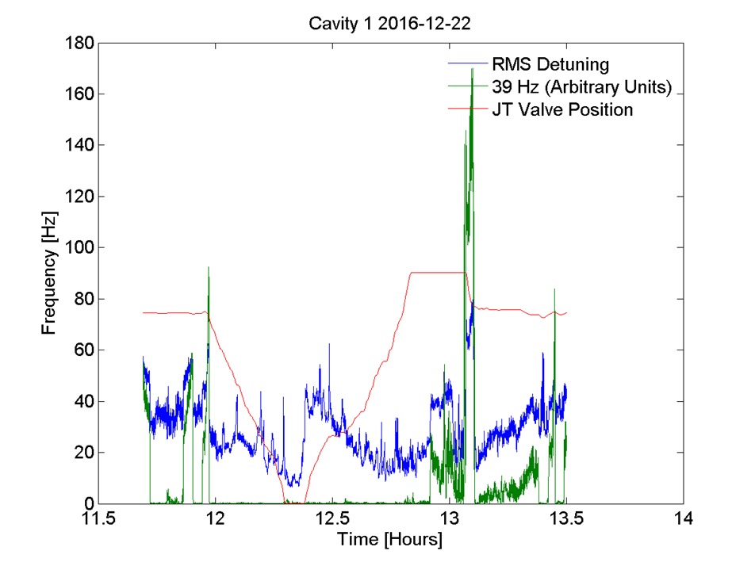
2K JT fully closed
Courtsey of Y. Pischanikov

Slide 21
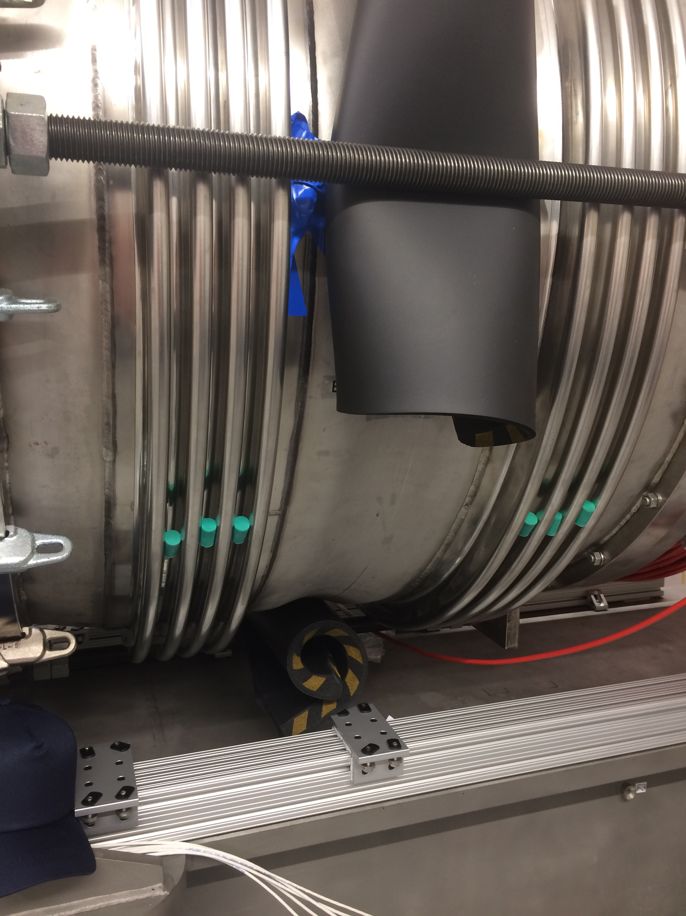
Upstream Cryomodule Bellows Modification
Rubber
Cork
Rubber
J. Holzbauer, etc

Slide 22
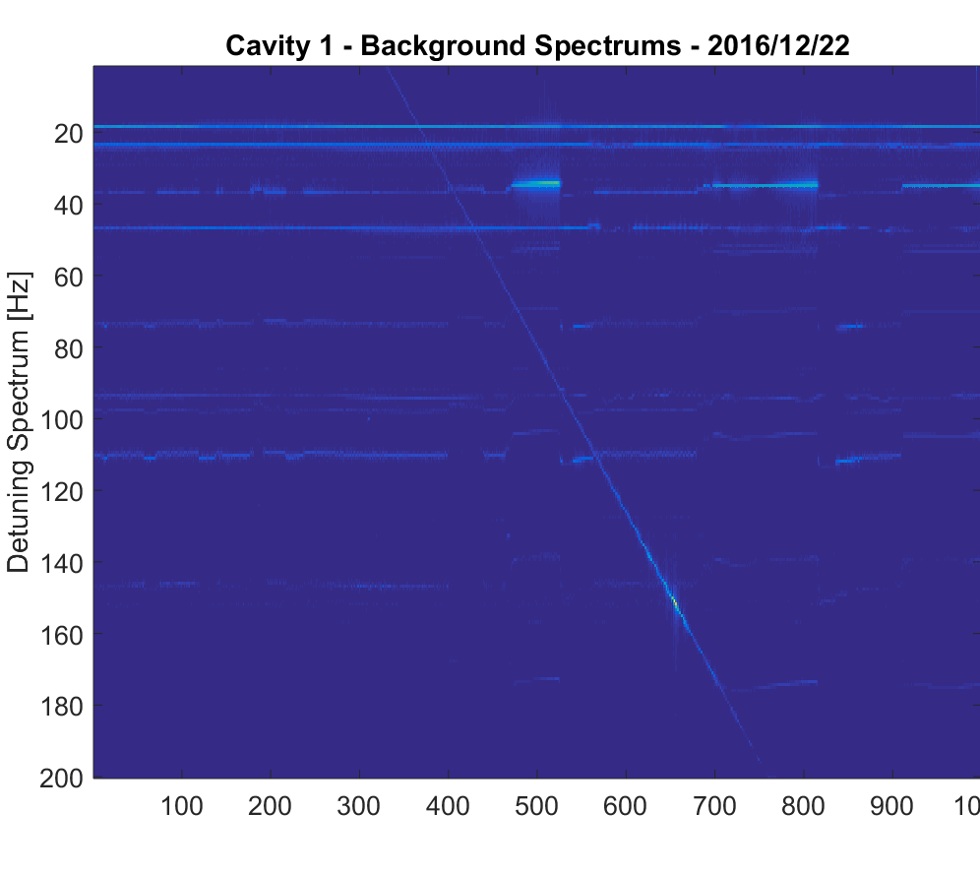
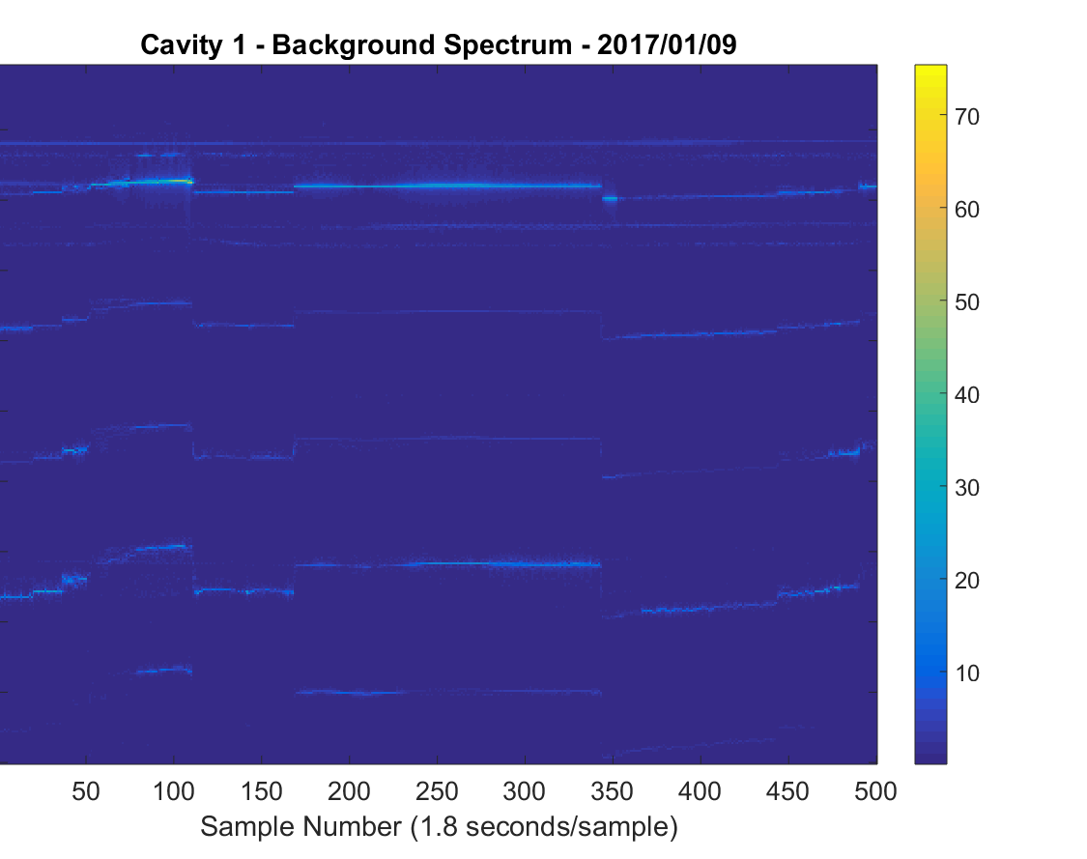
Upstream Cryomodule Bellows Modification
19 MHz line eliminated
Spectrum while bellows unconstrained
Spectrum while bellows constrained with rubber padding on collar and in convolutions.

Slide 23
Intermediary Summary
Contribution from cryo-flow is dominant.
Cryogenic mass flow induced vibration happens inside the cryomodule. JLAB pCM results may give us some indication of the differentiation of cryo system effects vs. cryomodule effects
External (outside CM) sources of vibration are less of concern compared to cryogenic vibration sources, but cannot be fully excluded yet. Once cryogenic vibration source is mitigated, external sources may become significant ( below LCLS II spec (10Hz)... )

Slide 24
Path forward

Slide 25
Planned pCM Microphonics Studies (1)
Cavities transfer functions (Piezo-to-RF). No low frequency (below 100Hz) resonances. Cavity/tuner TF did not change from HTS studies.
2K with JT valve fully closed for 5 min. Data shown
4K Microphonics was so large/ data has no value.
Mitigate large (near cavity #1) bellow vibration (analyzing data from geophones). 19 Hz line removed.
2K (recorded microphonics on all 8 cavities simultaneously). Analysis in progress
2K. Stable operation with JT control. Analysis in progress
2K. Fixed position of JT valve. Analysis in progress
2K. Close the flow to 5K shield. To be tested.
2K. Supply He through CD valve. To be tested
2K. Regulate Liquid Level into 2-phase pipe through 300mm pipe (Valve PV8AB the AB turn around). Analysis in progress
CM02. Warm. Vibration measurement using Piezos. To be tested

Slide 26
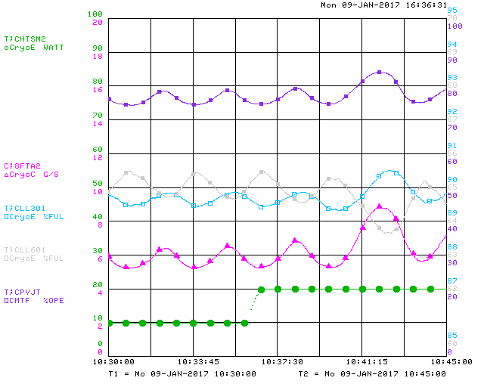
Planned Cryogenic Studies
2K. Stable operation with cold compressor. To be tested
  Lower temperature of 2-phase supply line
  2-phase supply line vibration
JT valve thermo-acoustic-oscillation. Mitigation to be implemented
Liquid level oscillation

Slide 27
Proposed plan for passive microphonics mitigation at CM2 (FNAL)
Support the capillary line from upstream end liquid level probe to cavity#1 & #8
Measure with Tuner (piezo-as a sensor) vibration of the 2-phase pipe invar rods clamps. If we will find it important to G-10 supports around the 2-phase for these long invar rods.
Evaluate (measure) transfer function of the cavity #1 (Cavity 1 attached rigidly to heavy gate valve)
Repeat warm/ impulse response of the cavities on the string (using piezo-as-a-sensors) ... review results
Larger diameter JT fill line
1-2 weeks to allow microphonics studies and vibration mitigations

Slide 28
Summary
More tests are planned.
Mitigations on cryomodule mechanical improvement are considered.
Current focus is on
  Vibrations of 2-phase supply line (Jay Theilacker)
  Helium gas supply temperature at JT valve input (Jay Theilacker)
  TAO in JT valve (ice on the top & correlation of JT valve vibration with cavity detuning)
  Gate valve rigidly attached to Cavity 1
  End cap bellows vibrations
Suppressing microphonics to required levels will need a concerted effort on the part of EVERY group involved in the design and operation of the machine
  Too early to draw any firm conclusions
  Important that FNAL put together strong team with expertise in all aspects (cryo; mech; control; tuners; analysis)
  We collected significant amount of the data/ have detail program for studies/ analyzing data & modifying test plan as we go..
Based on results from microphonics level at FNAL’s pCM assumption that resonance control of SRF cavities in LCLS II linac can be done without active piezo-control looks quite questionable.

