Slide 1
pCM Extended Tests
CM PRR January 10-11, 2017
Genfa Wu, Elvin Harms

Slide 2
Outline
Introduction
Minimum Acceptance Tests Updated
  Cavity multipacting processing
  Unit Testing
  Heatload measurement
Extended Tests in Progress
  Microphonics Studies
  Coupler Studies
  Linac LLRF validation
  Fast cool down strategy
  Active coil studies and external magnetic field
  HOM spectrums

Slide 3
Introduction
pCM at Fermilab was installed in July 2016.
Warm conditioning was conducted on all couplers in August 2016.
pCM cooled down in September 2016
pCM started cavity testing at 1.9K briefly under cold compressor mode
pCM cavity testing was completed at 2.1 K under warm pumping mode (Kinney pump) in October 2016
Cryoplant was shutdown for an upgrade.
pCM cooled down to 2K in December.

Slide 4
Minimum Acceptance Criteria
Beamline vacuum ~5E-10, unbaked spools
✔
✔
Cavity #5 is only one not meeting spec
✔
✔
✔
✔
✔
✔
✔
✔
pCM + FeedCap + EndCap ~13 W Static 2K
60.2 W 2K dynamic of 128 MV
✔

Slide 5
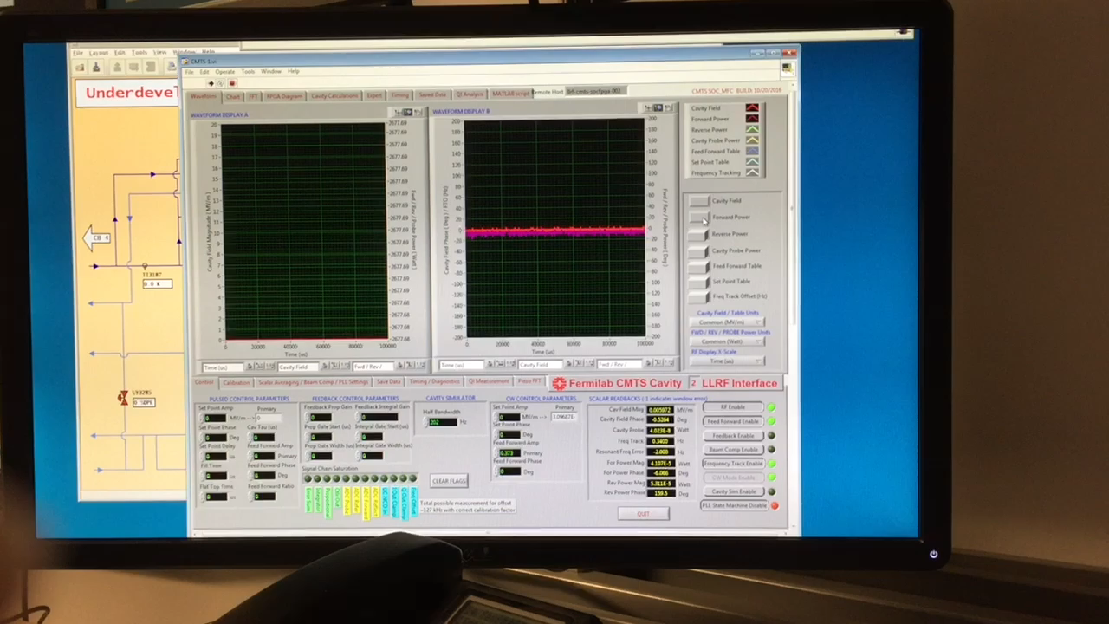
Multipacting Processing
Short RF pulsing to avoid the cryogenic instability
  1-10 Hz
  20-50 mS (Qext ~ 1e7 - 4e7)
  2-3 kW

Slide 6
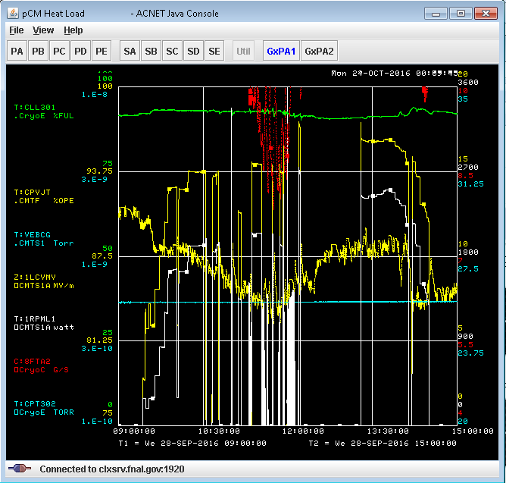
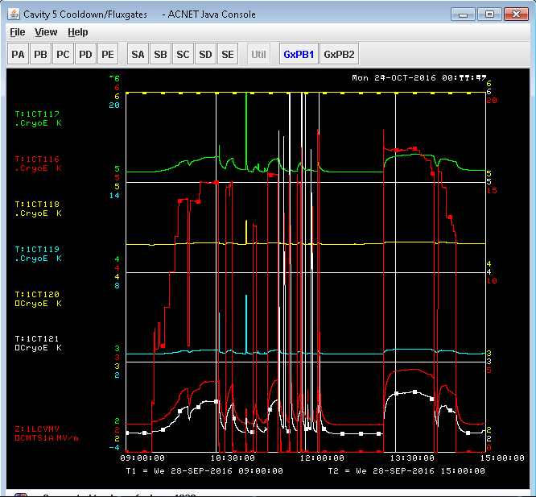
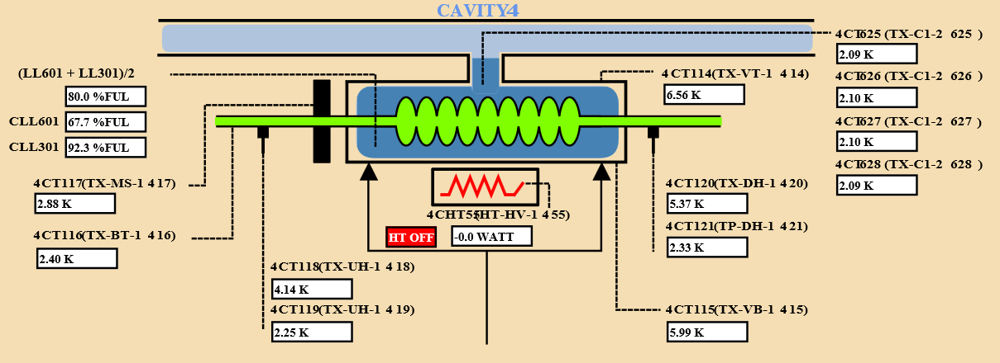
Multipacting Processing – CAV1
CAV1 was previously limited at 17.2 MV/m due to multipacting.
RF pulsed processing improved the gradient to 19.6 MV/m in pulsed mode.

Slide 7
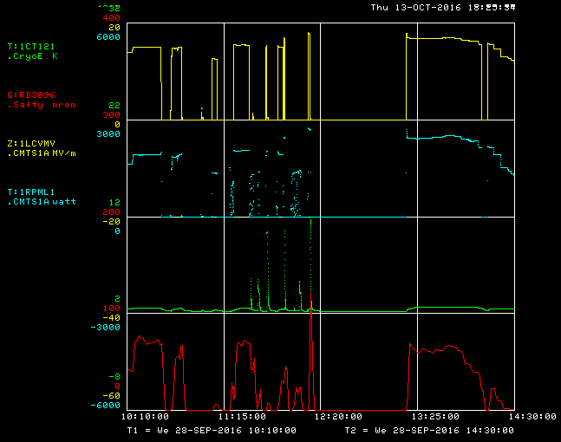
MP in HOM of cavity#1 (zoom)
Before processing
processing
After
processing
MP starts at ~12MV/m
HOM can T quickly goes up above threshold gradient
Processed in short pulses (seconds) until T< 20K
After processing no MP up to max gradient
Radiation reduced after processing,
Exist w/o MP
Gradient
RF power
HOM can Temp.
Radiation
Slide made by N. Solyak

Slide 8
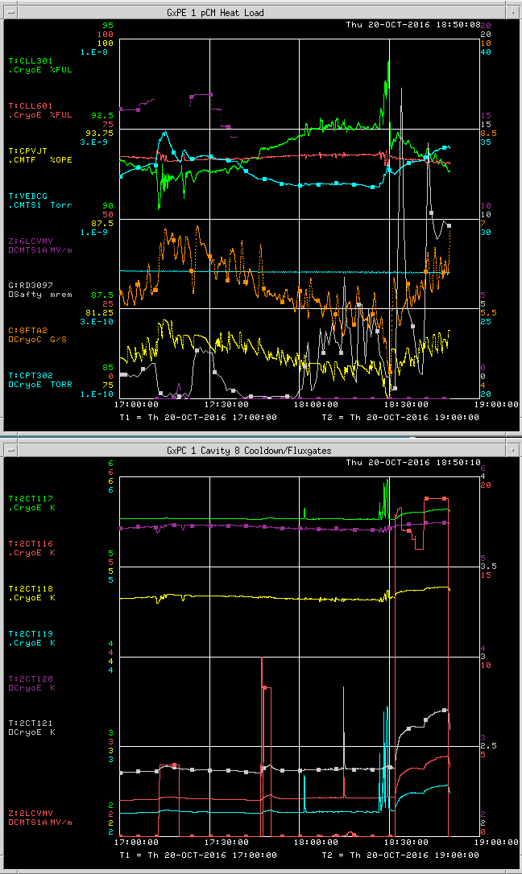
Multipacting Processing – CAV2
CAV2 was previously limited at 16.8 MV/m due to multipacting. Previously FE onset was 15.6 MV/m.
RF pulsed processing improved the gradient to 19 MV/m in pulsed mode. FE onset was the same. After 19 MV/m, quench was persistent. Similar to VTS result.
CAV2 ran 18.8 MV/m stably.

Slide 9
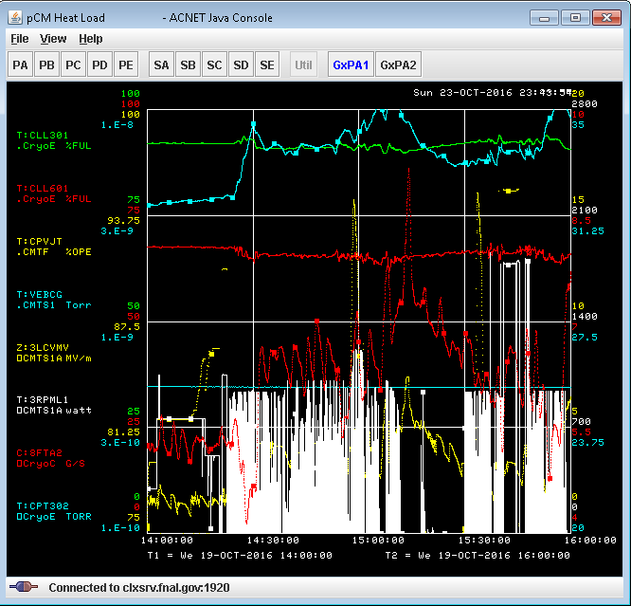
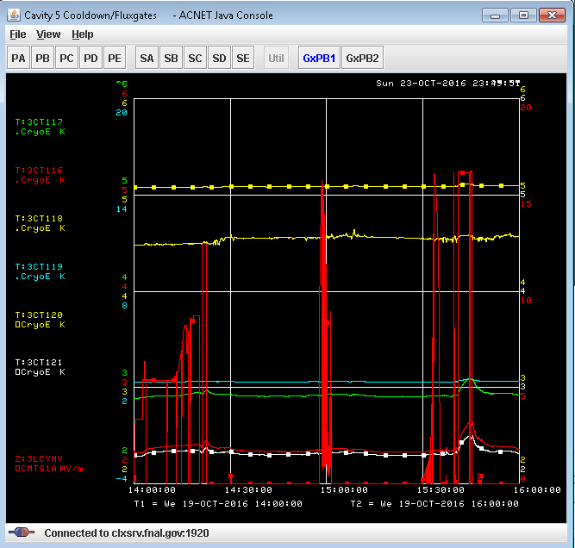
Multipacting Processing – CAV3
Processing has little effect (~2 hours). Cavity gradient was stable around 17 MV/m. (Exceeds specification)
Processing was limited due to pressure cannot keep up at 2.1K. Processing created pressure instability (>36 torr)
Additional processing at 2.0K may be achievable.

Slide 10
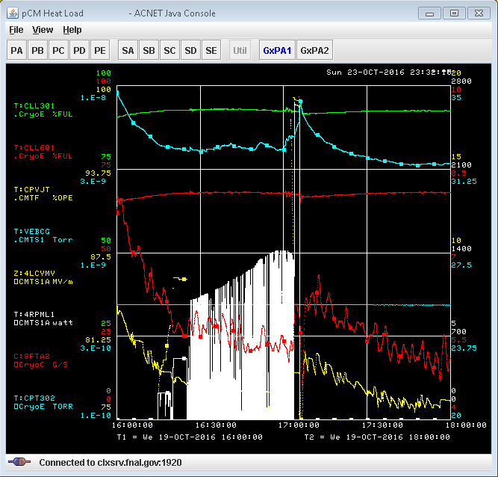
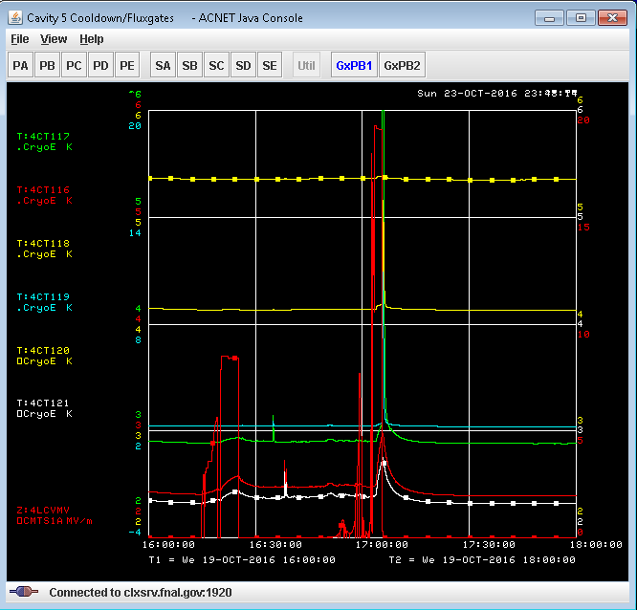
Multipacting Processing – CAV4
CAV4 Qext was adjusted to 4.18e7
40ms 2Hz processing was successful.
CAV4 maximum gradient was >20 MV/m
Parked at Eacc_ACNET = 19.2 MV/m. for 2 min. Pressure increased until cavity quenched. Very small FE at this gradient CW.
Processing was around 30 min. There was radiation during processing.

Slide 11
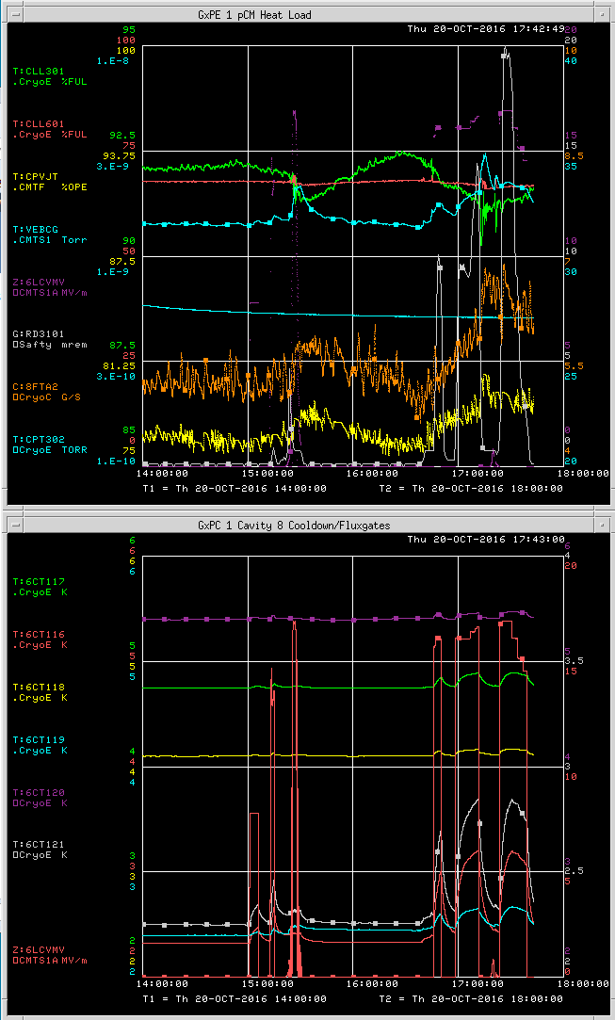
Multipacting Processing – CAV6
CAV6 was previously limited at 16.3 MV/m due to multipacting. Previously FE onset was 14.5 MV/m.
RF pulsed processing improved the gradient to >17 MV/m in pulsed mode. FE onset was the same. Continued pulse processing brought helium pressure too high.
CAV6 ran 16.9 MV/m stable.
More processing after cryogenic shutdown may benefit.

Slide 12
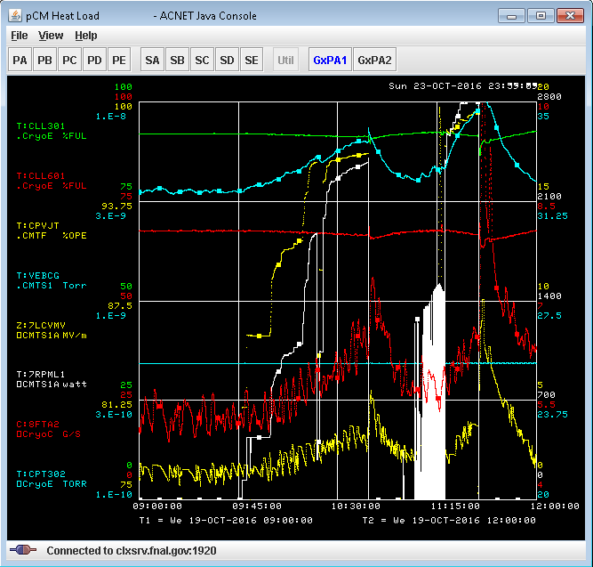
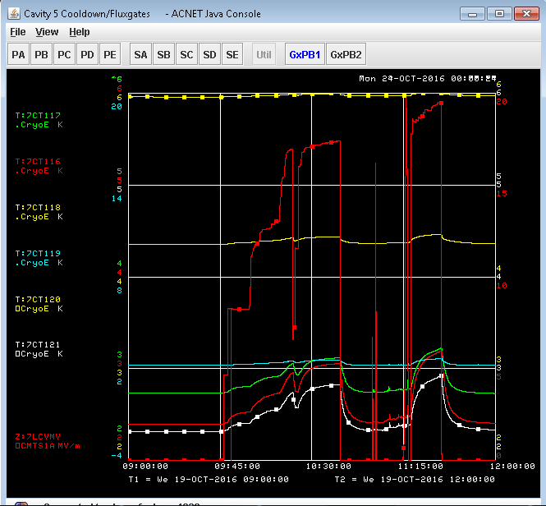
Multipacting Processing – CAV7
Cavity initially quenched at 17.4 MV/m, the same gradient as before 100K warm cycle.
Pulsing was set at 40 ms 2Hz (thanks to Mike), after pulsed processing, cavity went to 20 MV/m without pulsed quench.
Changing to CW, cavity was parked at 19.4 MV/m. FE was still below 50 mR/h. As the helium pressure started to increase, eventually cavity quenched after 2 min at 19.4 MV/m. I consider this limit is due to pressure increased to around lambda point.

Slide 13
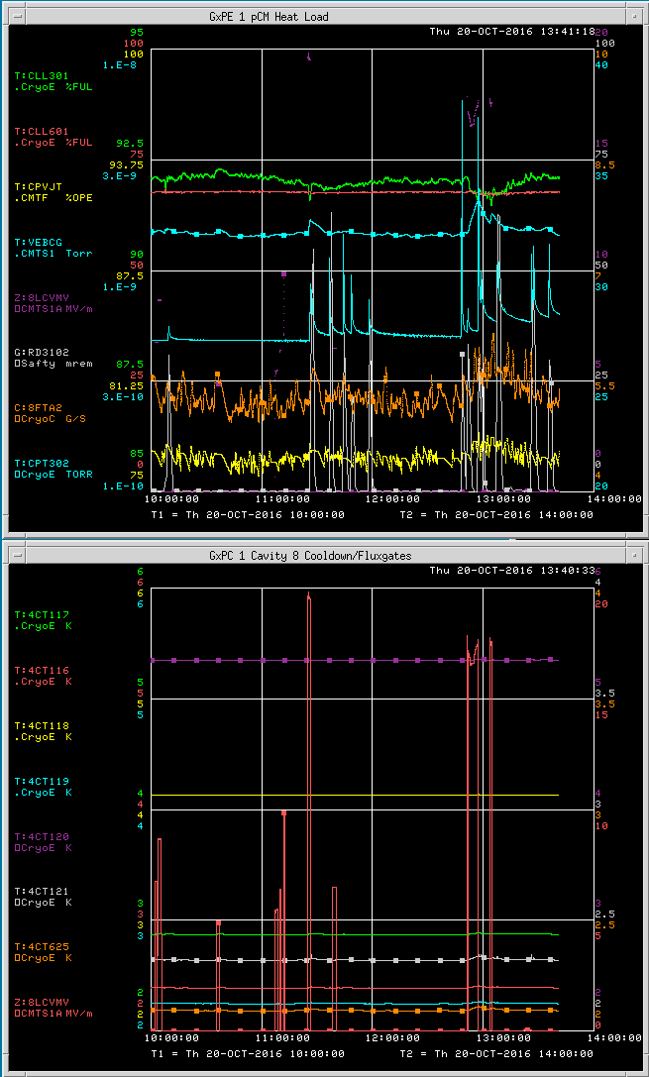
Multipacting Processing – CAV8
CAV8 was previously limited at 16.8 MV/m due to multipacting. Previously FE onset was 13.8 MV/m.
coupler Qext to 5e7.
RF pulsed processing improved the gradient to >20 MV/m in pulsed mode. No radiation was detected.
After parking at 19.3 MV/m for one or two minutes, cavity beam line vacuum experienced a vacuum spike which SSA8 also tripped. Radiation was moderate. Cryo was stable. Cavity temperatures/coupler temperatures were all normal.
During the subsequent pulsed mode or CW mode, CAV8 experienced vacuum/radiation spikes at an arbitrary gradient between 17.5 MV/m and 18.5 MV/m. See attached screen capture.
CAV8 was speculated to have multipacting that drove the residual gases around. It is to be verified after 300K warm up and the cryogenic shutdown.

Slide 14
Multipacting Determination
Consistent gradient limit (almost all cavities)
No or very low radiation (except CAV5 FE)
Quench field can be conditioned
No electron signals in FP
Two cavities experienced HOM can heating
  One processed away (CAV1)
  One still present (CAV5 with high FE)
VTS experience was similar

Slide 15
Possible Causes of Multipacting
Non baked beam line components that release H2
Long period (5-6 month) of cavity filled with N2
Coupler outgassing after exposed to air briefly
Active pumping is supplied by an ion-pump (Not a significant source)
  Turbo pump was valved out before cool down
1-cell cavity study is in progress

Slide 16
Multipacting Mitigation
RF pulse conditioning
  Successful in FNAL/pCM
Warm up and pump longer time
  No coupler conditioning

Slide 17
Cavity Limitations
Summary as of 2016-10-31 |  |  | at 2.1K
Cavity | Name | Eacc @<50mR/h [MV/m] | Max Gradient [MV/m] | Gradient limitation | FE onset [MV/m] | NOTE
1 | TB9AES021 | 18.2 | 21.2 | quench (cryo, admin limit) | 14.6 | Multipacting improved, <15min
2 | TB9AES019 | 18.8 | 19.0 | quench | 15.6 | Multipacting improved, <15min
3 | TB9AES026 | 17.2 | 17.3 | Quench (Multipacting, cryo, no x-ray) | 17.3 | No improvement, ~2h, limited by cryogenics
4 | TB9AES024 | 20.5 | 21.0 | Quench (Multipacting, admin limit) | 21.0 | Multipacting improved, <30 min
5 | TB9AES028 | 14.2 | 14.9 | Field Emission | 13.9
6 | TB9AES016 | 16.9 | 17.1 | Quench (Multipacting, cryo) | 14.5 | Multipacting improved, <15 min
7 | TB9AES022 | 19.4 | 20.0 | Quench (Multipacting, admin limit) | 12.7 | Multipacting improved, <15 min
8 | TB9AES027 | 17.5 | 20.0 | Quench (Multipacting, cryo) | 20.0 | Multipacting improved, <10 min, limited by vacuum interlock
TOTAL VOLTAGE |  | 148.1 | 156.2 | Average Eacc @FE onset = | 16.2
CAV3, CAV6 and CAV8 all exceeds specification. Additional RF processing at 2.0K may further improve cavity gradients.

Slide 18
Multipacting Processing Improved the Gradients at 2.1K
 | pCM (DOE Review) |  |  | pCM after RF Conditioning*
Cavity | Max Gradient [MV/m] | Usable Gradient* [MV/m] | FE onset [MV/m] | Max Gradient [MV/m] | Usable Gradient* [MV/m] | FE onset [MV/m] | Q0 @16MV/m 2K** extrapolated
TB9AES021 | 19.6 | 18.2 | 14.6 | 19.6 | 18.2 | 14.6 | 2.6E+10
TB9AES019 | 17.0 | 16.8 | 15.6 | 19.0 | 18.8 | 15.6 | 2.6E+10
TB9AES026 | 17.3 | 17.2 | No FE | 17.3 | 17.2 | No FE | 2.7E+10
TB9AES024 | 16.5 | 16.0 | No FE | 21.0 | 20.5 | No FE | 2.5E+10
TB9AES028 | 14.9 | 13.8 | 11.5 | 14.9 | 14.2 | 13.9 | 2.4E+10
TB9AES016 | 16.7 | 16.7 | 14.5 | 17.1 | 16.9 | 14.5 | 2.9E+10
TB9AES022 | 17.4 | 17.1 | 12.7 | 20.0 | 19.4 | 12.7 | 3.2E+10
TB9AES027 | 16.8 | 16.6 | 13.8 | 20.0 | 17.5 | No FE | 2.5E+10
Average | 17.0 | 16.6 | 14.7 | 18.6 | 17.7 | 16.2 | 2.7E+10
Total Voltage | 141.4 MV | 137.5 MV |  | 154.6 MV | 148.1 MV
*Usable Gradient: demonstrated to stably run CW, FE < 50 mR/h, no dark current
**Fast cooldown from 45K, >40 g/sec, extrapolated from 2.11K
***Also limited by administrative limit ~20MV/m

Slide 19
Cavity Performance at 2K (in progress)
Summary as of 2017-01-07
 | pCM after RF Conditioning***
Cavity | Max Gradient [MV/m] | Usable Gradient* [MV/m] | FE onset [MV/m] | Q0 @16MV/m 2K** extrapolated | Q0 @16MV/m 2K
TB9AES021 | 21.2 | 18.2 | 14.6 | 2.6E+10 | 2.7E+10
TB9AES019 | 19.0 | 18.8 | 15.6 | 2.6E+10 | 3.1E+10
TB9AES026 | 17.3 | 17.2 | 17.3 | 2.7E+10
TB9AES024 | 21.0 | 20.5 | 21.0 | 2.5E+10
TB9AES028 | 14.9 | 14.2 | 13.9 | 2.4E+10
TB9AES016 | 17.1 | 16.9 | 14.5 | 2.9E+10
TB9AES022 | 20.0 | 19.4 | 12.7 | 3.2E+10 | 3.3E+10
TB9AES027 | 20.0 | 17.5 | 20.0 | 2.5E+10
Average | 18.8 | 17.8 | 16.2 | 2.7E+10
Total Voltage | 154.6 MV | 148.1 MV
*Usable Gradient: demonstrated to stably run CW, FE < 50 mR/h, no dark current
**Fast cooldown from 45K, >40 g/sec, extrapolated from 2.11K
***Also limited by administrative limit ~20MV/m

Slide 20
Field Emission
Average Eacc@FE-onset >16 MV/m
Arrays of radiation detectors along the CM and both ends.
Notes:
15 radiation detectors. Maximum was used to plot.

Slide 21
Field Emission - Potential Causes
Coupler was used on CAV5 in HTS and cycled through HTS preparation.
Other couplers can have potential sources of particulates
Copper plated bellows are new compared to ILC cryomodule
pCM had to dis-assemble parts that was considered containing poor copper plating

Slide 22
Field Emission - Potential Mitigations
RF conditioning is limited by RF power
  High power can allow strong Qext and high peak field
  SSA power combiner may be an option
Helium processing is risky
High power pulsed processing
  Requires high power klystron
CAV5 FE processing is not planned as other cavities can make up the total voltage.

Slide 23
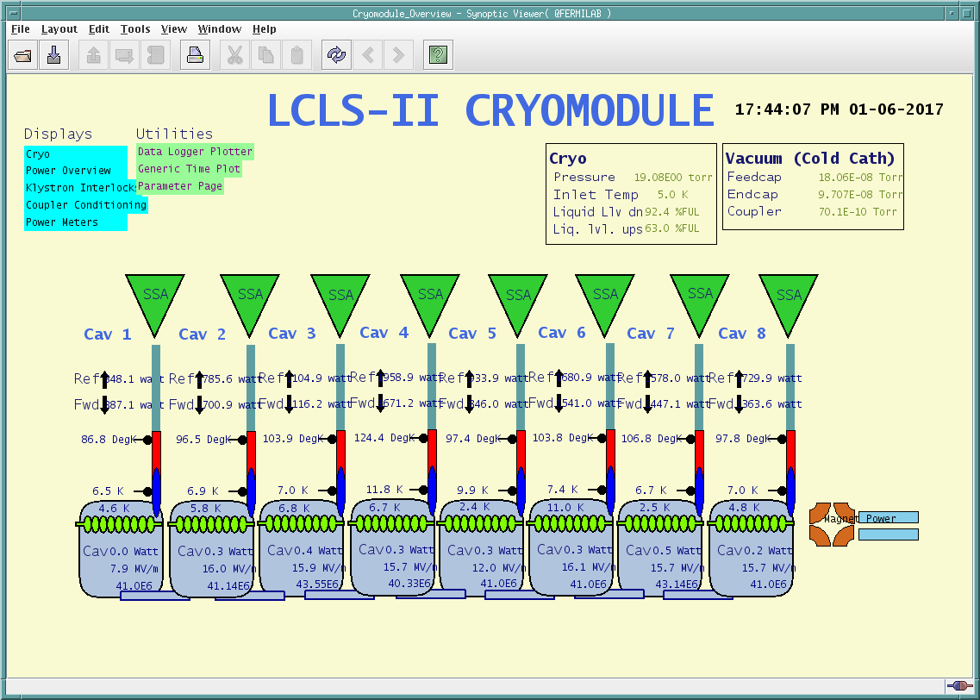
Cryomodule Unit Testing (in progress)
115 MV/m
120 MV
Combined radiation < 34 mR/h (not phase synchronized)
Notes:
Liquid level can be maintained.

Slide 24
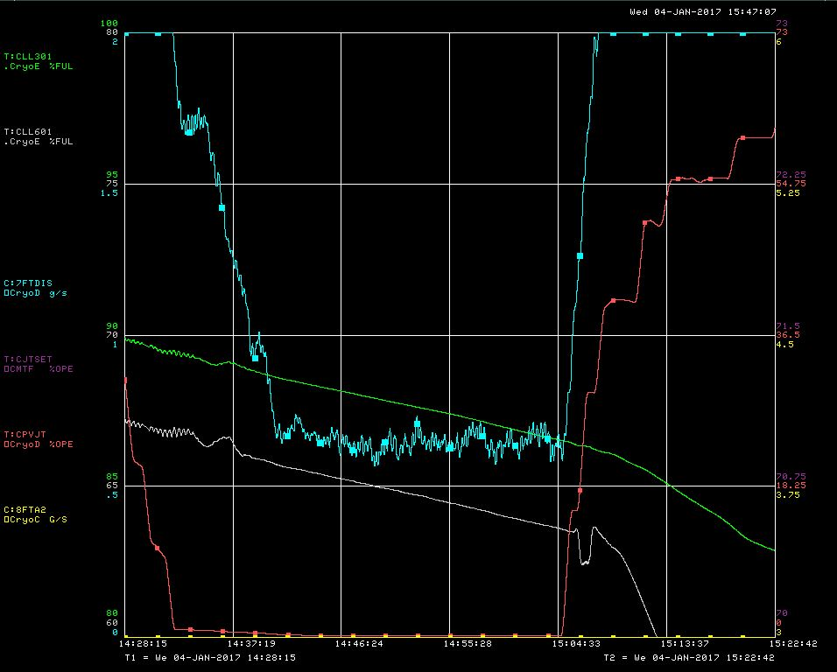
Heat Load Measurement - Static
Measured at 4K
Total ~ 13 W. pCM + FeedCap + EndCap
Courtesy of R. Wang

Slide 25
Heat Load Measurement – 2K Dynamic (Very Preliminary)
Measured at 2K
Total ~ 64 W@128 MV (extrapolated from 7 Cavity heatload)

Slide 26
Magnet Test
Twice cool down from room temperature to 4K
  Thermal straps survived thermal excursions
20A stable operation demonstrated.
  Negligible 2K dynamic heatload.
  No quench was experienced.
M. Tartaglia, V. Kashikhin, T. Strauss

Slide 27
Extended Tests
Priority | Test Name
1 | Microphonics Studies
2 | Fast Cool Down Strategy
3 | Coupler Studies
4 | SLAC LLRF ValidationActive
5 | HOM spectrum
6 | External Magnetic Field (can be part of item #7)
7 | Active Coil Compensation

Slide 28
Microphonics Status (Preliminary)
Cavity frequency detunings do not meet specifiation (10Hz)
External vibration source are investigated extensively.
  No apparent external sources were identified that can contribute to cavity microphonics
Cryogenic operation modes were systematically explored and microphonics study related to cryogenic is still in progress.
  Cryogenic mass flow has some close correlation to the microphonics.
  JT valve vibration also analyzed.
  JT actuator is replaced. Noise should improve.

Slide 29
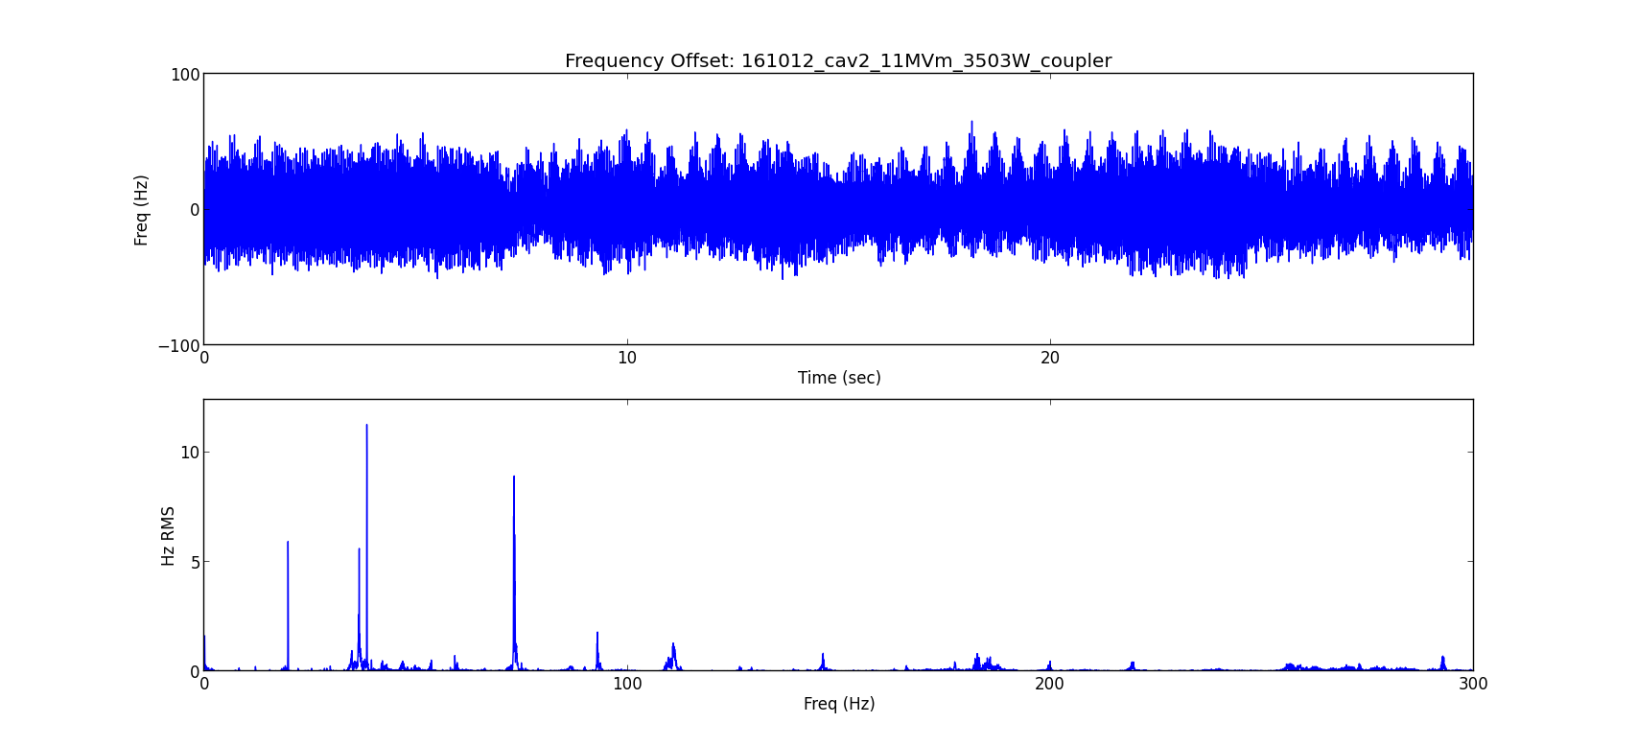
Microphonics
Work in progress to identify the source and isolate/dampen the vibrations
Frequency detuning
Spectrum analysis
Data captured by Joshua Einstein
Notes:
Significant pressure fluctuations , resulting 20 Hz large excursion

Slide 30
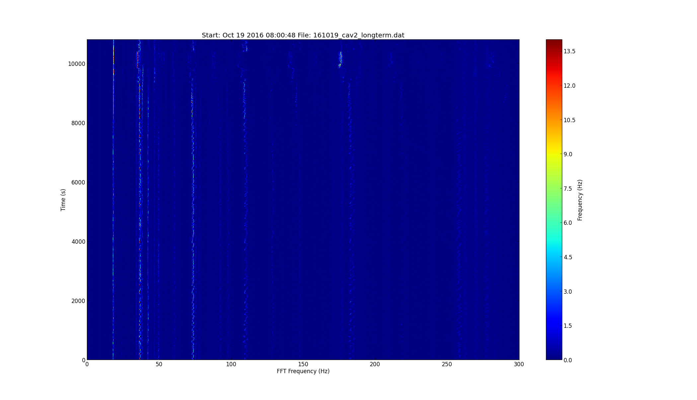
Microphonics
Work in progress to identify the source and isolate/dampen the vibrations
Time evolution of frequency spectrum
Data captured by Joshua Einstein
Notes:
Significant pressure fluctuations , resulting 20 Hz large excursion

Slide 31
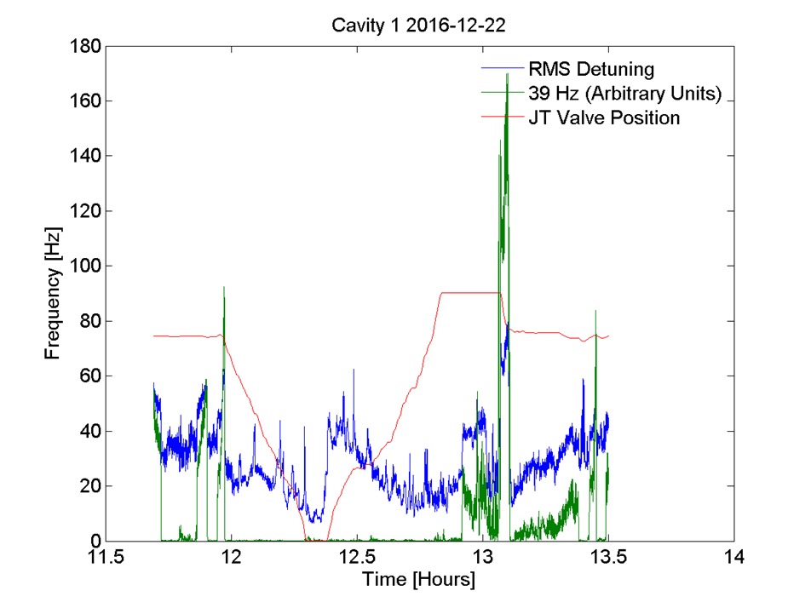
Extensive Studies are in Progress
Courtsey of Y. Pischanikov
Notes:
Flow related studies

Slide 32
Microphonics Mitigation
Several modifications were identified that can potentially improve vibration in production cryomodules.
  To be confirmed during on-going pCM microphonics studies.
  To be verified in CM02 and CM03.
Baffle in 2-phase pipe
Support the capillary line from upstream end liquid level probe to cavity#1
Add G-10 supports around the 2-phase for these long invar rods.
Consider a larger diameter JT fill line.
Consider JT valve modification to reduce acoustic oscillation

Slide 33
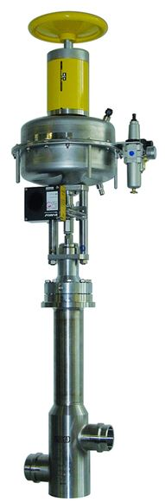
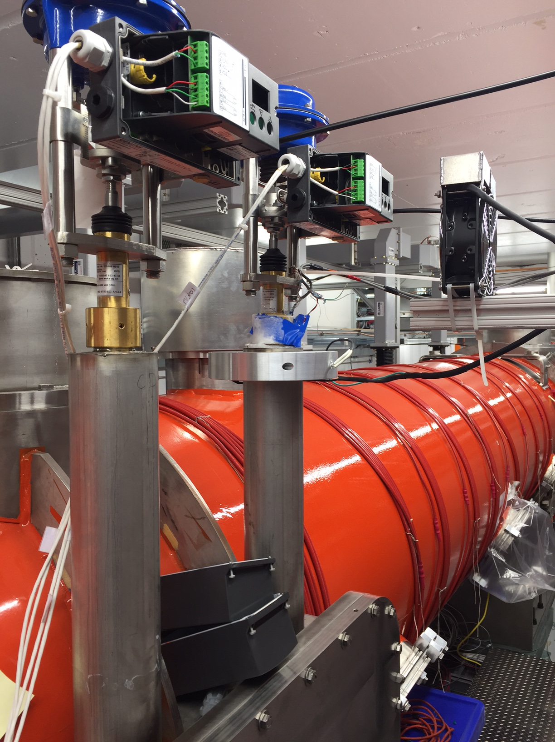
JT valve improvement
New quiet actuator installed
Installed thermal strap
Consulting with WEGA AG to eliminate the acoustic oscillation
Notes:
JLAB data showed 2-3g/s, no icing, 4-5 g/s icing

Slide 34
Fast Cool Down
Fast cool down in a cryomodule demonstrated
 | >40 g/s * | 32 g/s
Cavity | delta T(K) | delta T(K)
CAV1 | 3.8 | 3
CAV4 | 5.6 | 2
CAV5 | 8.3 | 5
CAV8 | 4.7 | 2.5
* Mass Flow out of range
CM PRR Jan. 10-11, 2017
Notes:
Flux expulsion is to be tested with external magnetic field

Slide 35
Cool Down Strategy (in progress)
To be developed
  Compare to slow cool down when remnant magnetic field is at minimal.
  Evaluate thermal current induced remnant field.
  Evaluate flux expulsion efficiency when ambient field is raised above specification.

Slide 36
Coupler Studies (Completed)
Couplers #1 thru #7 were processed at room temperature at power 2.5 – 4 kW
Coupler #8 was processed at cold with cavity OFF-resonance at 4kW
All couplers are tested at cold (2.1K) at power level 3.5kW and 3.2 kW (~12-20 hrs)
  QL =1.e7 (to keep cavity gradient < 15 MV/m)
  Max cavity gradient 12 MV/m
Max temperature at CF100 flange ~ 220K at 3.5 kW (coupler #4)
Couplers meet power and temperature specifications
Improvement was identified
Data by N. Solyak
Notes:
3.5kW does not settle below 200K. 3.2 kW stabilized. Worse than HTS. Production should improve

Slide 37
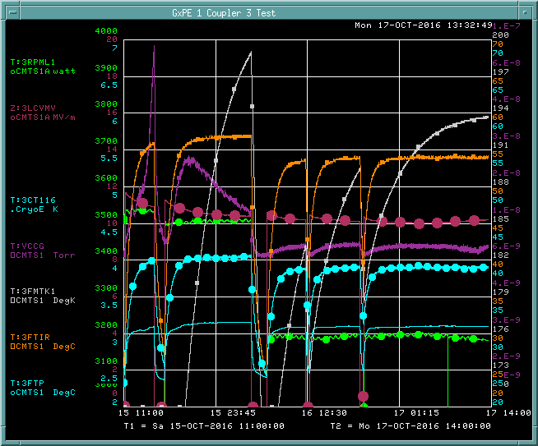
Coupler Studies (Completed)
Coupler 50K flange
Coupler 50K thermal straps can be improved
Data by N. Solyak
Notes:
3.5kW does not settle below 200K. 3.2 kW stabilized. Worse than HTS. Production should improve

Slide 38
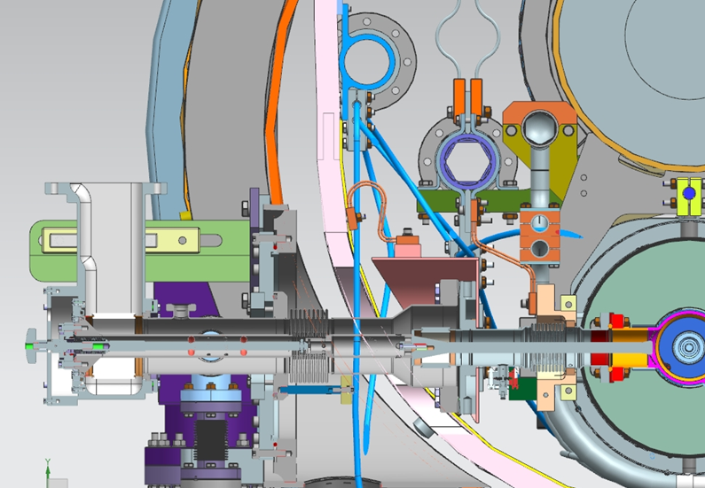
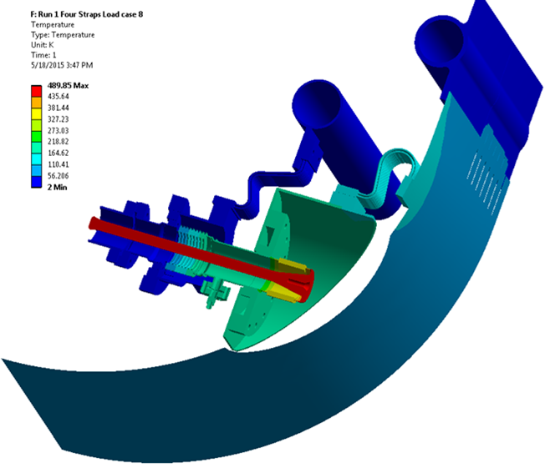
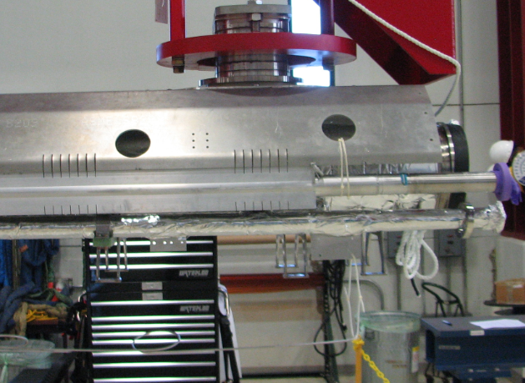
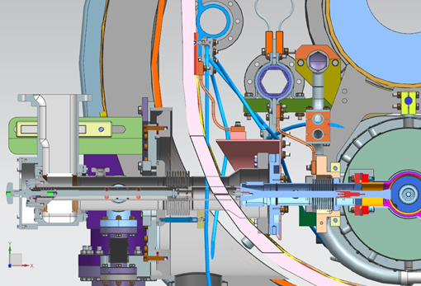
50K thermal intercept improvements in production CM
(vs. pCM)
XFEL design of CF100 flange to improve thermal contact between Aluminum can and flange
Thermal strap is connected to 50K pipe (closer)
Better thermal contact between braid and copper extension (flat surfaces)
JLAB pCM already has this feature
pCM
Production CM
50K
5K
Thermal analysis of pCM (NE-EO-2015-004) – Fischer/ANL

Slide 39
Extended Tests – HOM Studies
Measure each cavity’s HOM spectrum to assess the HOM coupler effectiveness
Measure HOM antenna heating when a 2GHz 5 W RF power is applied to simulate the beam induced HOM power.
No cool down cycle is proposed.
1 shift
Timergali Khabiboulline and Nikolay Solyak

Slide 40
Extended Tests – Linac LLRF (in Progress)
Install and test four production LCLS-II LLRF systems
Test runs in parallel to other test activities
Larry Doolittle, Curt Hovator and Brian Chase

Slide 41
Summary
Minimum tests completed and acceptance criteria were mostly met except microphonics.
  Cryomodule exceeds total voltage specification
  Cryomodule exceeds heatload specification
  Coupler exceeds power and temperature specification
  Radiation acceptable, no dark current measurement until microphonics is suppressed to below 10Hz.
Extended tests is in progress
  Mirophonics studies are in progress
  Mitigations to CM02 are in progress
Notes:
Through pcm testing, CM02 string assembly, single cavity test

Slide 42
Extra slides

Slide 43
Cavity Performance Measurement - Calibration
RF calibration
  Forward power at SSA output before the circulator
    Minimize the directional coupler signal deviation due to reflected power
    Calibration using calorimetric load
  Transmitted power and HOM power
    Network analyzer for warm and cold transmission lines
  Qext1
    Fast oscilloscope for decay time
    RF power decay
Heatload
  Massflow vs. known heater power

Slide 44
LLRF Power Measurement Linearity Measurement

Slide 45
Directional Coupler Forward Power
Data from John Reid and Co.

Slide 46
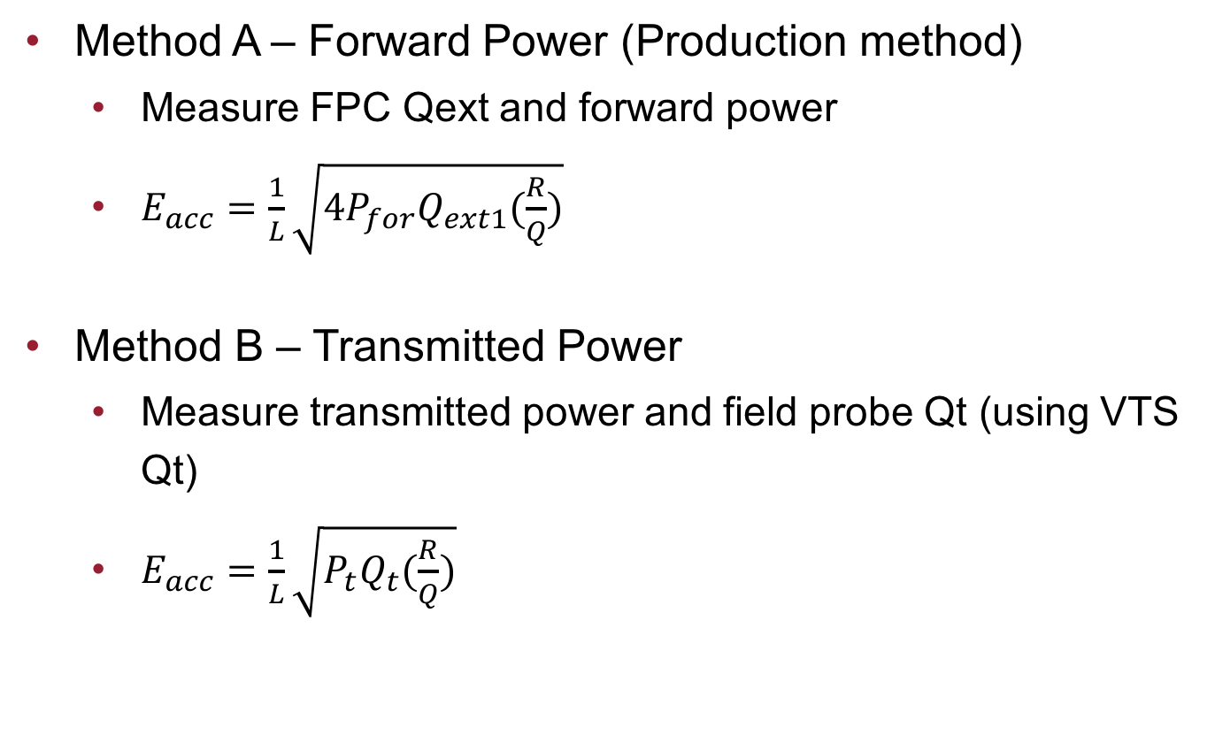
Cavity Performance Measurement - Gradient
Method A – Forward Power (Production method)
  Measure FPC Qext and forward power
  $E_{acc}=\frac{1}{L}\sqrt{4P_{for}Q_{ext1}(\frac{R}{Q})}$
Method B – Transmitted Power
  Measure transmitted power and field probe Qt (using VTS Qt)
  $E_{acc}=\frac{1}{L}\sqrt{P_{t}Q_{t}(\frac{R}{Q})}$

Slide 47
Cavity Gradient Measurement - Comparison
Method A – Forward Power (Production method)
  Waveguides assembly does not change
  Calibration is stable
  Less affected by environment
Method B – Transmitted Power
  Transmission line less rigid
  May require configuration changes due to signal levels
  More connections/disconnections
  VTS to cryomodule changes can happen
  VTS measurement error propagation

Slide 48
Gradient Measurement
Gradient comparison as of 2016-09-19
CAVITY | Name | % of Forward method over Pt method
1 | TB9AES021 | 4.2%
2 | TB9AES019 | 5.8%
3 | TB9AES026 | -5.8%
4 | TB9AES024 | -0.8%
5 | TB9AES028 | -4.5%
6 | TB9AES016 | 1.1%
7 | TB9AES022 | -3.3%
8 | TB9AES027 | 7.2%
 | Average | 0.5%
Note: | Mostly compared at low field

Slide 49
Coupler Heating Effect
The FPC antenna moves into the cavity as the coupler warms up.
Pfor increased by 4%-7% for the same gradient.
Two hours to stabilize.

Slide 50


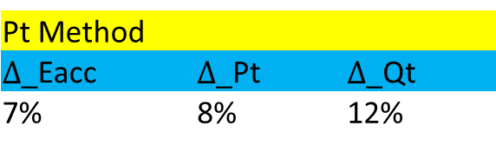
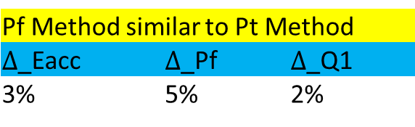
Error Analysis - Eacc
Pt Method
$∆$_Eacc | $∆$_Pt | $∆$_Qt
7% | 8% | 12%
Pt calibrated by insertion loss
Qt using VTS measured data
Pf Method similar to Pt Method
$∆$_Eacc | $∆$_Pf | $∆$_Q1
3% | 5% | 2%
Pf calibrated by calorimetric load
Q1 by 100%-50% transmitted power decay

Slide 51
Gradient Measurement during Production Testing
Measure decay time (Qext1) at low power (6-8 MV/m) in the beginning of the power rise.
Calibrate the transmitted power to the Eacc determined by the Pf.
Measure Pt to determine the Eacc. (Avoids the coupler heating effect).
Verify the Eacc is consistent at 16 MV/m between LLRF power measurement and agilent power meter

Slide 52
Cavity Performance Measurement - Heatload
Method A – Mass flow change (Fermilab Production)
  Measure mass flow delta to extrapolate heat load
Method B – Measure compensation heater
  Maintain constant mass flow
  Measure RF compensation heater power
Method C – dP/dT
  Close JT valve to allow pressure rise due to known heater powerdynamic heating
  Close JT valve to allow pressure rise due to dynamic heating
  Measure pressure rise dP/dT to calculate the heat load

Slide 53
Q0 Measurement
Record the static mass flow the day before and the day after.
Record the cryogenic parameters with known heater powers
  (3 hours for each of 2,4,6,8,10,12,14,16,18,20 W)
Bring cavity to 16 MV/m and wait 1-2 hours or until cryogenic parameters are stable.
Measure mass flow or pressure at the stable condition
Determine the dynamic heatload from mass flow or pressure of 16 MV/m from heater calibration.
Calculate the Q0 based on dynamic heatload and cavity gradient.

Slide 54
Mass Flow Method (Mass flow calibrated with a known heater)
Gradient and Mass Flow
Forward Power and Gradient
Liquid Level Correction
Liquid level, pressure and JT opening
Delta Mass flow = 1 g/s -> 13.7 W at supply mass flow
1 g/s -> 20.64 W at return mass flow

Slide 55
Q0 Accuracy
Both pressure and mass flow has standard deviation of <2%. 8% peak to peak deviation.
Heat load has 2.8% standard deviation, 11% peak to peak deviation
Gradient has 3% error bar.
Q error bar is 4.1% (std deviation) and 11.5% (based on peak to peak deviation).

Slide 56
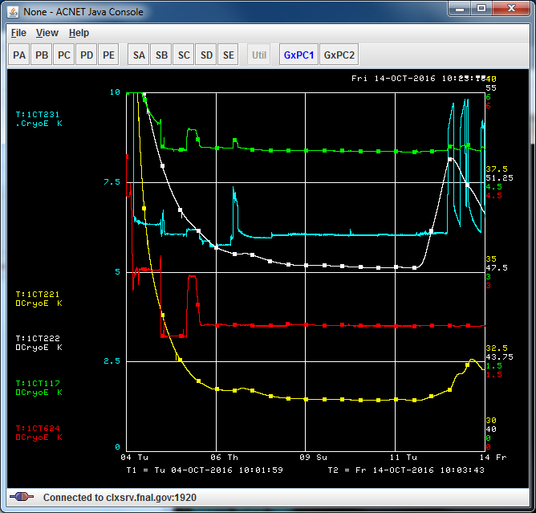
CAV1 Temperature Evolution
Coupler 5K
Mag shield outer
Mag shield inner
HOM coupler
Cavity T

