Slide 1
pCM Comparison
1.3 GHz Production Readiness Review - JLab
Andrew Burrill
Jan 10, 2017

Slide 2
Outline
Background
Assembly Facilities
Assembly Techniques
Testing Infrastructure
Test Plans

Slide 3
Background
LCLS-II project goal is to have JLab and FNAL use their unique SRF expertise to deliver equivalent performance cryomodules
Each lab has unique infrastructure and assembly practices that have been developed over the past 15+ years.
It is not practical or cost-effective to try to implement identical facilities and processes for a project of this size.
One of the goals of the pCM testing is to validate the assembly choices and practices at each lab by looking at overall CM performance and if it meets our requirements.

Slide 4
pCM Minimum Acceptance Test Criteria

Slide 5
Cavity Vertical Testing
JLab
Continuous pumping during vertical test – standard at Jlab
Dedicated dewars (7&8) for LCLS II
Single cavity per dewar
Low magnetic field, controlled with compensation coils
4 dedicated test inserts (identical configuration) equipped with pump systems
Cavities mounted and demounted in the cleanroom
FNAL
Active pumping up to right angle valve.
cavity under static vacuum
3 dewars available
Active compensation coils mounted locally around cavity
2 dewars capable of testing 3 cavities simultaneously
~ 5 mG ambient field in this configuration

Slide 6
Cavity and String Facility Comparison
JLab
Workcenters all under 1 roof
Multiple parallel assembly workstations
Cavity Vertical Testing and CM Testing in same building
FNAL
Workcenters spread over several buildings @ FNAL
2 buildings for CM Assembly
1 building for Vertical Testing
CMTS in separate facility
HPR and Chemistry facilities at both FNAL and ANL

Slide 7
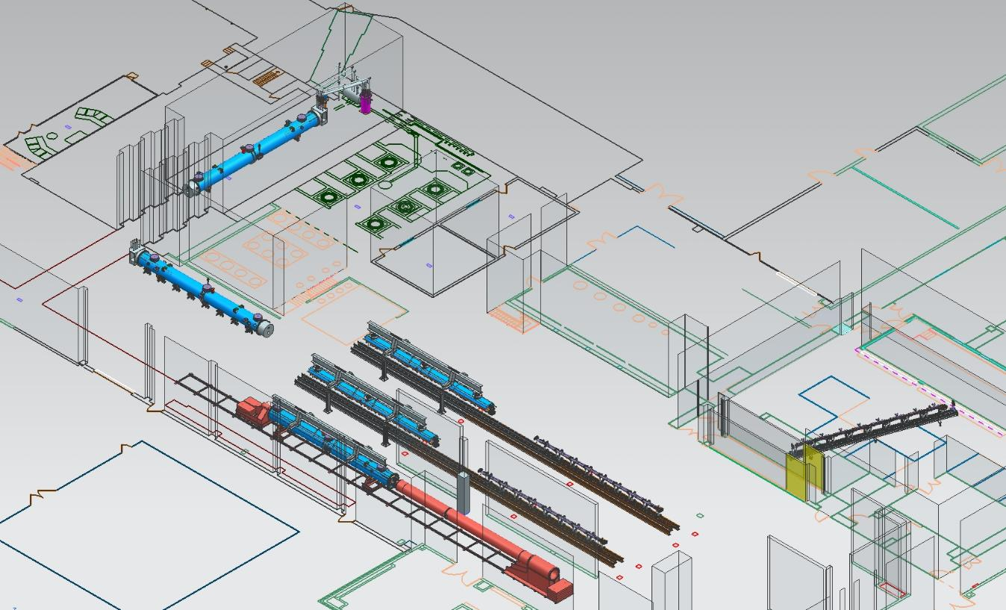
JLab Layout for LCLS-II CM Production
CM Testing
Phase II CM Assembly (2X)
Clean Room String Assembly
Phase I CM Assembly (2X)
Final Assembly / Prep for Testing
Vacuum Vessel Installation

Slide 8
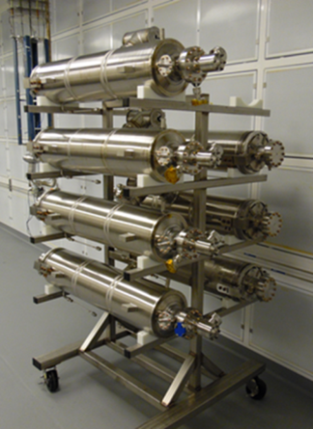
Qualified Cavities Staged for String Assembly
Cavities will be isolated, left under vacuum and installed on the clean room storage rack until all eight are available for assembly of a string. Assembly takes about 1 week.
Each cavity has an HPR prior to mounting on the rail
No N₂ purge used during string assembly
Couplers are installed as part of string assembly
Entire string is pumped down for leak check at the end of string assembly
String is left under vacuum

Slide 9
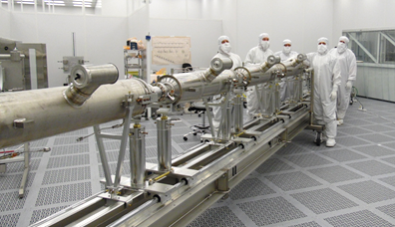
Cavity String Assembly in Clean Room
Component assembly tooling same as FNAL
“Lollipop” supports for each cavity and BPM subassembly
Lollipops mounted to mobile rail system
Use mobile rail system rather than rail-in-floor used at DESY, CEA/Saclay and FNAL
Transfer to CM assembly rails for cold mass assembly

Slide 10
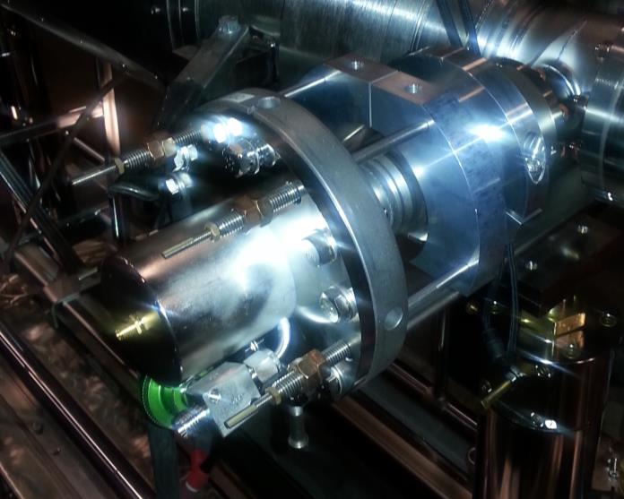
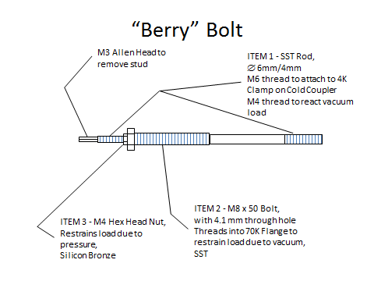
JLab Cavity String Assembly – Berry Bolts
Restraint that enables pump down and keep cavity string under vacuum using “Berry” Bolts
Installed outside of clean room during cryomodule assembly phase I

Slide 11
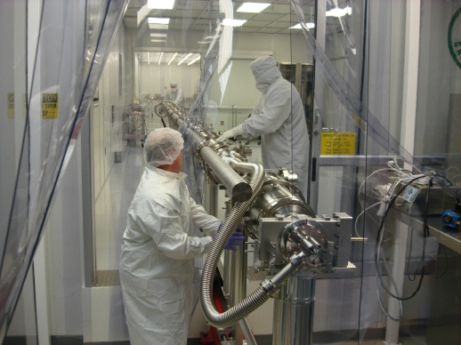
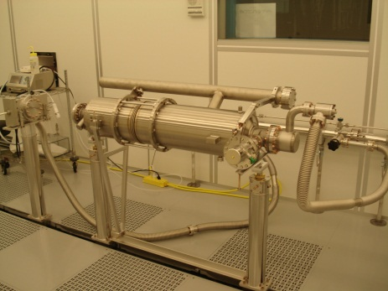
FNAL – String Assembly
Cavities are mounted with high power coupler and individually leak checked.
Once 4 cavities are mounted with couplers they are assembled into ½ of the string and leak checked.
Positive N₂ purge is used during assembly
Once second ½ is ready they are assembled together and leak checked again.
String is back-filled with N₂ prior to leaving the cleanroom.

Slide 12
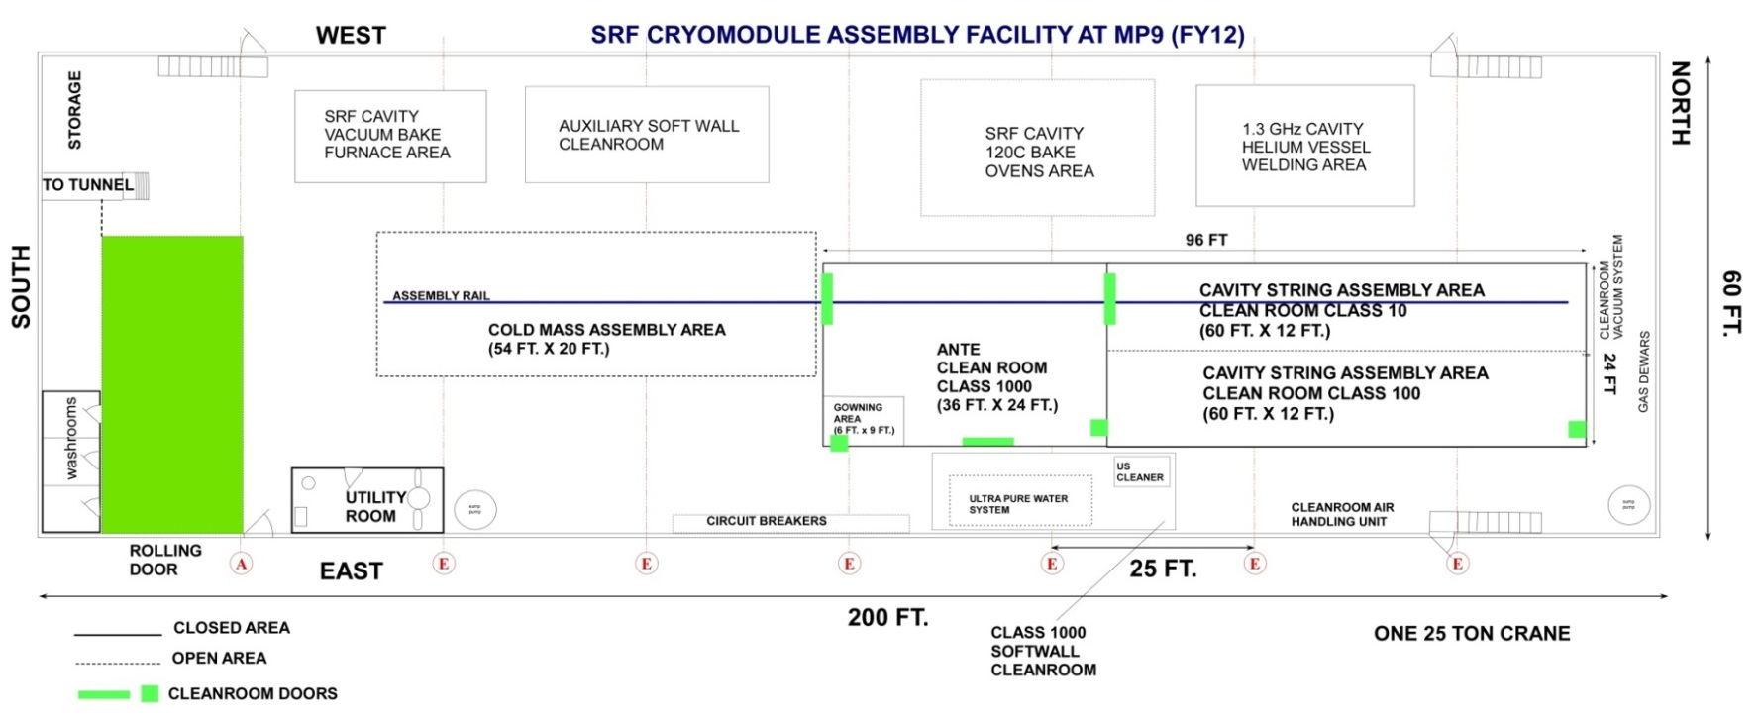
FNAL LCLS-II Production – CAF-MP9
Staging Area
for WS2
WS2
WS1
WS0

Slide 13
CAF-ICB during LCLS-II Production
Sick CM
repair area
WS5
WS3
WS4
WS6

Slide 14
Cryomodule Testing Infrastructure

Slide 15
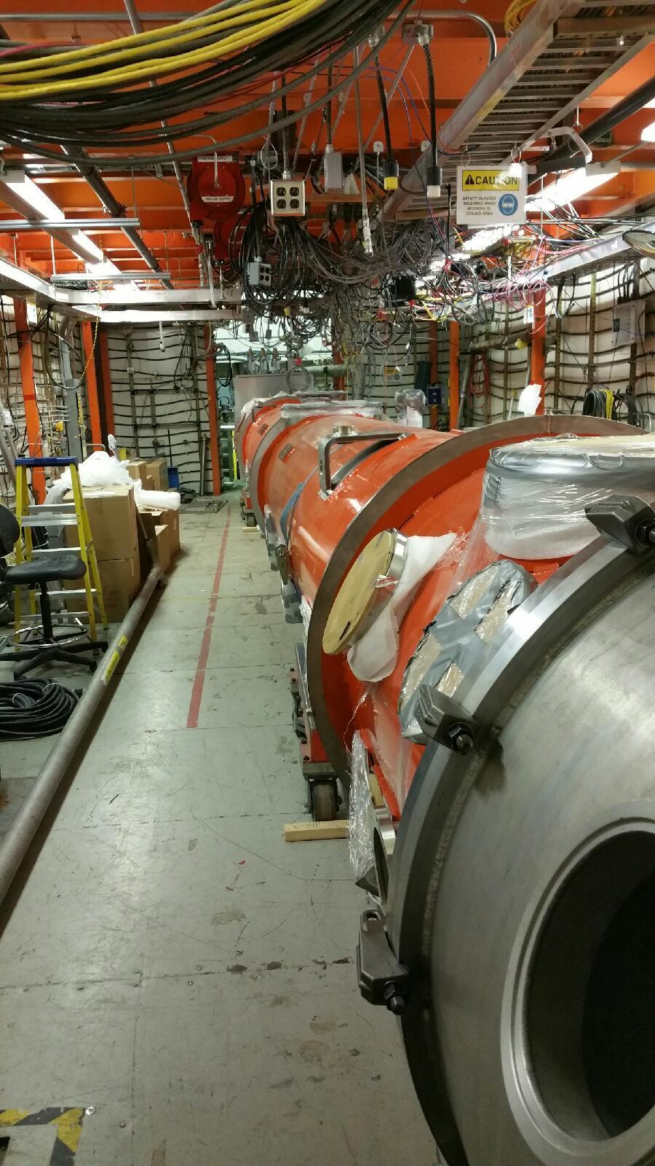
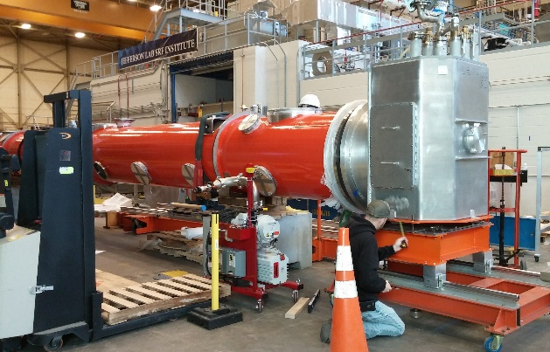
JLab CM Testing Infrastructure
JLab has an existing Test cave that has been modified for testing LCLS-II CMs.
New valve box for connection to CMs
New Feed cap and End caps fabricated
8 New SSAs being installed and commisioned
New RF waveguides installed

Slide 16
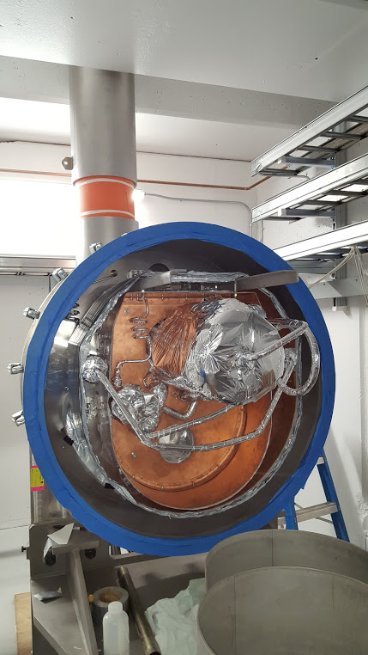
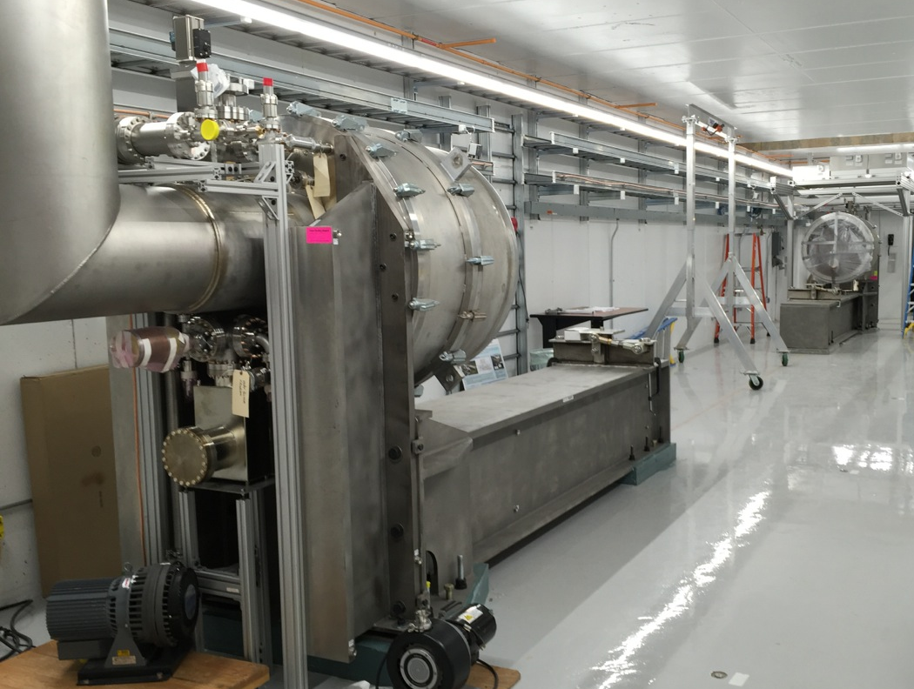
FNAL CM Testing Infrastructure
New CMTS at FNAL has been built and commissioned.
8 new SSAs have been installed and commissioned
Installation of all new RF and control cables
New Feed and End Caps

Slide 17
CM Testing Differences
FNAL
New Facility with redundancy
Cold compressor system
Kinney pump system
Dedicated Cryogenic System
> 30 g/s capability for cooldown
Facilitates cooldown studies
Previous experience Testing 1.3 GHz CMs
JLab
Existing Facility
Cryogenic System shared with vertical testing dewars
8 g/s capacity for cooldown
Slow and slower cooldown study
Previous experience testing cryomodules for CEBAF, SNS and others.

Slide 18
Test Plan – collaborative working document ( JLab, FNAL & SLAC)
Includes a laundry list of items.
Each lab has their own approach to satisfy these requirements
Demagnetization of cryomodule is done at both labs prior to testing
In the cave at FNAL - Before entering the cave at JLab
Warm RF Measurements
Cooldown to 2K
Optimize “Fast” cooldown from 45K (FNAL)
Verify flux expulsion
Test active magnetic field compensation
Low Power Cold Testing
High Power RF Testing
Thermal equilibrium / Cryogenic load studies
High Q conservation

Slide 19
pCM in-depth Validation Testing – FNAL ( Genfa Wu)
FNAL has developed a detailed validation test for the pCM that should answer the following questions.
How does the cavity performance vary as a function of cool-down procedure?
Key to understanding impact of Nitrogen doped cavities and possible trapped magnetic field
Do we need to demagnetize the vacuum vessel and use active magnetic compensation?
How well does the magnetic shielding perform, and was the magnetic hygiene program successful?
How well does the thermal anchoring for the FPC perform?
What is the microphonics spectrum for the LCLS-II CM?

Slide 20
Transportation Testing

Slide 21
CM Transportation
All 35 CMs will be assembled, tested at JLab and FNAL and then shipped to SLAC.
They will not be operated at SLAC until all CM are installed in the tunnel.
A single transportation validation test has been developed by to mitigate risk of damage to CM during transport – FNAL design, JLab leading transport test plan.
A new CM transport frame has been designed for the LCLS-II CMs.
Goal to keep vertical shock below 1.5 G and transverse below 0.6 G
XFEL believes there is a link to field emission and shock load on the CM
LCLS-II dark current spec is very tight – so this could be important.

Slide 22
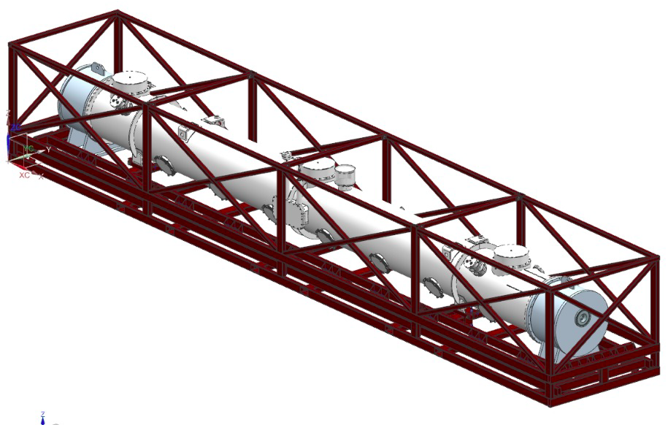
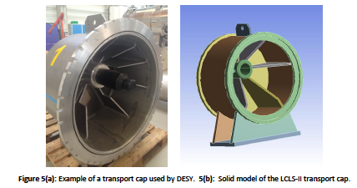
CM transport design – FNAL (McGee)
Images from Mike McGee

Slide 23
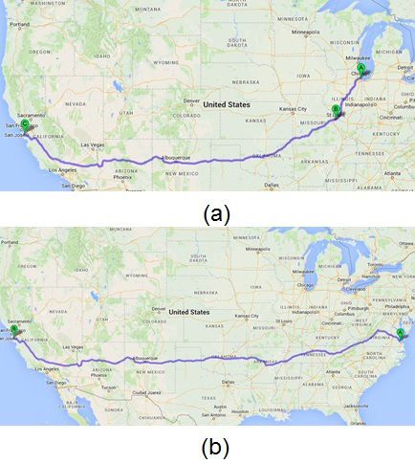
Proposed Shipping Test – under development
Test JLab pCM
establish performance baseline
Load pCM onto shipping frame, transport given route
Measure shock, beamline vacuum, etc.
Return to JLab & retest.
If CM performance does not deteriorate shipping test is complete and CMs can begin shipping to SLAC.
If problems are noted remedies and remediation will be developed.
Image from Mike McGee

Slide 24
Summary
SLAC needs CMs that meet the minimum acceptance criteria
We care about results.
The exact method in which they are produced is not as important.
Difference in processes that have delivered the pCMs are well understood. - no show stoppers.
We hope to learn from one another moving forward so we can all benefit.
Excellent communication between labs on all aspects of the project.
Cavity testing
Cleanroom practices
CM Assembly
CM Testing

