Slide 1
PIP-II: CW SRF Linac at Fermilab
Sergei Nagaitsev
Fermilab
February 9, 2017

Slide 2
PIP-II Goals
The goal of PIP-II is to support long-term physics research goals as outlined in the P5 plan, by delivering world-leading beam power to the U.S. neutrino program and providing a platform for the future
Mission Need Statement/CD-0 approved November 2015
Based on Reference Design/cost estimate
Analysis of Alternatives completed and reviewed by DOE
DOE/HEP has directed us to proceed with a Conceptual Design of a CW superconducting linac
R&D period: FY2016-2020
Construction period: FY2019-FY2025
Anticipating substantial Indian contribution

Slide 3
Alternative Selection
“Based on the analyses in the PIP-II AOA report, the IRC review and recommendations and higher likelihood for significant international contributions, HEP has selected option 1 for a CW SRF linac as the preferred option. Please direct your PIP II project team to prepare the conceptual design report for that option in preparation for Critical Decision 1.”
Notes:
Letter from Jim Siegrist – box is the decision from OHEP

Slide 4
PIP-II Technical Approach
Construct a modern 800-MeV superconducting linac, of CW capable components, operating initially in pulsed mode
Ameliorate space-charge forces at Booster injection
50% increase in Booster/Recycler/Main Injector per pulse intensity, while maintaining transverse & longitudinal emittance at current levels
Modifications to Booster/Recycler/Main Injector to accommodate higher intensities and higher Booster injection energy
Increase Booster repetition rate to 20 Hz
Maintain 1 MW down to 60 GeV or,
Provide factor of 2.5 increase in power to 8 GeV program
Described in the draft Conceptual Design Report

Slide 5
PIP-II Linac Scope
Section | Freq | Energy (MeV) | Cav/mag/CM | Type
RFQ | 162.5 | 0.03-2.1
HWR (β_{opt}=0.11) | 162.5 | 2.1-10.3 | 8/8/1 | HWR, solenoid
SSR1 (β_{opt}=0.22) | 325 | 10.3-35 | 16/8/ 2 | SSR, solenoid
SSR2 (β_{opt}=0.47) | 325 | 35-185 | 35/21/7 | SSR, solenoid
LB 650 (β_{opt}=0.65) | 650 | 185-500 | 33/22/11 | 5-cell elliptical, doublet*
HB 650 (β_{opt}=0.97) | 650 | 500-800 | 24/8/4 | 5-cell elliptical, doublet*
*Warm doublets external to cryomodules All components CW-capable

Slide 6
PIP-II SRF Program
Test one complete cryomodule of each frequency to full power
HWR & SSR1 @ PIP-II Injector Test with beam
HB650 in a test stand
test dressed cavities with RF power
SSR2 & LB650 in test stands
Resonance control of cavities in pulsed mode operation
Combination of High Q0, pulsed operation
Passive means: Mechanical design
Developing a peizo-based feed forward and feedback system
In collaboration with India/DAE laboratories

Slide 7
PIP-II: Cavity Parameters
Cavity Type | Aperture (diameter) (mm) | Effective length (cm) | Accelerating gradient (MV/m) | Epeak (MV/m) | Bpeak (mT) | (R/Q) (Ohm) | G (Ohm)
HWR | 33 | 20.7 | 9.7 | 44.9 | 48.3 | 275 | 48
SSR1 | 30 | 20.5 | 10 | 38.4 | 58.1 | 242 | 84
SSR2 | 40 | 43.8 | 11.4 | 40 | 64.5 | 297 | 115
LB650 | 83 | 74.6 | 15.9 | 39.7 | 75.4 | 377 | 191
HB650 | 118 | 112.0 | 17.8 | 38.3 | 73 | 610 | 260
Cavity Type | Cavities per CM | Number of CMs | Q₀ at 2K (10¹⁰) | Loaded Q (10⁶)
HWR | 8 | 1 | 0.5 | 8
SSR1 | 8 | 2 | 0.6 | 8
SSR2 | 5 | 7 | 0.8 | 5
LB650 | 3 | 11 | 2.15 | 3
HB650 | 6 | 4 | 3 | 6

Slide 8
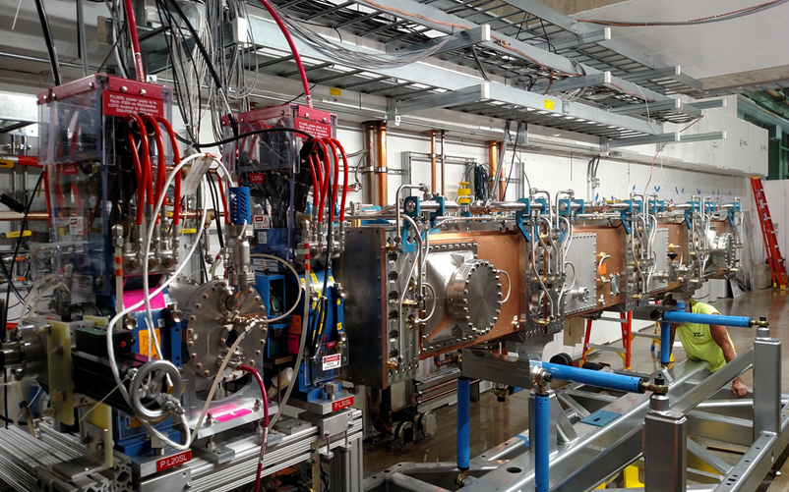
R&D: PIP-II Injector Test
2015
Now
2017
2018
2019
30 keV
2.1 MeV
10 MeV
25 MeV
RFQ
MEBT
HWR
SSR1
HEBT
LEBT
40 m, ~25 MeV
PIP2IT will address the address/measure the following:
LEBT pre-chopping: Demonstrated
Vacuum management in the LEBT/RFQ region: Demonstrated
Validation of chopper performance
Bunch extinction, effective emittance growth
MEBT beam absorber
Reliability and lifetime
MEBT vacuum management
CW operation of HWR
Degradation of cavity performance
Optimal distance to 10 kW absorber
Operation of SSR with beam
CW and pulsed operation
Resonance control and LFD compensation in pulsed operations
Emittance preservation and beam halo formation through the front end
Collaborators
ANL: HWR
LBNL:LEBT, RFQ
SNS: LEBT
BARC: MEBT, SSR1, RF
IUAC: SSR1

Slide 9
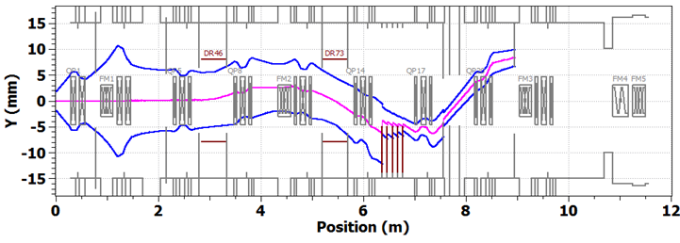
PIP-II : Chopping system
Two travelling-wave kickers working in synch and absorber
Two kicker versions, 50 Ohm and 200 Ohm
Passing bunch.
-250V, +250V on upper plates.
Removed bunch. +250V, -250V on upper plates. Case with 0.05% of beam leaking to scrapers is shown.
3σ envelopes. 2.1 MeV, 5 mA. A. Saini. Bipolar kicker version.

Slide 10
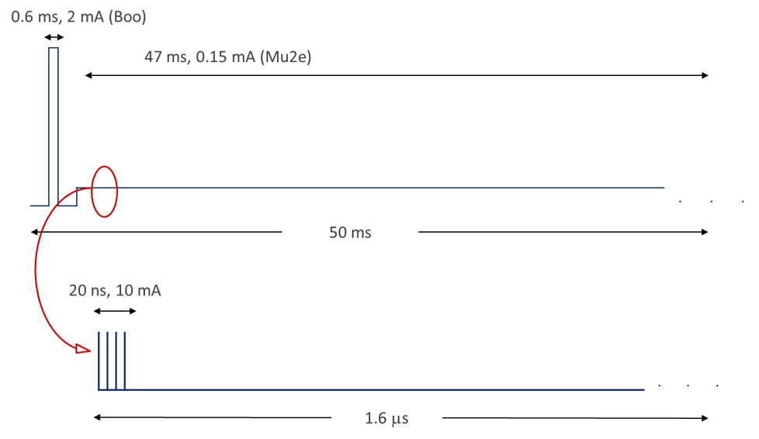
PIP-II and Next Generation Mu2e
First CW application
Possible beam structure:
Beam pulse length: ~20 nsec
Pulse repetition period: 1.6 μsec
Beam power: 100 kW
Three-year run achieves single event sensitivity of 2×10⁻¹⁸

Slide 11
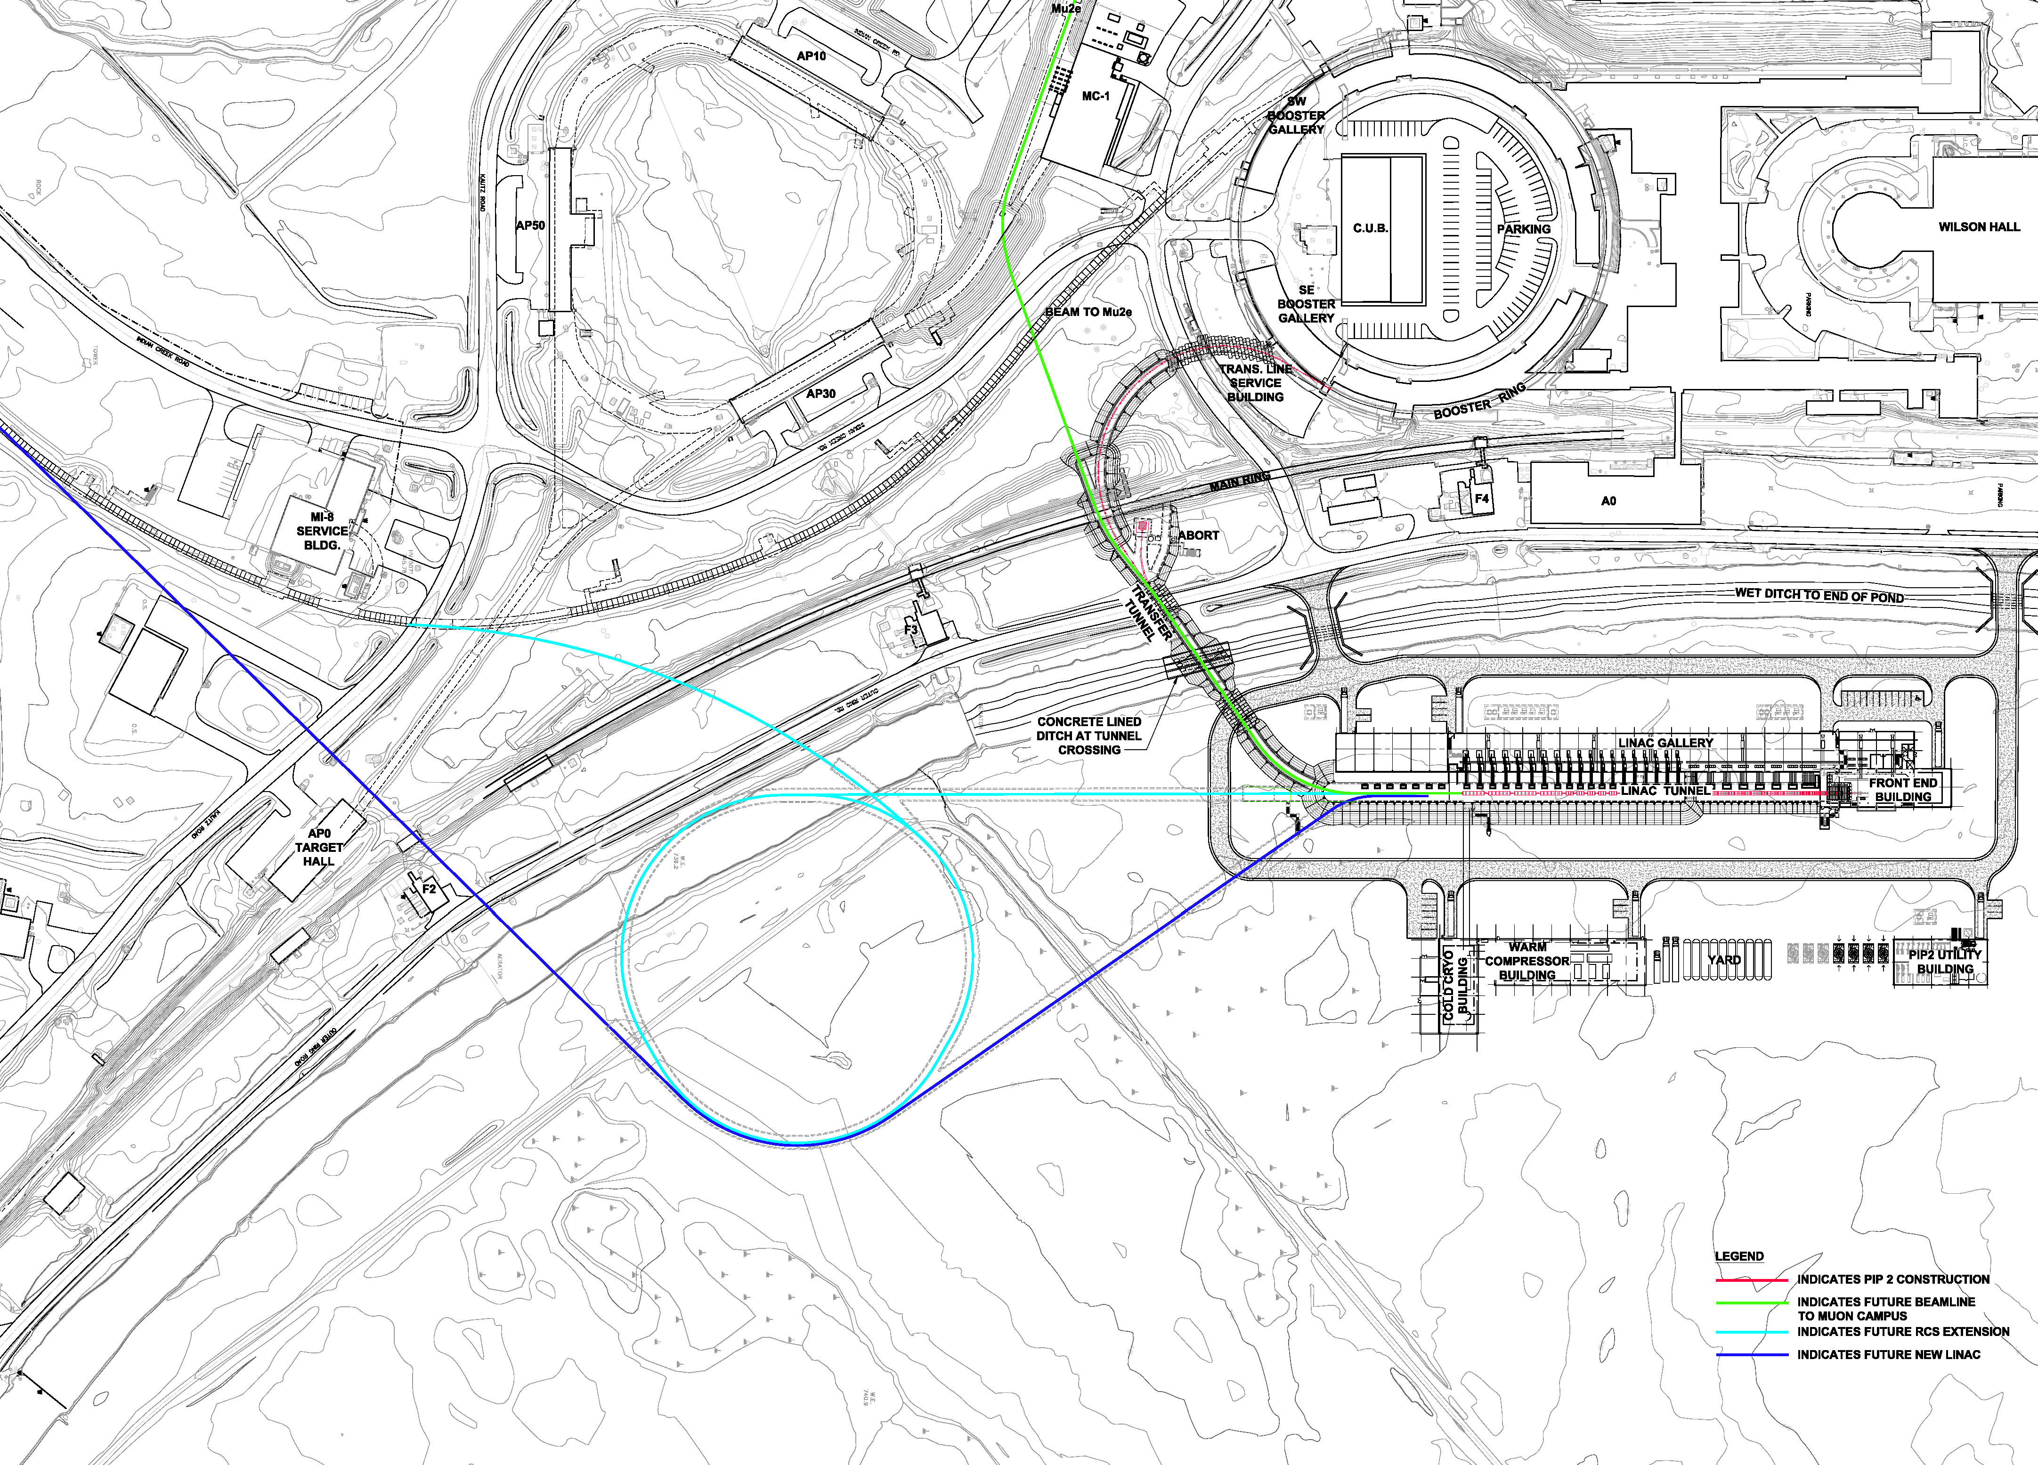
PIP-III (~2030) Goal: >2 MW on target

Slide 12
RF Technologies needed by intensity frontier accelerators, beyond present concepts
New, less costly proton (H-) linacs (at present, 1 MW ~ 1 B$) and synchrotrons (cost dominated by rf power)
New generation of RFQs for pre-injectors (high beam intensity, low cost); new concepts and ideas should be developed and tested;
Tunable high-power ferrite – loaded RF cavities (high voltage, low impedance, high power). New concepts should be invented and developed. New materials should be explored and tested.
For all of RF cavities (NC and SRF) one needs high power couplers, with low cost and reliable. New concepts, materials (ceramics having low loss tangent for RF and finite conductivity at DC), the technology should be explored.

