Slide 1
Workshop Goals,
Prospects for HEP SRF Accelerators in the US
Sergey Belomestnykh
GARD-SRF Roadmap Workshop
9 February 2017

Slide 2
Outline
Workshop goals and agenda
Introduction: Future HEP particle accelerators and superconducting RF technology
SRF challenges for HEP Intensity Frontier
SRF technology challenges for HEP Energy Frontier: ILC; future circular colliders
Synergies with NCRF
Summary
TESLA SRF cavity

Slide 3
Workshop goals
Discuss SRF R&D needed to support future HEP particle accelerators.
Provide material for constructing a ten-year roadmap for SRF R&D:
  Identify research thrusts;
  Specify key milestones;
  Specify research activities and parameters we would like to achieve;
  Propose “stepping stone” facilities as intermediate steps toward future discovery facilities. Ideally, such facilities would be multi-purpose: to validate key R&D concepts and to serve broader user community (e.g. light source).
A roadmap document will be developed after the workshop and presented to DOE in Germantown in early March.
SRF and NCRF roadmaps will be combined into a single document for the RF Technology thrust.
Similar effort in Advanced Accelerator Concepts resulted in Advanced Accelerator Development Strategy Report, published in 2016. The report is posted on the workshop Indico site.

Slide 4
GARD-SRF Roadmap Workshop at Fermilab
Workshop agenda:
  Plenary overview talks: Two talks on HEP physics requirements; Overviews from regions (Asia, Europe, USA); Report from NCRF workshop.
  Round table on cost of SRF machines and cost reduction avenues.
  WG1: Transformational routes for high gradient and Q → Ultimate Q and gradient limitations for SRF; New materials and surface structures; Fundamental understanding of SRF material properties.
  WG2: Evolutionary developments → Nitrogen doping and infusion, other surface treatments; Nb3Sn cavity development; Thin film technology; Abatement of Field Emission.
  WG3: RF ancillaries → RF power couplers, RF sources, HOM dampers, frequency tuners.
  Discussion on future US facilities to validate R&D concepts.

Slide 5
Introduction
Superconducting radio frequency technology is a cornerstone technology for the next generation of high-energy particle accelerators.
Future Intensity Frontier machine at Fermilab, PIP-III, will target > 2.4 MW proton beam power. One of the options under consideration is an 8-GeV SRF linac.
Future generation of lepton colliders will require RF systems to be “affordable” and able to support high luminosity.
The former necessitates cavities operating shorter acceleration systems (high accelerating gradient) with lower cryogenic losses (high quality factor). The latter means supporting very high beam currents (higher order mode damping) and delivering very high power to the beams (RF power couplers).
In this talk I will briefly describe challenges to the SRF technology arising from the next generation of HEP accelerators, outline possible R&D paths and point out synergies with NCRF technology.
Leitmotif: cost, cost, cost …

Slide 6
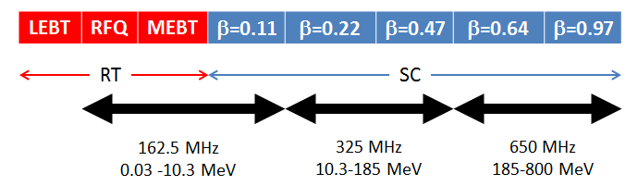
HEP Intensity Frontier: from PIP-II to PIP-III
PIP-II, an upgrade of existing Fermilab accelerating complex, will bring the beam power to 1.2 MW.
PIP-II 650 MHz cavities need further R&D on nitrogen doping to reach spec on Q.
PIP-II Technology Map
General parameters of SC cryomodules
CM type | Cavities per CM | Number of CMs | Acc. gradient (MV/m) | CM length (m) | Q₀ at 2K (10¹⁰) | Surface resistance, (nOhm) | Loaded Q (10⁶)
HWR | 8 | 1 | 9.7 | 5.93 | 0.5 | 9.6 (2.75) | 2.7
SSR1 | 8 | 2 | 10 | 5.2 | 0.6 | 14 (10#) | 3.7
SSR2 | 5 | 7 | 11.4 | 6.5 | 0.8 | 14.4 | 5.8
LB650 | 3 | 11 | 15.9 | 3.9 | 2.15 | 8.9 | 11.3
HB650 | 6 | 4 | 17.8 | 9.5 | 3 | 8.7 | 11.5

Slide 7
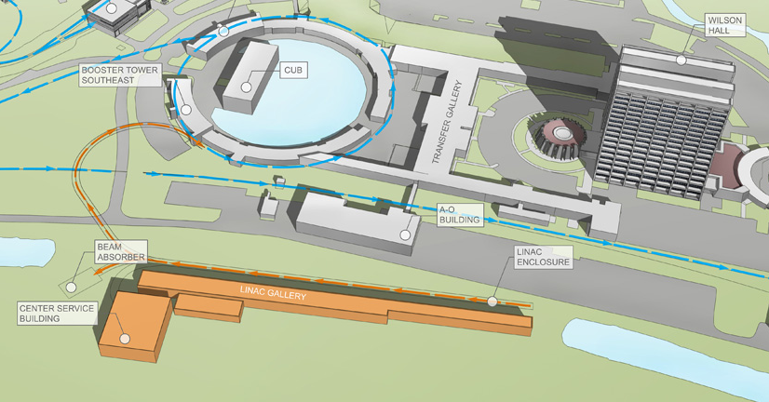
PIP-II Project
PIP-II is now a project in CD0 stage. We expect to get CD1 by early next FY.
PIP-II Project aims to provide 1.2 MW starting in 2025-26 with a new 800-MeV CW-capable superconducting linac.

Slide 8
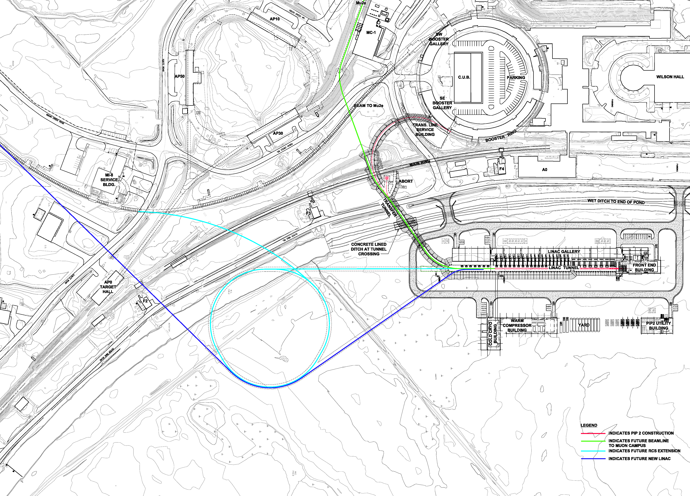
PIP-III
Achieving 2+ MW will require replacement of the Booster with either a 6-8 GeV pulsed linac or a rapid cycling synchroton (RCS) fed by a ≥0.8 GeV linac.
An SRF linac will operate at 650 MHz up to 3 GeV (CW-capable) and at 1.3 GHz up to 8 GeV (pulsed).
Challenges for SRF: High Q for CW and high gradient for pulsed operation.

Slide 9
Future colliders: scale of the problem
SRF: 800 cavities at 23.6 MV/m for EXFEL vs. 16,000 cavities at 31.5 MV/m for ILC
SRF: 22 MW SR power for LEP2 vs. 100 MW SR power for FCC-ee
SC magnets: 27 km LHC vs. 80 to 100 km FCC
SC magnets: 11 T Nb₃Sn for HL-LHC vs. 16 T Nb₃Sn / 20T hybrid for FCC-hh/SppC

Slide 10
SRF technology for ILC: state of the art
The ILC TDR specs, 31.5 MV/m with Q > 10¹⁰ and 90% yield, have been demonstrated on a small scale.
Average gradient of XFEL cryomodules is 27.9 MV/m* with only 5 of 98 tested CM modules below spec (23.6 MV/m). The average Q factor is ~1.4∙10¹⁰ at 20-23 MV/m.
Field emission (FE) is still an issue at high gradients.
ILC cost is still a major concern for funding agencies.
*⁾ Administratively limited to 31 MV/m

Slide 11
SRF technology for ILC: path to cost reduction
From the ILC TDR: “[the cost] is dominated by the SRF components and related systems, together with the conventional facilities. These two elements account for 73% of the total. The main linac itself corresponds to 67% of the total project.”
Reducing the main linac cost is the most efficient way to bring the ILC cost down.
Possible directions for short- and mid-term R&D: improve accelerating gradient and cavity Quality factor (Q); reduce cost of cavity and component fabrication; simplify cavity treatment. Long-term R&D would concentrate on alternative materials, e.g. Nb₃Sn.
Cost Breakdown from ILC TDR

Slide 12
Recent R&D progress on high Q / high gradient:
“standard” vs “N infused” cavity surface treatment
FNAL recently demonstrated (on single-cell cavities) a new treatment, which utilizes “nitrogen infusion”.
Achieved so far:
  45.6 MV/m → 194 mT
  with Q ~ 2∙10¹⁰!
Systematic effect observed on several cavities.
R&D to focus on :
  Optimize the recipe;
  Implement and demonstrate improvement with statistics on nine cells cavities;
  Better understanding and mitigation of FE;
  Demonstrate preservation of performance in cryomodule;
  Transfer technology to industry.
Courtesy A. Grassellino (FNAL)
Increase in Q by a factor of two
Increase in gradient ~15%

Slide 13
Potential ILC cost reduction
A cost model based on the ILC TDR and new progress in the SRF technology on cavity achievable efficiency (Q) and acceleration (E_{acc}), showing potential cost reduction up to 20%.

Slide 14
Future circular lepton colliders
Future e⁺e⁻ colliders, FCC-ee and CEPC, are considered as a potential first step toward hadron colliders FCC-hh and SppC, a la LEP before LHC.

Slide 15
Parameters of the circular lepton colliders
SRF systems for these machines will have to deal with very high RF power, high beam currents and strong HOM damping.
“Ampere-class” machine
Courtesy E. Jensen (CERN)
short bunches
“high gradient” machines

Slide 16
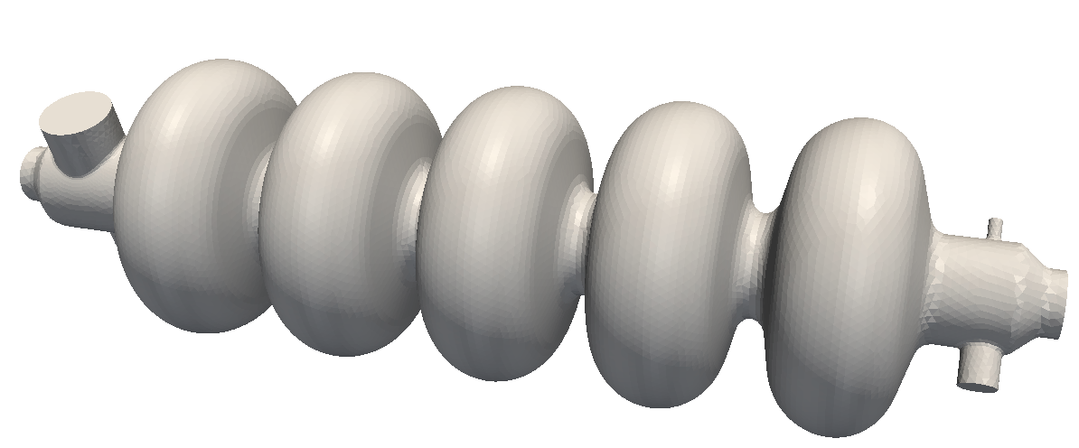
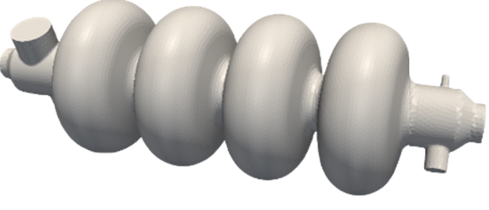
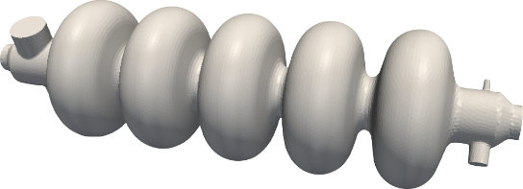
SRF technology for FCC-ee
Parameters of the FCC-ee options cover very wide range and cannot be satisfied with one SRF system design.
At the “high current” end, where the total voltage is relatively small, the design will be determined by strong HOM damping requirements and RF power couplers. Hence, single-cell cavity design. The gradients will be moderate (4-5 MV/m). Nb/Cu at 4 K is OK.
At the “high gradient” end, the total voltage is large and the design will be driven by optimization of the accelerating gradient in CW mode of operation. The number of cells per cavity will be limited to 4-5 to ensure adequate HOM damping. Nb/Cu or other alternatives (Nb₃Sn?) are under consideration, but require R&D.
Higher currents
400MHz, 1 cell, Nb/Cu
400MHz, multi-cells, Nb/Cu
Higher gradient
800MHz, multi-cells, Nb/Cu - bulk Nb
Courtesy E. Jensen (CERN)

Slide 17
SRF technology for CEPC
CEPC’s main physics goal is operation at 240 GeV center-mass energy as a Higgs factory.
The collider RF system will consist of 384 650-MHz 5-cell SRF cavities operating at 19.3 MV/m with Q of 4∙10¹⁰.
Nitrogen doping and magnetic flux expulsion technologies will be used to support high Q.
Thin film SRF technology, e.g. Nb₃Sn is under consideration as possible alternative.
CEPC layout from J. Y. Zhai, et al., SRF2015

Slide 18
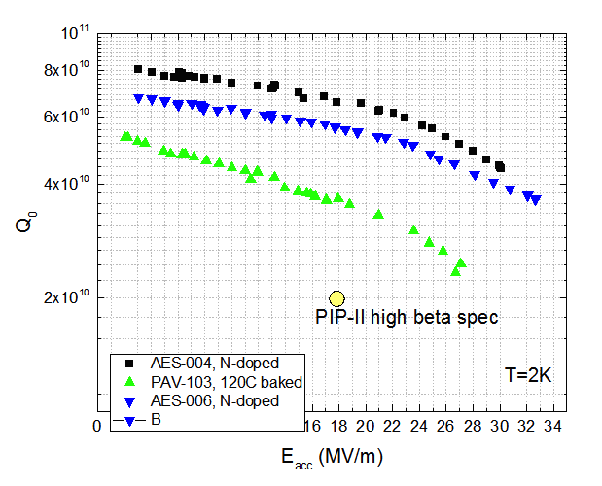
Nitrogen doping for 650 MHz
Applying nitrogen doping to 650 MHz (β = 0.9) leads to doubling Q compared to 120°C bake (standard surface treatment ILC/XFEL), ~7∙10¹⁰ at 2 K – world record at this frequency.
CEPC spec
Courtesy A. Grassellino (FNAL)

Slide 19
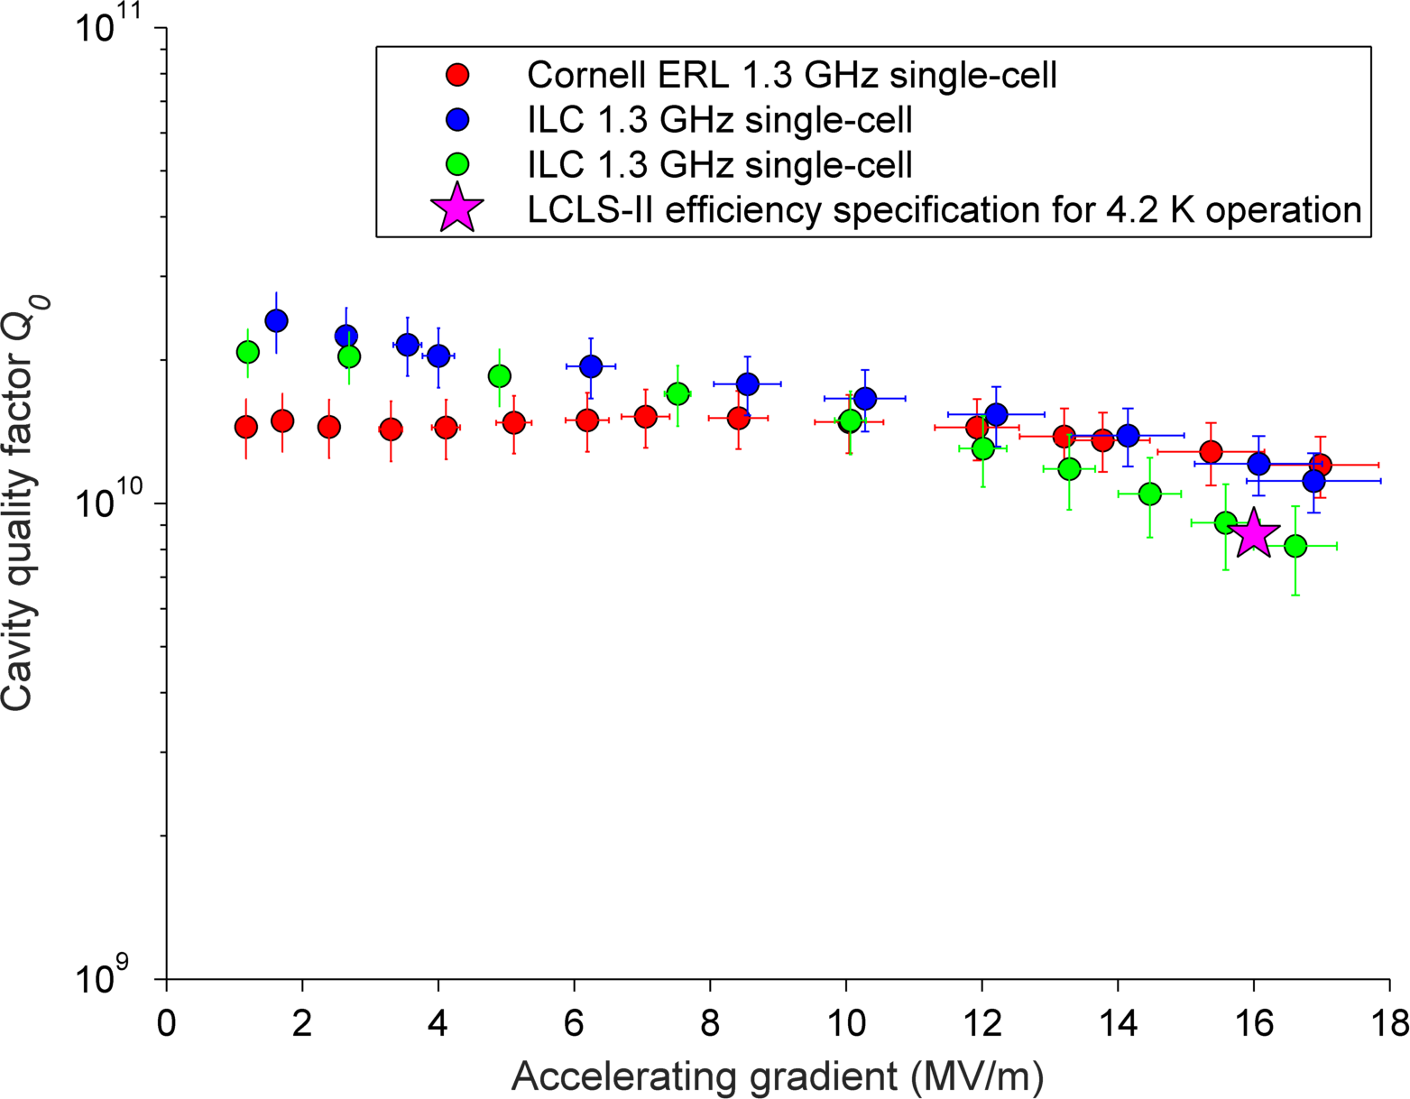
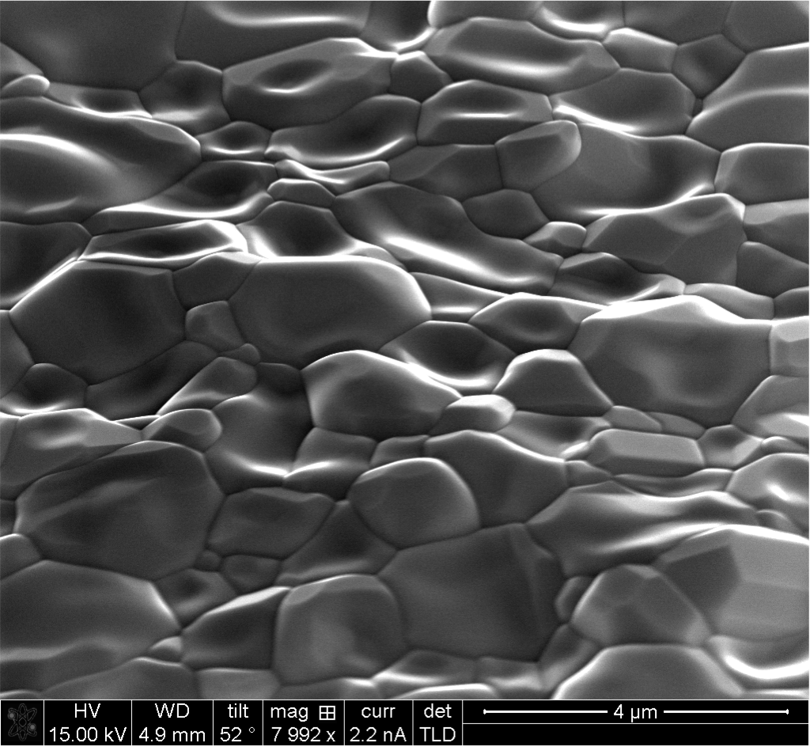
Nb₃Sn SRF cavity R&D
R&D on 1.3 GHz single-cell cavities at Cornell: Recent test results consistently demonstrate gradients >16 MV/m with Q > 10¹⁰ at 4.2 K.
Very promising for future colliders. Next steps: extend this technology to multi-cell cavities and lower frequencies; exploring ways to improve gradient.
Nb₃Sn cavity surface
Courtesy Cornell University
Courtesy D. Hall and M. Liepe (Cornell)

Slide 20
Multi-purpose ILC facility?
ILC beam
to IP
Linac 1
Linac N
Injector 1
Experiment 1
Injector N
Experiment N
Can we imagine a multi-purpose facility based on ILC? Is this crazy enough?
The SRF linac can be sectioned into several linacs. Each linac can have different energy and beam parameters, tuned to a particular user community. Then a facility for a particular purpose could be built around each linac, e.g.
  Linac 1: CW FEL (a la LCLS-II)
  Linac 2: pulsed FEL (a la European XFEL)
  …
  Linac N: MaRIE-like machine, especially if high-power proton linac happens to be nearby ☺
Time-share concept, e.g. 50% time for HEP, 50% for other experiments working in parallel.

Slide 21
Synergies with NCRF
High-power fundamental power couplers.
Flexible RF power distribution system
High-efficient RF sources
New analytical and modeling tools

Slide 22
Summary
Future HEP IF and EF accelerators require advances in SRF technology beyond state-of-the-art.
Cost reduction is very important aspect of R&D aimed at developing this technology.
Electron-positron colliders will require large-scale SRF installations, e.g. 16,000 cavities for ILC.
Recent advances – nitrogen doping and nitrogen infusion, magnetic flux expulsion – demonstrate that there is still room for improvement using bulk Nb.
Further progress can be achieved with thin film techniques, especially Nb₃Sn cavities.

