Slide 1
High Q roadmap – bulk Nb
Anna Grassellino
31 January 2017

Slide 2
So far, and plan for today
Yesterday afternoon discussion focused on impact of different R&D pathways (near to mid term) on cost of SRF HEP machines, in particular ILC, FCC, PIP-3
We gave space to all ideas and contributions and asked to evaluate the impact
Some R&D pathways can contribute largely to the cost of SRF accelerators:
  recall Marc Ross on Q “cryoplant cost for LCLS-II is of the same order as full linac cost”
  for ILC 20-40% cut can come from Q and gradient improvement (N-dope,Nb3Sn)
  For FCC huge cost cuts would come from Nb-Cu technology because of 400 MHz f
However, we saw also lots of 1-2%. Some people commented (including myself) that it got a bit boring; these are valuable comments, as it has to do with our identity: what do we want SRF R&D to be for the next decade? Do we want to be a technology chasing cost reduction, or chasing the “enabling”? Or both?
The two concepts coincide only up to some extent.
This is what we are here for with this workshop. DOE has asked us to write a ten year roadmap for SRF R&D in US. Do we want to keep all of these R&D pathway, or drop the 1 percents?

Slide 3
Today’s plan
Today, we dive into the technical discussion to define milestones on most promising pathways to increase Q and gradients
  Surface processing (N doping, Nb3Sn…)
  Field Emission
  Cavity shape
Start with evolutionary and move towards more revolutionary and fundamental understanding [ eg up to 55 MV/m, beyond 55 MV/m]

Slide 5
High Q roadmap
What Q can we achieve with surface processing
  Evolutionary AND revolutionary
How to robustly maintain this Q (magnetic flux)
  Evolutionary AND revolutionary

Slide 6
What next for processing for high Q?
Continue explore N doping – high T, low T (infusion), vary p.p., vary gases
Is N unique or would other impurities have same or even more dramatic effect?
N infusion shows a cut in BCS resistance of a factor up to 5! 2 nOhms for 20 MV/m, 1.3 GHz, 2K! Can we go even further?
Extend to other frequencies (650 started) but also lower (can it help 4.2K for QWR and spoke?) and higher (2.6? 3.9?)

Slide 7
How low can we drive BCS resistance?
Factor of 5!

Slide 8

Trapped Flux Surface Resistance
$$R_{S} \left( 2 K,B_{Trap} \right)={R_{BCS} \left( 2 K \right)+R}_{0}+R_{Fl}$$
These losses can be reduced by minimizing these contributions:
$$B_{ext}$$
𝐵_𝑒𝑥𝑡
Magnetic shielding/hygiene improvement
$$η$$
𝜂
Fast Cooling
Material Optimization
S
Optimizing mean free path

Slide 9
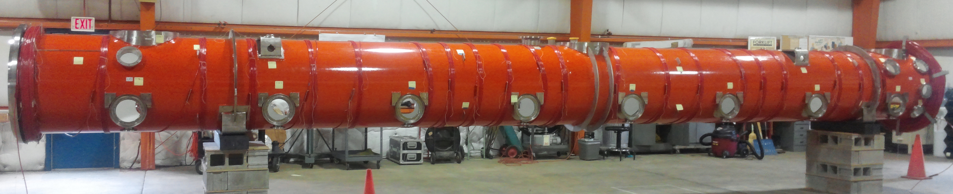
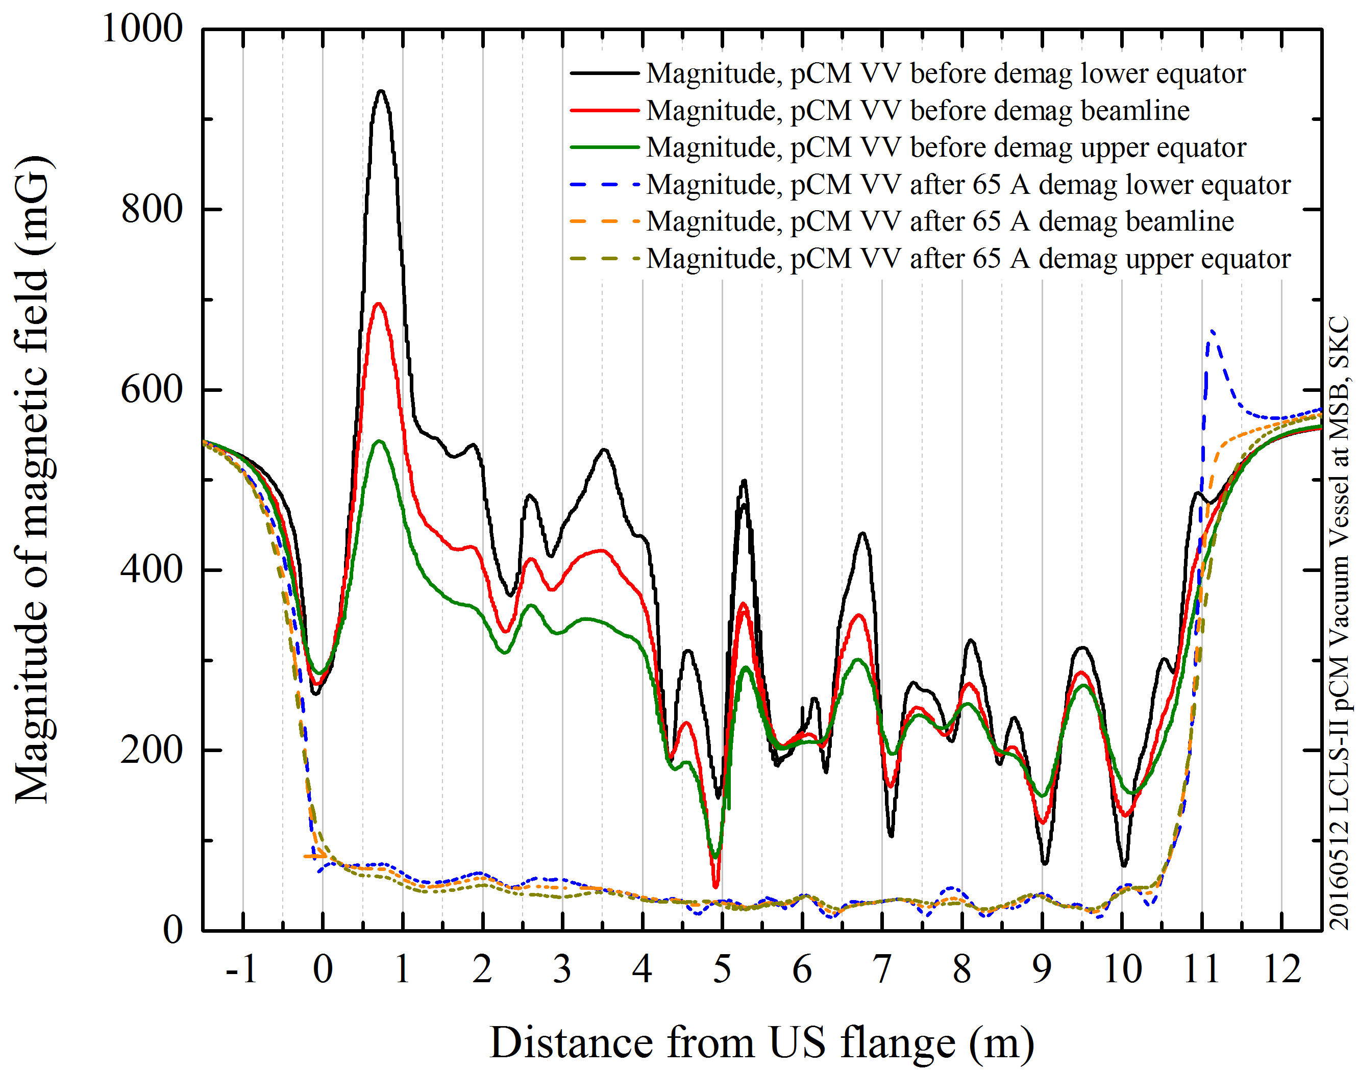
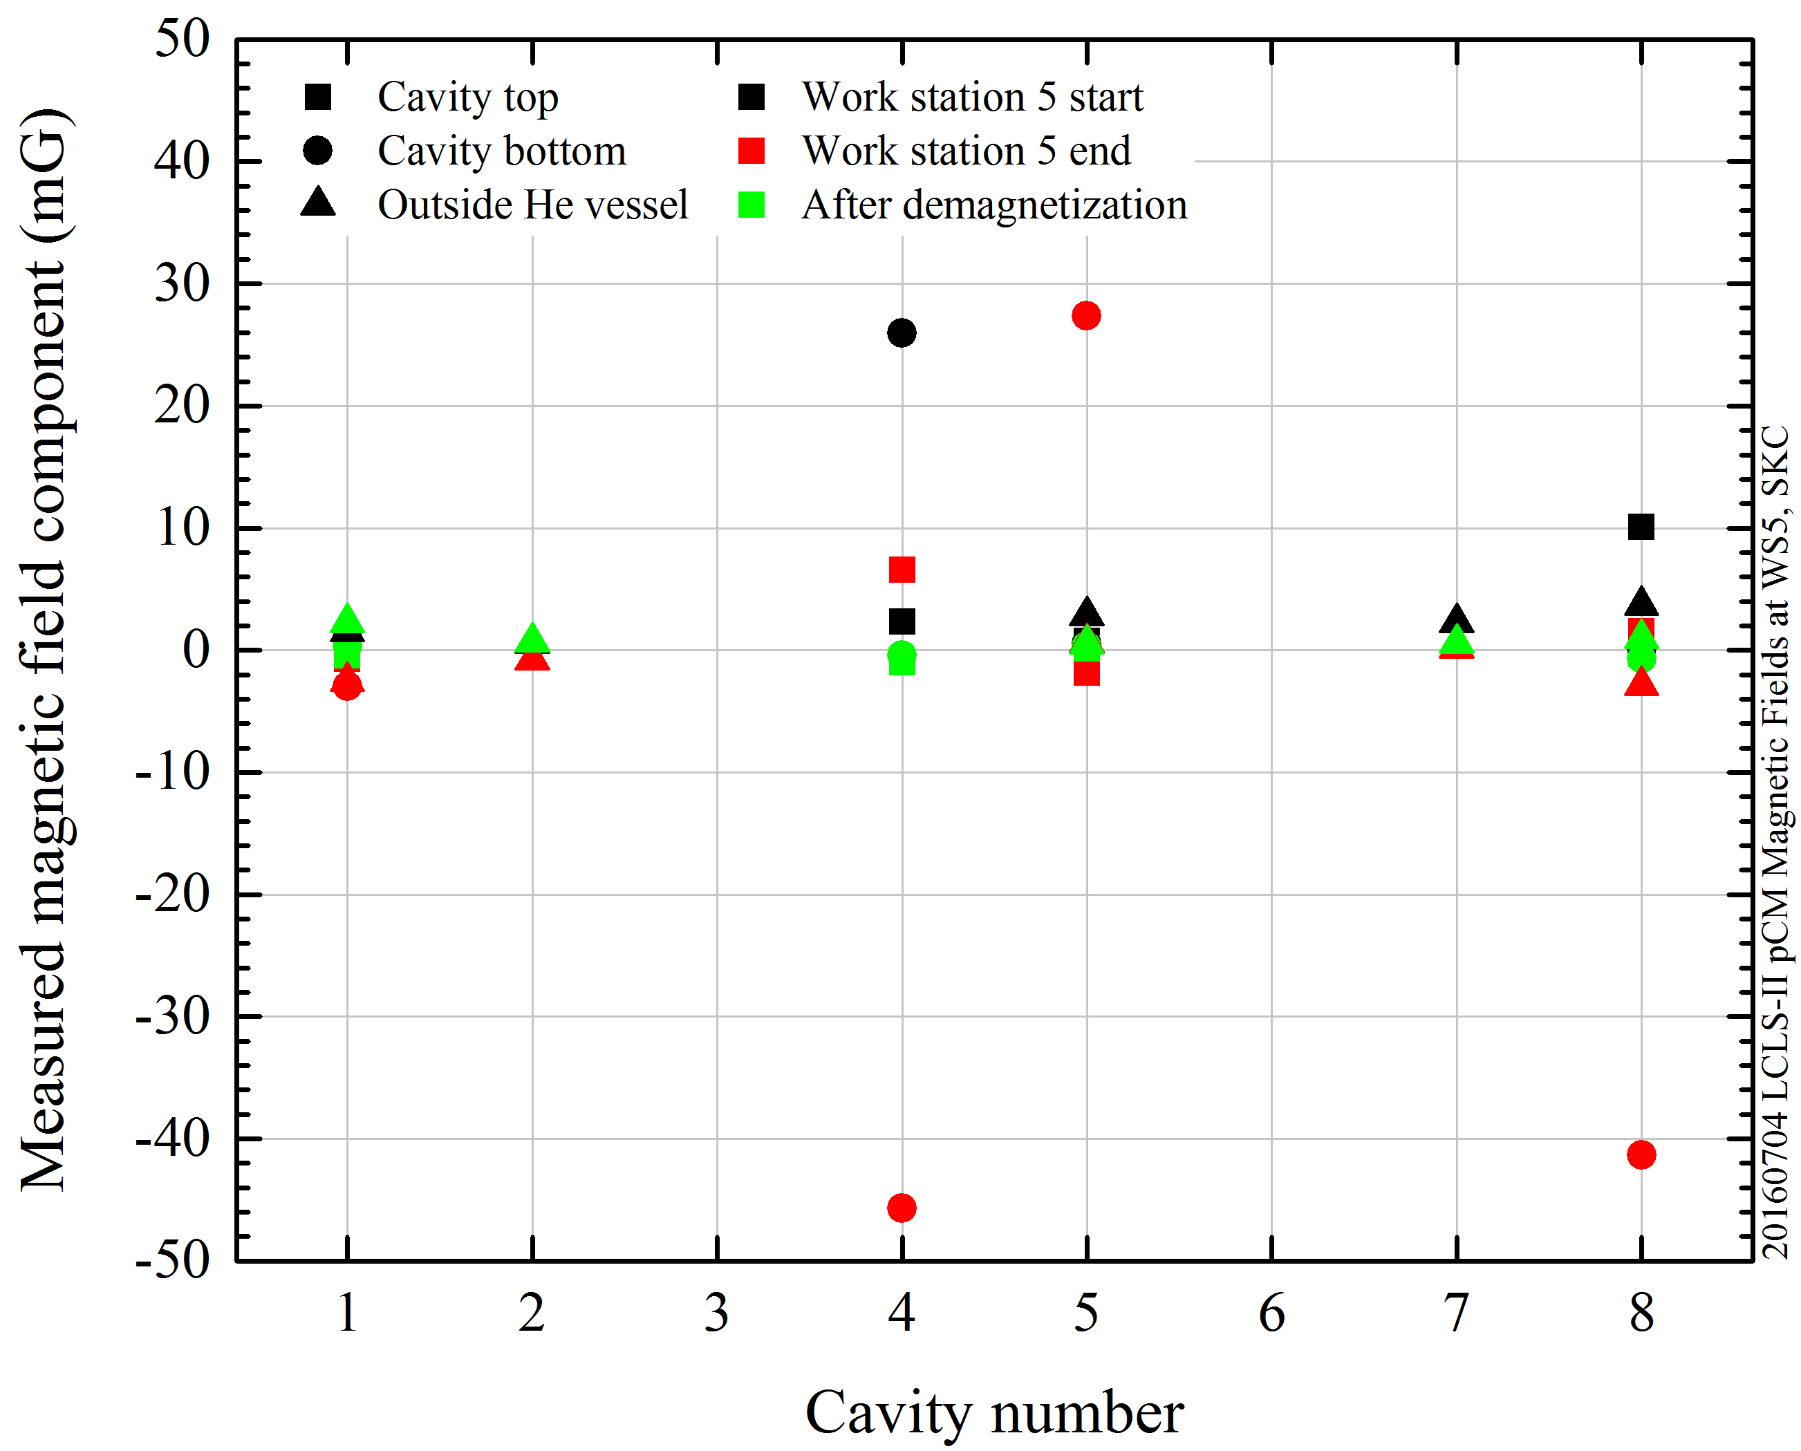
Minimization of remnant field in the cryomodule: we need to develop “in situ” removal of B flux which will remove issues for both cooling and quench
Coils for magnetic field demagnetization
Empty vacuum vessel
Assembled Cryomodule
Demagnetization
Demagnetization
A. C. Crawford, https://arxiv.org/pdf/1507.06582.pdf
S. K. Chandrasekaran et al, TUPLR027, LINAC16

Slide 10
Marc’s operational nightmare: we need to develop “in situ” removal of B flux
which will ease issues for both cooling and quench
Summary as of 2017-01-26 |  |  | Slow Cool down
 | pCM Gradient |  |  | pCM Q0
Cavity | Max Gradient [MV/m] | Usable Gradient* [MV/m] | FE onset [MV/m] | Q0 @16MV/m* 2K Fast Cool Down | Q0 @16MV/m* 2K Slow Cool Down
TB9AES021 | 21.2 | 18.2 | 14.6 | 2.6E+10 | 1.8E+10
TB9AES019 | 19.0 | 18.8 | 15.6 | 3.1E+10 | 1.5E+10
TB9AES026 | 19.8 | 19.8 | 19.8 | 3.6E+10 | 3.3E+10
TB9AES024 | 21.0 | 20.5 | 21.0 | 3.1E+10 | 2.1E+10
TB9AES028 | 14.9 | 14.2 | 13.9 | 2.6E+10 | 1.9E+10
TB9AES016 | 17.1 | 16.9 | 14.5 | 3.3E+10 | 2.0E+10
TB9AES022 | 20.0 | 19.4 | 12.7 | 3.3E+10 | 2.1E+10
TB9AES027 | 20.0 | 17.5 | 20.0 | 2.3E+10 | 1.8E+10
Average | 19.1 | 18.2 | 16.5 | 3.0E+10 | 2.1E+10
Total Voltage | 154.6 MV | 148.1 MV
*CAV5 was at 14 MV/m
80 g/s

Slide 11
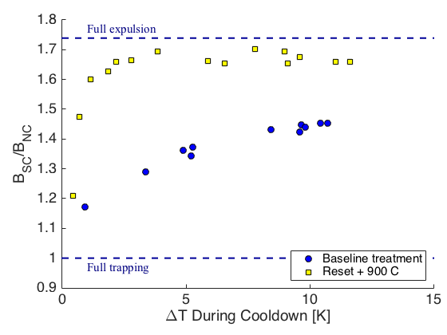
High T baking for flux expulsion improvement: we need to develop specs for material vendors for assuring flux detrapping
Not all materials show good flux expulsion even with large thermal gradient
High T treatments are capable to improve materials flux expulsion properties
Full expulsion
Full expulsion
After 900C
After 1000C
Full trapping
Full trapping
S. Posen et al., J. Appl. Phys. 119, 213903 (2016)

Slide 12
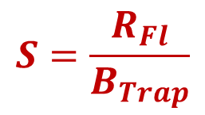
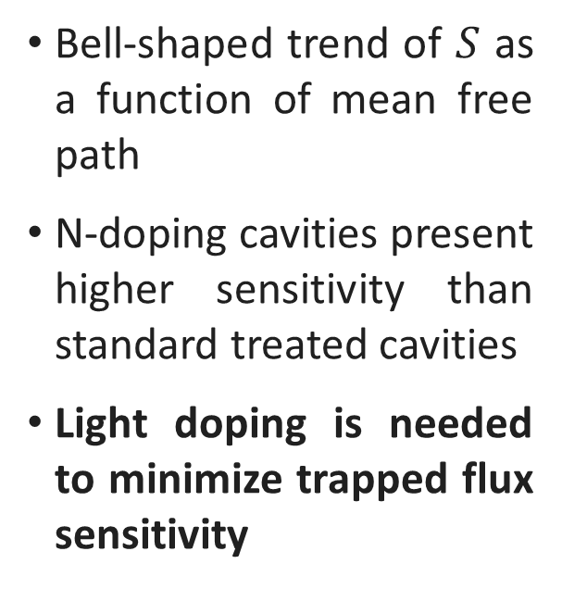
Light doping to minimize trapped flux sensitivity: can we find a sweet spot (or different doping strategy) to have both very low BCS AND sensitivity?
Trapped flux sensitivity:
$$S=\frac{R_{Fl}}{B_{Trap}}$$
Bell-shaped trend of $S$ as a function of mean free path
N-doping cavities present higher sensitivity than standard treated cavities
Light doping is needed to minimize trapped flux sensitivity
2/6 N-doping
M. Martinello et al., App. Phys. Lett. 109, 062601 (2016)

