Slide 1
Parallel-Feed SRF Accelerator Structure w/ Thin Film Technology
Paul B. Welander, Zenghai Li, Sami Tantawi
SLAC National Accelerator Laboratory, Menlo Park, CA 94025
Feb 9-10, 2017
GARD SRF Workshop

Slide 2
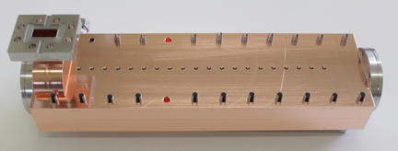
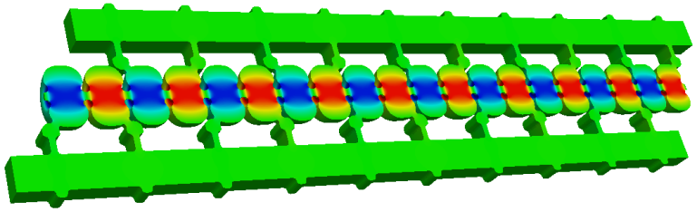
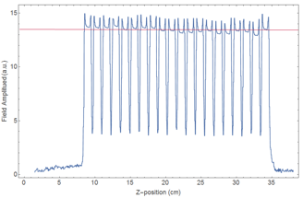
Novel Parallel-Feed Accelerator Structure
Split-cell structure is much more efficient, easy to build and tune
Successful high-gradient demo at X-band: 300 ns pulses @ 120 MeV/m w/ no observable breakdown after ~50 hours
Distributed Coupling to Each Cell
Inexpensive Fabrication Demonstrated
0
Field amplitude (a.u.)
-S11(dB)
-30
Position (cm)
11.3
Frequency (GHz)
11.41
Solid-Model of Split-Block Assembly
Single frequency rather than the traditional 20 resonances
Easy Tuning
Development of such a structure only possible through modern virtual prototyping using high power computing
S. Tantawi, P. Borchard, Z. Li
Notes:
5 microsecond 10 kHz 10 MV/m two channel cooling

Slide 3
Adapting the NC X-band Structure for SC L-band
 | 1.3 GHz TESLA | 1.3 GHz Parallel-Feed
R/Q (Ω/m) | 984 | 2570
E_{surf}/E_{acc} | 2.0 | 5.3
B_{surf}/E_{acc} (mT/(MV/m)) | 4.2 | 4.0
P_{loss} (mW/m/(MV/m)) | 101 | 43
Q₀ | 1.0e10 | 0.91e10
Dynamic RF cavity loss reduced by nearly 60% versus TESLA cavity.
Surface magnetic fields reduced 5% for the same gradient. However:
  Larger “packing ratio” possible with parallel-feed structure → active accelerating length is greater percentage of total length.
  Utilizing multi-frequency acceleration will enable even higher gradients (> 70 MV/m) for the same max surface magnetic field.

Slide 4
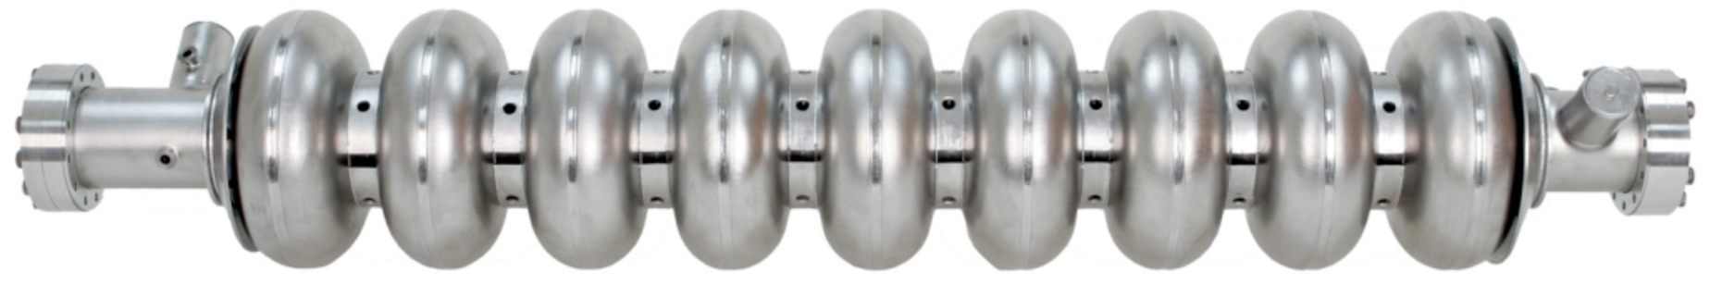
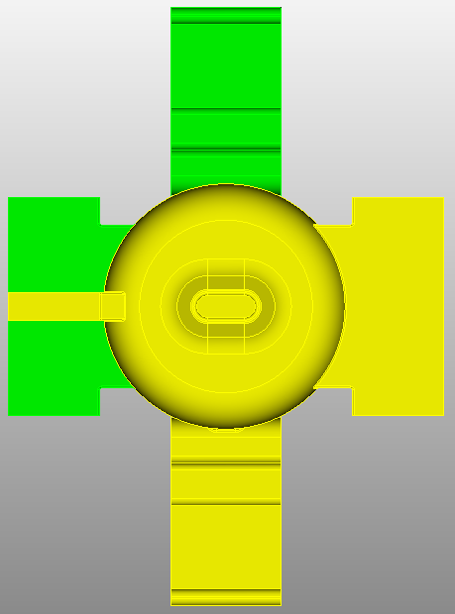
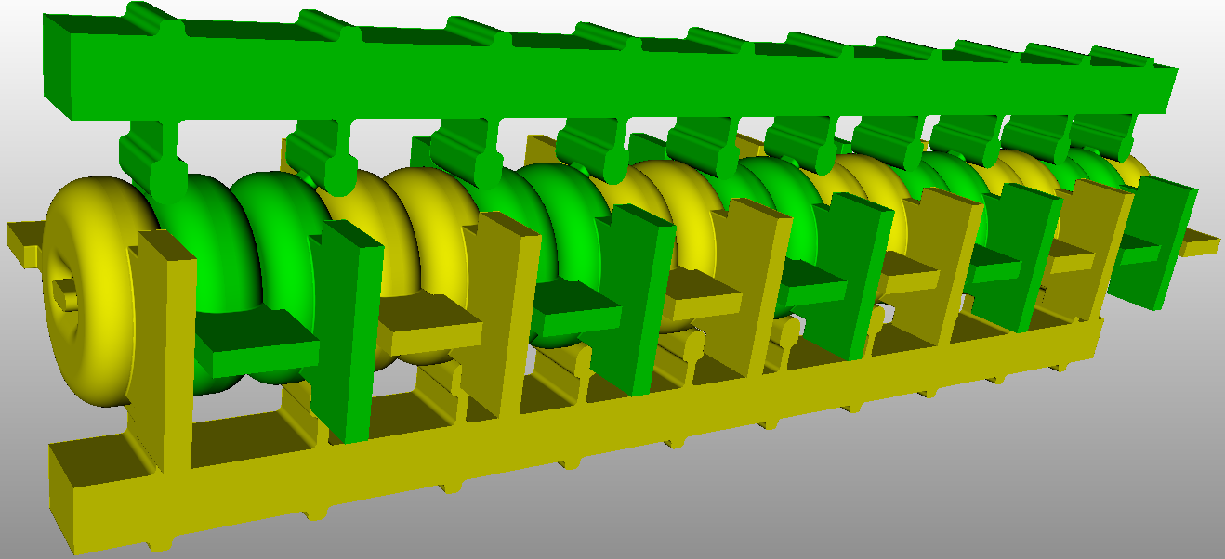
Higher Order Modes
9-cell TESLA Cavity
Narrow beam aperture increases cavity shunt impedance
RF fed in parallel to each cell
HOMs must also be extracted at each cell
Upstream & Downstream HOM Couplers
SSRL 20-cell NC Crab Cavity w/ Vertical & Horizontal HOM Couplers
Zenghai Li

Slide 5
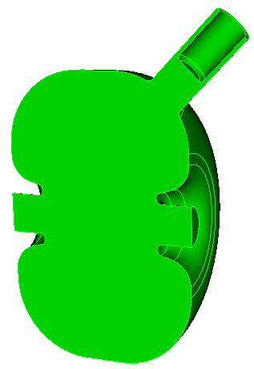
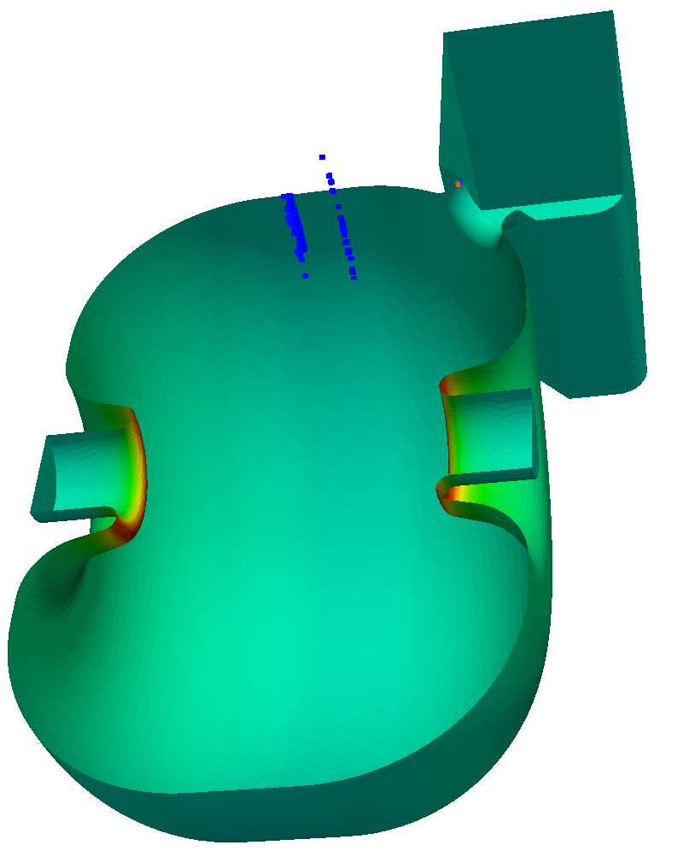
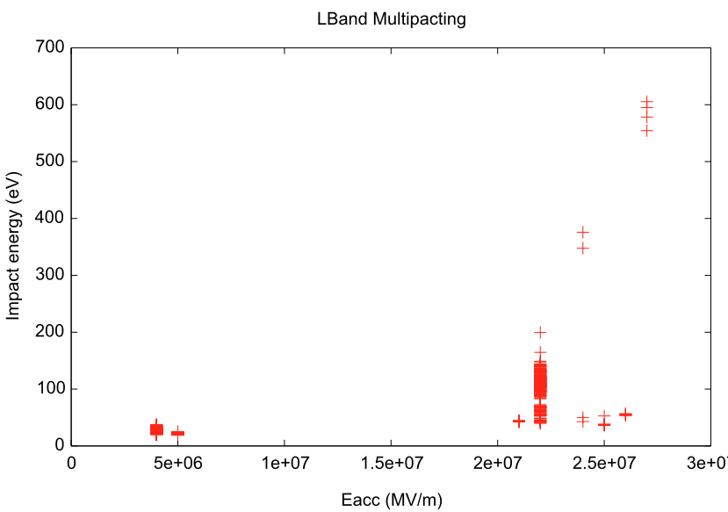
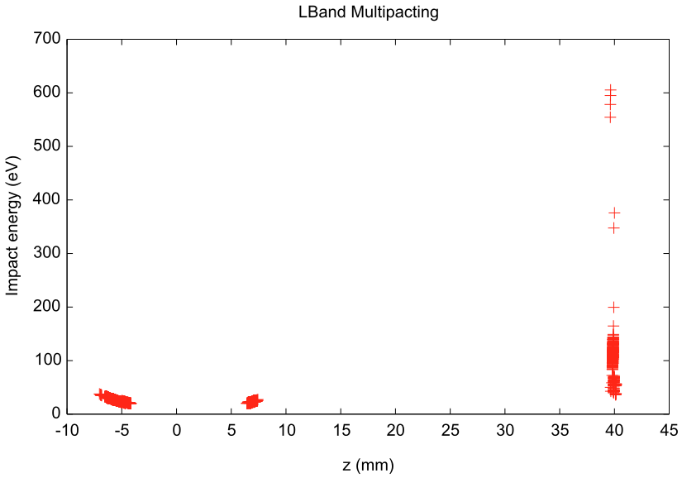
Cavity Tuning and Multipacting
Isolated cells → each tuned independently
Multipacting simulations
On very small region at the coupling iris
Low impact energy. Should be easily processed through

Slide 6
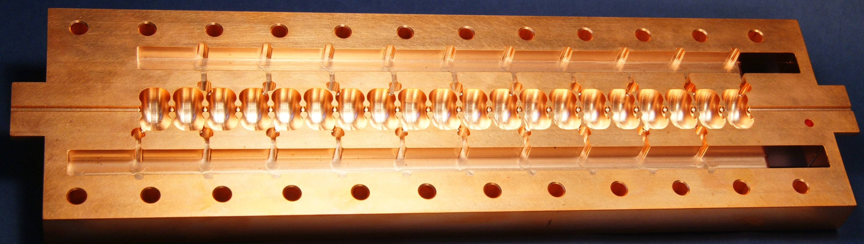
Fabricating a Parallel-Feed Cavity Prototype
Challenge #1 is how to fabricate:
  Parallel-feed accelerator structure requires an SRF thin-film coating on Cu.
  Open structure permits different coating approach than monolithic cavities.
  Reentrant topology makes coating non-trivial.
  SLAC Cu structure is brazed. SRF cavity to be welded or bolted.
  Accelerating mode has no azimuthal current, but excitation of HOMs and a lossy joint could kill efficiency.
  Short-term plan: 2-cell S-band prototype
  Long-term plan: Optimized 12-cell L-band accelerator structure

Slide 7
Backup Charts

Slide 8
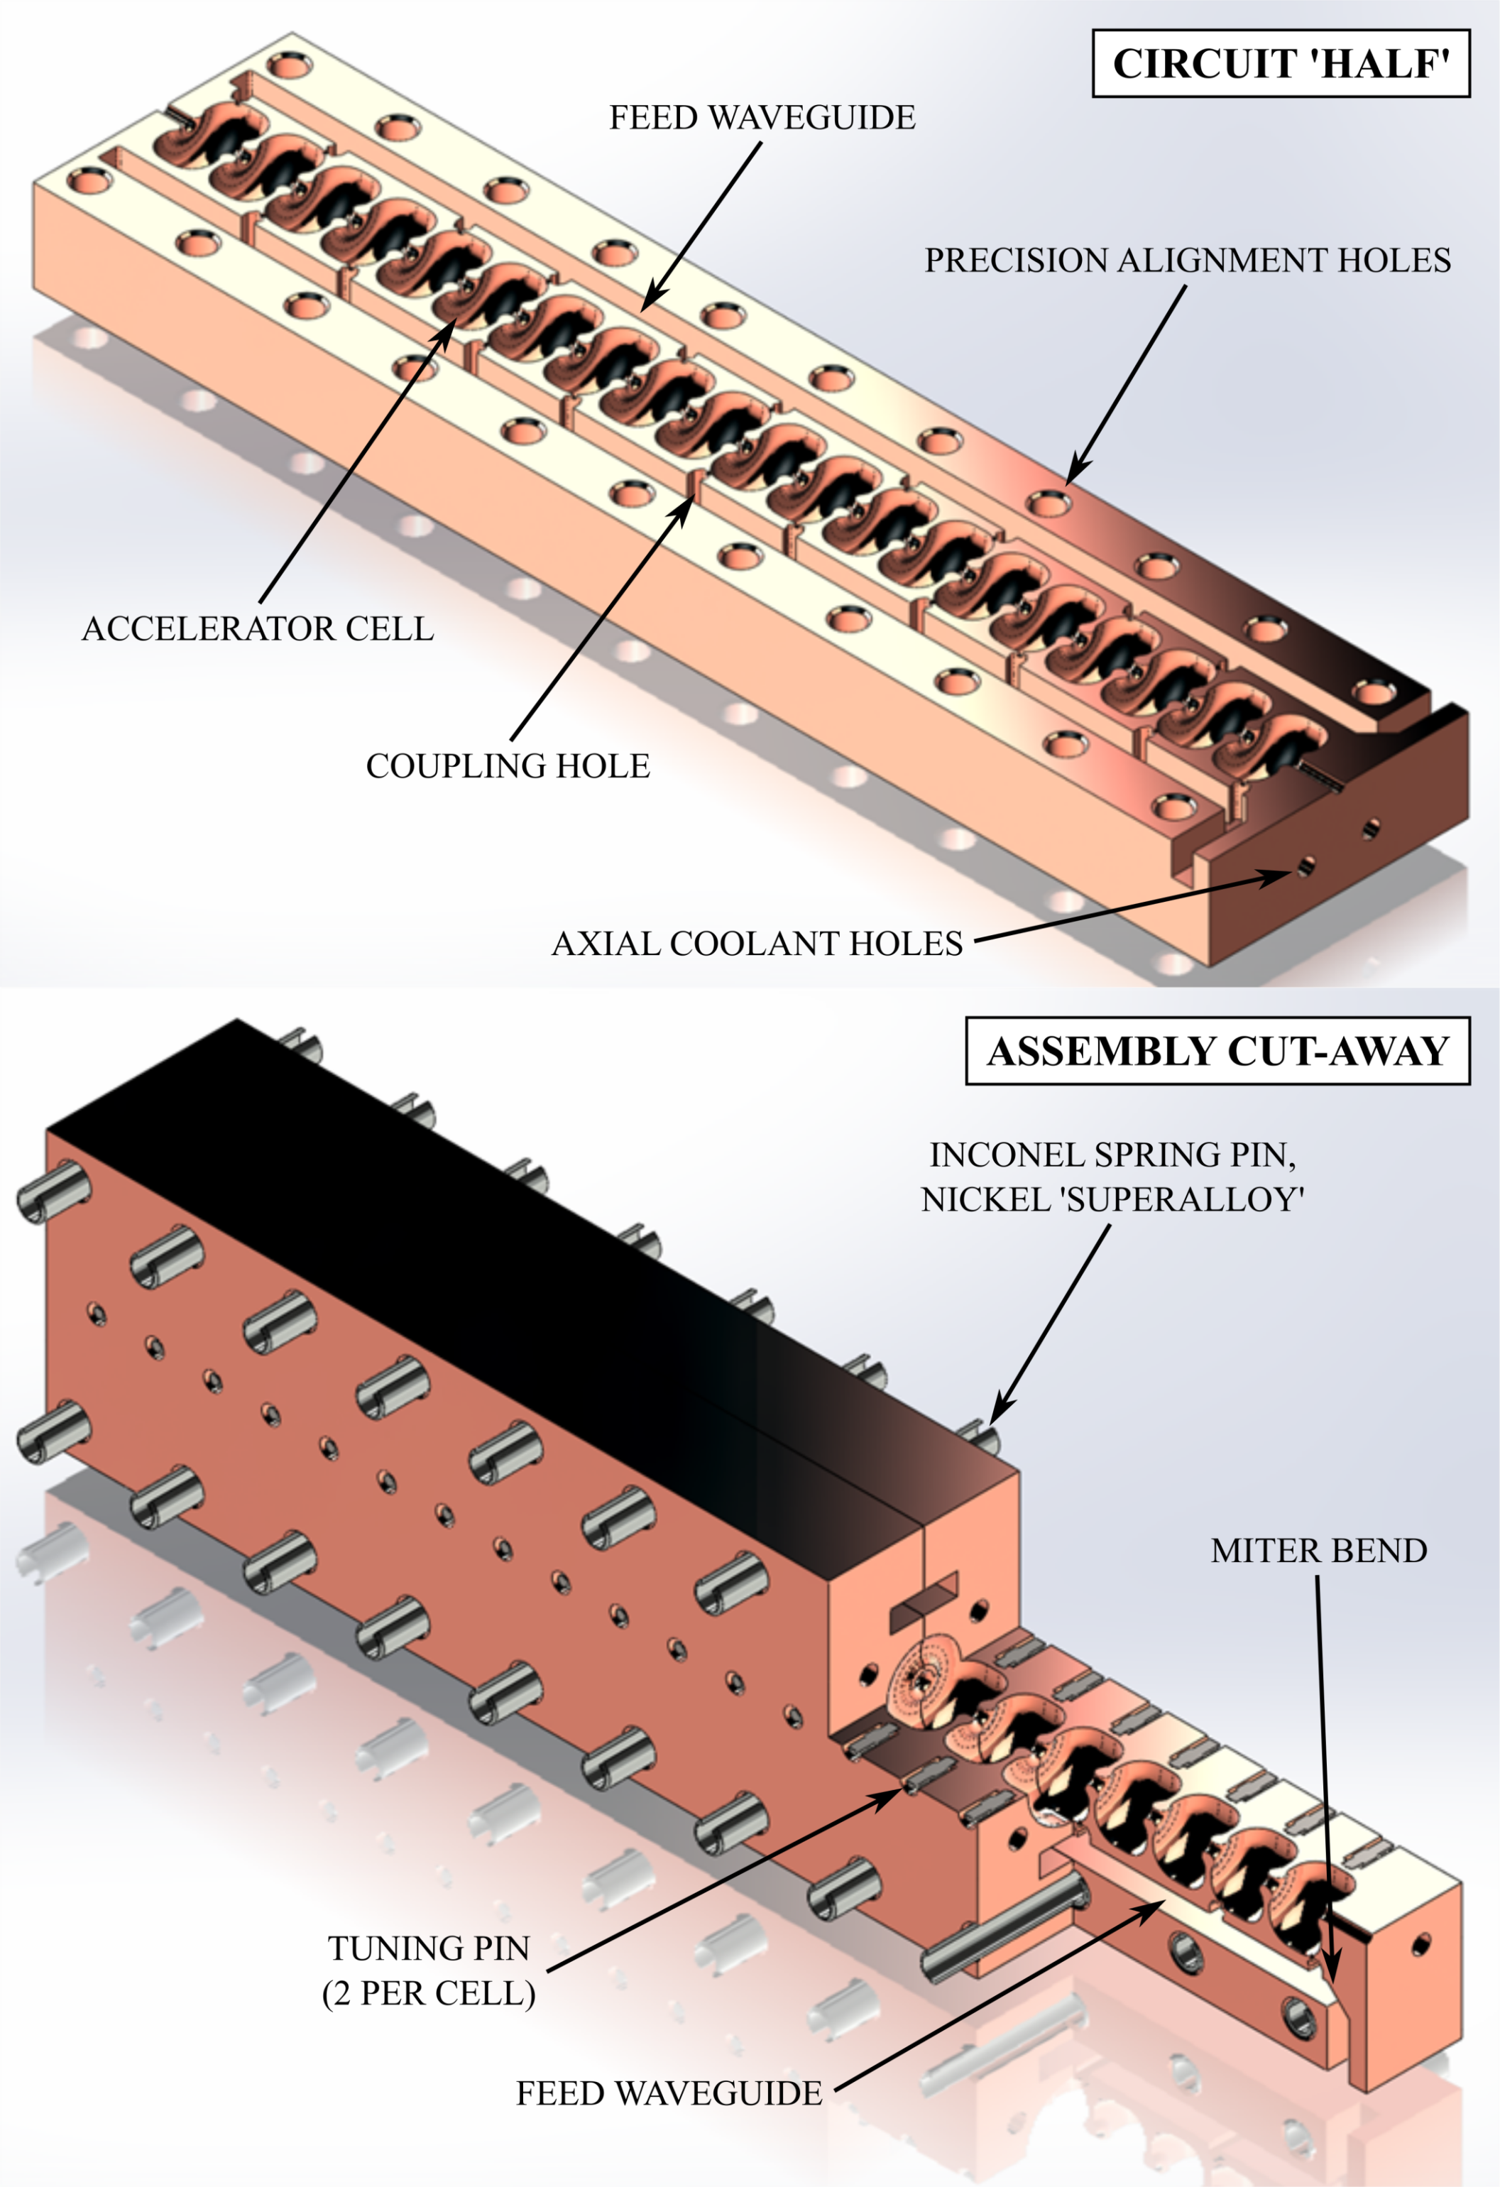
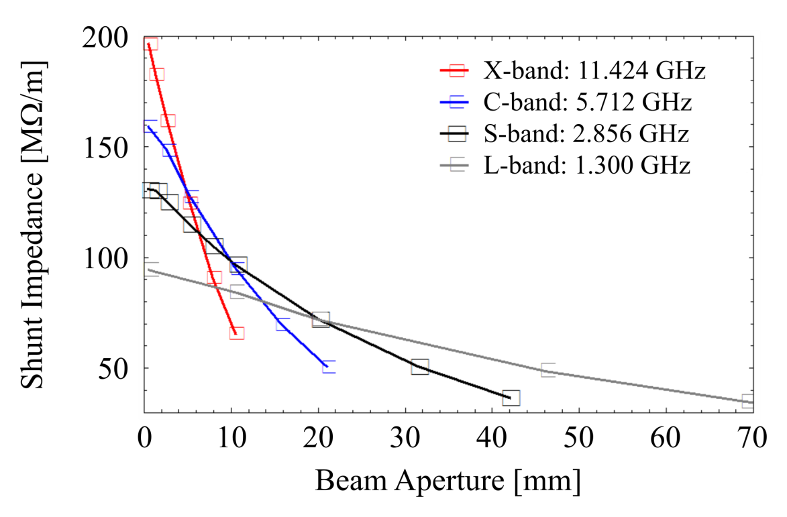
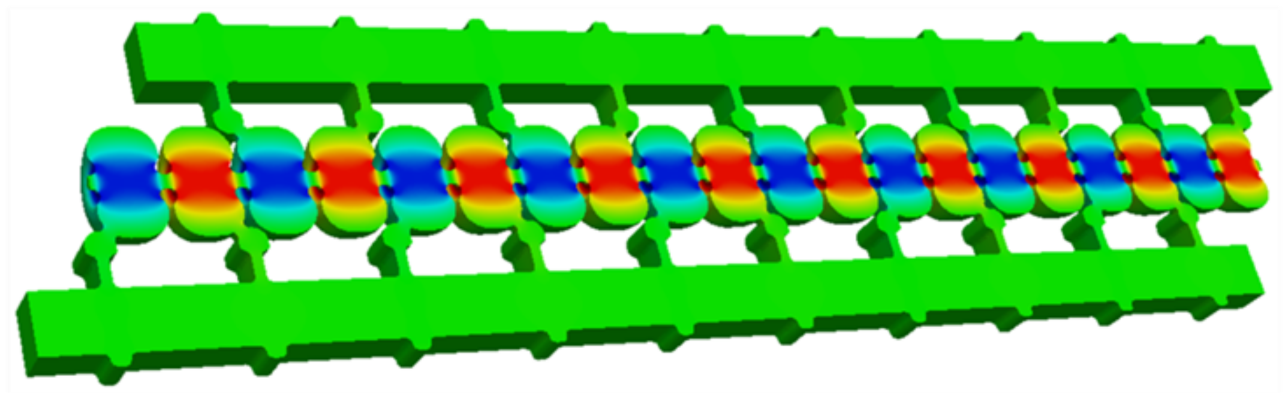
Highly Efficient Direct-Feed Split-Cell Cavity
Z. Li & S. Tantawi

Slide 9
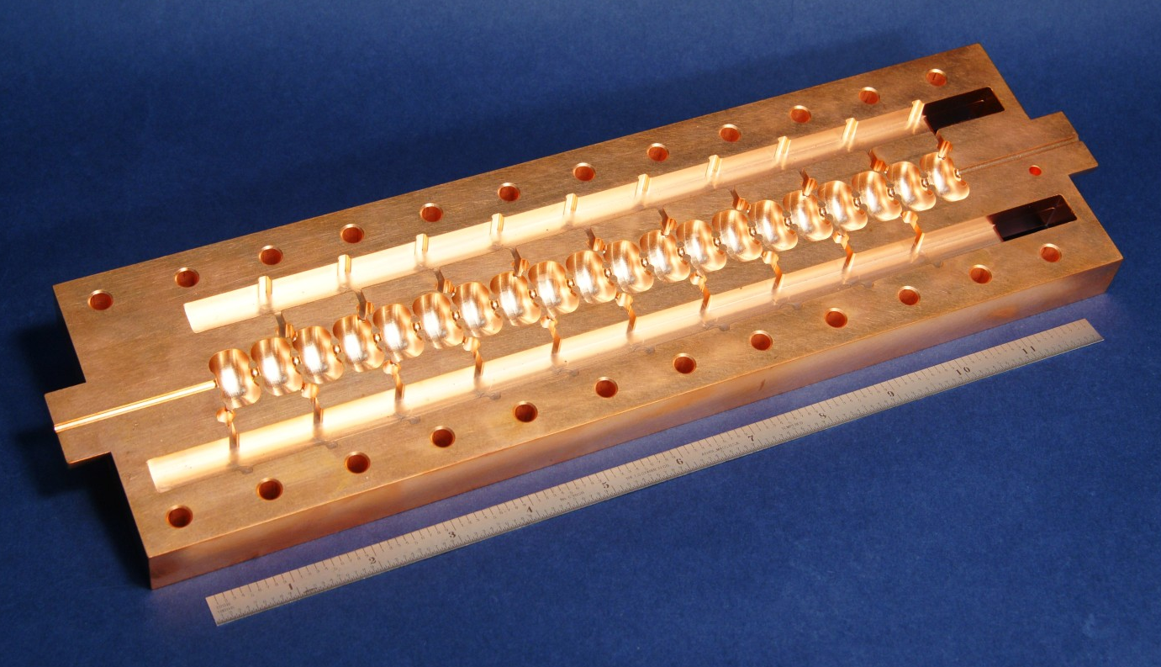
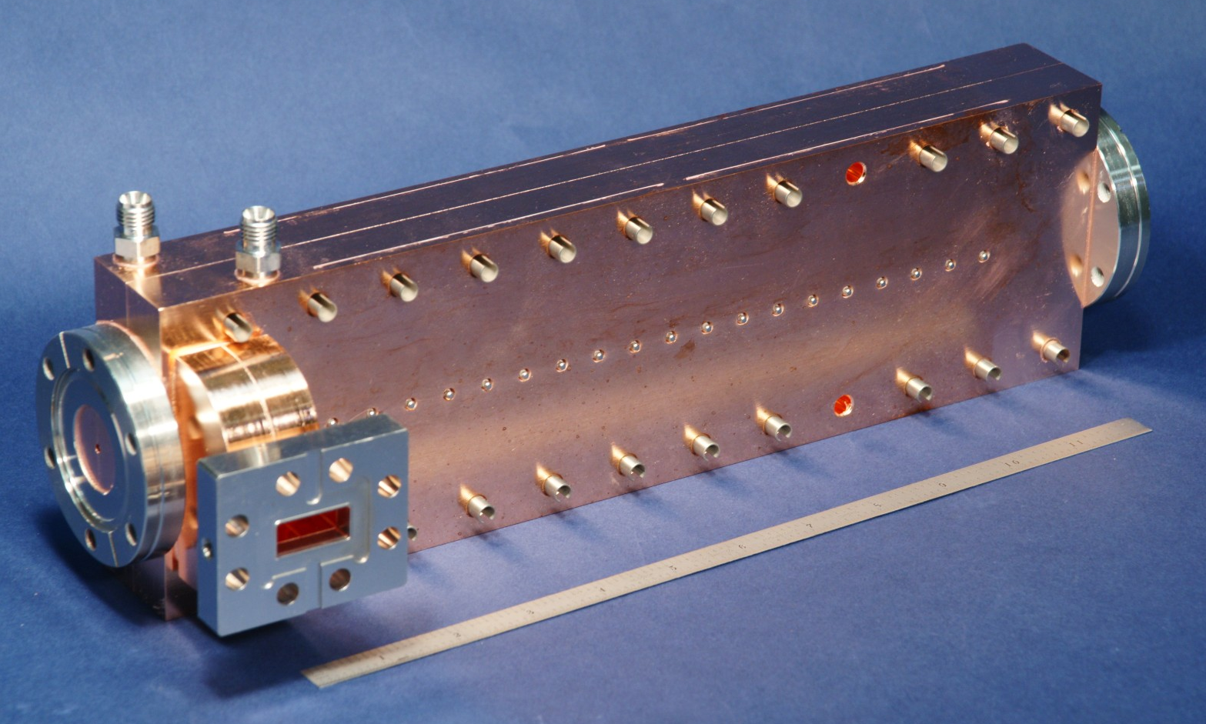
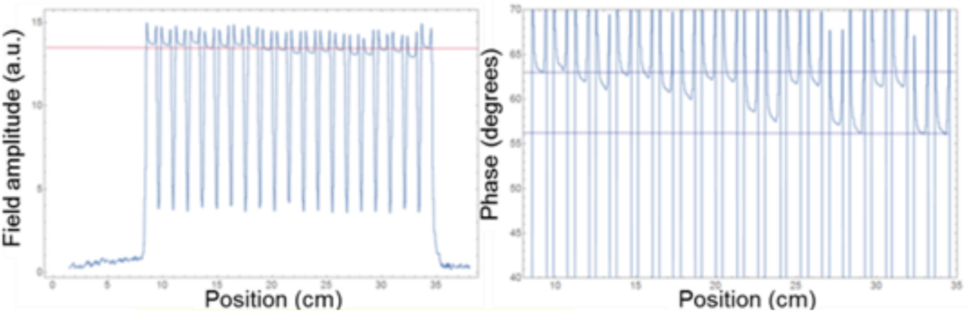
Demonstration in Cu at X-band
20-cell X-band structure fed by two waveguides from a single RF input.
Bead-pull measurement shows uniform field dist.
Currently under test, has exhibited up to 130 MV/m.

Slide 10


Multi-Frequency Acceleration Has Potential to Impact Efficiency and Gradient of Normal and Superconducting Structures
Typically gradient ~ (power)^{1/2}
Performance of cavity improves when powered with two different RF modes
  Efficiency: Linear superposition of fields by adding power in the two modes.
  Gradient: doubling the accelerating gradient without doubling surface fields; ~ 300 MV/m gradient at room temp
Potential for > 70 MV/m superconducting accelerators
f=11.424 GHz, R_{s}=181 M$Ω$/m
f=18.309 GHz, R_{s}=63 M$Ω$/m
Structure has total Shunt Impedance is 244 MΩ/m.
S. Tantawi, M. Nasr

Slide 11
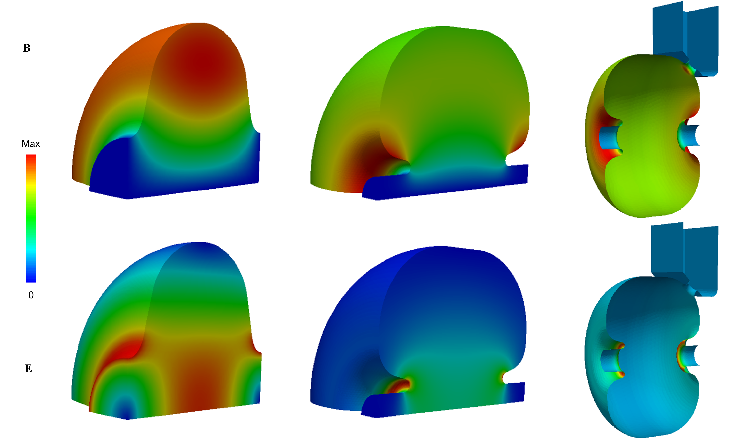
Field Comparison: TESLA vs. High-Efficiency Cell
B
Max
0
E

