Slide 1
New Shape Cavity
Rongli Geng
Jefferson Lab
GARD-SRF Roadmap Workshop
Fermilab, February 9-10, 2017

Slide 2
Question from Organizer
New shape cavity development, Low-Loss, Ichiro, LSF, Re-entrant cavities have demonstrated single cells to reach 55 MV/m at Q of 10^10. What is the recommended future development program for demonstrating 50 MV/m in a 9-cell cavity of advanced shape? (Geng, Solyak, D e l a y e n , Welander)

Slide 3
Outline
Comparison of shapes
Prior work on cavity shapes at JLab
LSF
CEBAF Low-loss
Recommended future development program for demonstrating 50 MV/m in a 9-cell cavity of LSF shape

Slide 4
Comparison of Cavity Shapes
 |  | TESLA | Low-loss/ICHIRO (LL) | Re-entrant (RE) | Low-surface-field (LSF)
frequency | MHz | 1300 | 1300 | 1300 | 1300
Aperture | mm | 70 | 60 | 60 | 60
Epk/Eacc | - | 1.98 | 2.36 | 2.28 | 1.98
Hpk/Eacc | mT/(MV/m) | 4.15 | 3.61 | 3.54 | 3.71
Cell-cell coupling | % | 1.90 | 1.52 | 1.57 | 1.27
G*R/Q | Ω² | 30840 | 37970 | 41208 | 36995
JLab has been prototyping LSF shape for following reasons
20% more efficient as compared to TESLA shape
12% gain in Hpk/Eacc, therefore also permitting gradient margin
Keep Epk/Eacc the same, therefore avoid field emission at high gradient
Impact from lower cell-cell coupling expected to be manageable

Slide 5
LSF
TESLA

Slide 6
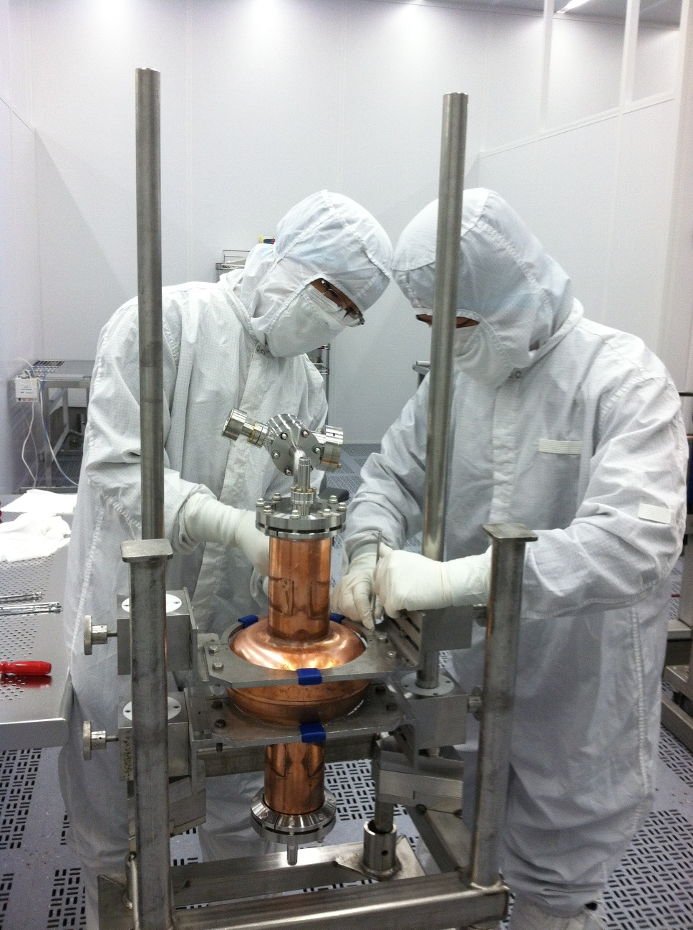
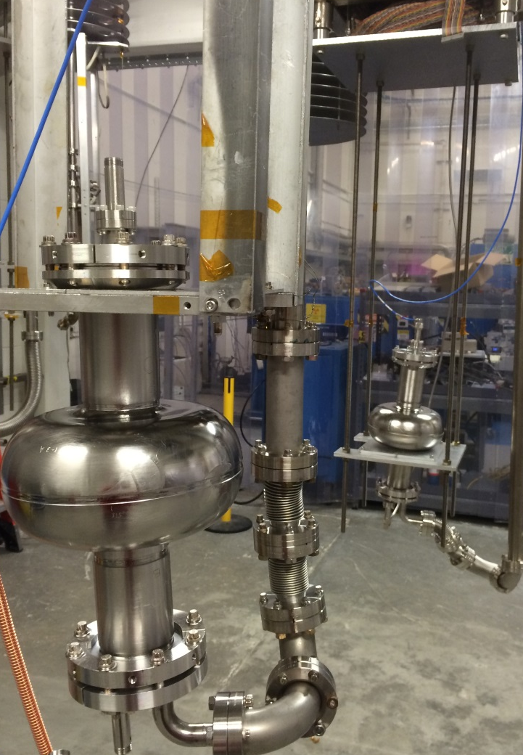
LSF Prototype Cavities
LSF1-1 Nb-Cu coated 1-cell
X. Zhao et al., SRF2013, TUP083
LSF1-2, LSF1-3 Large-Grain Nb 1-cell
R.L. Geng et al., IPAC2015, WEPWI013

Slide 7
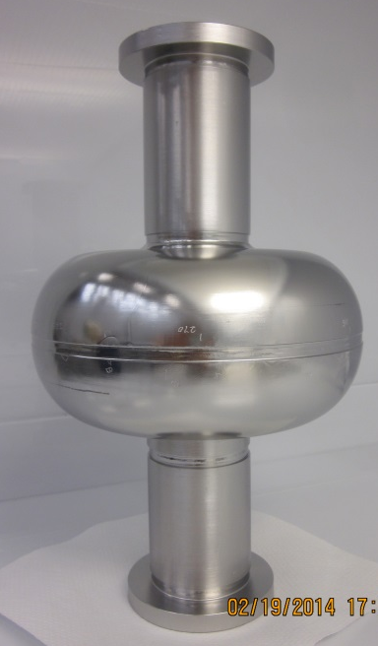
LG cavity LSF1-3 (JLab-SLAC-PKU collaboration)
30% increase in Q₀
LSF1-3
1.3 GHz
LSF Shape
Ningxia RRR > 300
Large-grain Nb
Cavity processing:
BCP 60 um + 800Cx2hr + BCP 20 um + 120Cx9hr
$$\frac{Q_{0}(1.8K)}{Q_{0}(2.0K)}≥1.56$$
IPAC2015, WEPWI013

Slide 8
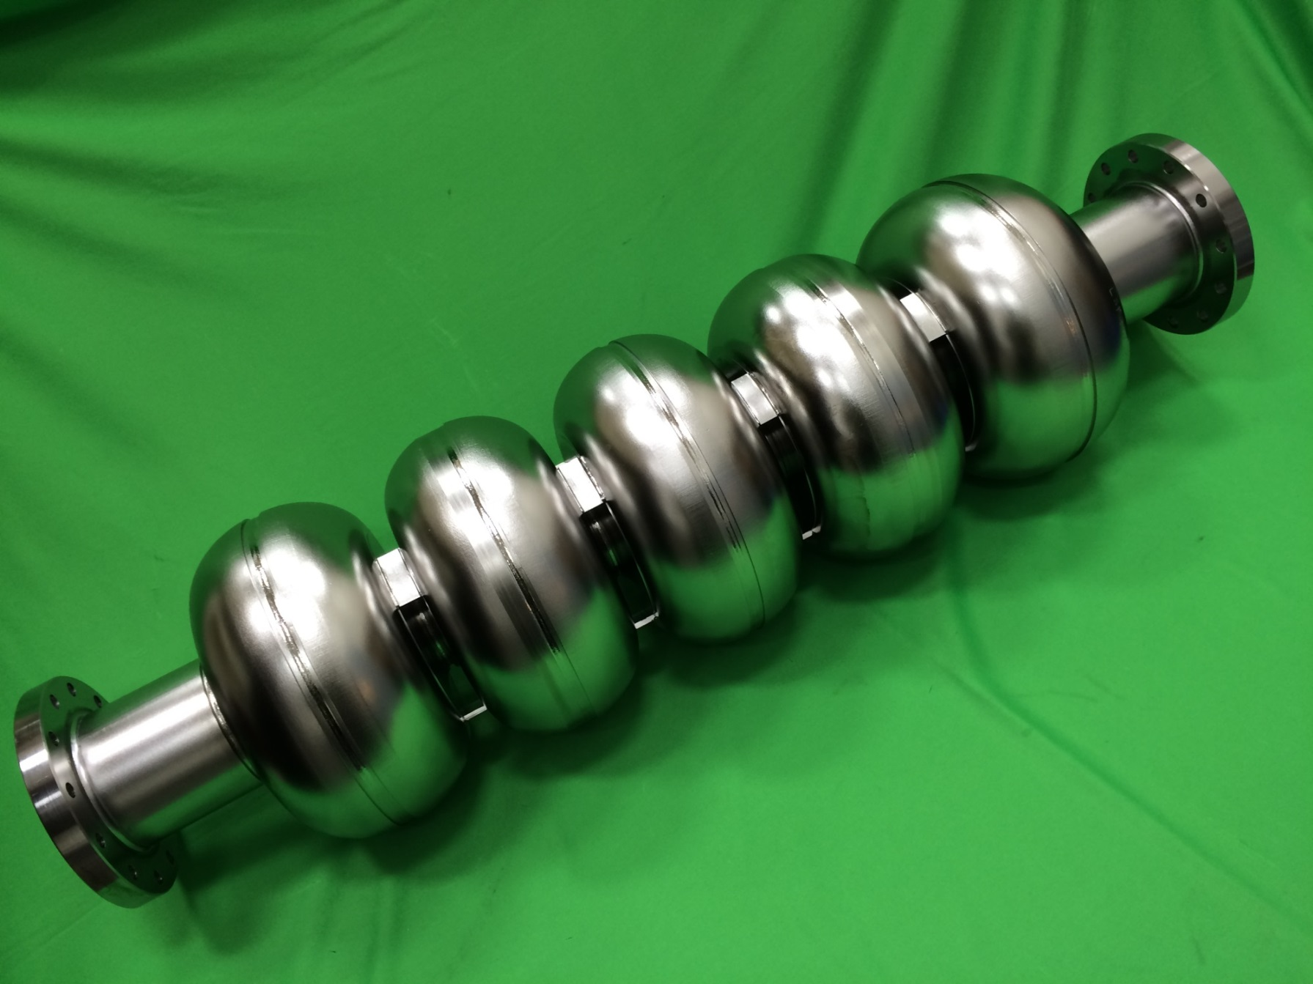
LSF Prototype Cavities
First 5-cell LSF completed on March 3, 3016
JLab in-house built with fine grain Nb

Slide 9
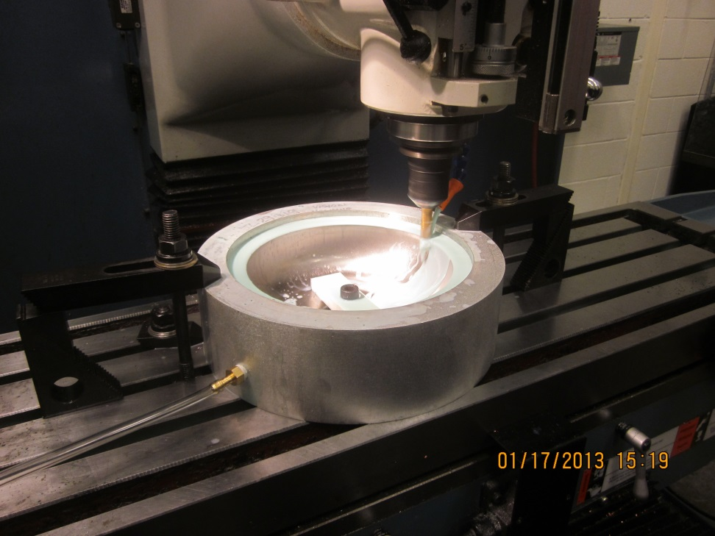
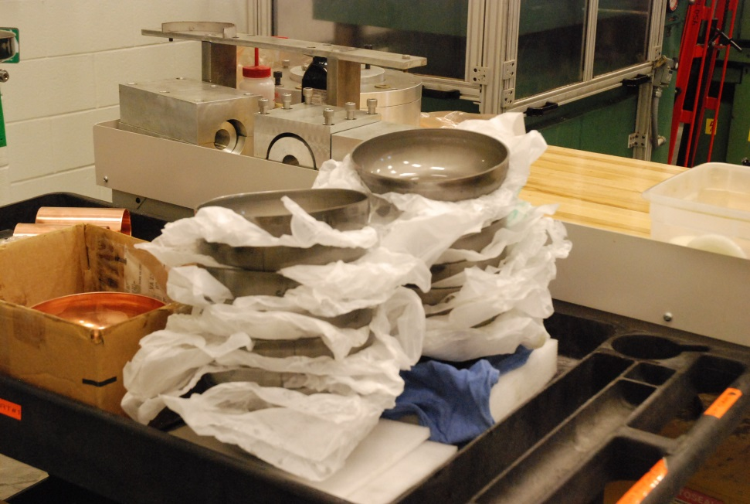
All Parts for First 9-Cell LSF in Hands

Slide 10
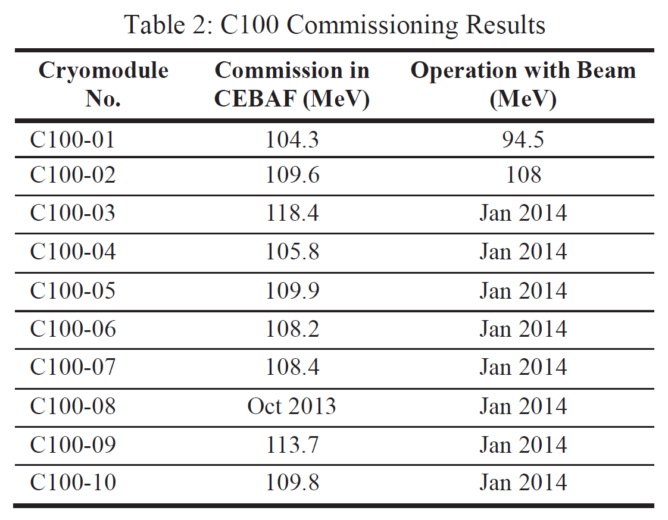
Low-Loss Shape Cavity Accelerating Beam
CEBAF 12 GeV Upgrade Cavity
1.5 GHz, Low-loss Shape, 53mm bore dia.
C. Reece, TTC Meeting, Feb. 28-Mar.3, 2011
J. Hogan et al., PAC2013, WEZAA2

Slide 11
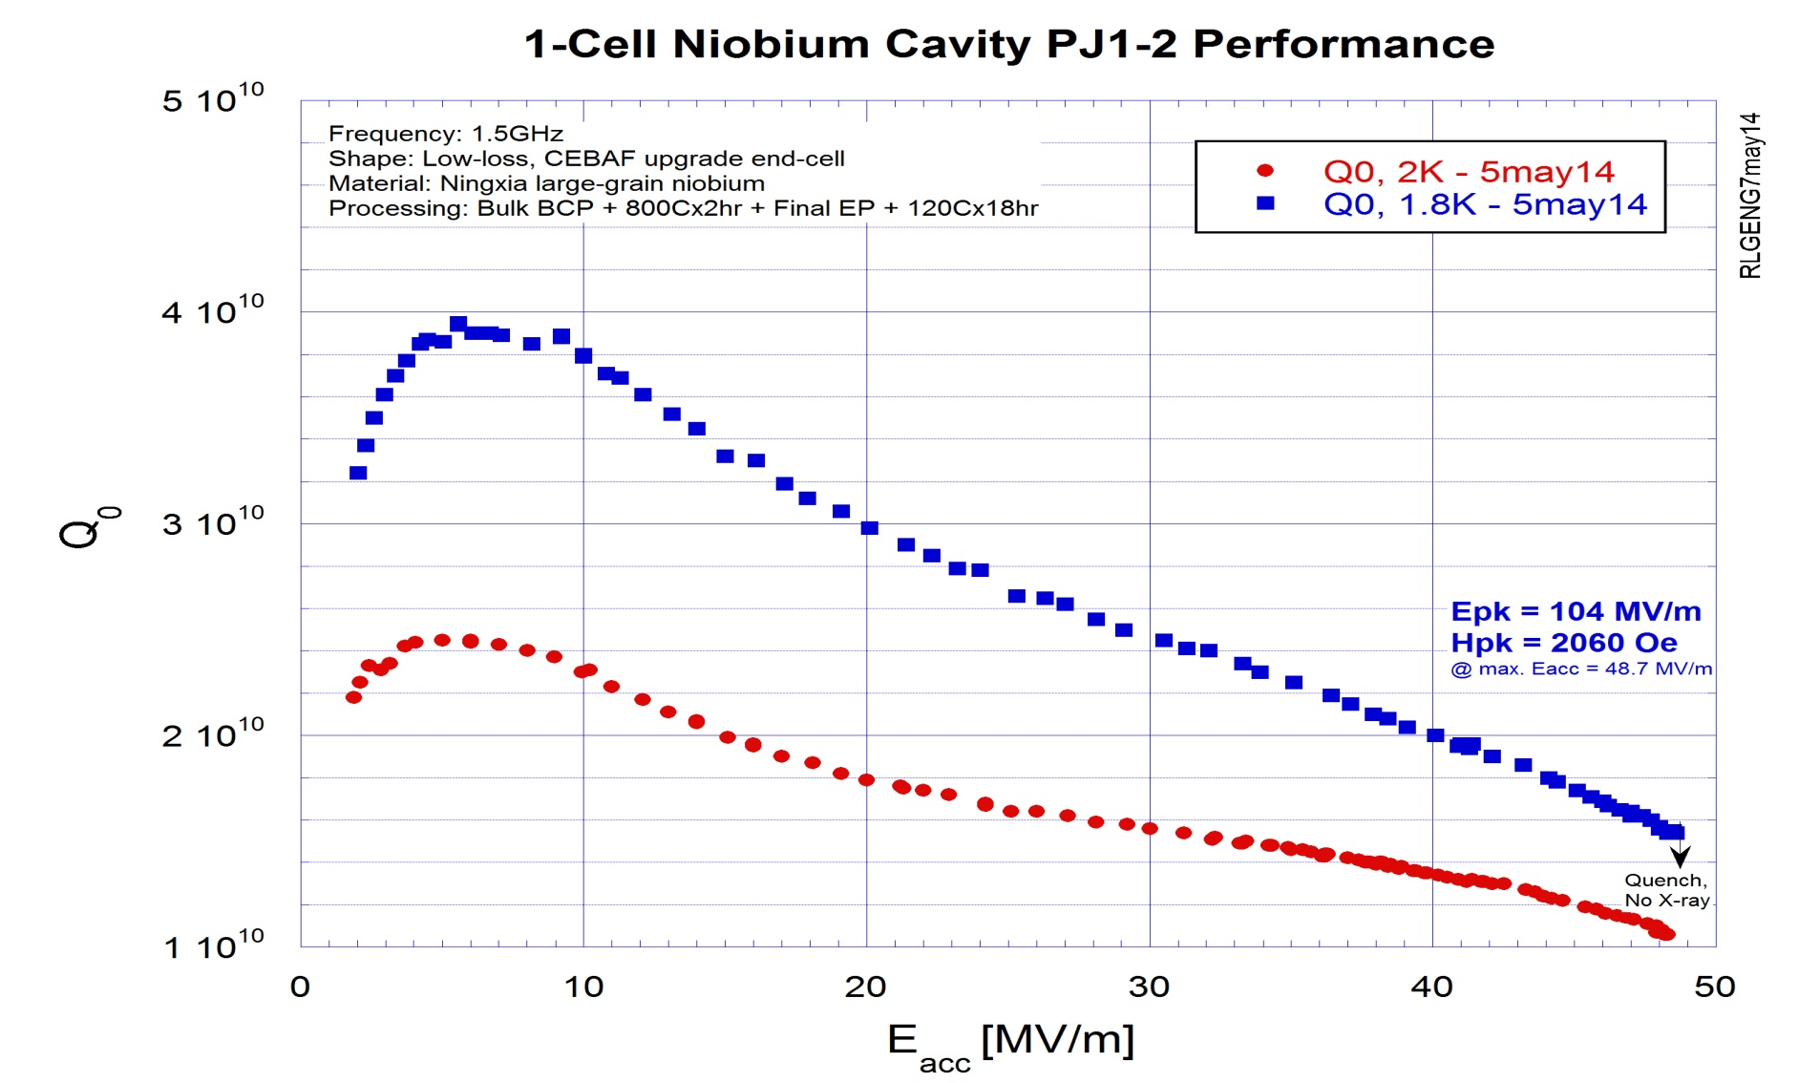
High Gradient High Efficiency 1-cell CEBAF-type
PJ1-2 (JLab-PKU-OTIC collaboration)
Ningxia
RRR> 300
LG Nb
IPAC2015, WEPWI013

Slide 12
Recommended Future Program
A 3-year program with goal of achieving 50 MV/m in 9-cell LSF cavities estimated effort of $2M.
Complete processing and testing 5-cell LSF cavity by end of 2017; complete EBW of first 9-cell LSF cavity (w/o HOM couplers) with existing half-cells, process and test by end of mid-2018.
Complete industrial fabrication of six LSF cavities using high-purity large-grain Nb, process and test by end of 2019.
See talk on “Large-Grain Nb” for why it is selected.

