Slide 1
PIP-3 Cost Driver - Cryomodule
Genfa Wu
2017-02-09

Slide 2
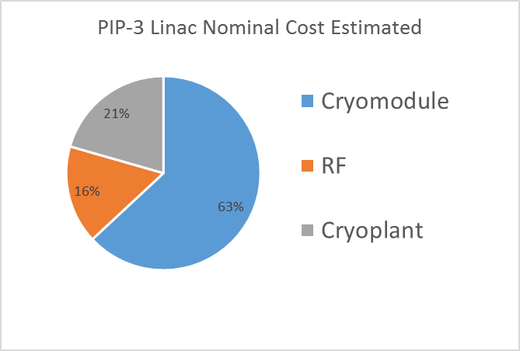
PIP-3 SC Linac Parameters
8 GeV Linac
3 GeV CW 650 MHz Linac
24 MV/m
Q0 5e10
Static heat load 7 W per cryomodule
50% heat load margin
5 GeV Pulsed 1300 MHz Linac (1% duty cycle)
25 MV/m
Q0 2e10
Static heat load 2 W per CM
50% heat load margin
2.5 MW Beam power

Slide 3
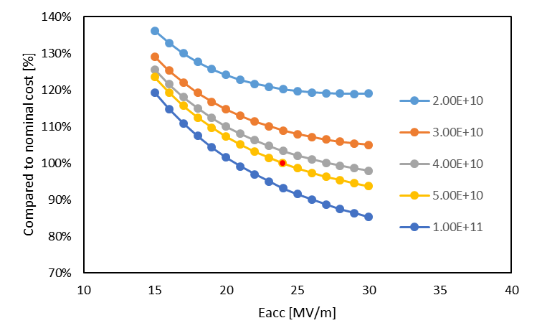
Estimated Nominal Cryomodule Cost – Cavity Performance
Double Q0 => 7% cost reduction
24 to 30 MV/m => 6% cost reduction
Notes:
LCLS-II, 1.3 GHz, 9-cell, 300 cavity. $10 m.
PIP-3 Scale to 650 MHz = X8 x5cell/9cell. X4mm/3mm, 120 cavities (20 cryomodules), -> $20-$24 M$ 3GeV CW linac
FCC 12 GV/100MW, 400 MHz 5 cell. 5mm thick. 600 cavities.

Slide 4
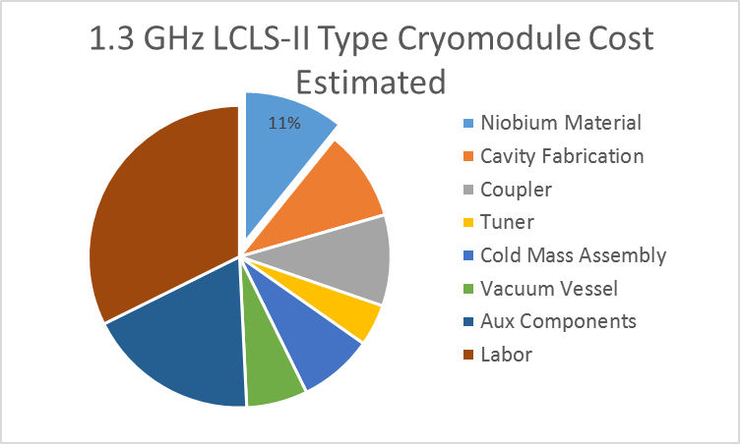
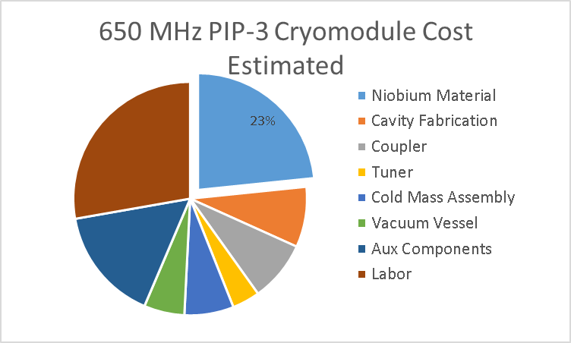
Estimated Nominal Cryomodule Cost - Material
US Cost based on LCLS-2
650 MHz Niobium material cost is ~$20M
Copper | $2.66 /lbs
Niobium | $150.00 /lbs
Nb/Cu potential cost savings ~7%
Notes:
LCLS-II, 1.3 GHz, 9-cell, 300 cavity. $10 m.
PIP-3 Scale to 650 MHz = X8 x5cell/9cell. X4mm/3mm, 120 cavities (20 cryomodules), -> $20-$24 M$ 3GeV CW linac
FCC 12 GV/100MW, 400 MHz 5 cell. 5mm thick. 600 cavities.

Slide 5
PIP-3 Cost Summary
650MHz Linac
Double Q0 saves 7% total cost
Improving Eacc saves 6% total cost
Improving Material to Nb/Cu saves 7%
1300MHz Linac
Q0 improvement brings small cost savings due to low duty cycle
Improving Eacc from 25-30 MV/m saves 5%
Total savings combined: 26%
Notes:
$75 M savings

