Slide 1
Cost impact of films, Nb₃Sn and N-doping Technologies for FCC
Sam Posen
GARD-SRF Worksbop
Fermilab
9-10 February 2017

Slide 2
Required Wall Power to Cryoplant Per Cell
R_{res} = 5 nΩ
LHC, Nb/Cu
400 MHz, 10 MV/m
2.0 K
4.5 K

Slide 3
Nb 800 MHz – R_{res} based on LCLS-II Production
R_{res} = 5 nΩ
LHC, Nb/Cu
400 MHz, 10 MV/m
R_{res} = 3 nΩ
2.0 K
4.5 K

Slide 4
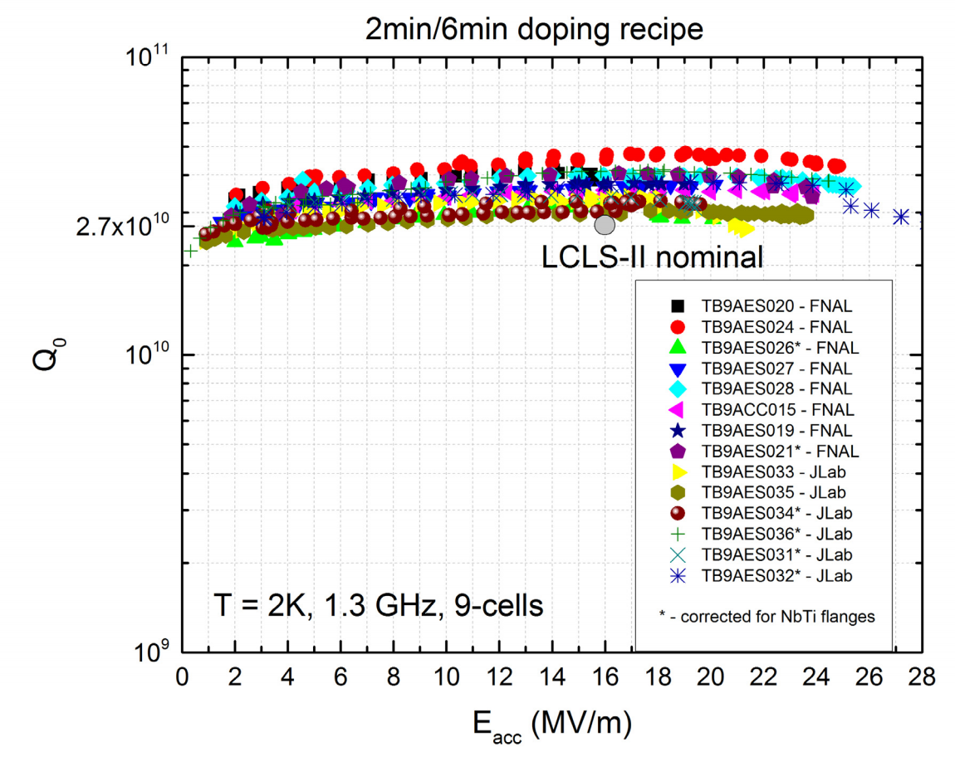
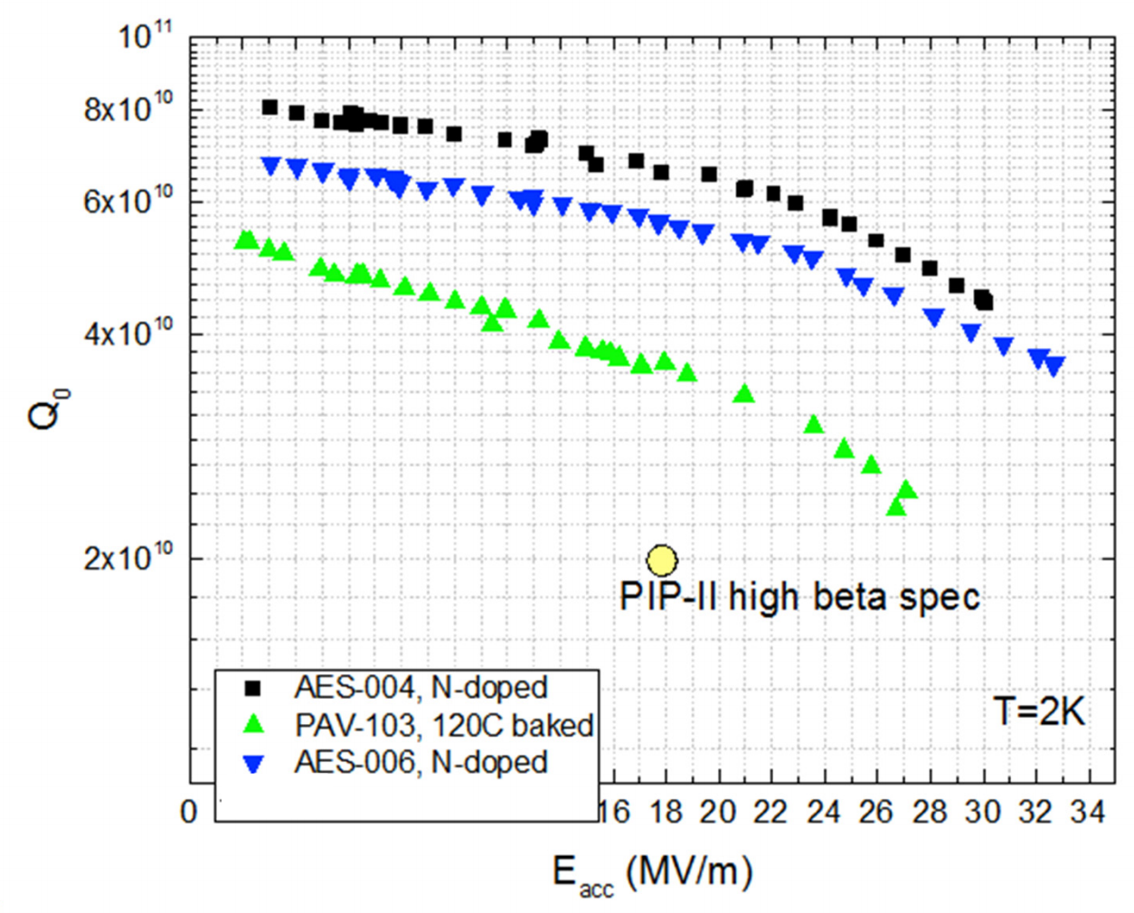
N-doping Estimate at 800 MHz
Can interpolate between 1300 MHz and limited experience at 650 MHz
1300 MHz
650 MHz
Plots from A. Grassellino, IPAC15

Slide 5
N-doping – Estimate based on other Frequencies
R_{res} = 5 nΩ
LHC, Nb/Cu
400 MHz, 10 MV/m
R_{res} = 3 nΩ
N-doped Nb, 800 MHz,
20 MV/m
2.0 K
4.5 K

Slide 6
Nb 400 MHz, No Q-slope – Estimate Based on Flat ECR film
R_{res} = 5 nΩ
LHC, Nb/Cu
400 MHz, 10 MV/m
R_{res} = 3 nΩ
R_{res} = 35 nΩ
N-doped Nb, 800 MHz,
20 MV/m
2.0 K
4.5 K

Slide 7
Nb 400 MHz, bulk-like with minimal residual
R_{res} = 5 nΩ
LHC, Nb/Cu
400 MHz, 10 MV/m
R_{res} = 3 nΩ
R_{res} = 35 nΩ
R_{res} = 3 nΩ
N-doped Nb, 800 MHz,
20 MV/m
2.0 K
4.5 K

Slide 8
Nb₃Sn Coating – Estimate based on 1.3 GHz
R_{res} = 5 nΩ
LHC, Nb/Cu
400 MHz, 10 MV/m
R_{res} = 3 nΩ
R_{res} = 35 nΩ
R_{res} = 3 nΩ
N-doped Nb, 800 MHz,
20 MV/m
R_{res} = 10 nΩ
2.0 K
4.5 K

Slide 9
Nb₃Sn Coating – Optimized Residual
R_{res} = 5 nΩ
LHC, Nb/Cu
400 MHz, 10 MV/m
R_{res} = 3 nΩ
R_{res} = 35 nΩ
R_{res} = 3 nΩ
N-doped Nb, 800 MHz,
20 MV/m
R_{res} = 10 nΩ
2.0 K
R_{res} = 3 nΩ
4.5 K

