Slide 1
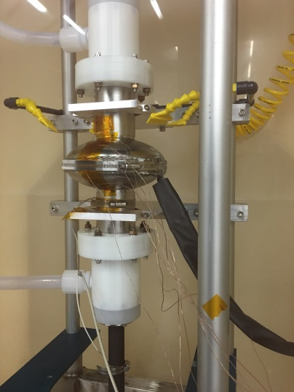
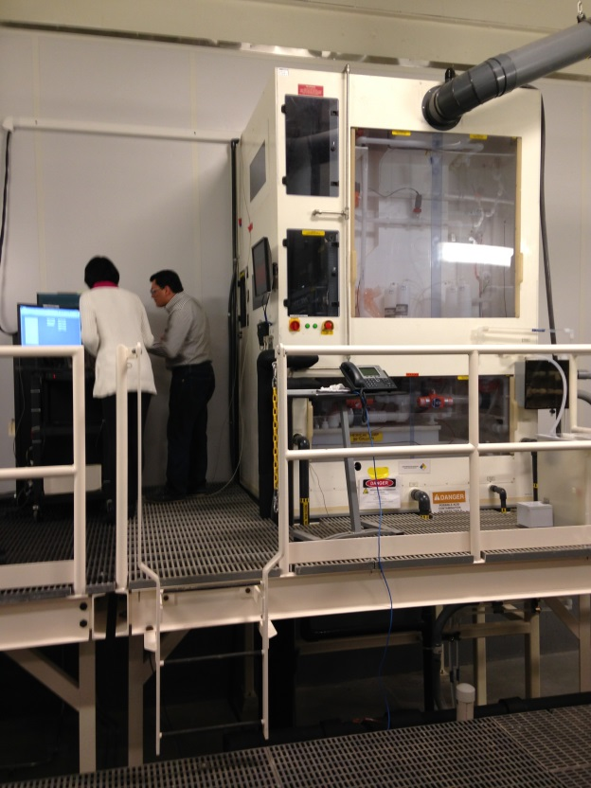
Cost Reduction of Cavity Processing
Objective: Lower the cost of industrial processing of Nb cavities
Safer, greener chemistry - eases industrialization
“Vertical” processing – reduced touch labor, amenable to automation
HF- free electropolish
“Pulse-reverse,” “cathodic polishing”, “bi-polar polishing”
Faraday Technology, Inc. patents (model SBIR effort)
5% sulfuric acid – demonstrated high performance single-cell and multicell success
Sodium hydroxide
…
JLab collaborations with Faraday Technology & KEK/Nomura Plating
Small sample R&D – parameter analysis
Translating to single and multi-cell cavities
VEP chem cabinet and pulse power supply now commissioned within our cleanroom suite (switching kiloamps)
Effort presently funding limited
C. Reece & H. Tian

