Slide 1
ILC Luminosity upgrade
Nikolay Solyak
GARD-SRF Roadmap Workshop
FNAL, 9-10 February, 2017

Slide 2
Discussion
What is the cost impact of increasing ILC luminosity from its design value by about a factor of 2 ?
One approach to increasing luminosity is to increase the beam rf pulse length to 1.4 ms from 0.72 ms and accelerate a train of 2600 (instead of 1300) bunches. This doubles the beam power.
With higher Q is it possible to trade lower refrigerator cost for higher RF power cost? Is the impact of high beam power a concern?
(Nikolai Solyak)

Slide 3
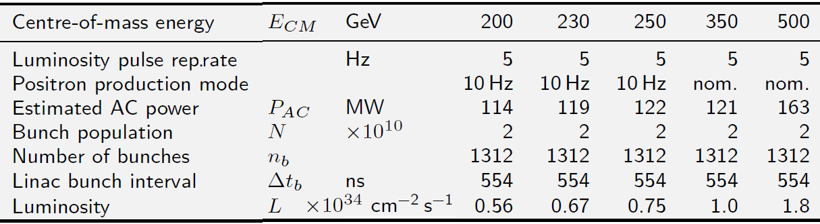
ILC (TDR)

Slide 4
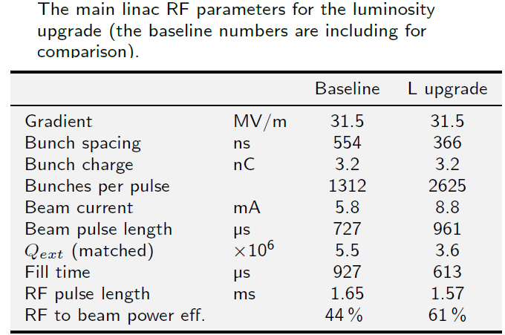
Possible upgrade

Slide 5
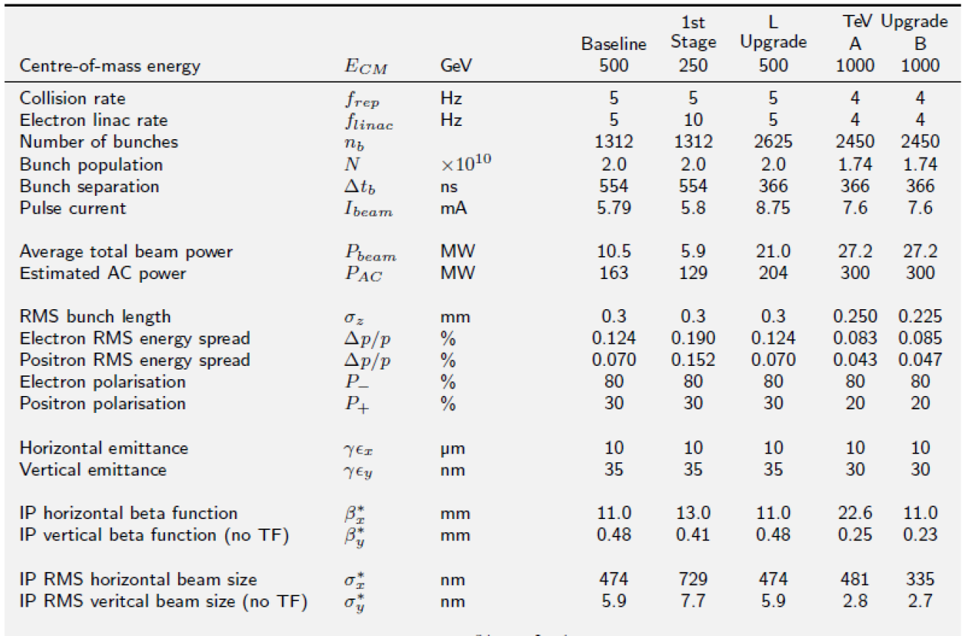
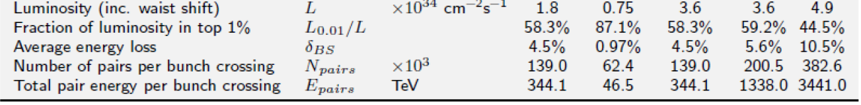
Table 1: Upgrade and staging options for the ILC (beyond the baseline 500 GeV centre of mass machine) -TDR

Slide 6
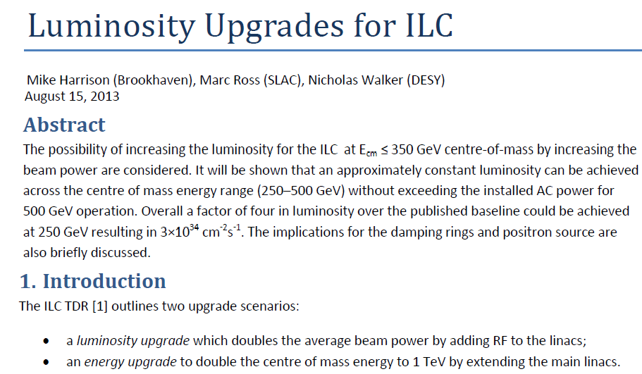
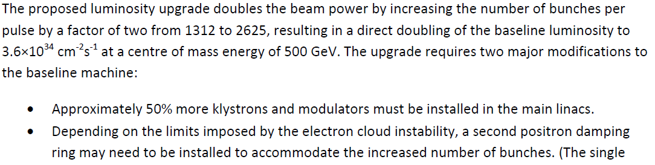

Slide 7
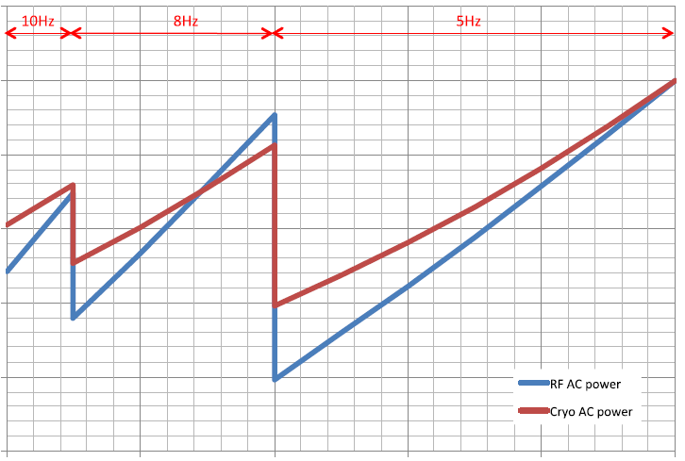
350 GeV
250 GeV
500 GeV
AC power associated with the main linacs’ RF and cryogenic systems, relative to the installed values at 500 GeV centre of mass operation.

Slide 8
Summary
x2 lumi upgrade scenarios (comment from Nick Walker):
The current TDR lumi upgrade assumes just doubling number of the bunches (i.e. 2600 vs 1300, still same RF pulse length and rep.rate); this requires adding 50% more klystrons and modulars (not to mention a possible second positron damping ring) and is probably about ~0.4-0.5 Billion 2012 US $.
Although it is perfectly valid to discuss increasing the RF pulse length,
the message here is not to forget the implications for the sources, in particular positron production —already a challenge at the baseline numbers.
Increasing of Q0 is beneficial for cryogenic power saving. Doubling Q0 → ~3% saving (out 7.8 BILCU)

