Slide 2
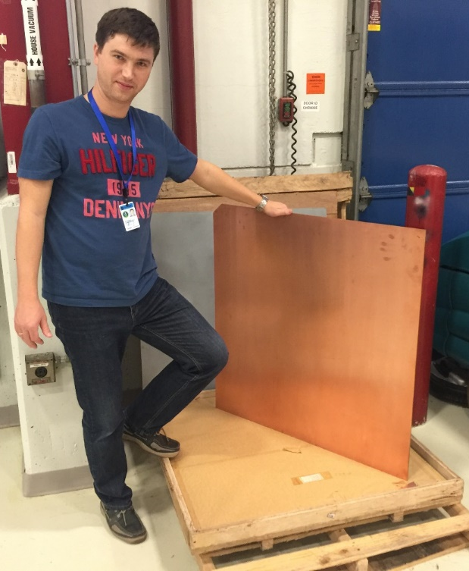
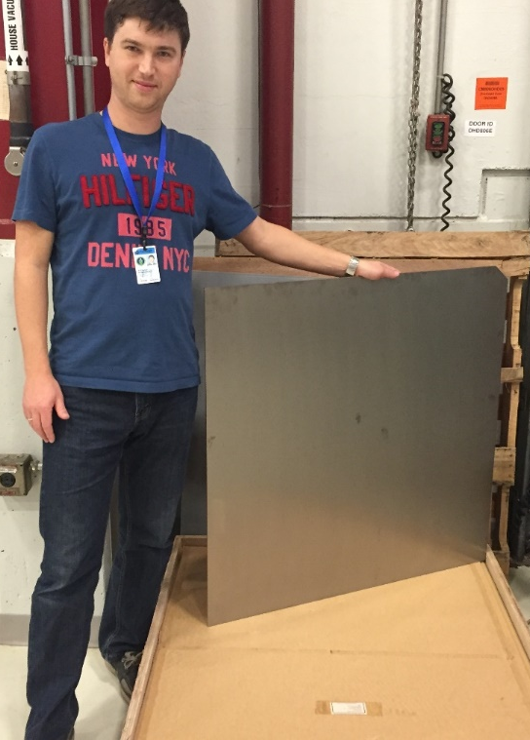
1 m² Nb-Cu Sheet Explosion Bonded
Propose cost reduction -1
Via Nb-Cu Composites
Nb 1 mm/Cu 4 mm,
Material made by explosion bonding Cu with high RRR Nb
X4 - 5 reduction over Nb
Cavities made via hydroforming and spinning

