Slide 1
Seamless Cavity
Bob Rimmer
Jefferson Lab
GARD-SRF Roadmap Workshop
Fermilab, February 9-10, 2017

Slide 2
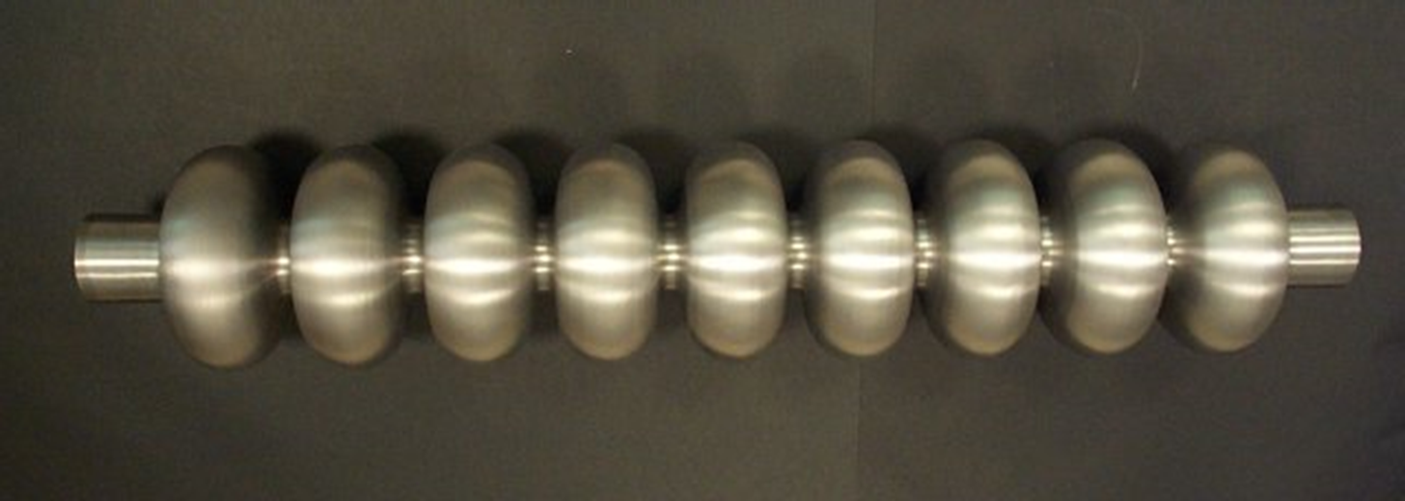
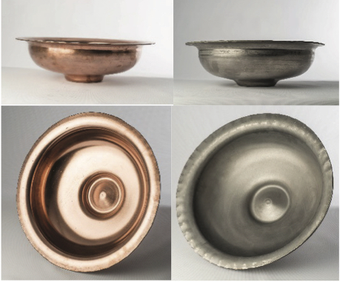
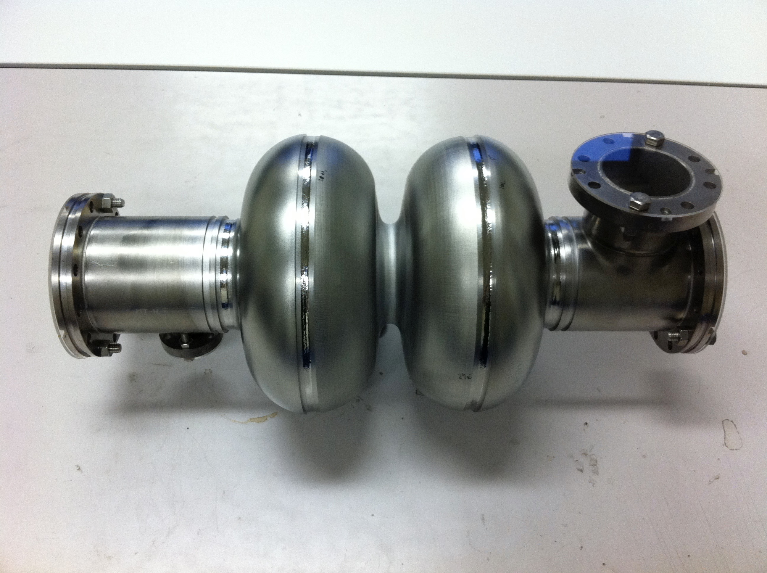
Alternative cavity fabrication methods
Is a completely seamless cavity possible?
Seamless cavity
and end group
J. Buttles,
Bailey Tool, TX
Hydroforming, W. Singer, DESY
http://www.baileytool.com
Hydroforming,
K. Saito, KEK
Spinning, E. Palmieri, INFN
Impulse forming
New experiments by CERN using Bmax process in France
Seamless dumbbell, K. Sennyu, MHI
http://www.bmax.com

