Slide 1
  Cut Cavity Materials and Cavity Fabrication Costs
New cavity materials
  Nb-Cu composite
New fabrication methods
  Hydroforming
  Spinning

Slide 2
Cavity Material-Cost Reduction
Cost of bulk niobium is a major factor for SRF accelerators
  especially for low frequency (<650 MHz)
  the required Nb per cell scales as 1/f².
Propose Cavity cost reduction via Nb-Cu Composites
  Nb 1 mm/Cu 4 mm,
  X5 reduction over Nb
  Material can be made by explosion bonding Cu with high RRR Nb
1-cell and 3-cell cavities made by DESY, KEK
  Proof of principle to 40 MV/m established

Slide 3
Cavity Fabrication-Cost Reduction via
Seamless Techniques with Nb-Cu Composites
Eliminate expensive e-beam welding and trim machining of parts
High quality surface preparation possible
  as with bulk Nb cavities that show high performance
Rapid production rate
Hydroformed and Spun 1-cell cavities already proven
  Hydroformed 3-cells Nb proved to > 35 MV/m
  Spun single cell Nb proved to 40 MV/m
  Spun 3-cell Nb under test at FNAL
Collaboration with INFN, DESY, and KEK, US industry

Slide 4
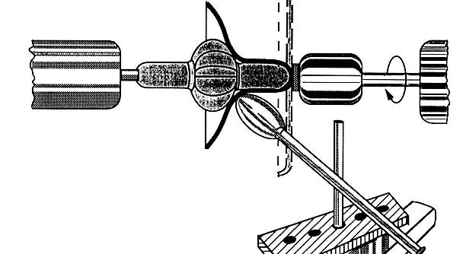
Principles of
Hydroforming and Spinning

Slide 5
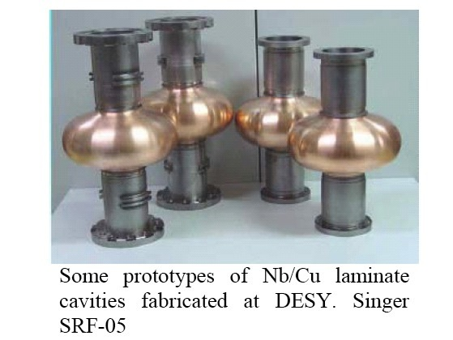
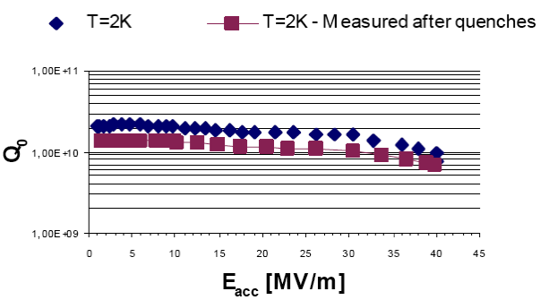
Proof of Principle
1-cell Nb-Cu Composite Hydroformed
Reaches 40 MV/m

Slide 6
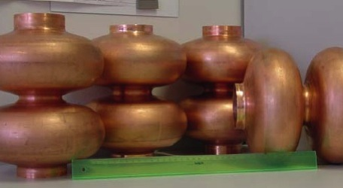
2-cell Nb-Cu Hydroformed

Slide 7
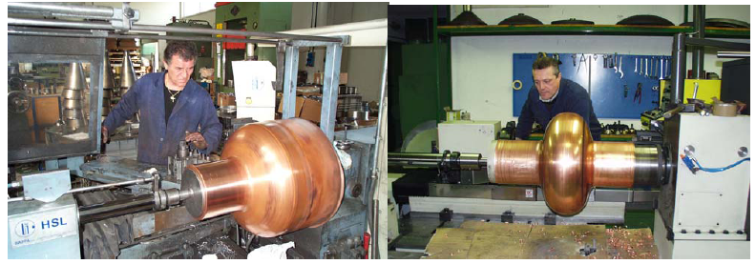
500 MHz Single Cell Spun from Nb-Cu Sheet

Slide 8
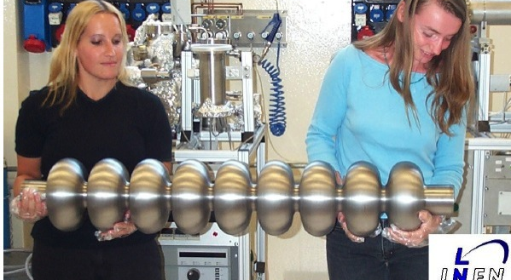
9-cell Nb Cavity Made by Spinning

Slide 9
Proof of Principle for Spinning
1.3 GHz Single Cell Nb Spun Cavity – 40 MV/m

Slide 10
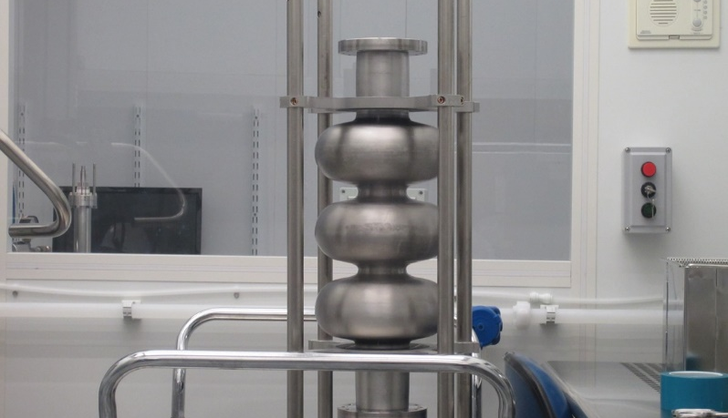
3-cell Cavity Made From Nb Tube By Spinning At INFN
Test at FNAL
E_{acc} 34 MV/m
T=2K

Slide 11
Hydroformed 3-cells
Welded into 9-cells
30 – 35 MV/m Proved

Slide 12
1300 MHz Nb-Cu Composite Cavities Reach 40 MV/m

Slide 13
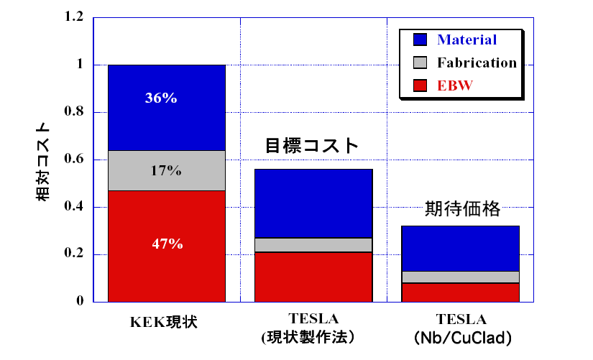
Scenario of cost reduction
Cost evaluation of Nb/Cu clad seamless cavity
The present cost considering effect of mass production is still higher than expected level
Relative cost
Nb bulk Cavity
Nb/Cu Clad
seamless
By T.Fujino Ph.D Thesis 2003
KEK Existing
ILC Mass production
Nb/Cu Clad Seamless

Slide 14
Nb-Cu Composite Cavity Material & Seamless Fabrication
Cost Reduction Plans
Short term
  Fabricate, process, and test 1-cell 650 MHz Nb-Cu composite cavities via spinning
  Thinning/delamination at beam tubes controlled by die selection and larger area for starting material
Medium term
  Fabricate and test multicell composite cavities
Long term
  Involve industry for mass-production
  Apply High Q treatment to Nb-Cu composite cavities
    Lower temperature of N-doping

