Slide 1
Expected impact for improved EP technique, such as Vertical EP or HF free EP
Fumio Furuta, Matthias Liepe, Cornell

Slide 2
Expected impact for improved EP technique, such as Vertical EP or HF free EP
Potential/impact:
VEP:
Simplified integration with other processing steps
Simplified infrastructure (reduced facility costs)
HF-free
Reduced environmental impact
Lower risk (no HF)
Higher performance ?

Slide 3
Expected impact for improved EP technique, such as Vertical EP or HF free EP
Current status:
9-cell VEP high Q, high gradient demonstration at Cornell
HF-free EP single cell high gradient performance demonstration (Faraday, FNAL)
Ongoing R&D programs at Cornell, Faraday, JLAB, KEK
Faraday/Cornell: first 9-cell scale HF-free, bi-polar VEP done

Slide 4
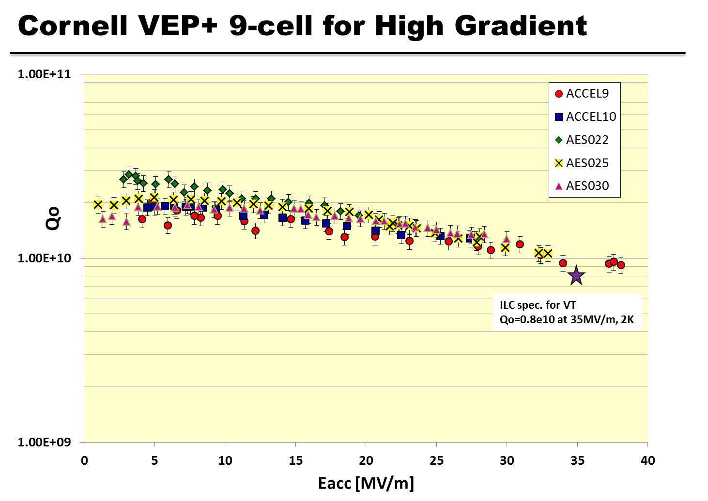
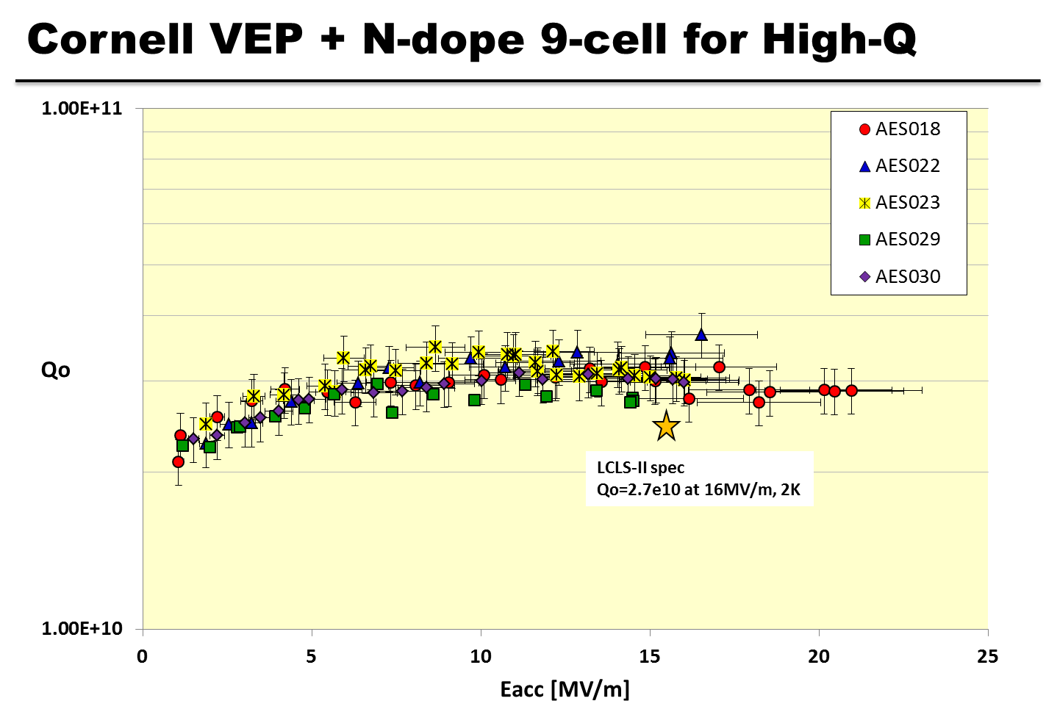
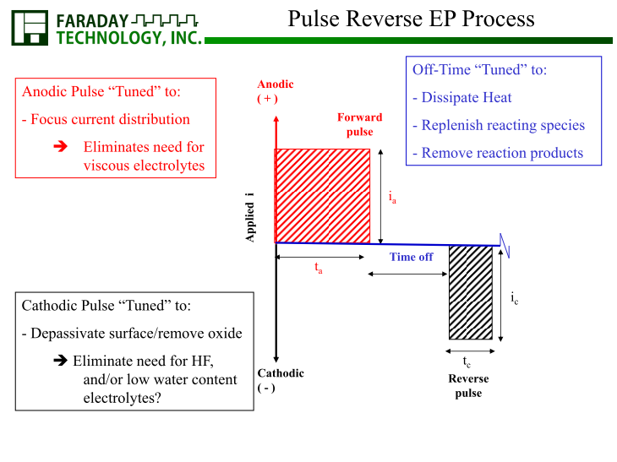

Slide 5
Expected impact for improved EP technique, such as Vertical EP or HF free EP
Next steps / suggested development program :
R&D program on pulse-reversed (bi-polar) vertical polishing
Explore HF-free electrolyte (e.g. 5-10 wt% H₂SO₄ in H₂O) and acid-free salt-based electrolyte.
Study surface chemistry
Optimize process
Transfer to 9-cell cavities and study high-field, high Q performance
Demonstrate reproducibility and high yield on 9-cell cavities

