Slide 1
Large-Grain Niobium
Rongli Geng
Jefferson Lab
GARD-SRF Roadmap Workshop
Fermilab, February 9-10, 2017

Slide 2
Questions from Organizer
What are the pros and cons for long term cost reduction via Nb materials using large grain Nb? What are the best case and worst case scenarios for total cost reduction. Also, single cell cavities of explosion bonded Nb-Cu have been fabricated and tested to 40 MV/m. What is the anticipated material and fabrication cost saving of using explosion bonded Nb-Cu over Nb? (Geng, C. Reece, Yamamoto)

Slide 3
Fore Matter
As always, a credible estimation in ownership cost reduction when large amount of money is involved requires knowledge in resources, production, and market etc.
Proper constrains must be placed first. If a credible design is existing already, such as for ILC, any cost saving solution in one area must deliver without raising cost in other areas.
When you have an existing design AND a demanding specification AND limited time such as ILC in three years, cost saving is achieved by simplification and by replacement of “plug compatible” and “risk neutral” inexpensive alternatives.
Because it simplifies Nb material production by eliminating steps, Large-Grain (LG) Nb is in the right direction toward cost reduction.
Although 40 MV/m has been demonstrated in single-cell explosion bonded Nb-Cu cavities, there are still many steps to be fulfilled. Therefore, therefore this technology should be discussed separately and will not be discussed in this talk.

Slide 4
Outline
Milestones of LG Nb since 2005
Learning of LG Nb material properties
Some recent results on LG Nb cavity at JLAB
Conclusion

Slide 5
Milestones since 2005
2005, introduction of LG (ingot) Nb by JLab
Quickly proliferated
  2007, full-scale 9-cell cavities at DESY in 2007
  2007, 45 MV/m with Q0 2E10 at 2K in single-cell 1.3 GHz cavity by PKU-JLAB collaboration
  2010, two LG 9-cell cavities (AC112, Ac113) began beam operation at DESY
  2011, 45 MV/m with Q0 1E10 at 2K in full-scale 1.3 GHz 9-cell cavity at DESY
  2014, full-module LG cavity (7/8) demonstration

Slide 6

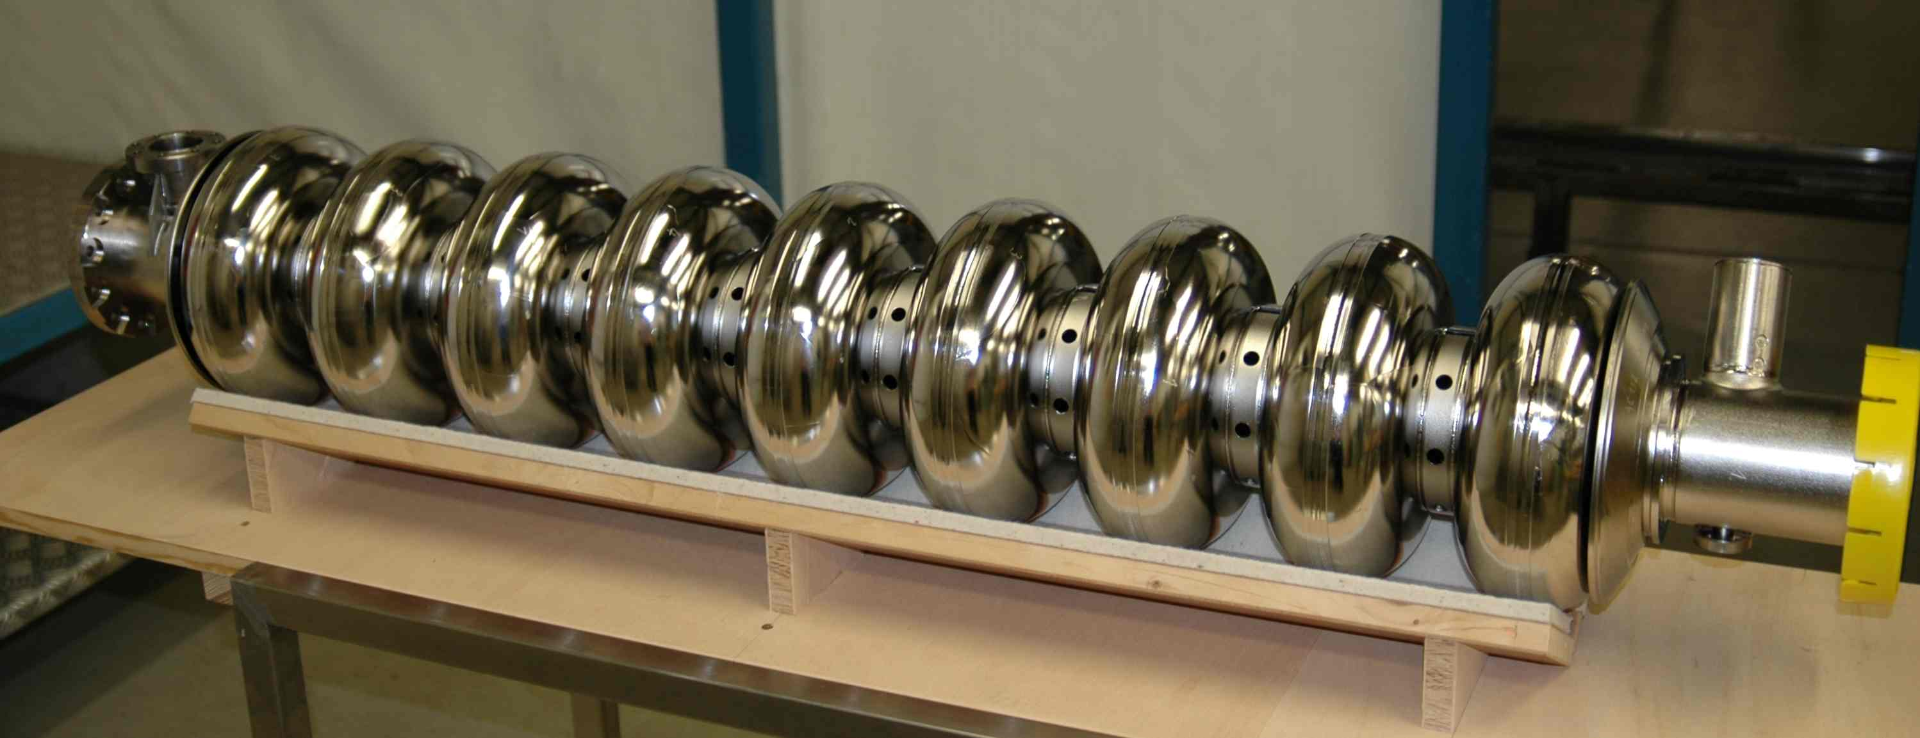
First 9-Cell Large-Grain Nb Cavities
3 cavities: AC112, AC113, AC114
W. Singer, TTC meeting, April 23-26, 2007

Slide 7
Record Q0 of 1.6E10 at 43.5 MV/m at 2K by PKU 1-Cell 1300MHz Large-Grain Nb Cavity in collaboration w/ JLAB
Q0 1.6E10 at 43.5 MV/m at 2K
J.E. Chen, K. Zhao, SRF2007, MO101 (2007).

Slide 8
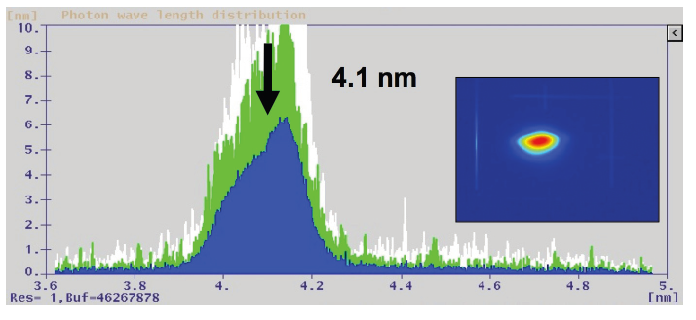
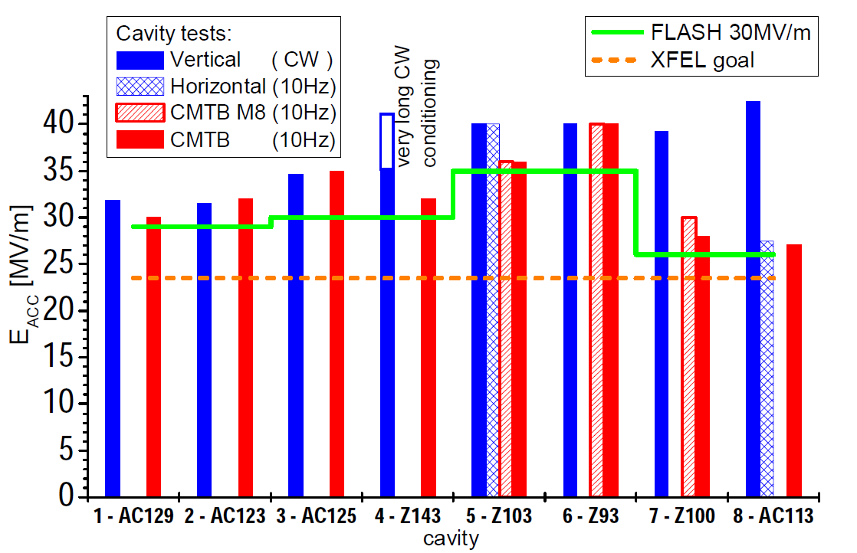
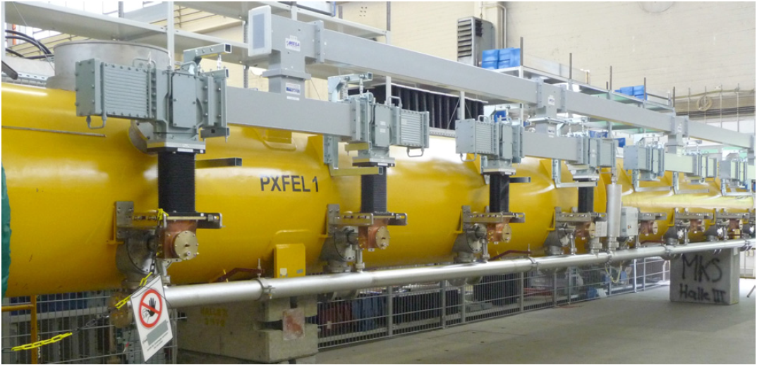
9-Cell Large-Grain Nb Cavity Beam Operation in FLASH at DESY
2 cavities, AC112 and AC113, in beam operation since 2010
Contribution to realization of 1.25 GeV beam and 4.1 nm laser
S. Schreiber, FEL2011
D. Kostin et al., SRF2009
Large-Grain
Cavity

Slide 9
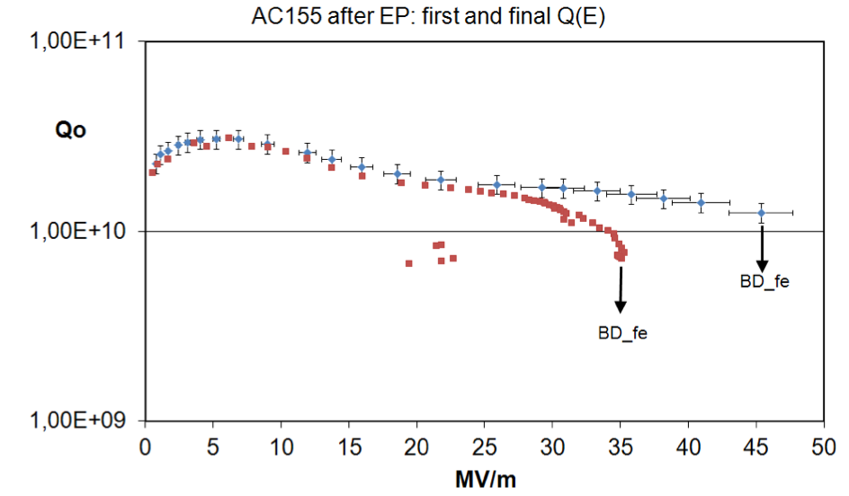
Record High Gradient 45 MV/m at Q0 > 1E10 by
Full-Scale 9-Cell Large-Grain Nb Cavity at DESY
D. Reschke et al., SRF2011, THPO046 (2011).

Slide 10
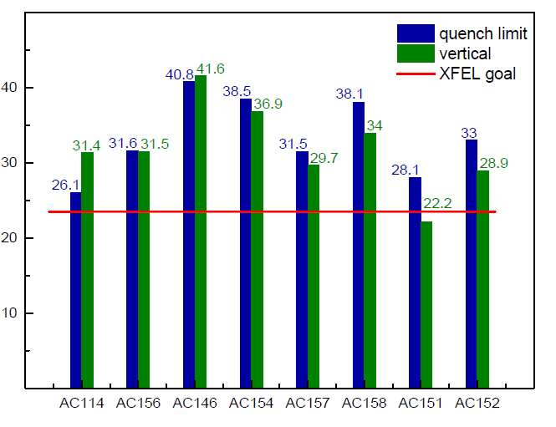
New Progresses since ILC TDR Publication
Large-grain cavity cryomodule tested at DESY
  7 out 8 cavities are industrially built LG cavities, 9-cell, TESLA shape

Slide 11
Learning of LG Nb Material Properties
Grain boundaries
  Flux penetration
  GB pinning centers
  GB weak links
Phonon peak in thermal conductivity
Mechanical properties
P. Kneisel et al., Review of ingot niobium as a material for superconducting radiofrequency accelerating cavities, Nuclear Instruments and Methods in Physics Research A 774 (2015) 133–150.

Slide 12
>35MV/m SRF Technology Matrix
Option | Material properties | Material production | Cavity prototype demo | Cryomodule prototype demo | Field-trial in real world system | Operational system with beam
FG Nb | Y | Y | Y | Y | Y | Y
LG Nb | Y | Vendor for Ingot slicing | Y | Y | Y | Y
Surface dirtying (FG or LG) |  | Y | Y
Nb3Sn

Slide 13
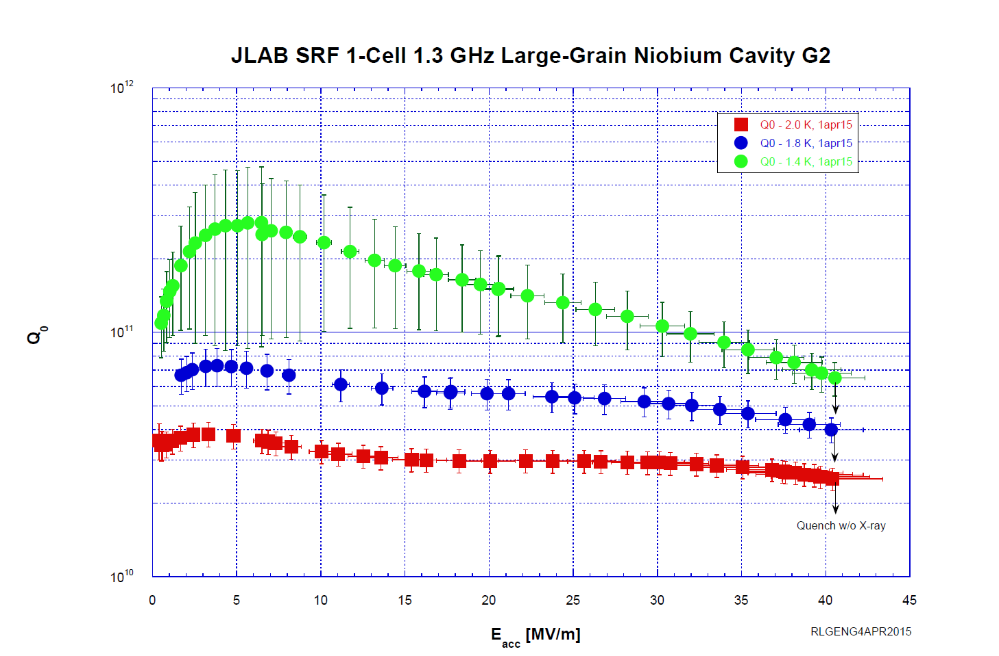
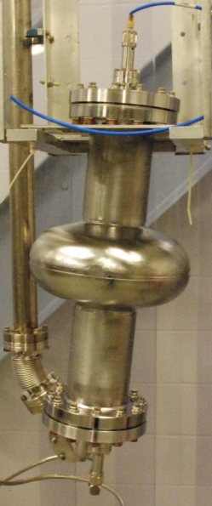

1.3 GHz, TTF shape
Tokyo-Denkai Large-Grain Nb

Slide 14
Nb material cost analysis
Requested quotes from manufacturers to determine the cost to produce 88 Nb discs (∅235 mm, 3.175 mm thick) with center hole, ready for deep-drawing with these alternative specifications:
  Fine-grain, RRR>300 (XFEL specs)
  Ingot Nb, RRR>150
The direct cost for the Ingot Nb option was a factor 3.7 lower than the fine-grain option
The lowest quote from 2 Nb suppliers was used for the fine-grain Nb sheets
G. Myneni, G. Ciovati

Slide 15
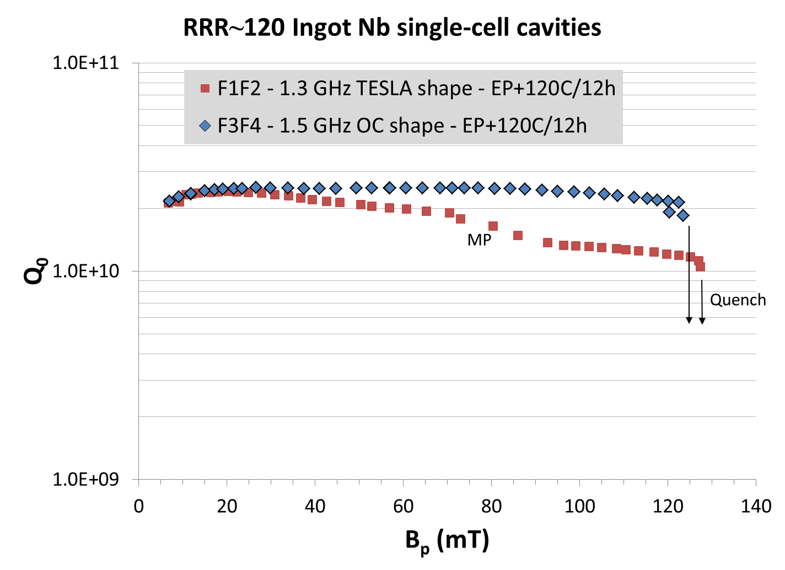
RRR~120 ingot Nb at high gradient
T=2 K
E_{acc}=31 MV/m
Similar performance measured in 1.3 GHz single-cell cavity at KEK from similar material
G. Ciovati, P. Dhakal, G. Myneni, Supercond. Sci. Technol. 29 (2016) 064002

Slide 16
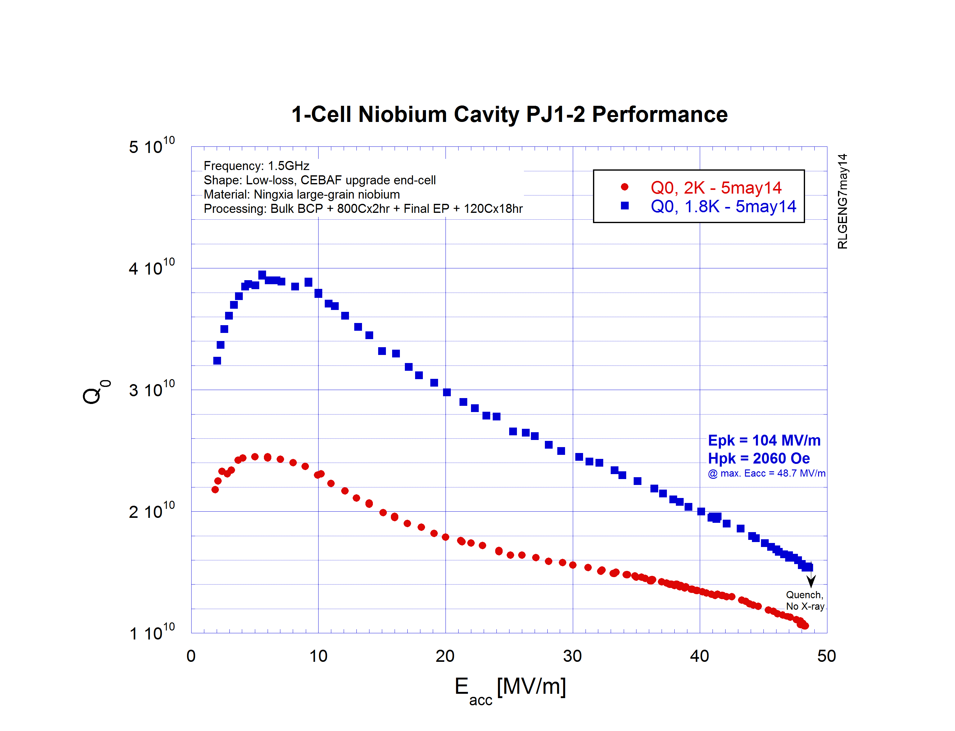
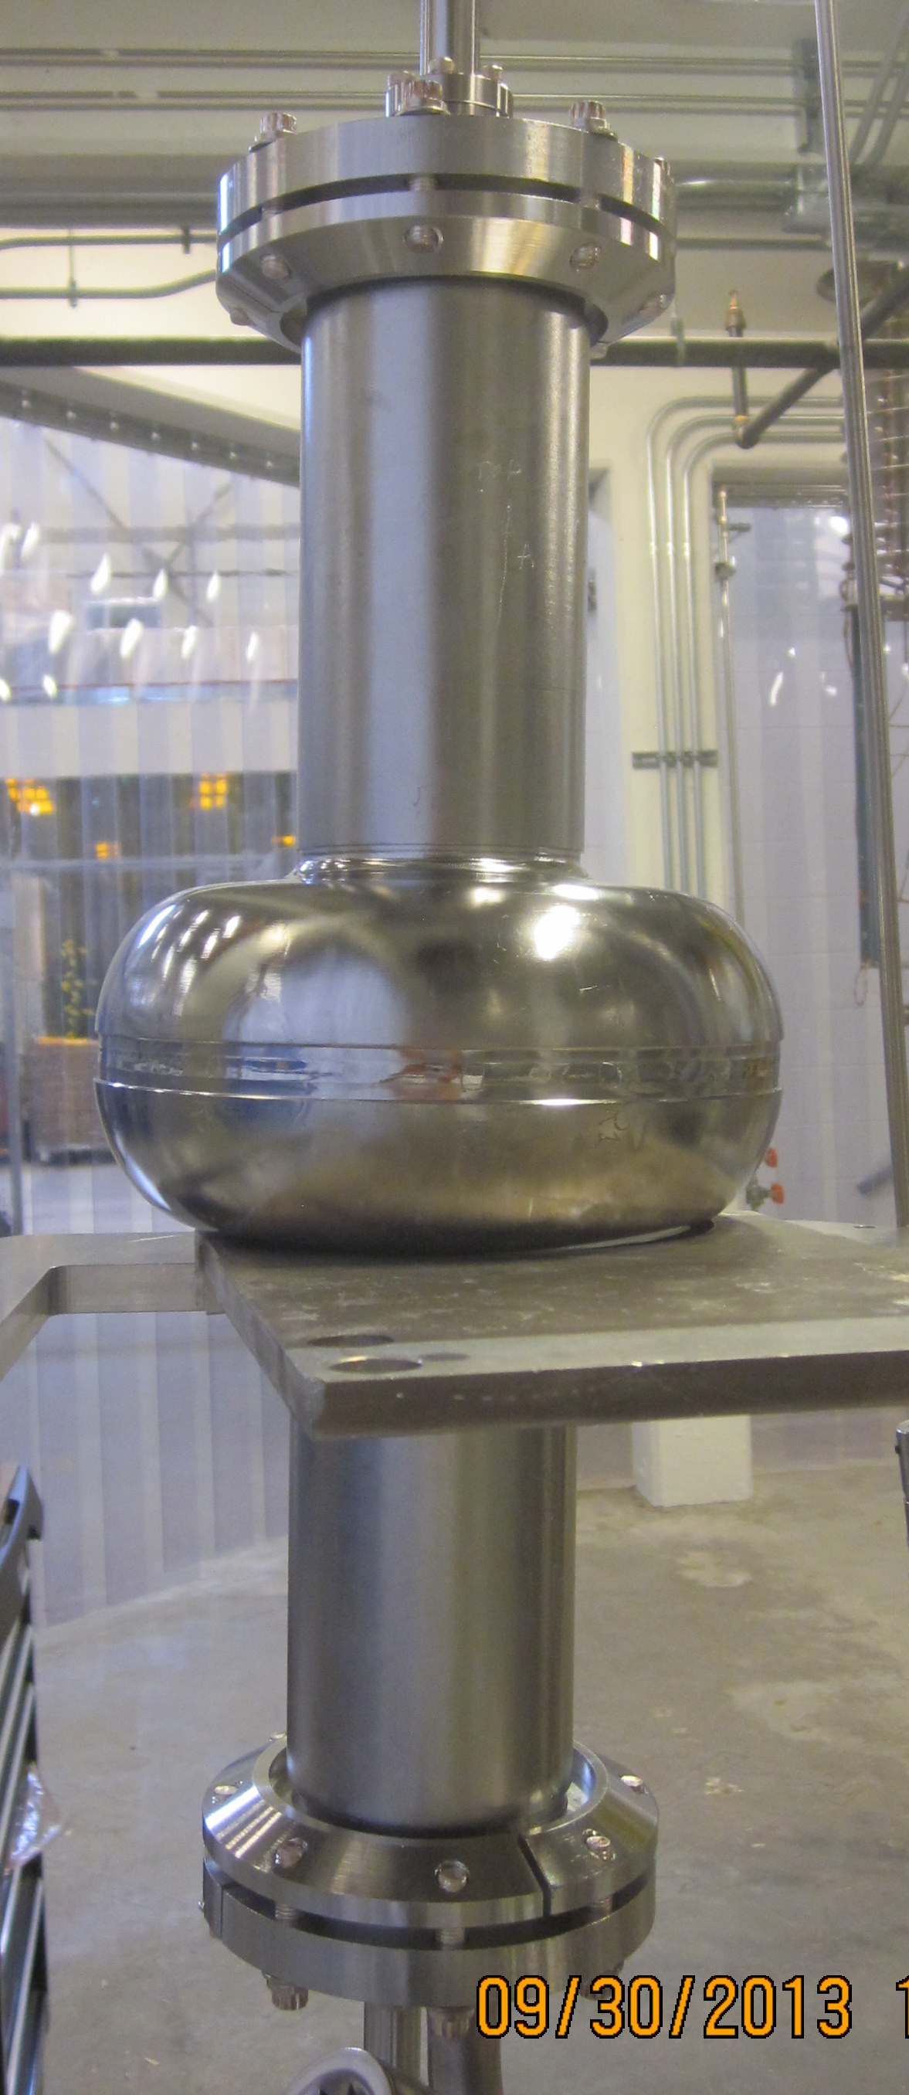

LG cavity PJ1-2 (JLab-PKU-OTIC collaboration)
1.5 GHz, CEBAF upgrade Low-Loss Shape
OTIC Large Grain Nb
Cavity processing: Bulk BCP + 800Cx2hr
Final Processing: EP 30 um + 120Cx18hr

Slide 17
Conclusion
LG Nb cavity technology has demonstrated cavity prototype, cryomodule prototype, field-trail in real world system and some beam operation experience. It is therefore a option on the table for near term application.
We continue to learn how Nb material work through LG, especially the role of grain boundaries.
Superiority of LG Nb is demonstrated at cryomodule system level with understanding of material properties. 30% higher Q0 as compared to FG tested in “plug compatible” fashion.
JLAB continues to develop advanced cavities using LG Nb
  LSF shape (20 % more efficiency)+ LG Nb (30% more efficiency) -> total 50% more efficiency compared to TESLA shape + FG
  Ultimately LSF shape + LG Nb + N infusion?
JLAB continues to optimize LG material properties toward the realization of its full potential in cost saving.

