Slide 1
ILC cost reduction (question #4)
N.Solyak,
SRF workshop, FNAL, Feb. 9-10, 2017

Slide 2
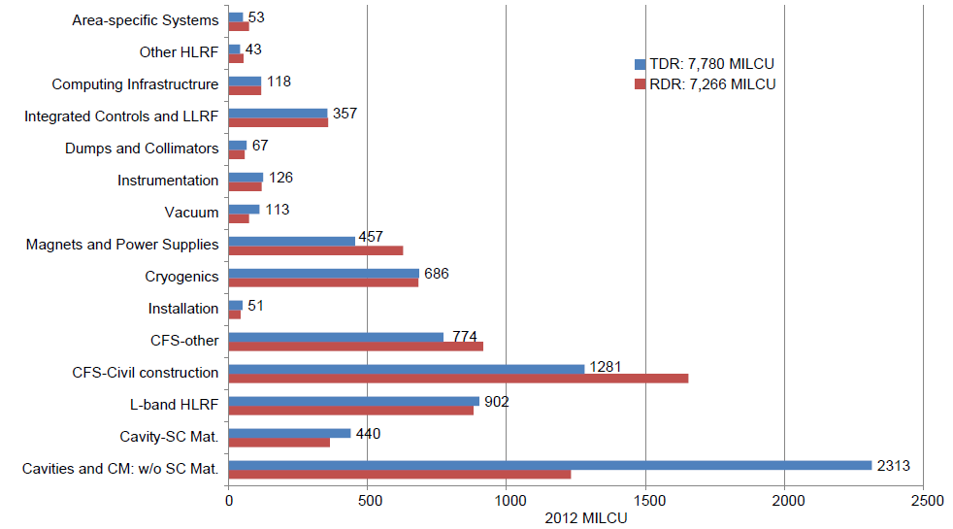
ILC cost distribution
The cost is dominated by the SCRF components and related systems, together with the conventional facilities. These two elements account for 73% of the total.
The main linac itself corresponds to 67% of the total project. Thus investing in a carefully selected main linac R&D should be most efficient in bringing the ILC cost down.

Slide 3
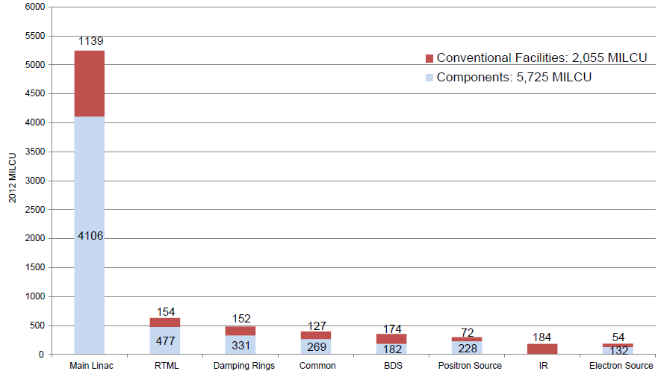
54%
72%
Distribution of the ILC value estimate by system and common infrastructure, in ILC Units. The numbers give the TDR estimate for each system in MILCU

Slide 4
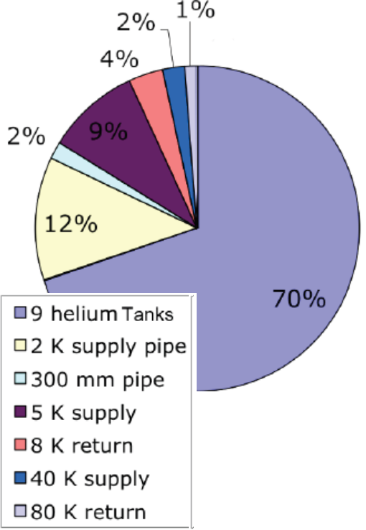
Cryogenic heat load and system
Distribution
(ILC TDR)

Slide 5
Linac systems scales with gradient (length) for fixed Energy
Cavities and CM (incl. materials) = 35.4%
Cryogenic (~90% of total) = 8 % cryo-power G
CFS (x55% of total) = 9%
HLRF (x10% of total -PDS ?) = 1.1 %
LLRF (50%) = 2.3%
Other (instr, vacuum, install, ~50%) ~2.2%
--------------------------------------------------------------
Total ~ 58% = 50 % + 8 %
(possible saving on PDS)
 | Other+ML+cryo | Total %
Gx1; Q0x1,nom | 42 + 50 + 8 | 100 %
Gx1; Q0x2, Q | 42 + 50 + 4 | 96 %
Gx2; Q0x1, grad | 42 + 25 + 16 | 83 %
Gx2; Q0x2, | 42 + 25 + 8 | 75 %
Gx2; Q0x4, | 42 + 25 + 4 | 73 %
Gx2; Q0:2, | 42 + 25+ 32 | 99 %
Assumption:
HLRF –same req. (not true – need modification → cost~2-5% up)

Slide 6
ILC cost reduction – cost model developed
A simplified cost model has been developed based on the ILC TDR and new progress in the SRF technology on cavity achievable efficiency (Q0) and acceleration (E_{acc}), showing potential cost reduction estimated to be in the range from 10% (35 MV/m) to 20% (45 MV/m) in ILC operation (with 20% spread).
This recent progress in raising Q of SRF cavities has been driven by large R&D efforts at FNAL and other US labs, and further boosted by the LCLS-II project.
Assumptions:
ML tunnel length and number of CM’s scales as 1/E_{acc}
Part of cryogenic ~ E_{acc}^{α =(0.6-1)}
HLRF – same cost (possible saving on distr. system ?)
Other systems – same cost
Hi-G Q-slope
Q0/2
Q0
2xQ0

Slide 7
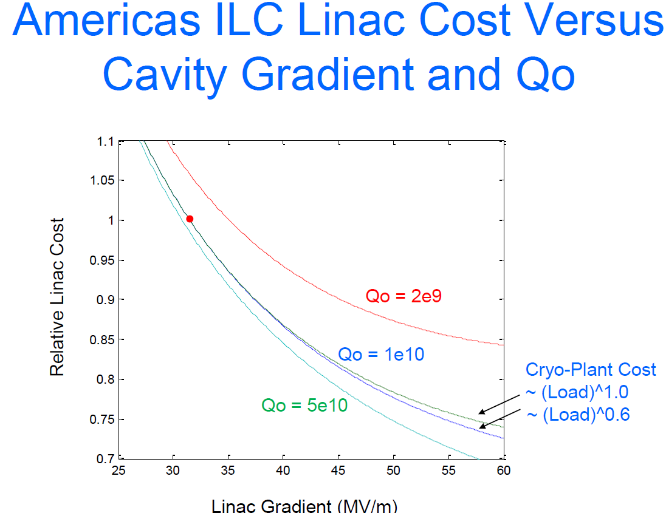
C.Adolphsen

Slide 8
Required modifications of RF components→ Cost
Longer RF pulse: QL ~E_{acc}; T_{fill}~1/QL
  1.65 µs → 2.58 µs for 2xE_{acc}
  New reqs for klystron and modulator
FPC power requirements
  P (pulse)~ E_{acc}; P (avrg)~E_{acc}*Pulse
Cost increase ???
Strategy: increase beam current ~Eacc

