Slide 1
Contribution to Round Table Discussions - preliminary draft -
Akira Yamamoto
GARD-SRF Workshop, held at Fermilab,
9-10 Feb. 2017

Slide 2
Round Table Panel Discussion Topics Energy and Luminosity Frontier SRF R&D Session 1: Cost Round Tables – H. Padamsee
What is the cost of 250 GeV (380 GeV) Higgs (Top) Factory as a start-­‐up mode for ILC? Discuss the cost as a fraction of ILC cost. An earlier estimate by Nick Walker had this fraction as 65%.
→ (Nick Walker, Solyak, Yamamoto)

Slide 3
ILC 250 GeV Staging Scenario ILC-TDR, V3 Part-II, p. 234.

Slide 4
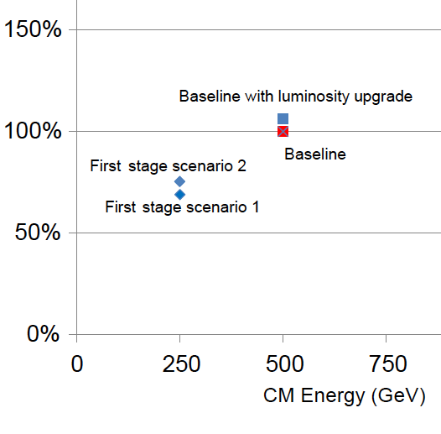
ILC Sub-System Cost Fractions ILC-TDR, V3, Part-II, p. 286
TDR Baseline (500 GeV)
Conventional
Facilities
Further saving of ≥ 5 % (1/2 x 10%)
expected from SRF cost-reduct. R&D
Components

Slide 5
Cost Reduction Estimate w/ Nb and High-Q&G (at KEK)
ILC Cost Reduction Proposal 160711b
Cost Fraction | Cavity-CM (reduced to 90%) | CFS-tunnel (reduced to 90%) | HLRF (~ const.) | Cryog. (see note) | Fraction to ILC total Cost
Cost Reduction Fraction Nb-Material: Surface Process |  |  |  |  | 2 ~ 3 % 8 ~ 9 %-α
TDR : E= 31.5 MVm Q = 1.0e10 - w/ 2nd-EP | 0.38 | 0.16 | 0.10 | 0.07 ^{*1} | 0.71 (
Hi-G, Hi-Q : E= 35.0 MVm Q = 1.6e10 (⬅ 2 x 0.8e10) - w/o 2nd-EP | 0.34 - ( 0.01 ~0.015) | 0.14 | 0.10 + α | 0.057 ^{*2} | (0.637) 0.627 ~ 0.622+α
Note: *1: ML Cryogenics fraction is 0.08 – 0.01 = 0.07 (←0.01 for for other cryogenics of Sources, DR, BDS etc). *2: Cryo: cost reduction; Effective saving of the cryogenics capacity down to 1/1.6 with improving Q for dynamic loss → 0.625 Breakdown: static (constat) 0.07 x ~ 0.2 = 0.014 dynamic (reduced) 0.07 x ~ 0.8 x 0.625 = 0.035 ---------------------------------------------------------------------- sum: = 0.049 Relative cryogenic power ratio: 0.049 / 0.07 = 0.7 (→ Cryogenics power to be reduced to 70 %). Conversion to the Cryogenics cost (following power-index of (^0.6) → 0.7^0.6 = 0.81 (→ Cryogenics cost to be reduced to 81 %) Cryogenics cost fraction in Hi-G, Hi-Q → 0.07x 0.81 = 0.057 (→ caving fraction: 0.013)

Slide 6
ILC Staging Options
TDR: 500 GeV
Staging: 250 GeV
Option F
(Case 2)
Option E
(Case 2)
Option D
Option C
(Case 1)

Slide 7
Options for Staging at 2x125 GeV
 | ACC. [GeV] | Tunnel [GeV] | Feature
TDR | 2 x 250 | 2 x 250 | TDR-2013
TDR - updated | 2 x 250 | 2 x 250 | ML tunnel width 11 → 9.5 m, & center-wall 3.5 → 1.5 m Detector hall access w/ vertical shafts No ML-tunnel extension (of 1.4 km), respecting G-upgrade
Opt. F (Case 2) | 2 x 125 | 2 x 250 | ML distributed + Full (air-conditioned) tunnel → Beam transport line cost (to be added)
Opt. E (Case 2) | 2 x 125 | 2 x 250 | ML upstream + Full (air-conditioned) tunnel → Beam transport line cost (to be added)
Opt. D | 2 x 125 | 2 x 250 | Simple (no air-conditioned empty tunnel + ML downstream → RTML, Circular/U-turn Tunnel duplicated
Opt. C (Case 1) | 2 x 125 | 2 x 125 | Min. 2 x 125 GeV w/ no add. tunnel for H.E. extension →Minor additional tunnel (~ 500 m) included for future energy-upgrade work, to be possible in parallel to the continuous 250 GeV run.

Slide 8
Round Table Panel Discussion and Topics Energy and Luminosity Frontier SRF R&D Session 1: Cost Round Tables – H. Padamsee
What are the pros and cons for long term cost reduction via Nb materials using large grain Nb? What are the best case and worst case scenarios for total cost reduction. Also, single cell cavities of explosion bonded Nb-­‐Cu have been fabricated and tested to 40 MV/m. What is the anticipated material and fabrication cost saving of using explosion bonded Nb-­‐Cu over Nb? →(Geng, C. Reece, Yamamoto)

Slide 9
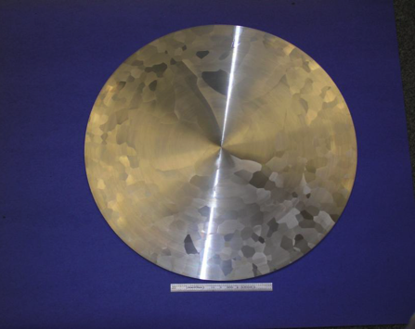
Niobium material preparation
Motivation
Niobium material cost for fabricating SRF cavity cell and end-groups is relatively high.
If the ingot purity and manufacturing method for each part is optimized precisely as well as satisfying the ILC specification shown in the TDR, the cost will be reduced significantly.
Approach
Optimize the ingot purity with a lower residual resistivity ratio (RRR) with accepting specific residual content.
Simplify the manufacturing method such as forging, rolling, slicing and tube forming with
small loss.
Ingot
Sheeting / tubing
(forging, rolling, slicing, tube forming)
Total, 50% off
Ingot
Slicing.
Shin MICHIZONO, ACFA, Jan.19
19
2017

Slide 10
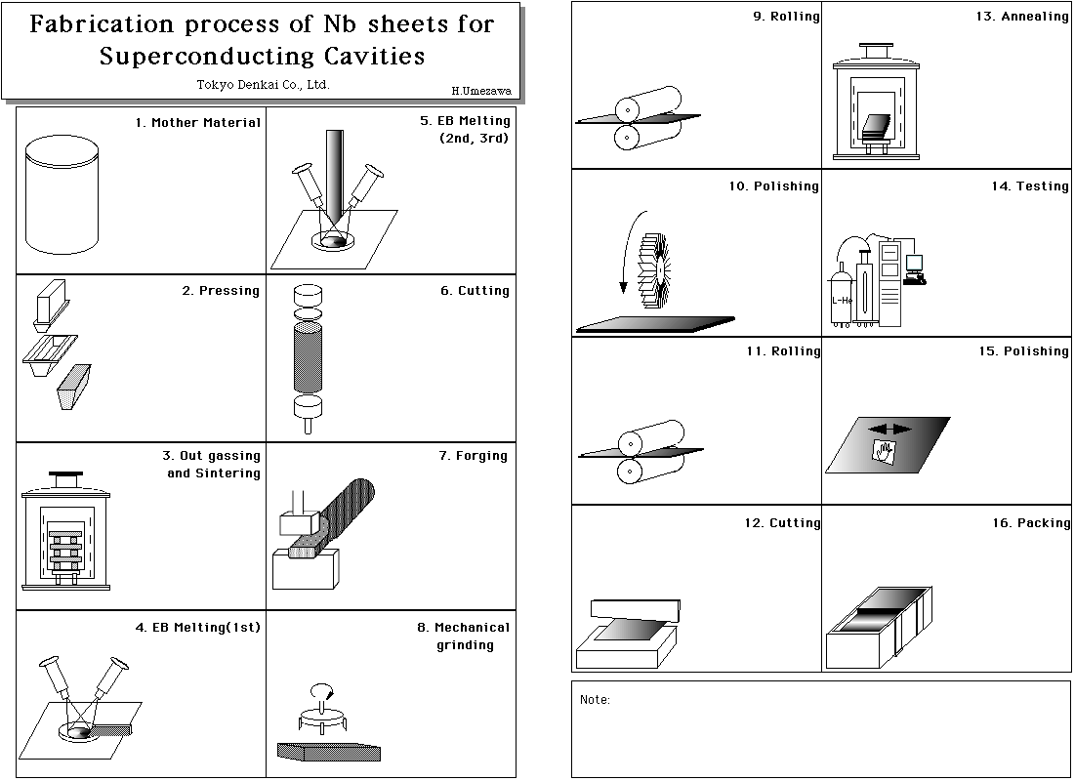
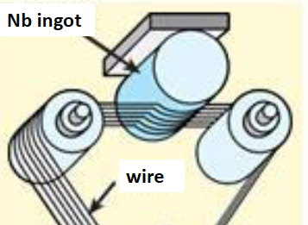
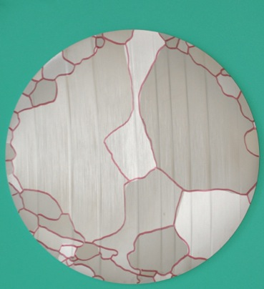
FG-Nb rolled or LG-Nb sliced from Ingot
Courtesy: G. Myneni
50 mm
Cleanness highly secured

Slide 11
Gradient Reached w/ Nb-Ingot Sliced
Result from DESY, 2012
50 mm
ILC Gradient
45 MV/m
reached
Cavity Spec.
KEK-02 (Ingot-sliced, LG, 2016): 38 MV/m
KEK-01 (Rolled, FG, 2014): 36 MV/m

Slide 12
Round Table Panel Discussion and Topics Energy and Luminosity Frontier SRF R&D Session 1: Cost Round Tables – H. Padamsee
What is the expected impact for improved EP technique, such as Vertical EP or HF free EP?) What is the recommended development program?
→ (Liepe, Yamamoto)

Slide 13
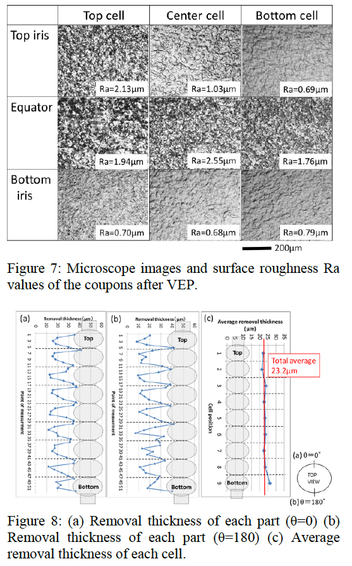
Vertical EP R&D by KEK-Marui G.

Slide 14
VEP w/ NaOH and Alternate-Current
Motivations:
VEP:
space-efficient operation
NAOH:
Safe surface operation
Low viscosity

Slide 15
Backup Information (confidential)
Do not upload and do not distribute !
Sent to panel conveners and organizers, only, for understanding for further detailed study in progress.

Slide 16
Preliminary Cost Estimate for the ILC Staging with 250GeV
Rev. 170205
 | e-/e [GeV] | Tunnel [GeV] | Value Fraction CFS* [GILCU] | Value Fraction SRF [GILCU] | Value Fraction Others** [GILCU] | Value Total (GILCU] (Oku-JY) | Value Total [%] | Reduct. [%] | Cost- Red. R&D Effect [%] | Total Impact to Reduction [mid. %] | Total Impact to Value (GILCU] (Oku-JY)
TDR | 250/250 | 500 | 2.375 | 2.757 | 2,855 | 7.987 (8,309) | 100 % | 0 | - 11.9 % - (13.5-1.6#) | - 11.9 % | 7.037 (7,320)
TDR updated | 250/250 | 500 | (x 0.943) 2.240 | 2.757 | 2.855 | 7.852 (8,168) | 98.3 % | -1.7 % | - 11.9 % - (13.5-1.6) | - 13.6 % | 6,901 (7,179)
Opt. F | 125/125 | 500
Opt. E | 125/125 | 500 | (x 0.909) 2.159 | 1.414 | 2.019(+α) | 5.592 (5,817) | 70.0 % | -30.0 % | - 5.5 % - (6.25 -0.8) | 35.5 % + (α) | 5,152 (5,359)
Opt. D | 125/125 | 500 | (x 0.806) 1.914 | 1.414 | 2.019(-β) | 5.347 (5,640) | 66.9 % | -33.1 % | - 5.5 % - (6.25 -0.8) | 38.1 % (β) | 4,944 (5,143)
Opt. C | 125/125 | 250 | (X 0.734) 1.746 | 1.414 | 2.019(-β) | 5.179 (5,388) | 64.8 % | -35.2 % | - 5.5 % - (6.25 -0.8) | 40.7 % (β) | 4,736 (4,927)
*) CFS total cost (including the main campus land/surface and buildings) to be confirmed. ** )Both effects of additional undulator (80 m) for e+ yield and some fraction of common category to ML are included. Effect of HE beam transport addition (+α), and RTML transport-line reduction effect ( −β) to be further evaluated. # ) Tunnel length reduction because of the high-G not to be taken, in order to keep reasonable contingency (1.6 % for full 250 GeV and 0.8% for 125 GeV.
TDR:
250 GeV e-
250 GeV e+
Option F:
125GeV e-
125GeV e+
Option E:
125GeV e-
125GeV e+
Option D:
125GeV e-
125GeV e+
125GeV e-
125GeV e+
Simple tunnel
Option C:

