Slide 1
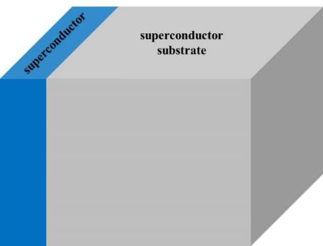
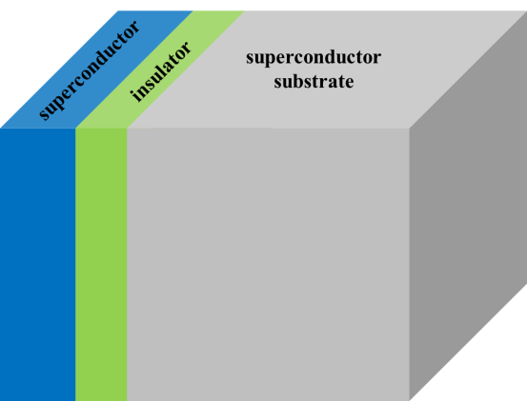
The next technologies
Dirty high H_{c} superconductor ($≲λ$)
eg., Nb₃Sn
Dirty Nb ($≲λ$)
insulator
Clean Nb
Clean Nb
Clean Nb
(Present technology)
Dirty Nb on clean Nb
(Next technology) SS structure
SIS structure
The fourfold benefit of the layered structure will improve the maximum E_{acc} and Q₀ : (1) the reduction of gap is small in the dirty layer
(2) suppress the surface current and enhance the theoretical field limit
(3) prevent the vortex penetration by the additional barrier . SIS structure is thought to provide with a further robust barrier and reduce vortex dissipation.
(4) In addition, dissipation decreases and Q increases because a part of current flows on the low loss surface (eg, Nb₃Sn).

Slide 2
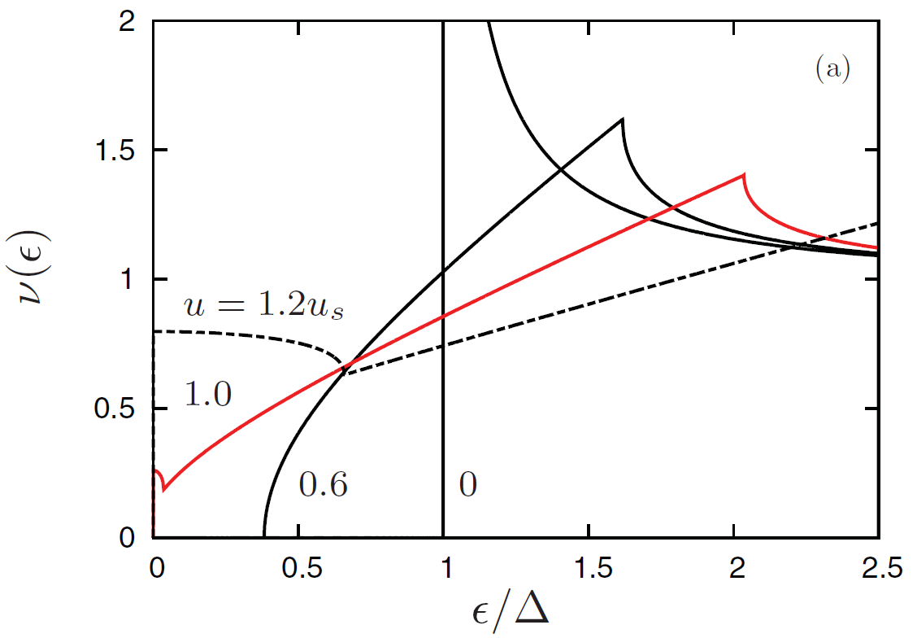
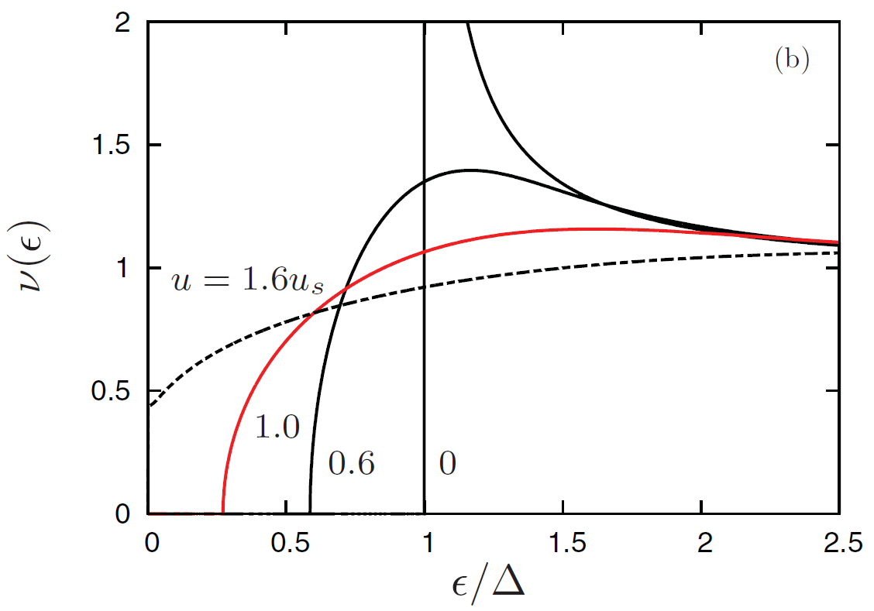
①
Since excited quasiparticles increase and contribute to the surface resistance as the gap decreases, a larger gap is desired. The gap in the dirty layer is rather well behaved at a high field!
→ cure the high field Q drop
Note here B_{c1} is a bulk property and given by the bulk clean SC:
B_{c1}～170mT remains after layered.
clean
dirty
Gap under a current (narrow!)
Gap under a current
(wider than clean case!)
Becomes gapless before arriving at
the superheating field!
F. P-J. Lin and A. Gurevich, Phys. Rev. B 85, 054513 (2012)
A. Gurevich, Rev. Accel. Sci. Technol. 5, 119 (2012)

Slide 3
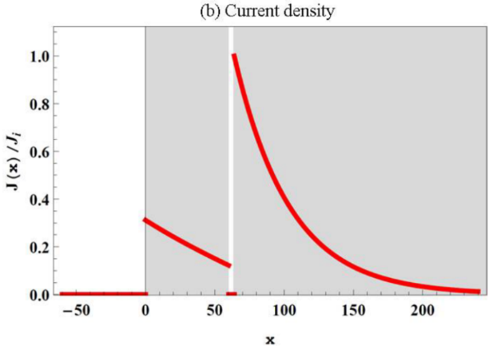
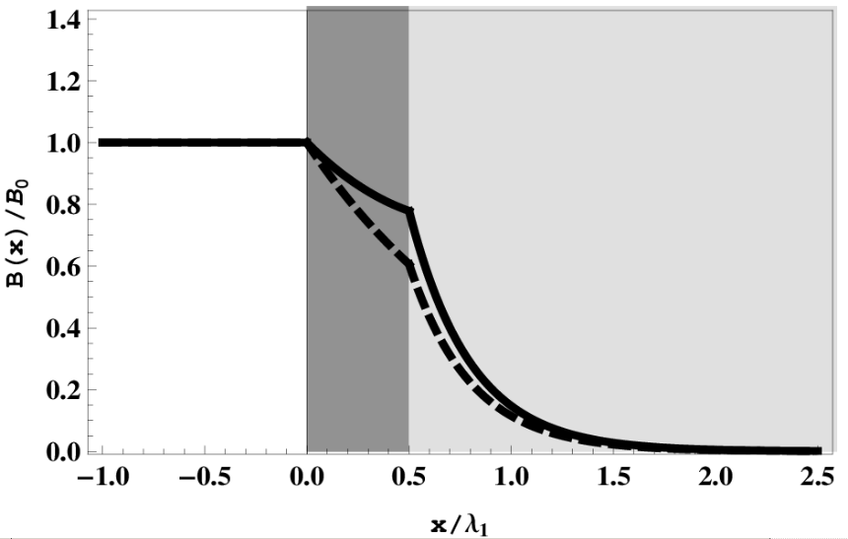
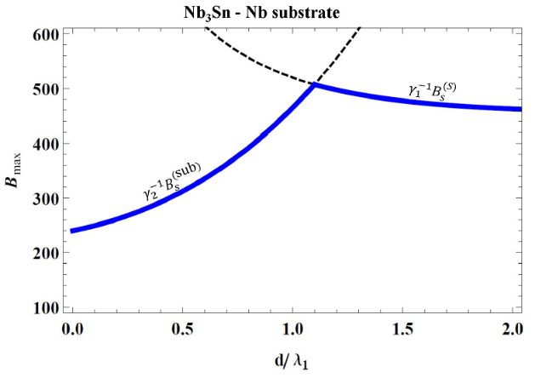
②
The surface current is suppressed.
The current suppression means an enhancement of the field limit, because the theoretical field limit is determined by the current density.
The gap reduction due to the current is further prevented.
λ₁ (> λ₂)
λ₂
This is SIS case.
SS case is similar.
This slope corresponds to the current density.
The surface current is suppressed!
SS case:
T. Kubo, in Proceedings of LINAC2014, p. 1026, THPP074.
SIS case:
T. Kubo et al., Appl. Phys. Lett. 104, 032603 (2014).
A. Gurevich, AIP Advance 5, 017112 (2015).
S. Posen et al., Phys. Rev. Applied 4,044019 (2015).
B_{s} of Nb₃Sn
B_{s} of Nb
Figures from T. Kubo, Supercond. Sci. Technol. 30, 023001 (2017)

Slide 4
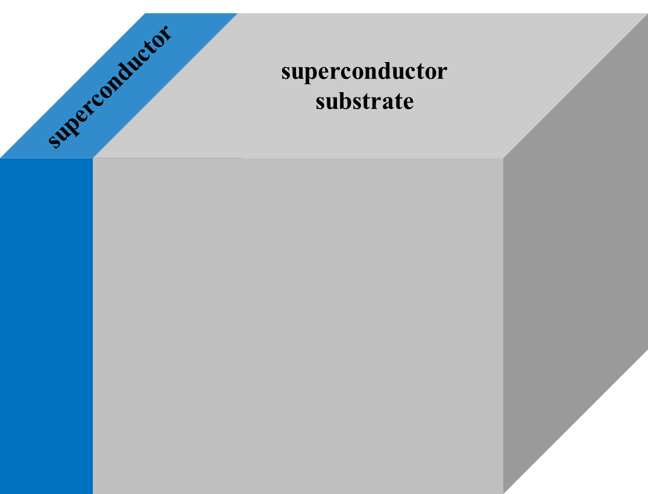
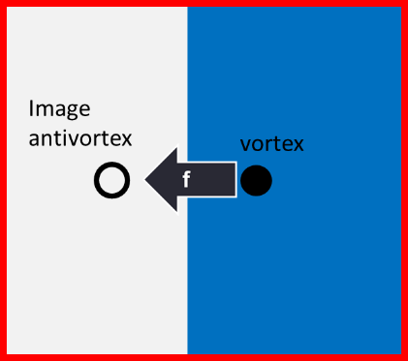
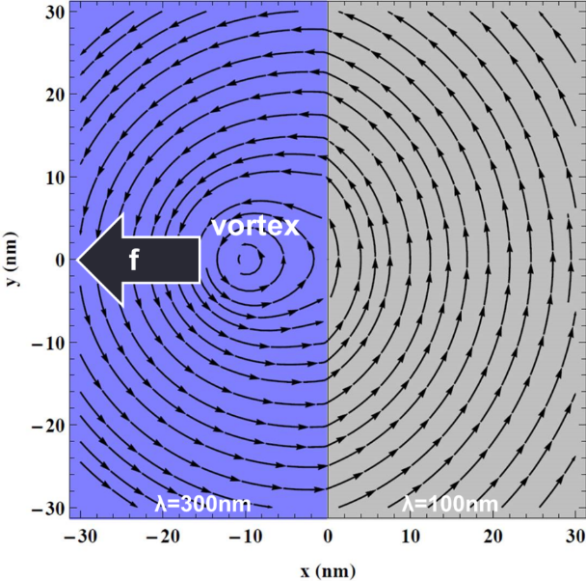
③
Vacuum side
superconductor side
Bean-Livingston
barrier
In SS case, vortices are expelled by the boundary if λ^{(layer)}> λ^{(bulk)}. (left figure)
T. Kubo, in Proceedings of LINAC2014, p. 1026, THPP074.
M. Checchin et al., in Proceedings of IPAC2016, p. 2254, WEPMR002
In SIS case, vortices disappear at the insulator.
A. Gurevich, AIP Advance 5, 017112 (2015).
See also T. Kubo, Supercond. Sci. Technol. 30, 023001 (2017)

Slide 5
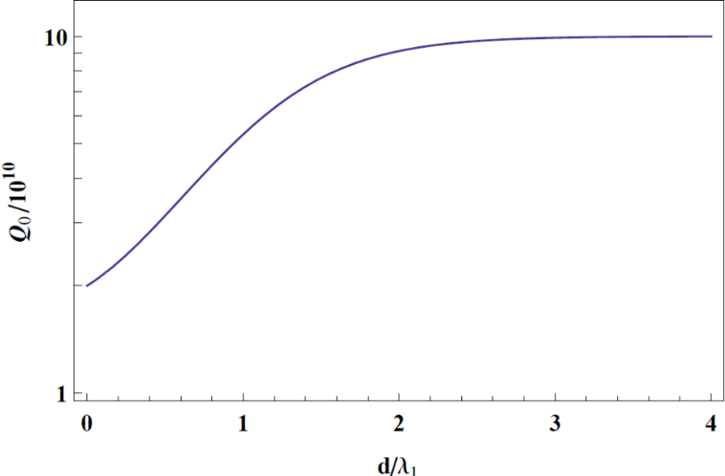
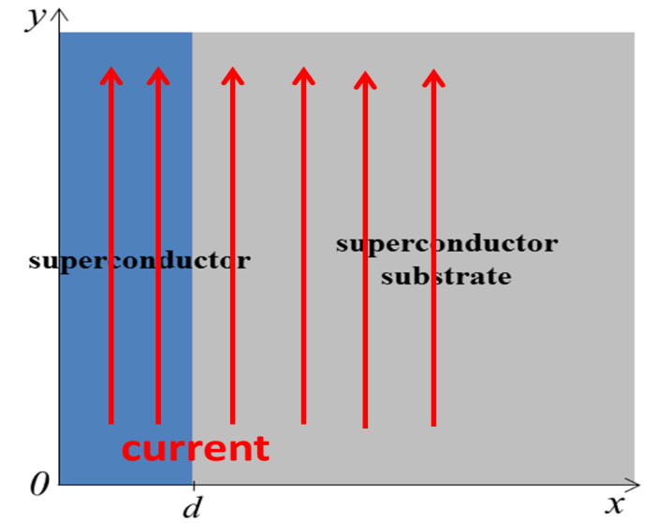
④
If the surface layer has a lower surface resistance than the bulk, the total surface resistance decreases, because the screening current flows on both the surface layer and bulk.
Thin Nb₃Sn on Nb substrate
2(K)
Q^{Nb3Sn}=1×10¹¹
λ_{Nb3Sn}=120nm
Q^{Nb}=2×10¹⁰
λ_{Nb}=40nm
are assumed
Q improve
A. Gurevich, AIP Advance 5, 017112 (2015)
T. Kubo, Supercond. Sci. Technol. 30, 023001 (2017)
R_{s}

