Slide 1
New SRF research opportunities
A. Gurevich, FNAL, Feb. 9-10, 2017
?
How far can Q(H) and E_{acc} be increased?
How far can the extended Q(H) rise
be extended?
New SRF materials (Nb₃Sn, pnictides)
Surface nanostructuring and multilayers
New imaging and SRF characterization
tools (STM coupled with microscopy
and Q(H) measurements)
Theory development
?
Single cell, TESLA @1.5 K
A. Romanenko et al, APL 105, 234103 (2014)
Theory: Residual resistance and BCS surface resistance at strong fields, nonequilibrium effects. Enhancement of extended Q(H) by impurities and multilayers. RF dissipation of vortices at very strong RF drive and generation of vortices upon cooling through T_{c}
Nb₃Sn, NbN, pnictides are more temperamental than Nb, have current-blocking grain boundaries, and suffer from local nonstoichiometry and low H_{c1}. To what extent can these materials features be ameliorated by surface nanostructuring and impurity management?
Is N, Ar or Ti-doping the only way to reverse the Q-slope? Any other possibilities? – Ag, Si, Ge, … Deposition of N-doped thin films and multilayers on Nb cavities can capitalize on the Q(H) rise and reverse the reduction of breakdown fields. Can it be done on Nb₃Sn?

Slide 2
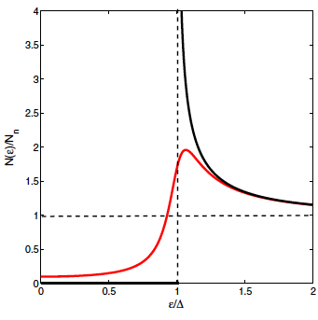
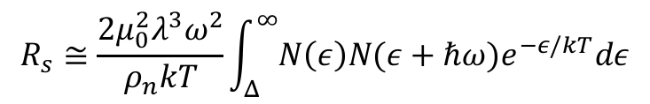
Broadening of gap peaks in N(ε) reduces R_{s}
A. Gurevich, FNAL, Feb. 9-10, 2017
Low-frequency surface resistance at 1-2 GHz, hf/kT ≈ 10⁻²
Broadened gap
peak and subgap
states in the
Dynes model
$$R_{s}≅\frac{2μ_{0}^{2}λ^{3}ω^{2}}{ρ_{n}kT}\int_{Δ}^{∞}{N\left(ε\right)N(ε+ℏω)e^{−ε/kT}dε}$$
Idealized
BCS model
Density of states with broadened gap peaks:
R_{s} can be reduced by:
electron-phonon inelastic
scattering
proximity-coupled
metallic suboxides
Dilute magnetic impurities
Optimal inhomogeneities
The log. term in R_{s} results from the singularity
in the BCS density of states (γ = 0) at ε = Δ
Broadening of gap peaks
in N(ε) can reduce R_{s}
by 4-5 times

Slide 3
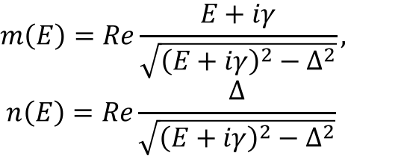
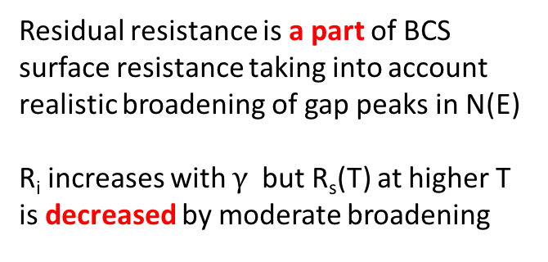
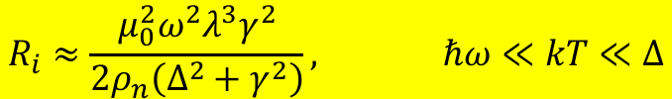
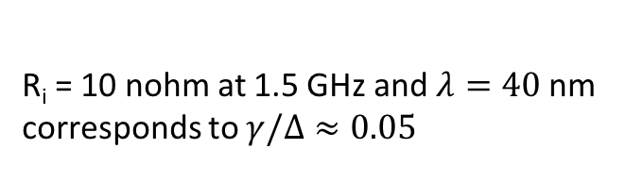
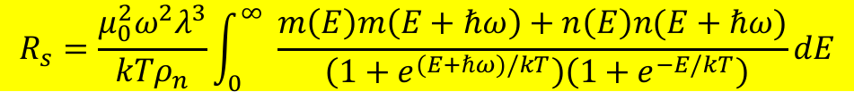
Tuning BCS residual surface resistance
A. Gurevich, FNAL, Feb. 9-10, 2017
Generalized Mattis-Bardeen:
A. Gurevich, SUST 30, 034004 (2017)
$$R_{s}=\frac{μ_{0}^{2}ω^{2}λ^{3}}{kTρ_{n}}\int_{0}^{∞ }{\frac{m\left(E\right)m\left(E+ℏω\right)+n\left(E\right)n(E+ℏω)}{ \left(1+e^{(E+ℏω)/kT}\right)\left(1+e^{−E/kT}\right)}dE}$$
$$m\left(E\right)=Re\frac{E+iγ}{\sqrt{{\left(E+iγ\right)}^{2}−Δ^{2}}},$$
$$n\left(E\right)=Re\frac{∆}{\sqrt{{\left(E+iγ\right)}^{2}−Δ^{2}}}$$
Residual resistance is a part of BCS
surface resistance taking into account
realistic broadening of gap peaks in N(E)
R_{i} increases with $γ$but R_{s}(T) at higher T
is decreased by moderate broadening
$$R_{i}≈\frac{μ_{0}^{2}ω^{2}λ^{3}γ^{2}}{2ρ_{n}\left(Δ^{2}+γ^{2}\right)}, ℏω≪kT≪Δ$$
R_{i} = 10 nohm at 1.5 GHz and $λ=40$nm
corresponds to $γ/Δ≈0.05$

Slide 4
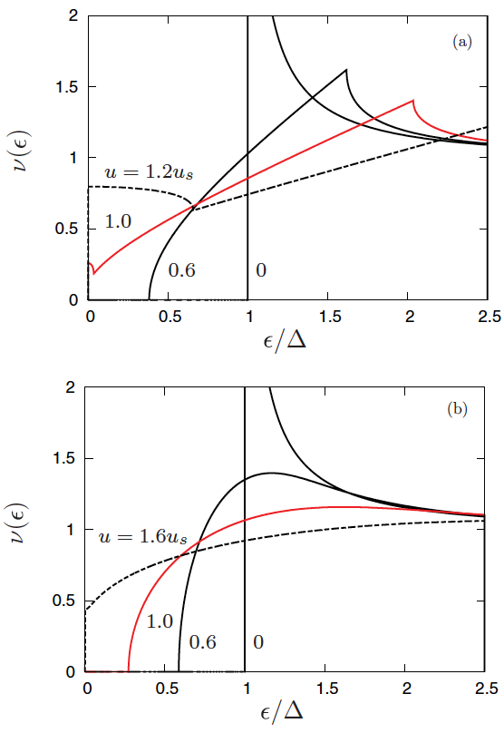
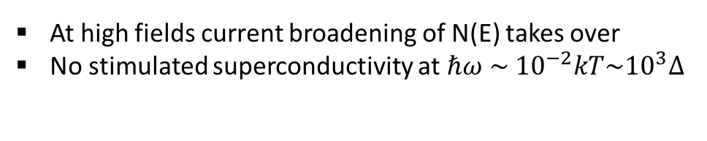
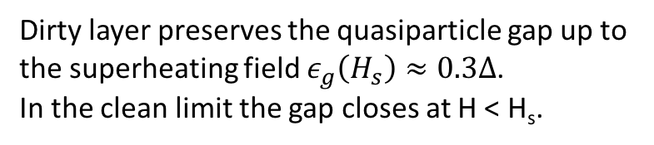
RF current broadening of N(E) and Q(H) rise
A. Gurevich, FNAL, Feb. 9-10, 2017
Mattis-Bardeen R_{s} was derived for weak RF fields (few mT):
At high fields current broadening of N(E) takes over
No stimulated superconductivity at $ℏω \sim {10}^{−2}kT\sim {10}^{3}Δ$
Dirty layer preserves the quasiparticle gap up to
the superheating field $ε_{g}\left(H_{s}\right)≈0.3∆$.
In the clean limit the gap closes at H < H_{s}.
clean
Theory of nonlinear R_{s}(H) based on nonequilibrium BCS
Good agreement with
JLab and FNAL data
RF field suppression of R_{s}
Requires sharp gap peaks
in N(E) at H = 0
STM in parallel field can
reveal how N or Ti
doping affects N(E)
dirty
A. Gurevich, PRL 113, 087001 (2014).

Slide 5
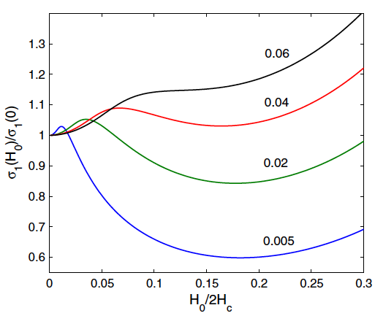

Tuning R_{s} for weak rf field with parallel dc field
A. Gurevich, FNAL, Feb. 9-10, 2017
Superimposed parallel strong dc and weak rf fields probe the rf suppression of R_{s}(H) under equilibrium conditions
R_{s}(f,H₀) tuned by dc field
R_{s} measurements on striplines
combined with STM in parallel field
can reveal mechanisms of nonlinearity
of R_{s}(H) and the extended Q(H) rise.
Different ratios of hν/Δ at $kT=0.2Δ$
A.Gurevich, PRL 113, 087001 (2014).

Slide 6
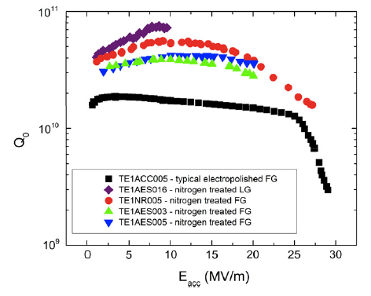
Extending the extended Q(H) rise in N-doped Nb cavities above the superheating field of Nb
A. Gurevich, FNAL, Feb. 9-10, 2017
Optimized dirty N-doped layer
Alloyed Nb
film of optimum
thickness
H_{s}, H_{c1}?
Cavity grade
bulk Nb
A few nm thick
Al₂O₃ spacer
A. Grasselino et al, SUST 26, 102001 (2013)
A few μm thick dirty layer at the surface
Increases the GL parameter κ = λ/ξ, and
decreases both H_{s} and H_{c1}:
To capitalize on the extended Q(B) rise
and reverse the reduction of H_{c1} and H_{s}
Use an optimized Nb bilayer to push
the breakdown field above both
superheating fields up to 250-300 mT
before
after
A. Gurevich, AIP Advances, 5, 017112 (2015)

Slide 7
Path to 60-120 MV/m
A. Gurevich, FNAL, Feb. 9-10, 2017
Maximum screening field H_{m} at optimal thickness
Dirty Nb layer: H_{c} = 200 mT, H_{s} = 170 mT, l = 2 nm, and λ =λ(ξ₀ /l)^{1/2} = 180 nm
H_{m} = 288 mT, E_{acc} = 70 MV/m d_{m} = 0.44λ = 79 nm.
20% gain as compared to H_{s} = 240 mT of clean Nb
Nb₃Sn: H_{s} = 0.84H_{c} = 454 mT and λ = 120 nm (moderately dirty):
H_{m} = 507 mT, E_{acc} = 120 MV/m, d_{m} = 1.1λ = 132 nm
doubles the superheating field of clean Nb

Slide 8
Why are dielectric barrier essential?
A. Gurevich, FNAL, Feb. 9-10, 2017
Artificial I layers (Al₂O₃, etc) in ML structures
Natural oxide interfaces which do not dissolve
during deposition of S layers
Direct deposition of S (dirty Nb, Nb₃Sn, etc) onto Nb
dirty 1-2 µm
diffusion layer
Intercept penetrating vortices and arrest
thermomagnetic avalanches
Great reduction of vortex dissipation
Increase H_{s} and H_{c1}
Stop interdiffusion of impurities
Smooth decrease of imp concentration,
reduction of H_{s} and H_{c1} at the surface
No protection against penetration
of vortices at surface defects
Interdiffusion cannot be avoided

