Slide 1
Breakthrough Ideas, Materials, Surface Structures to Pursue to Reach Revolutionary Gradients and Quality Factors
Sam Posen
GARD-SRF Worksbop
Fermilab
9-10 February 2017

Slide 2
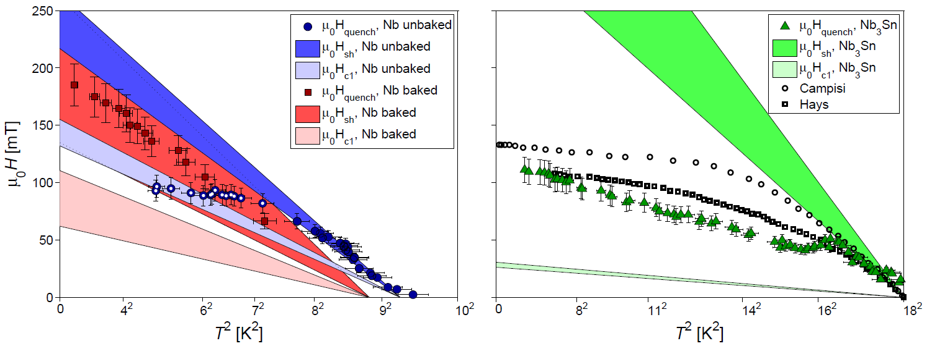
Nb₃Sn at 50-80 MV/m
High power pulsed testing of Nb₃Sn cavities shows:
High T: maximum field that extrapolates far above 50 MV/m
Low T: indicative of defects, similar drop-off to Nb not optimized for high field operation
No sign of fundamental limit in Nb₃Sn yet
Low T drop-off indicative of surface defects
High T behavior trends towards
E_{acc} ~ 95 MV/m
CW quench
S. Posen, N. Valles, and M. Liepe, Phys. Rev. Lett., 115, 047001 (2015).

Slide 3
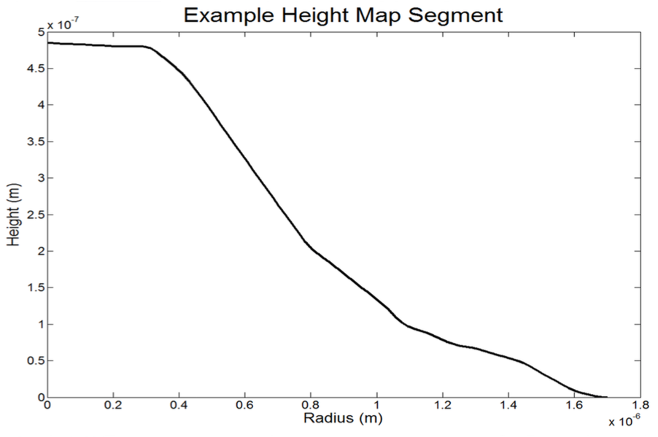
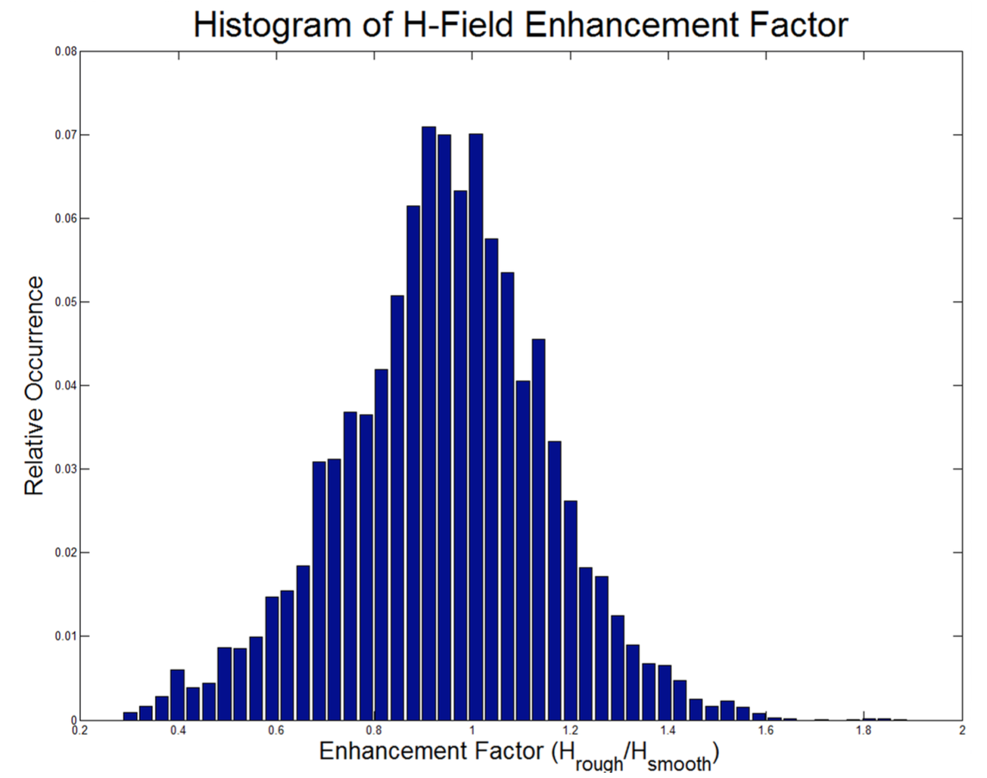
Increasing E_{acc} in Nb₃Sn Cavities
Substantial recent improvement in maximum E_{acc} with high Q₀
Several promising paths forward for continued progress including:
Smooth sharp-edged surfaced
Reduce low tin content regions
20-40% increase: 22-25 MV/m
Cornell: AFM scan of Nb₃Sn sample
Field enhancement factor >1.5
Several promising paths forward for continued progress in E_{acc} (previous presentation)
Single cells are great tools: rapid feedback on recipes, ability to dissect and look at quench spots
With progress in CW mode, use pulsed measurements to continue to probe ultimate potential
4 μm
Y. Trenikhina, S. Posen, D. Hall, and M. Liepe, Proc. SRF Conference 2015, TUPB056, 2015
S. Posen, Ph.D. Thesis, Cornell University (2015).
R. Porter, D. L. Hall, M. Liepe, J. T. Maniscalco, Proc. Linac Conference 2016, MOPRC027 (2016).

Slide 4
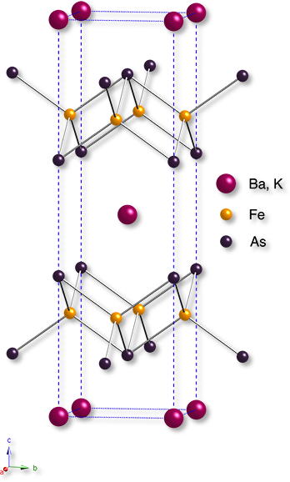
Survey of Materials Other than Nb and Nb₃Sn
Nb₃Sn will provide experience working with small-ξ materials
Experimental and theoretical work will help identify promising materials (and geometries) to pursue
Some beneficial properties in accelerator applications for potential SRF materials:
High Q₀ at higher T, where cooling is more efficient
High maximum field
MgB₂?
NbN/NbTiN?
Pnictides?

