Slide 1
Transformational SRF routes – intro thoughts
Alexander Romanenko
GARD-SRF Workshop
9 Feb 2017

Slide 2
Goal – how to probe and push the limits of gradient and Q?
Gradient
Conventional wisdom is that superheating field (~55 MV/m for clean Nb) is the “hard” limit
What is meant by “limit”?
Is the ”limit” directly confirmed by any experiments?
We need to explore it
What if we remove a CW constraint?
Can we slow down/make penetrating flux not to lead to quench?
Need to probe/explore the relevant timescales (<1 nsec)
Can we take advantage of layered structures from this point of view?
If we can sustain RF fields up to Hc2 -> 100 MV/m
Up to Hc3 -> 300 MV/m (EP+120C bake)
Above Hc3?

Slide 3
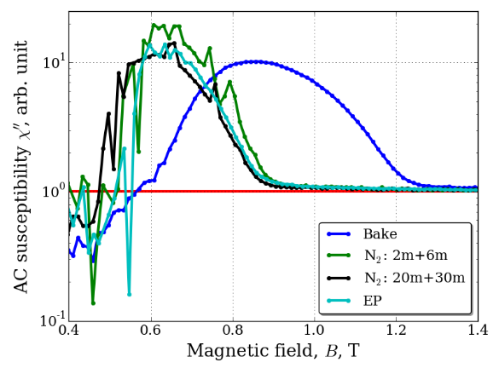
Up to what fields does superconductivity exist in the walls?
EP+120C
300 MV/m
200 MV/m
T=2K

Slide 4
One established way to probe gradient limits
N. Valles, PhD thesis

Slide 5
Q factor
Quality factor
For 2-1.8K operation, we discussed in previous session how to dramatically abate BCS resistance (doping, Nb3Sn)
The highest Q factor (at T->0)we can achieve is limited by residual resistance
If we understand/control the origin of the remaining Rres after flux, hydrides etc are removed – can Q be infinite at low enough T?
NB: DC conductivity is infinite in SC
This is unique for SRF
Would it be useful for accelerators?
Certainly will be for non-accelerating applications
How to address it?
One example: STM, PCT - is density of state different from the “ideal” BCS?

