Slide 1
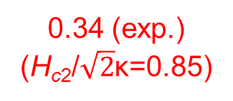
MgB₂ for SRF?
Liarte et al., SUST 30, 033002 (2017)
40
6.9
5.8
0.051
0.34 (exp.)
(H_{c2}/$\sqrt{2}$κ=0.85)
0.33
(0.83)
High T_{c}
Low residual resistivity (~ 0.1 μΩcm)
High H_{c}, high H_{sh}
Low H_{c1} – can be enhanced by reducing film thickness
Effect of two energy gaps – can be manipulated by impurities
Polycrystalline vs. single crystalline – properties not much affected
On metal substrates - OK
Field emission?
Degradation in water – cleaning?

Slide 2
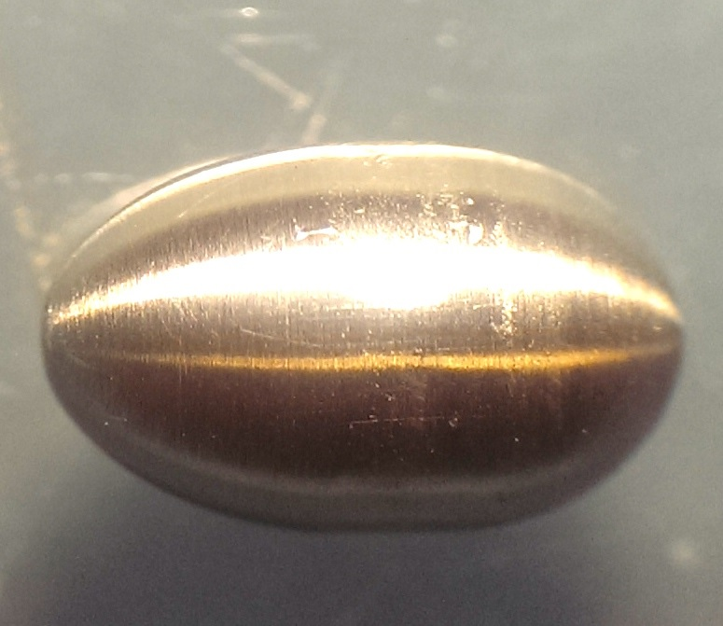
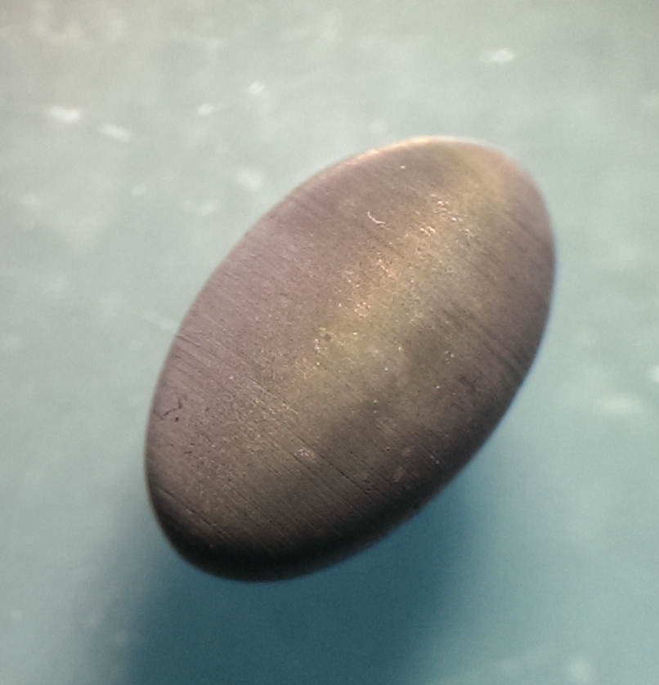


H_{c1} vs. Film Thickness; H_{vp} with Film Coating
Tan et al., Scientific Rep. 6, 35879 (2016)
Nb0
Nb200
Tan et al., APL Materials 3, 041101 (2015)
H_{c1} increases as film thickness decreases.
Thin film coating on Nb ellipsoids: > 400 Oe H_{vp} enhancement observed.

Slide 3

2” MgB₂ Films on Cu Grown by HPCVD
Deposition temperature ~ 470°C, much lower than HPCVD on other substrates.
Eutectic Mg–Cu liquid promote growth of MgB₂ at low temperature. Mg₂Cu alloy acts as a source of Mg for the growth of MgB₂.
T_{c} = 37 K
Cu cavity, 11.4 GHz
(Paul Welander, SLAC)
Au et al., J. Mater. Chem. A1, 9983 (2013)

Slide 4
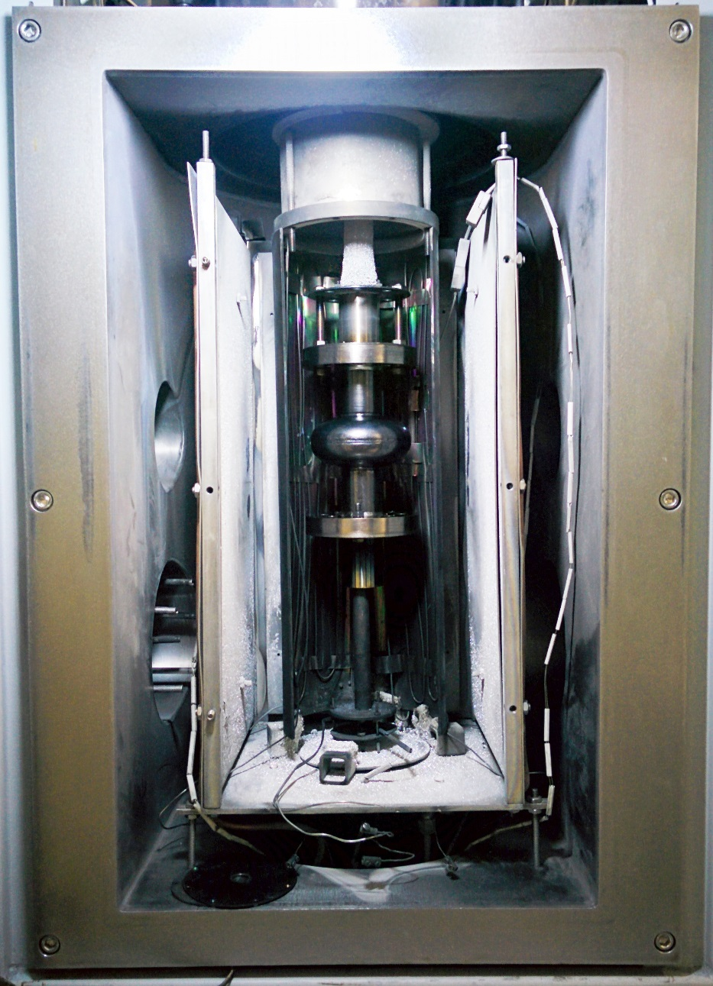
Coating of 3 GHz SRF Cavity by HPCVD
B₂H₆ and Mg vapor are introduced to the interior of the cavity while it is being rotated and slowly moved along its central axis.
Films on substrates mounted on a 3.9 GHz mock cavity show T_{c} = 39 K
18.5 GHz Dielectric Resonator

Slide 5
Thin Films vs. Real Cavity
Thin films:
  necessary for studies of fundamental properties
  may not predict cavity coating performance
Cavity coating
  ultimate demonstration of viability
  needs new facilities

