Slide 1
Next Steps and Validating Milestones for high Q CW Machines – Nb₃Sn and Flux
Sam Posen
GARD-SRF Worksbop
Fermilab
9-10 February 2017

Slide 2
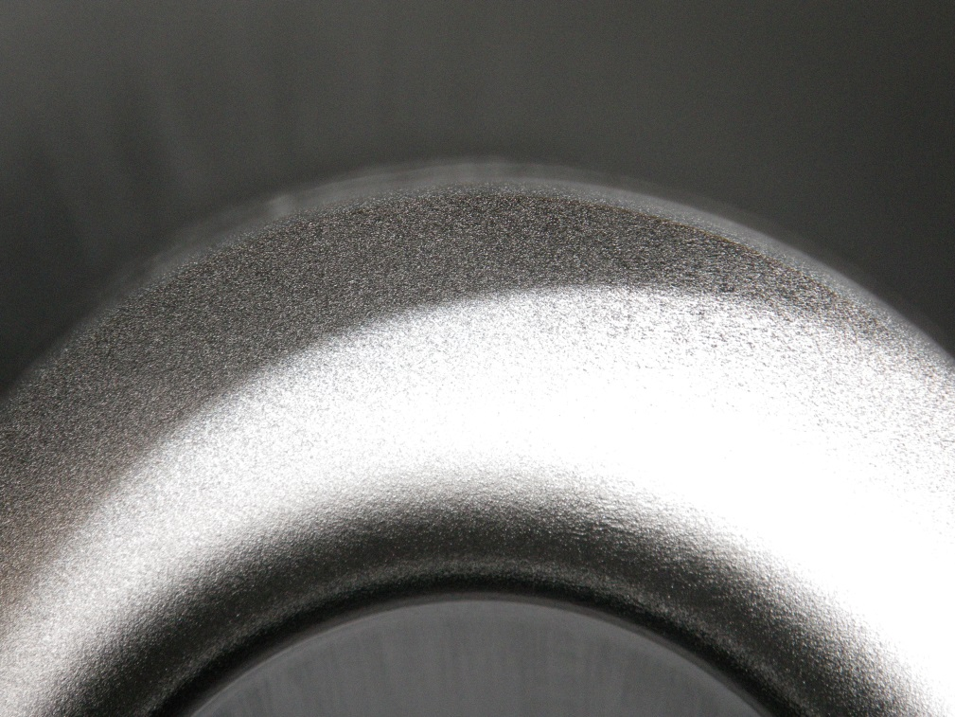
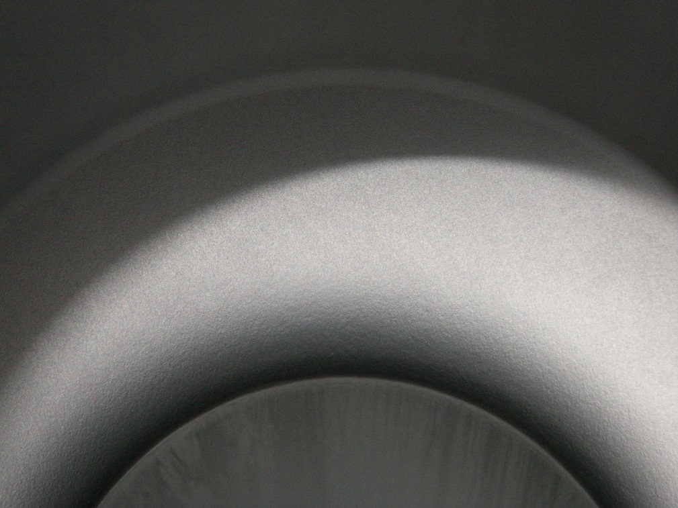
Nb₃Sn Films: Advantage of Higher T_{c}
Nb₃Sn bulk films currently by far has the most promising SRF results of non-Nb superconductor implementations
Recent progress: reliable achievement of fields ~15 MV/m and higher with Q₀~1x10¹⁰ at 4.2 K and 1.3 GHz (Cornell)
Bulk films: Cornell, JLab, Fermilab
  (Nb₃Sn/Cu: CERN)
Some obvious next steps for development within the next 4-5 years:
  Maximum E_{acc}
  R_{res}
  Muticell Cavities
Niobium Surface
After Nb₃Sn Coating
D. Hall, M. Liepe, S. Posen, Cornell University

Slide 3
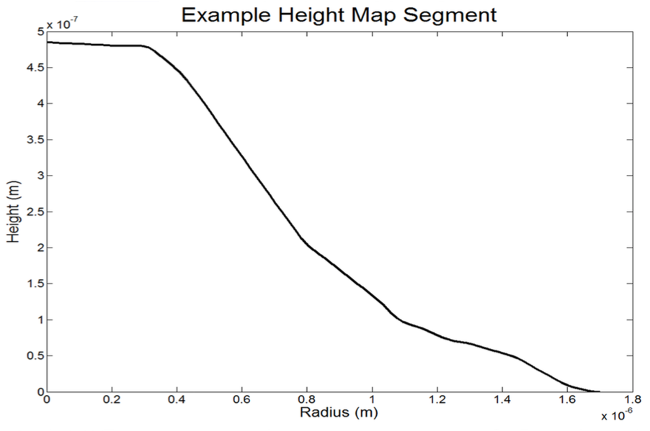
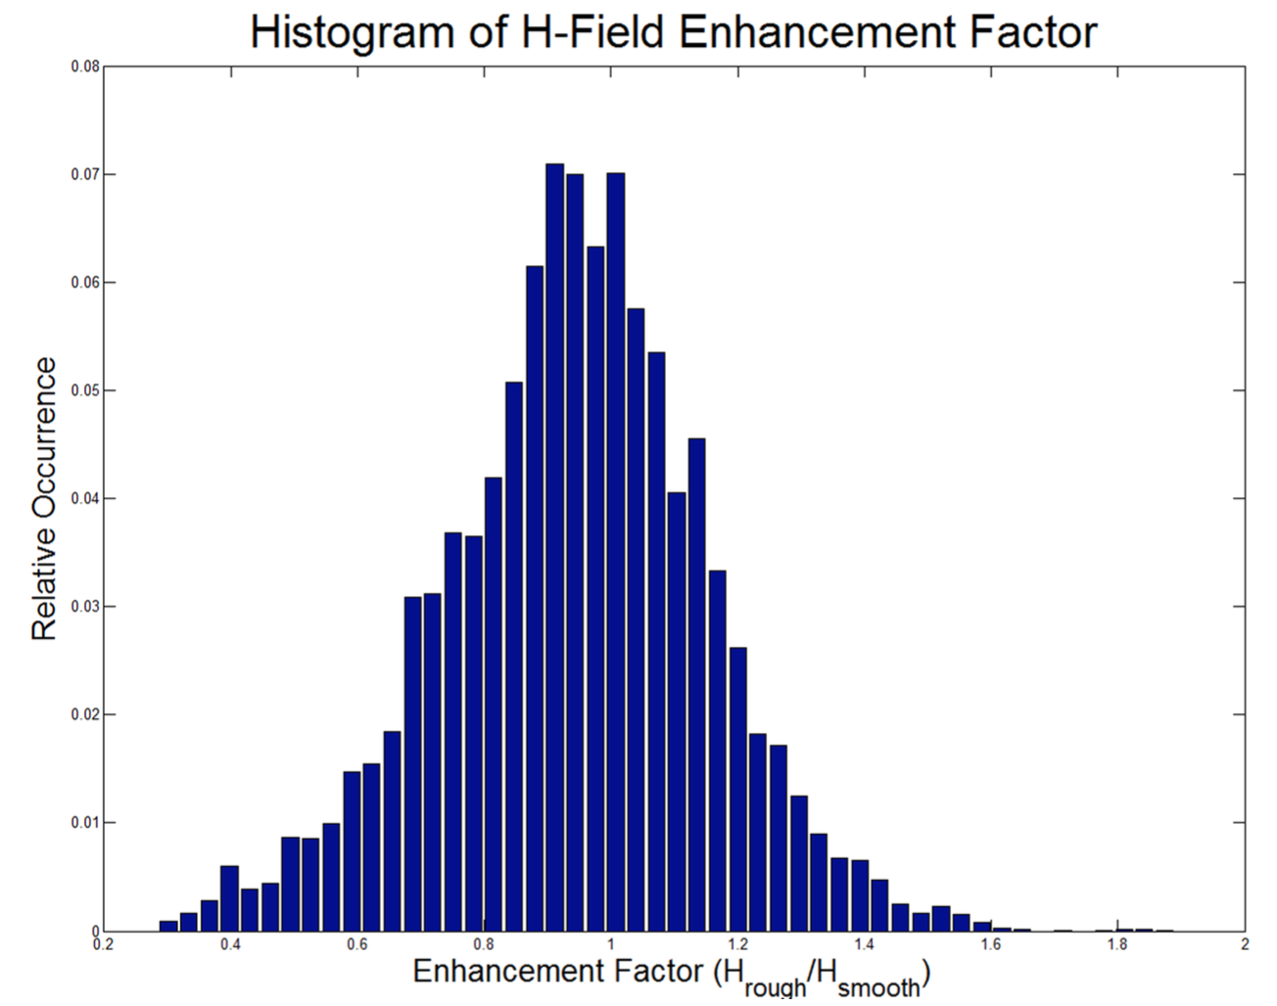
Increasing E_{acc} in Nb₃Sn Cavities
Substantial recent improvement in maximum E_{acc} with high Q₀
Several promising paths forward for continued progress including:
  Smooth sharp-edged surfaced
  Reduce low tin content regions
20-40% increase: 22-25 MV/m
Cornell: AFM scan of Nb₃Sn sample
Field enhancement factor >1.5
4 μm
Y. Trenikhina, S. Posen, D. Hall, and M. Liepe, Proc. SRF Conference 2015, TUPB056, 2015
S. Posen, Ph.D. Thesis, Cornell University (2015).
R. Porter, D. L. Hall, M. Liepe, J. T. Maniscalco, Proc. Linac Conference 2016, MOPRC027 (2016).

Slide 4
Reducing R_{res} in Nb₃Sn Cavities by ~50%
Significant R_{res} in Nb₃Sn connected to trapped flux, thermocurrents
Concentrated effort on reducing R_{res} could significantly increase Q₀
2.0 K: R_{res} dominant
4.5 K: less expensive cryogenics
More uniform cooldown: R_{s} 2x smaller
Notes:
2 K and 4.2 K

Slide 5
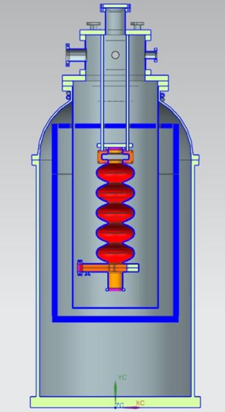
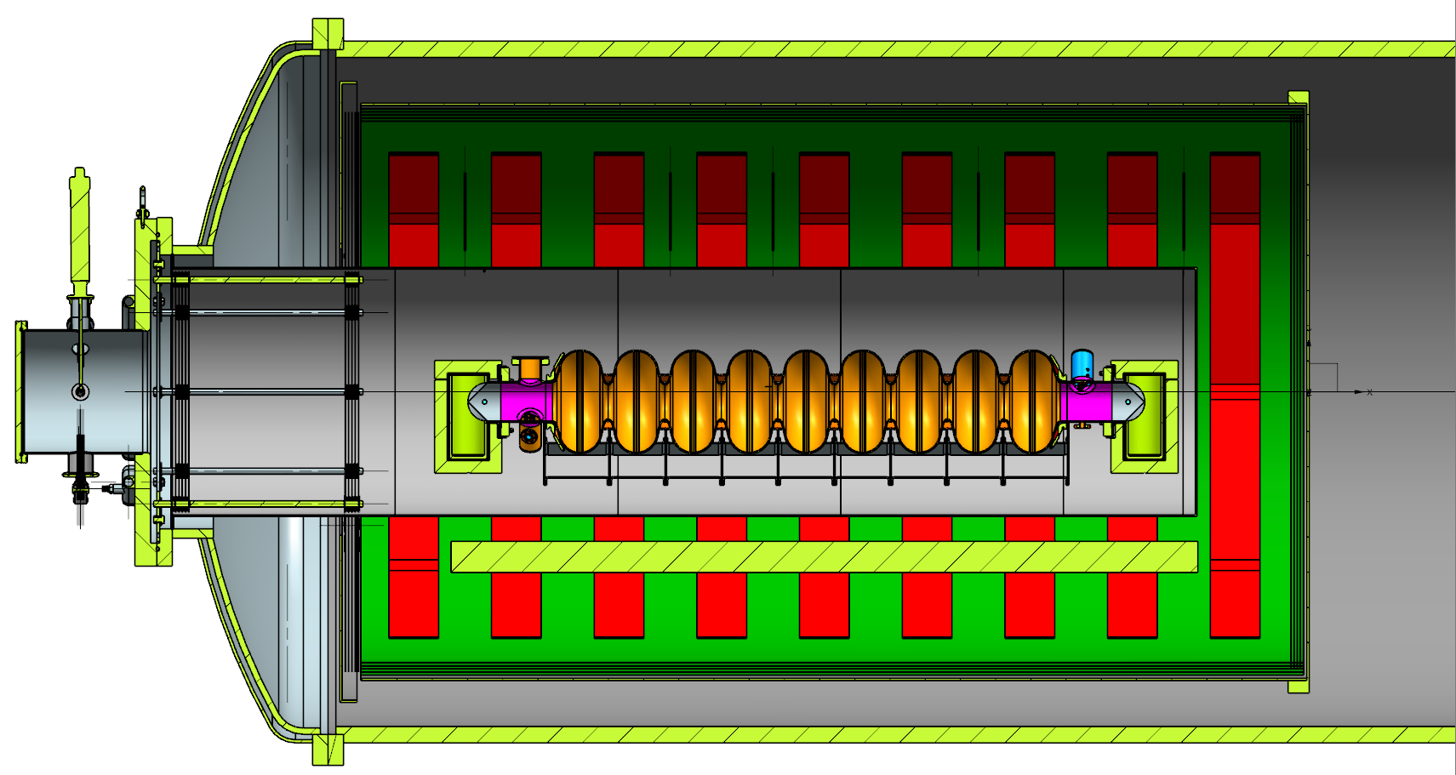
High Performance Multicell Cavities
Fermilab and JLab each work towards multicell coatings
Challenges: uniformity, endgroups, NbTi flanges
Should investigate other frequencies (both higher & lower)
Important to develop practical aspects – microphonics, cooldown, optimal operating temperature
Horizontal test stand tests will be informative
Recipe development for uniform coatings of cavities with large surface area: multicell & low frequency – higher vapor pressure, longer annealing?
Fermilab - Designed for up to 5-cell 650 MHz
JLab - Designed for up to 5-cell 1.5 GHz with waveguides

Slide 6
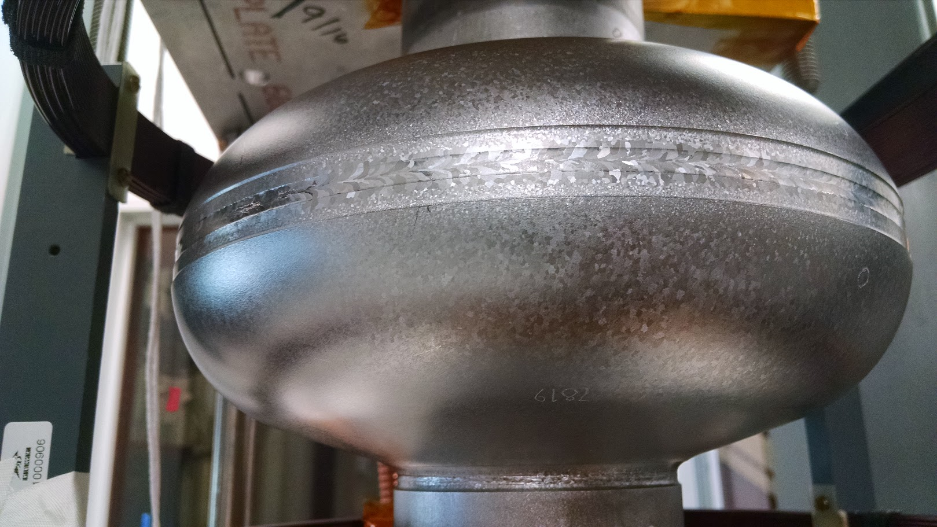
Specifications to Minimize Flux Trapping
Flux expulsion R&D at Fermilab:
  Few mG trapped flux causes significant Q₀ degradation
  As received material from vendors varies in expulsion behavior
  Heat treatment improves expulsion, but may require >900 C
Wah Chang
Complete Expulsion
1000 C 4 h vastly improves expulsion
Tokyo Denkai
Complete Trapping
S. Posen, M. Checchin, A. C. Crawford, A. Grassellino, M. Martinello, O. S. Melnychuk, A. Romanenko, D. A. Sergatskov, and Y. Trenikhina, Jour. App. Phys, 119(21), 213903.

Slide 7
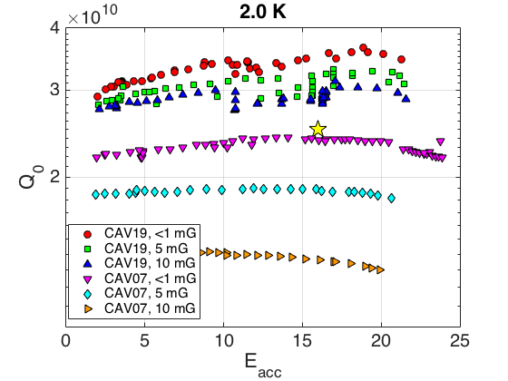
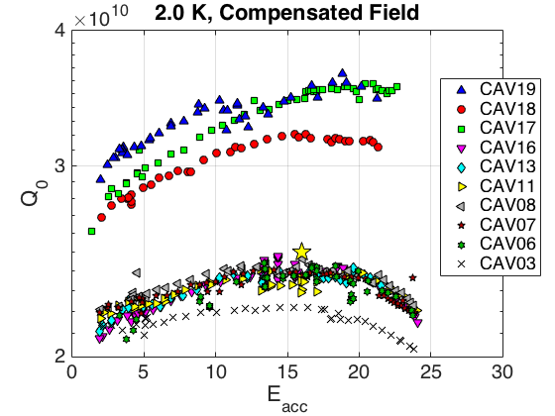
Specifications to Minimize Flux Trapping
Experience with LCLS-II cavities: same observations
  Few mG trapped flux causes significant Q₀ degradation
  As received material from vendors varies in expulsion behavior
  Heat treatment improves expulsion, but may require >900 C

Slide 8
Specifications to Minimize Flux Trapping
It is clear that expulsion is a bulk property
  Grain boundaries?
  Dislocations?
Every large grain cavity that we have measured has had strong expulsion
  Fewer grain boundaries?
  Less work – fewer dislocations?
Endeavor to develop understanding of physical mechanism so we can update material specifications to provide strong expulsion (1-2 years)

