Slide 1
Field Emission its Understanding and Control
Rong-Li Geng
Jefferson Lab
GARD-SRF Roadmap Workshop
Fermilab, February 9-10, 2017

Slide 2
Question from Organizer
What are the state of the art and the new ideas to pursue abatement of field emission in vertical test and cryomodules? (Wu, Kelly, Geng, Padamsee, Martinello)

Slide 3
Outline
Review of state of the art in FE control
Ideas in further raising FE onset
Examples of on-going work in understanding and control of FE at JLab
Conclusion

Slide 4
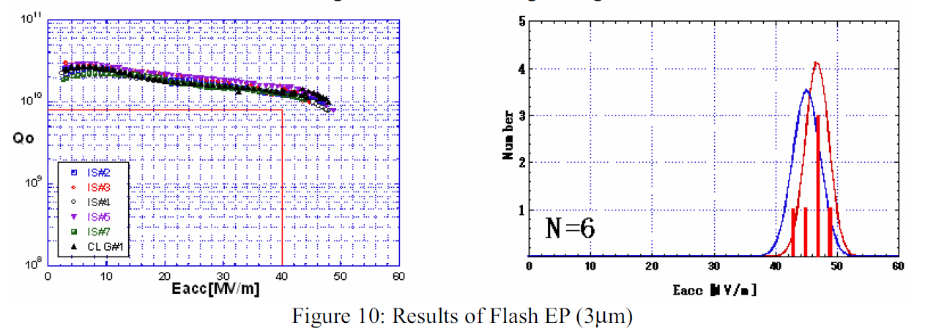
State of the Art in Single-Cell Cavity Testing
ILC baseline surface processing + additional fresh EP
Theory: Remove embed Nb_{x}S_{y} that can not be removed by USC or HPR alone
F. Furuta, K. Saito et al., SRF2007, TUP10

Slide 5
State of the Art in Full-Scale 9-Cell Cavity Vertical Testing
ILC baseline surface processing
IPAC2011, MOPC111

Slide 6
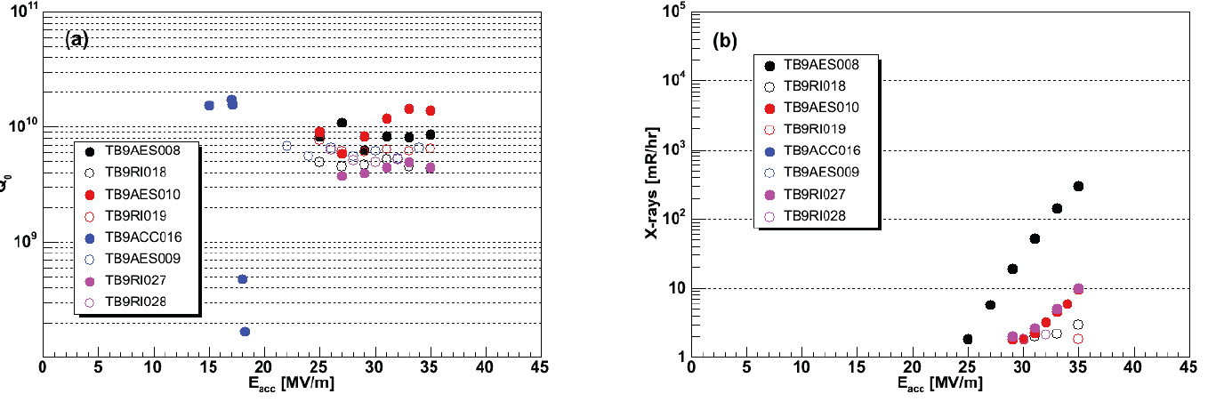
State of the Art in Full-Scale 9-Cell Cavity Horizontal Testing
HTS @ FNAL
FE measurements site dependent!
Be careful when comparing apples to pears
VTA @ JLAB
A. Hocker et al., IPAC2012, WEPPC049

Slide 7
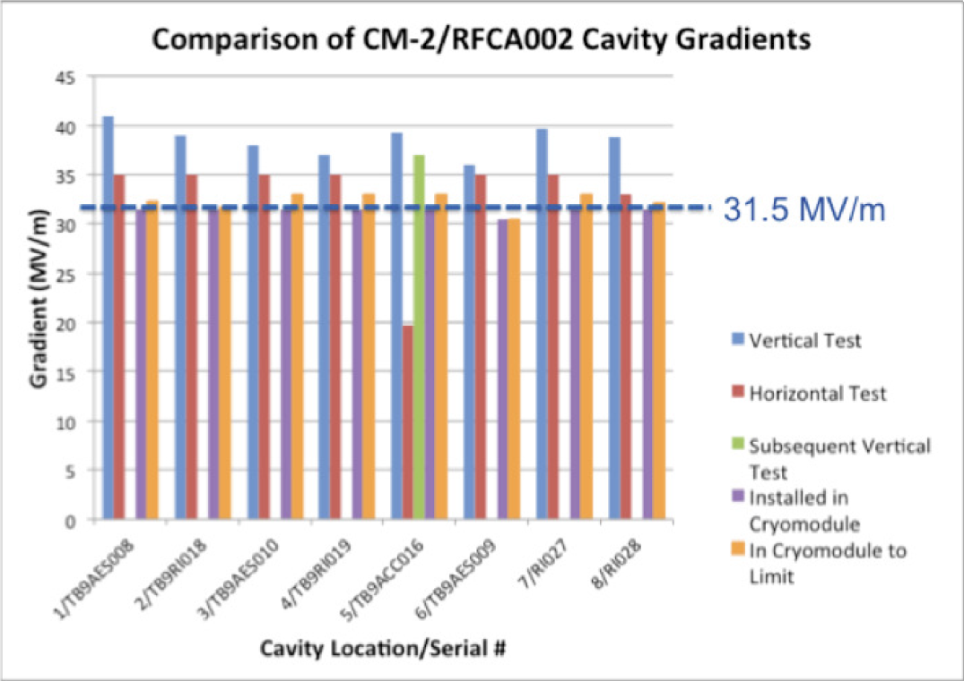
State of the Art in Full-Scale Cryomodule Testing
E. Harms et al., SRF2015, FRAA03

Slide 8
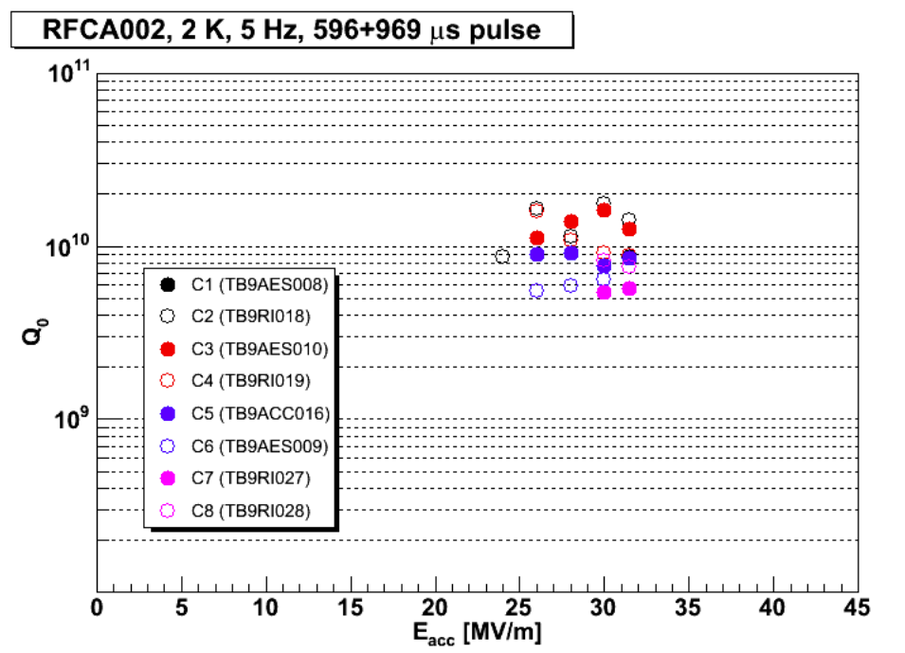
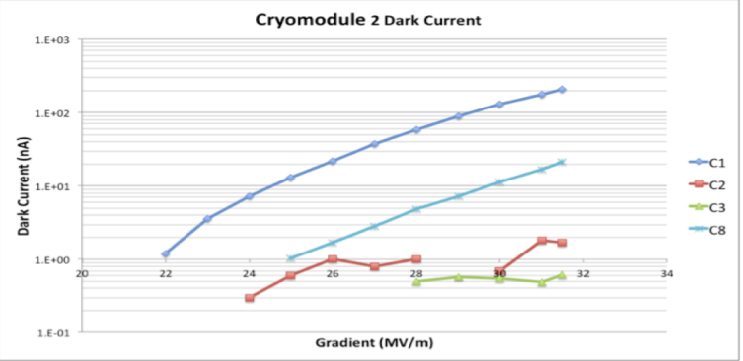
FNAL CM2 Q₀, FE, Dark Current
FE X-ray onset ≥ 19 MV/m
Dark Current at 31.5 MV/m
4 out of 8: No detectable
2 out of 8: ~ 1nA
1 out of 8: ~ 10 nA
1 out of 8: ~ 100 nA
E. Harms et al., SRF2025, FRAA03

Slide 9
Summary of State of the Art High G
50-60 MV/m, Best 1-cells, alternative shape
40-45 MV/m, best 9-cells, TESLA shape
36 MV/m one 9-cell without beam
57hours
31.5 MV/m, 7 9-cell without beam
unknown hours
> 30 MV/m, several 9-cells with beam
15 hours at 3 mA
Several hours close to 9 mA
Vertical test
Cryomodule test
without beam
Cryomodule test
with beam
RG, TTC @ Saclay, France, July 5-8, 2016

Slide 10
Field Emission
Continuous progress has been made over decades in raising FE onset at all levels of cavity testing.
“FE-free” vertical testing demonstrated in single-cell up to 50 MV/m and full-scale 9-cell up to 40 MV/m.
Presently there is lot of enthusiasm in advancing SRF cavity gradient to 60-80 MV/m via new material and in raising Q₀ at 30-40 MV/m in niobium cavities.
While achievement of low surface resistance is an important goal, one must not forget to fight FE.
FE in SRF accelerator operation remains a challenge.
Extrapolating the state of the art, due to its exponential nature, we foresee FE a bottle neck in SRF cavity operation at > 40 MV/m without or with beam.
FE study and control should be a high priority in high gradient SRF portfolio within GARD program.

Slide 11
New (and not so New) Ideas in Raising FE Onset
Micro-EP (more later)
Derived from “Fresh EP” idea of Saito & Furuta demonstrated in 2007.
A Vertical EP machine a perfect tool for this task
End-group cleaning
End-group brushing, steam cleaning, dry-ice cleaning
Low-particulate assembly
Low-particulate beamline components
Ion pumps, gate valves…
In-situ processing
Helium processing
A useful tool for CEBAF upgrade cavity FE improvement at JLab
On top of everything, understanding is needed regarding the nature of actual field emitters at all stages of cavity surface preparation, string assembly, and beam operation.
origin, mechanism of transportation into cavity…
FE mapping
“Forensic” studies of post-operation cavities

Slide 12
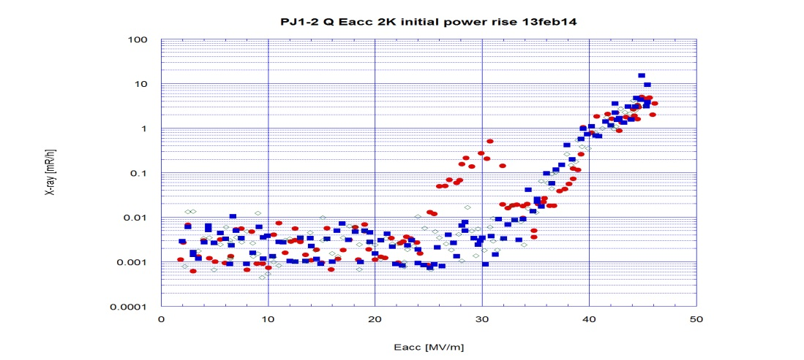
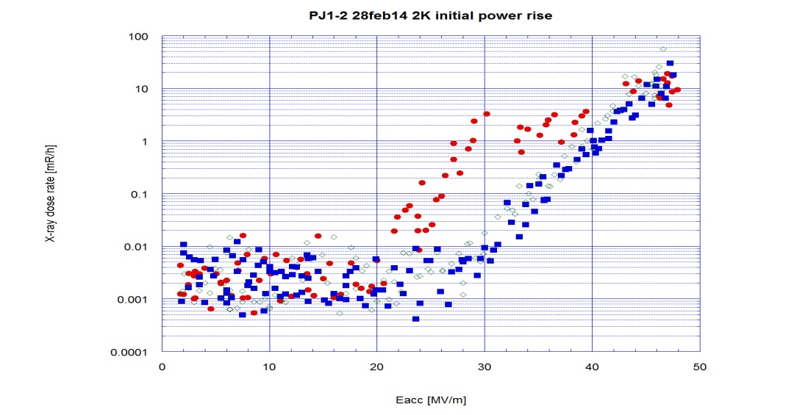
Demonstration of Field Emission Free @ E_{pk}>100 MV/m
Field emission free
Epk 104 MV/m
Re-HPR only
Achieved by using standard ILC EP processing at JLab horizontal EP machine
This result encourages µEP effort based on vertical EP machine at Cornell (see F. Furuta, 2nd LCC/ILC Cavity Group Meeting, Nov. 6, 2013)
Next step is to test even less removal down to 1 µm
+ µEP + ER + USC + HPR

Slide 13
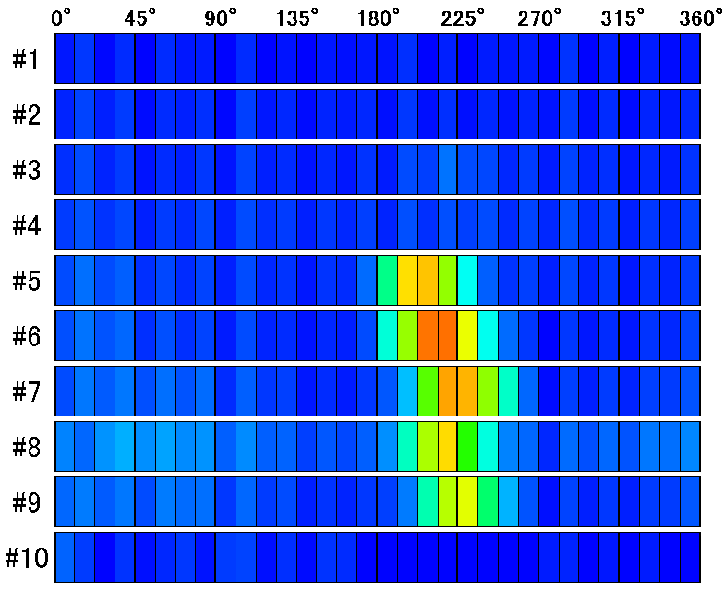
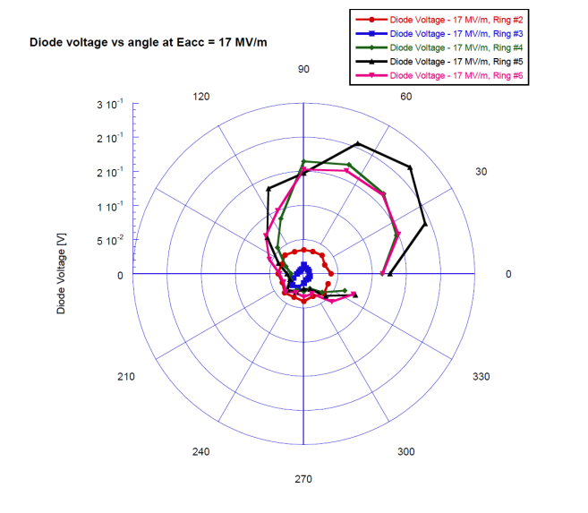
Understanding and Reduction of FE – FE Mapping
Joint testing/comparison of Kyoto/KEK sX-mapping & JLab diode ring X-Mapping Vertical Test Area, Jefferson Lab SRF Institute, Oct. 9 – 15, 2016

Slide 14
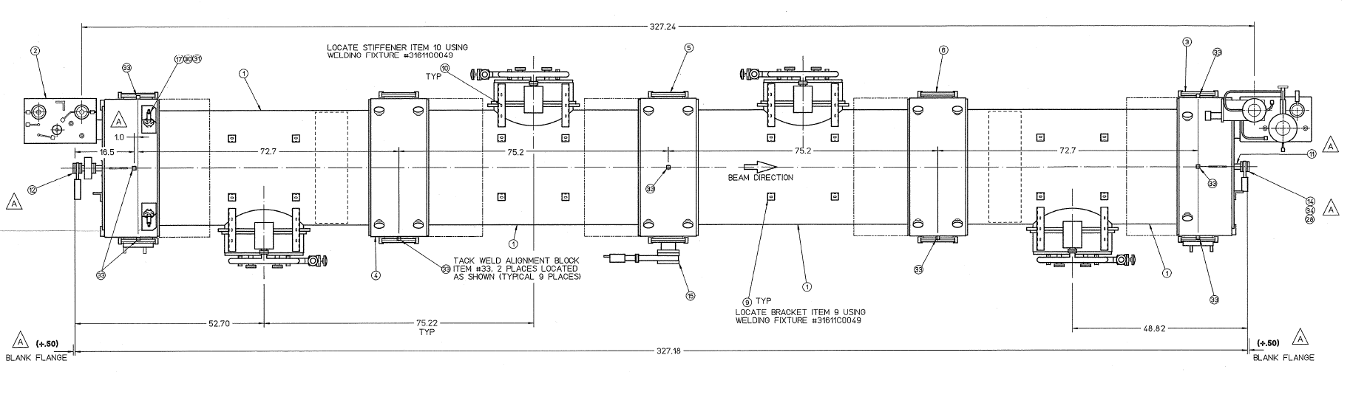
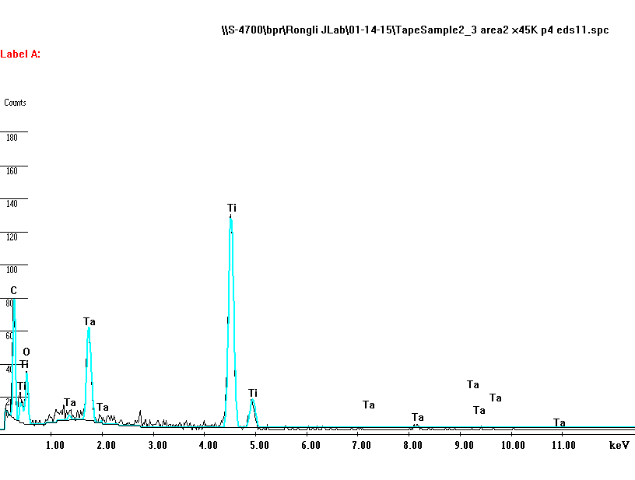
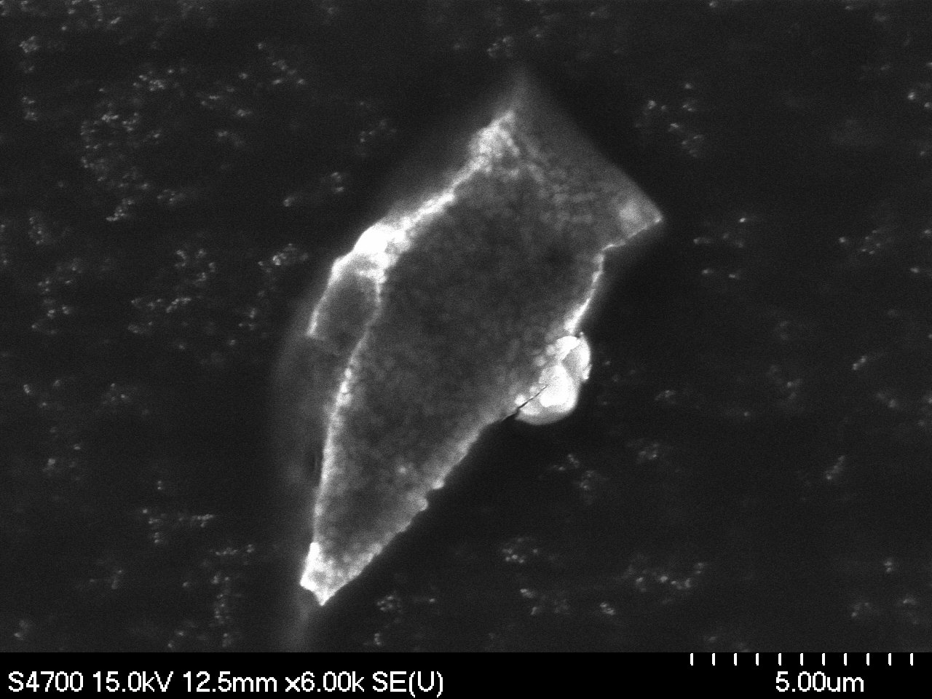
Direct Evidence of Particulate Transportation
Pilot study with module FEL2 of identical design, previously operated with beam
Conventional
Ion pump (Ti)
DI (noble)
Ion pump (Ti/Ta)
IPAC2016, THOBB03

Slide 15
FE Detection Around 12 GeV Upgrade Cryomodules in CEBAF Tunnel
On-going testing with JLAB-SLAC cooperation

Slide 16
Conclusion
FE is foreseen a bottle neck in SRF cavity operation at > 40 MV/m without or with beam. Carry out R&D now.
FE control is needed at all levels from SRF cavity surface prep to cavity beam operation. New progress will benefit all DOE SRF accelerators.
Low FE operation of SRF accelerators a defining goal. Use DOE SRF accelerators, ASTA, CEBAF, LCLs-II, as test bed for FE studies.
FE diagnostics hold key toward a deeper understanding and raising FE onset to next level. Increase level of effort in FE diagnostics, exploit on-going SRF production project such as LCLS-II.
FE study and control should be a high priority in high gradient SRF portfolio within GARD program. An annual investment of $1M for next five years is recommended.

