Slide 1
High Power Processing for Field Emisison

Slide 2
The Field Emission Situation
Vertical tests 29%
CM tests 19%

Slide 3
XFEL Vertical Tests
XFEL Cryomodule
Need improved surface treatment, HPR++
Improved assembly

Slide 4
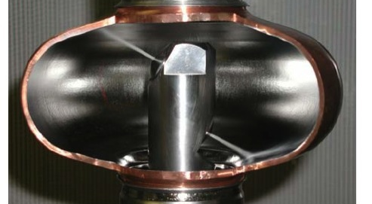
CO₂ jets cleaning single cell Proven at DESY for FE Reduction

Slide 5
High Pulsed RF Power Conditioning for FE Proof of Principle
1995
Three 5-cell, 1.3 GHZ cavities
BCP preparation
EP not yet in fashion
NO HPR
Not yet invented for SRF
First power rise, limited by FE
HPP with 1 MW 150 usec
Finally limited by High Field Q-slope
Reached Eacc 28 – 32 MV/m

Slide 9
High Pulsed Power Processing FE

Slide 10
FE strong at 10 MV/m for first power rise
Cavities all prepared without HPR
Empirical relation
R&D: With HPR above relation may prove more favorable
E.g. E (cw) = 0.8 E(pulsed) to be investigated
If so, Limit of HPP processing effectiveness
Eacc (pulse) 48 MV/m => Eacc (cw) = 38 MV/m
=> Hpk = 200 mT (near max for Nb)
Need high power test stand for 2- 3 MW x 200 usec
Variable coupler

Slide 11
Conditioning Cryomodule?

Slide 12
_{LEP-2, 300 cavities}
125 kW /cavity
Conditioning in CM
6 -> 7.5 MV/m

Slide 13
XFEL

Slide 14
200 kW/cavity RF power

