Slide 1
What are the state of the art and the new ideas to pursue abatement of field emission in vertical test and cryomodules?
Martina Martinello
GARD SRF Workshop 2017

Slide 2
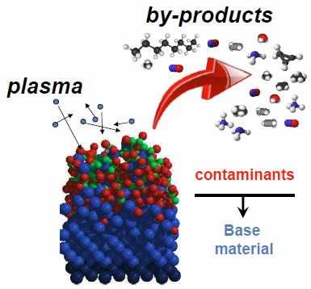
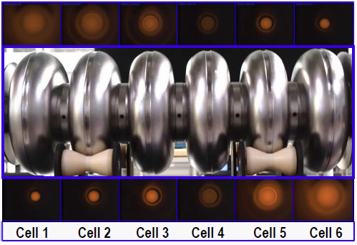
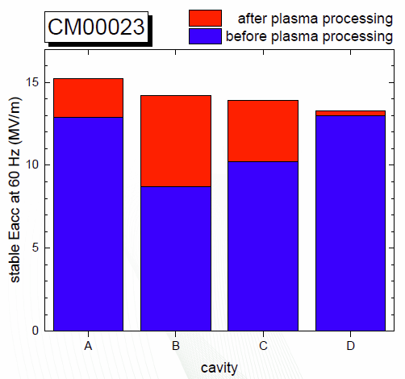
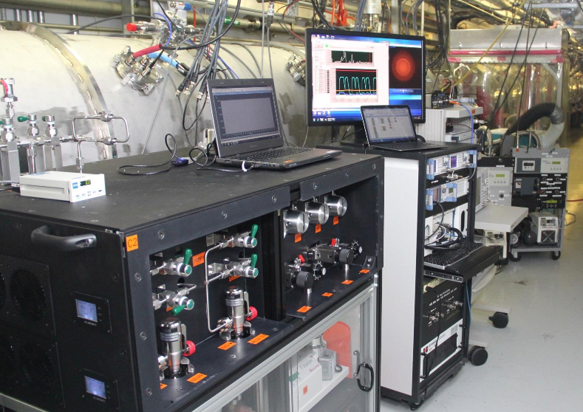
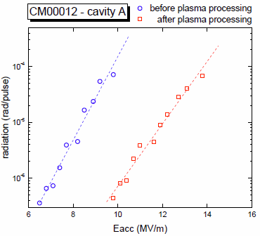
State of the Art: Plasma Processing at SNS
In-situ removal of hydro-carbons via Ne-O₂ plasma processing
Increasing the work-function $φ$
$$\frac{dE_{acc}}{E_{acc}}\sim \frac{3}{2}\frac{dφ}{φ}$$
20-30% increase in $E_{acc}$
3 cryomodules successfully processed at SNS
<$E_{acc}$> increases ~ 21%
Ex:CM00012
<$E_{acc}$> = 12.3 MV/m before PP
<$E_{acc}$> = 15.3 MV/m after PP
Significant reduction of radiation level

Slide 3
State of the Art: Plasma Processing at SNS
In-situ removal of hydro-carbons via Ne-O₂ plasma processing
Increasing the work-function $φ$
$$\frac{dE_{acc}}{E_{acc}}\sim \frac{3}{2}\frac{dφ}{φ}$$
20-30% increase in $E_{acc}$
Successful technology to mitigate field emission and increase the maximum accelerating gradient without disassembly and re-assembly the cryomodule at prohibitive cost
3 cryomodules successfully processed at SNS
<$E_{acc}$> increases ~ 21%
Ex:CM00012
<$E_{acc}$> = 12.3 MV/m before PP
<$E_{acc}$> = 15.3 MV/m after PP
Significant reduction of radiation level

Slide 4
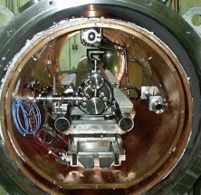
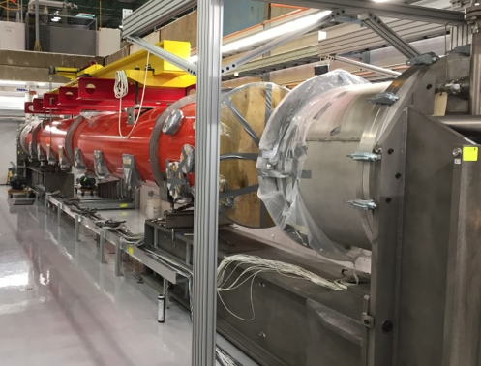
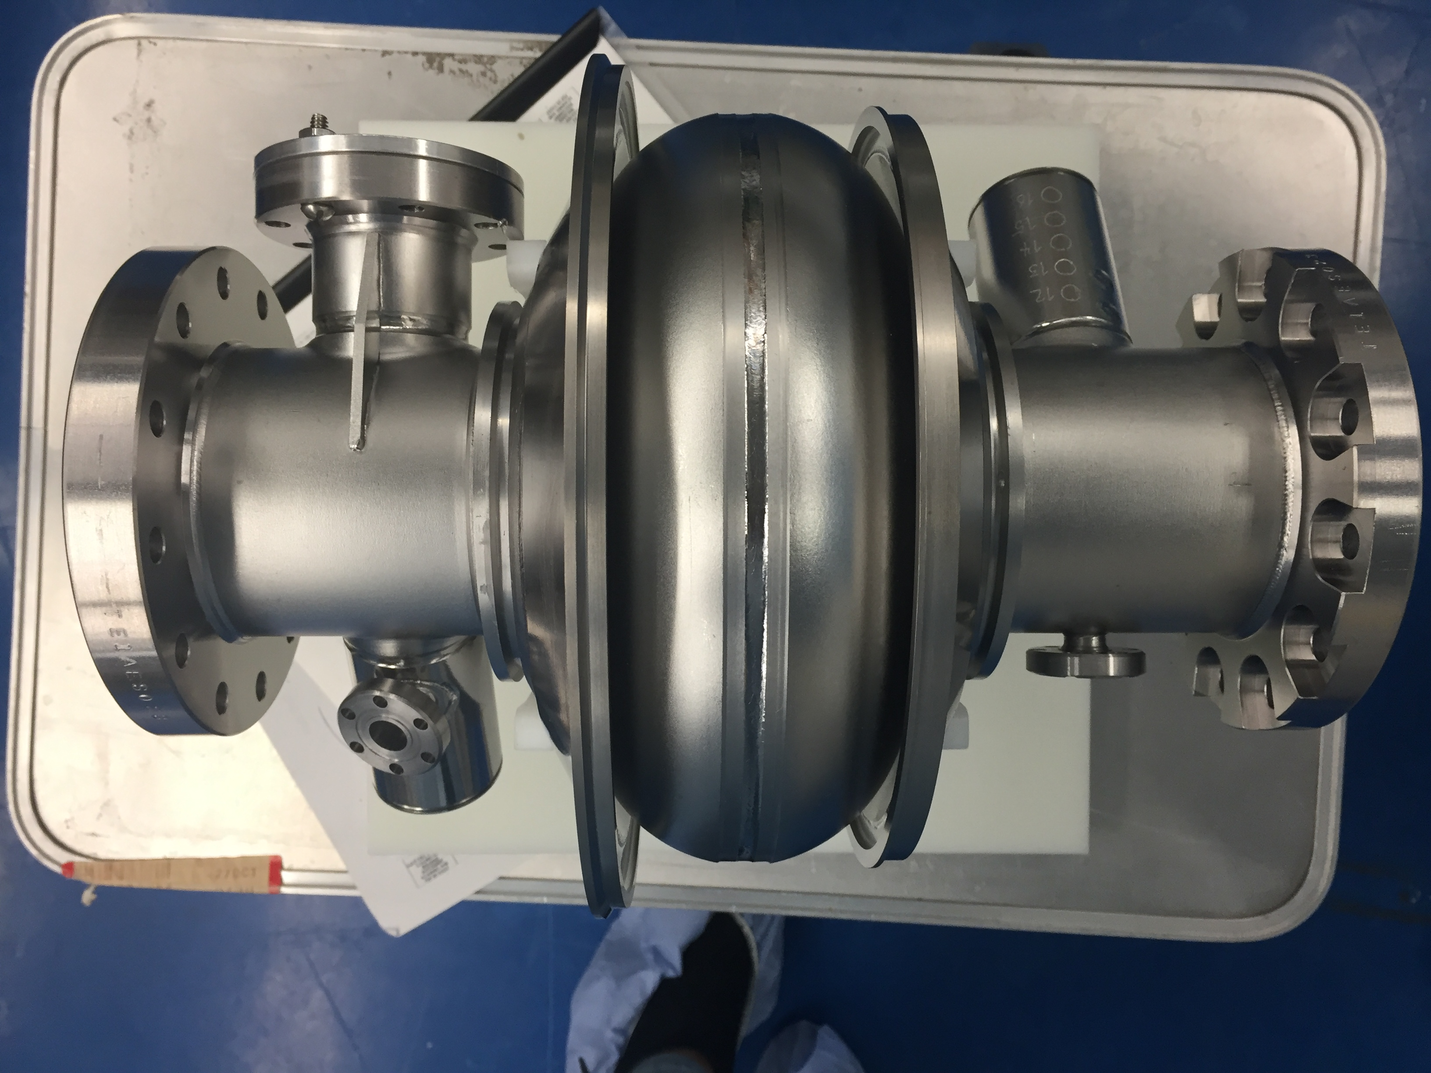
Mid-Term Goals: Plasma processing for LCLS-II
2017
2018
2019
2020
Present
Applicability of SNS plasma processing to LCLS-II
Design of RF and vacuum system
Goals
Plasma ignition in 9-cells cavity
Plasma processing and RF test of 9-cell cavities in VTS
Improve maximum $E_{acc}$ of field emitting cavities
Goals
Plasma processing in-situ in a cryomodule-like environment (HTS)
Monitor of plasma ignition based on resonance shift
Goals
Plasma processing in-situ in LCLS-II cryomodules
Improve maximum $E_{acc}$ of ~ 15-20 %
Goals
Plasma processing of 1.3 GHz single-cell cavity
RF test in VTS

Slide 5
Long-Term Goals: Extension to other accelerators
PLASMA PROCESSING FOR LCLS-II
2017
2018
2019
2020
Single-cell
9-cells VTS
9-cells HTS
LCLS-II cryomodules
PLASMA PROCESSING FOR HIGH GRADIENT MACHINES
2018
2019
2020
2021
2022
Studying more aggressive plasma mixtures
Eliminate/Smooth metallic contaminants
Improve effectiveness of the process to all kind of field emitters
Processing of cavities with different frequencies/shapes
Defining guidelines to develop plasma-processing friendly cryomodule

