Slide 1
Topic: Ancillary Systems for future accelerators
drhgfdjhngngfmhgmghmghjmghfmf
Mike Kelly
GARD/SRF workshop, Round Table discussion
Feb 9-10, 2017

Slide 2
What are the needs for future accelerators?; what drives cost?
Directions
Moderately-high (>10 mA) to very high-intensity (~several Ampere) beams
(Mostly) CW operation
I assert the cost drivers are:
Uniqueness of each component → lots of man hours
Physical size → cavities, modules, subsystems are large
Touch labor → more man hours
Materials/technology for ancillaries is important, but does not have cost implications as bullets 1,2,3
My perspective
ATLAS, FRIB, PIP-II, ILC/APS-U
High-intensity multi-ion driver for isotope production

Slide 3
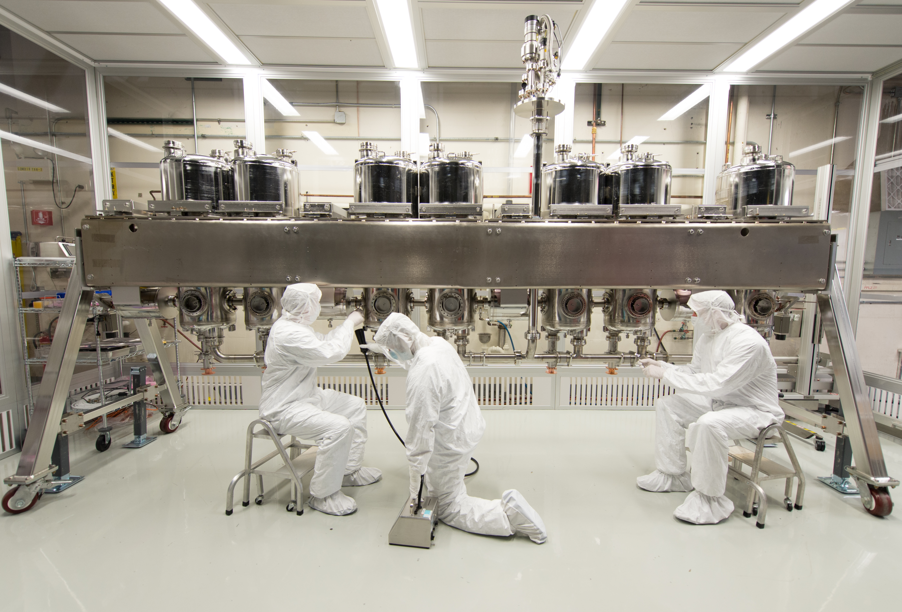
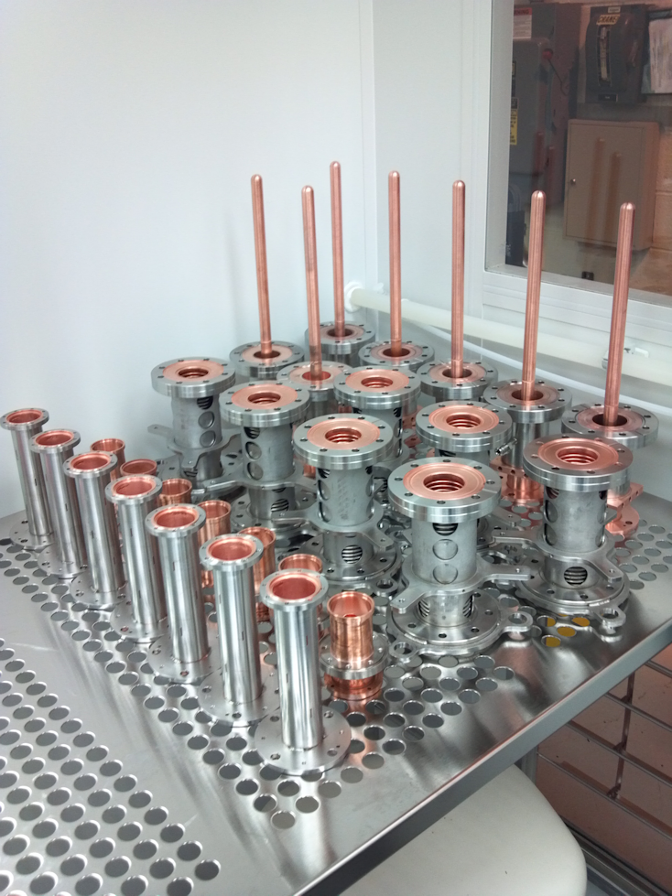
Modern ‘Moderately’ high-power coupler
ATLAS 4 kW CW Variable Couplers for 72 MHz
UNIT COSTS based on 8 FY17 $
$5.4K
Primary point: costs dominated by development/testing
M&S, materials, plating → $16k/unit
$112k/module
Initial Development 1.5 FTE, Fabrication 0.5 FTE, Testing/Qualification 0.5 FTE
~$900k
I
$5.5K
$3.3K
$1.5K

Slide 4
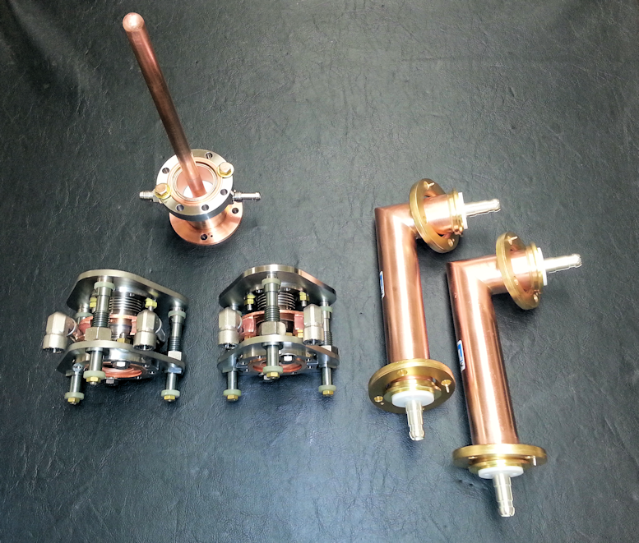
Similar ‘Moderately’ high-power coupler for FRIB
Quantity ~100 FRIB 4 kW CW Adjustable Couplers for 80 MHz
Primary point: Even on quite large projects manpower/touch labor is substantial
M&S, materials, plating → my assumption $12k/unit
$1.2M total (this is my WAG)
Initial Development 1 FTE-year, Fabrication 1 FTE-year, Testing/Qualification 2 FTE-year
~$1M (does not include all qualification that FRIB may still need to do)
I

Slide 5
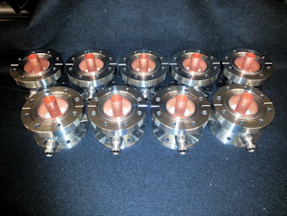
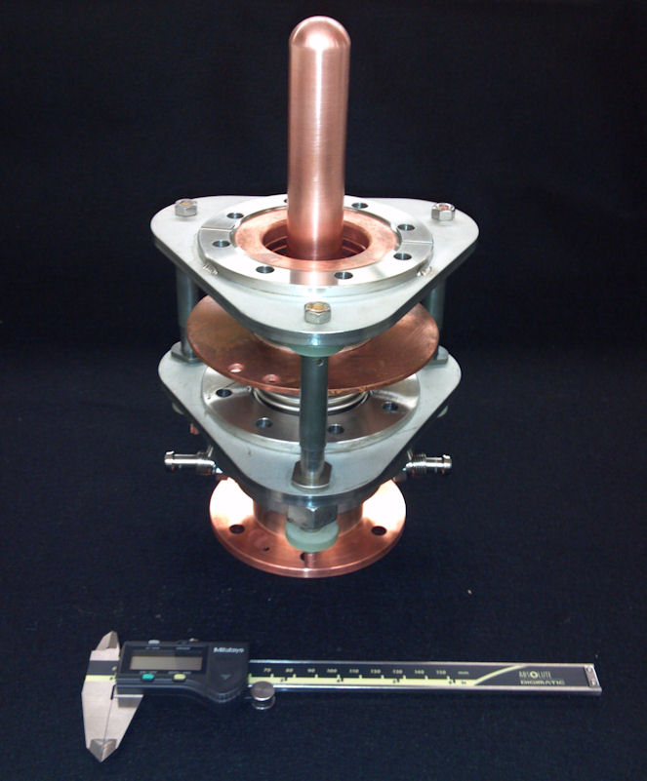
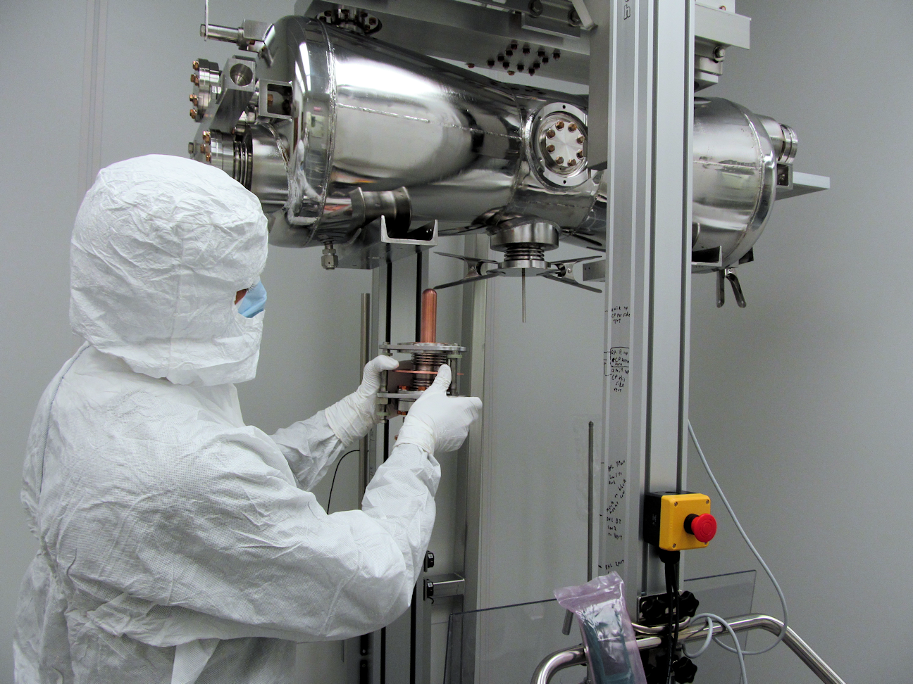
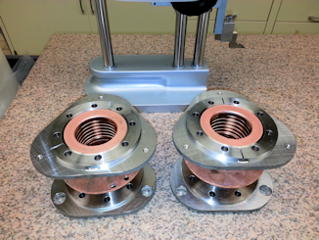
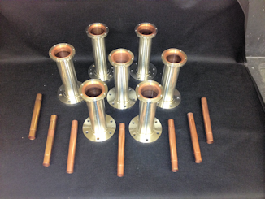
Coupler for pip-ii hwr
All new components (re-do all design analysis even though mostly scaled from ATLAS design)
M&S ~$400 K
Effort ~$1M

Slide 6
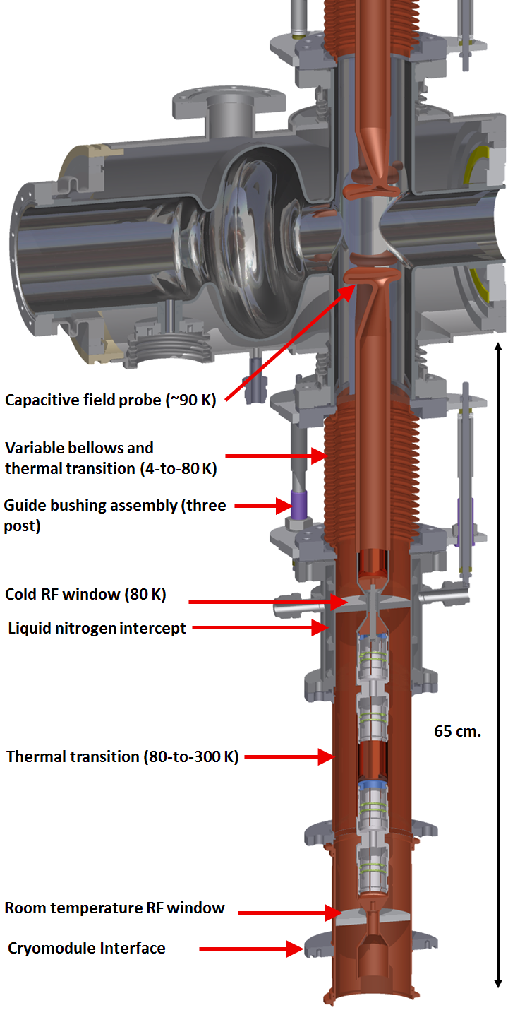
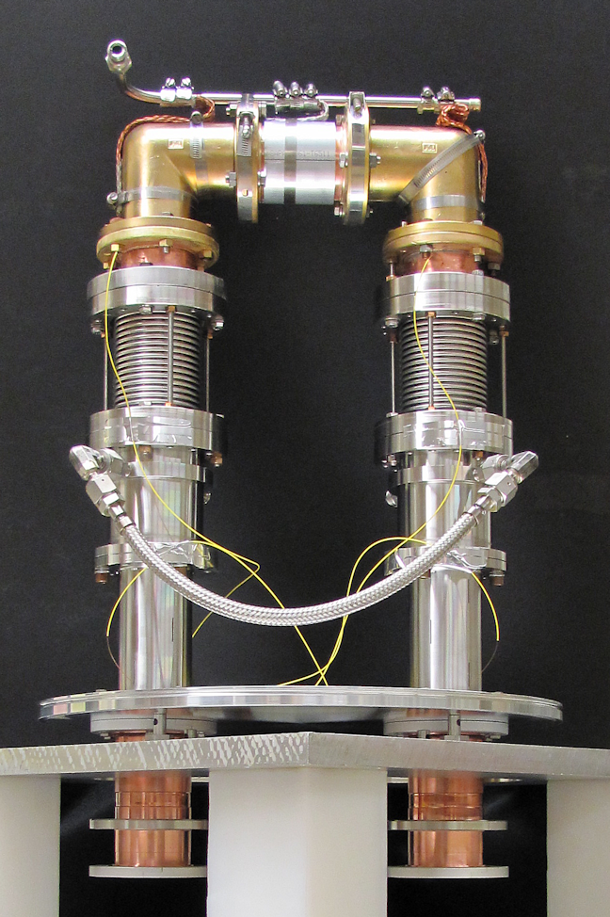
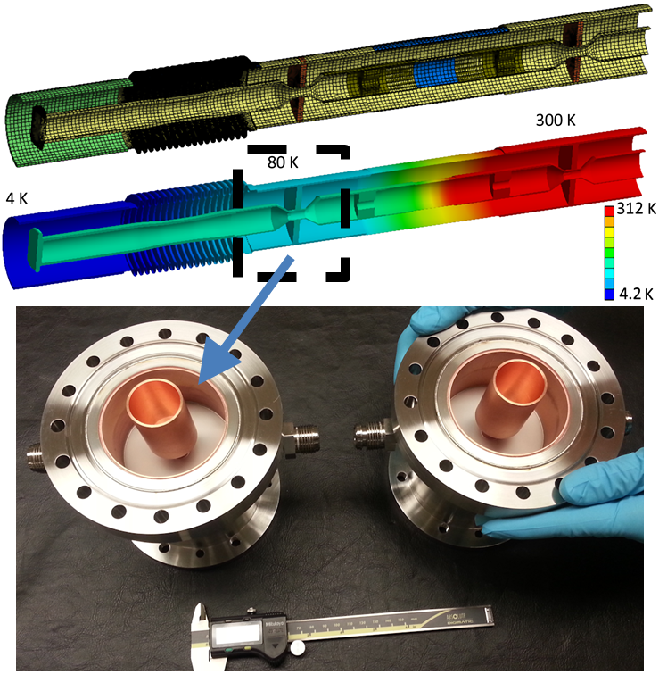
1.4 (1.3) ghz 20 kW CW coupler for APS-U
(Tested to 18 kW CW)
M&S cost ~$80K
Effort: 2 FTE-year (more to come) ~$500K
Again, all new design, development effort

Slide 7
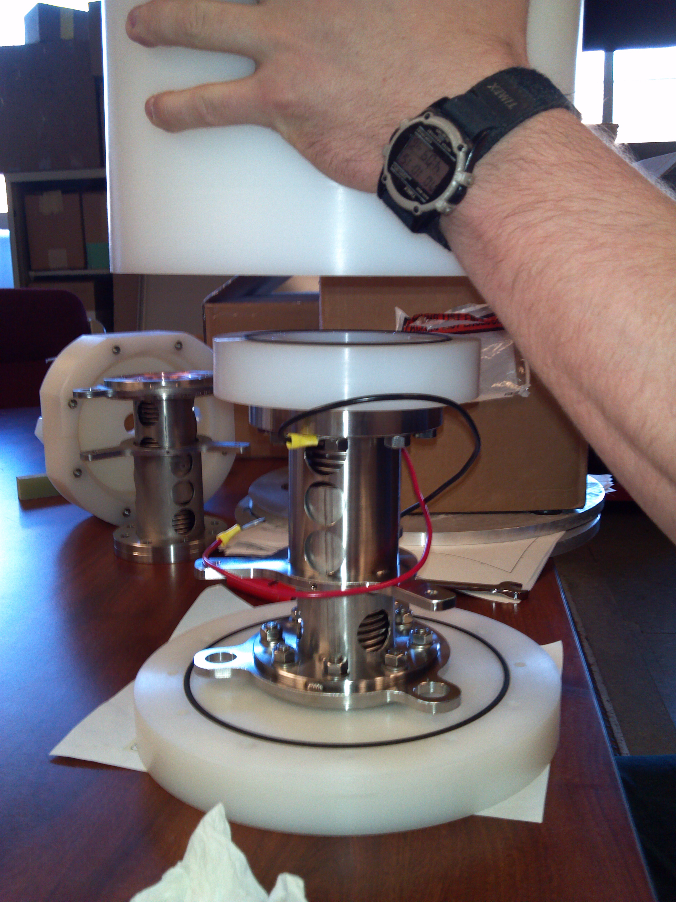
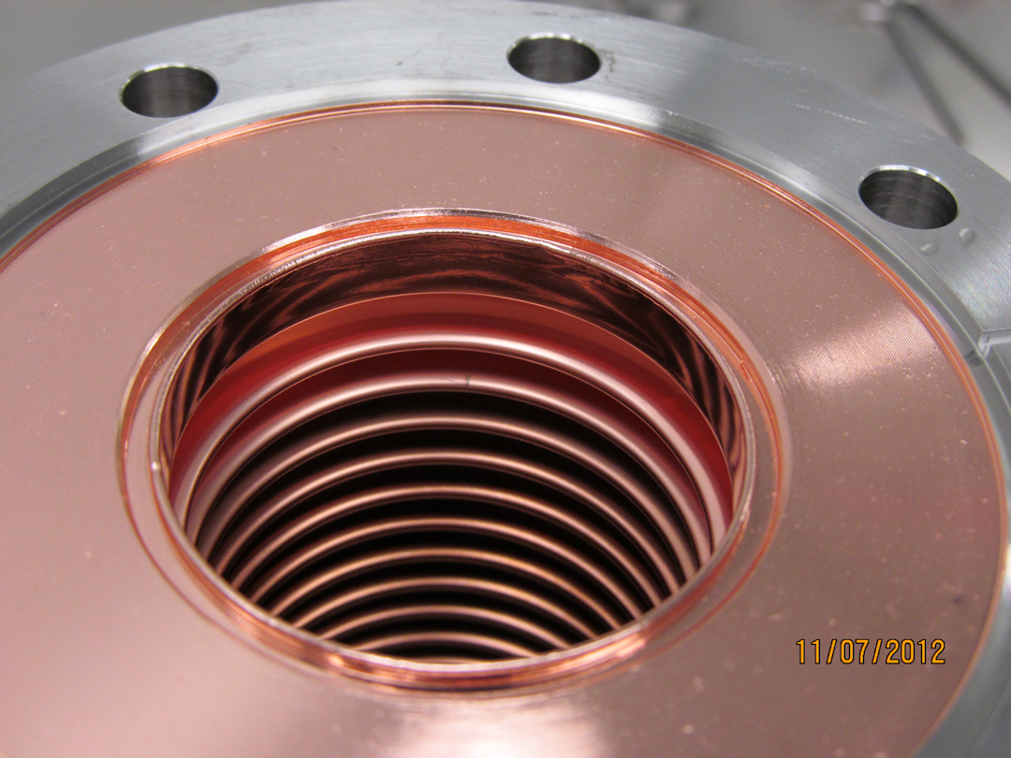
Touch Labor for complex components
Primary point: Plating itself is not expensive; it is also fairly reliable one establish by a good vendor for a particular component e.g.
Plating cost $500/unit
Touch labor per unit 2 man-days
I

Slide 8
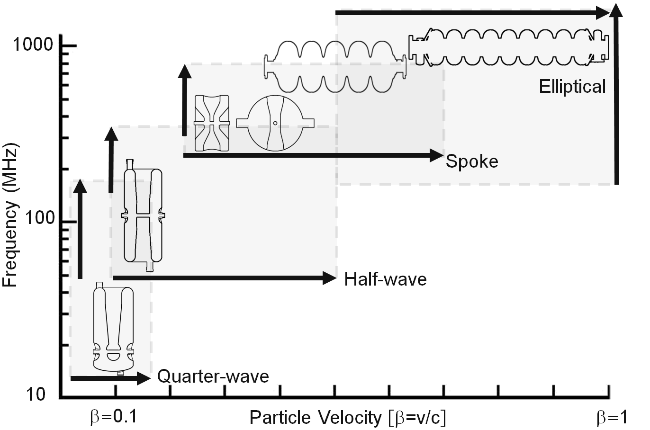
Generally useful classes of Hardware in terms of frequency/velocity
Can similar arguments be made for couplers or other ancillary systems? More importantly, is any ‘standardization’ possible?

Slide 9
Some thoughts/a SMALL proposal
Observations
Even under the worst cases materials/M&S cost are only 5% (e.g. $500K/$10M) of a cryomodule fully loaded cost
→ costs savings are possible by eliminating expensive materials, copper plating, but this is very limited
If manpower for couplers is included, the cost is 10% - 25% of the module cost
→ obvious statement: substantially more cost savings possible in principle
Proposal: Can we have a generally available class of well characterized components available from industry ‘off the shelf’?
Phase I: (perhaps led jointly by a couple of lab(s)/university(s))
systematic study of global needs for the next 10-15 years
Frequency ranges (100-3900 MHz ?), Power (4-1000 kW ?), Variability of Qext?
Is there a class of power coupler components that could be generally useful
Phase II: (perhaps led jointly by industry)
Industrial partners collaborate with labs to provide generally useful components (i.e. rated for a given frequency range, power and temperature) as a catalog item?

Slide 10
Final Comment
Like everything else → Must be driven by the right people, must engage the right industry
Cost savings/performance gains possible by improvements in subsystems alone is worth pursuing
A moderate (few $M) development to bring to the community fairly complete set of ‘catalog rf windows’ could make an excellent contribution to the field and pay back very quickly
Subsystem improvements taken alone will fall into the category of evolutionary change
HOWEVER, it is really new cavity technologies that will drastically change subsystem design (i.e. optimal frequencies will change, cavity and subsystem sizes will change) → revolutionary change possible due to major reductions in physical size → I have some pointed comments this…

Slide 11
Some Implications of emerging technologies (especially for ion linacs and intensity frontier)
drhgfdjhngngfmhgmghmghjmghfmf
Mike Kelly
GARD/SRF workshop, Round Table discussion
Feb 9-10, 2017

Slide 12
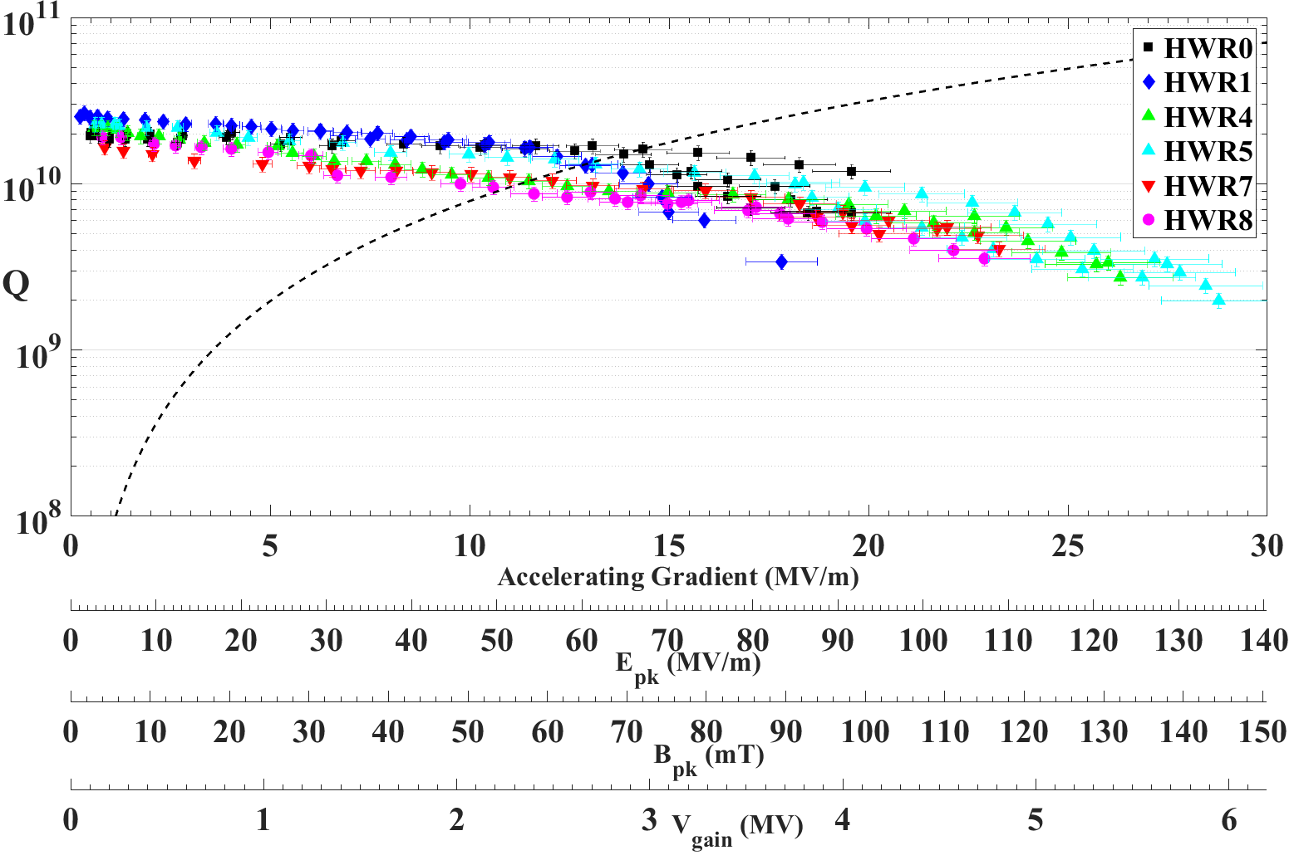
Proof of principle of E_{peak}>100 MV/m in production cavities using standard HPR
Courtesy Zack Conway

Slide 13
Suppose we had Nb₃Sn cavities providing “2k Quality Factor” at 4.5 K and reaching B_{p}~80 mT (should Not be 20 years)?
Present ion linacs start at ~100 MHz, 4.5 K → large accelerating gaps, low Rs, but very costly several x $100K
We don’t want to ‘coat’ this kind of cavity; Rs already pretty low at 4.5 K
At f=400 MHz and 4.5 K, Rs of 60 nΩ (Nb) → 6 nΩ (Nb3Sn)
So what?
So, this would radically change the way ion linacs are built

Slide 14
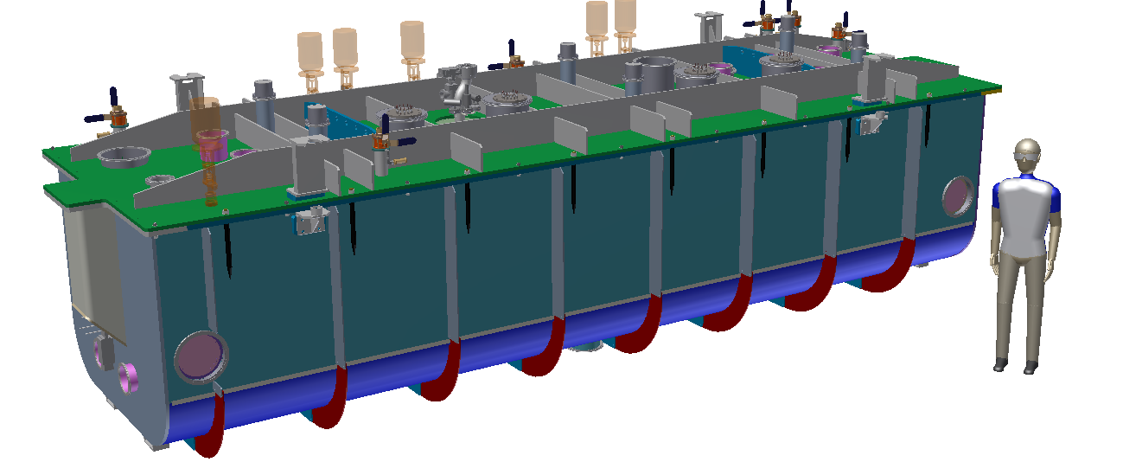
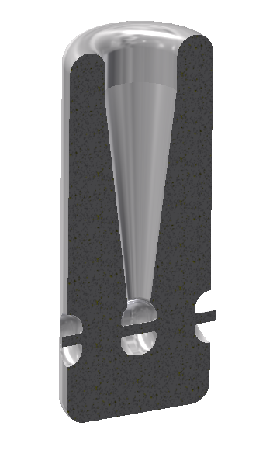
Present Ion linac cryomodules are enormous in all dimensions
~100 MHz
At 400 MHz, each cavity would provide only ¼ voltage of lower frequency device → it will require 4X more cavities
However, both transverse dimensions reduce by ~4X, volume ~16X
Huge reduction in materials, manpower, ease of almost every aspect of fabrication, cleaning (will not be 16X reduction in cost, but would be several times)
~400 MHz

Slide 15
Proposal
(Step back) Study fundamental and practical implications of new materials (How should we build linacs with e.g. Nb₃Sn → We don’t want to just coat the cavities we have
Build a (higher frequency ion linac) accelerating cavity with considerations from (1.)
Scalability
Is there a way to get away from the few x $100K per cavity model?
Can we reduce the unit cost by ~10 for these smaller structures?

Slide 16
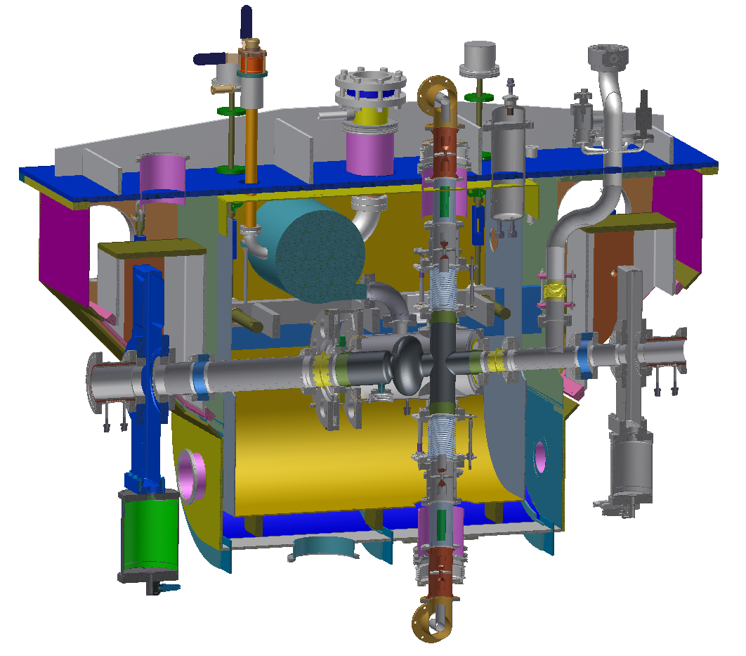
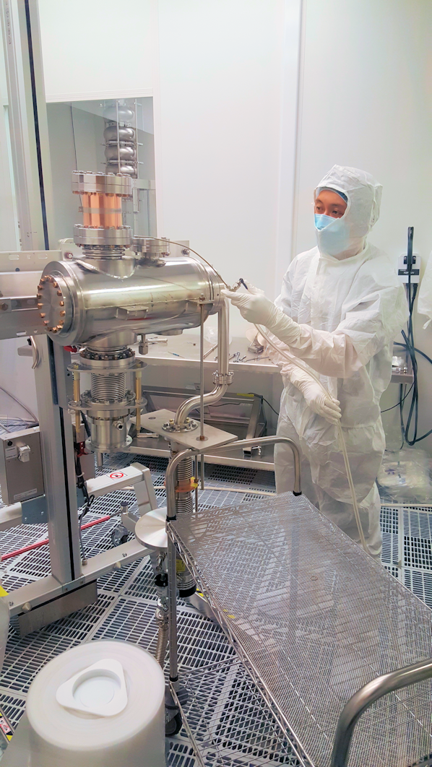
The APS-U 1.4 GHz Bunch Lengthening cavity is an Excellent opportunity to put nb₃sn to practical use right now
2 meter
HOM damper
Tuner
‘RF’ Gate Valve
Cavity
Coupler
‘RF’ Gate Valve

