Slide 1
SPX Cavity Layout

Slide 2

Damper Overview
Damper assembly: bottom
Temperature distribution
Power handling is 900 W for LOM and 150 W for HOM loads.
Loads are affixed with high temperature S-bond solder
Resists particulation due to its high density, temperature strength, and wear resistance.
Thermal conductivity ~100 W/ (ºK m).
Power density spectrum in LOM damper

Slide 3
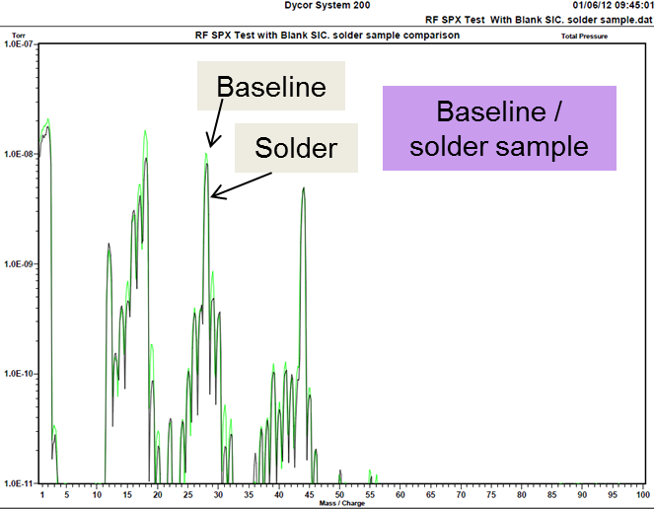
Damper: Mechanical Tests
S-bond solder
Re-melting measurements
Pull force for various bonding methods
Vacuum residual gas analysis

Slide 4
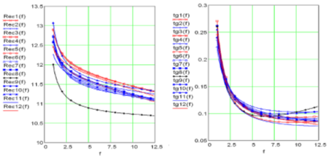
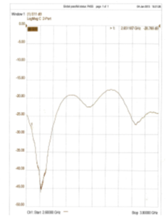
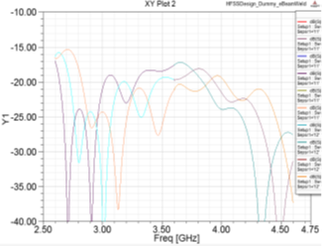
Damper: Electrical Tests
(a) Real
(b) Loss tan
Variation of permittivity among homogenous material
Return loss of prototype damper
Permittivity of SiC (Real & Imaginary)
Return loss of HOM damper

