Slide 1

Sample Measurement:
Coupon/Cut-out studies
Potential Measurement Techniques for SRF Nb R&D
Peter J. Lee
Shreyas Balachandran
NHMFL-Florida State University
With input from Tom Bieler (MSU) and Steven Anlage (UM)

Slide 2
Goals
Develop coupon measurement techniques to:
  Explain materials origin of SRF cavity performance and use to help predict impact of new materials and processes.
  Enable faster/cheaper testing of new materials, processing strategies, and techniques.
Develop materials models that can be tested with coupons and cavities:
  Atomistic models for flow stress and doping interactions.
  Crystal plasticity models for cavity materials.
    Better predictability of cavity forming techniques.
Technique Requirements:
  SRF relevant properties- H_{c3}, Surface pinning, defect classification. Can we measure R_{s} in coupons?
  Sample preparation that does not change the sample chemistry or microstructure.
  Relevant characterization of microstructure, microchemistry and topography.

Slide 3
Some Cut-out/Coupon tests
Coupon cavities- RF structures on substrates
AFM (Attocube FNAL), RT MSU
TEM?
STM (IIT – Zasadzinski)
Neutron Scattering?
Elastic recoil (AR)
Magneto Optical Imaging ( examples here)
High resolution EBSD/ ECCi, modelling (here)
AC Susceptibility (here)
Near-Field Microwave (Anlage - here)
Material Modelling (MSU, ASU)

Slide 4
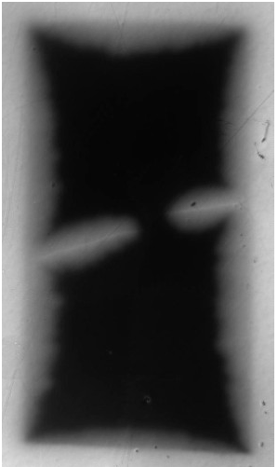
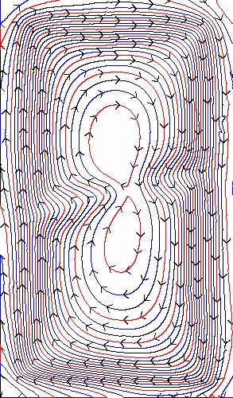
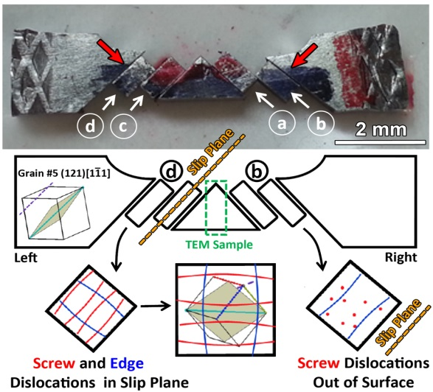
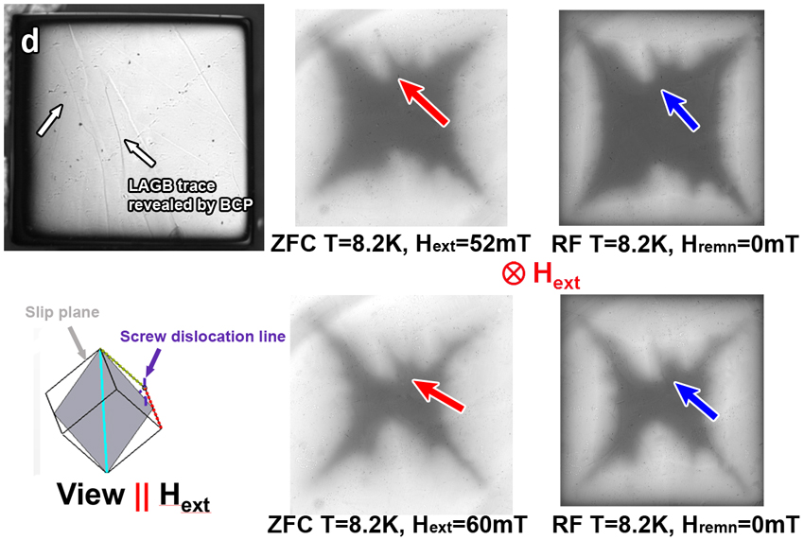
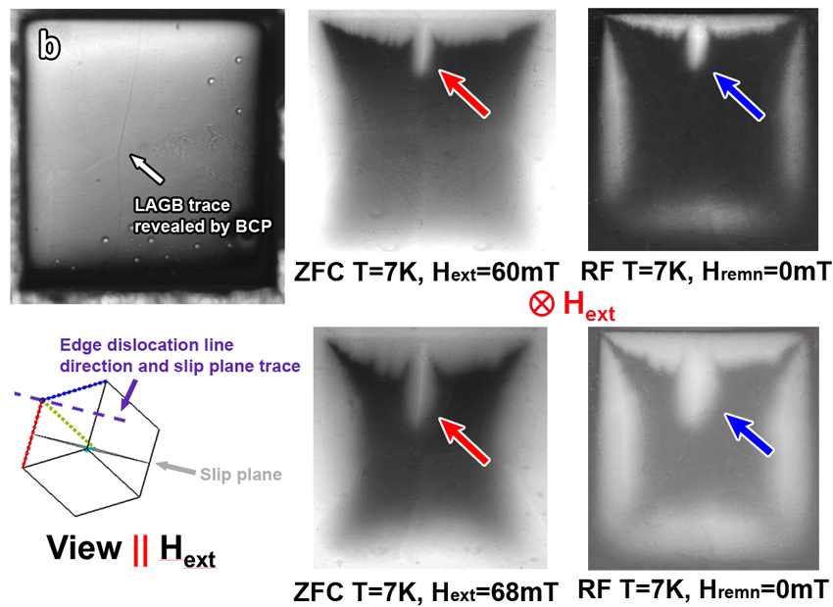
Example 1:MO imaging - Flux penetration along low angle grain boundaries (defects) in designed deformed coupons
Current streamlines
Equipment modifications needed but this technique can be used to visualize and quantify:
Flux trapping
Dynamic changes in flux

Slide 5
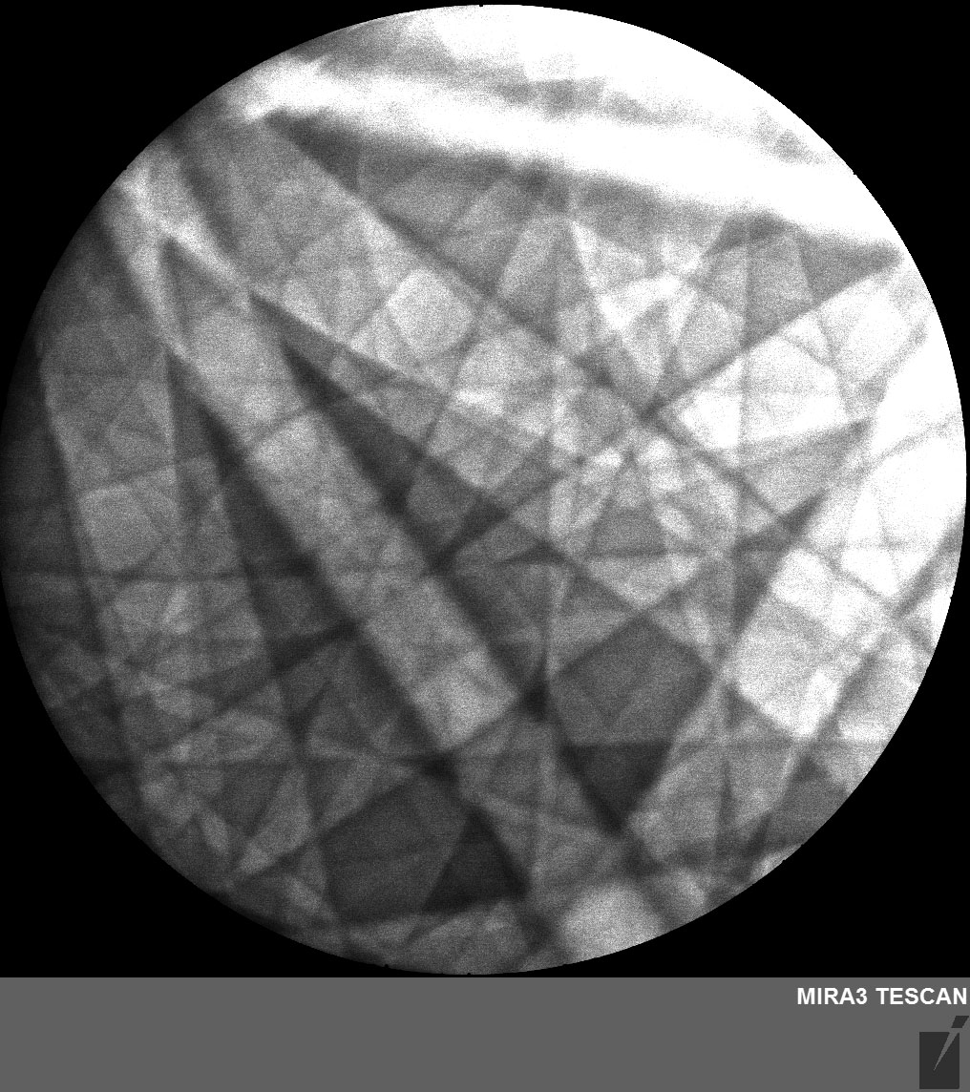
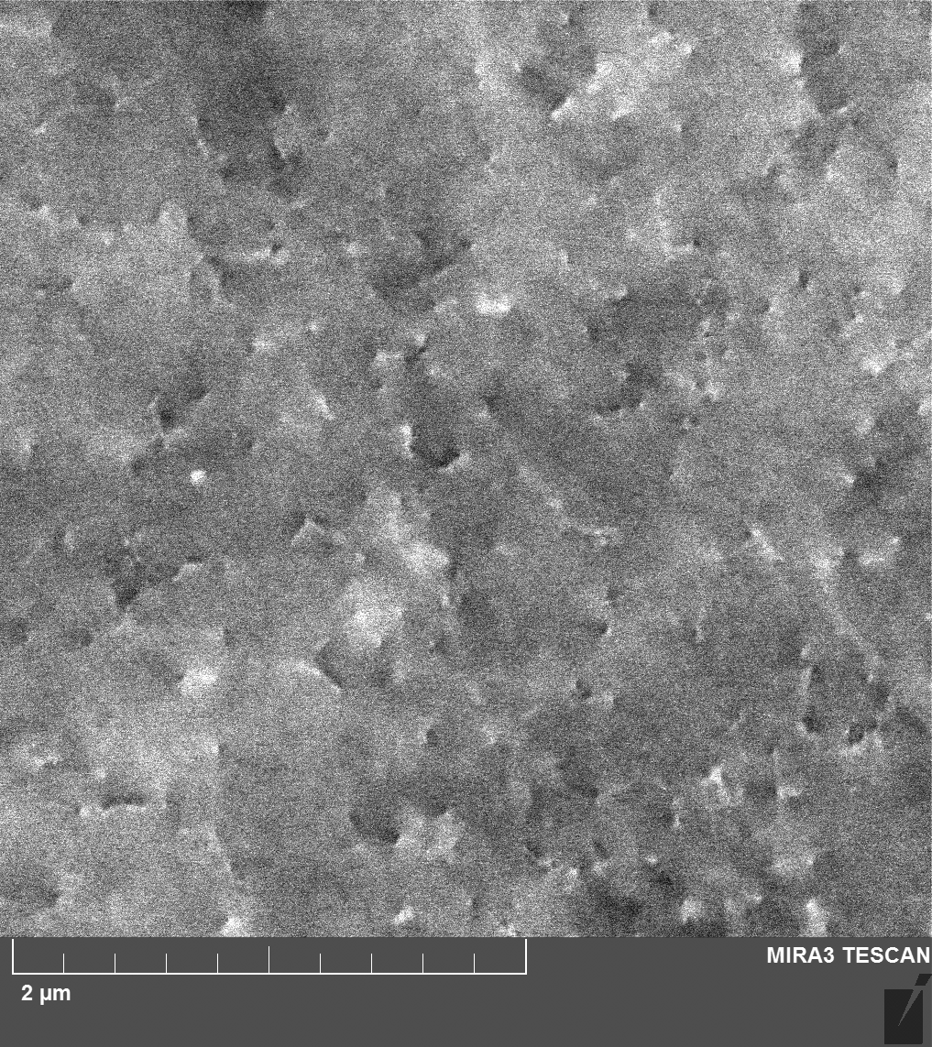
Example 2: ECCI - Resolving dislocation level information
Electron Channeling Contrast Image of sample as-extracted from ingot shows a variety of dislocation types and inclinations with spacing of ~300 nm
e.g. ~perpendicular to surface (circle), inclined to surface (ellipse)
(Dislocation image formed by small orientation changes near dislocation and edge of channeling band)
(031)
BSE
o
Electron Channeling Pattern

Slide 6
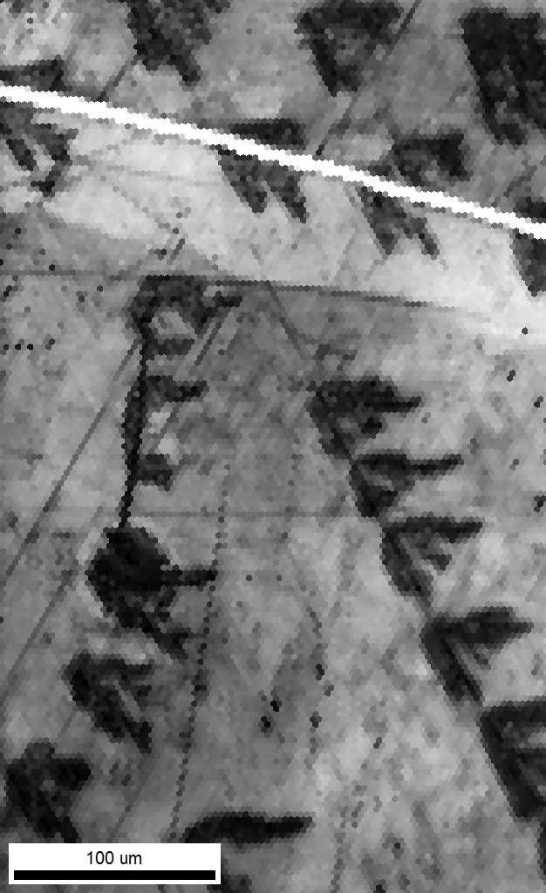
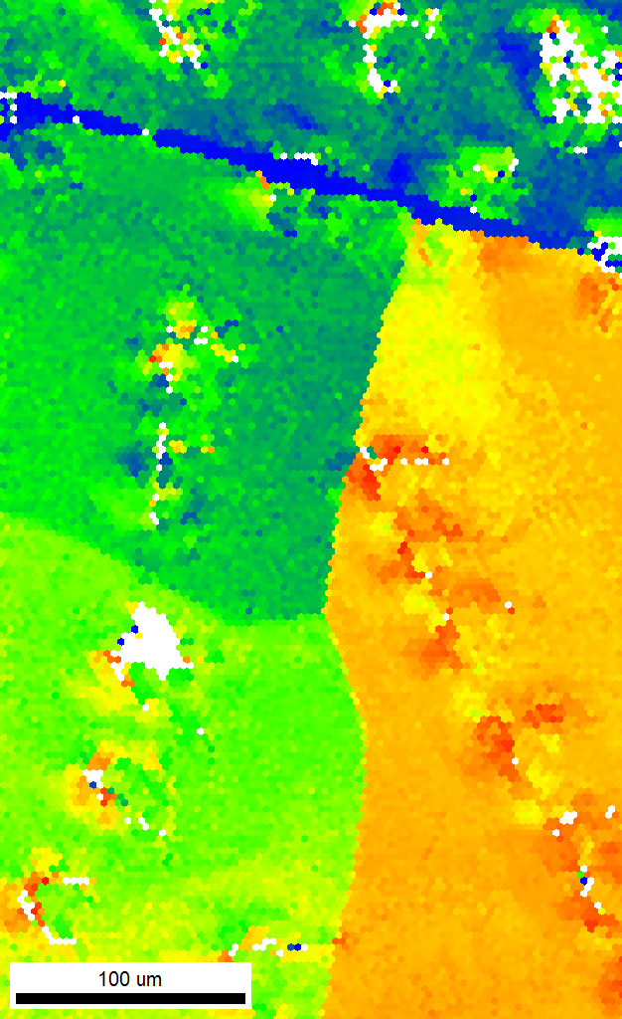
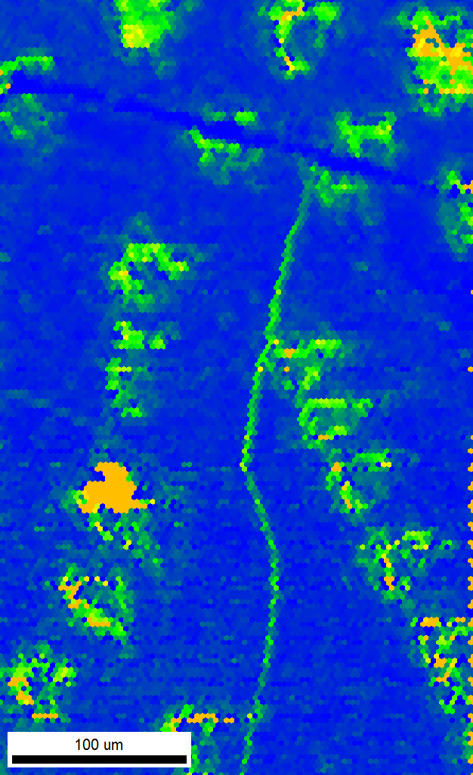
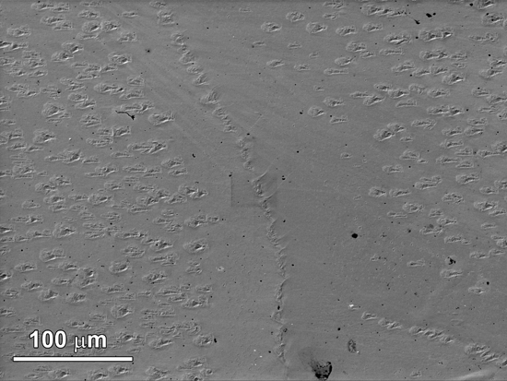
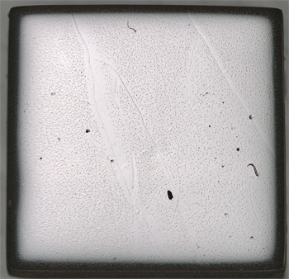
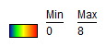
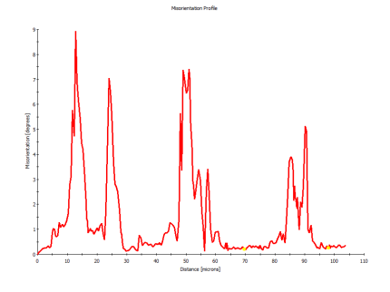
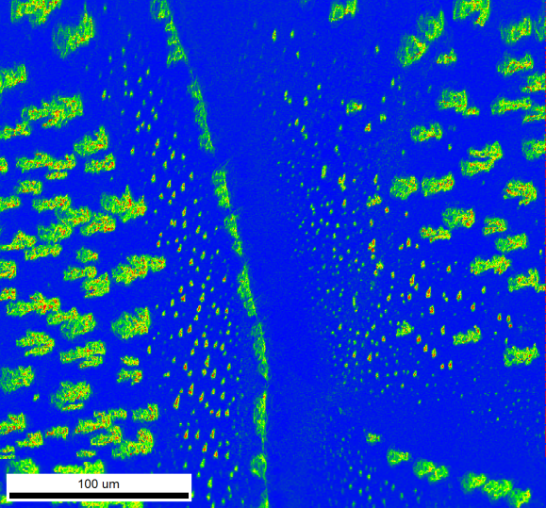
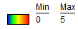
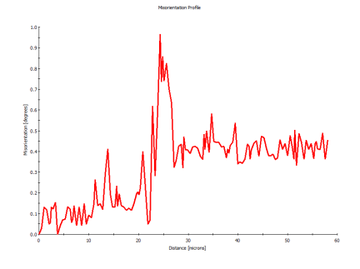
Example 3: Strain characterization with EBSD
Hydride scars with up to 10 ° orientation gradients and high dislocation density
High Angle Grain Boundary
Low angle boundary
NbH_{x}
scars
LAGB
Optical
Image
IQ
GROD
LAM
°
9
Example: Surface hydrides may form on scratches (or plastic deformation below a scratch - see IQ map)
Orientation gradient maps indicate strain around the hydrides that may cause breakdown of superconductivity
Can measure strain at interfaces
°
5
)
s
e
e
r
g
e
d
(
n
0
Distance, microns
110
o
i
t
a
t
n
e
i
r
o
s
i
0.45
°
M
Boundary
0
Distance, microns
60

Slide 7
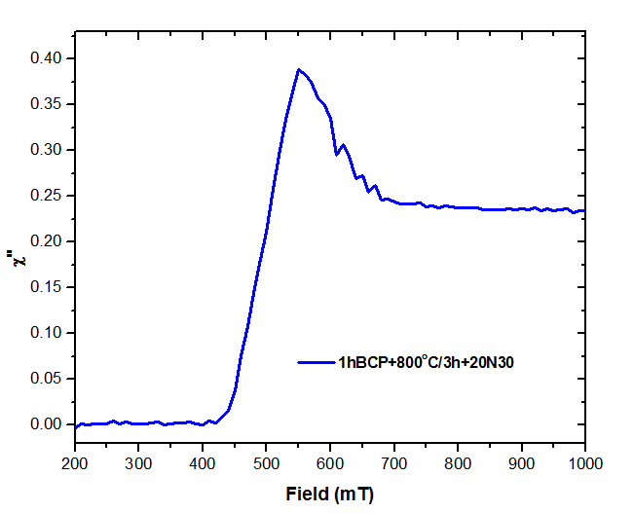

Example 4: Magnetization: AC susceptibility: A surface sensitive technique
Imaginary part (ac amplitude 10 μT and frequency 100 Hz)
Small ac field is applied to probe the very near surface.
The upper critical field (H_{c3}) is dependent on the mean free path of the surface.
  Higher H_{c3} means lower mean free path.
Could be developed for analysis for dilute solutions, and surface segregation.
Potential for measuring impact of defect structures in conjunction with microscopy.
Temp. 4.2K
Normal
Decreasing field
H_{c2}
1hBCP+800°C/3h+20N30/800°C
H_{c3}
Superconducting
N-doped samples from P. Dhakal/JLab

Slide 8

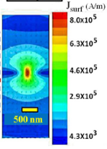
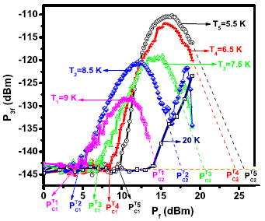
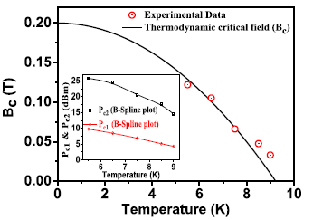
Example 5: RF microscope to measure local nonlinear response and correlate with materials nanostructure
Measure
harmonic
response P_{3f}
Data on bulk Nb (sample from T. R. Bieler, MSU)
We measure:
Local lower rf critical field B₁(T)
Local upper rf critical field (extinction of SC) B₂(T)
P_{3f} (dBm)
P_{f} (dBm)
Input power at 5.3 GHz
DOE/HEP Funded May 2017
Notes:
Recently updated (and funded!): New magnetic write head probe (from hard disk drives utilizing perpendicular recording) that creates even more intense local fields, and moved to a dry refrigerator system that allows measurements to continue for weeks at a time. UM can now insert rf magnetic vortices at will in to the superconductor (thin film and bulk Nb), again measuring the lower critical rf field B₁(T). The periodicity allows UM to calibrate the rf flux scale for the microscope! They see numerous new features in the bulk Nb nonlinear response heretofore invisible with this technique. With this microscope UM are now in position to understand how the materials nanostructure will affect the rf properties, and the list of projects involves a number of groups in the SRF community.

Slide 9
Some discussion points
Cavity → Coupon (= cutout). What are the pathways to develop coupon →cavity.
  Dedicated facilities to develop coupons with different materials and microstructures.
  Develop existing techniques and compare results across labs (e.g. round-robin type sharing).
  Facilitate sample availability and create database of results.
Identify new techniques.
  Nuclear reflectometry- Capable of probing surface and sub-surface. User facility operated by NIST.
  Development of surface sensitive X-ray methods- Beamlines available in the US. It has been valuable in understanding Nb/O interfaces (Delheusy, 2008).
    3-D X-ray tomographic diffraction to characterize subsurface defect content
  Coupon RF studies- How can we develop this? Can we make RF circuits on substrates and test them? NHMFL, has RF groups.. Can this be an option?
    RF microscope to zero in on interesting defects
Lee: SRF GARD roadmap workshop, FNAL Feb 9-10, 2017
9

Slide 10
Extra Example Slides

Slide 11
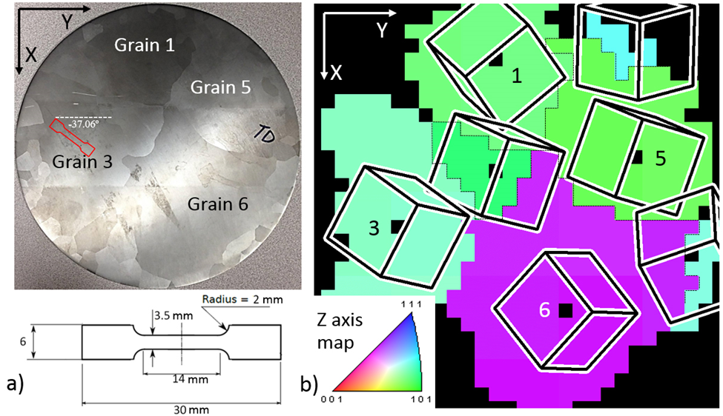

Design based microstructure- superconducting studies
SRF grade high purity Nb (Tokyo Denkai Nb). Tensile samples designed to create specific dislocation structures .
Collaboration between FSU and MSU brings together expertise in physical metallurgy and superconducting property measurements together.
Individual dislocations are loops. Can be separated into edge and screw components.
Dislocation structures are complex- Interaction od dislocations lead to subgrains, boundaries, misorienation between crystals.
Notes:
OrientExpress indexing program. Laue XRD is able to index large ingots to determine orientation information.

Slide 12
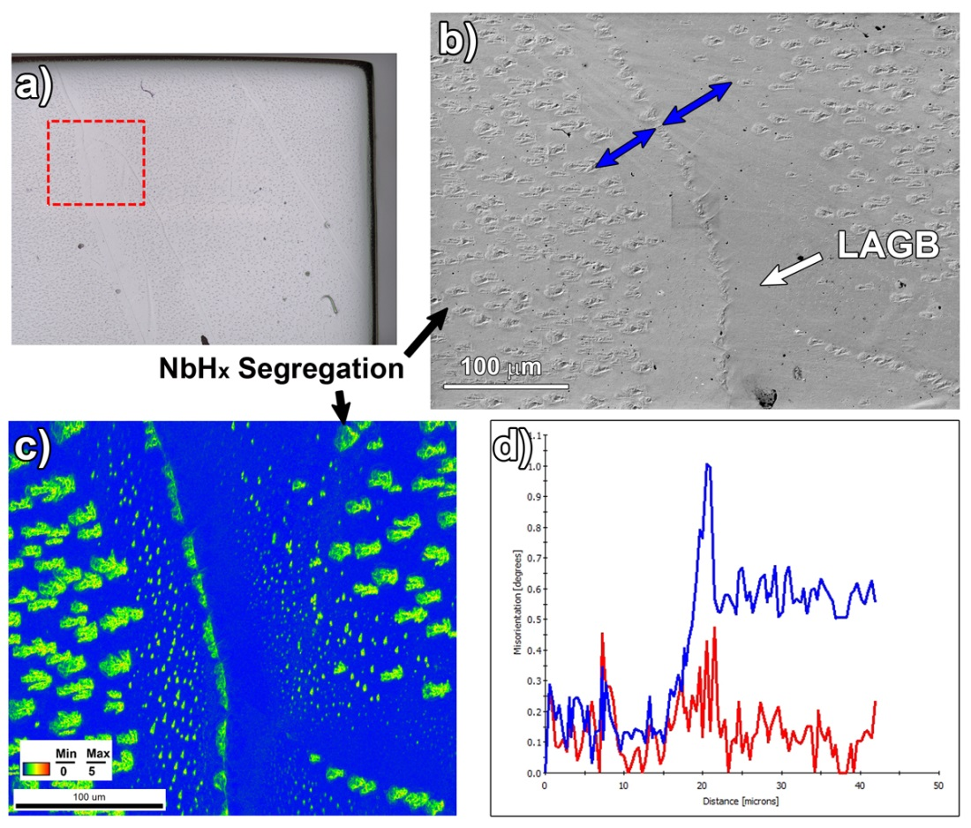
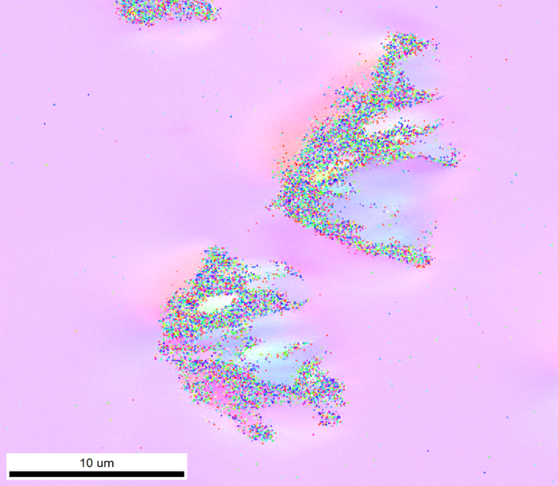
Hydride debris along LAGB’s- Flux penetration due to hydrides?
Orientation gradients indicate strain around the hydrides- Ongoing work on strain and breakdown of superconductivity in progress.
LAGB’s are strain related structures. Hydrides also lead to strain in the Nb matrix.

Slide 13
AC susceptibility: N₂-doping makes Nb dirty: EP increases the surface mean free path
Higher H_{c3} value on nitrogen doped niobium.
N-doped samples from P. Dhakal/JLab

Slide 14
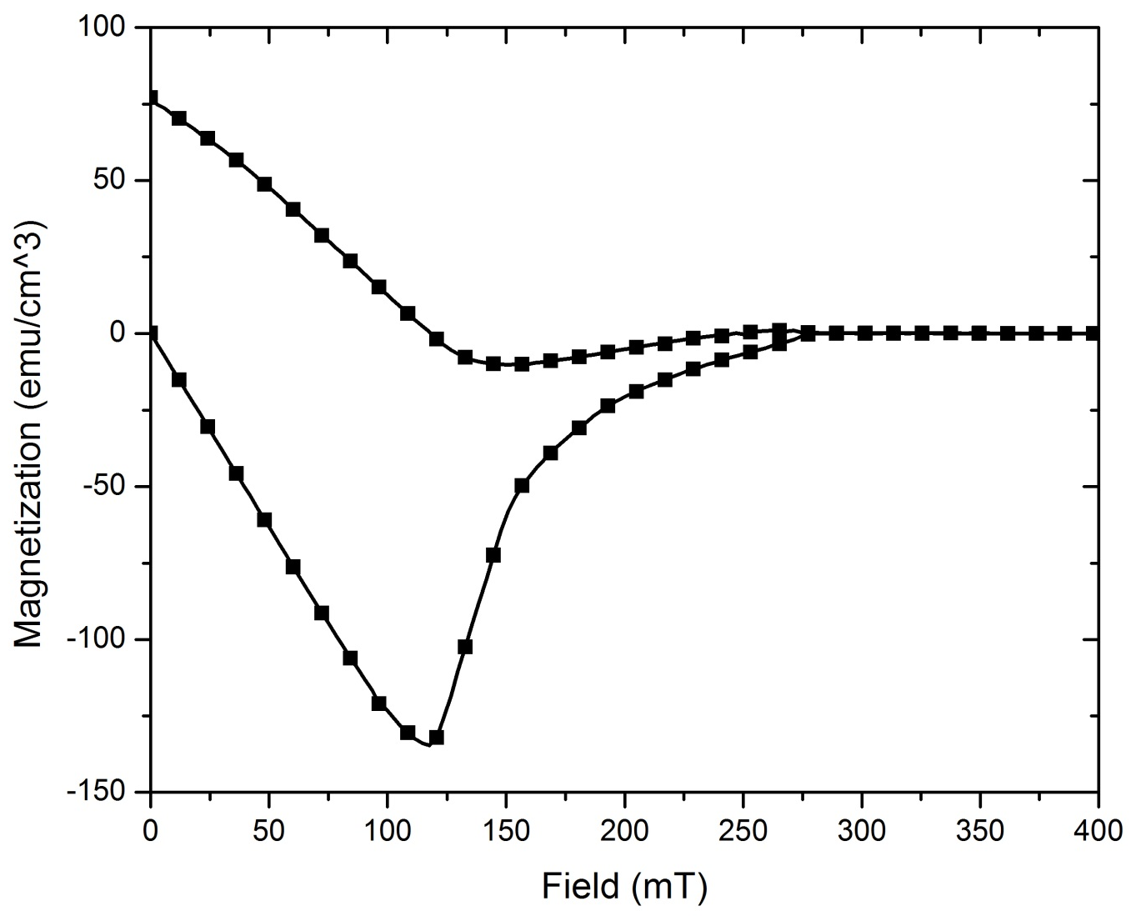
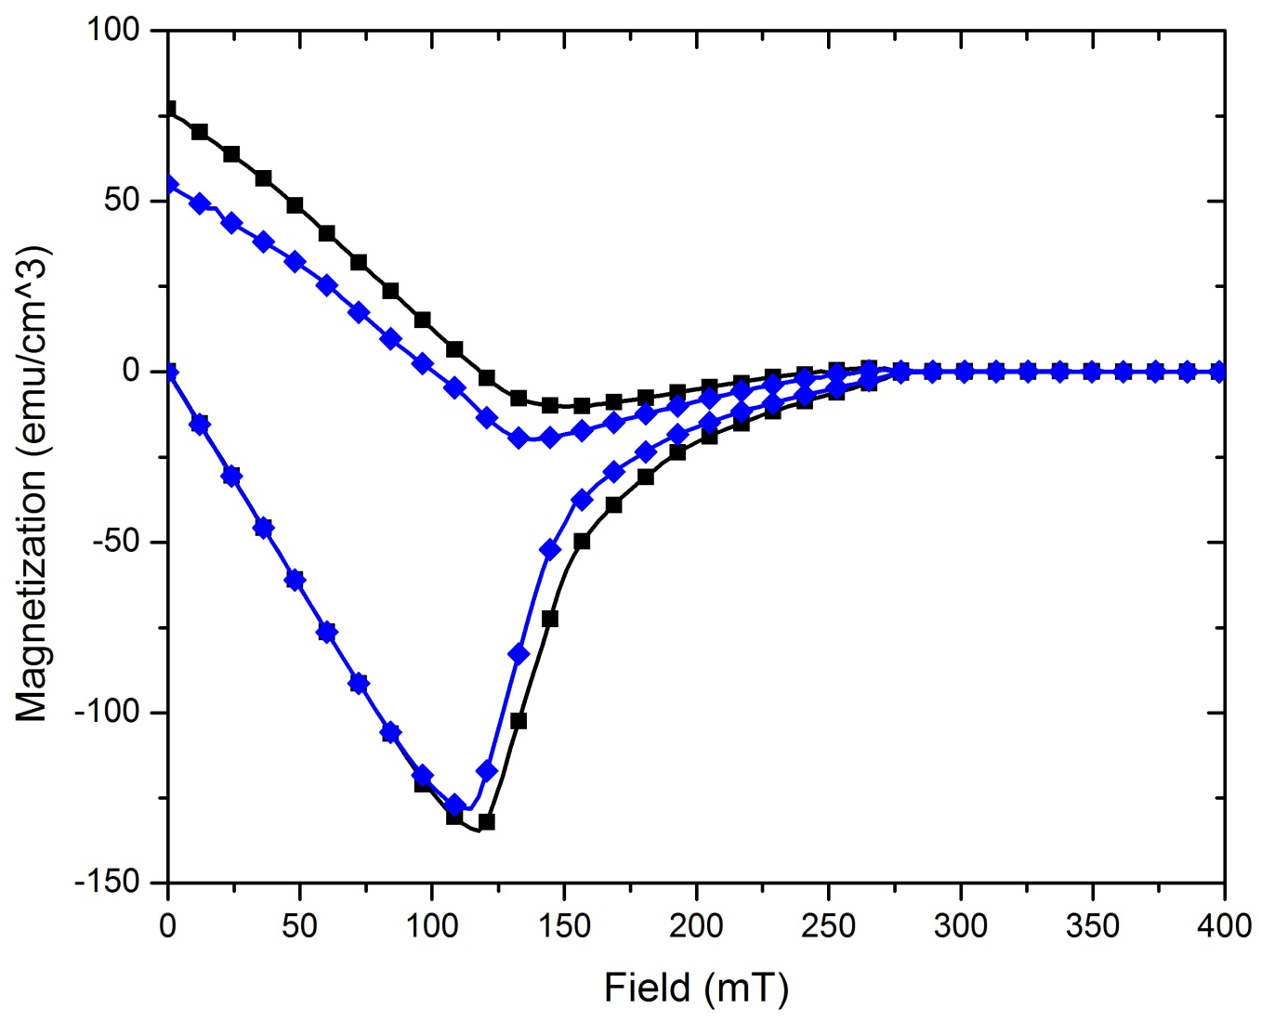
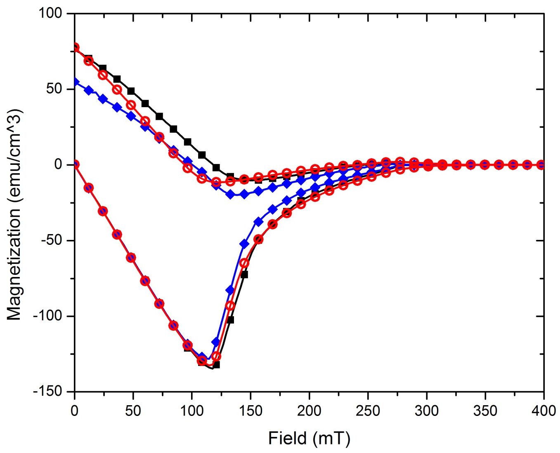
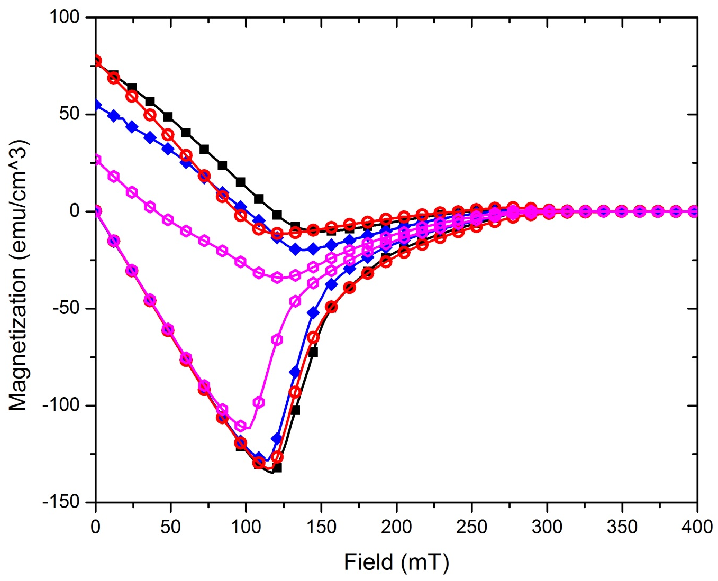
DC Magnetization: N-doped Nb after EP shows reduction in pinning sites
Temp. 4.2K
DC magnetization at 4.2K temperature shows the reduced area between the curve for N-doped Nb after Electropolishing (EP) indicating lesser amount of pinning centers.
1hBCP+800°C/3h
1hBCP+800°C/3h+20N30/800°C
1hBCP+800°C/3h
+10μmEP
1hBCP+800°C/3h
+20N30/800°C+10μmEP
N-doped samples from P. Dhakal/JLab

Slide 15
Microscopic Investigation of Materials Limitations of Superconducting RF Cavities
Steven Anlage, Bakhrom Oripov, Physics Dept., University of Maryland
Idea: Measure local nonlinear response and
correlate with materials nanostructure
DOE/HEP May 2017
Inject rf
current
locally
Measure
harmonic
response P_{3f}
Estimated B_{rf} ~ 220 mT @ 1.5 GHz
Data on bulk Nb (sample from T. R. Bieler, MSU)
We measure:
Local lower rf critical field B₁(T)
Local upper rf critical field (extinction of SC) B₂(T)
P_{3f} (dBm)
P_{f} (dBm)
Input power at 5.3 GHz
Notes:
The basic idea is to locally stimulate the surface of the superconductor with an intense rf magnetic field and then measure the nonlinear response of the superconductor. The incident magnetic field at frequency f (1-5 GHZ) is on the order of the critical field of Nb (~220 mT). The third harmonic 3f response comes from defects, or intrinsic nonlinear response, of the material. We use the nonlinearity current density scale J_{NL} to quantify the defects – the lower J_{NL}, the weaker the superconductor, and the stronger the nonlinear response, as shown in the schematic diagram on the upper right.
The lower left diagram shows the measured nonlinear response of bulk Nb vs. input rf power and temperature. We see a clear onset field (which we call B₁(T)) and a downturn of the nonlinear response that extrapolates to zero at B₂(T). These correlate with the rf critical fields at this location on the sample, as shown in the plot on the lower right. The ability to directly measure the local rf critical fields at the temperature and frequency of SRF applications is unique.

Slide 16
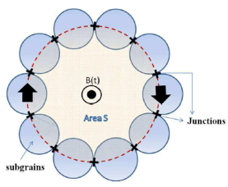
Microscopic Investigation of Materials Limitations of Superconducting RF Cavities
Steven Anlage, Bakhrom Oripov, Physics Dept., University of Maryland
Latest results with perpendicular recording head (Western Digital) and dry fridge
DOE/HEP May 2017
Local injection of
rf flux quanta in
granular Nb film
Local rf critical
field B₁(T)
Proposed Funded activities:
Nonlinear Response Scanning Pre-Characterized Defects (dislocation tangles) in Bulk Nb
Compare P_{3f} on EP, BCE treated surfaces of Nb
Measure local rf B₁(T) in S/I/S/I… multilayers
Using the probe to inject trapped dc flux in different defects and investigate local rf response
SRF Cavity Residual Resistance Measurement to mK Temperatures
Collaborators for DOE Proposal (Accelerator Science and Technology R & D in High Energy Physics)
Gigi Ciovati, Jefferson Laboratory.
Alex Gurevich, Old Dominion University.
X. X. Xi, Temple University.
Oleg Malyshev, Accelerator Science and Technology Centre, STFC Daresbury Laboratory, UK.
Tobias Junginger, TRIUMF, Canada.
Notes:
We have updated the experiment with a new magnetic write head probe (from hard disk drives utilizing perpendicular recording) that creates even more intense local fields, and moved to a dry refrigerator system that allows measurements to continue for weeks at a time. We can now insert rf magnetic vortices at will in to the superconductor (thin film and bulk Nb), again measuring the lower critical rf field B₁(T). The periodicity allows us to calibrate the rf flux scale for the microscope! We see numerous new features in the bulk Nb nonlinear response heretofore invisible to us. With this microscope we are now in position to understand how the materials nanostructure will affect the rf properties, and the list of projects involves a number of groups in the SRF community.

