Slide 1



Other linac-based experiments downstream of the cryomodule
P. Piot*
IOTA/FAST 5th Users’ meeting
June 6, 2017
* Joint appointee with Northern Illinois University

Slide 2
Research opportunities at the FAST e-injector
FAST/IOTA supports collaborative research opportunities with Universities, National labs, and Industries
e-injector can support research relevant to other (than HEP) programs within DOE:
  NP: electron-cooling, phase space manipulations, magnetized beam in IOTA
  BES: formation and diagnosis of bright e- beams, phase-space manipulations, electron-laser interactions
  NNSA: tests of subsystems for MARIE (LANL)
e-injector has been (and is being) leveraged to secure funding outside of DOE: e.g. NSF, DOD, DHS.

Slide 3
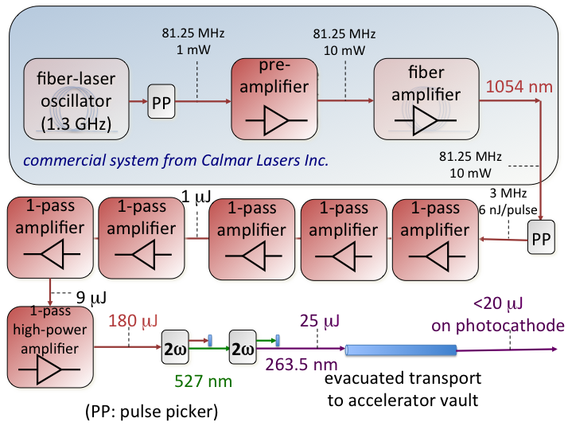
The IOTA/FAST Overview
~300-MeV e- injector section
RF gun
SRF linac
test beamlines
Bunch
compressor
SRF cavities
2.5 MeV
p source
IOTA
beam
dumps
laser
Key Components of FAST e-injector:
  Photoinjector electron source:
    50 MeV beams
    Flexible beam parameter
  SRF linac:
    Up to 300-MeV
    Stabilized bunches
  Extensive suite of diagnostics
  Real-estate for experiments

Slide 4
Experiments
Acceleration to 300 MeV!
  Beam characterization
IOTA-related tests:
  Beam diagnostics
  Preparatory tests of subsystems for OSC
Multi-bunch wakefield (B. Carlsten’s talk)
Gamma-ray source via ICS
Longer term
  Radiation/laser-based beam manipulations,
  Interaction with crystals
  Application of flat beams
  Advanced acceleration/manipulations

Slide 5
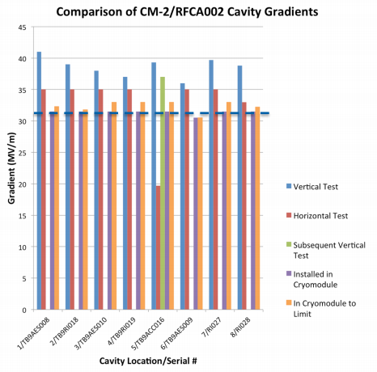
Acceleration to <300 MeV
Adapted from Elvin Harms
The 50-MeV beam is accelerated in a cryomodule (8 SRF cavities)
Produced stable beams with energies up to 300 MeV
arranged as macropulses.
IOTA requires ~150-MeV e-beams
ILC
goal
[E. Harms, et al. SRF2015 (2015)]

Slide 6
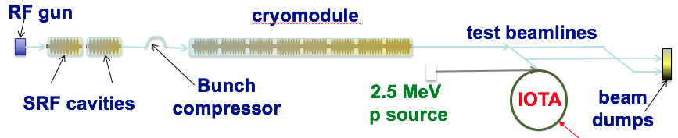
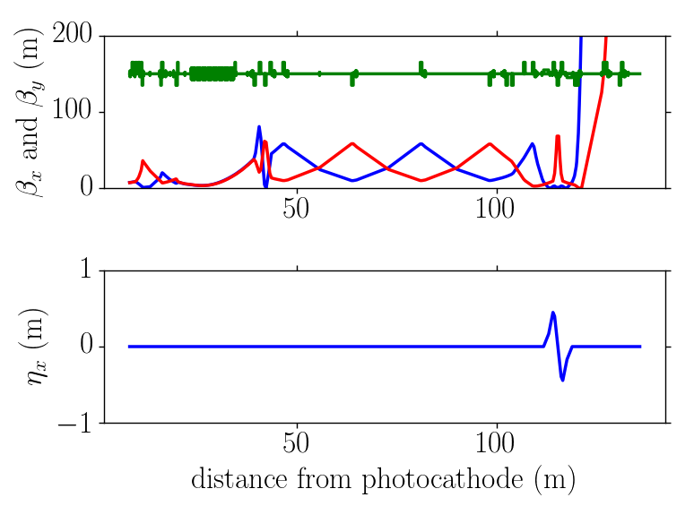
Acceleration to <300 MeV: beam optics
Extensive models of the beamline.
Nominal lattices available in ELEGANT (D. Broemmelsiek)
ELEGANT used for single-particle optics.
ASTRA & IMPACT-T used for the injector.
IMPACT-T & IMPACT-Z used for the entire beamline.
Start2End simulations and optimization performed with py-based GlueTrack (initiated at DESY).
200 pC
BC1 off
all ELEGANT lattices available at
https://github.com/NIUaard/FAST

Slide 7
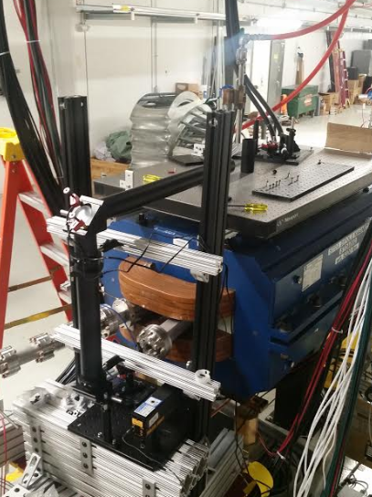
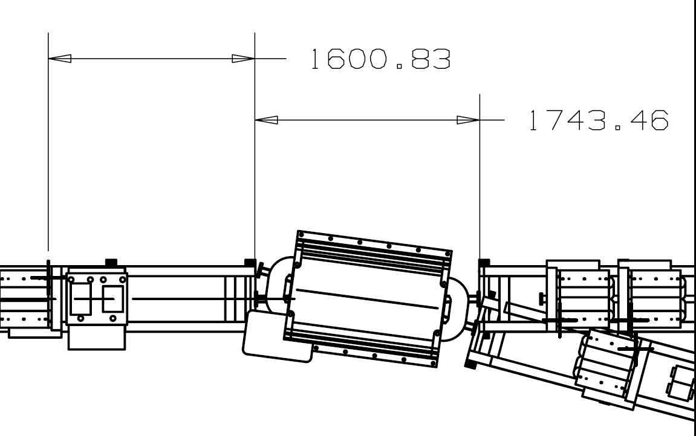
IOTA-related tests using D600 dipole magnet
Imaging of SR for beam profile monitor for IOTA (Romanov, et al.)
Single-photo detection using PMT (Stancari, et al.)
Spectral measurement at 2 μm + amplification (Andorf, et al.)
Energy (MeV) | Critical wavelength (nm) | photons in BW (%) | Energy flux per e- (J)
100 | 2734 | 15.8 | 2.66e-22
150 | 810 | 7.2 | 1.21e-22
200 | 342 | 3.0 | 5.0e-23

Slide 8
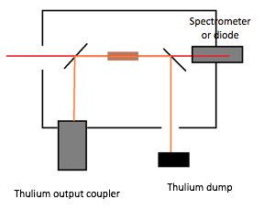
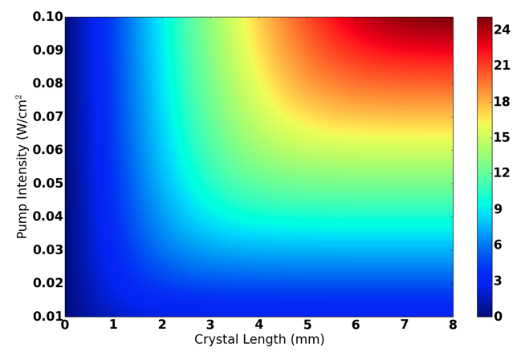
Test of OSC-experiment subsystem
OSC will operate in the [2200,2900] nm spectral range
Amplifier medium is a Cr:ZnSe pumped by a Thulium laser.
Recently procured all the components necessary to assemble the amplifier.
We are trying to get ready to perform an experiment in the summer demonstrating amplification of synchrotron radiation around ~2500 nm.
M. Andorf, et al., CLEO’17
https://doi.org/10.1364/CLEO_AT.2017.JW2A.90

Slide 9
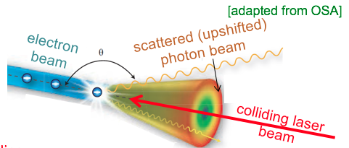
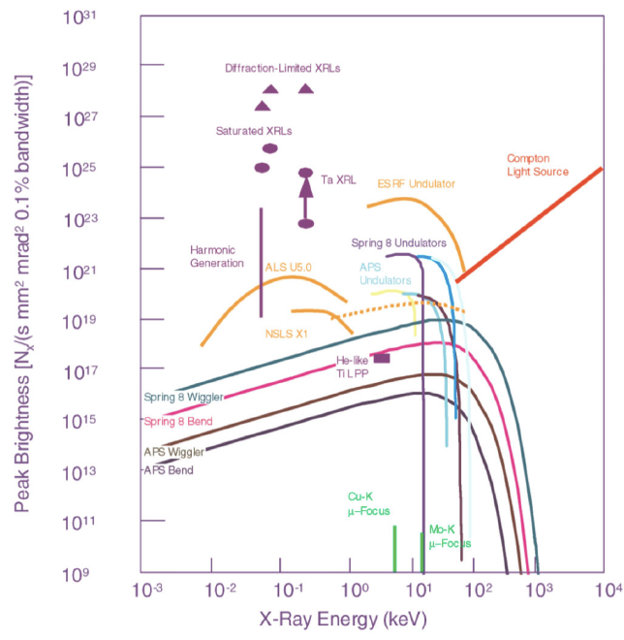
Inverse-Compton Scattering for high-flux gamma-ray production (funded by DHS DNDO-ARI)
Use a conventional superconducting radiofrequency (SRF) linear accelerator which readily produce electron bunches at high frequencies.
Develop a recirculation optical cavity to collide the e-bunches and laser pulses at high rep. rates
  upgrade the laser currently available,
  design and install a suitable interaction region.
Combine SRF linac with optimized optical cavity to produce high-flux γ rays (we anticipate Watt level average power)
FAST 3000
bunches
[F. Hartemann et al. PRSTAB 8, 100702 (2005)]
FAST 1
bunch

Slide 10

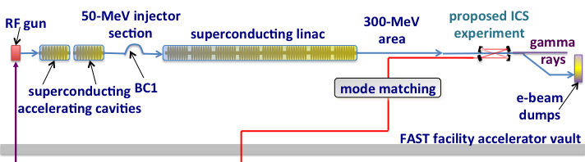
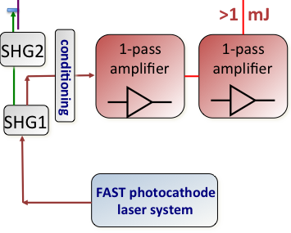
Overview of the proposed experiment
UV
IR transport
highlighted yellow boxes indicate the subsystems to be developed in support to the ICS γ-ray experiment
IR

Slide 11
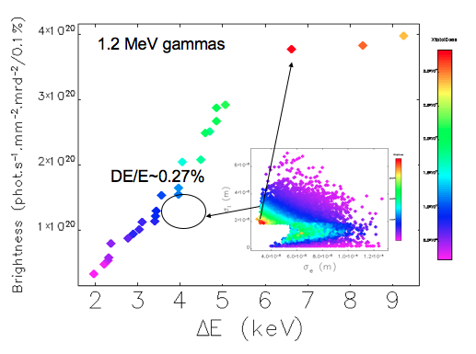
γ-ray brightness optimization
Brightness in
phot./sec/mm/mrd/0.1% BW
# of γ
photons
# of collision
per sec
1 to 15,000 at
FAST
# colliding
photon
# of γ
photons
# e-
suppression
factor <1
D. Mihalcea et al., to appear in NIMB
http://dx.doi.org/10.1016/j.nimb.2017.03.140
sizes of colliding laser (L) and
electron(e) beams

Slide 12
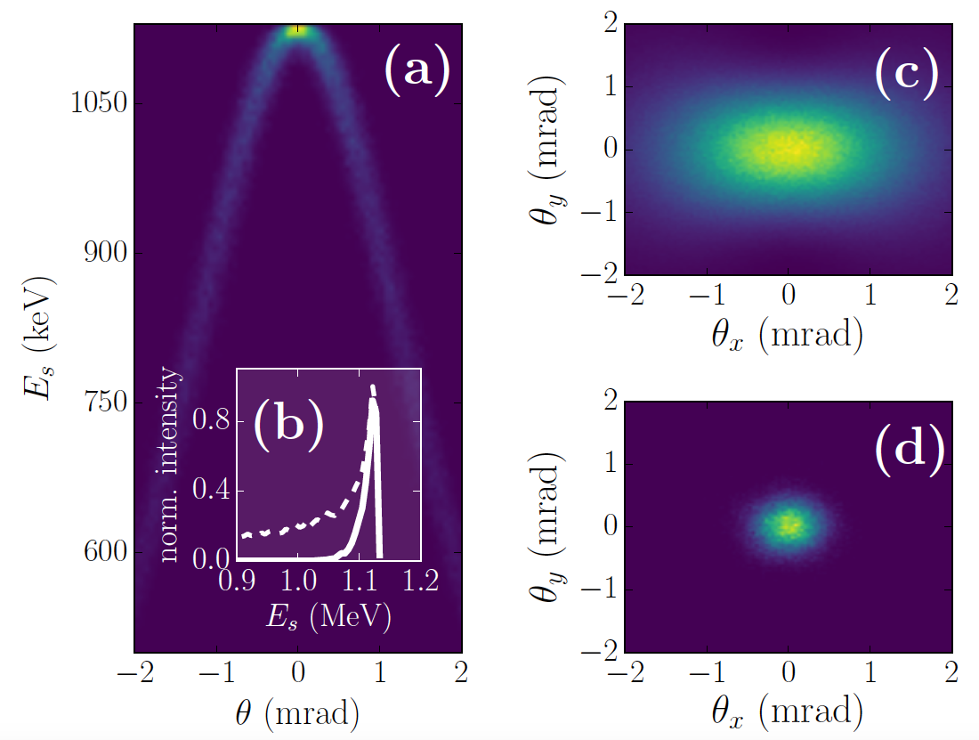

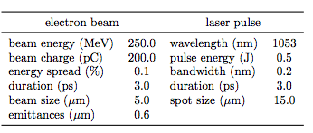
Anticipated performances
γ-ray parameters
e- & laser beams parameters

Slide 13
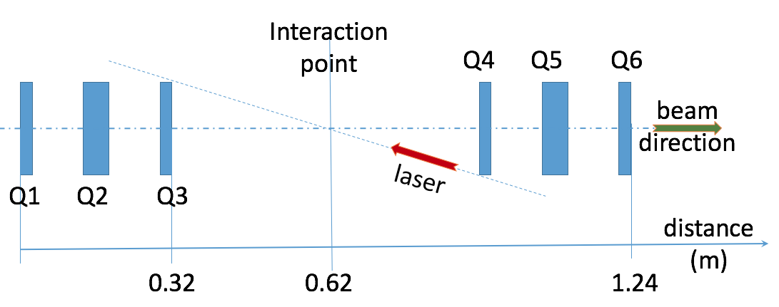
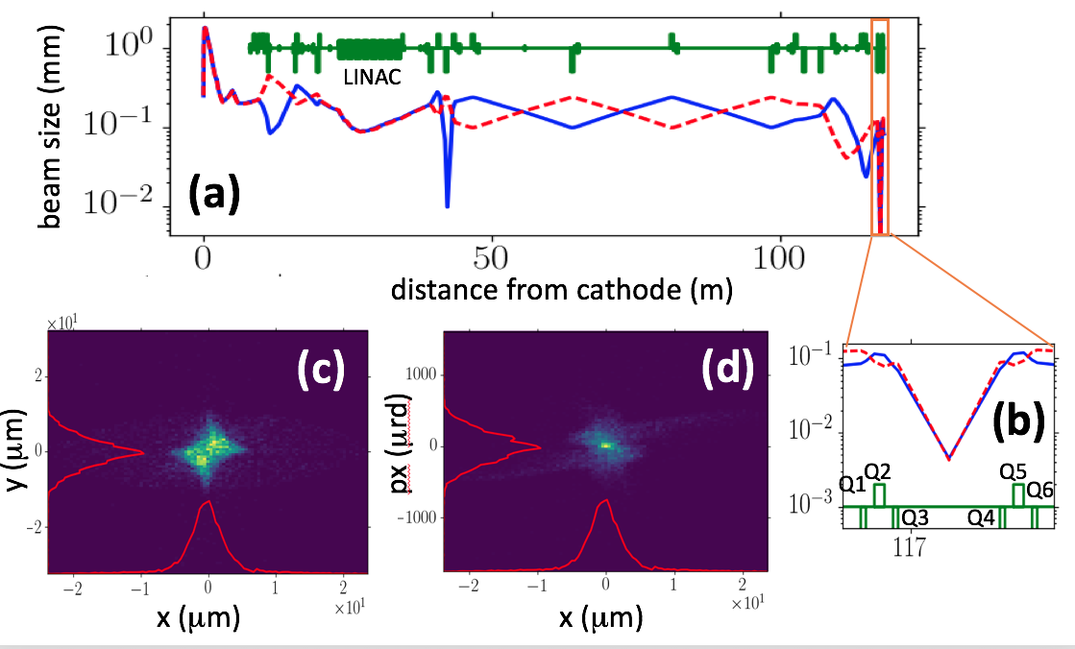
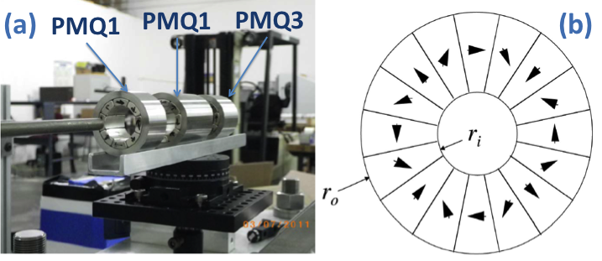
Beam dynamics Considerations
ELEGANT matching +
Impact-T tracking over
the ~120 m (space-
charge included only)
Final focus needs to be compact and use PM quadrupole magnets
Vibration is an issue

Slide 14
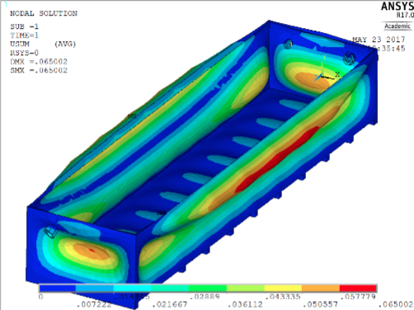
Possible interaction area
Interaction region foreseen downstream of D600
  Small-aperture permanent quadrupole
  Decoupled from transport to HE dump /injection to IOTA
Vibration measurement to be incorporated in design
e-
beam
to
dump
IR laser
e-beam
[Design by A. Khizhanok,
MS thesis in Dept. of
Mechanical Eng., NIU
Adviser: J.-T. Gau]

Slide 15
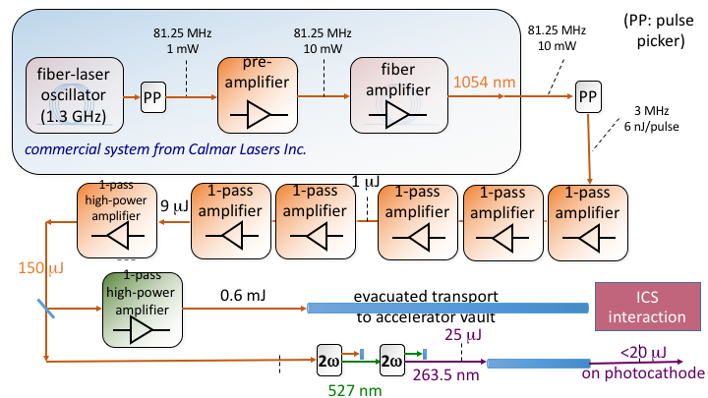
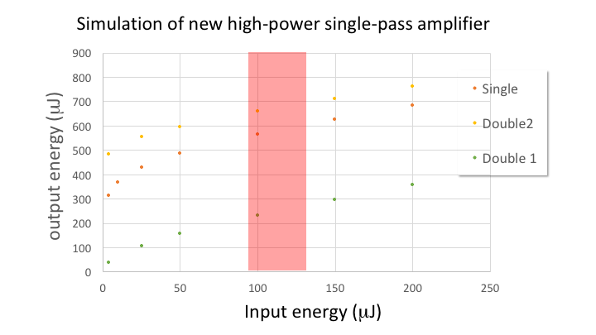
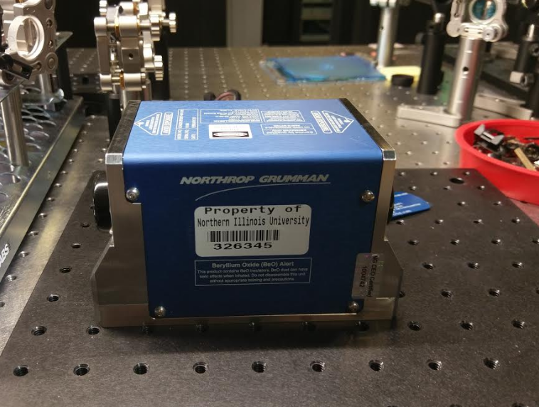
Progress on laser upgrade
Current laser system was
optimized (J. Ruan, et al.)
1st amplifier received from
Northrop-Grumman to be
tested (part of M. Urfer MS thesis)

Slide 16
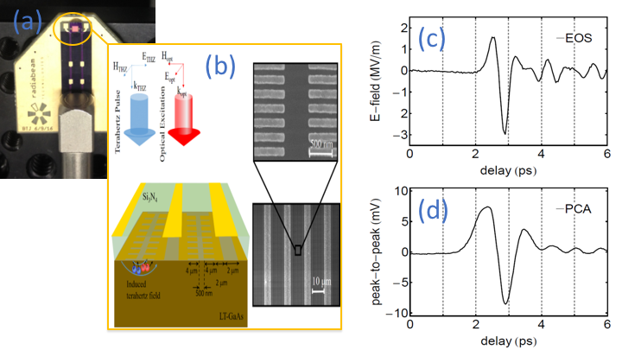
ICS timeline (still in discussion)
1st interaction planned in 2019
Summer 2017:
  Characterize beam downstream the cryomodule (especially transverse emittance & energy spread)
  Commission the laser amplifier and demonstrate E>0.5 mJ
  Finalize design of the optical cavity
Fall 2017
  Manufacture PMQ
  Build optical transport line?
Beyond
  Finalize and construct interaction
  area with associated diagnostics,
  test some diagnostics when beam
  time available

Slide 17
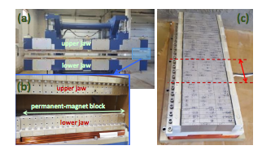
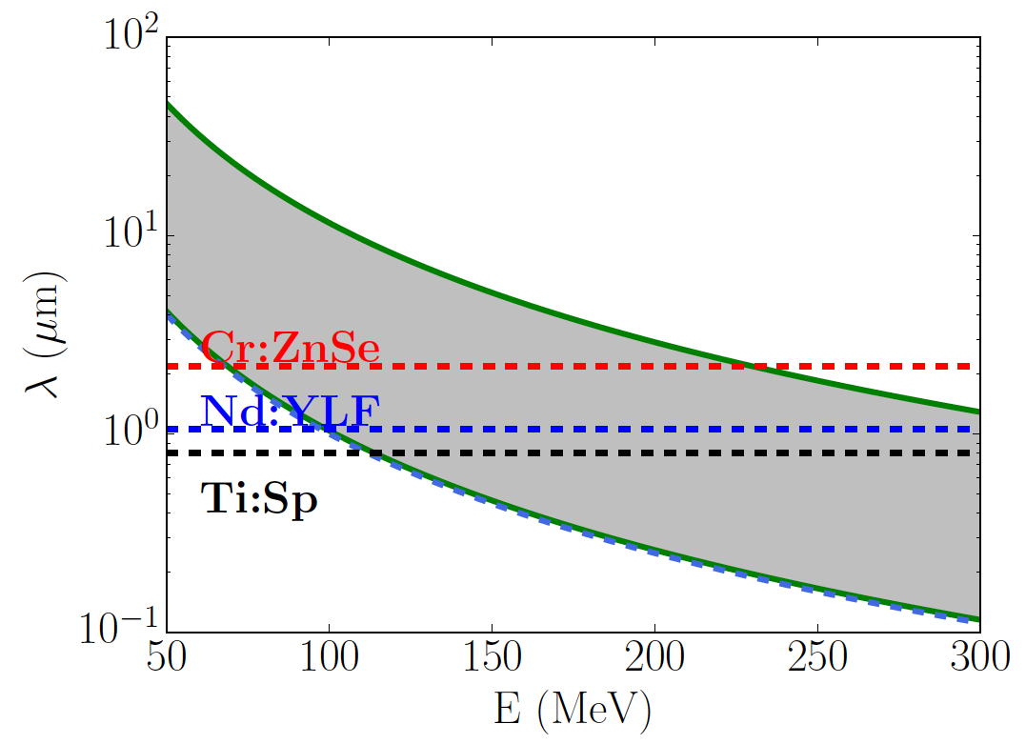
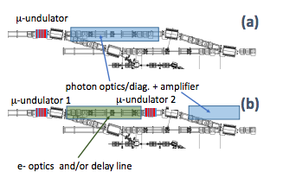
Possible longer-term experiments: laser/radiation-based manipulations
Capitalize on the infrastructure
available from the ICS
  High-energy laser pulse
Optical- or self-manipulation of
e beams
  OSC R&D (UR interference)
  Energy/density modulation
  (optical-replica diagnostics, …)
  Controlled chromatic aberrations
  aka beam conditioning (Zholents
  PRSAB 2005)
  Radiation sources
  Longitudinal-space-charge amplifier
[P. Piot, NAPAC16]

Slide 18
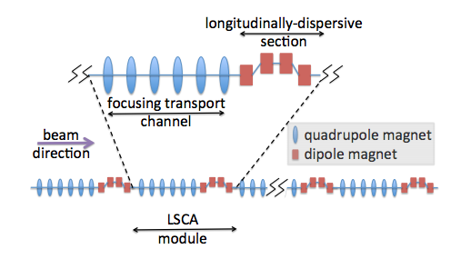
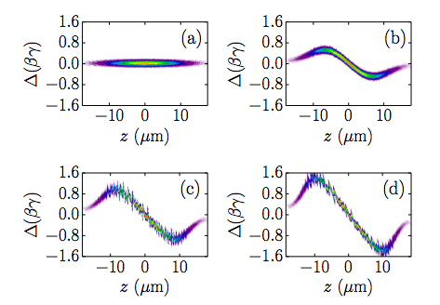
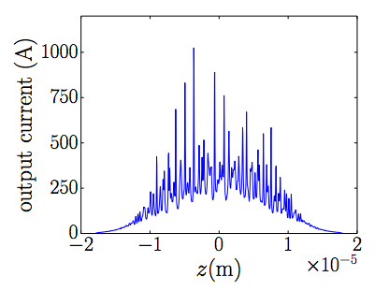
Possible longer-term experiments: LSCA
Cascaded longitudinal space-charge amplifier was investigated in FAST using start-to-end simulations (simplified model)
[H. Halavanau, 10.1016/j.nima.2016.03.002

Slide 19
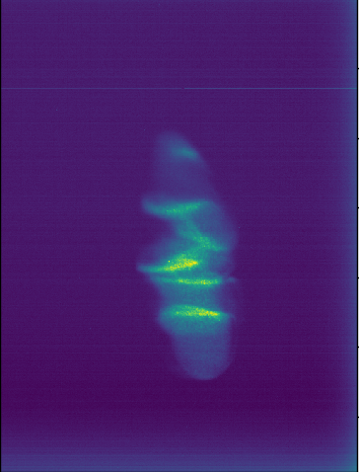
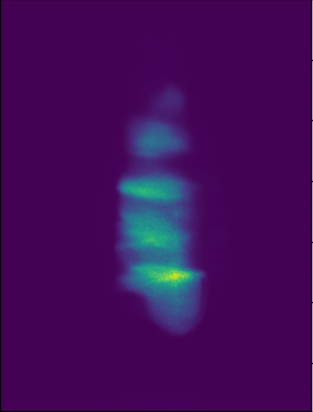
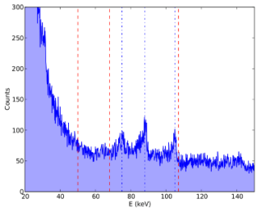
Final comments: other opportunities being explored
Wakefield due to a bunch train in a DLW
Compatibility of high-repetition-rate beam driven acceleration concept (e.g. DWFA)
Resuming the channeling radiation experiment in collaboration with MEPHI, IPN Lyon, U. Ferrara.
Applications of ultra-relativistic
flat beams (see Halavanau’s talk):
  Acceleration in DLAs (ACHIP collaborations)
  Diving wakes in planar structures
  Micro-undulator tests
1 bunch
200 bunches
[F. Lemeny, P. Piot @PITZ]
energy
Summer16 CR
experiments

