Slide 1
Rapid Cycling Synchrotron Design with Integrable Optics
Jeffrey Eldred
FAST/IOTA collaboration meeting
6 June 2017

Slide 2
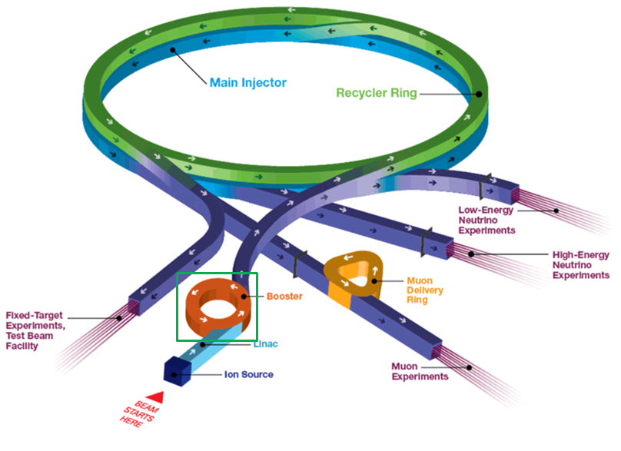
2
2
Fermilab Proton Accelerator Facility
Jeffrey Eldred | Rapid Cycling Synchrotron Design with Integrable Optics
Notes:
2
2
2
2
2
2

Slide 3
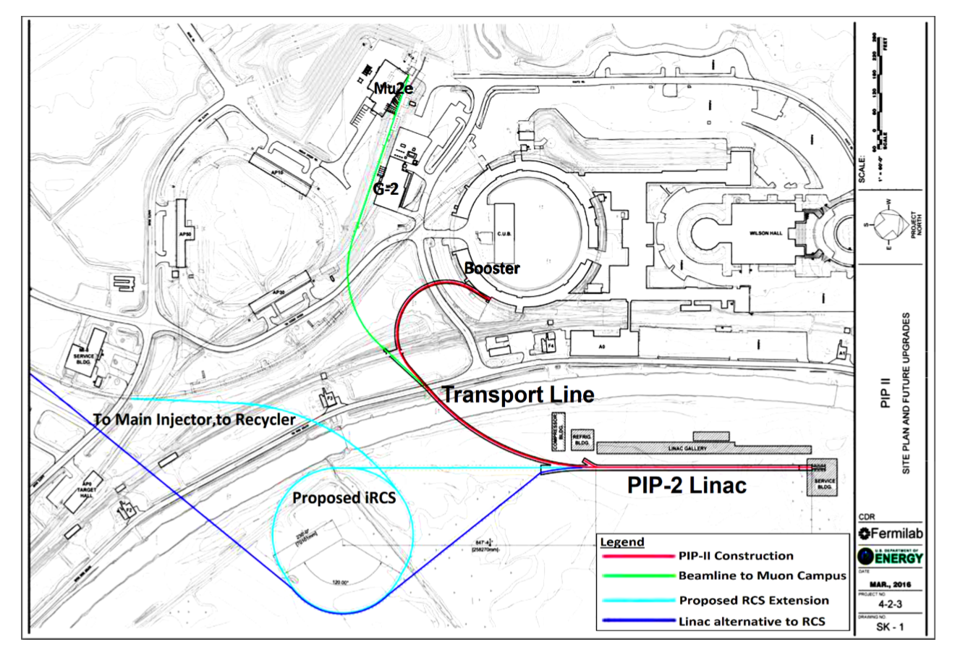
3
3
(Proposed) PIP-III Intensity Upgrade
Jeffrey Eldred | Rapid Cycling Synchrotron Design with Integrable Optics
Notes:
3
3
3
3
3
3

Slide 4
4
Rapid-Cycling Synchrotron Design
Modern RCS design calls for several features:
Dispersion-free drifts, for RF
Low momentum compaction factor, to avoid transition.
Low beta functions, for maximum emittance per aperture.
Mitigation of collective instabilities, throughout the ramp.
Integral RCS design is a promising innovation to provide significant nonlinear focusing but it is necessary to demonstrate this can be done in the presence of strong space-charge forces.
Application to low-energy, high-intensity hadron rings:
Rapid-Cycling Synchrotrons (RCS)
Hadron accumulator rings
Jeffrey Eldred | Rapid Cycling Synchrotron Design with Integrable Optics
Notes:
4
4
4

Slide 5
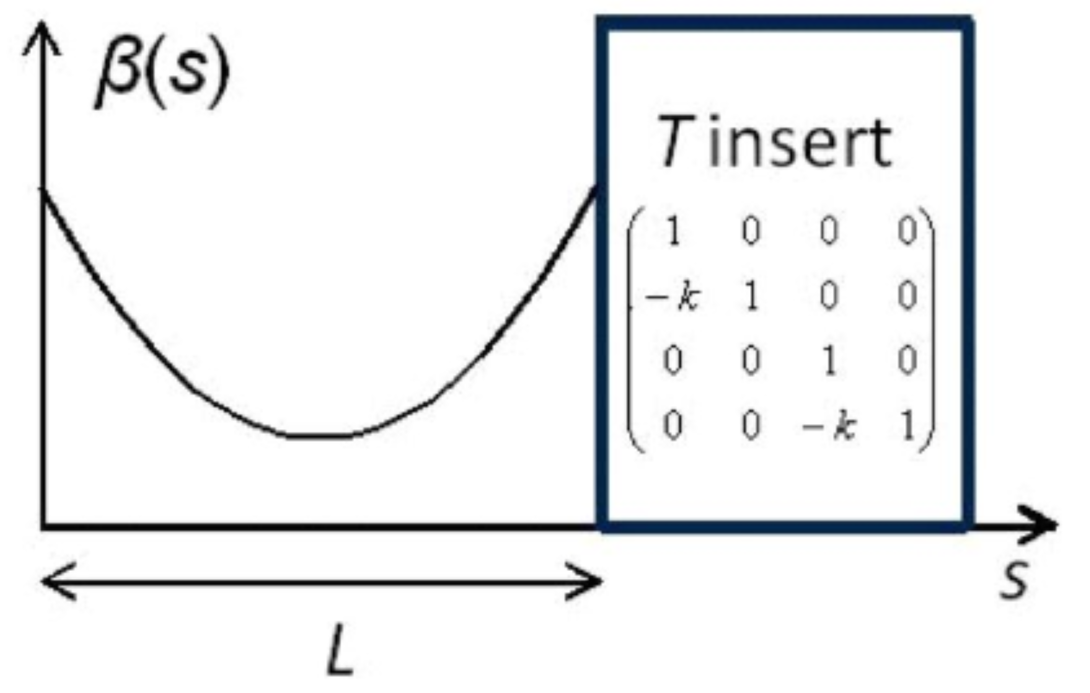
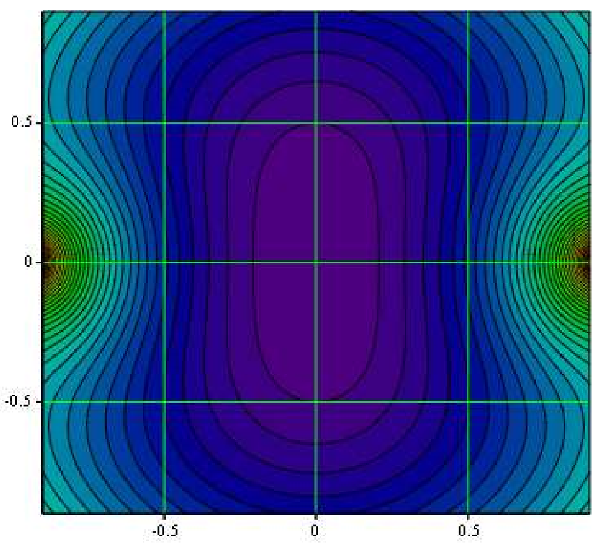
5
Danilov-Nagaitsev Integral Design
Time-independent kick:
Nonlinear kick separable in elliptic coordinates:
Jeffrey Eldred | Rapid Cycling Synchrotron Design with Integrable Optics
Notes:
5
5
5

Slide 6
6
Integral Design with Periodicity
...
Jeffrey Eldred | Rapid Cycling Synchrotron Design with Integrable Optics
Notes:
6
6
6

Slide 7
7
7
Lattice Design
Jeffrey Eldred | Rapid Cycling Synchrotron Design with Integrable Optics
Notes:
7
7
7
7
7
7

Slide 8
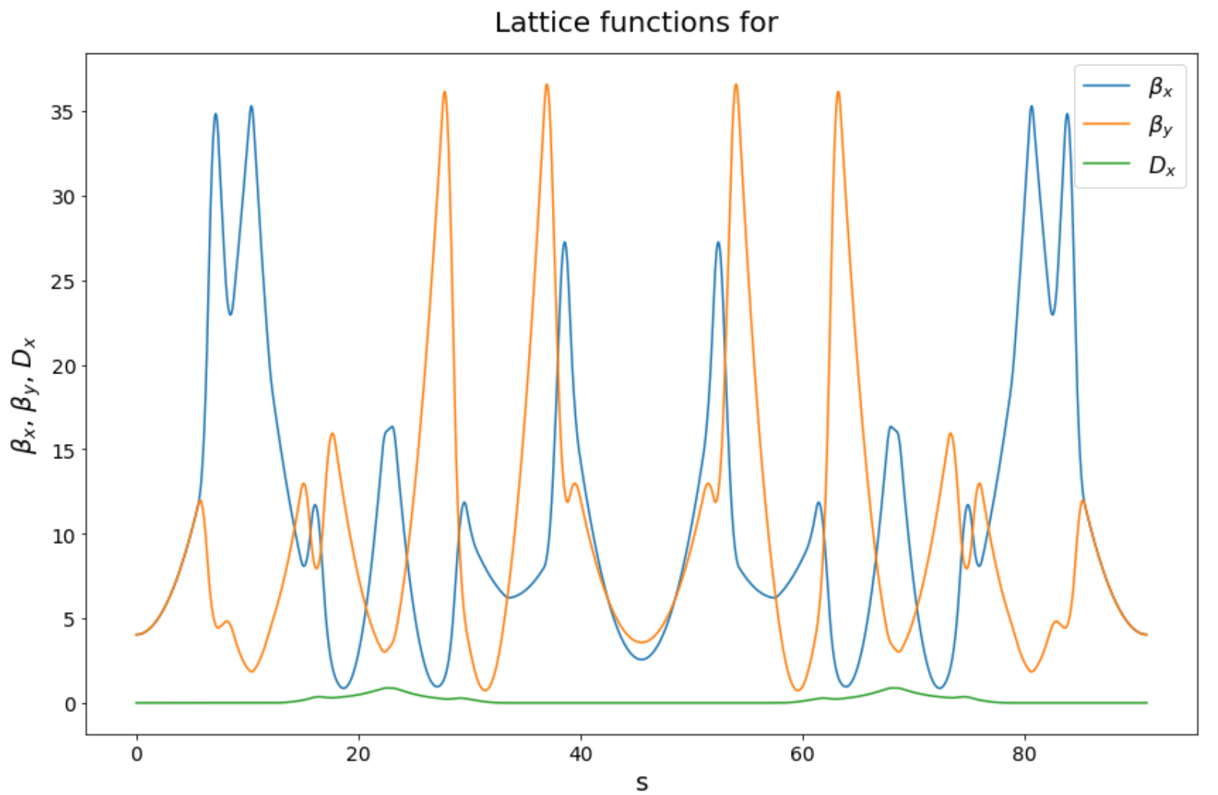
8
iRCS v2 Lattice Parameters
Periodicity: 6
Circumference: 542 m
Bend-radius rho: 15.4 m
Max Beta function: 35 m
Insertion length: 11.2 m
Betatron Tune: 16.8
Insert Phase-Advance: 0.3
Nonlinear t-value: 0.15
Minimum c-value: 3 cm
Beta at insert center: ~4 m
Corrected Chromaticity: -7.7
Natural Chromaticity: -33
Second-order Chromaticity: -132
Jeffrey Eldred | Rapid Cycling Synchrotron Design with Integrable Optics
Notes:
8
8
8

Slide 9
9
9
Synergia Simulation
Of Mismatched KV Beam
Jeffrey Eldred | Rapid Cycling Synchrotron Design with Integrable Optics
Notes:
9
9
9
9
9
9

Slide 10
Simulation Parameters
Coasting proton beam with injection energy of 0.8 GeV.
Initial normalized emittance 20 mm mrad.
2D KV beam with 5% mismatch from equipotential contours.
Lattice phases adjusted to anticipate space-charge tune-shift.
Map order = 6 (except SBENDs).
10240 macroparticles with a 32x32 grid for PIC space-charge.
8 kicks per element, 170 elements per cell, 6 cells per revolution.
500 revolutions of iRCS (3000 iterations of periodic cell).
Conventional Design Case:
No nonlinear insert, strong sextupoles for chromaticity correction.
Integrable Design Case:
With nonlinear insert, weak sextupoles for chromaticity matching.
Jeffrey Eldred | Rapid Cycling Synchrotron Design with Integrable Optics

Slide 11
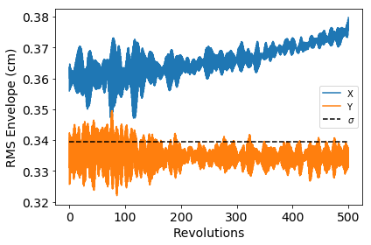
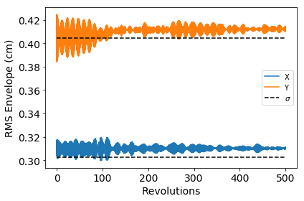
11
Change in RMS Beam Size
Conventional Design Case
Integrable Design Case
RMS beam size is unbounded in the conventional case.
RMS beam size rapidly equilibrates in the integrable case.
The nonlinear focusing also changes the aspect ratio of the beam.
Jeffrey Eldred | Rapid Cycling Synchrotron Design with Integrable Optics
Notes:
11
11
11
11
11
11

Slide 12
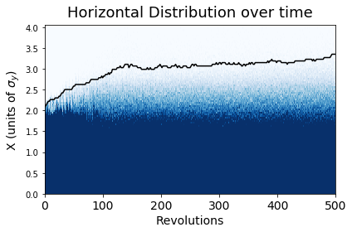
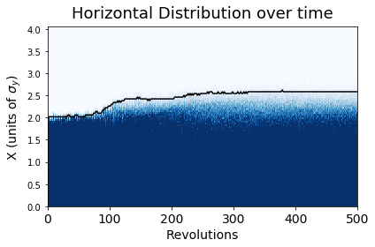
12
Change in Transverse Beam Halo
Conventional Design Case
Integrable Design Case
Black line indicates the 99.9 percentile of beam distribution.
Beam halo is suppressed and steady in the integrable case.
Jeffrey Eldred | Rapid Cycling Synchrotron Design with Integrable Optics
Notes:
12
12
12
12
12
12

Slide 13
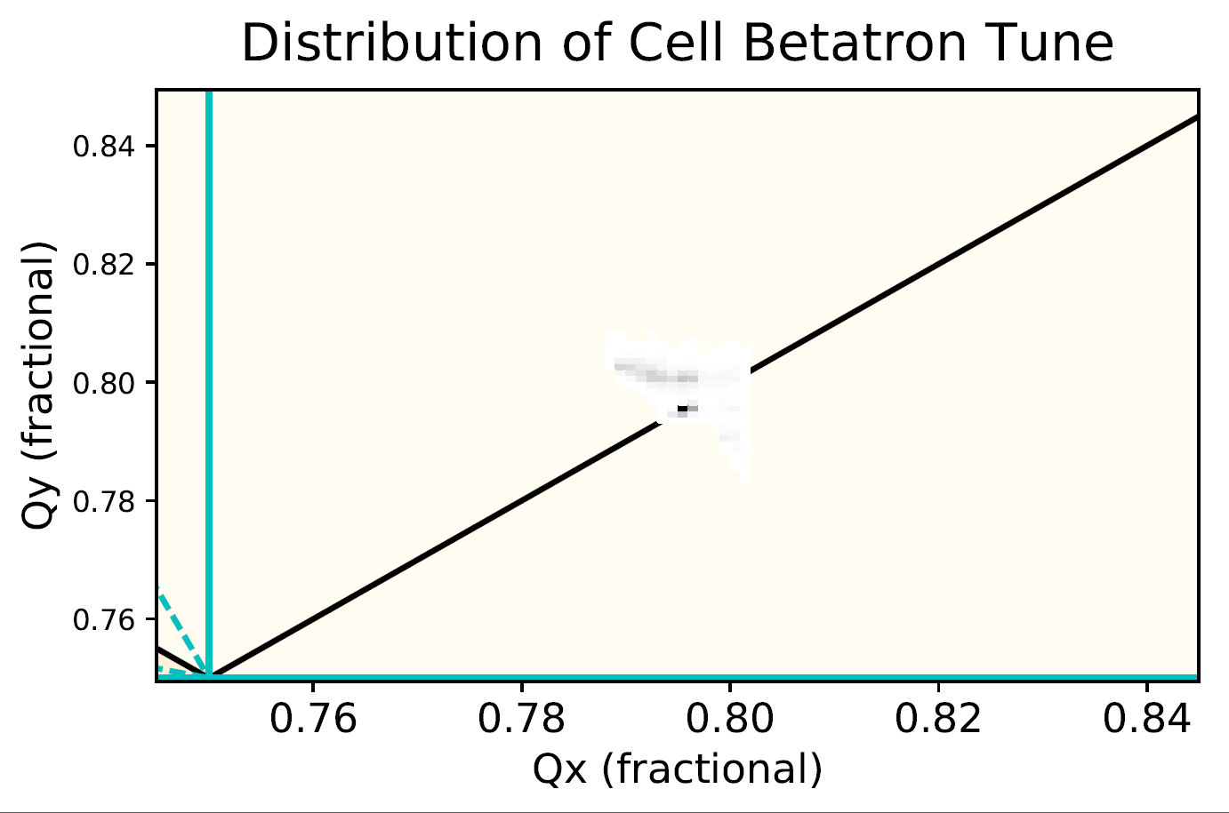
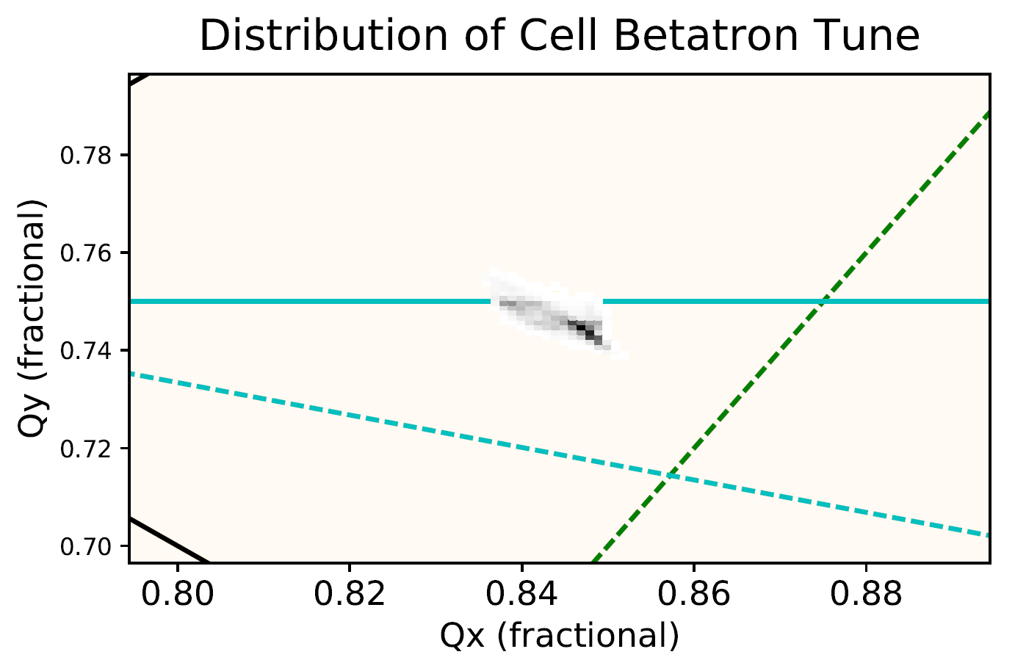
13
Change in Beam Tune and Tune Distribution
Conventional Design Case
Integrable Design Case
Tune distribution across one periodic cell (1/6 of RCS ring).
Quad component of the nonlinear element causes a tune shift.
Integrable case outperforms conventional case even while spanning a fourth-order resonance line.
Jeffrey Eldred | Rapid Cycling Synchrotron Design with Integrable Optics
Notes:
13
13
13
13
13
13

Slide 14
Next Simulation Experiments
Waterbag distribution with beam intensities required to support multi-MW operation of Main Injector.
Simulation with 3D bunched beam instead of 2D coasting.
Simpler iRCS lattice with higher periodicity.
Lattice with random quad errors to break periodicity and investigate impact of integrable optics on dynamic aperture.
Ring performance with a different type of nonlinear element.
Jeffrey Eldred | Rapid Cycling Synchrotron Design with Integrable Optics

Slide 15
15
15
Questions?
Jeffrey Eldred | Rapid Cycling Synchrotron Design with Integrable Optics
Notes:
15
15
15
15
15
15

Slide 16
16
16
Backup
Jeffrey Eldred | Rapid Cycling Synchrotron Design with Integrable Optics
Notes:
16
16
16
16
16
16

Slide 17
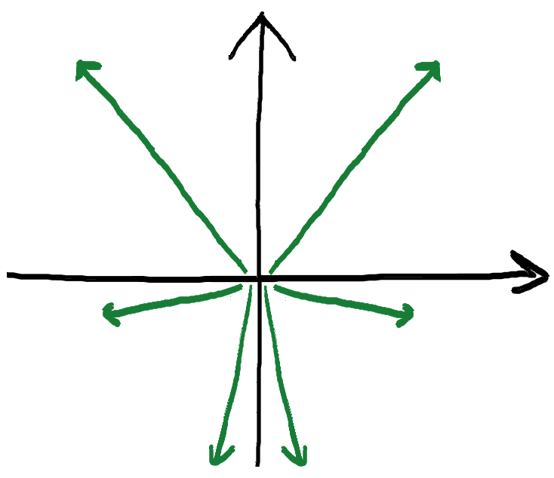
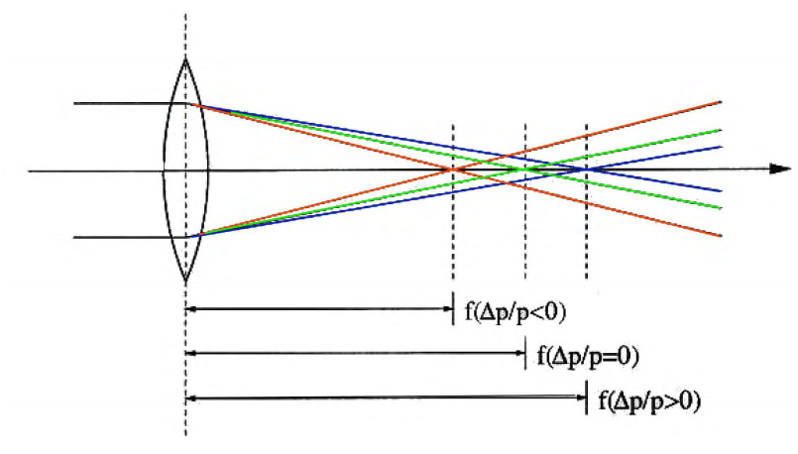
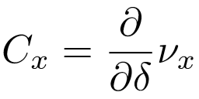
17
Chromaticity Correction
Definition of Chromaticity:
Sextupoles are places in dispersion regions to cancel chromaticity:
Betas and phase advances carefully controlled to cancel out the resonant driving terms:
Jeffrey Eldred | Rapid Cycling Synchrotron Design with Integrable Optics
Notes:
17
17
17

Slide 18
18
Chromaticity Correction
...
Tins Phase Advance:
Q2 =nπ
Sextupole Cancellation: Q1+Q2 = (2k+1) π
Jeffrey Eldred | Rapid Cycling Synchrotron Design with Integrable Optics
Notes:
18
18
18

