Slide 1
Commissioning and Plans of the IOTA Electron Injector
Dan Broemmelsiek
FAST/IOTA Scientific Program Meeting
5 June 2017

Slide 2
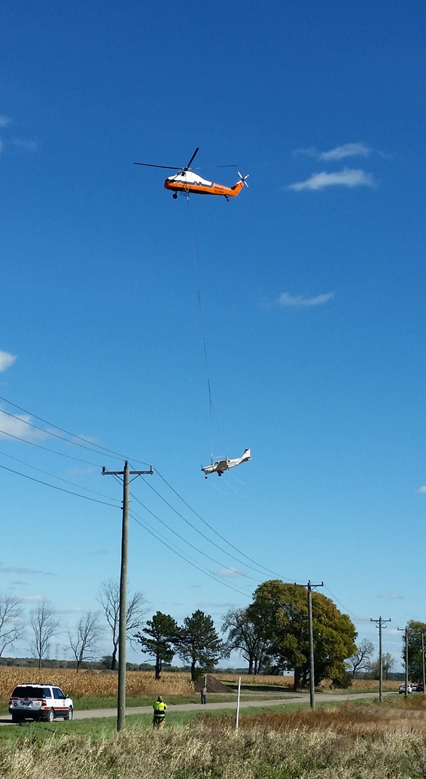
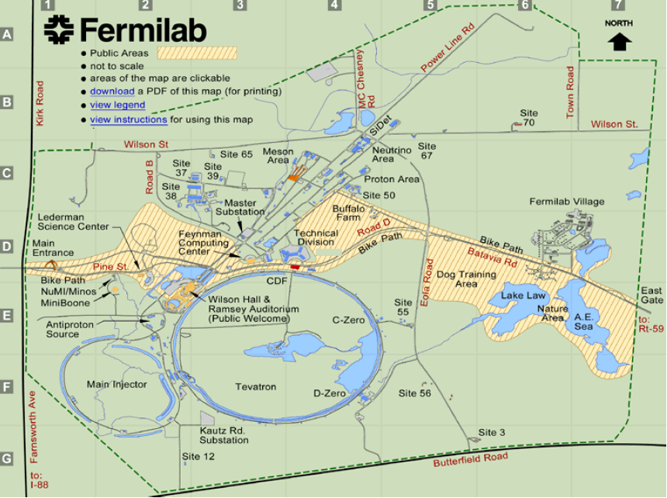

Location
FAST

Slide 3
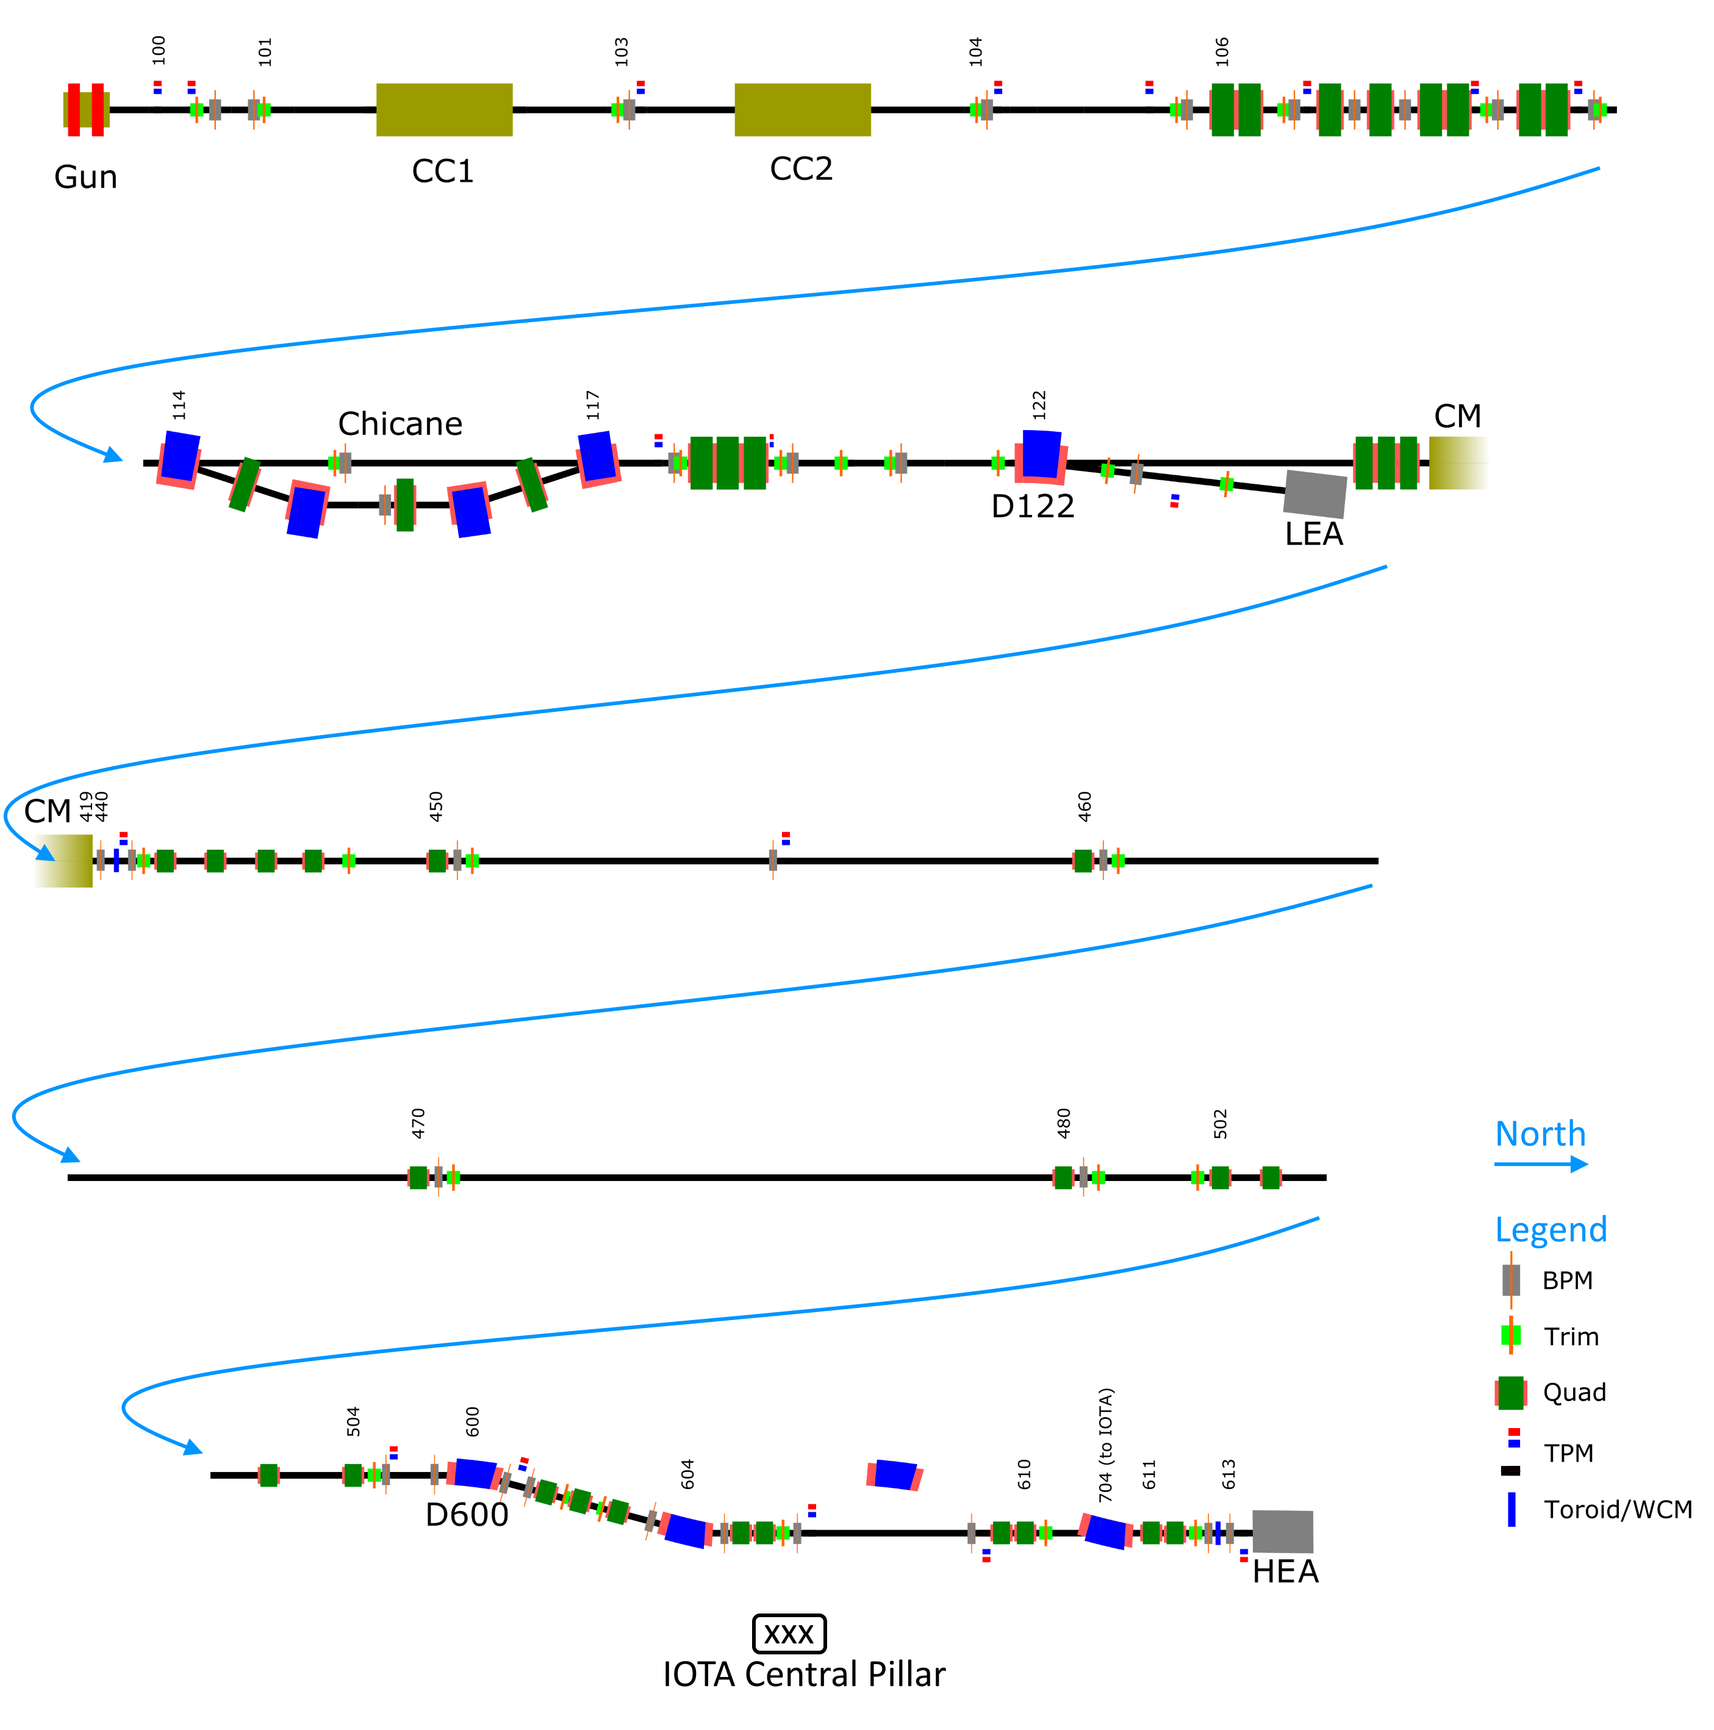

Slide 4
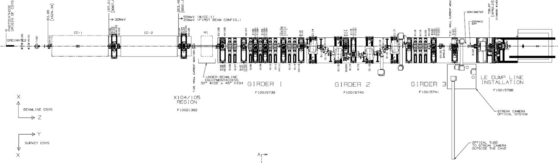
Electron Injector
Parameter | Value | Unit
Bunch charge | 0.02 – 3.2 | nC
Bunch train duration | 1 | ms
Bunch frequency within train | 3 | MHz
Number of bunches/train | 1 – 3000
Bunch train frequency | 1 – 5 | Hz

Slide 5
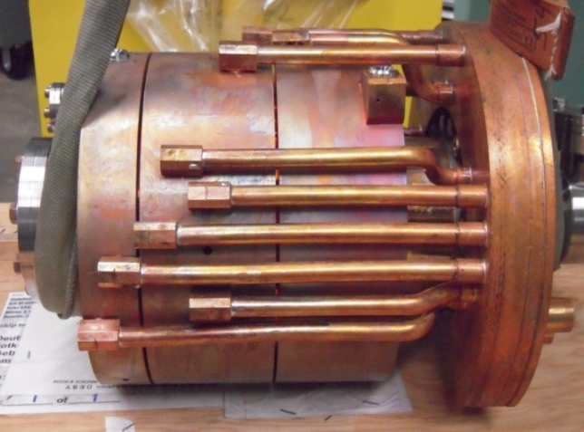
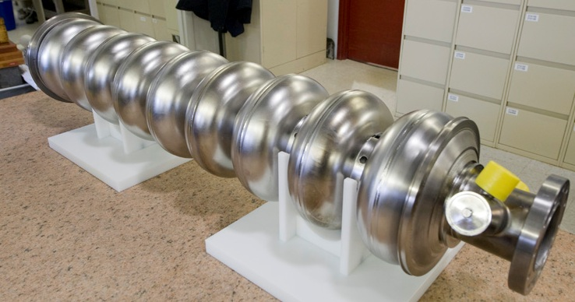
Gun and Capture Cavities
1.3 GHz, normal conducting, 1.5 cell RF electron gun
  Cs₂Te photocathode excited by 254 nm uv laser
  Gun 42 MV/m, ~4.5 MeV electrons
Two 1.3 GHz 9-cell SRF cavities
  CC1 at 27.5 MV/m
  CC2 at 17 MV/m
  Parameter scaling, spectrometer based beam energy > 50 MeV

Slide 6
Construction

Slide 7
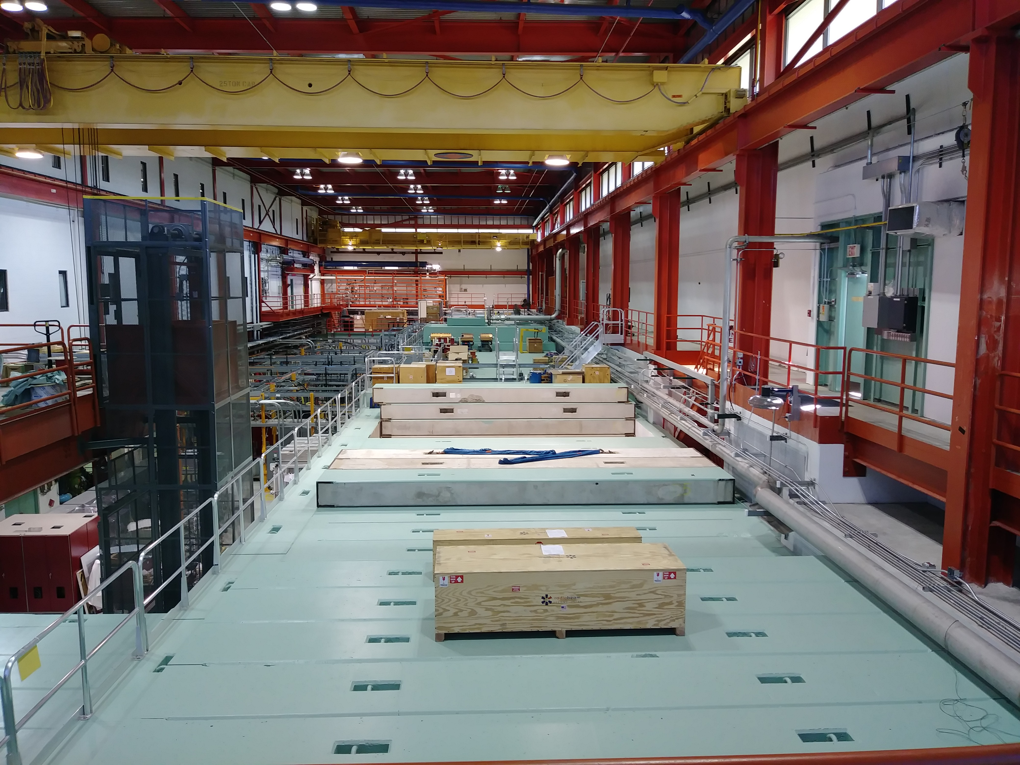
Construction

Slide 8
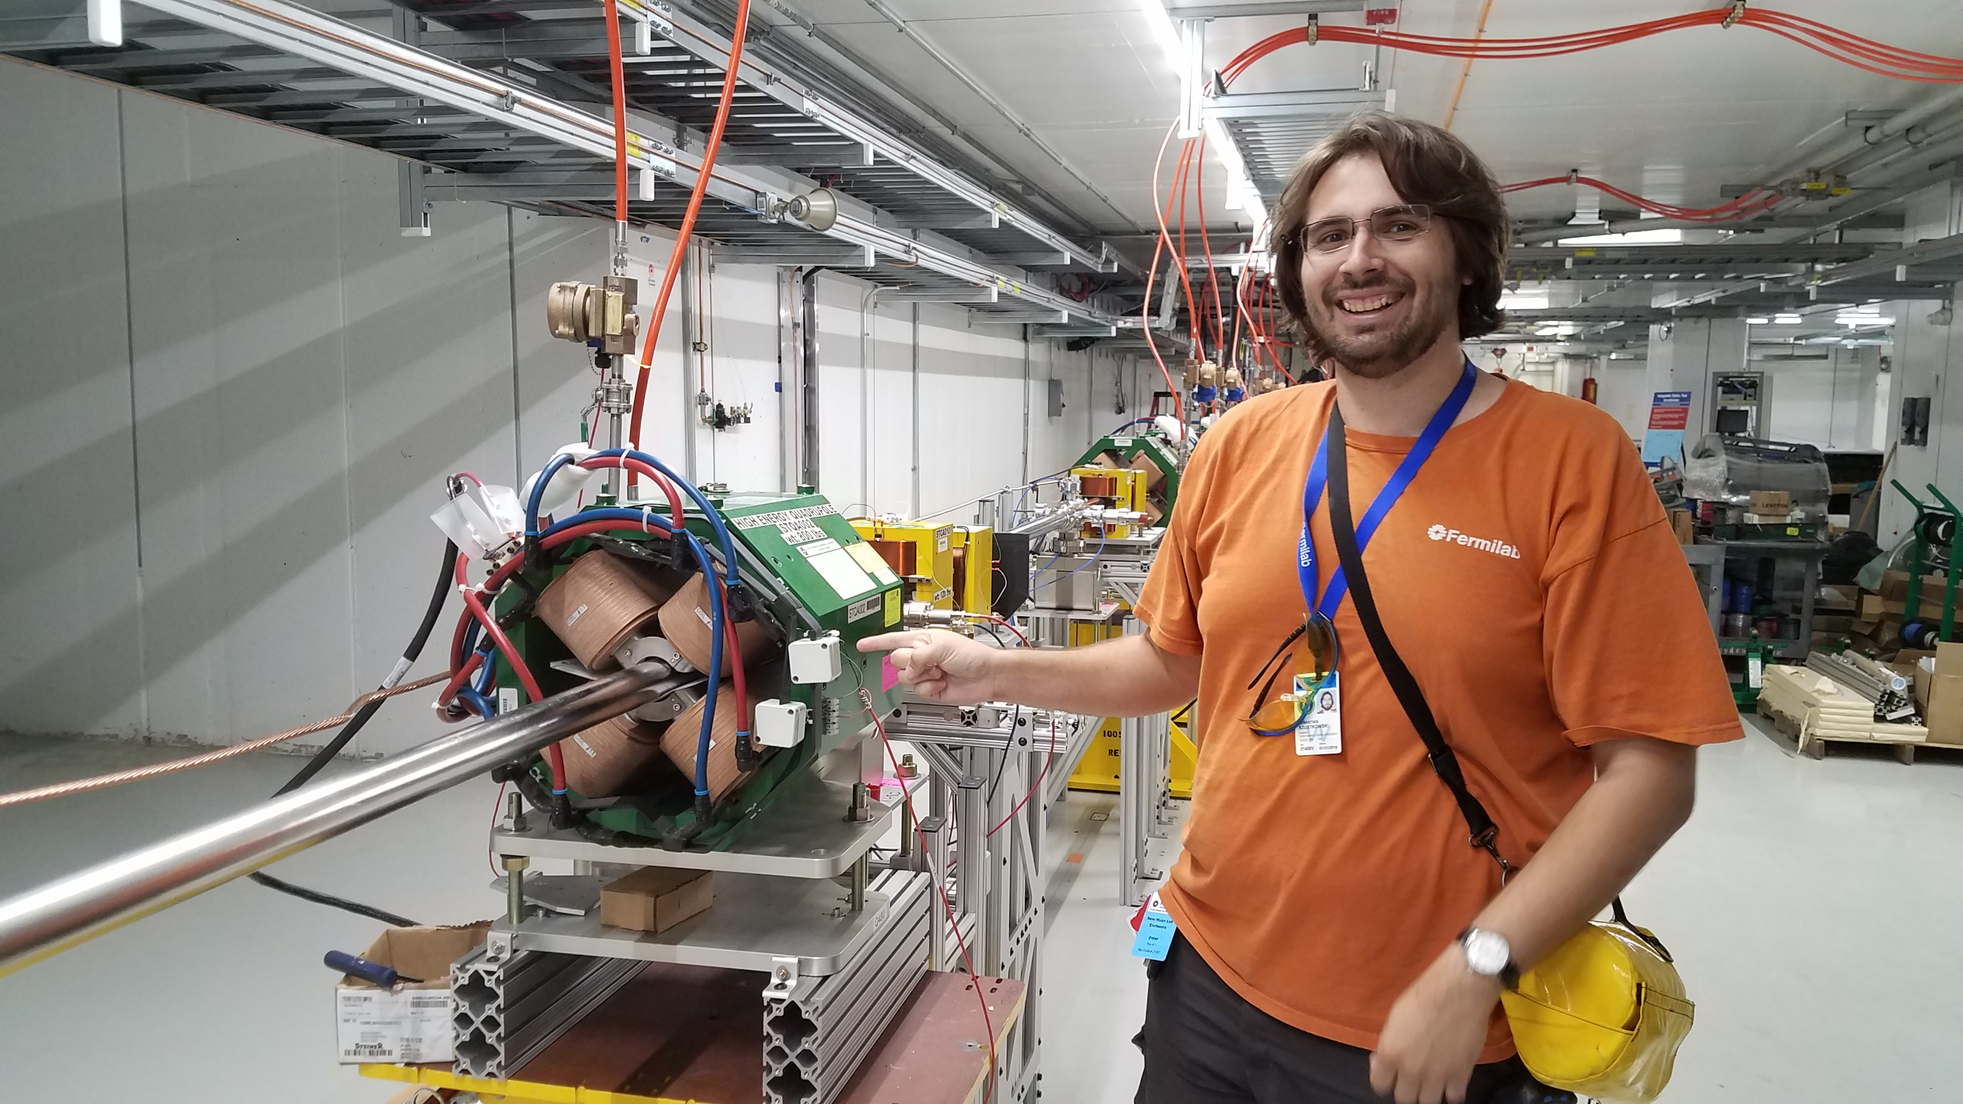
Installation

Slide 9
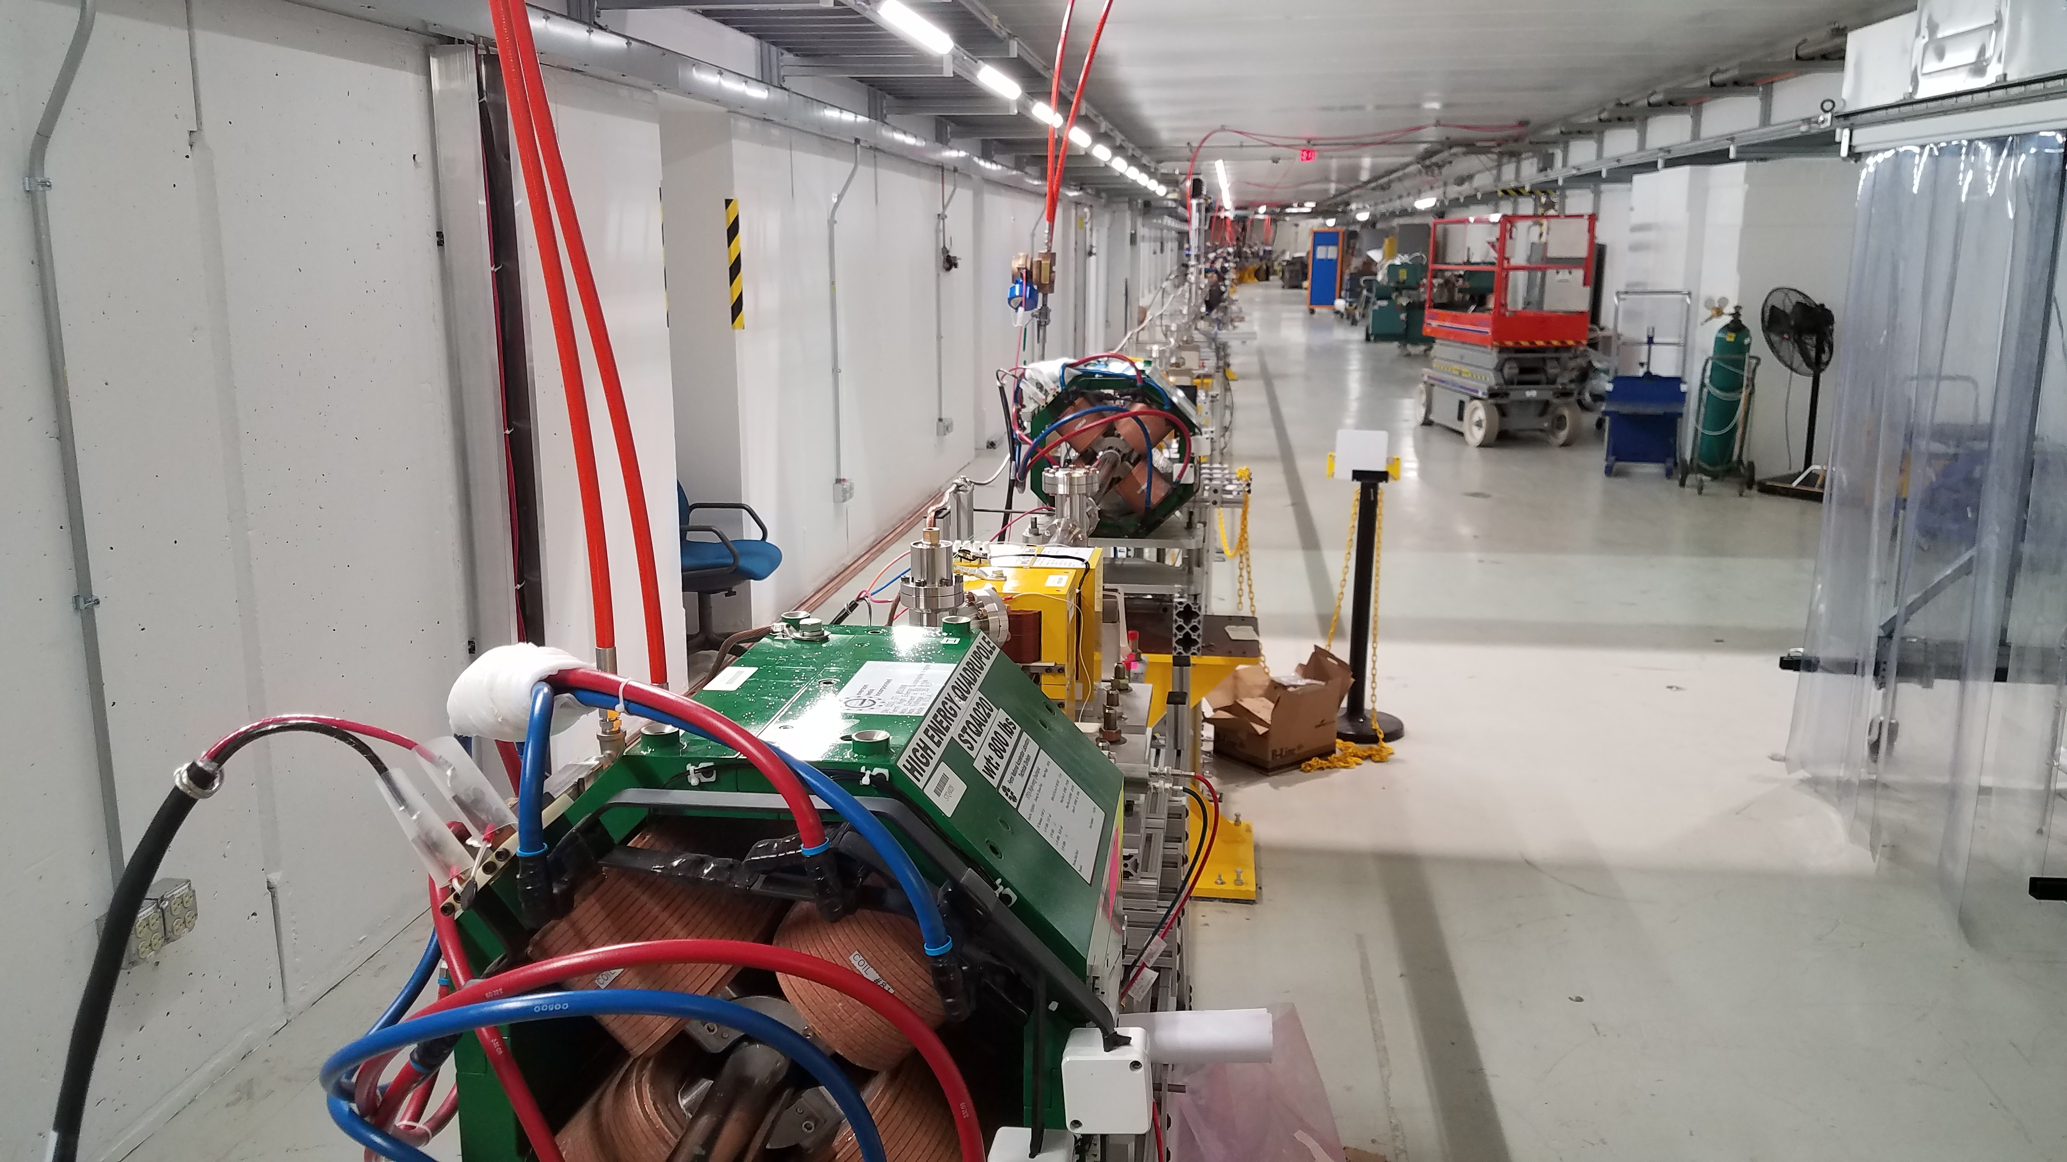
Installation

Slide 10
Schedule/Planning

Slide 11
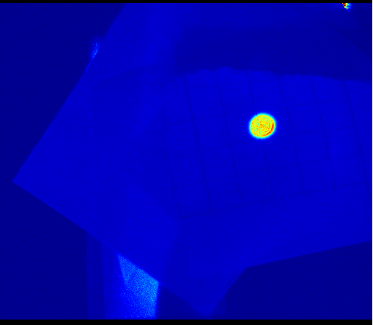
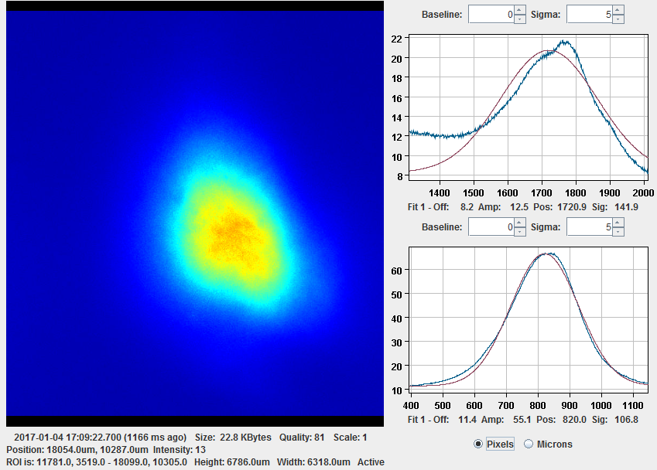
FAST Laser Status
IR Amplifiers have been realigned for improved nominal running and for testing of the inverse Compton scattering experiment
Frequency-doubling crystals (IR → UV) have been realigned for a better beam profile
New transport laser shutter is controlled by the MPS
Interlock test for laser in cave is complete. UV laser to cave expected in the next few days.
Masked UV spot after 15 meter simulated transfer line. Spot size is about 5mm in diameter
Raw UV spot after conversion

Slide 12
Study Plans for FAST in 2017
55MeV Beam phase space tomography experiments
Flat beam transform ~ Talk by Alex Halavanau 10:00-10:15AM
Emittance investigation and optimization for both 55Mev and 300MeV beam ~ Talk by Philippe Piot 10:50:11:10AM
Z-slicer and THz generation. (This will also use Flat beam )
Investigations of Wakefields effect in SCRF Cavities, Collaboration with LANL, NIU ~ Talk by Bruce Carlsten 10:30-10:50AM
300Mev Synchrotron light imaging and spectral analysis

