Slide 1
IOTA Optics Update: Flexibility for Experiments
Aleksandr Romanov
FAST/IOTA collaboration meeting
6 June 2017

Slide 2
Overview
Introduction and common description of IOTA
Configurations for planned experiments
Injection scheme
Conclusion

Slide 3
Intorduction
IOTA will be a unique machine dedicated to accelerator physics research, capable of working with electrons and protons. Currently six experiments are worked out in details, five of which will be operated with both protons and electrons:
One nonlinear magnet (1NL)
String of octupoles with profiled gradients (same lattice as 1NL)
Two nonlinear magnets (2NL)
Electron lens (EL)
McMillan lens (MM)
Optical stochastic cooling (OSC, with electrons only)

Slide 4
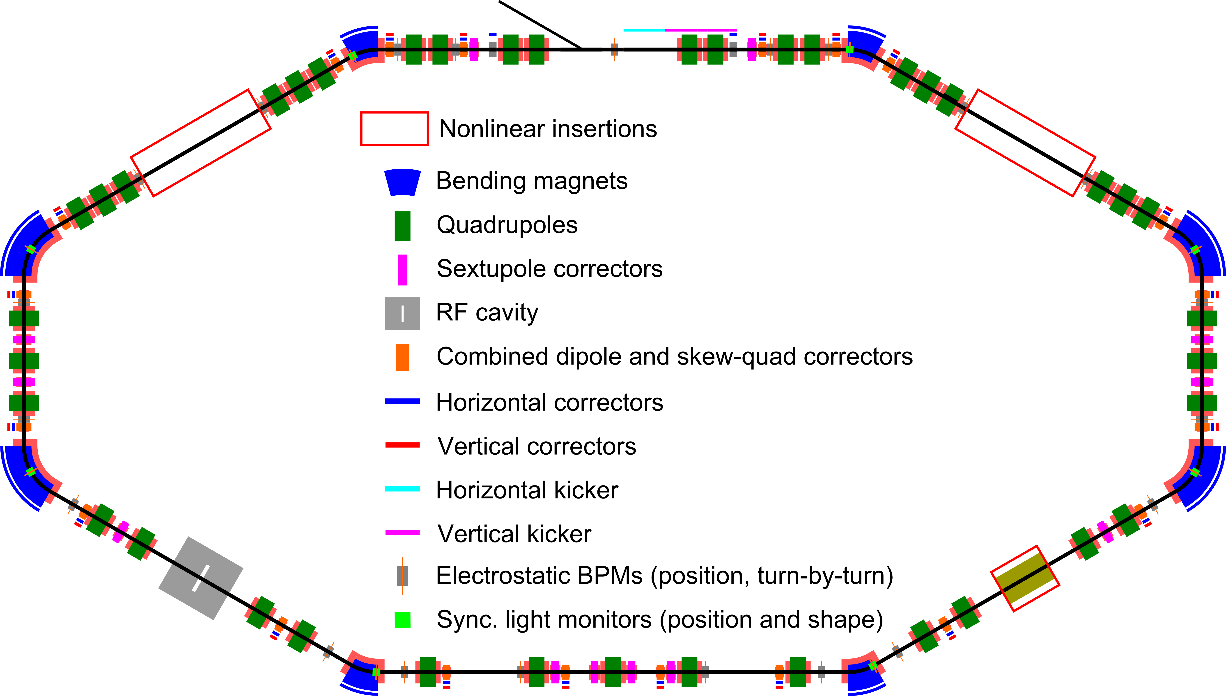
IOTA layout

Slide 5
IOTA naming convention

Slide 6
Parameters
Momentum | < 200 MeV
Perimeter | 40 m
RF voltage | <1 kV
RF frequency | 30 MHz & 7.5 MHz
3 Experimental gaps | 2x180 cm, 1x150 cm
Main vacuum chamber aperture (R) | 25 mm
Lambertson and kickers aperture (R) | 20 mm
Electrons | 10⁹ e, 5 mA
Protons | 10¹¹ p, 35 mA
Vacuum | 6x10⁻¹⁰ torr

Slide 7
Main components
Lambertson magnet |  | 1 | Horizontal, injection in vertical plane
Kickers |  | 1 hor. & 1 vert. | Horizontal for studies only
Main dipoles |  | 4x60 deg & 4x30 deg | Powered in series with Lambertson
Quads |  | 39 | Powered in pairs with individual shunts
Trims | Hor. | 8 | In main dipoles
 | Vert. | 2 | For injection bump
 | Hor. | 20 | Combined correctors
 | Vert. | 20
Skew-quads |  | 20
Pickups |  | 21 | Turn-by turn position
Sync. light monitors |  | 8 | Shape and position
RF |  | 1 | Dual frequency
Solenoid |  | 1 | For electron and McMillan lenses
Sextupoles |  | 12 | In six families

Slide 8
Constraints for IOTA lattices
Specific requirements to the arc transport matrix, which can be formulated in terms of specific betas, dispersions and phase advances.
Mirror symmetry of power supplies
Betas should be matched to aperture limitations in the ring and in the experimental insertions
Pencil beam approach (requires larger momentum compaction)
Positive decrements (for electrons)
Proper positioning of sextupoles
Small errors (after correction):
Parameter | Max error
Betas at the insertion | 1%
Beta beating | 3%
Dispersion | 1 cm
Closed orbit at insertion | 0.05 mm
Phase advance between insertions | 0.001

Slide 9
Lattice configuration: one nonlinear magnet (1NL)
Momentum | 150 MeV
Tunes, x,y | 5.3, 5.3
Mom. comp. | 0.072
Emittances, x,y | 3.4 E-6 cm
Bunch length @1kV | 11 cm
Energy spread | 1.34 E-4
Sync. Tune @1kV | 5.5 E-4
Damp. times (x,y,s) | (0.92,0.92,0.23) s

Slide 10
Experiment configuration: two nonlinear magnets (2NL)
Momentum | 150 MeV
Tunes, x,y | 5.1, 5.1
Mom. comp. | 0.067
Emittances, x,y | 3.8 E-6 cm
Bunch length @1kV | 11 cm
Energy spread | 1.35 E-4
Sync. Tune @1kV | 5.3 E-4
Damp. times (x,y,s) | (0.89,0.89,0.24) s

Slide 11
Experiment configuration: electron lens (EL)
Momentum | 150 MeV
Tunes, x,y | 4.056, 3.556
Mom. comp. | 0.024
Emittances, x,y | (5.5, 0.14) E-6 cm
Bunch length @1kV | 7 cm
Energy spread | 1.46 E-4
Sync. Tune @1kV | 3.2 E-4
Damp. times (x,y,s) | (0.79,0.62,0.28) s

Slide 12
Experiment configuration: MCMillan lens (MM)
Momentum | 150 MeV
Tunes, x,y | 3.72, 3.78
Mom. comp. | 0.024
Emittances, x,y | 4.7 E-6 cm
Bunch length @1kV | 7 cm
Energy spread | 1.46 E-4
Sync. Tune @1kV | 3.2 E-4
Damp. times (x,y,s) | (0.69,0.69,0.28) s

Slide 13
Experiment configuration: optical stochastic cooling (OSC)
Momentum | 100 MeV
Tunes, x,y | 5.42, 3.42
Mom. comp. | -0.0165
Emittances, x,y | 1.4 E-7 cm
Bunch length @30V | 21 cm
Energy spread | 1.06 E-4
Sync. Tune @30V | 5.3 E-5
Damp. times (x,y,s) | (1.9,1.9,1.09) s

Slide 14
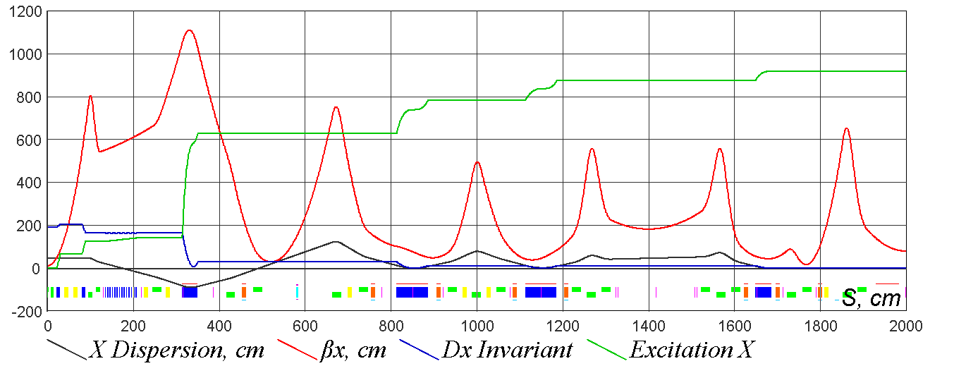
OSC: some details
OSC at IOTA requires smallest emittance possible
Undulator with 7 periods (radiation at 2.2 um)

Slide 15
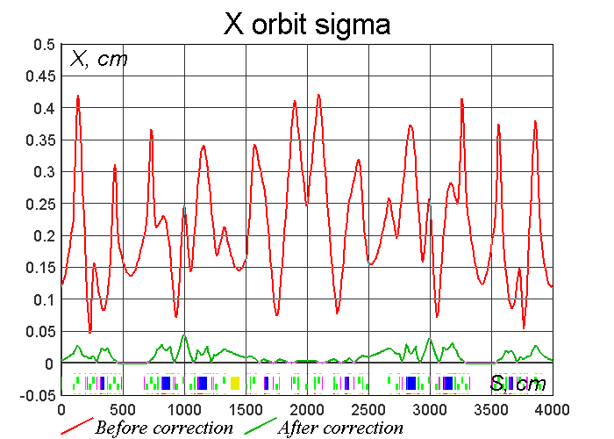
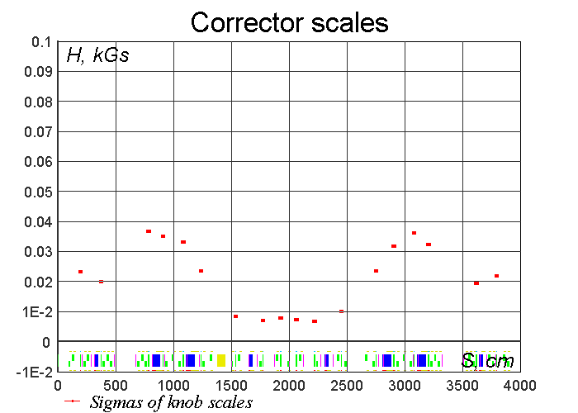
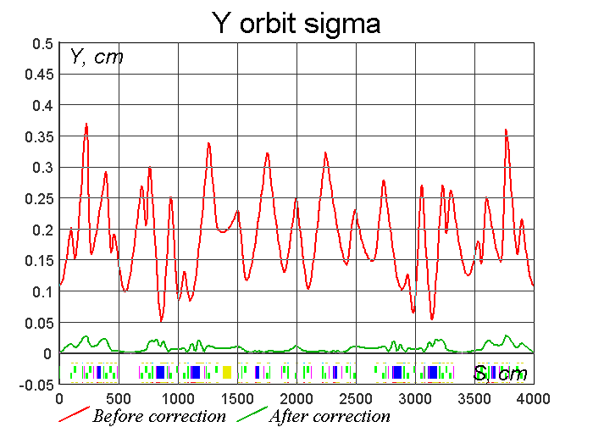
Example of orbit correction study for 1NL
Statistical analysis of 1000 random error sets with normal distribution
Quads X and Y shifts: 0.1mm
Bends X and Y shifts: 0.1mm
Bends tilt errors 0.01 mm/mm
Goal is <50um in the insertion

Slide 16
Lattice correction
Extended LOCO method of beam based model dependent analysis will be used for lattice errors reconstruction and correction.
Fit model so that it best describes measured experimental data using multiple iterations of SVD based inverse task solver.
Simulations shows that with BPMs precision of 1um and better lattice can be corrected to required levels.
Recent work demonstrated that it
should be possible to correct lattice
parameters to required precision
(THPOA24, NAPAC 2016)
Parameter | Max error
Betas at the insertion | 1%
Beta beating | 3%
Dispersion | 1 cm
Phase adv in T-ins | 0.001

Slide 17
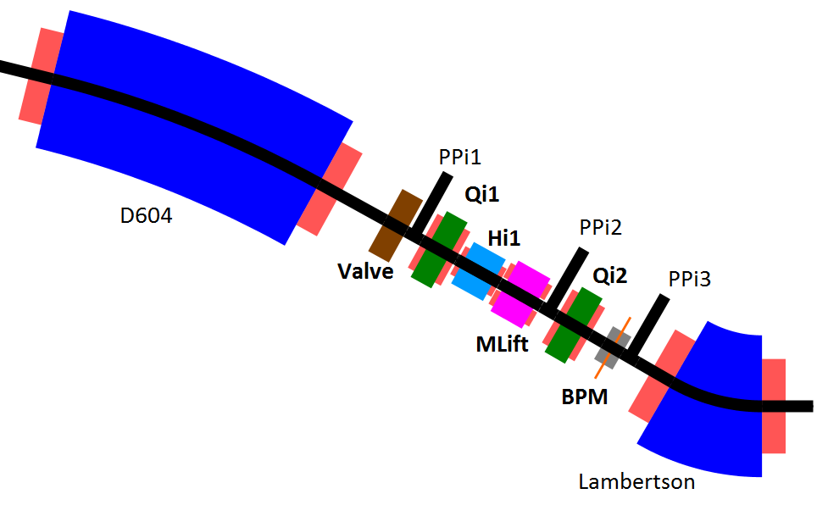
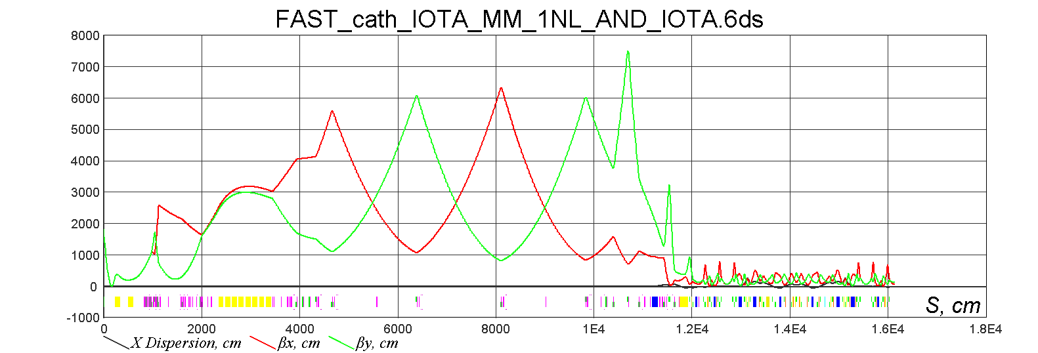
Injection
Protons fill all injection channel (d=15 mm)
Aperture limitations
20 mm radius in Lambertson
20 mm radius for plates in kickers
Kicker strength limited to equivalent of 70 G for electrons and around 500 G for protons
Field in combined correctors limited to 120 G
Field in bump correctors limited to 1 kG

Slide 18
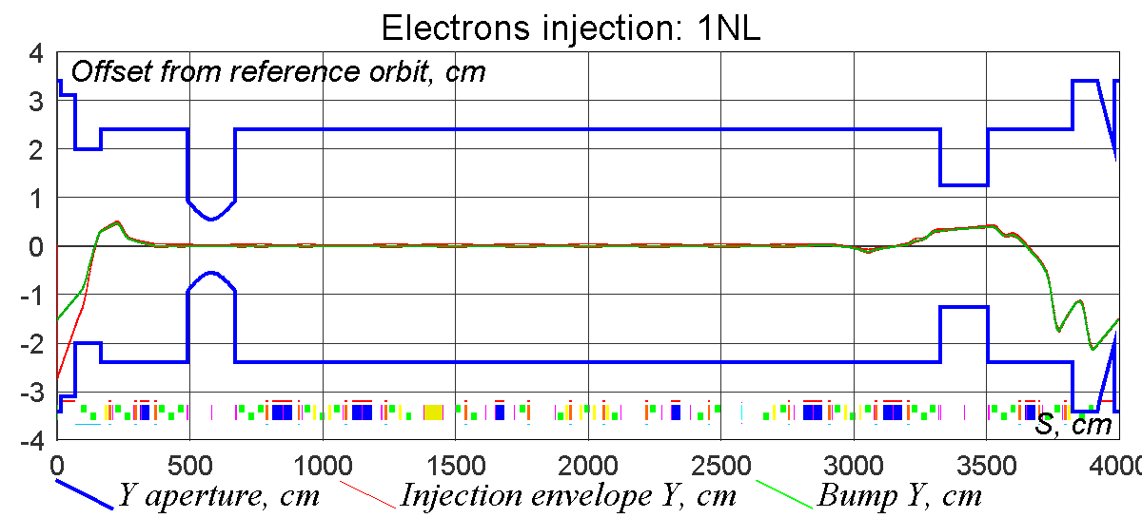
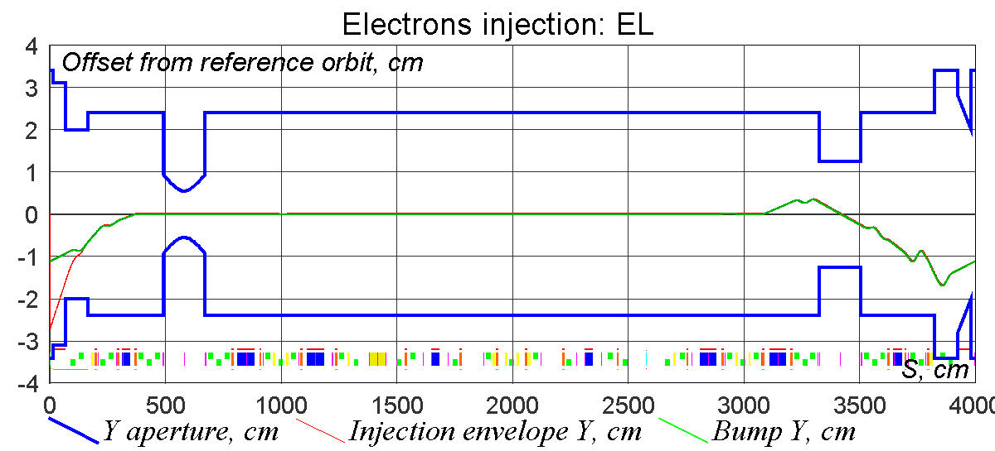
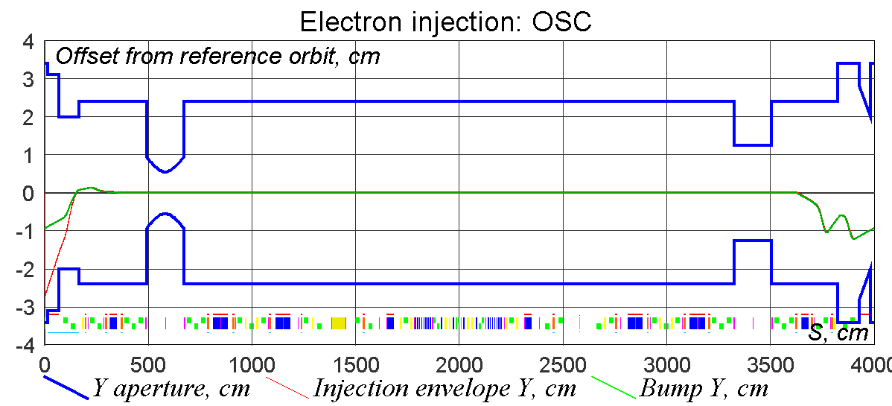
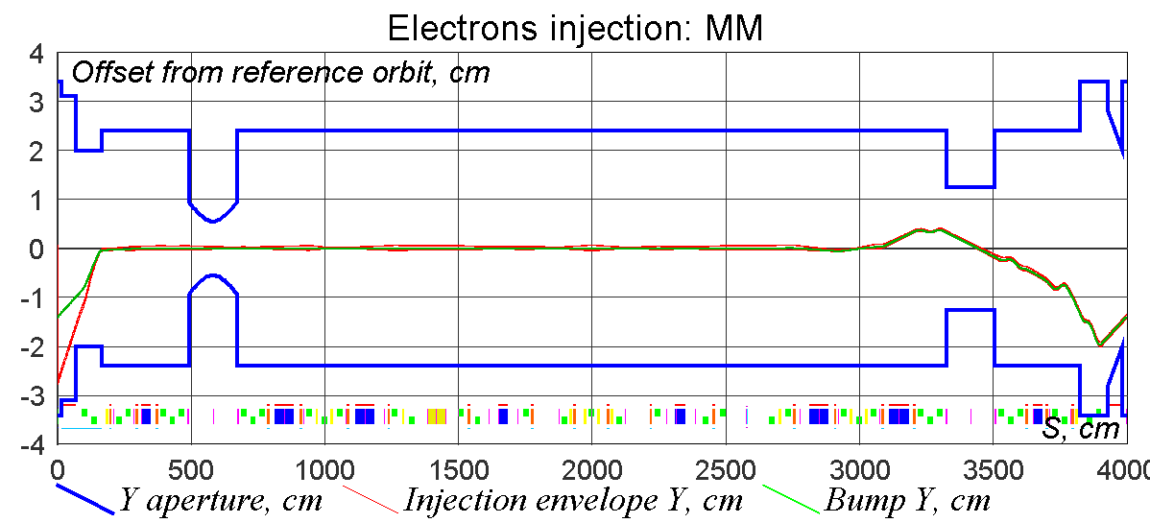
Injection: electrons
Clearance (Y): | 3.8 mm | 18 sigmas
Clearance (Y): | 5.5 mm | 140 sigmas
Clearance (Y): | 5.5 mm | 171 sigmas
Clearance (Y): | 5.1 mm | 11.5 sigmas

Slide 19
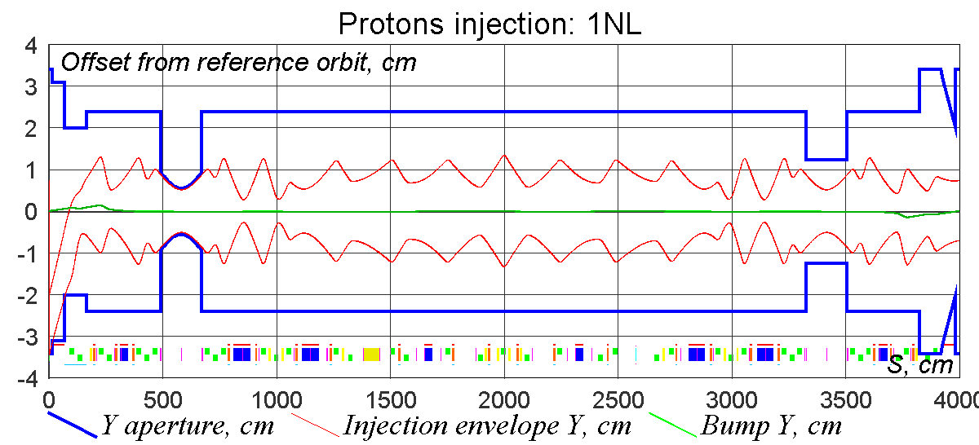
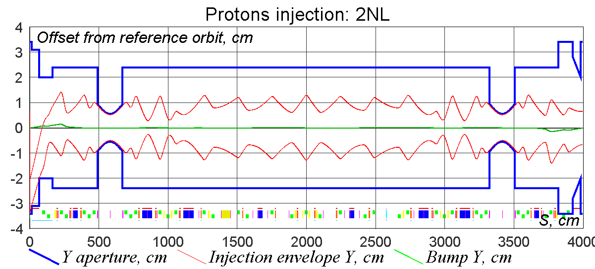
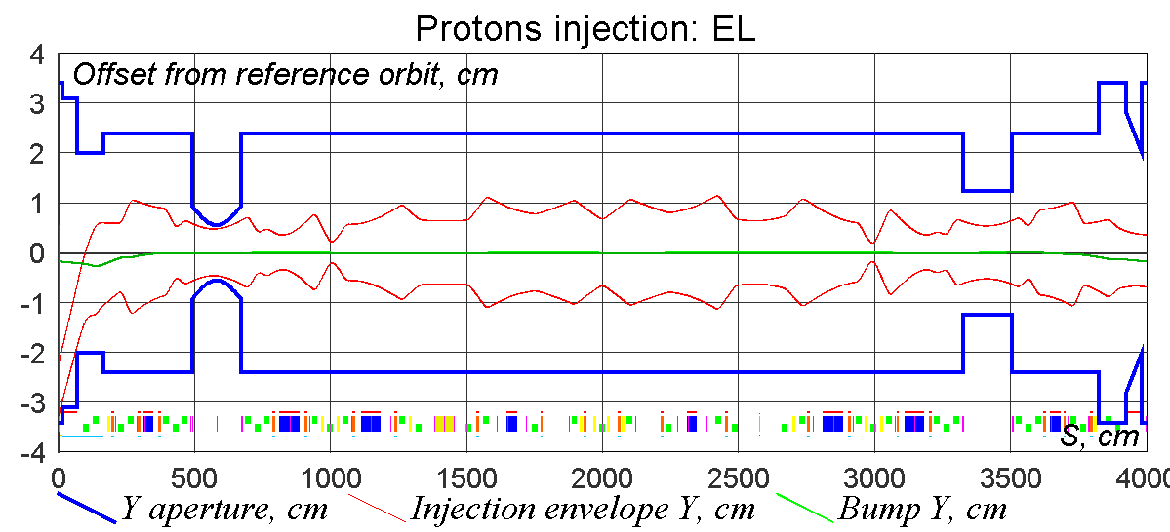
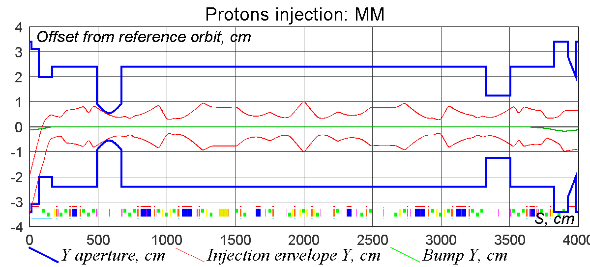
Injection: protons
Emittance | 40 um | Kicker | 74 G
Emittance | 40 um | Kicker | 73 G
Emittance | 20 um | Kicker | 52 G
Emittance | 15 um | Kicker | 64 G

Slide 20
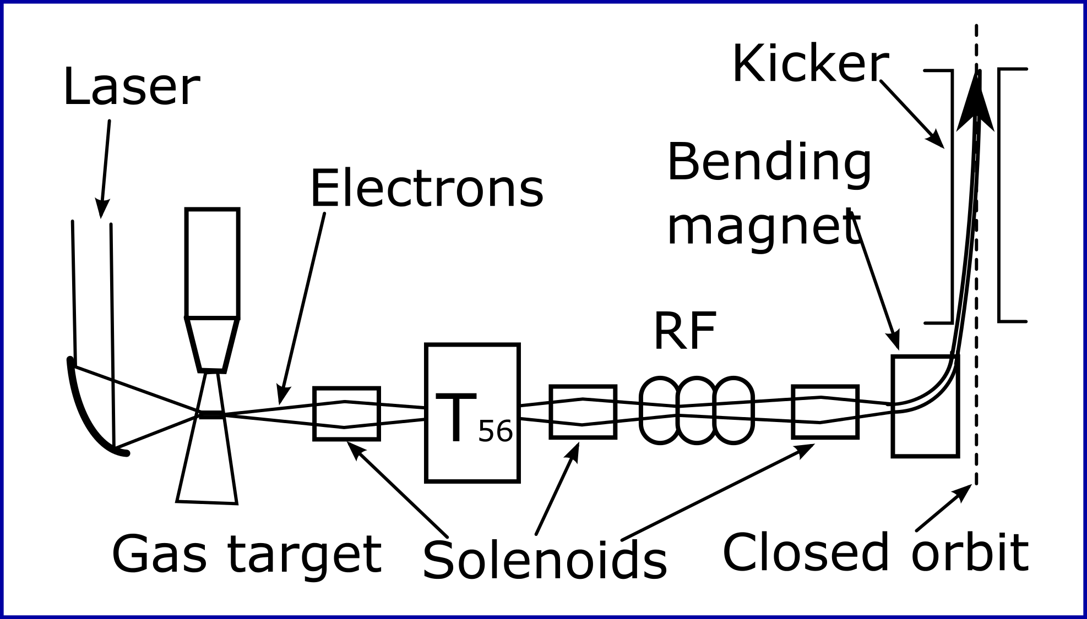
Reversal injection of electrons
During experiments with protons it will be helpful to have short electron bunches circulating in opposite direction to precisely tune lattice parameters.
Less problems with electrostatic pickups
Possible to use synchrotron light
Realization:
From FAST
LPWA based
Active ongoing collaboration is established with A.A. Sahai and A. Seryi from Oxford aimed at PIC simulations of LPWA to find suitable parameters of laser and plasma

Slide 21
Example of linear space charge compensation for 1NL
Algorithm was developed to find self-consistent solutions in presence of linear space charge forces and at the same time preserving necessary form of T-insert transport matrix.
Plots illustrate lattice functions across one path through IOTA for the same initial conditions but space charge forces being “on” and “off”
NL magnet at t=0.3
SC tune depression: -0.4

Slide 22
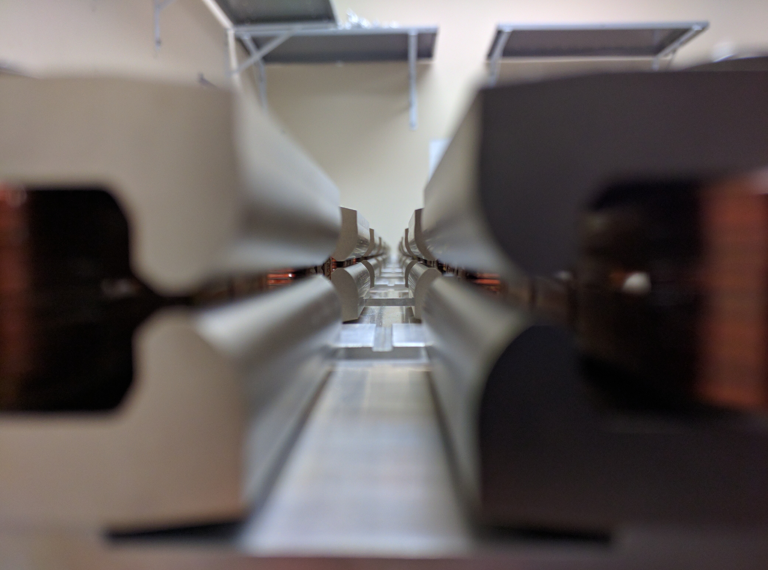
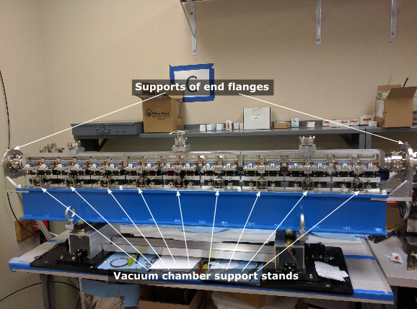
Nonlinear magnet
Magnet arrived on site
Will be referenced and then installed to the final position in the ring

Slide 23
Conclusion
The design of IOTA ring is flexible and balanced
All major aspects of the ring design are finalized and allow operation of the first phase experiments
Nonlinear dynamics is under intense studying
You are very welcome to propose additional experiments!

