Slide 1
CM Assembly Outside Clean Room
13 January 2017

Slide 2
Summary of Lessons Learned
Lessons Learned
Jlab Overview of assembly issues
  Use the latest drawing, period.
  If you bought parts before the latest drawing was released, modify them to the latest released drawing before using
FNAL
  Magnetic leads length and soldering issues resolved
  RF measurements/tooling refined
  No major issues with electrical, flanges will be pre-assembled and checked
  Magnetic shield design refined
  Welding: change to socket welds on warmup/cooldown lines, orbital welds on 2 Phase lines

Slide 3
Summary of Lessons Learned
Lessons Learned
FNAL (cont)
  Cavity tuners: bench tests, magnetic hygiene, demag to be done as groups of 8
  JT valves
    Welding process magnetized VV, successfully degaussed
    Grounding to be improved
  Coupler warm end installation
    Went well
    Personnel were trained, more to be trained

Slide 4
Summary of Design Changes

Slide 5
Summary of Design Changes
  Couplers: Modified ILC design to modified XFEL
  Bellows and spools: Kurt Lesker made, plated by Nomura
  Cold mass upper: fully assembled at WXCX
  Invar rod clamps: design improved, stronger, assembly clearance
  Baffle added to 2 Phase line
  FPC 50K thermal straps attached directly to line, better heat transfer
  FPC 5K intercept modified to hold vacuum forces (JLAB request)
  Magnet leads improved
  Tuner split rings: added set screws for more solid fit
  50K shields: AL6061 changed to AL1100
  Instrumentation: reduced amount
  JT fill line: proposed diameter change ½” to 1” (microphonics)

Slide 6
Magnetic Hygiene/ Demagnetization
Magnetic hygiene covered everything.
Despite best intent, module re-magnetized during assembly.
Residual field increased with welding. Observed in realtime at JLab.
Can demag after assembly using 65 amp program to less than 5 mG.
VV’s at both labs successfully demagged to less than 50 mG, though JLab had to wait for VV04 (1st production) to get there. Likely due to final bake, WXCX did.
Active cancellation does not appear to be needed at this time, but not sure what to expect at SLAC. Need to work with them to address this Operational issue.

Slide 7
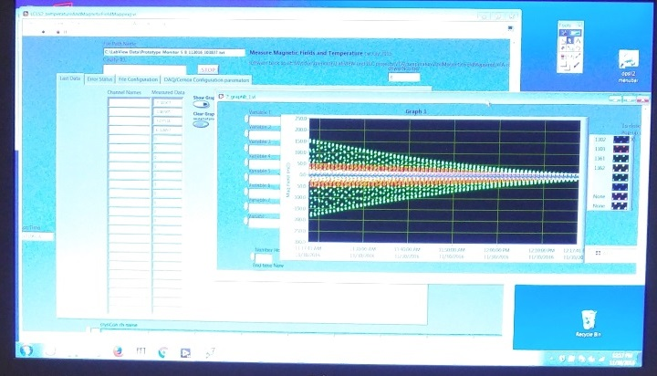
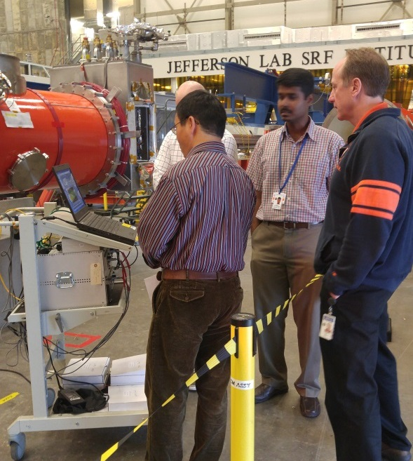
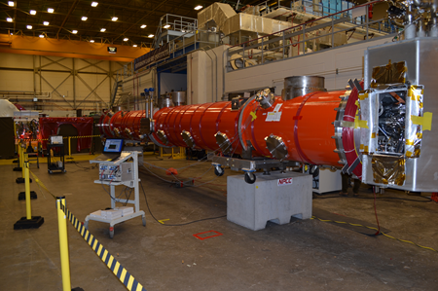
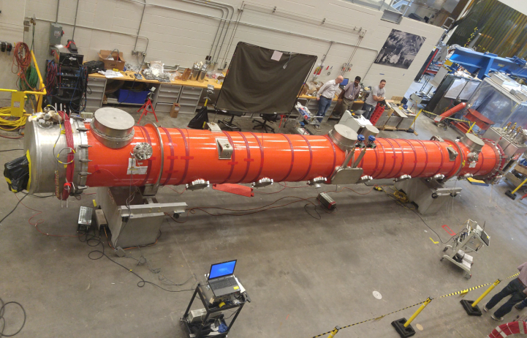
Magnetic Hygiene Program (cont.)
Jlab Demag
pCM was degaussed. FNAL visitors/advisors in attendance.
Fluxgate# | 1314 | 1324 | 1369 | 1367 | 1362 | 1361 | 1302 | 1303
Before | -5.1 | -8.4 | 0.94 | 12.32 | 0.00 | -9.96 | 1.46 | -8.67
After 35 A | 5.0 | 1.79 | 6.17 | -2.2 | -5.78 | -1.92 | -0.48 | -1.01
After 65A | 4.26 | 1.29 | 3.96 | -1.88 | -3.45 | -2.31 | -1.02 | -1.21

Slide 8
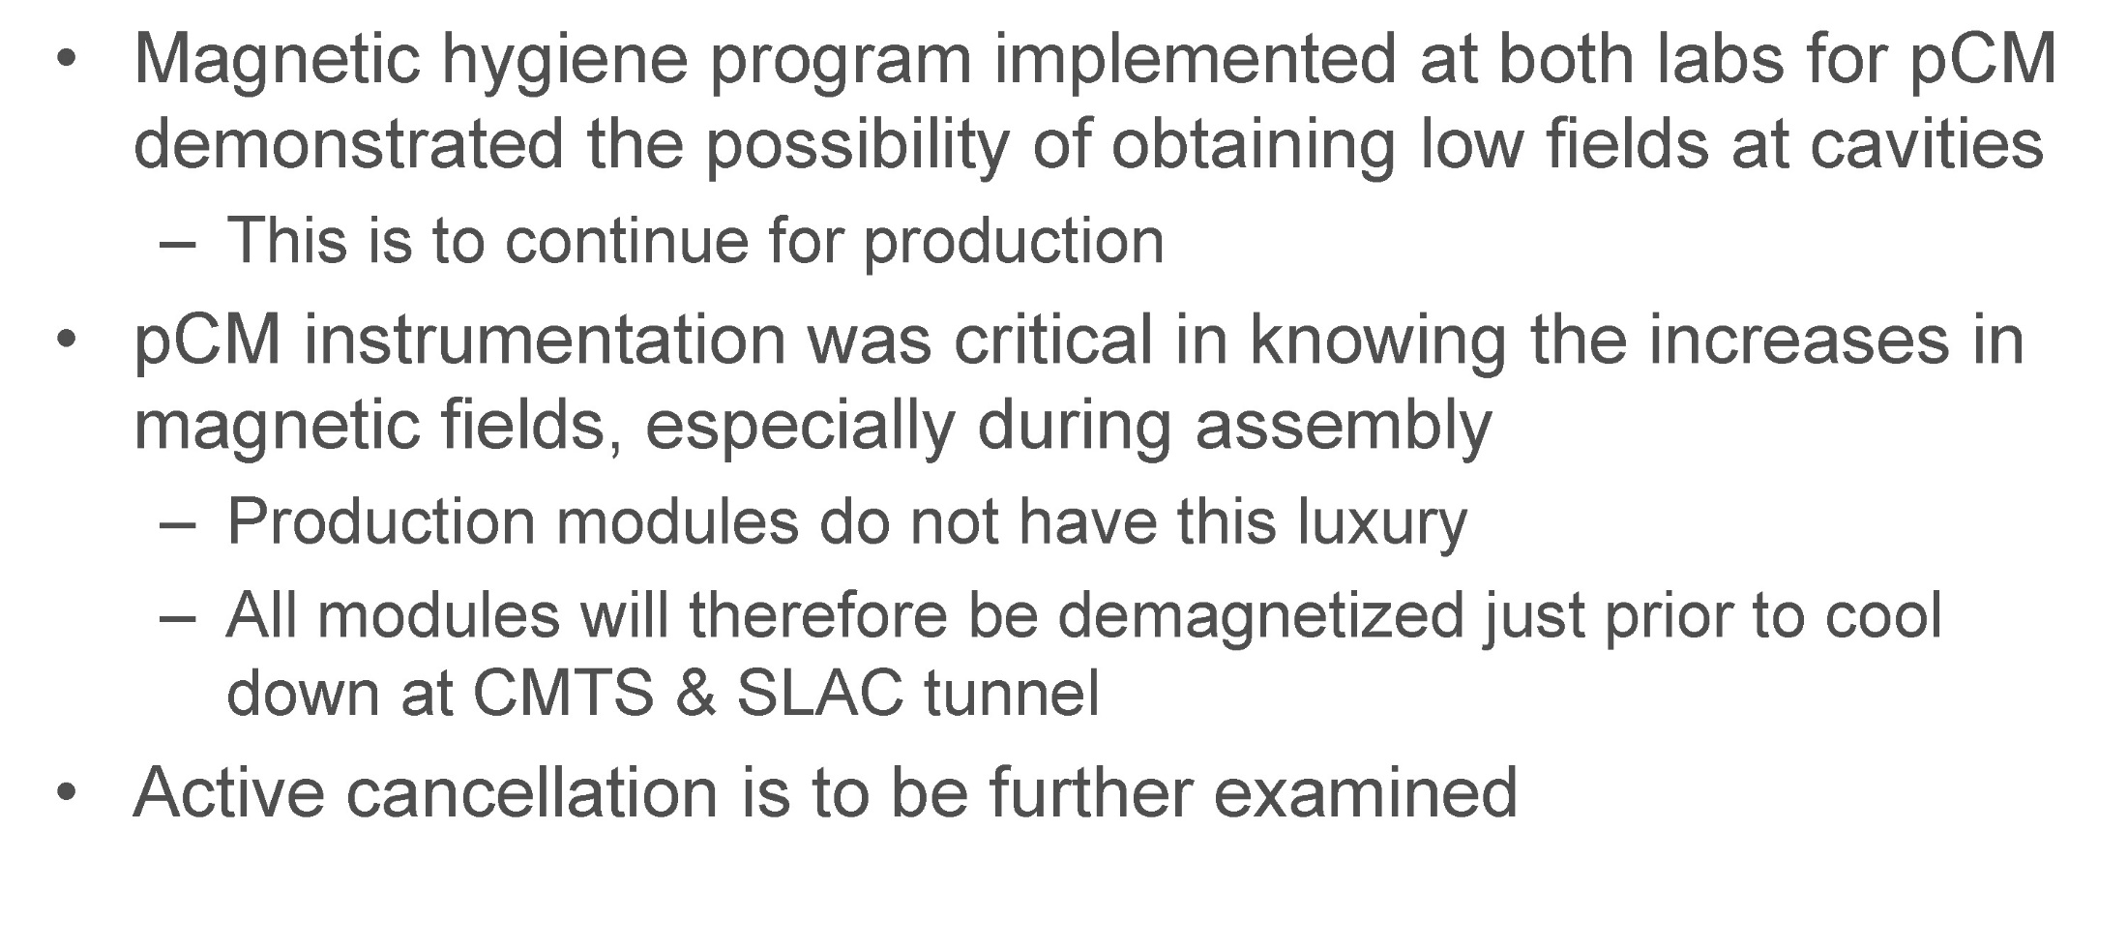
Demagnetization at SLAC
Flux trapping observed after quench is an Operational issue which will need to be addressed at SLAC.

Slide 9
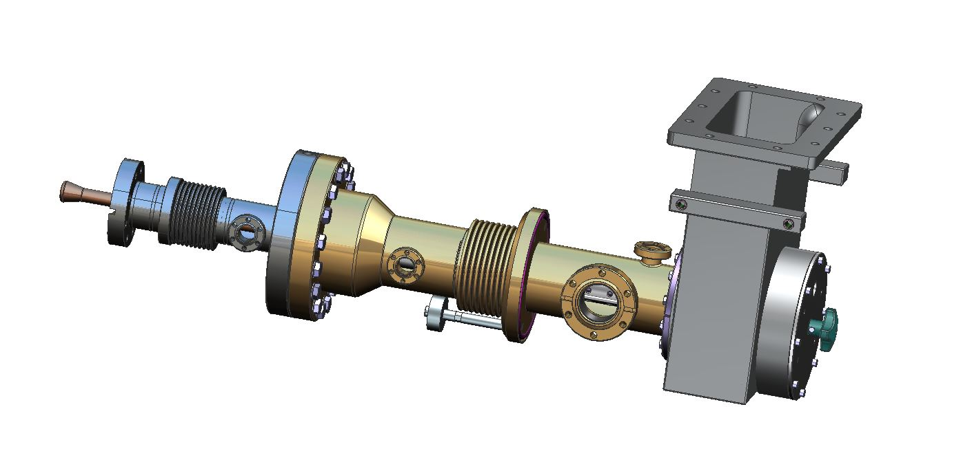
LCLSII FPC Configuration
LCLSII FPC Waveguide
LCLSII FPC Cold Part
FPC Instrumentation:
5 and 50K heat sinks
temperature sensors
Electron probes
Arc detectors in the warm part
Arc detector on FPC waveguide
One ionic pump for 8 warm couplers
One vacuum gauge for 8 warm couplers
LCLSII FPC Warm Part
LCLSII FPC manual antenna actuator
(rotation movement)
Remark DESY XFEL use linear movement

Slide 10
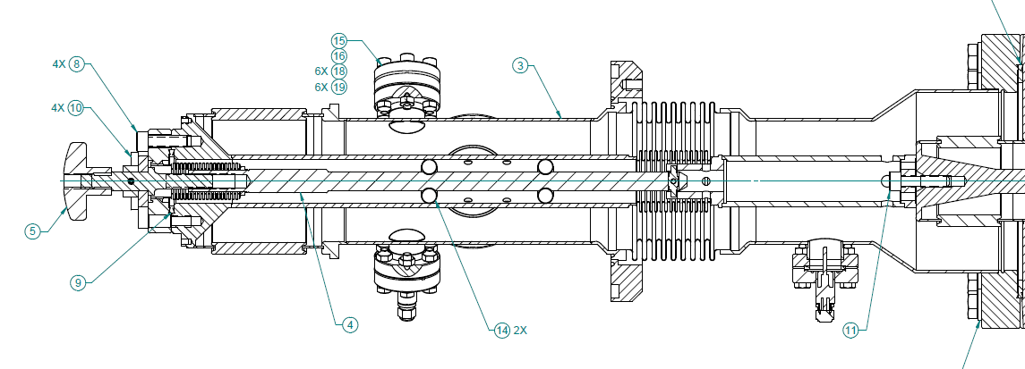
Push rod and manual actuator – major issues identified
4 of 8 Jlab cavities untunable
Unreliable bayonet link used in rotation mode, under heavy loads
Manual actuator – rotation movement !!!
XFEL design specifies linear movement for this component
The PEEK plastic material is not robust enough to operate in cryogenic condition, under UHV loads and with stiff 150 um copper plated bellows. Was not able to adjust the Q at 4 10^-7 on any couplers with PEEK links.

Slide 11
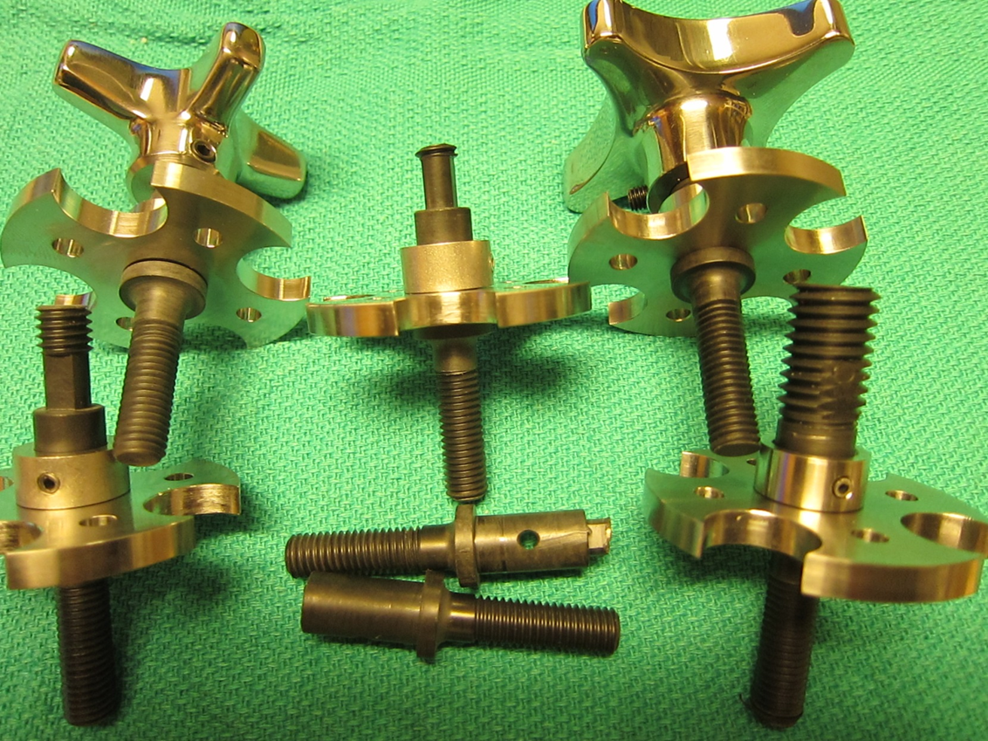
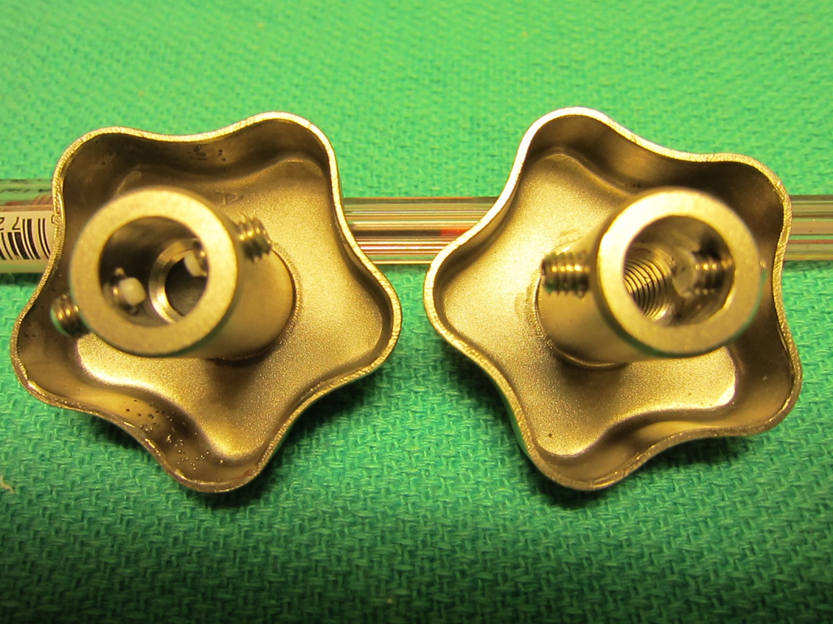
Damaged plastic pieces in Warm Couplers
Damaged

Slide 12
FPC Assembly at FNAL
Major differences between FNAL and JLAB assembly
  JLAB assembly done with string under vacuum requiring tooling to restrain cold end and warm end
  FNAL backfilled string, similar to XFEL process
  FNAL pCM does not use tuning knobs, uses motors
    No net torque applied to tuning link, so no problems were discovered
    Experience at FNAL- coupler system is much stiffer than ILC design due to increased plating thickness on IC
Further investigation of tuning knob/link failure at JLAB is needed (KP opinion)
  Redesign to a manual push/pull system with no applied torque to tuning link may be required

