Slide 1
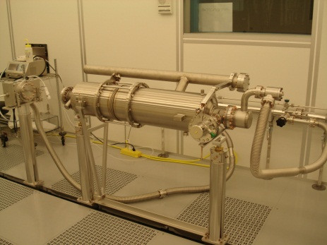
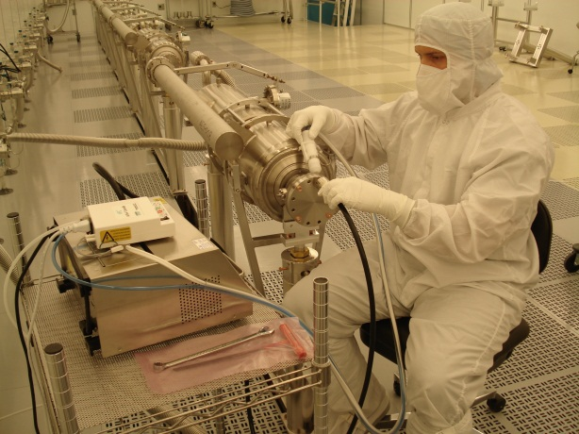
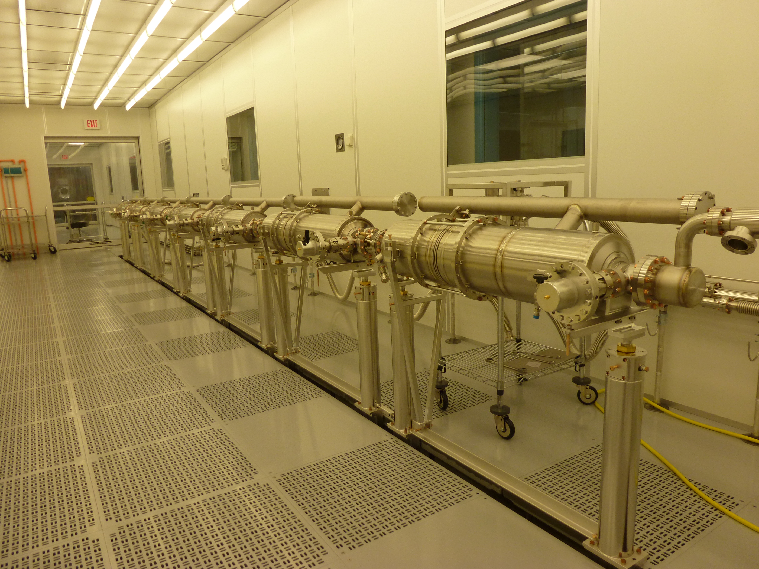
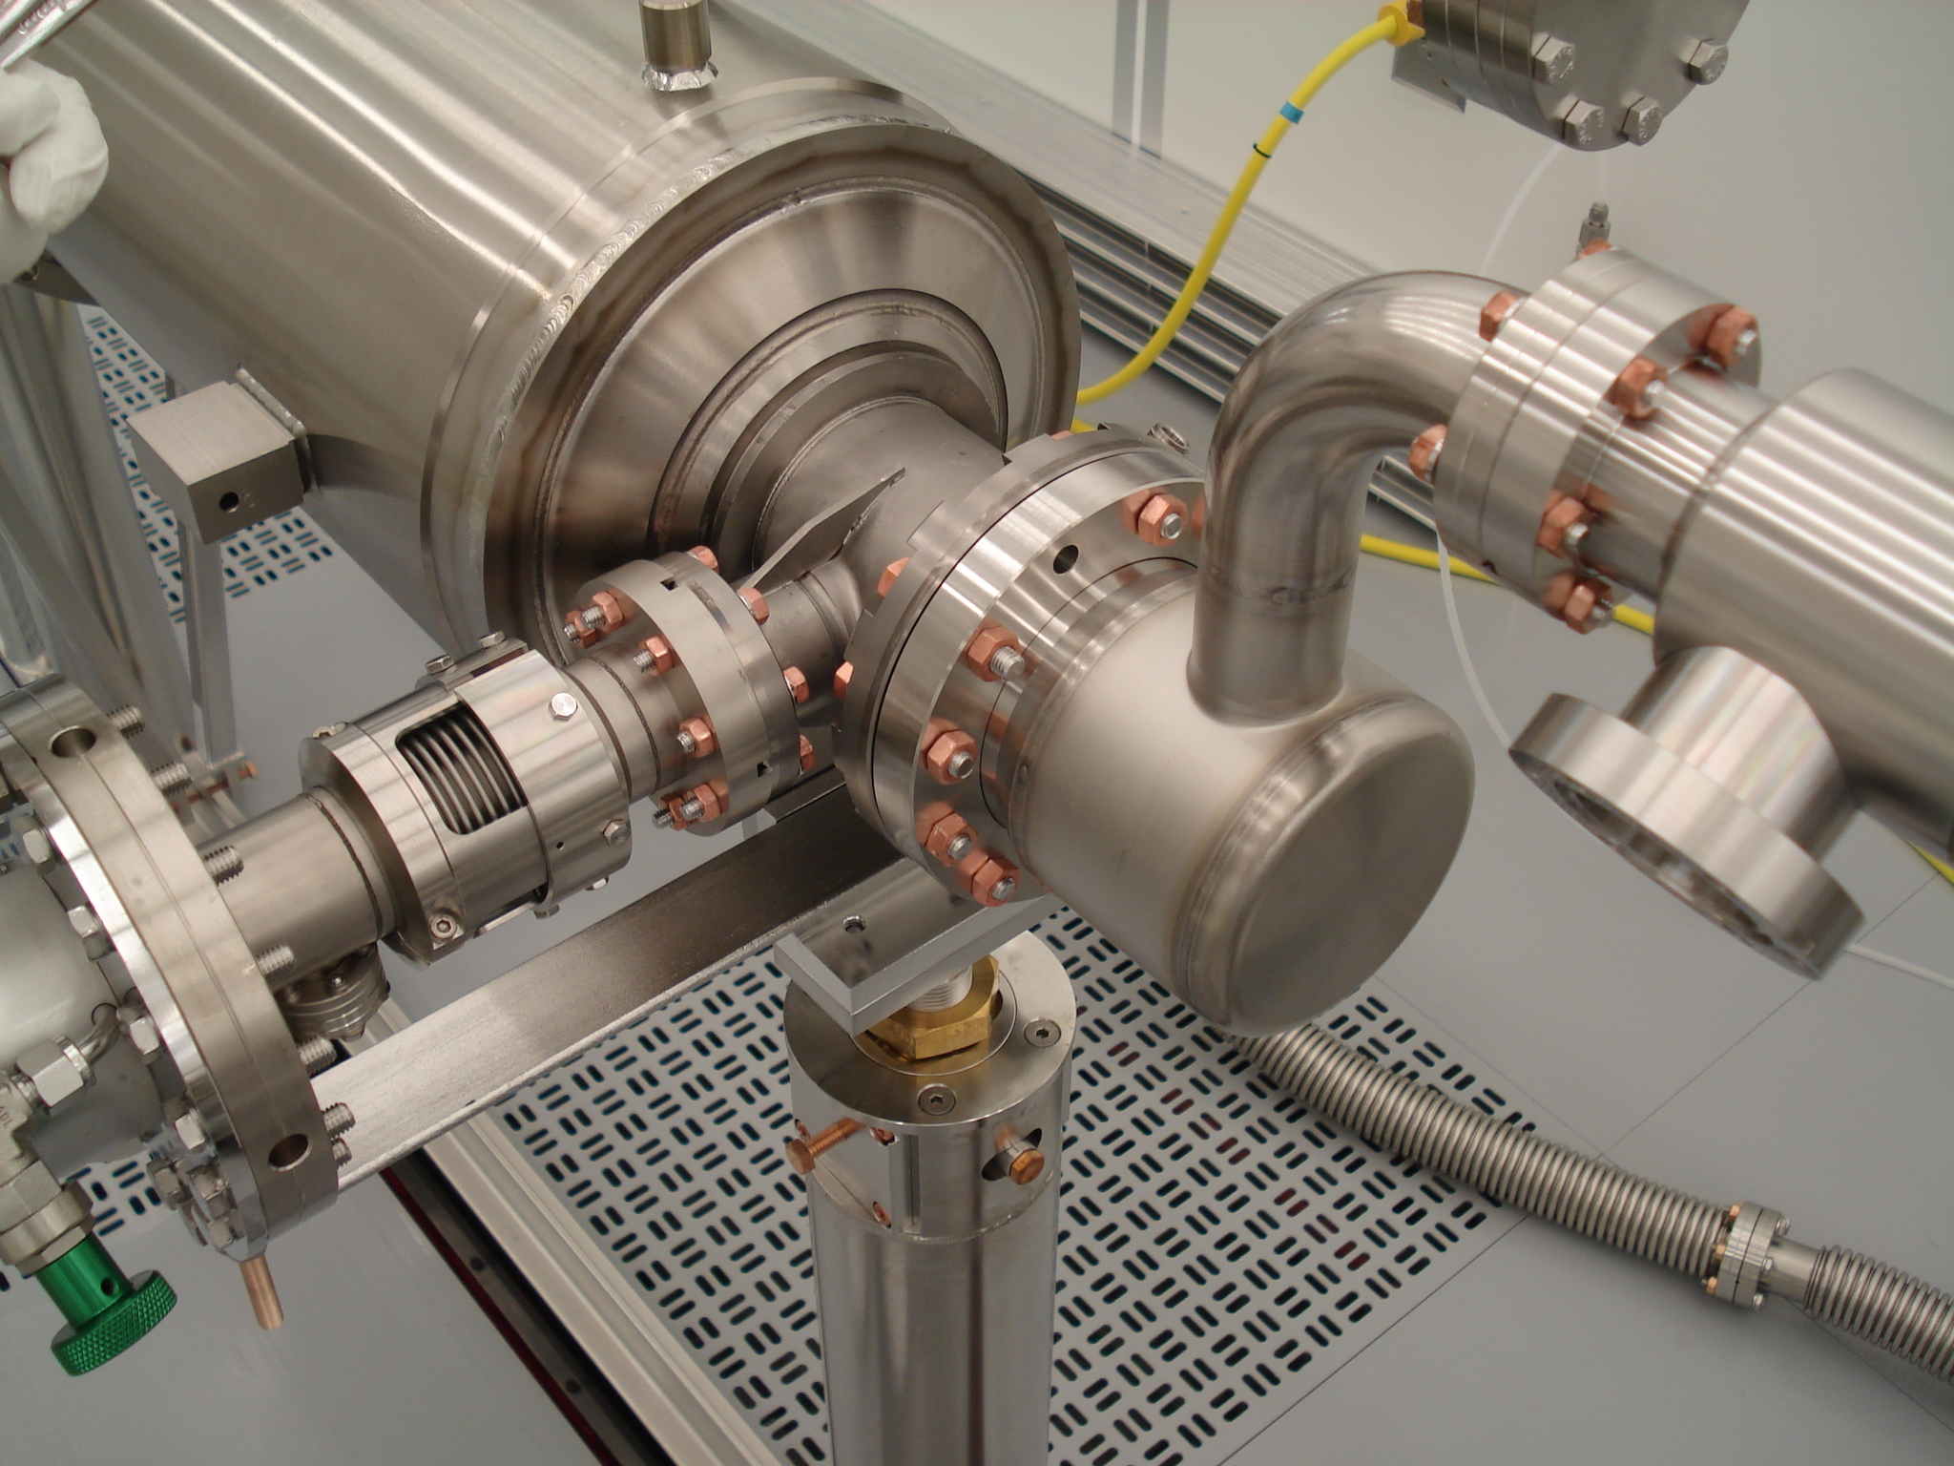
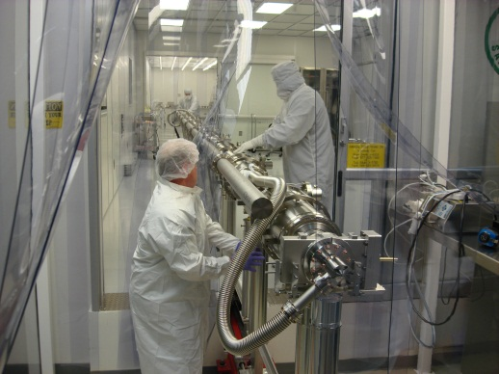
String Assembly Workflow
Receive/Clean peripheral parts/hardware
Receive dressed qualified Cavities
Assemble dressed Cavities to form a String in WS1
HTS tested
with FPC
Yes
No
Assemble cold end of FPC to the dressed cavity in WS0
Leak Check & Backfill
Roll the string out of the cleanroom to WS2

Slide 2
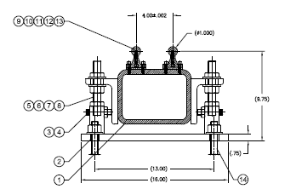
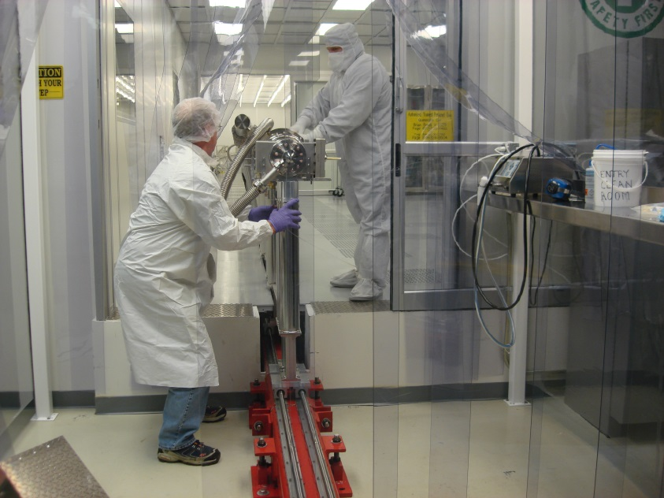
Rail for Cavity String Assembly
Rail length: 3.65 m, 12 rails aligned to each other to 0.1 mm

Slide 3
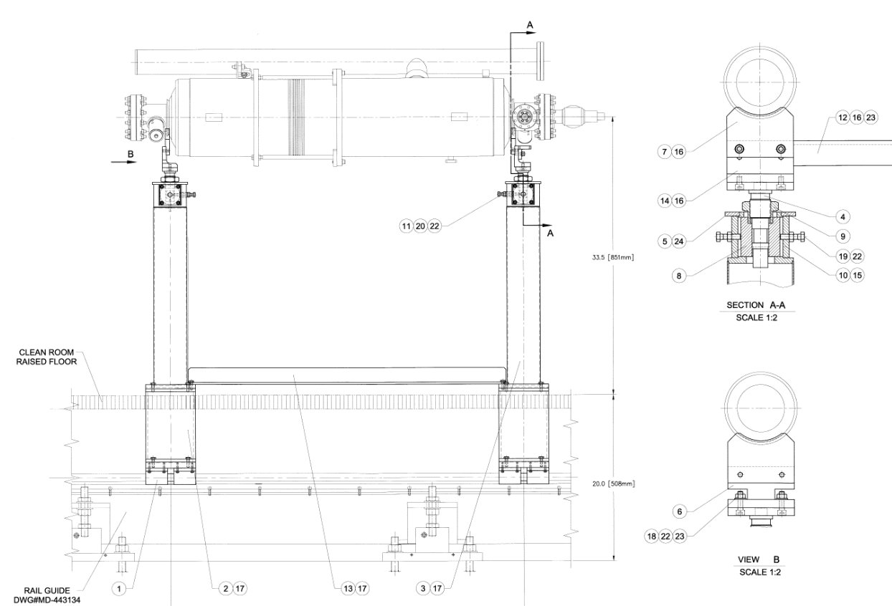
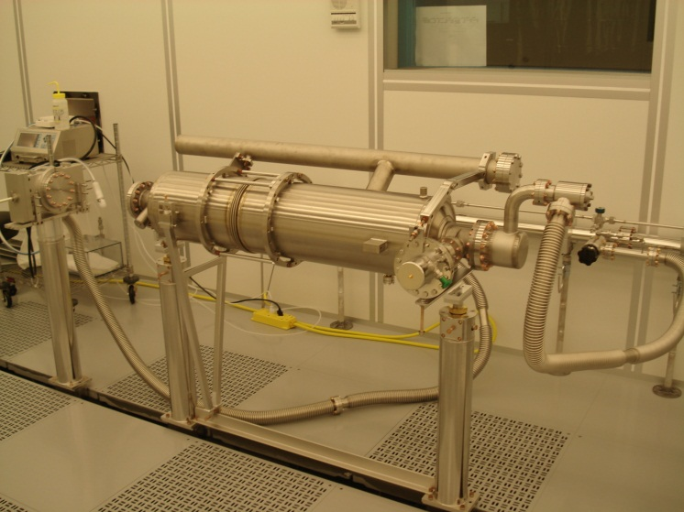
1.3 GHz Cavity Support Posts Fixture
Cavity is supported through the alignment ring on the beampipe flange at the field probe end (modified plate to support the LCLS-II cavity through the tuner split ring)
Cavity is supported through the alignment ring on the beam pipe flange at the coupler end (use as-is for LCLS-II)

Slide 4
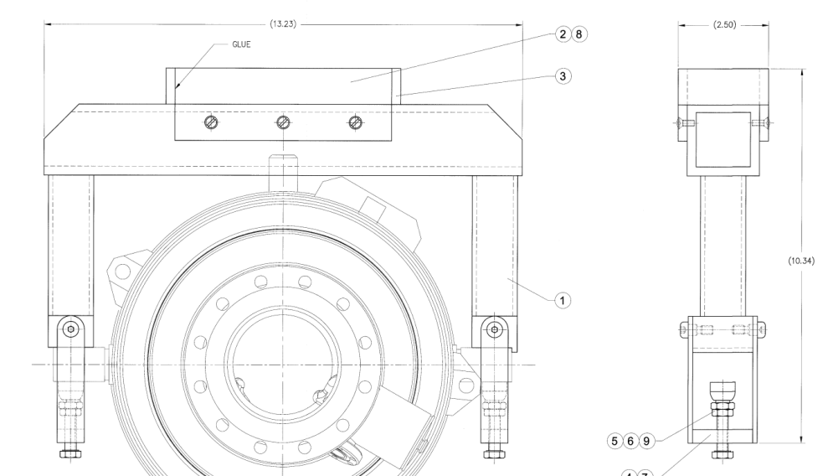
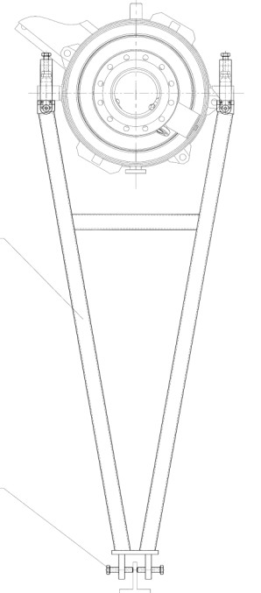
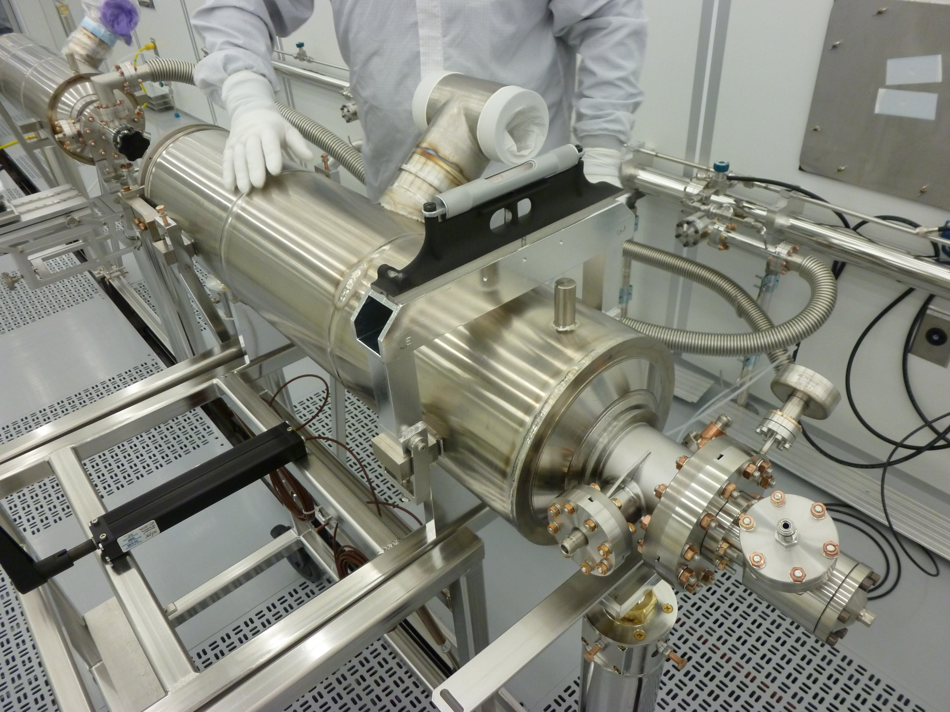
Cavity Alignment in the cleanroom
Rotational Alignment Fixture:
Coupler position: parallel to earth with respect to the cavity helium vessel 4 lugs

Slide 5
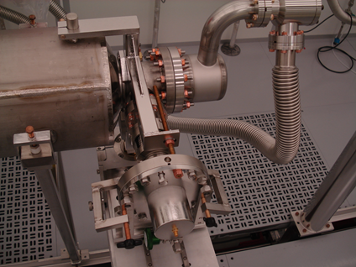
Cold End Coupler Assembly (WS0)
Assemble pump/backfill/purge flex hose to cavity
Leak check, RGA the dressed qualified cavity (received with beamline under vacuum)
Backfill the cavity
Leak check the coupler pair in the processing stand as delivered
Backfill
Remove a cold end coupler from the stand and/or storage manifold
Assemble cold end coupler to the cavity using particle free flange assembly (PFFA) procedures.
Pump down, leak check, RGA

Slide 6
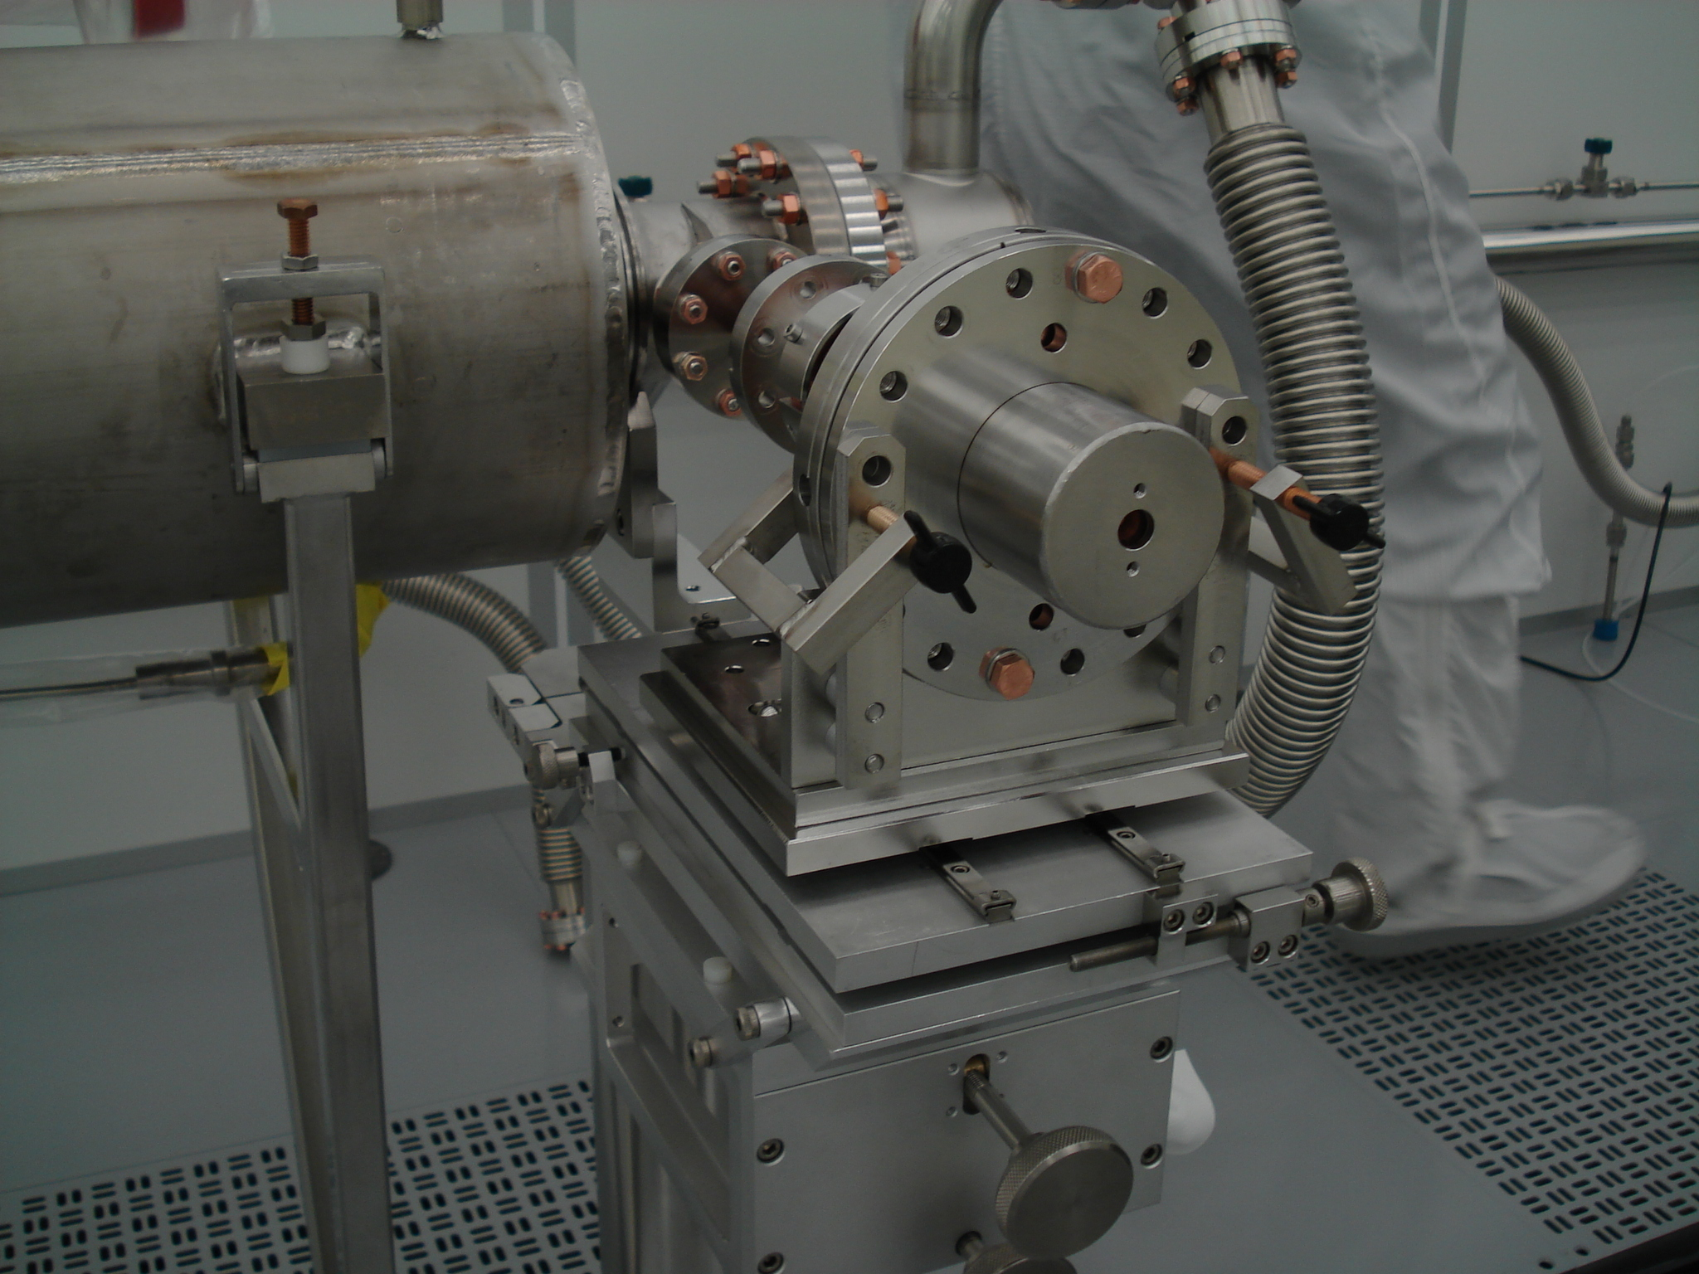
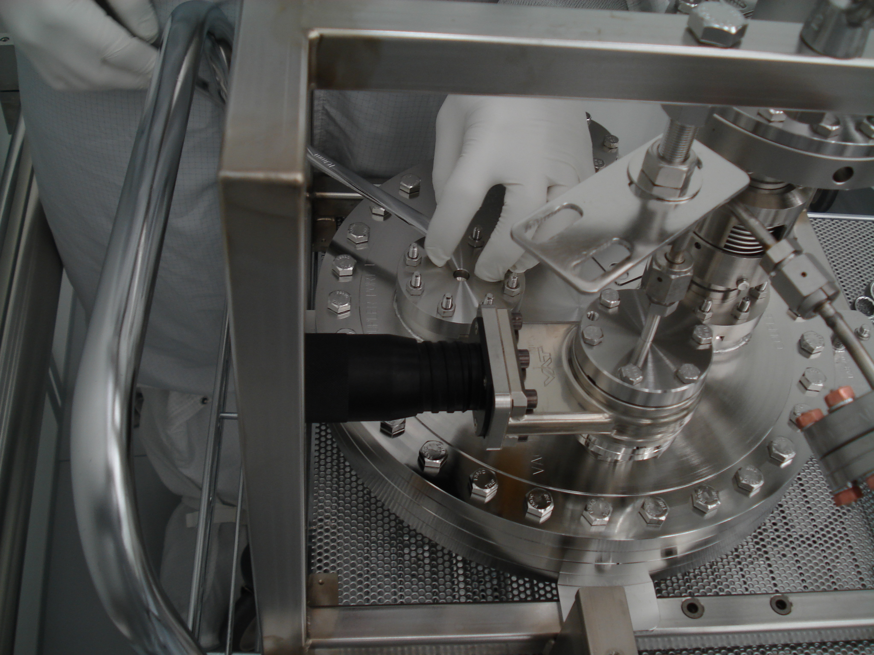
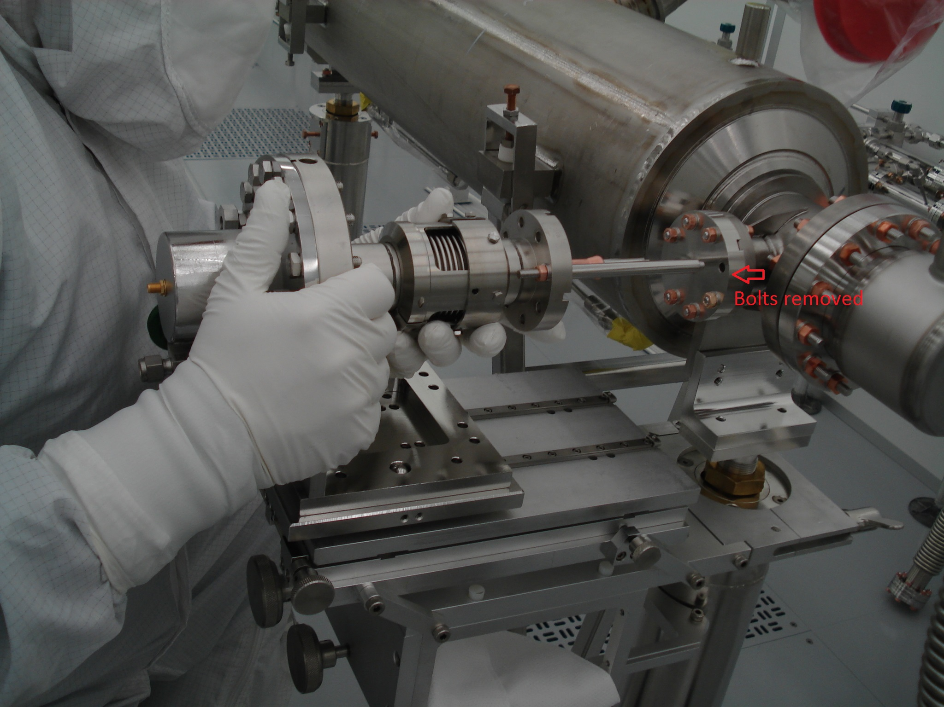
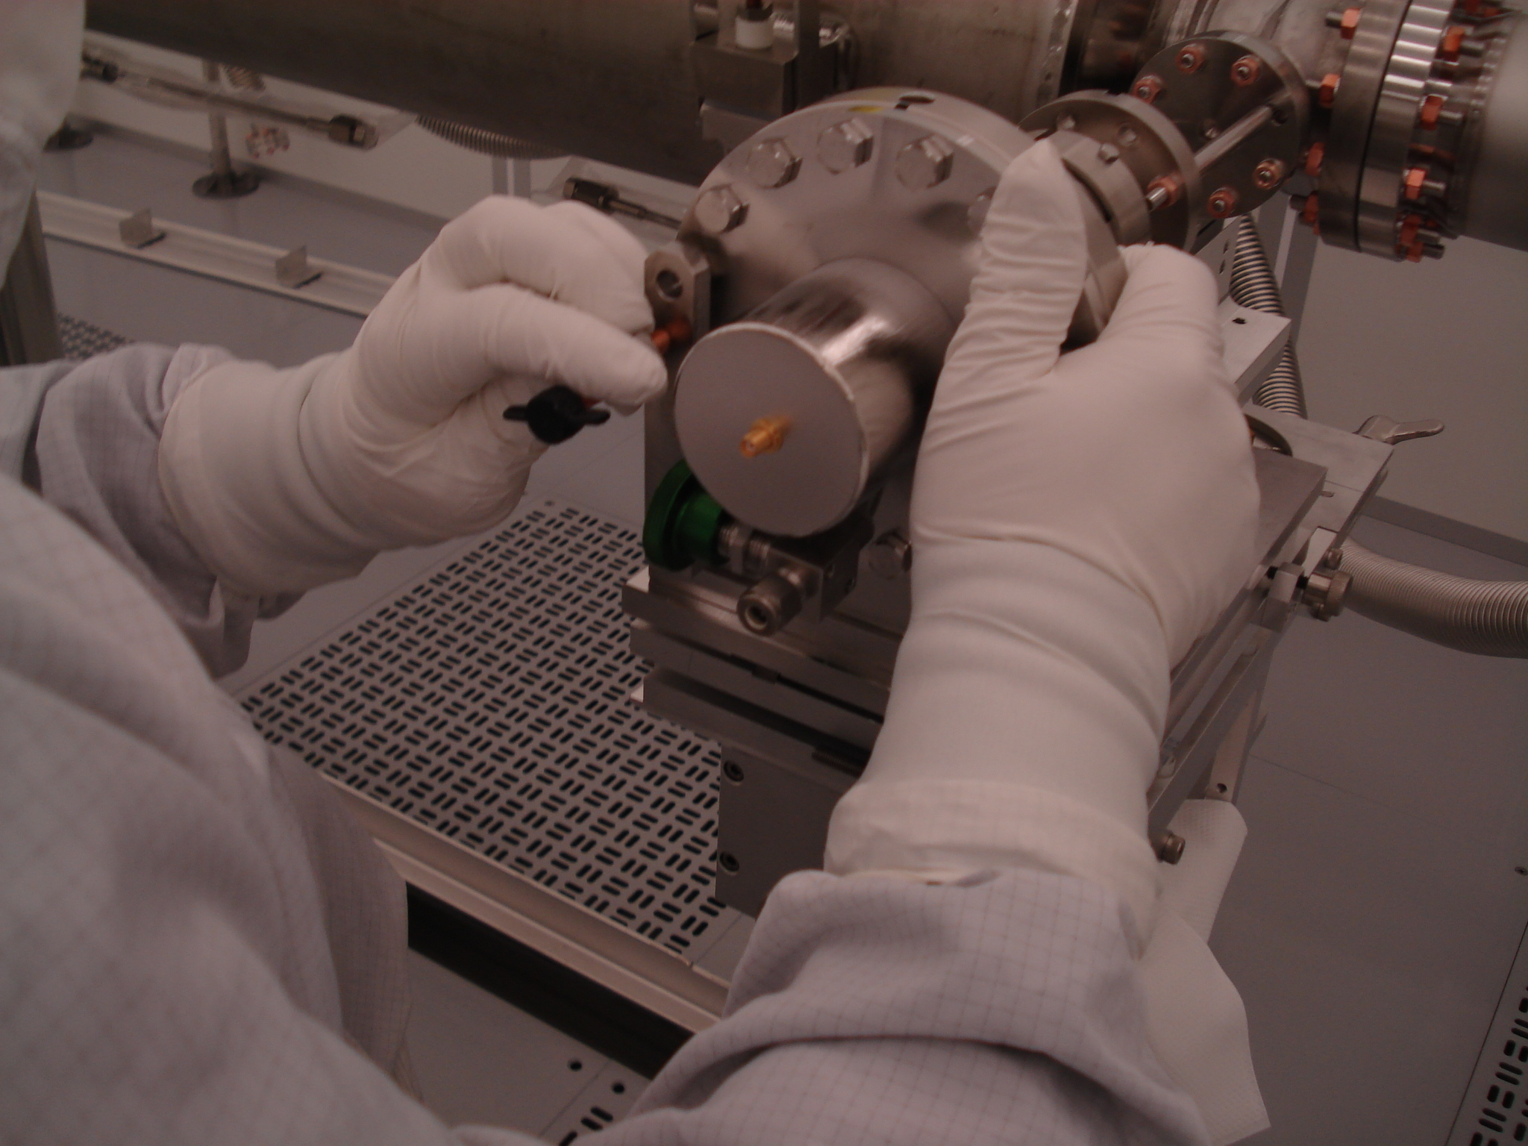
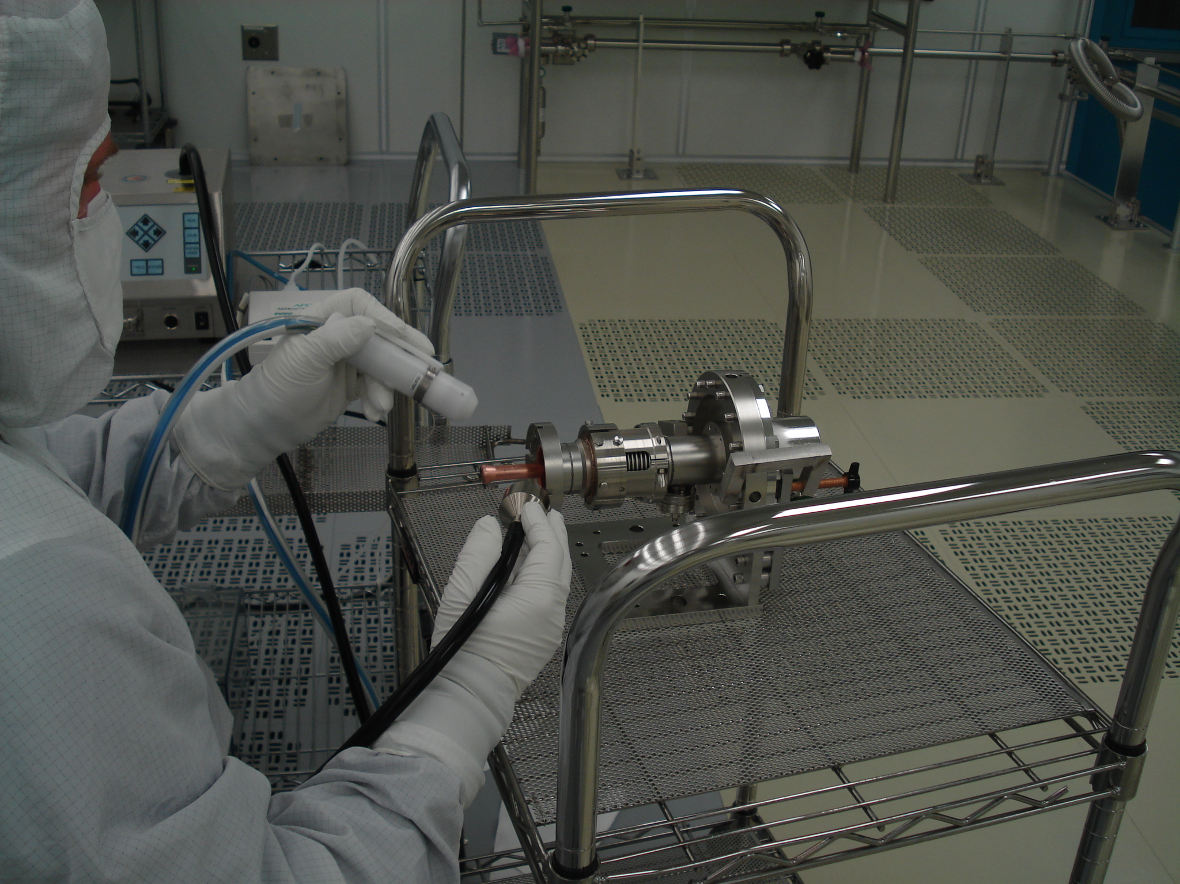
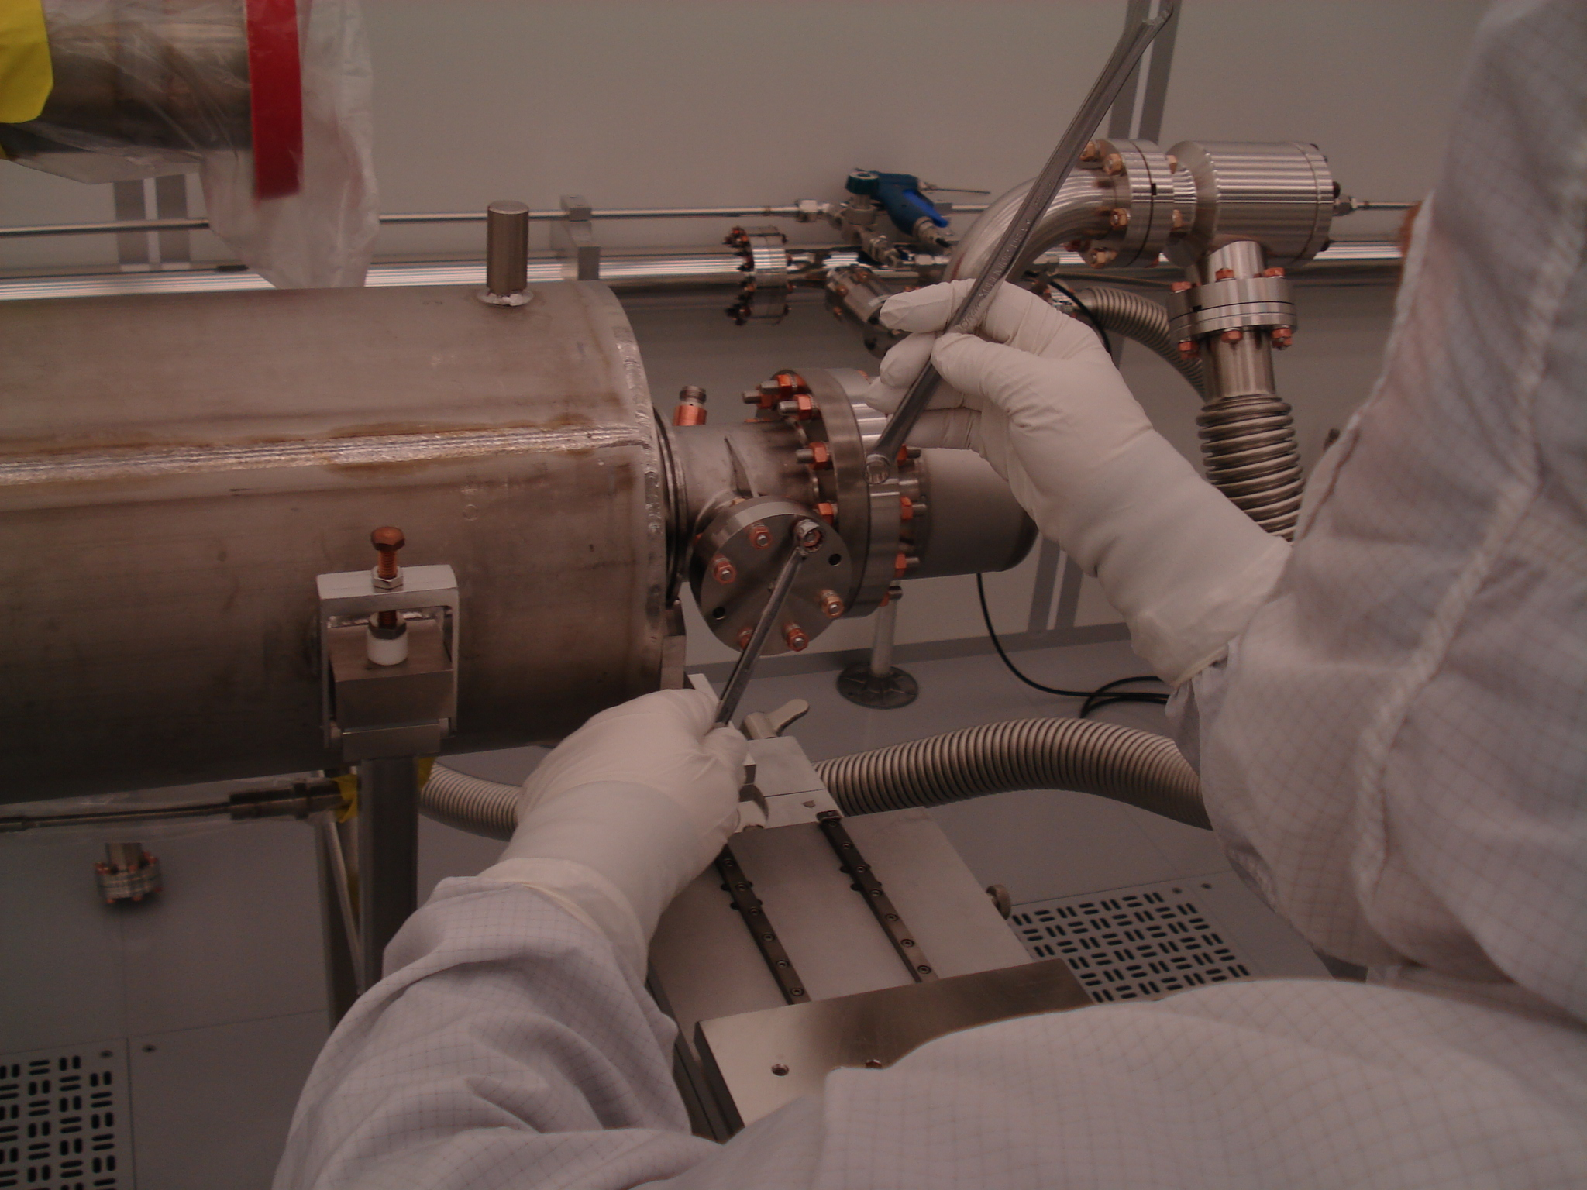
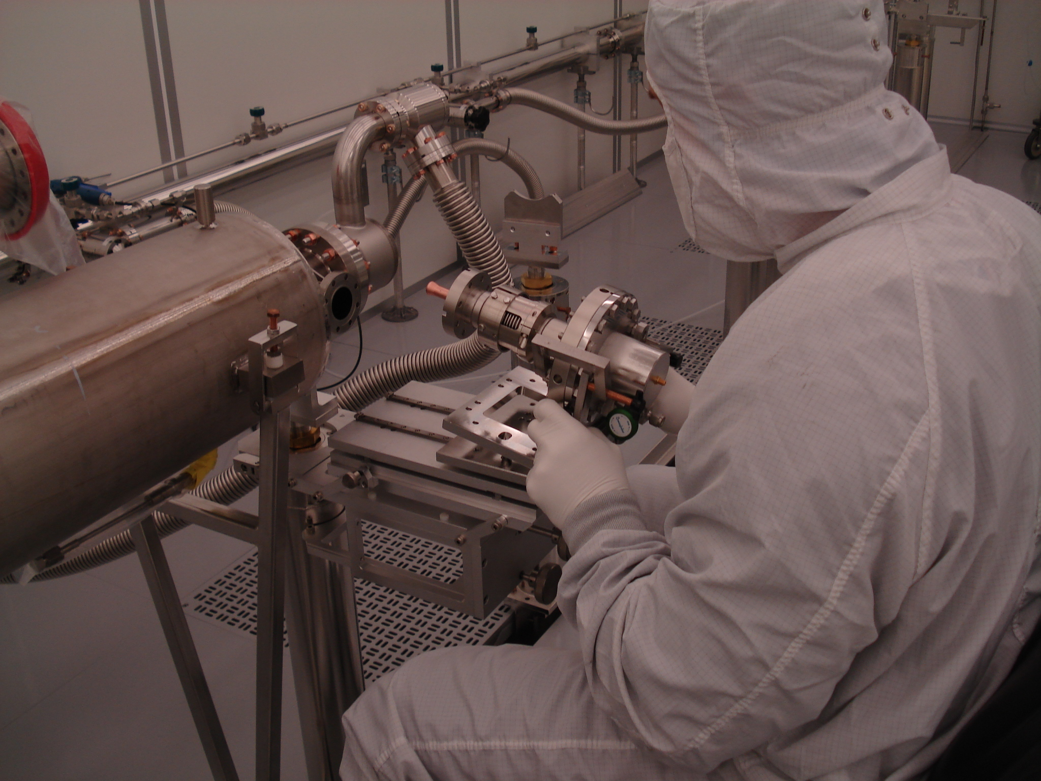
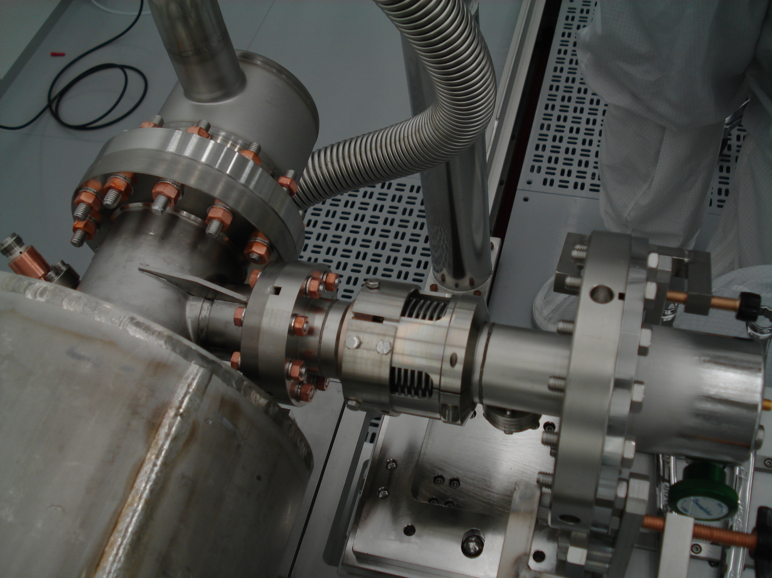
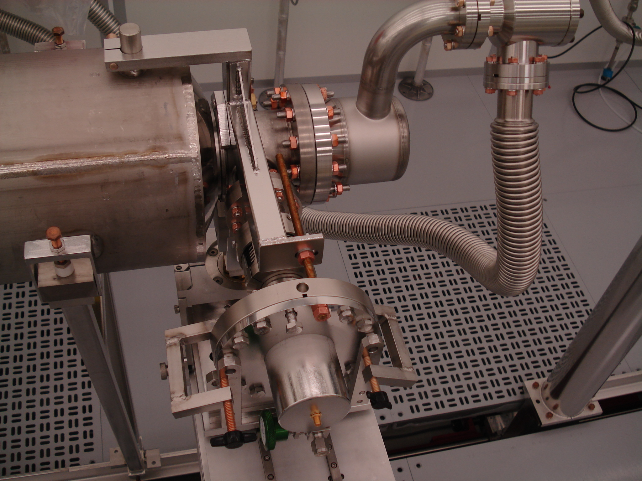
pCM at WS0

Slide 7
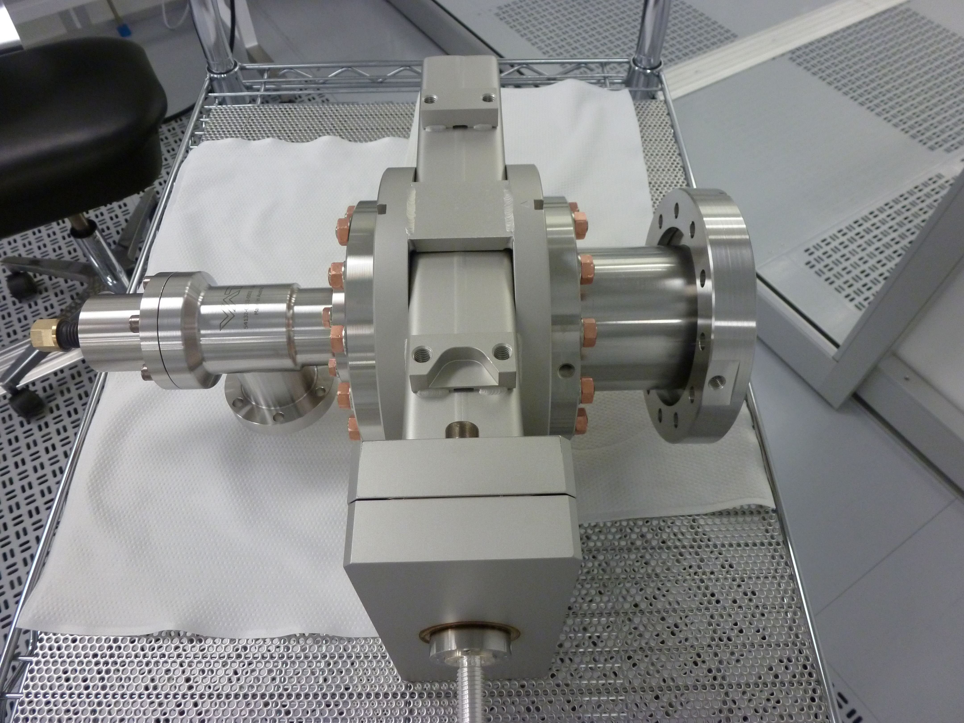
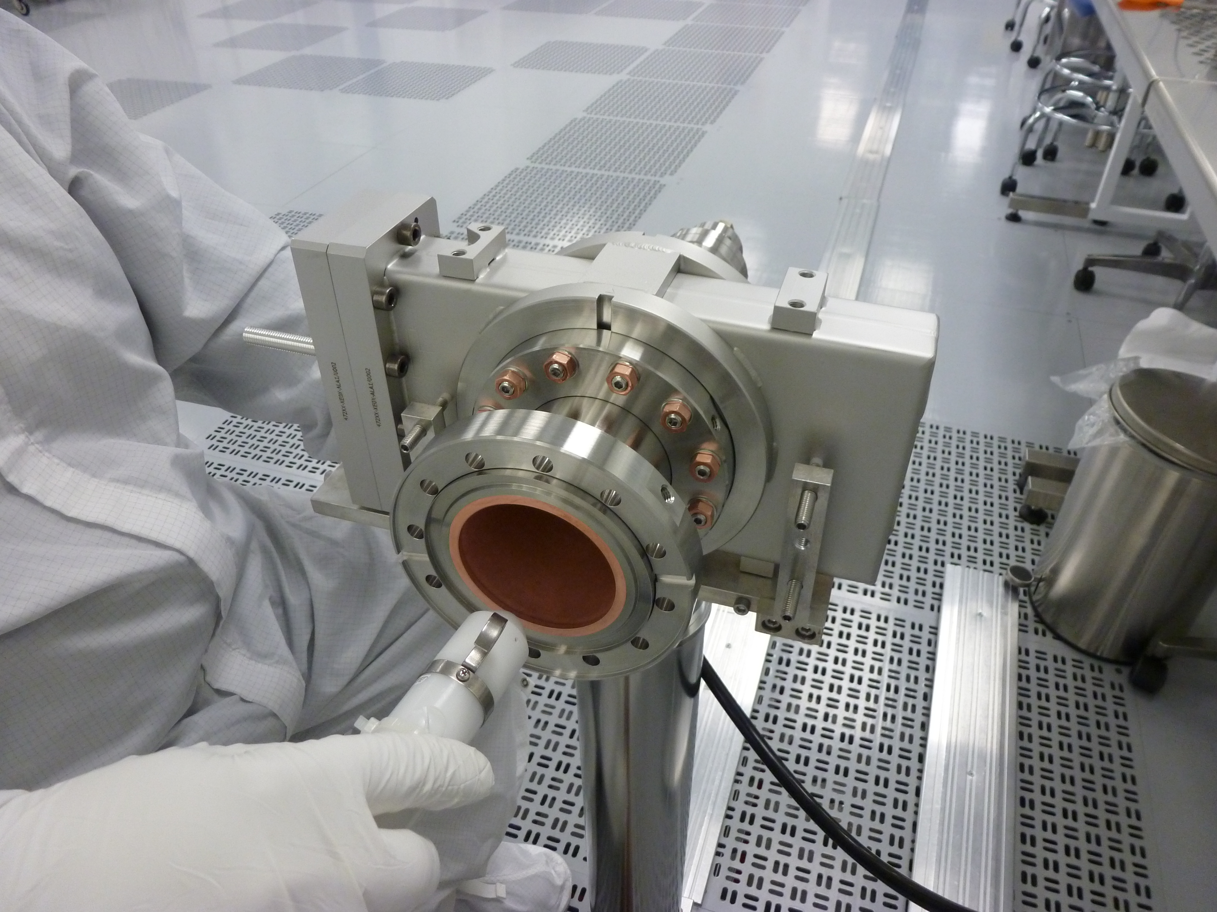
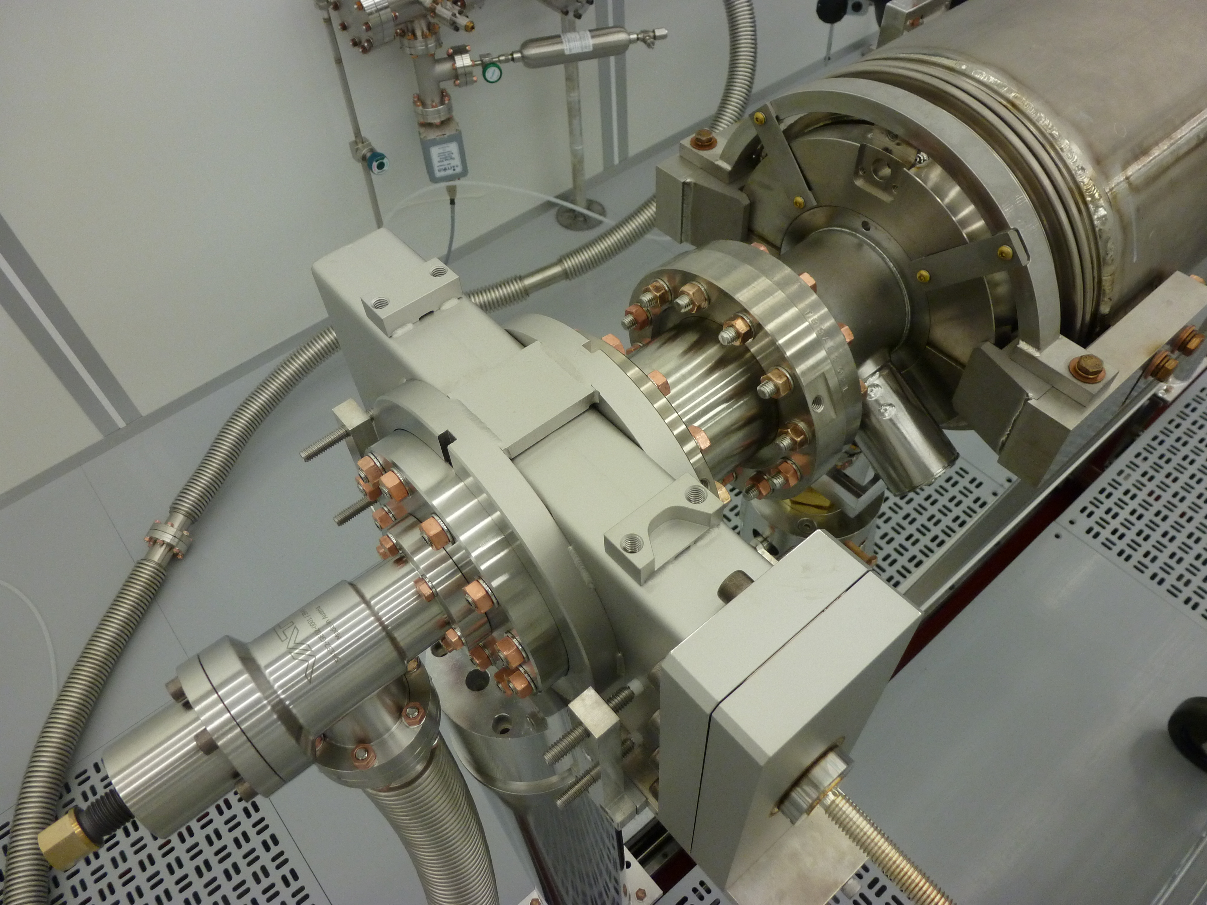
String Assembly-I (WS1)
Align 8 cavities for string assembly
Gate Valve (GV1) to Cavity #1 Assembly:
  Check the particle free cleanliness of the GV and clean as needed
  Sub-assembly of the GV peripherals
  Installation to the cleanroom post and flex hose assembly
  Alignment to the cavity beam line flange
  Assemble the gate valve to the cavity

Slide 8
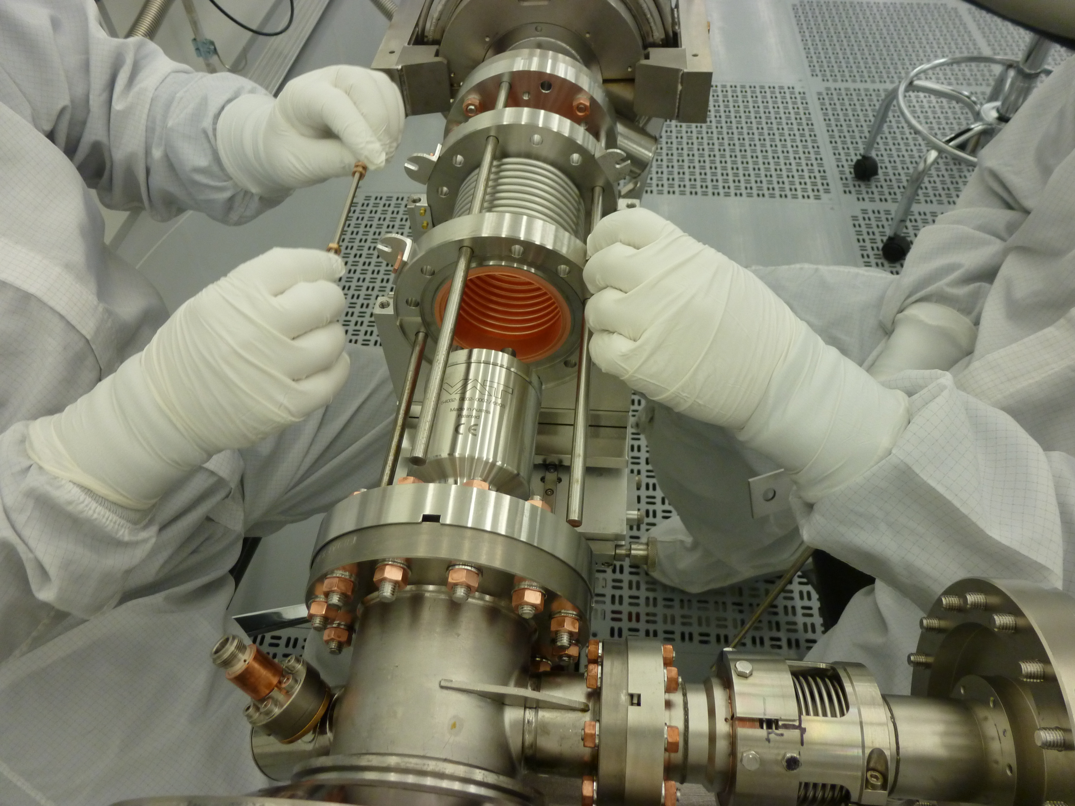
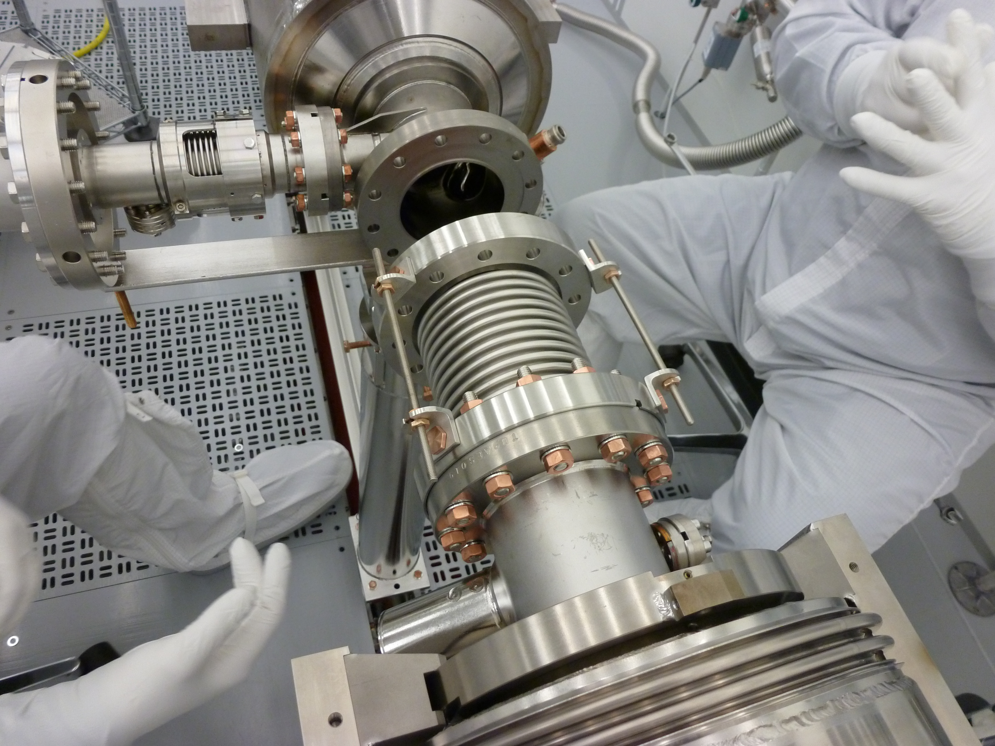
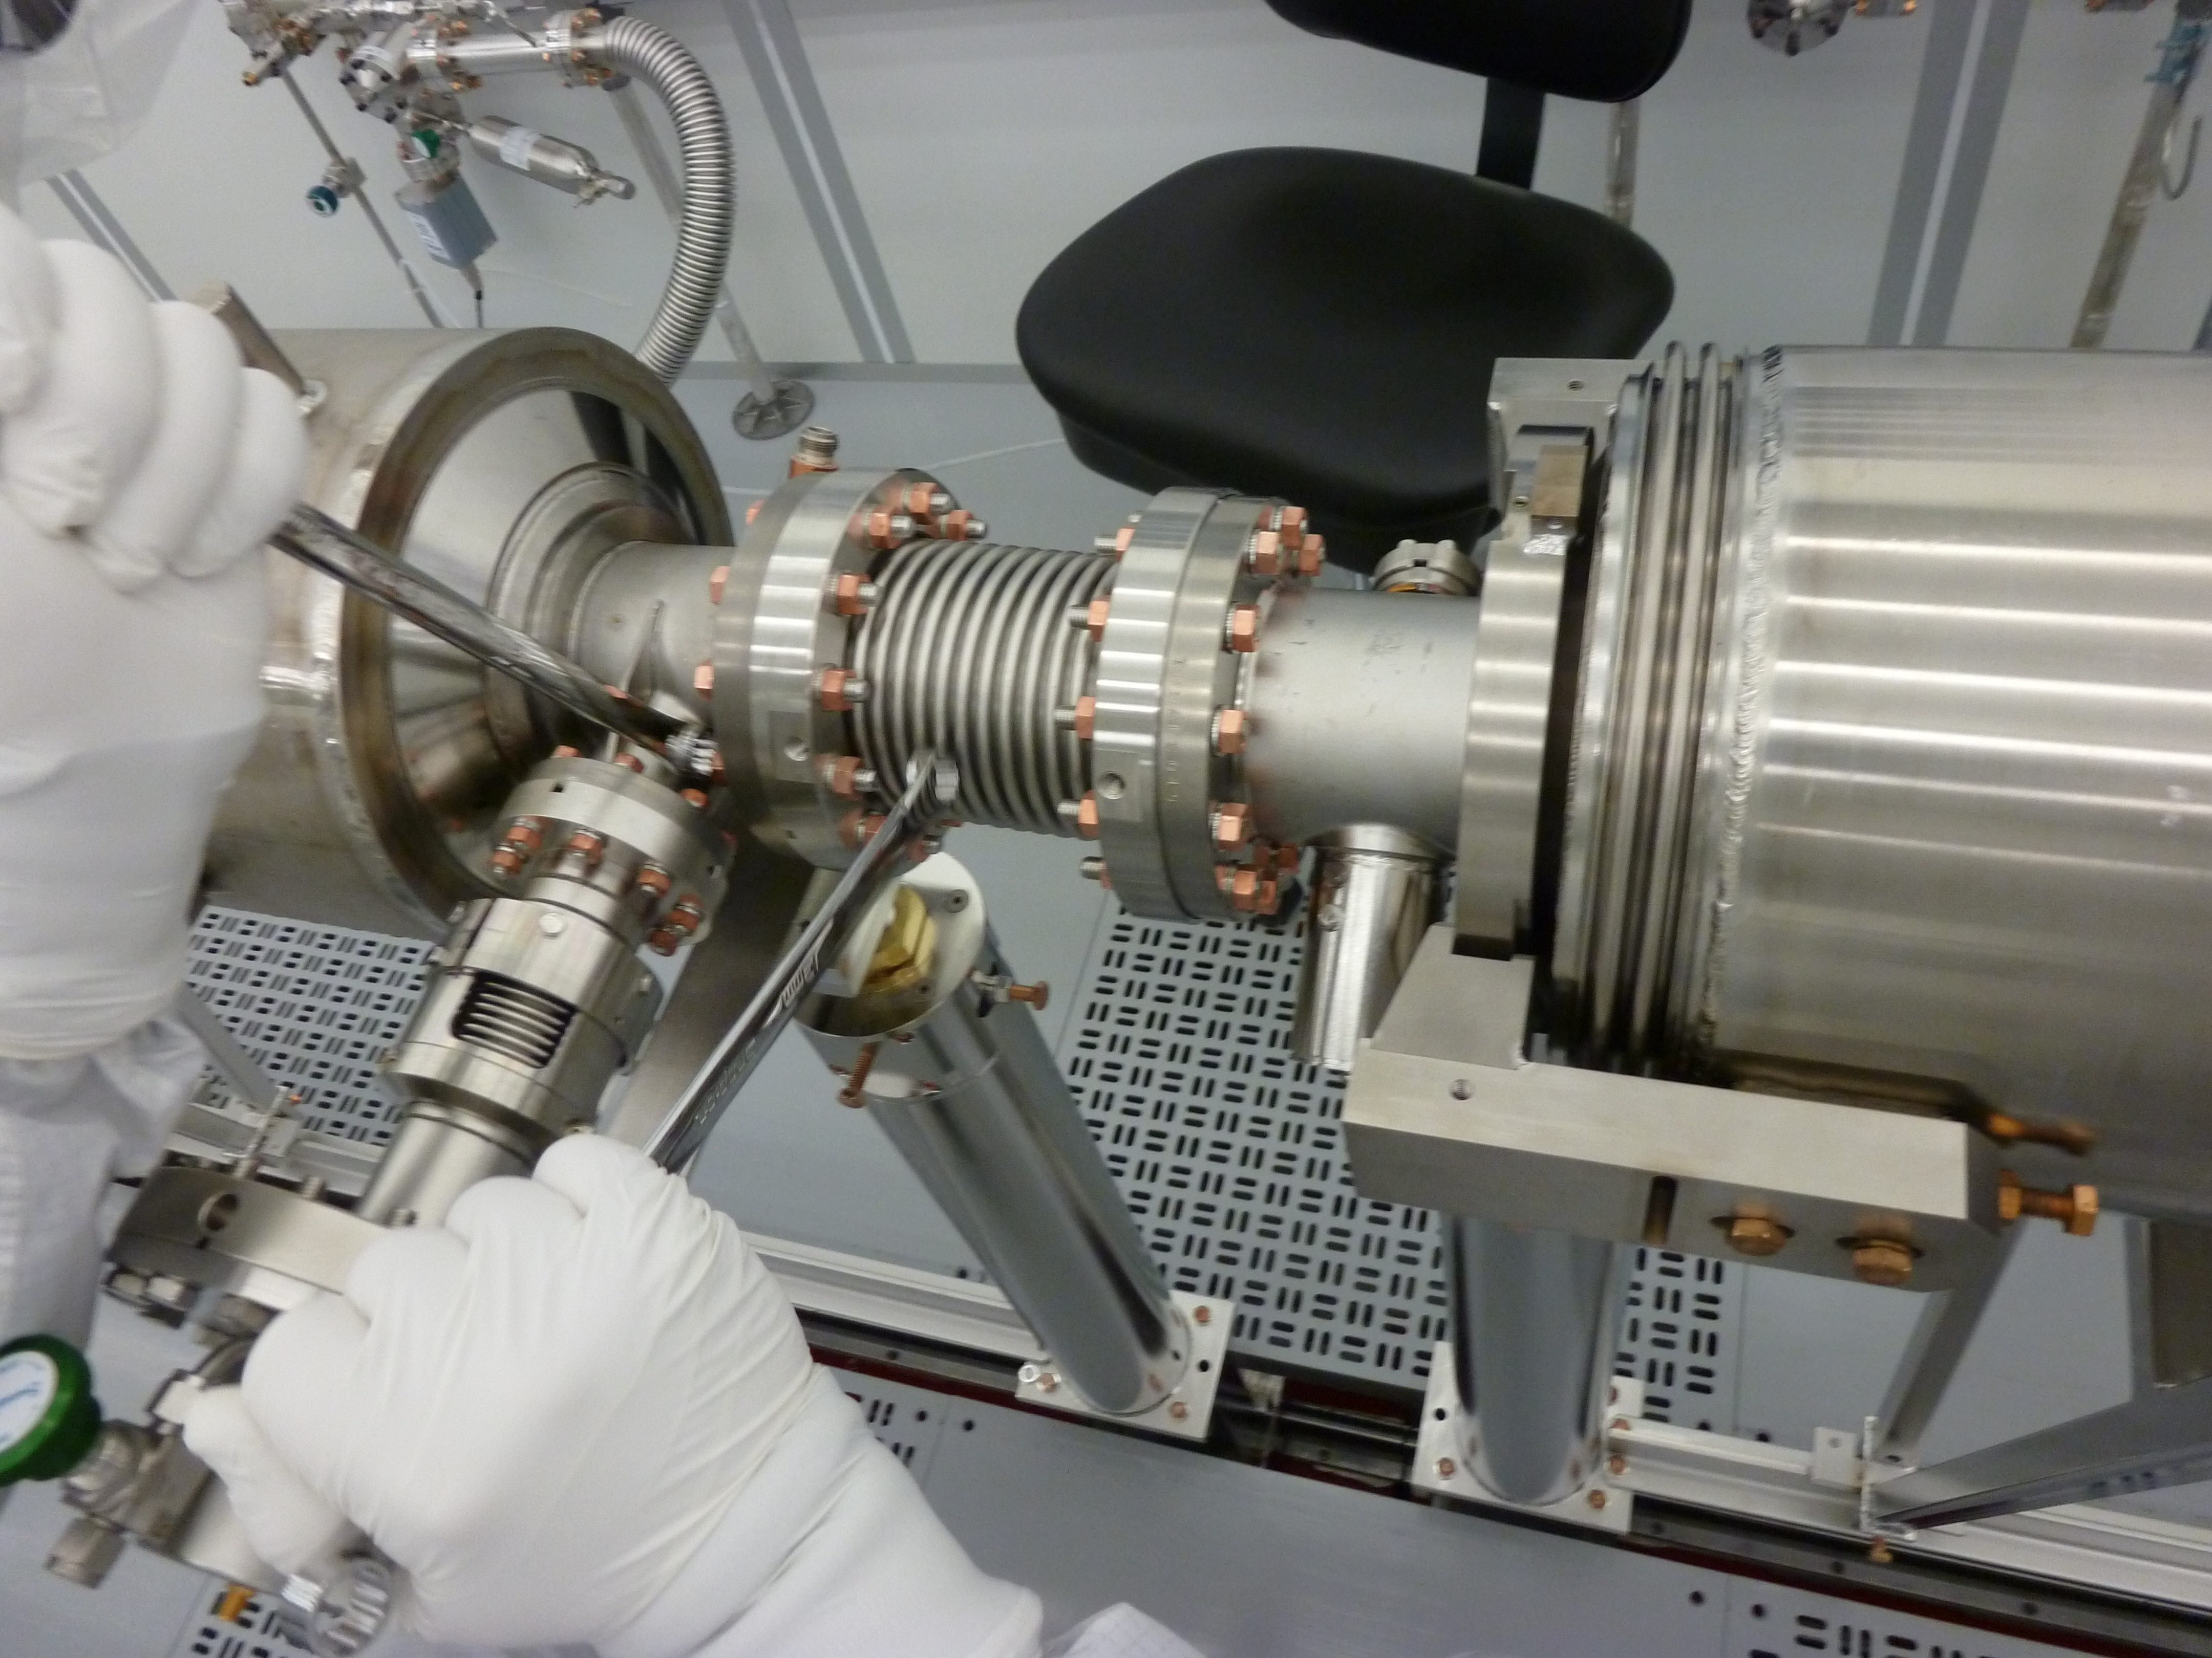
String Assembly-II (WS1)
Cavity to Cavity Assembly with the interconnect bellows:
  Assemble flex hose to the cavity Pump down and Leak check
  Backfill
  Align the interconnect bellows to the cavity field probe end beampipe flange
  Assemble with PFFA
  Align the bellows to the cavity coupler end beampipe flange
  Assemble with PFFA

Slide 9
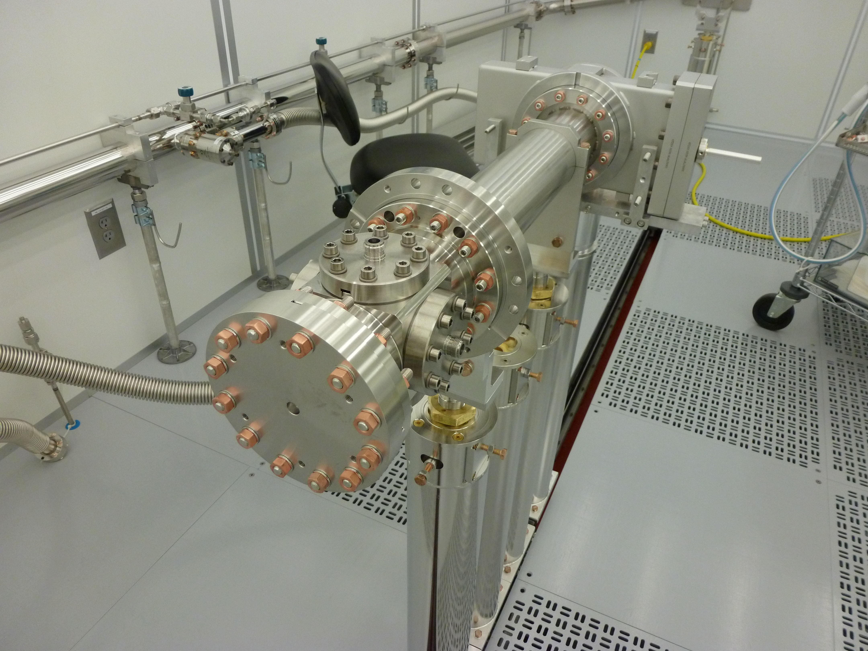
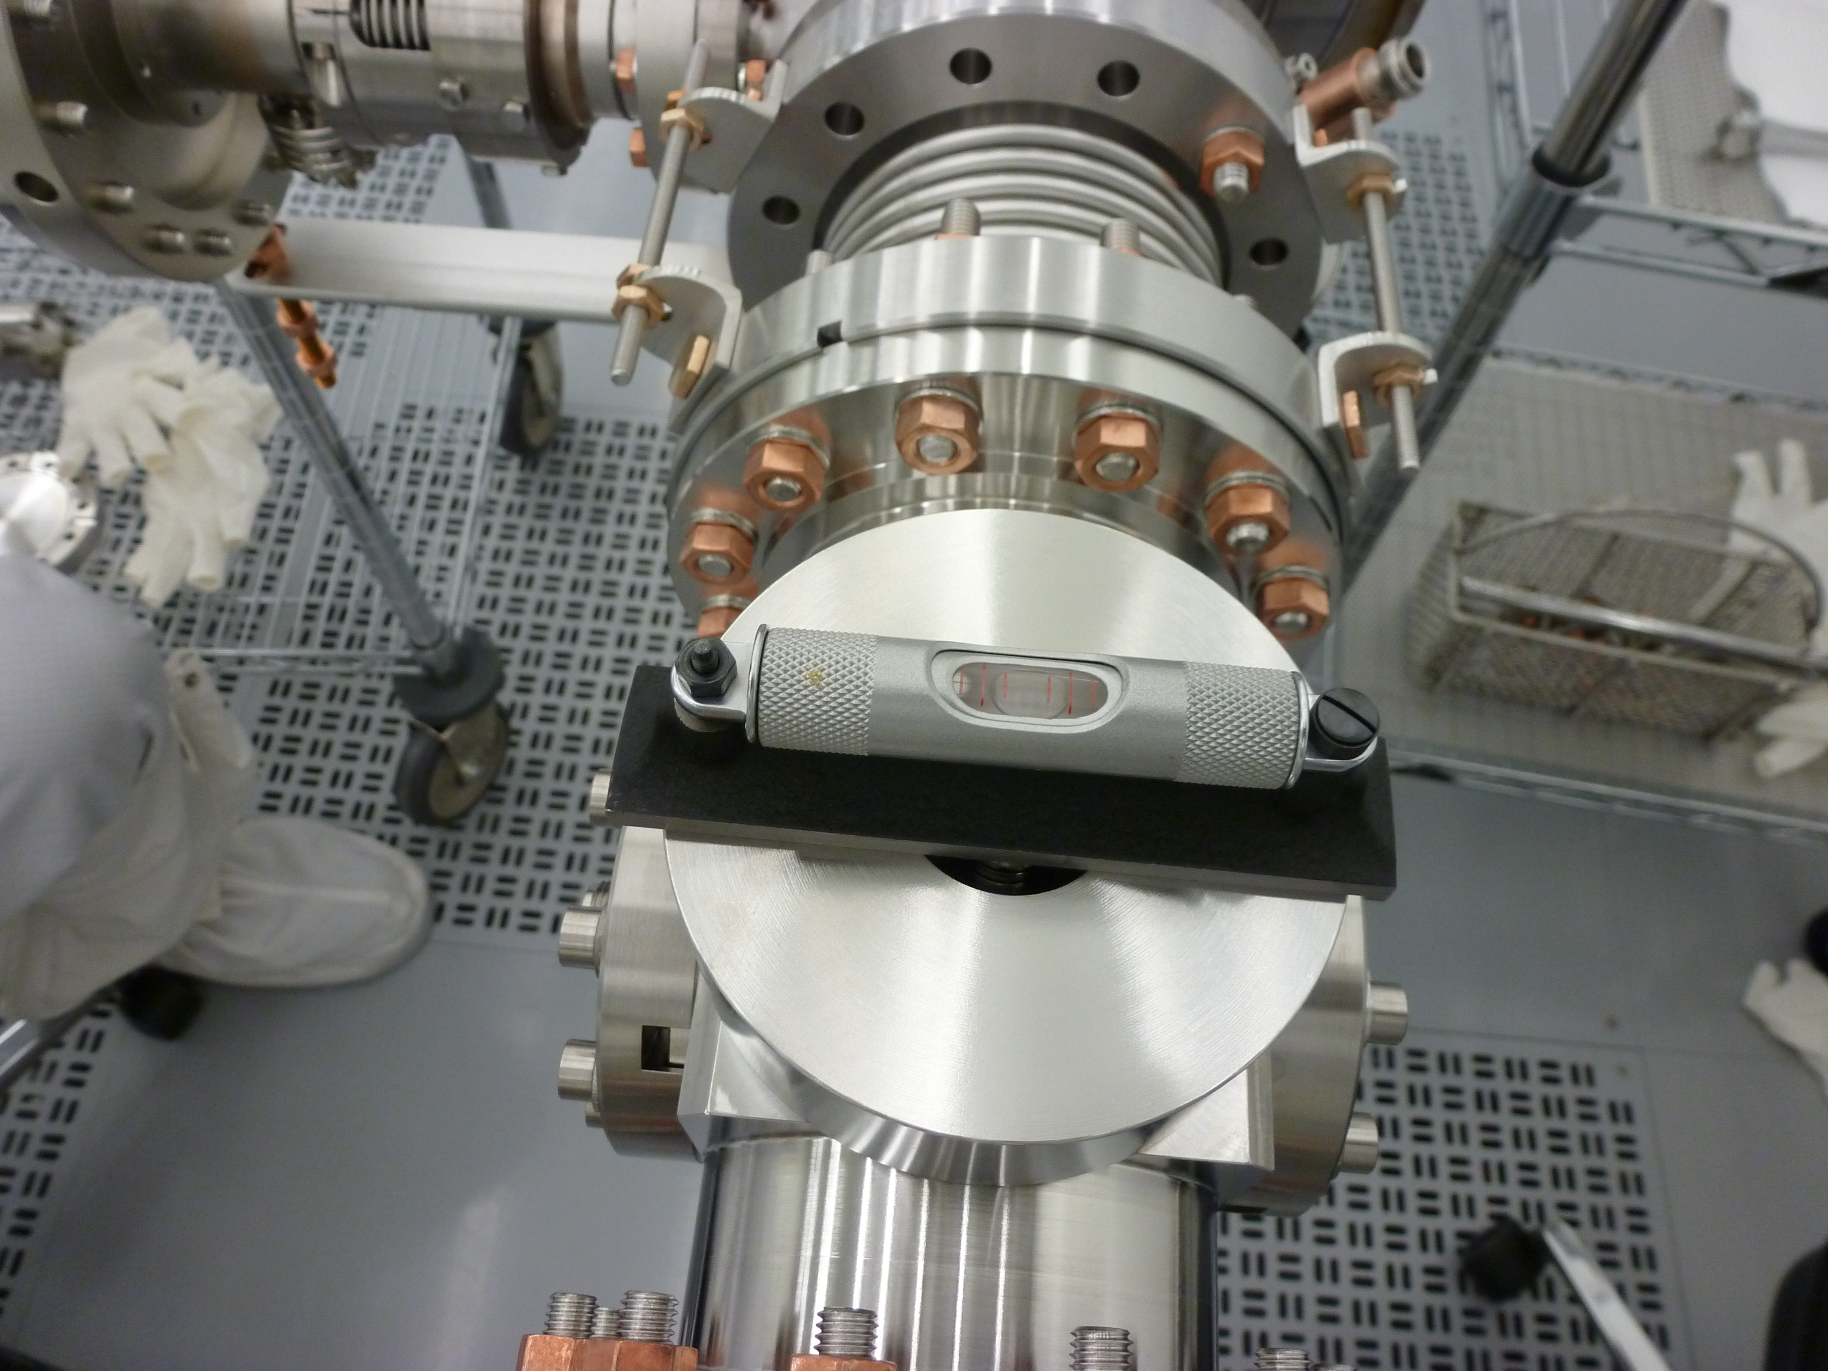
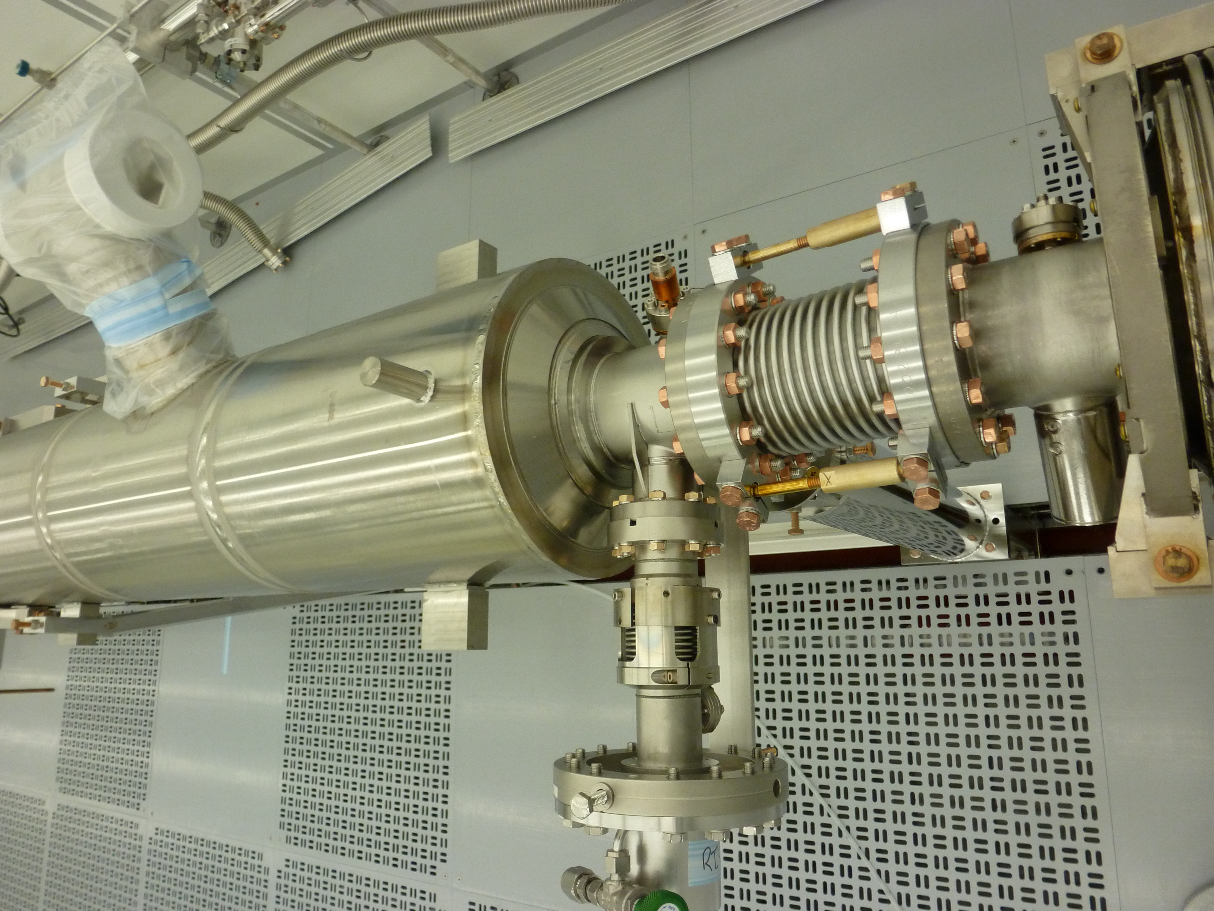
String Assembly-III (WS1)
BPM+Magnet Spool Tube+GV2 assembly and leak check
BPM/Magnet package subassembly to the 8 cavities string
Pump down the fully assembled cavity string, bag the bellows, leak check. Backfill
Roll out of the cleanroom to WS2

