Slide 1
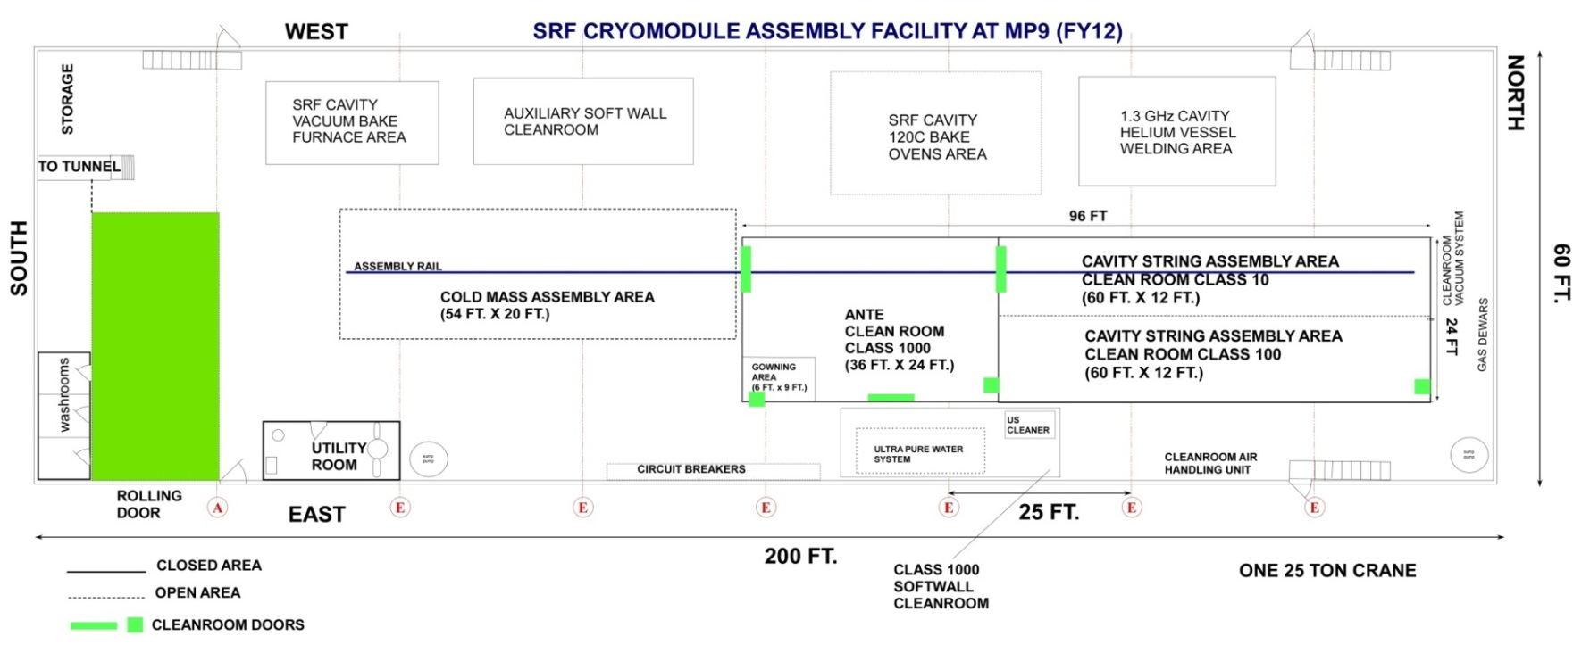
CAF-MP9 during LCLS-II Production
WS2
WS1
WS0

Slide 2
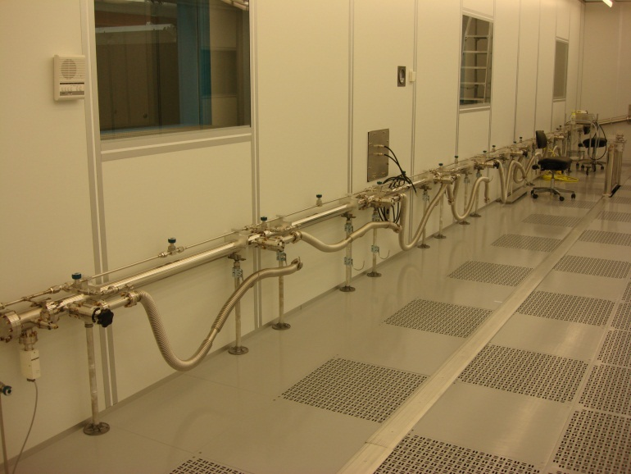
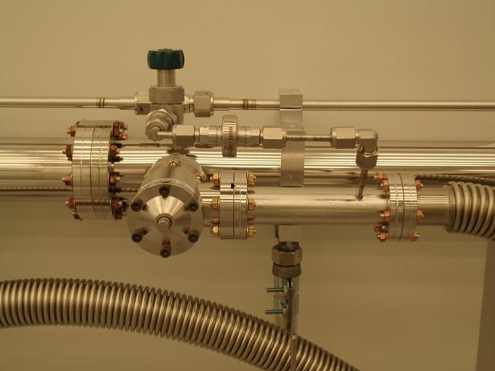
Vacuum / Purge / Backfill Manifold
3 inches diameter 304 electro-polished SS vacuum header
1/2 inches diameter 304 electro-polished SS backfill/purge line which also goes under the raised floor
8 pump/purge points to assemble 8 cavities string + magnet/BPM package with LN2 boiled-off gas cross flow during assembly (1 liter/min)
Vacuum gauge and calibrated leak
Nitrogen in-line and point of use filters: Mott Defender series sintered all metal (0.03 micron)

Slide 3
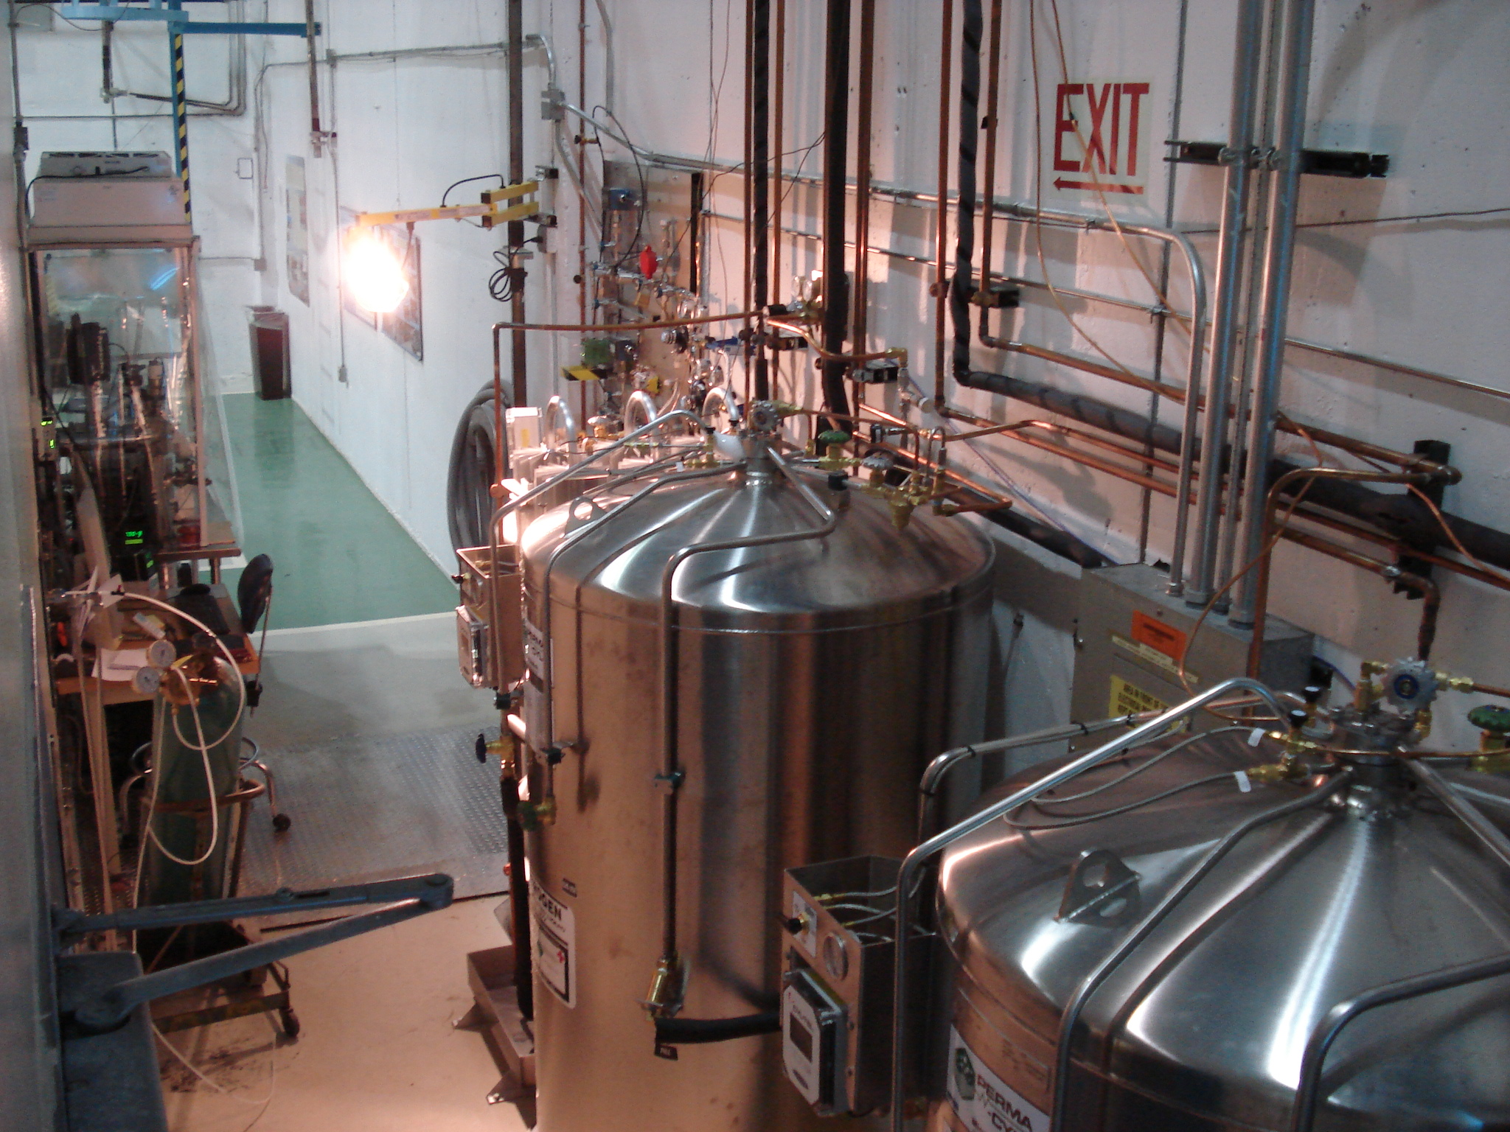
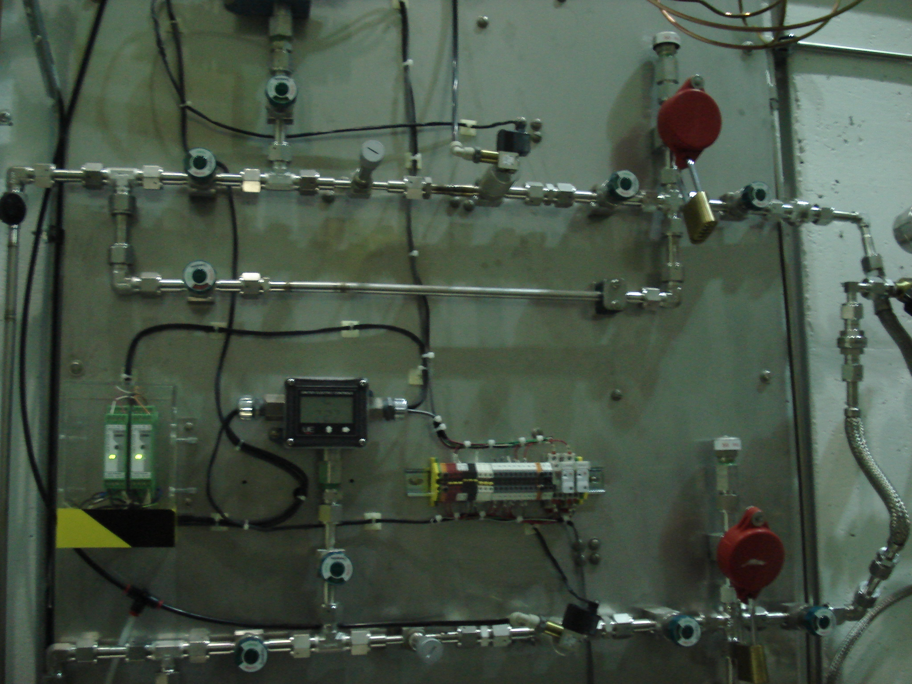
Boiled-off Gas Dewars and Manifold
Upgraded dewars for the anticipated LCLS-II throughput:
300 liters LN2 dewar for cavity backfill and purge
1000 liters LN2 dewar with volumizer for Class 10 WS1 and Sluice area blow guns
1000 liters LN2 dewar with volumizer for Class 10/100 WS0 and UHV cleaning area blow guns
Gas manifold for the cavity backfill and purge operations:
Filter, relief valve, solenoid valve, needle valve, pressure transducer
Set values: Backfill the cavity beamline to 1050 mbar abs pressure with 1 liter / minute flow rate. Purge will start immediately when the pressure transducer senses less than 50 mbar gauge and will stop when it reaches to 50 mbar gauge slightly above atmospheric pressure.

Slide 4
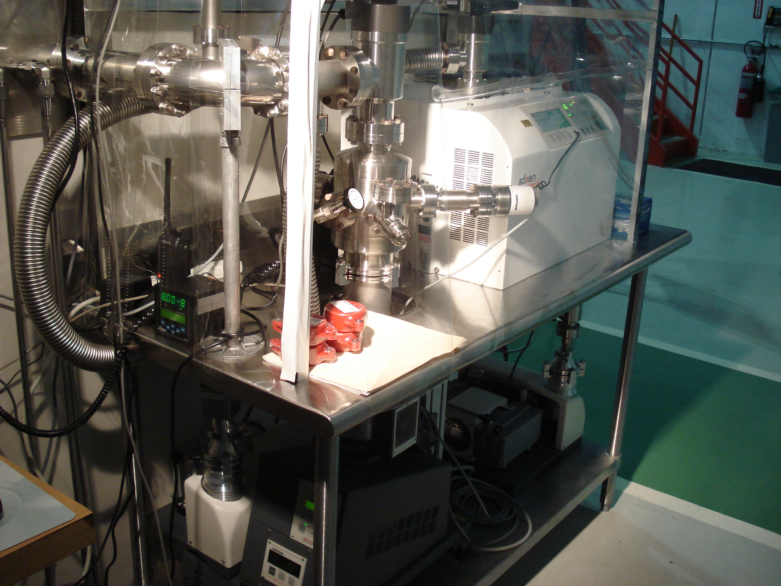
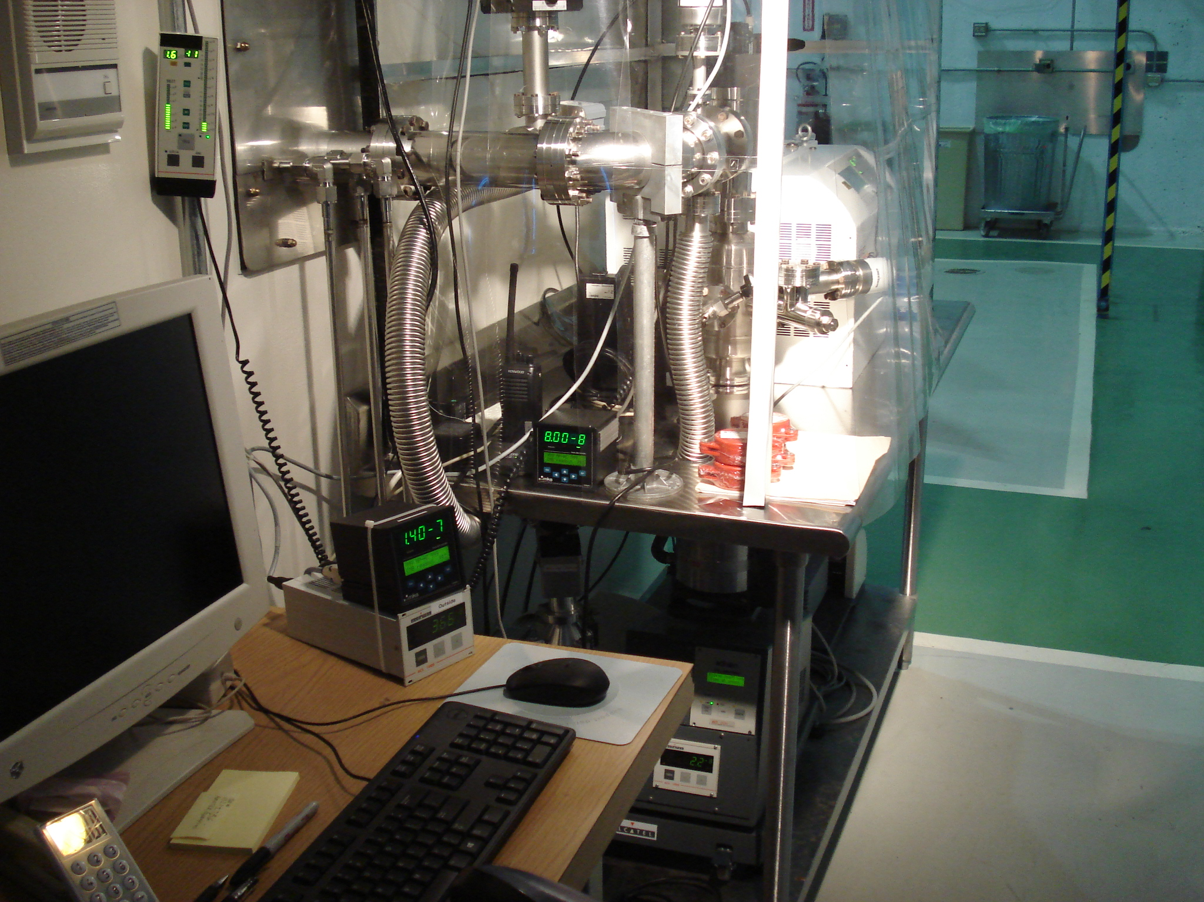
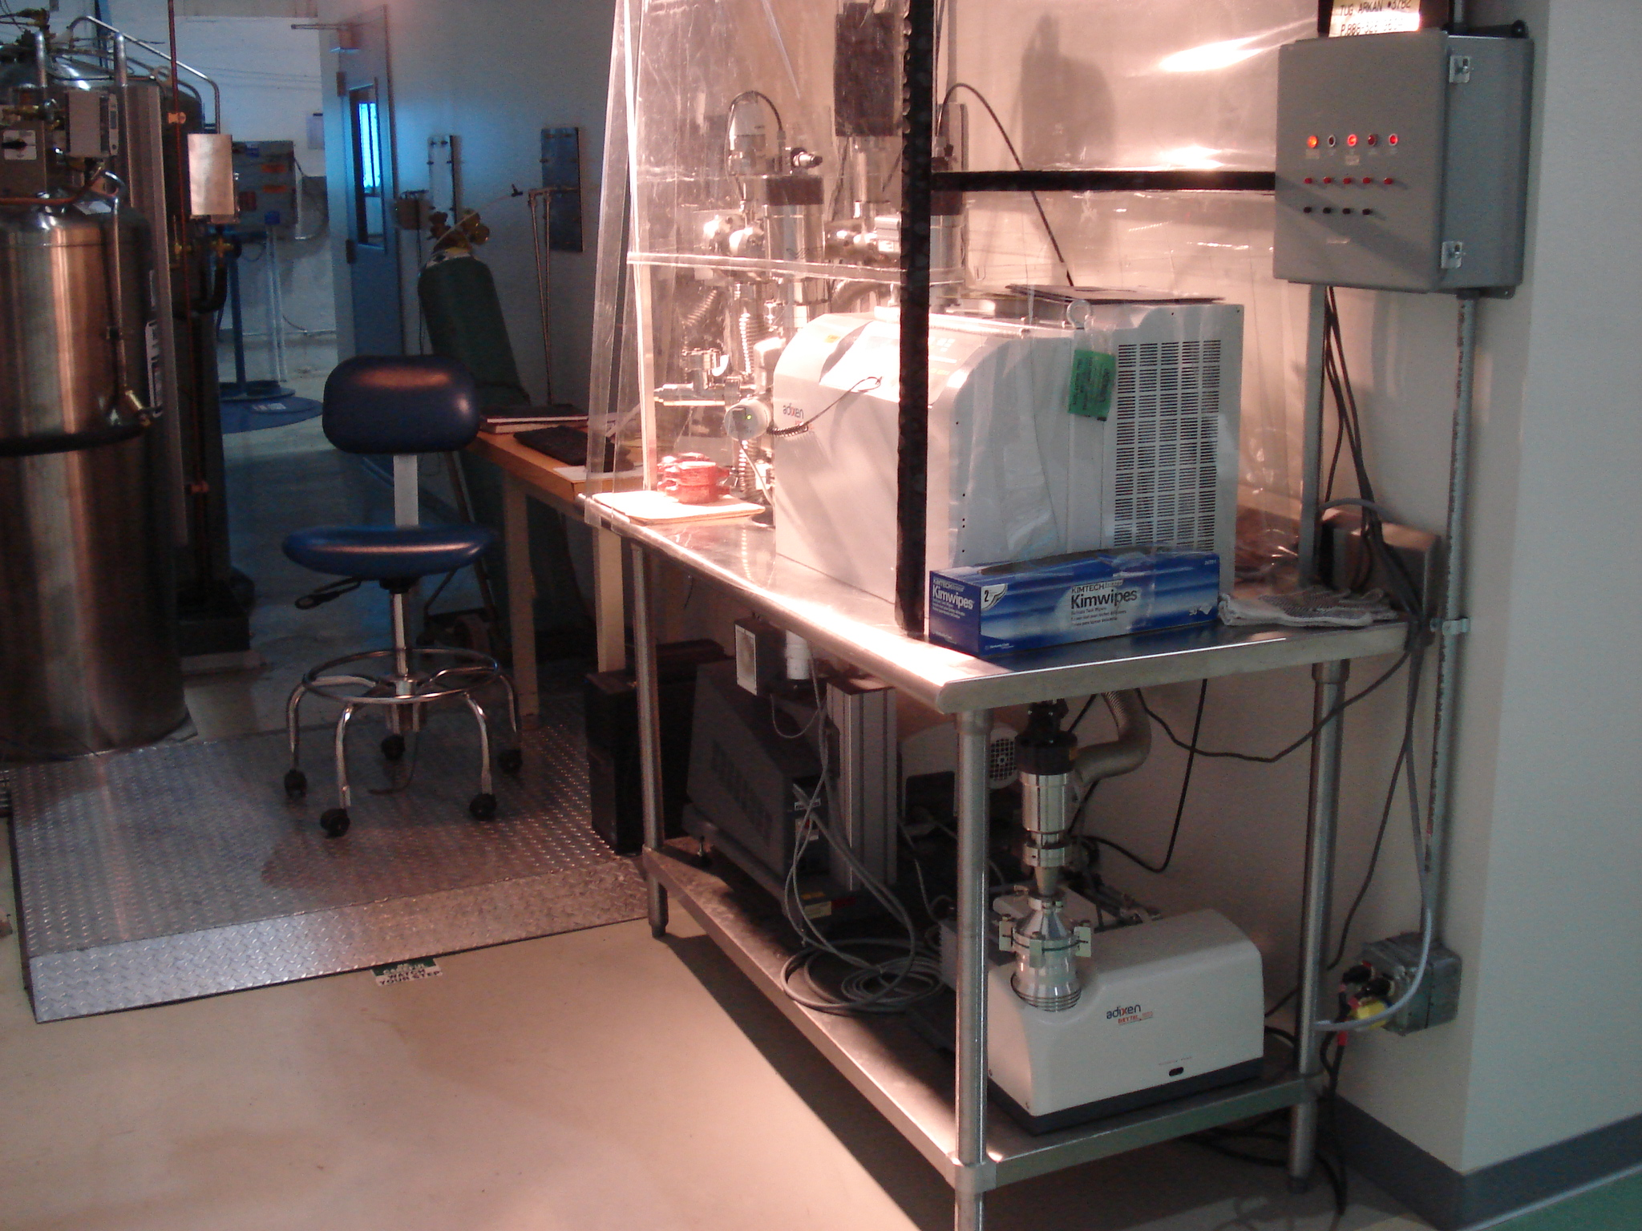
Vacuum Pumping & Leak Checking Equipment at WS1
Roughing pump: Alcatel 1025 Drytel diaphragm
Turbo Station: Alcatel ACT 202H Turbo station with ATH300 turbo pump and Alcatel 1025 Drytel diaphragm backing pump
Leak Detector (assembled to the vent of the ATH300 Turbo pump): Alcatel ASM 182 TD+
RGA: Ametek Dymaxion
Gauges: 2 MKS wide range gauges, 2 Alcatel cold cathode gauges
Calibrated leak: Assembled at the furthest point on the vacuum manifold in the cleanroom

Slide 5
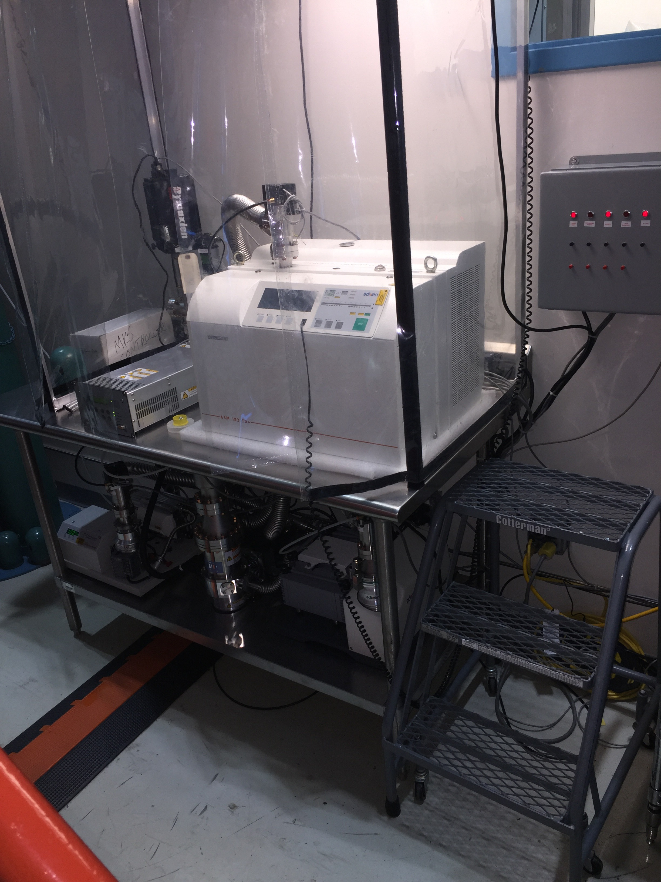
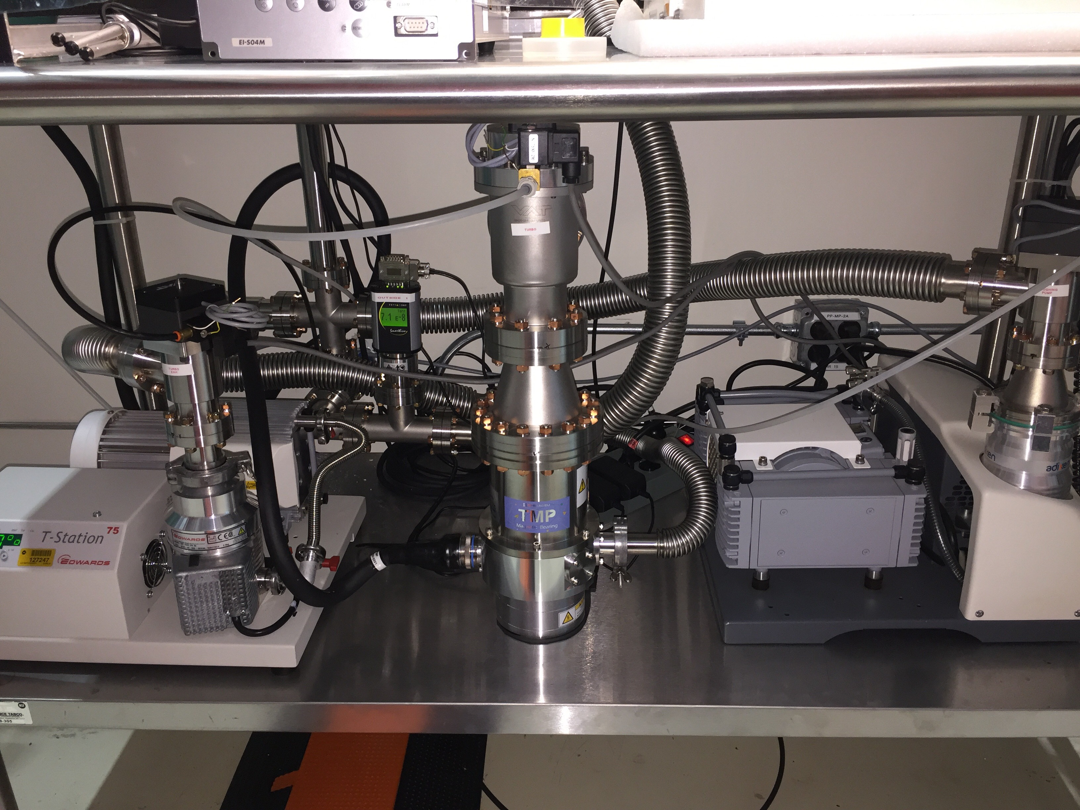
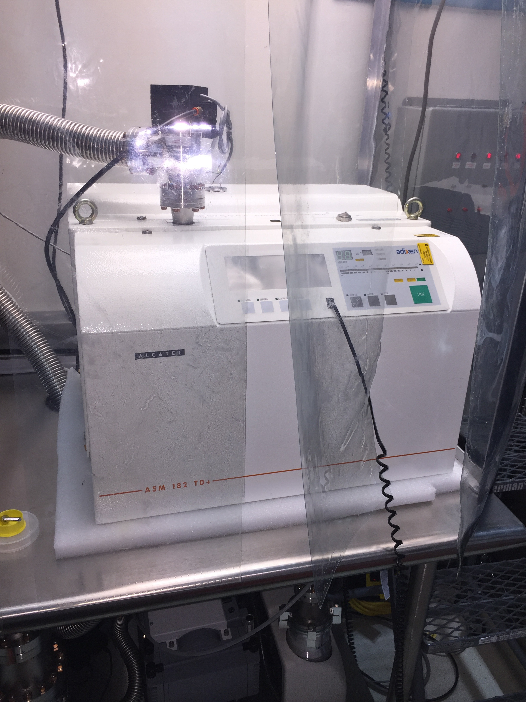
Vacuum Pumping & Leak Checking Equipment at WS0
Roughing pump: Adixen dry pump 1025
Turbo Station: Edwards T-station 75 with Shimadzu turbo
Leak Detector (assembled to the vent of the turbo pump): Alcatel ASM 182 TD+
RGA: Ametek Dymaxion
Gauges: 1 inside MKS and 2 outside Thiracont
Calibrated leak: Assembled at the furthest point on the vacuum manifold in the cleanroom

