Slide 1
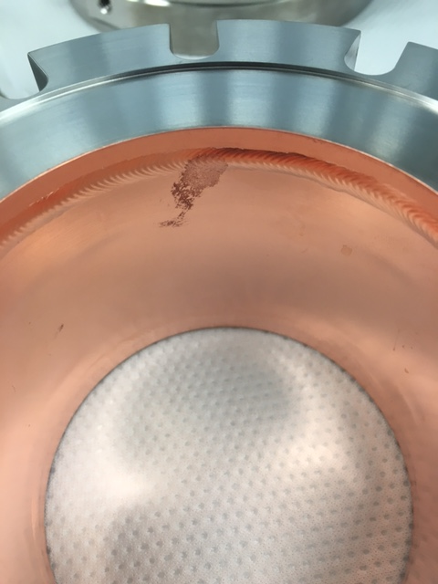
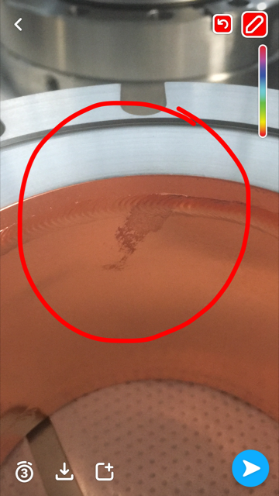
Short spool F10041117 #1003 (rejected)
Before cleaning
After cleaning

Slide 2
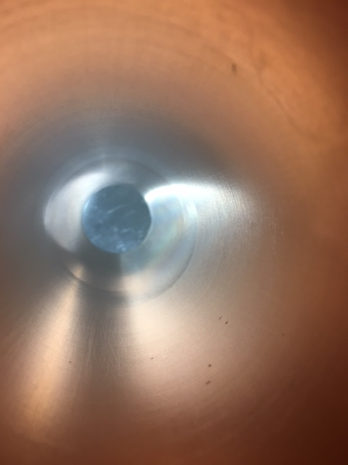
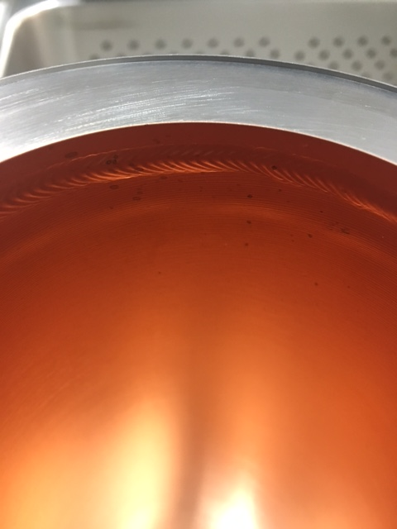
Long Spool F10052775 #1006 (rejected)
After cleaning

Slide 3
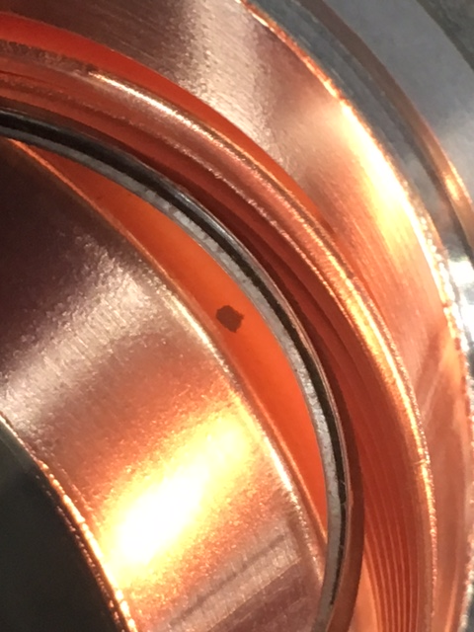
Long Bellows F10041075 #1020 (rejected)
Dark spot has a black color raised blemish in the center

Slide 4
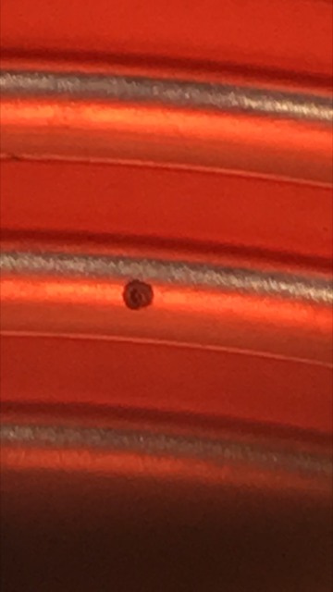
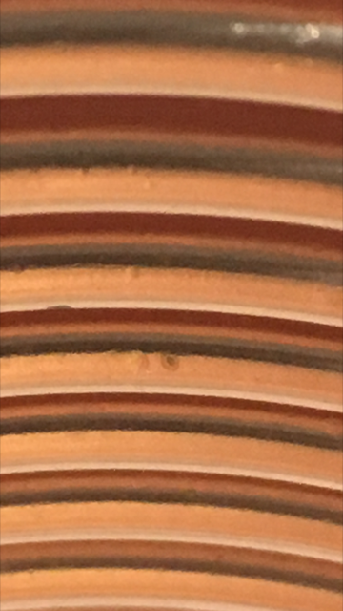
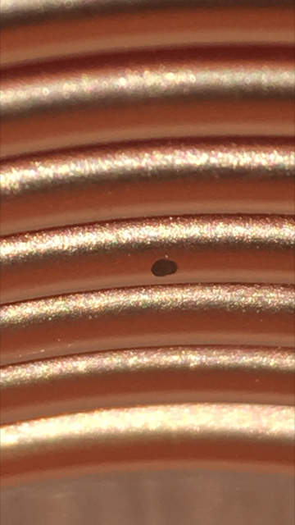
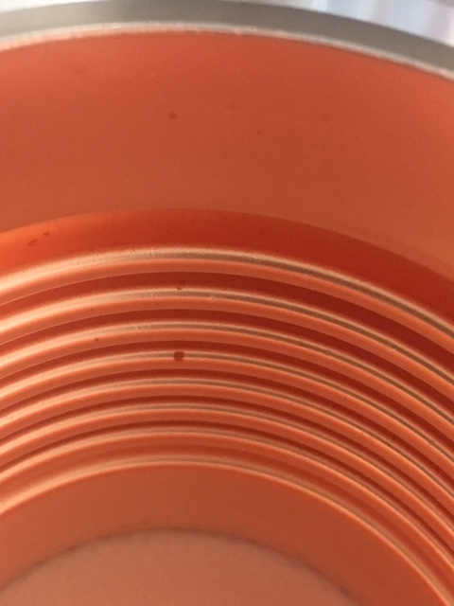
Long Bellows F10041075 #1027 (rejected)
Before Cleaning
After Cleaning
Dark spot has a black color raised blemish in the center + bottom of the convolutions are not copper plated + lots of pits and dents

Slide 5
Standard UHV cleaning at CAF
Total 35 minutes in ultrasonic compared to 10 minutes during the QC at SLAC
20 mins Simple green with ultrasonic on
Rinse
15 mins Micro90 with ultrasonic on
Rinse
Alcohol
Dry with filtered Nitrogen
Leave under Class 10/100 hood for a few days
Bring into main Cleanroom

